Slide 1
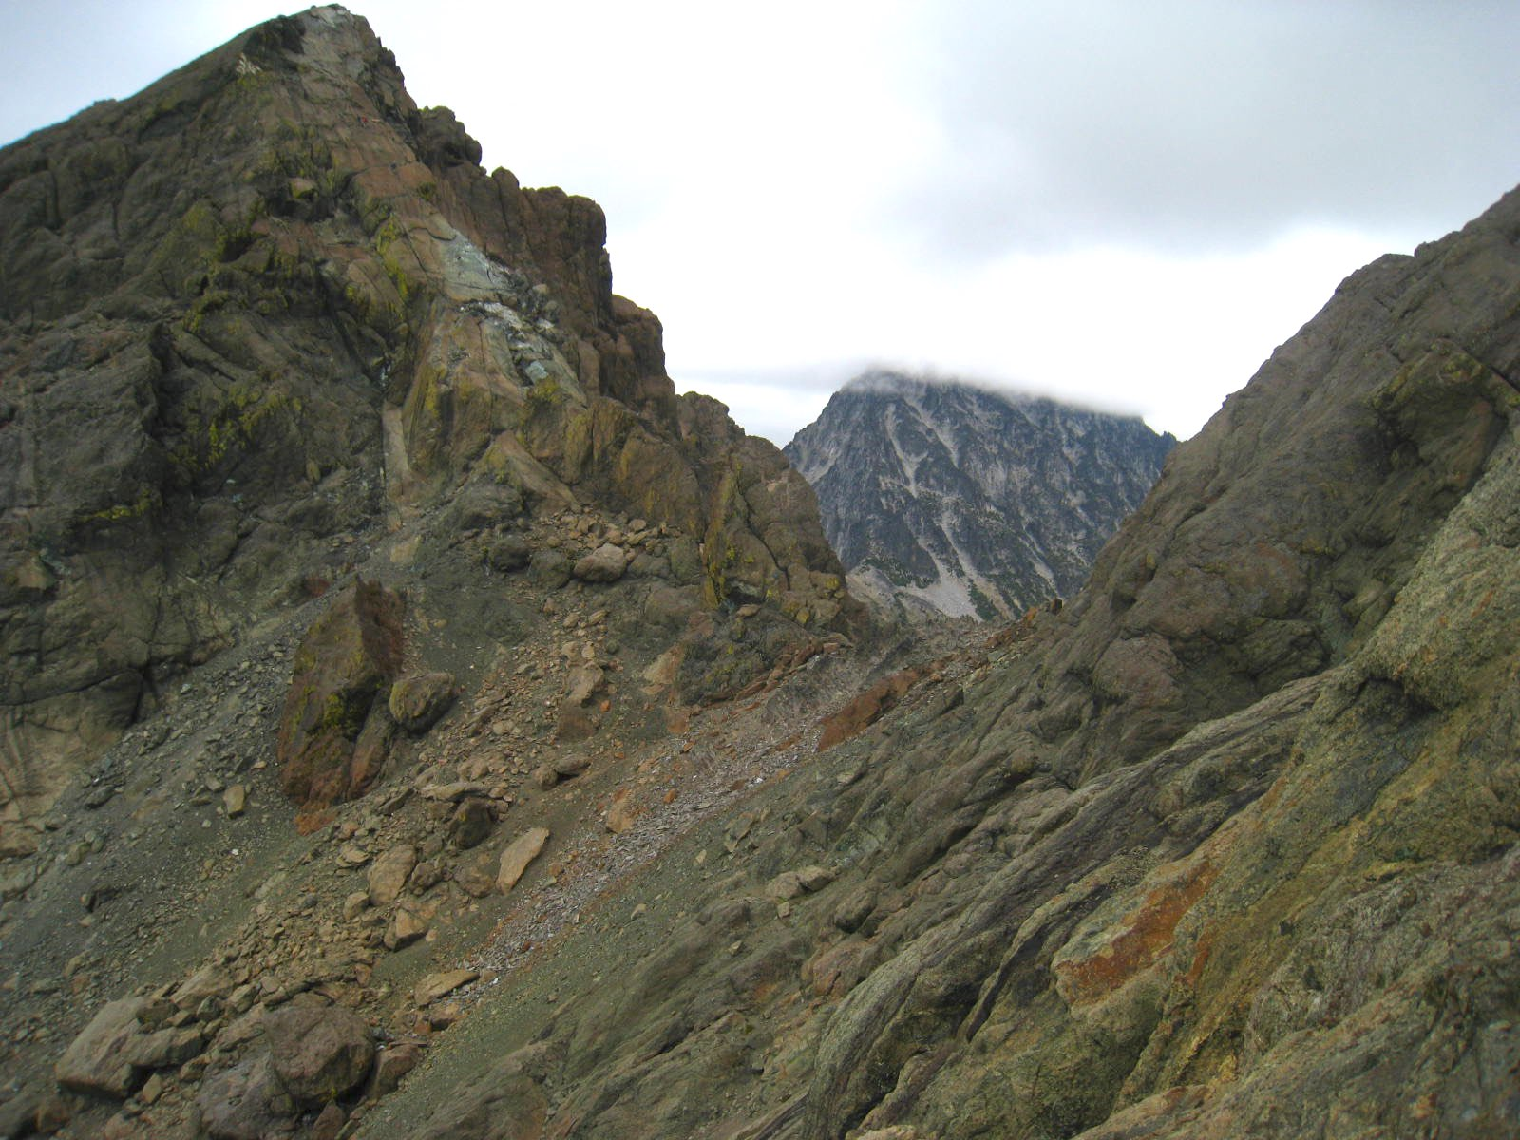
Rockfall Avoidance
Everett Mountaineers 2022

Slide 2
This is North-South Ingalls Peak saddle — a scree field where helmets are necessary.
Photo credit: Brian Booth

Slide 3
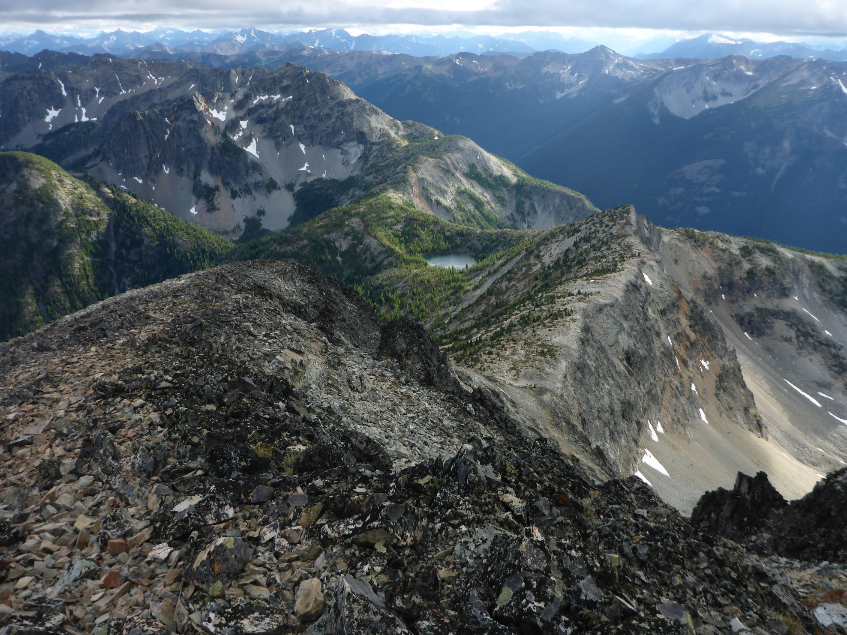
Here's an area in North Cascades National Park where rocks are both loose and large — VERY hazardous.
Photo credit: Brian Booth

Slide 4
Awareness

Slide 5
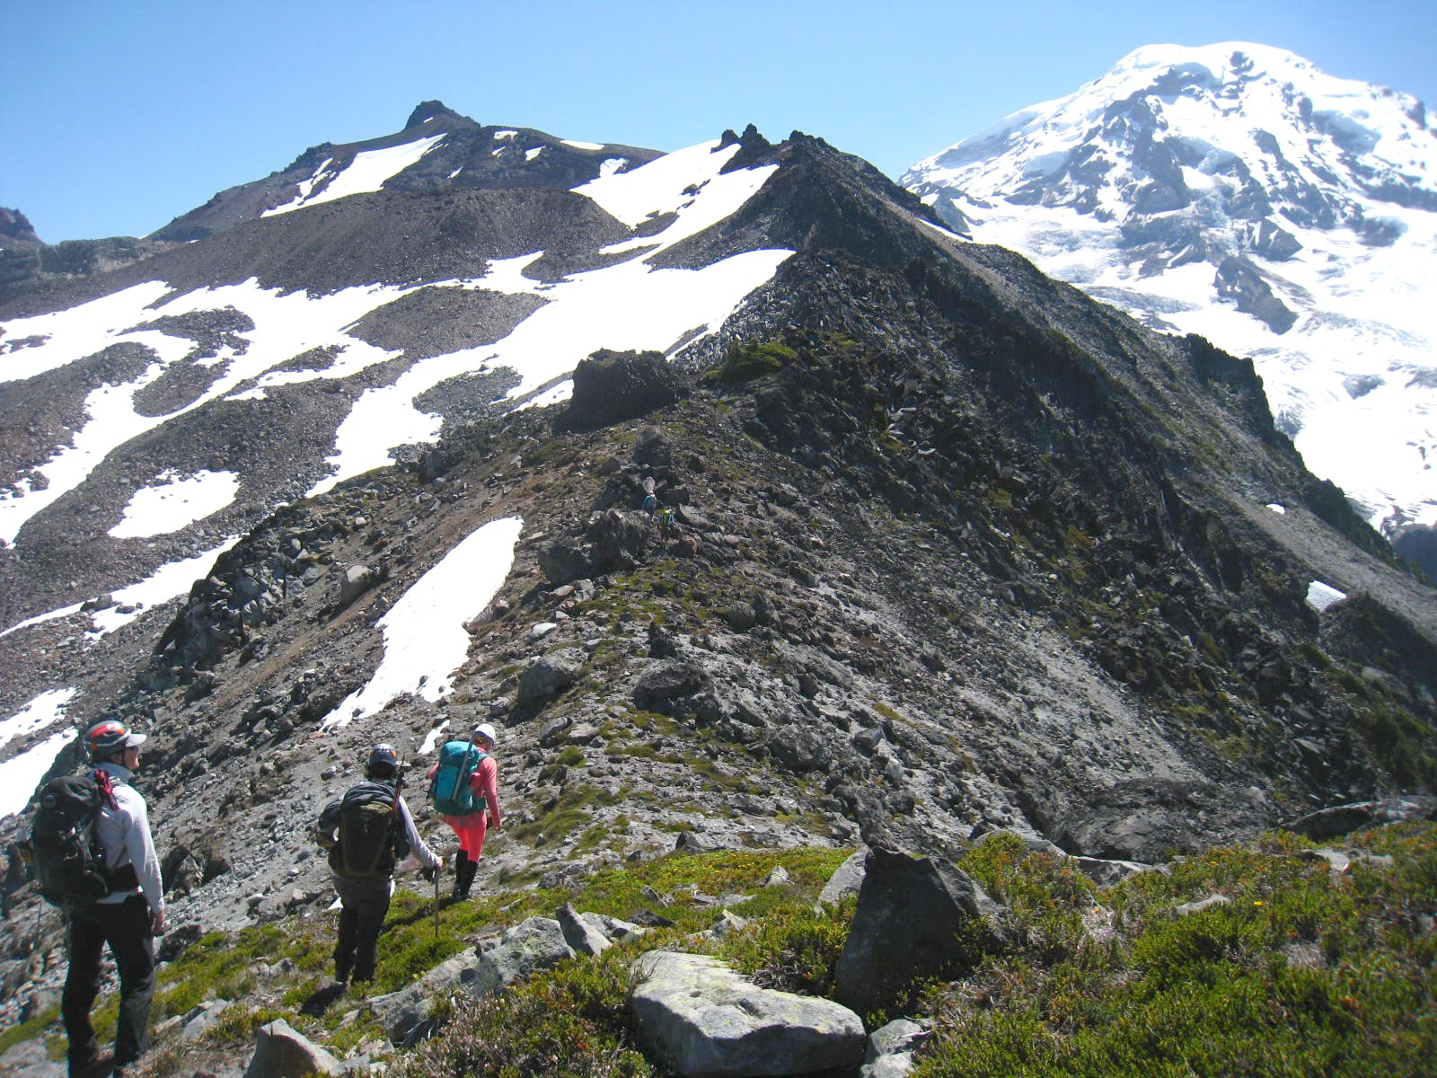
Helmet
Don it before you need it.
Your helmet provides no benefit while it’s in your pack.
When your helmet is on your head, your pack is lighter.
Photo credit: Brian Booth

Slide 6
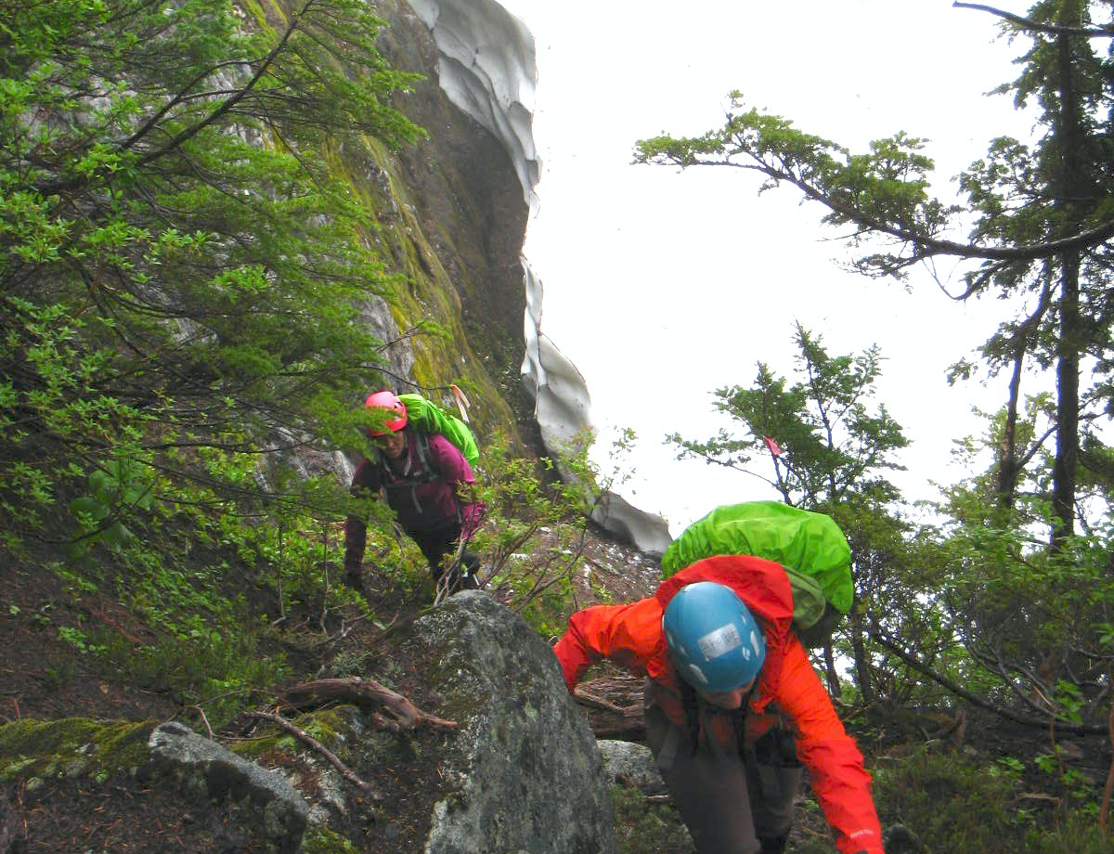
Helmet
There can be rockfall hazard even below timberline.
This party donned helmets because thick forest blocked their view of determining whether or not there was rockfall hazard.
Photo credit: Brian Booth

Slide 7
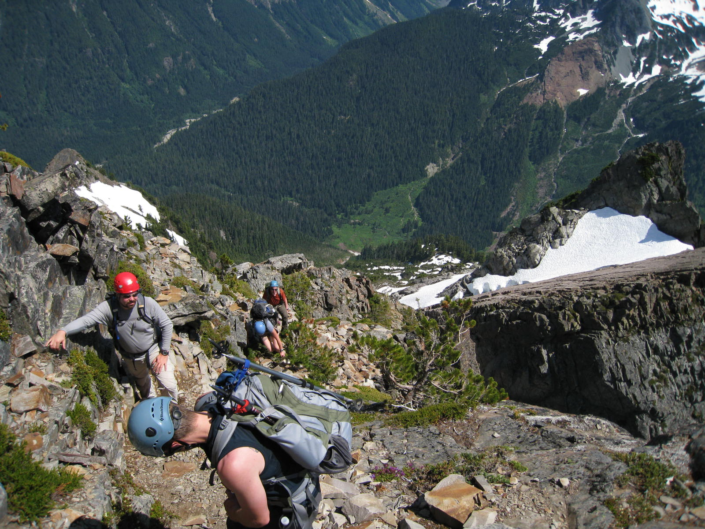
ROCK! ROCK! ROCK!
Be aware of other climbers’ positions.
Be prepared to yell “ROCK-ROCK-ROCK”!
Photo credit: Brian Booth

Slide 8
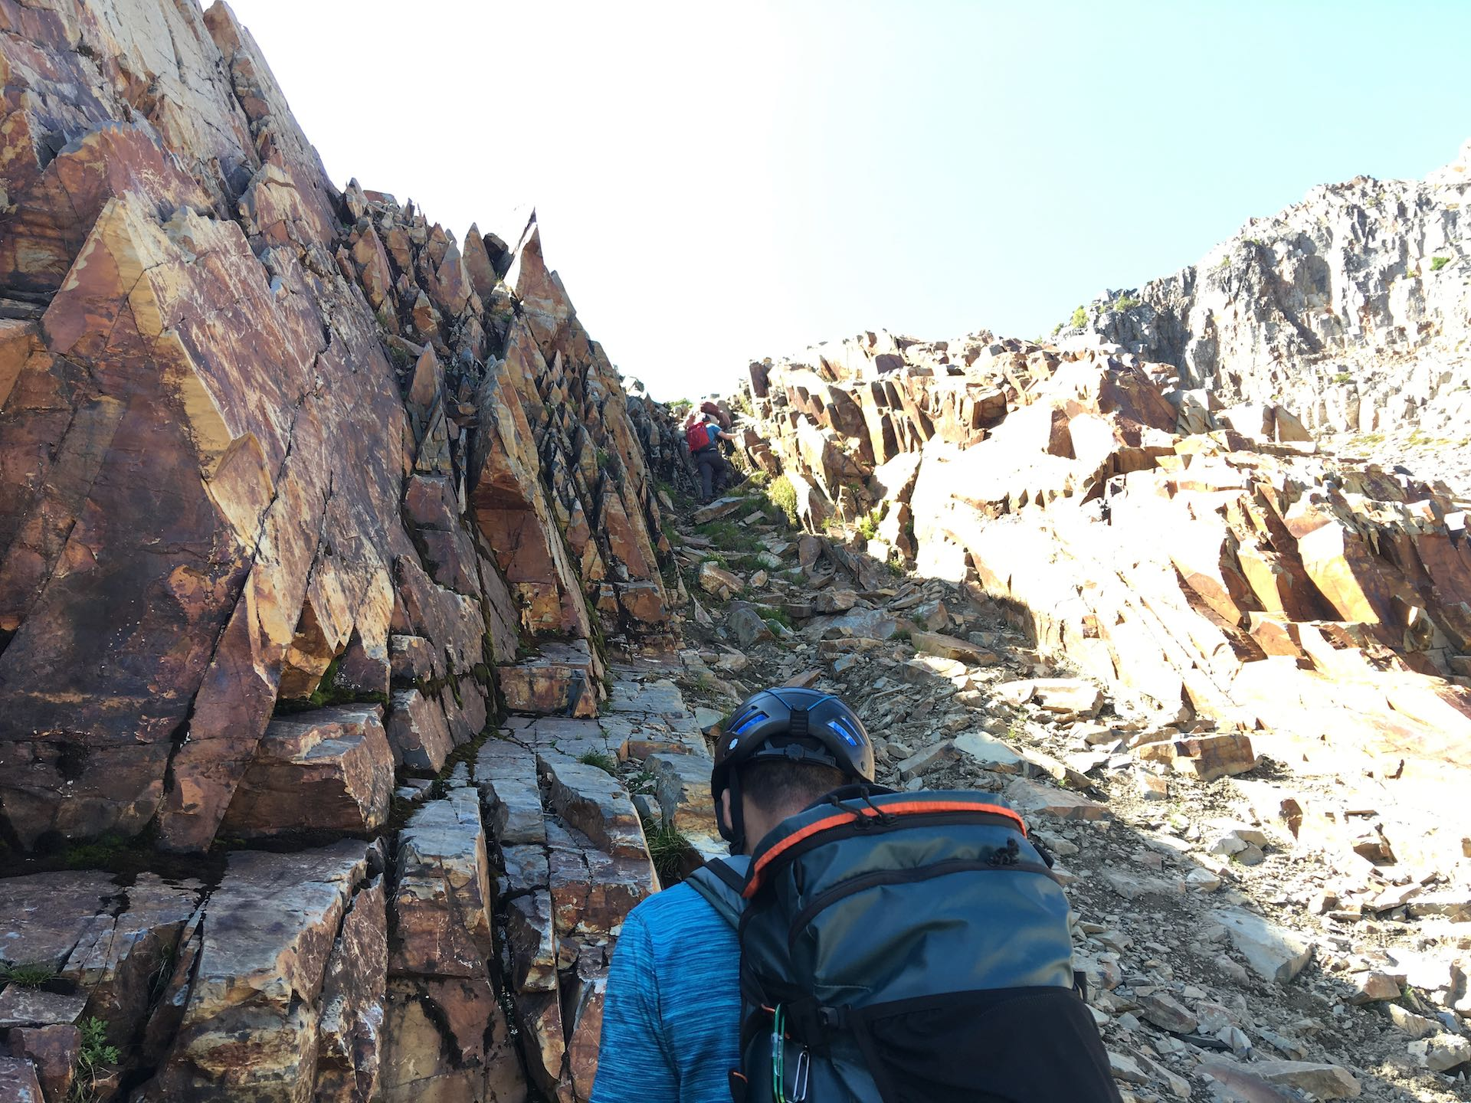
ROCK! ROCK! ROCK!
If you hear “ROCK-ROCK-ROCK” above you:
Move out the way if you can, otherwise lower your head to protect your face.
Direction of rockfall
Direction to move for safety
Photo credit: Mark Burgess

Slide 9
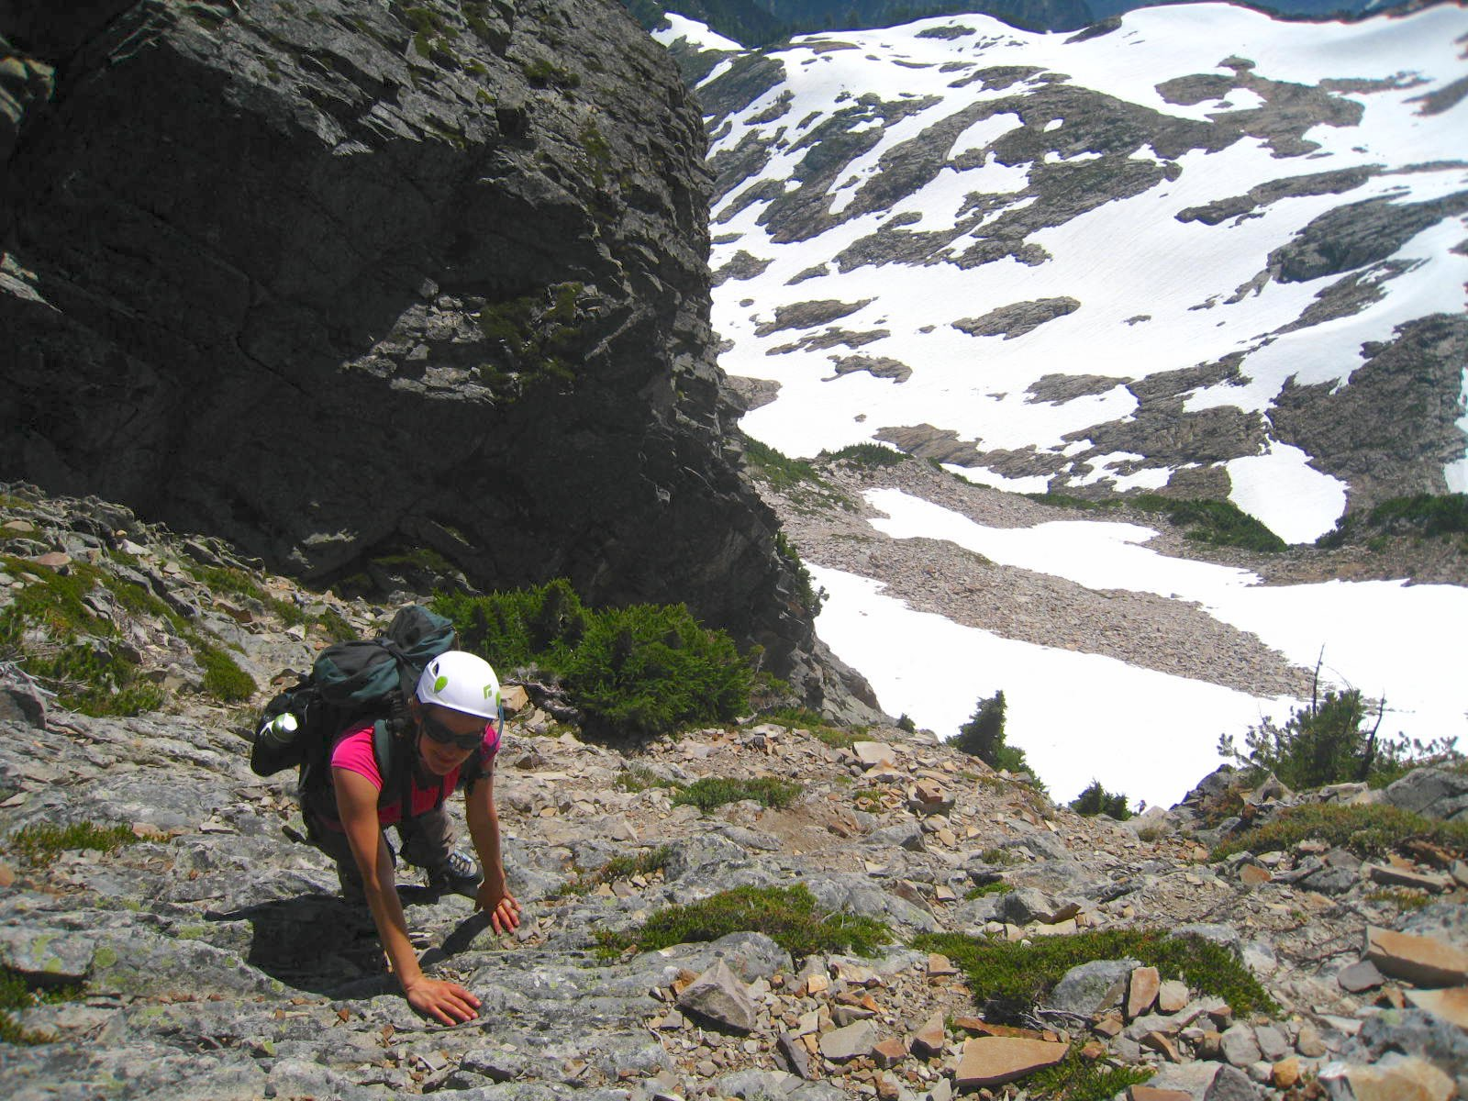
ROCK! ROCK! ROCK!
If possible, lift hands off handholds to avoid crushing-type injury.
Photo credit: Brian Booth

Slide 10
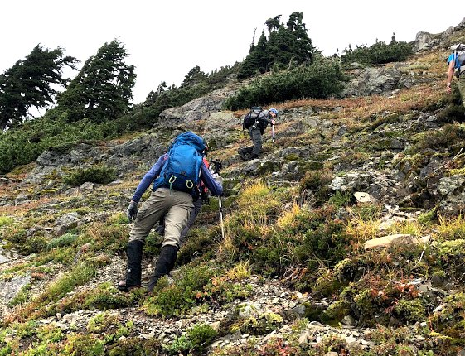
Footwork
To reduce the chance of dislodging a rock, step carefully.
Transfer your weight to your upper leg, then slowly and smoothly push down on it — rather than rapidly “pushing off” from your lower leg.
Requires good leg strength. Prepare by doing squats at gym.
Photo credit: Carshena Harvin

Slide 11
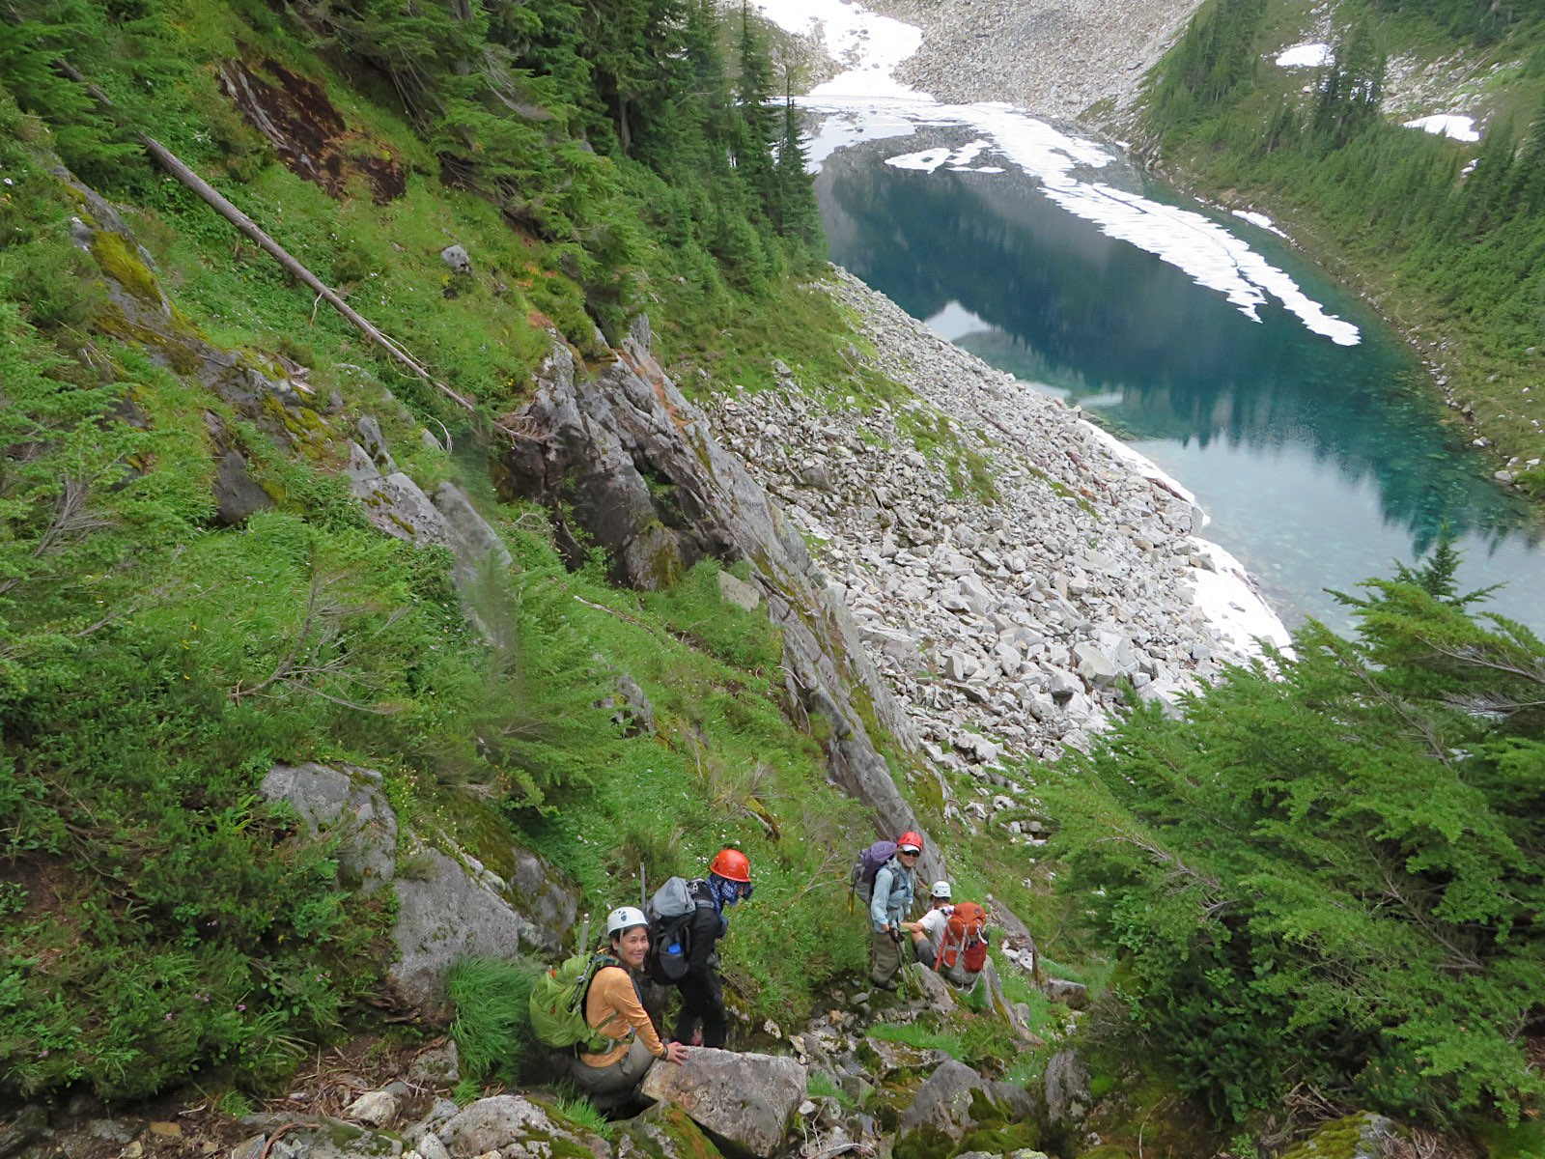
Beware of mud
Be aware that rockfall hazard increases when soil is saturated. Mud is weaker than dry dirt.
Photo credit: Brian Booth

Slide 12
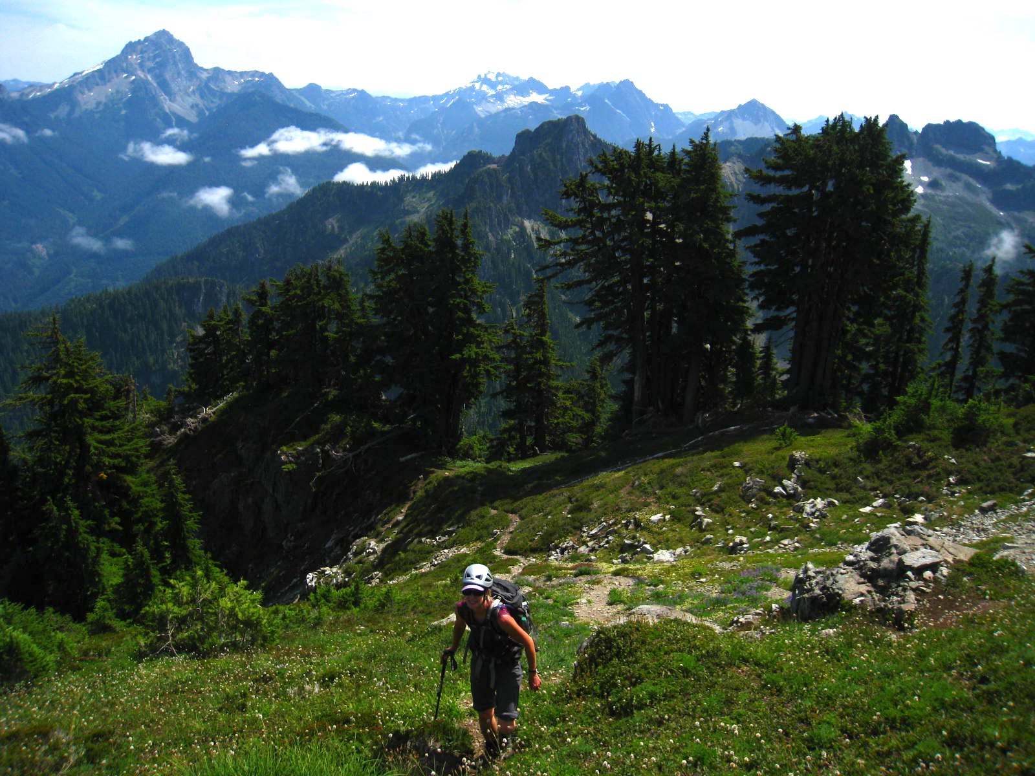
Stay alert
In meadows, rocks may be few in number, but can still be very loose.
Don’t let your guard down just because it’s a meadow with pretty flowers.
Photo credit: Brian Booth

Slide 13
Travel strategies

Slide 14
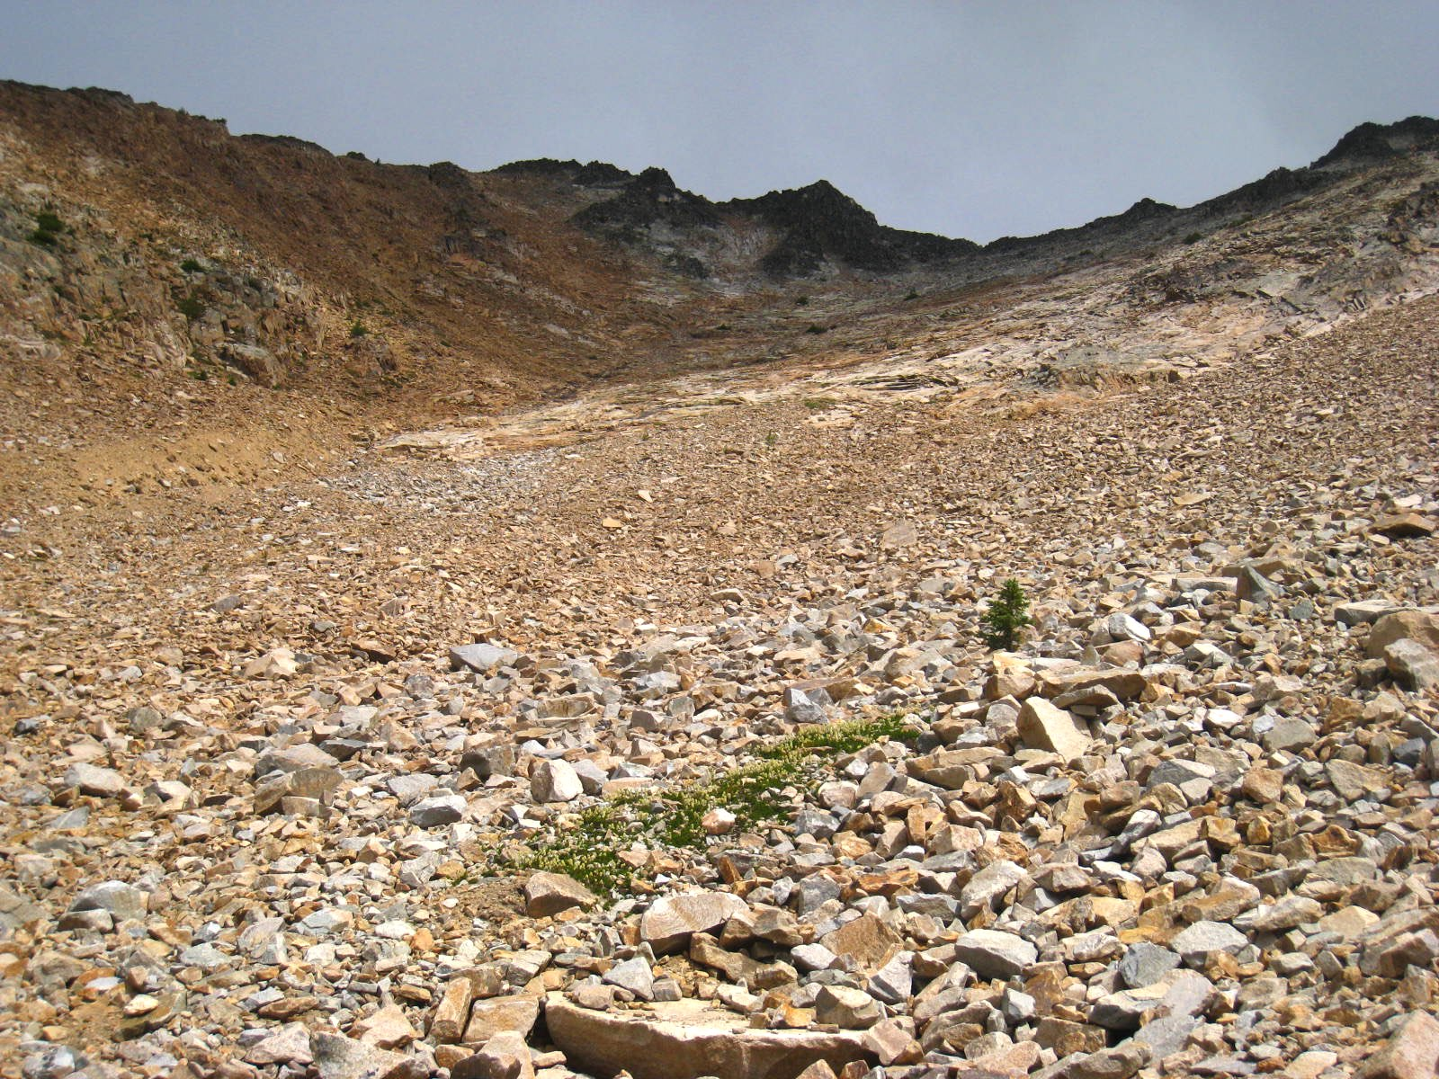
Spread laterally
If ascending a broad talus field like this, consider spreading out laterally to avoid being each other’s “firing line”.
Photo credit: Brian Booth

Slide 15
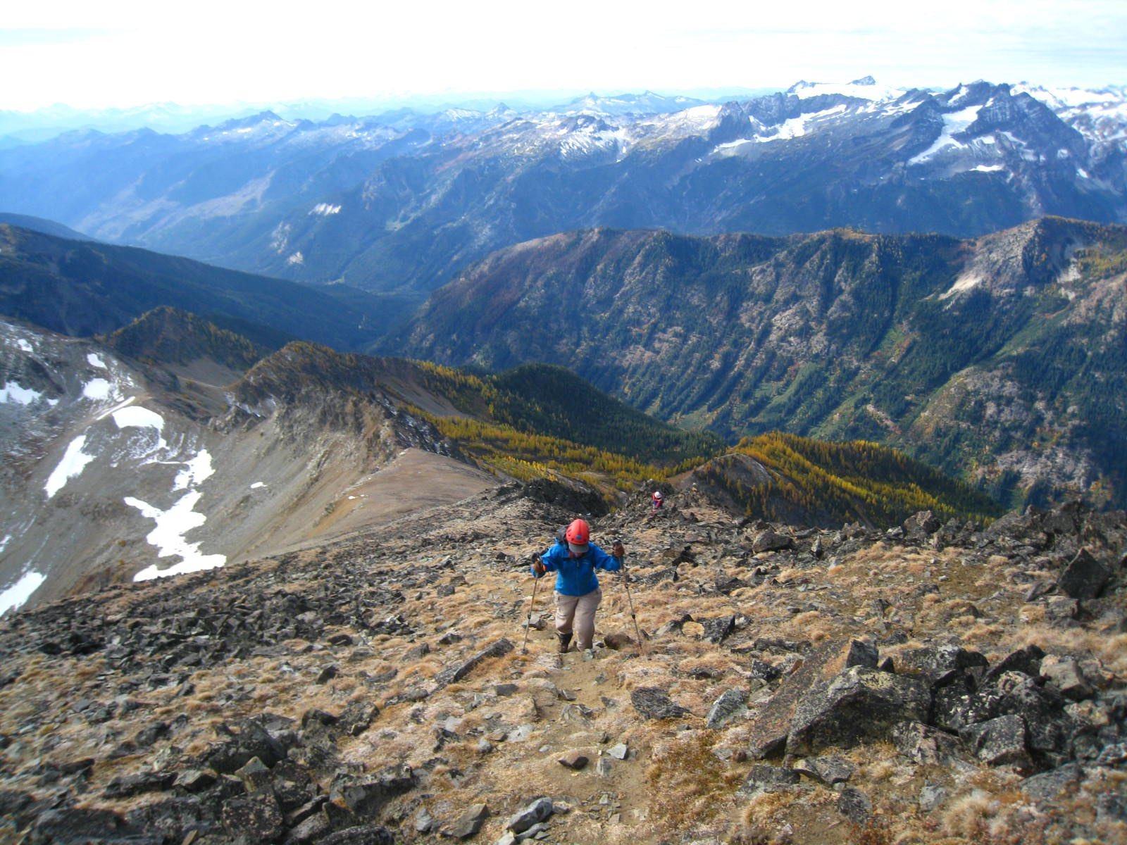
Stay apart
Consider spreading far apart. If the lead climber dislodges a rock, the lower climber has increased time to move out of the way.
Photo credit: Brian Booth

Slide 16
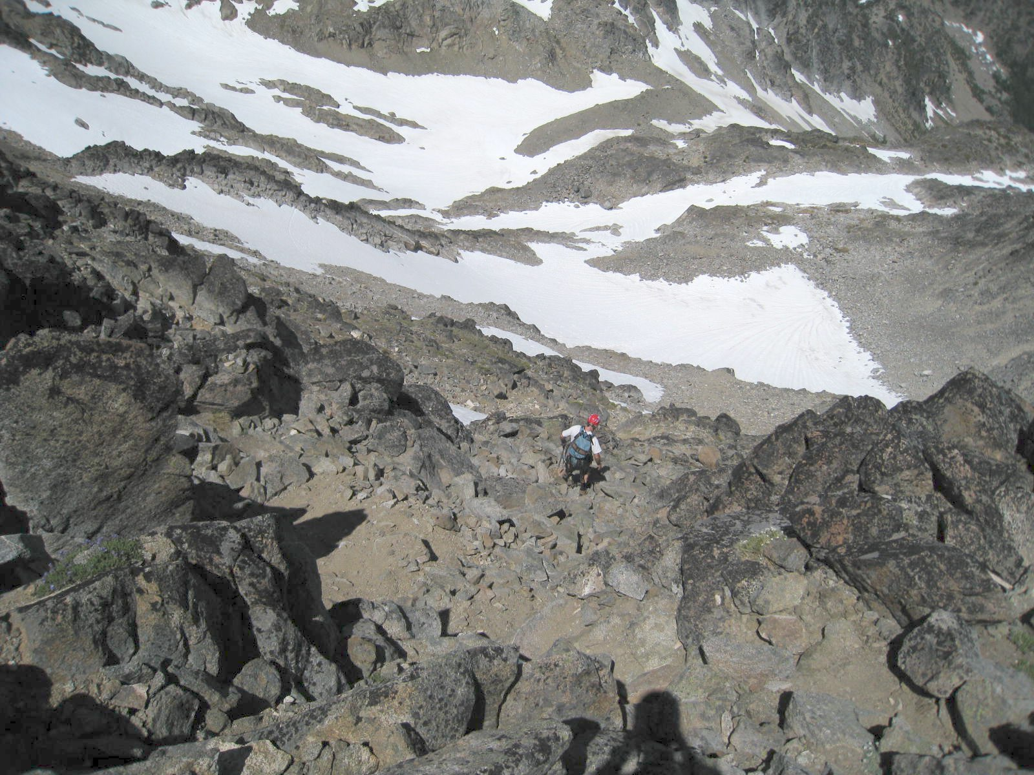
Stay apart
These climbers are going one at a time, in a section of gully with extremely loose rock.
The second climber doesn’t start traveling until the first climber is safely out of the gully.
Photo credit: Brian Booth

Slide 17
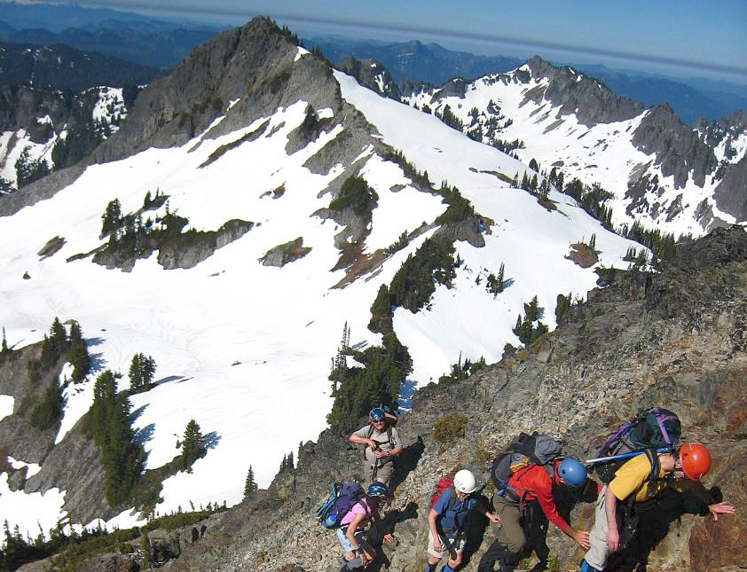
Stay together
If a rock is dislodged, it will be limited in how much speed it picks up.
This party split up into two groups. Within each group, members stayed close together. The groups went one group at a time through this section.
Photo credit: Brian Booth

Slide 18
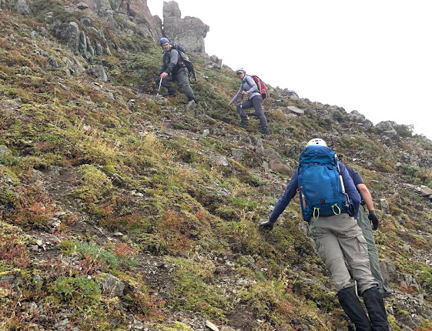
Zig-zag
Consider zigzagging to avoid traveling single file up the fall line.
When zigzagging, top climbers should pause while lower climbers pass beneath.
Photo credit: Carshena Harvin

Slide 19
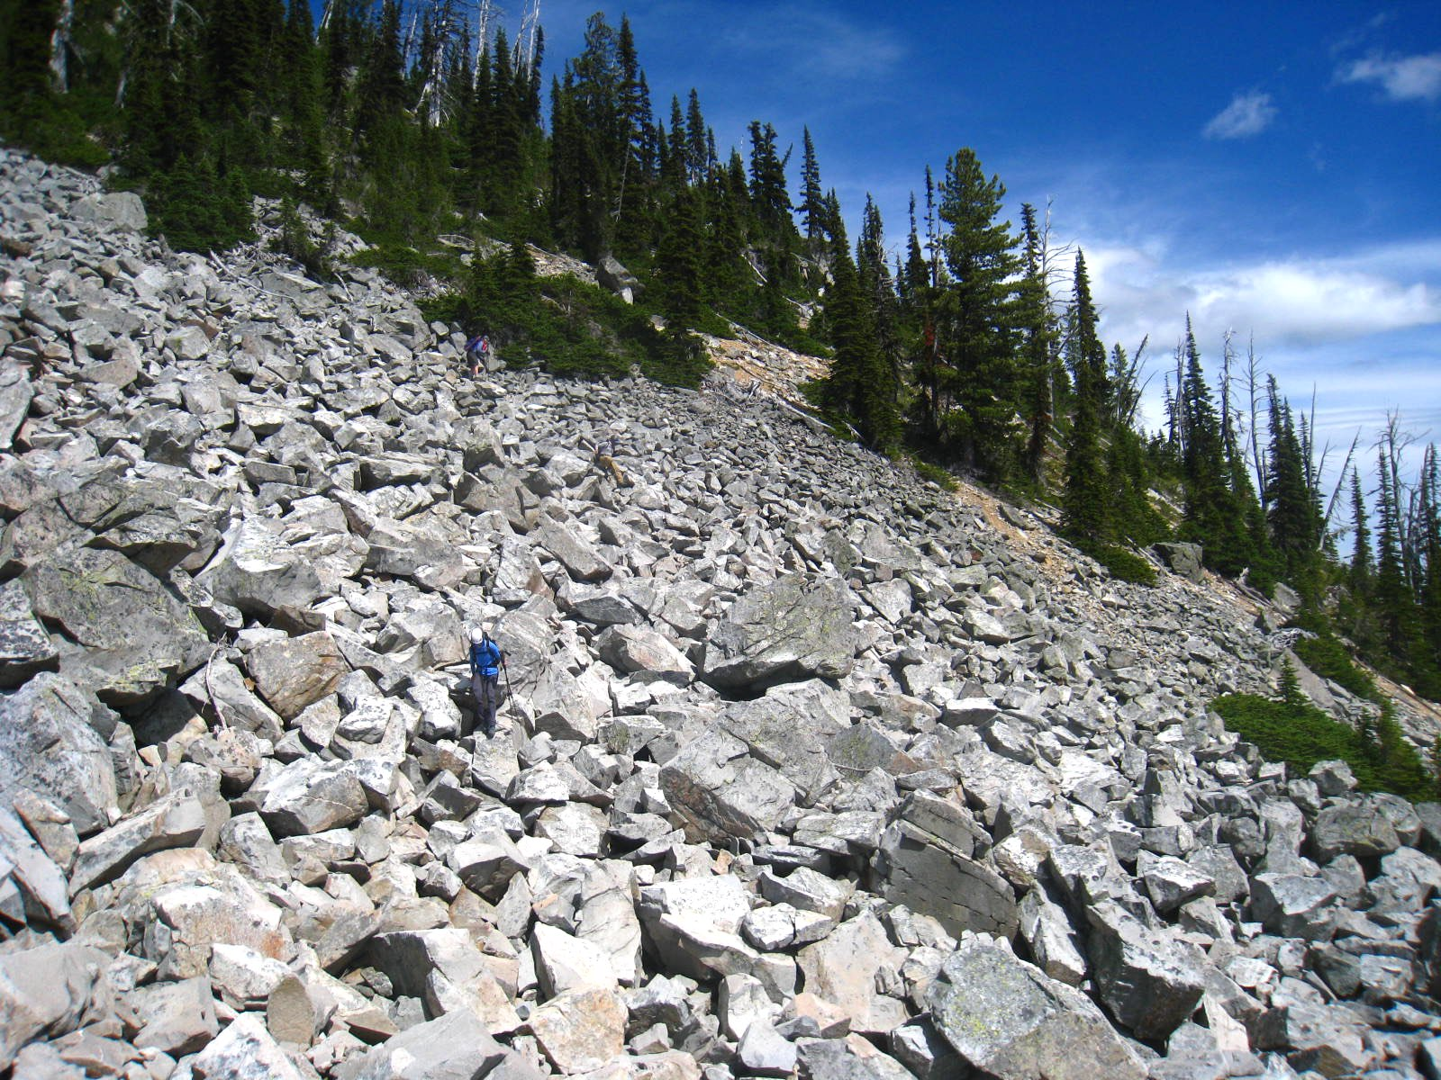
Zig-zag
Party descending on a diagonal to avoid having being in each other’s firing line.
Photo credit: Brian Booth

Slide 20
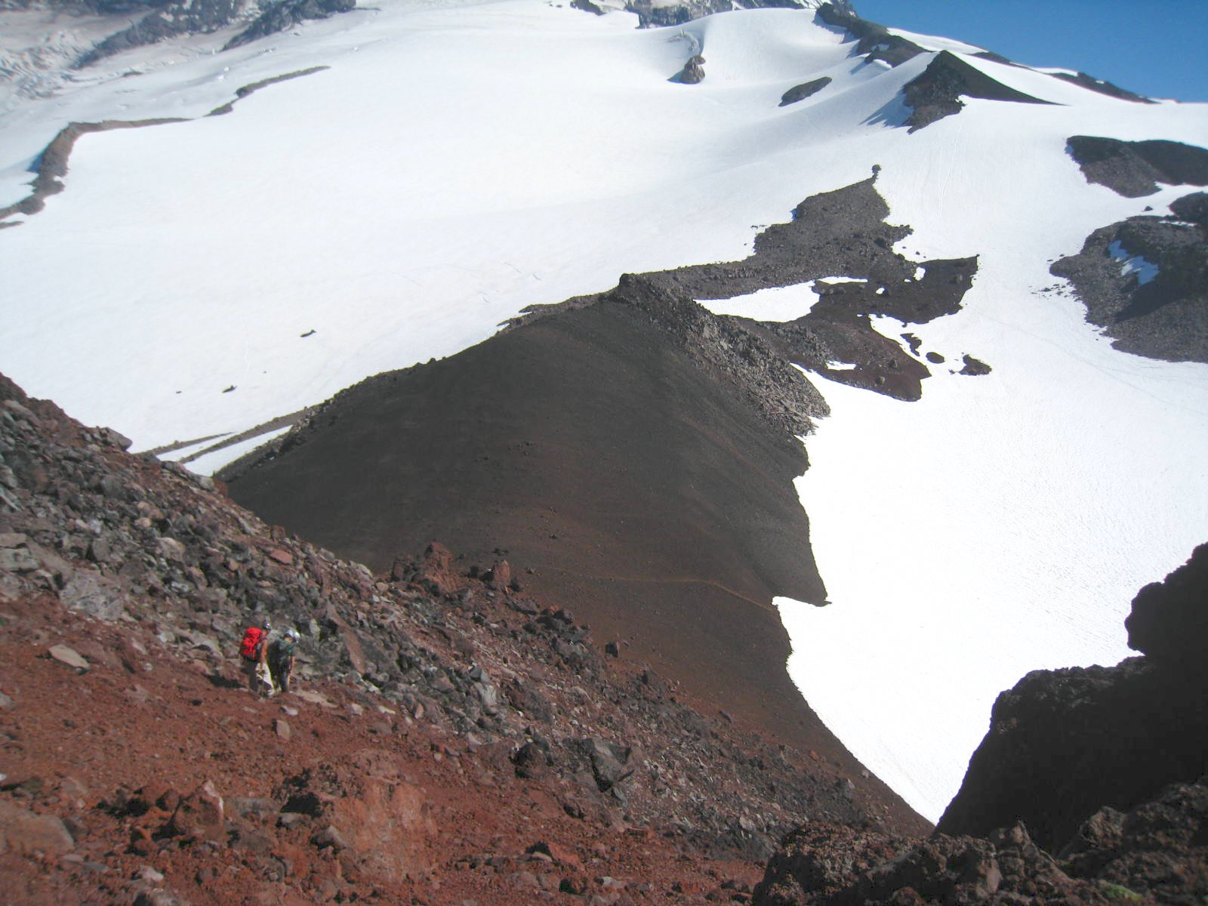
Diagonal
Volcanic plug domes are sometimes more like a pile of rubble than a “mountain”.
Party is traveling on a diagonal to avoid being in each other’s firing line.
Direction of travel
Direction of rockfall
Photo credit: Brian Booth

Slide 21
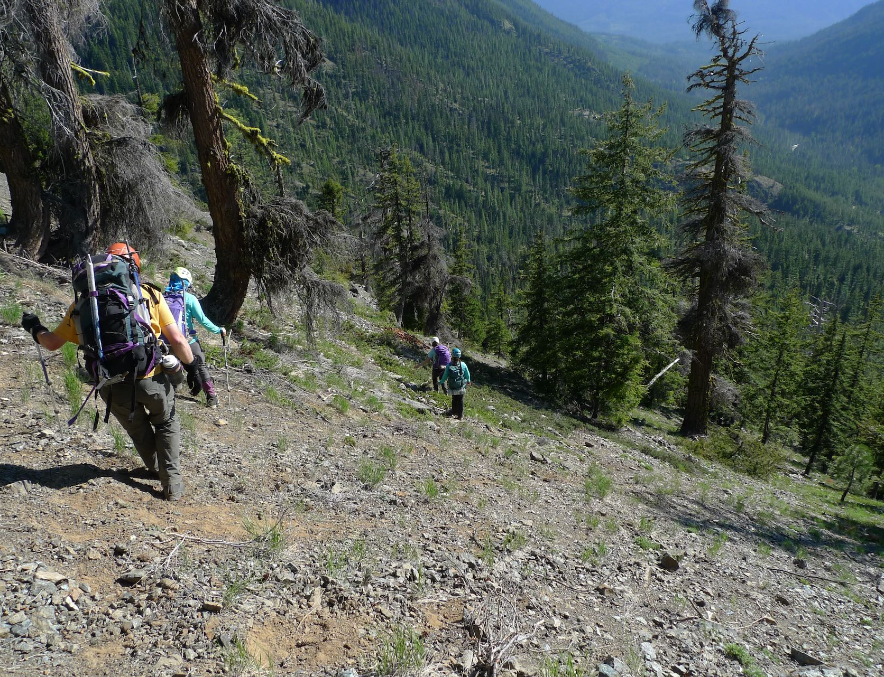
Diagonal
Forest fire can result in loose dirt and rock.
Party is traveling on a diagonal to avoid being in each other’s firing line.
Direction of travel
Direction of rockfall
Photo credit: Mark Burgess

Slide 22
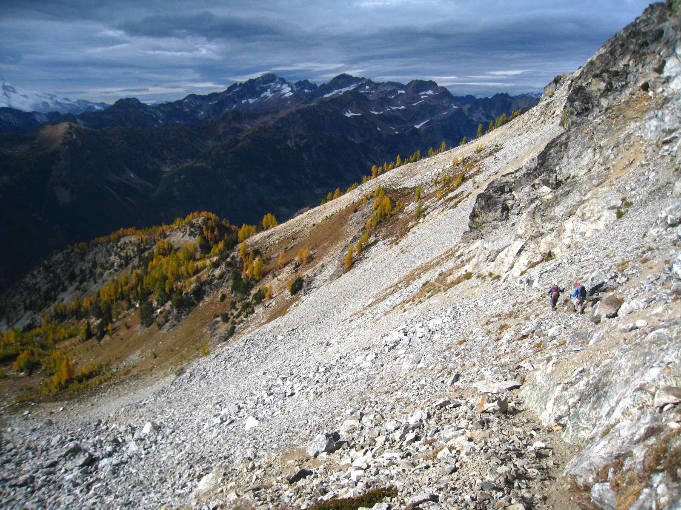
Traverse
Party is traversing (sidehilling) to avoid being in each other’s firing line. Traversing can be slow and tiring.
Direction of travel
Direction of rockfall
Photo credit: Brian Booth

Slide 23
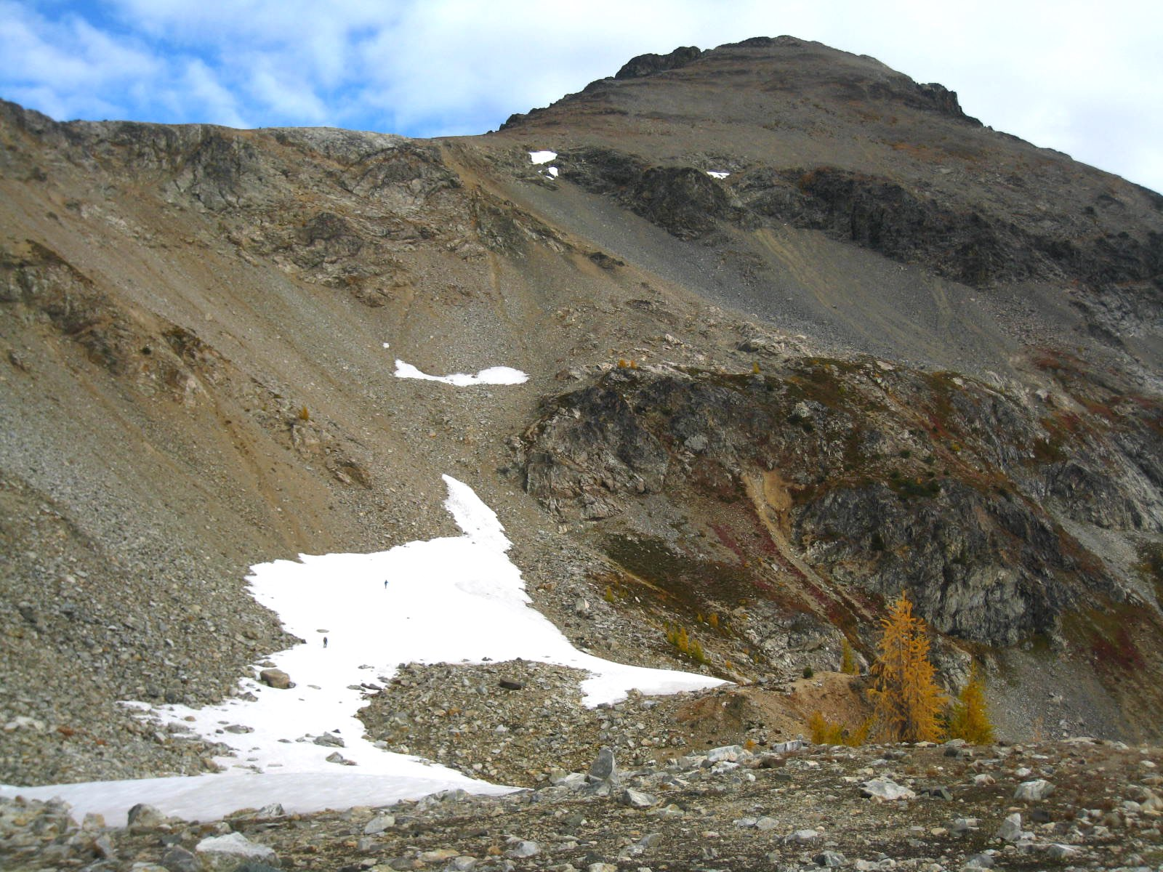
Use snowfields
If there is mixed rock and snow, sometimes it’s best to maximize your travel on snow so you can minimize your travel on loose rock.
Photo credit: Brian Booth

Slide 24
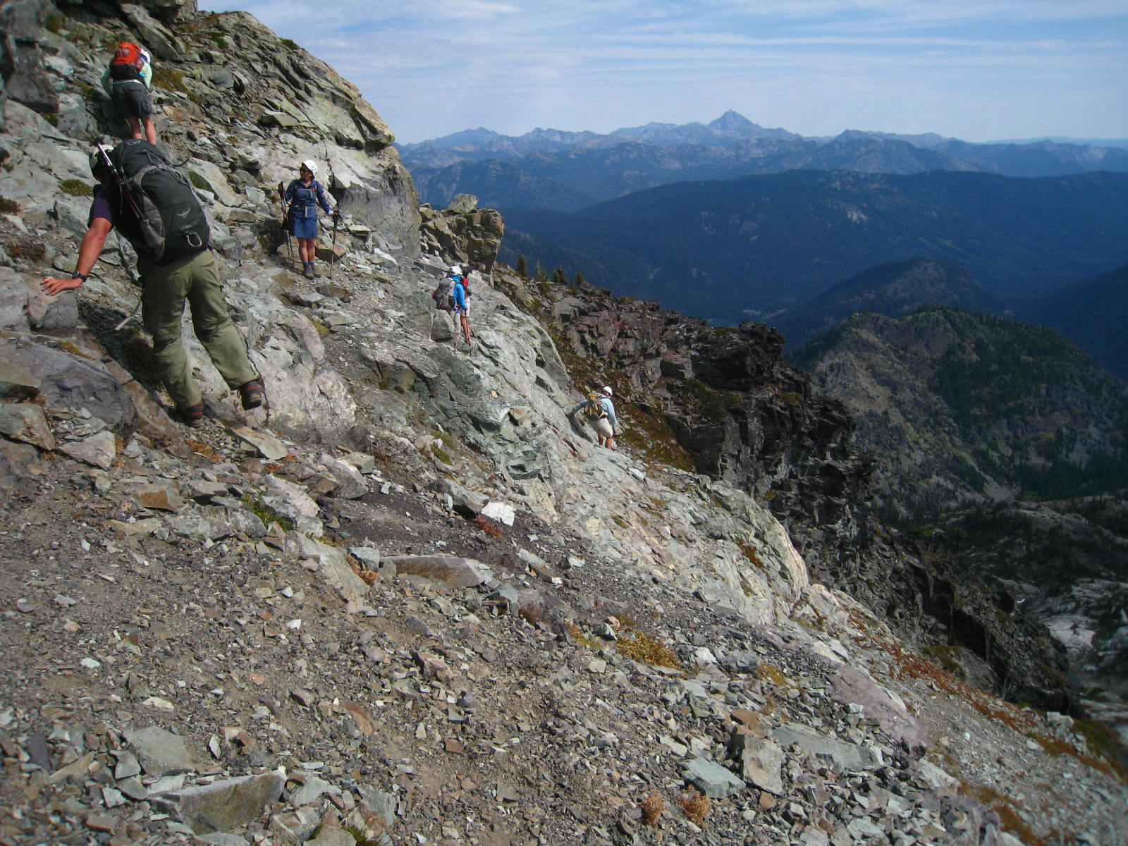
There is no single strategy that can be used for minimizing rockfall hazard in all situations.
Sometimes you have to weigh one strategy versus another and determine which is best for the current situation.
Photo credit: Brian Booth

Slide 25
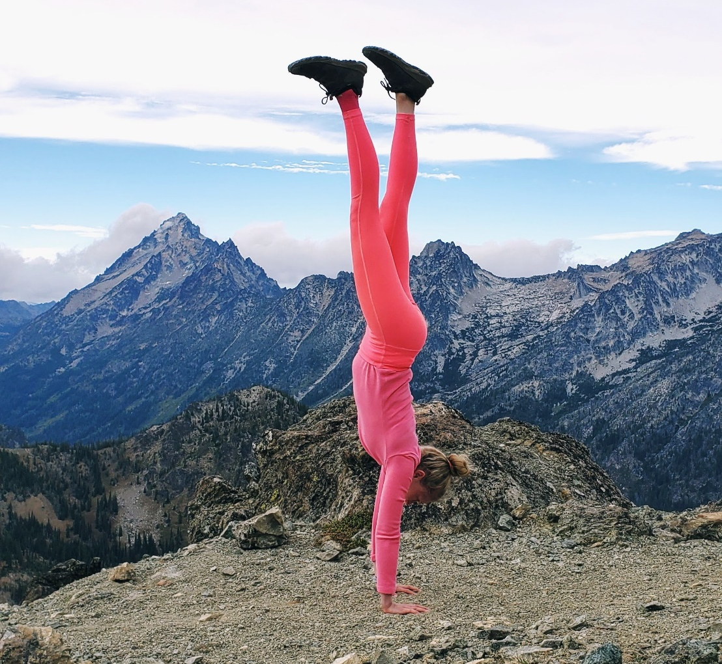
The key to safety in the mountains is achieving the right balance. ☺
Photo credit: Brian Booth

Slide 26



