Slide 1
Leader Resources Seminar
Or how to spend more time outside and less time on your computer
Tess Wendel and Katie Tishler
Everett Mountaineers at Snohomish PUD
October 19, 2016

Slide 2
The Agenda
Feedback
Incident Reports
Handling Difficult Situations and Complaints
Member Privacy
Guest Policy
Member Communications
Recruiting new volunteers- online and other tools
Routes/places
My branch and committee pages
Youth
Marketing Help
Q&A!!!

Slide 3
Feedback
4 Feedback forms
  Courses, field trips/lectures, trips, events
When are these sent?
How do I view?
Who can see these
Surveygizmo
Notes:
Feedback forms are sent after the end date of the course, trip, activity. You can view feedback in one lump view on the My Feedback tab on your profile page. Or by activity/course by going to My Activities or My Courses and clicking the ALL button next to the listing.
The leader and admins on the committee can view feedback. Want to do a fancy survey? Try SurveyGizmo, volunteer log in for survey gizmo is found in Leader Resources- Shared Activity Resources Folder

Slide 4
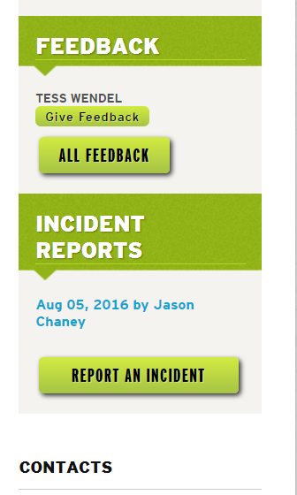
Incident Reports
Incident reports available to leaders AND participants
Where do they live?
What happens when you report an incident
Notes:
Incident reports live connected to the activity.

Slide 5
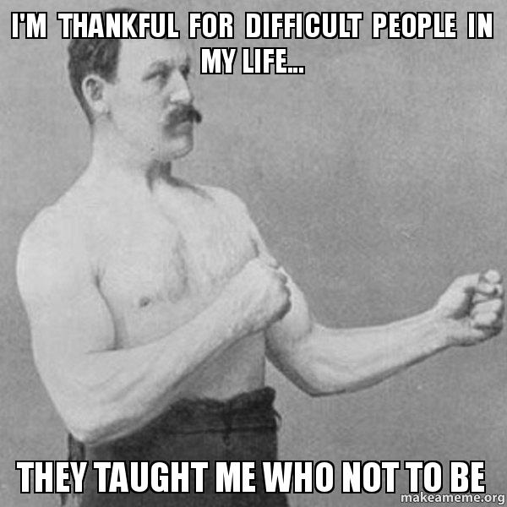
Handling Difficult Situations and Complaints
Board Policies
  Harassment
  Anti discrimination
  Problem Behavior
  Whistleblower
Committee, branch or staff?
Notes:
See Leader Resources for Mountaineers Complaint Form which should be filled out by anyone who witnessed or experienced Harrassment or Problem behavior.

Slide 6
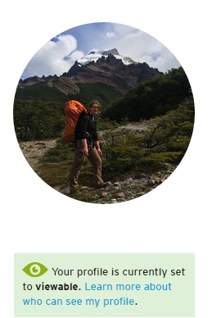
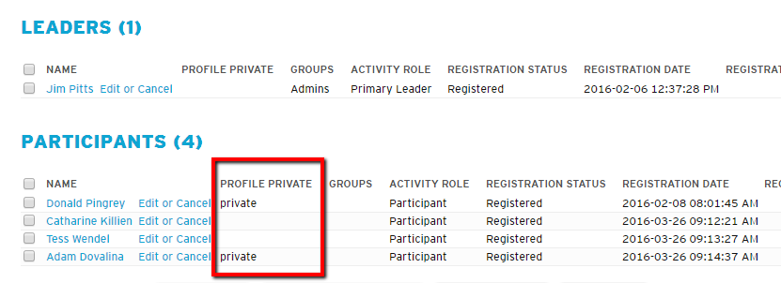
Member Privacy
Board policy
  Ability to opt out of emails
  Personal info not shared with other orgs
  Members shall respect the wishes of other members
What this means on mountaineers.org ?
What does this mean on a trip by trip basis?
  Carpooling- bcc versus cc
Notes:
See all the different ways a profile can be viewed: https://www.mountaineers.org/membership/mountaineers-privacy-policy-explained
Got some logistics and want to allow people to opt in?- send out a google sheet.

Slide 7
Guest Policy
Fill out Guest Profile
Why is this important?
Board Policy
  Non-members may participate in club activities with these considerations:
      For activities that charge a fee:
        Non-members shall pay a higher fee than members so there is a benefit to joining the Mountaineers.
      For activities that are free to members:
        Non-members may participate in two activities per year at no charge (as a trial membership)
Notes:
Make sure to close out your activities so if a guest cancels it won’t count towards their 2 activities.
You as a leader can override pre-reqs on an activity if someone wants to join something more technical but only add them if you know they have the skillset. Make sure they create a guest member profile for waiver, emergency contact info and for future engagement opportunities with the Mountaineers.

Slide 8
Member Communications
Automatic Emails
  You’ve been registered or you’ve been cancelled
  Member Drip Emails
  Leadership Applications
  Roster updates/leaders permission requests
Newsletters
Magazine
Notes:
https://www.mountaineers.org/blog/managing-your-mountaineers-e-mail-preferences
As a gentle reminder to be respectful of our volunteers' time, we now send an email to anyone who canceled after registration closed three times in the last three months AND a an email to anyone who registered and did not show up for an activity. Canceling before registration closes and or letting the leader know you cannot make helps ensure someone from the waitlist can take your place, and means your trip-mates aren't waiting the trailhead for someone who cannot make it.
Peter Dunau handles all email newsletters and can be reached at peterd@mountaineers.org
https://www.mountaineers.org/volunteers/leader-resources/how-to-get-help-marketing-activities-courses-events
Suzanne Gerber handles the magazine, suzanneg@mountaineers.org

Slide 9
Recruiting new people- online tools
Volunteer Profile and Find Volunteers
Historical course and activity rosters
Instructor Opportunities
Volunteers Needed

Slide 10
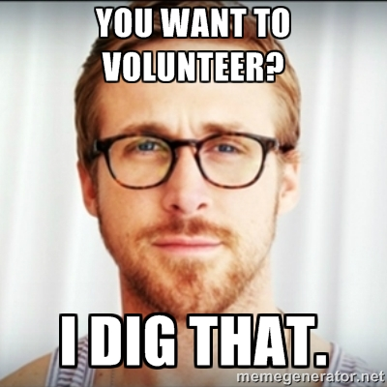
Recruiting new people- other tools
Thinking ahead
Job descriptions
Start with small, consistent opportunities

Slide 11
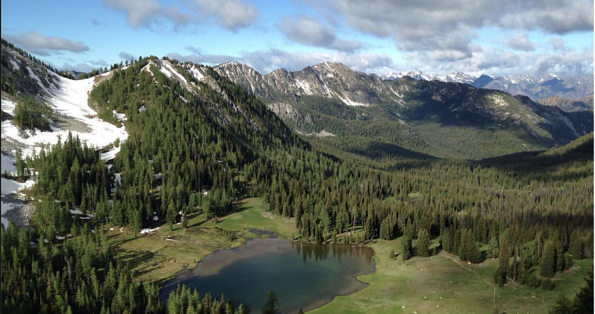
Routes/places
What’s new in routes/places
  Map view
  Alternate title
  Trip reports
Board policy
Adding new ones?
Notes:
Routes/places listings sometimes list 3 peaks, or two lakes and you may just be going to one of them. We have alternate titles so if the route place listing says Abiel, Silver and Tinkham Peak you can pick just Silver Peak or Abiel and Tinkham.
If you want to add a new route/place please make sure that it doesn’t already exist by searching the system. If one exists that is similar but just needs some beefing up please email info@mountaineers.org with updated text/info.
If you want to add a new one go to Leader Resouces- how to schedule a new route/place is near the top
https://www.mountaineers.org/volunteers/leader-resources/how-to-get-help-marketing-activities-courses-events
Scroll through Jeff’s how to.. Reach step 2 which is EXECUTE and here is the direct link to the form.
https://www.mountaineers.org/explore/routes-places/++add++mtneers.route
Put in as much info as you can- once you are done change the “State” in the right hand corner from Private to Submit for Publication so Jeff Bowman can review it for landmanagers and do a quick spell check.

Slide 12
My Branch and Committee Pages
Advertise when your main course isn’t in session
  Do you know your short url?
Event calendars
Online file storage
Mountaineers.org is always looking for new content – write a blog!
Notes:
If you are an admin on your branch or committee you will see an Edit button that will allow you to edit content on your page like a word document except that you can also add in photos or videos.
Also look for the Add New tab in the yellow admin bar for creating new folders/files and links for your committee.
https://www.mountaineers.org/volunteers/leader-resources/branch-committee-how-tos

Slide 13
Youth
Qualified Youth Leader
Current Youth Programs
  Mountain Workshops
  Pioneers, Explorers and MAC
  Summer Camp
Family activities
Youth in adult programs
Youth Forms
Notes:
Only 1 qualified youth leader is needed per activity, not all instructors need to be QYL.
Sign up and train to be a youth leader here: https://www.mountaineers.org/youth/volunteer-with-youth

Slide 14
Marketing Help
Website
Email communications
Social media
Print
Notes:
https://www.mountaineers.org/volunteers/leader-resources/how-to-get-help-marketing-activities-courses-events

Slide 15
Q&A

