Slide 1
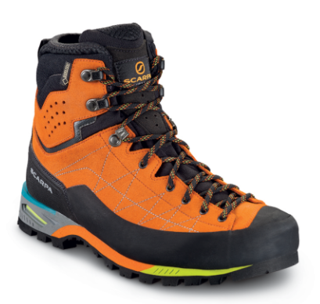

Purchasing Mountaineering Boots
Presented By: Susan Hausmann (some slides from Andy Tangsombatvisit)
Favorite Scramble: Cashmere Mountain (Andy - Hibox Mountain)

Slide 2

Types of Mountaineering Boots
Lightweight Mountaineering or Scrambling
- rigid backpacking boots
Full Mountaineering
- robust, durable, and expensive
Plastic “expedition” Mountaineering Boots
  - Do NOT buy for this class

Slide 3
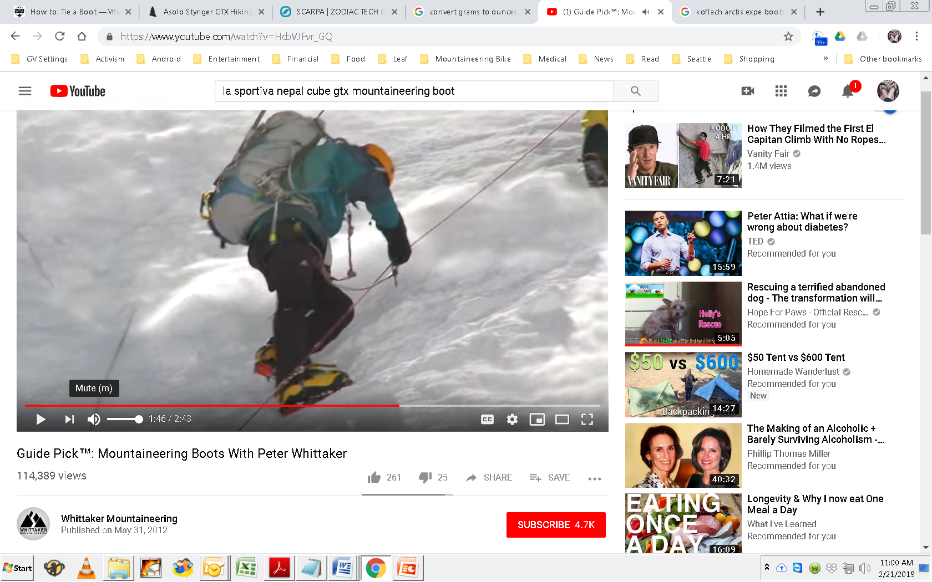
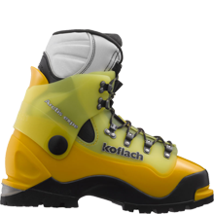
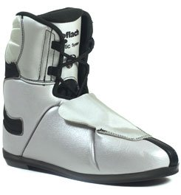
NOT for this class
Plastic Mountaineering Boots
Koflach Arctis Expe boot with liner
We won’t go up Denali with Peter Whittaker in this scramble course

Slide 4
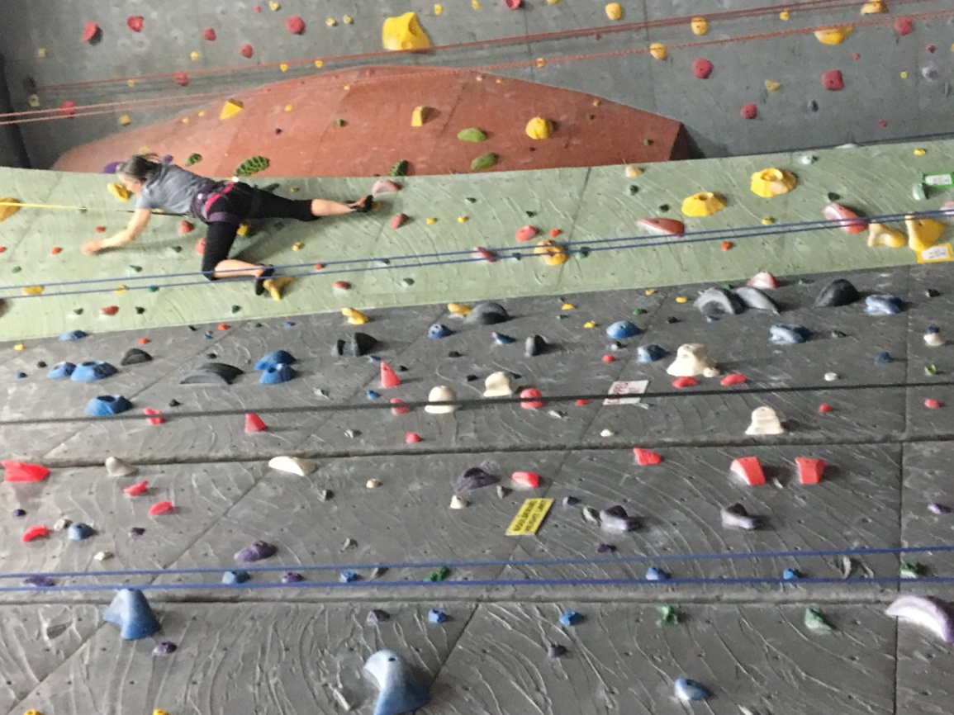
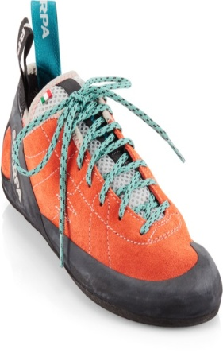
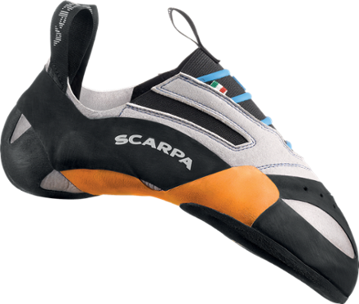
  NOT for this class
  Rock Climbing Shoes

Slide 5
Mountaineering Boots
  TOUGH enough to withstand scrapes on rock
  RIGID enough to kick steps in hard snow
  OFFER aggressive tread for secure travel in mud and snow
  PROTECT your feet from loose rock and talus
  Lightweight hiking boots are NOT suitable for this class

Slide 6
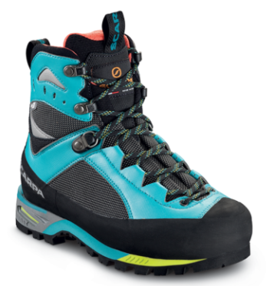
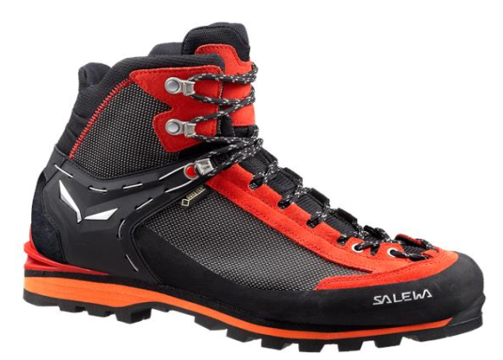
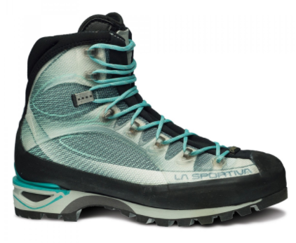
Types of Mountaineering Boots
Lightweight Mountaineering or Scrambling

Slide 7
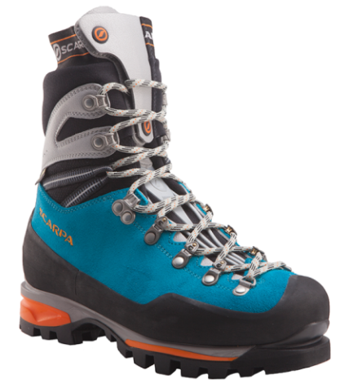
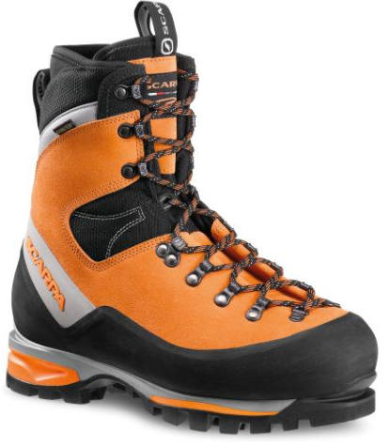
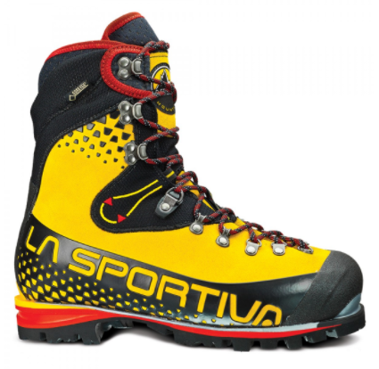
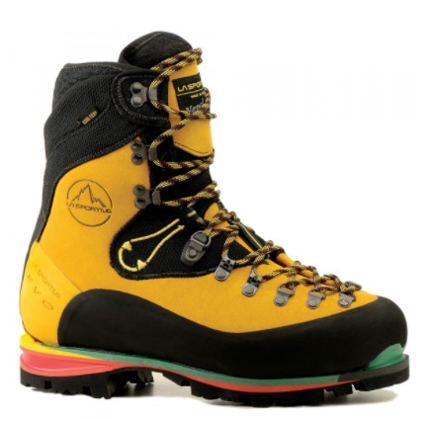
Types of Mountaineering Boots
Full Mountaineering Boot

Slide 8
Lightweight vs Full Mountaineering
Feature | Lightweight (Scramble) | Full
Cost | $200 - $300 | $400 - $600
Flexion | Some flexion | Stiff!
Weight (women’s) | 2 lbs 5 oz | 3 lbs 4 oz (30-40% heavier)
Waterproof | Yes (Gore-Tex) | Yes (Gore-Tex) plus more insulation
Crampon | Strap-on | Step-in

Slide 9
Performance and Fit
Back 2/3rds of your foot will remain anchored in place, while your toes have room to wiggle
Too tight = constricts circulation (cold toes), neuropathy, damaged toenails, blisters
Too loose = blisters

Slide 10
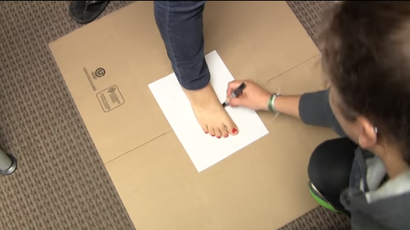
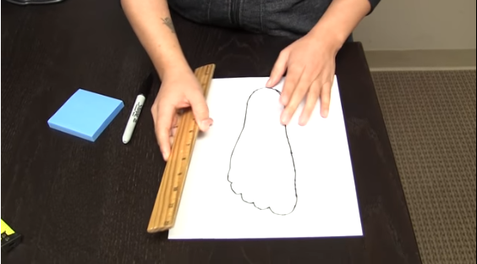
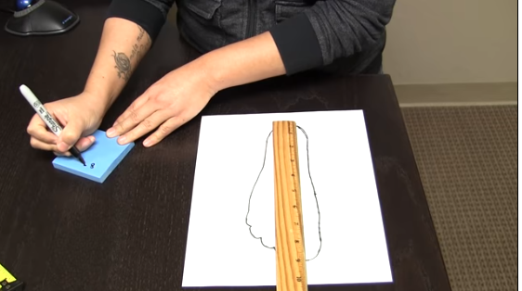
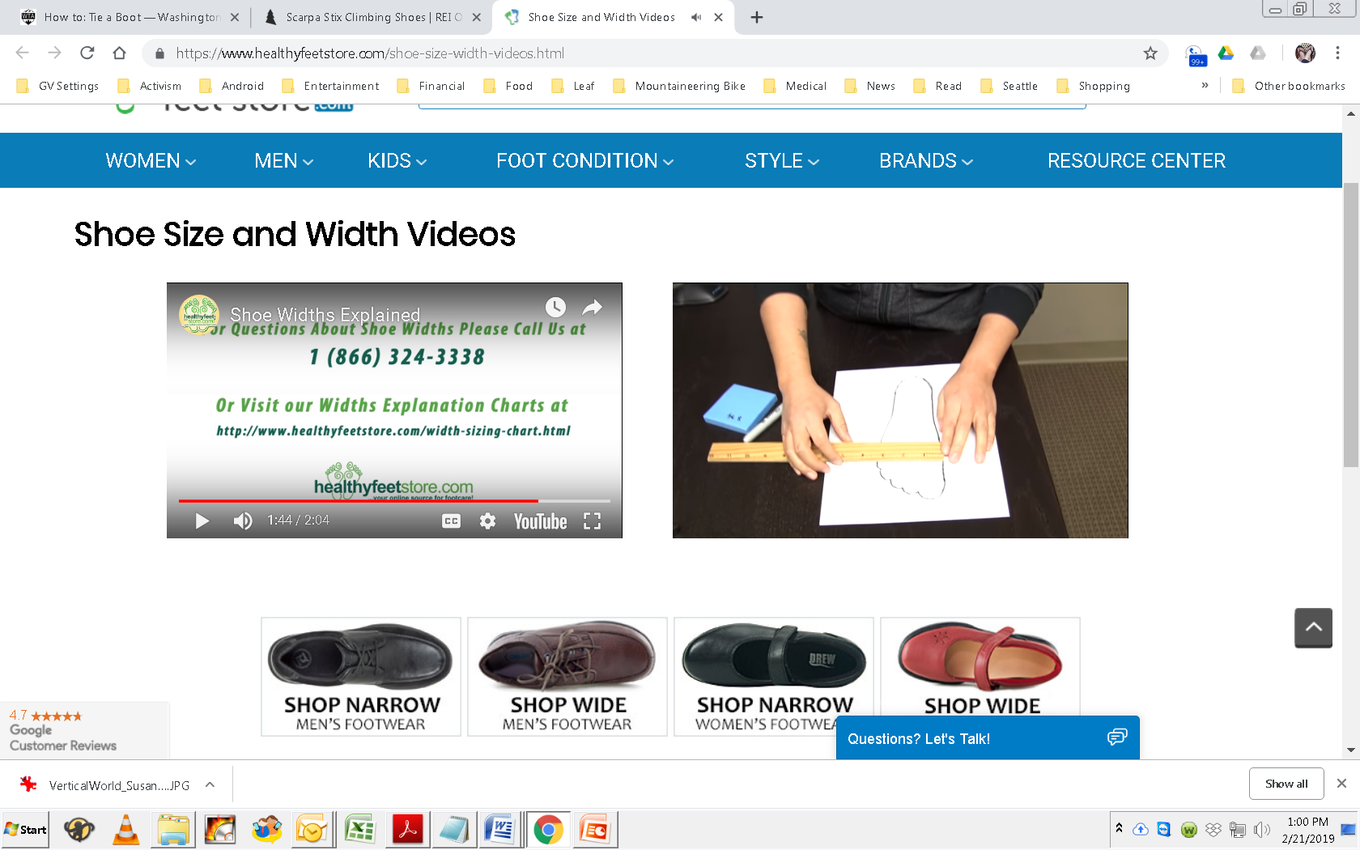
Boot widths vary – Measure both feet
https://www.healthyfeetstore.com/shoe-size-width-videos.html

Slide 11
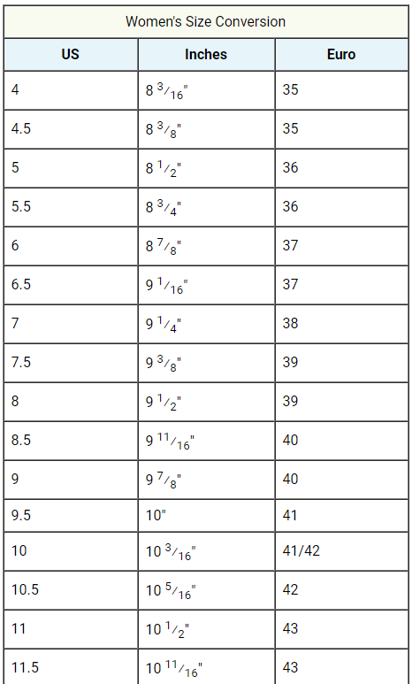
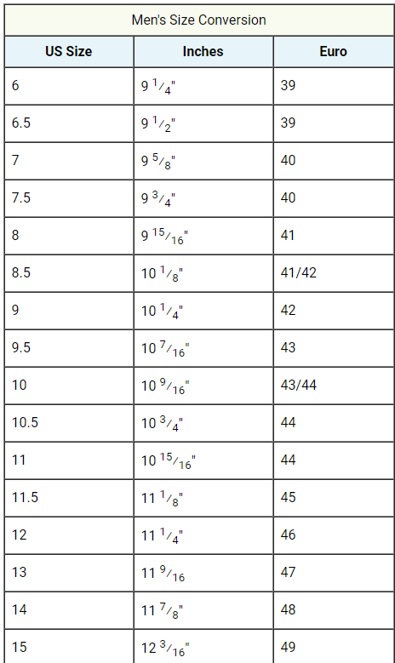
Fit - size

Slide 12
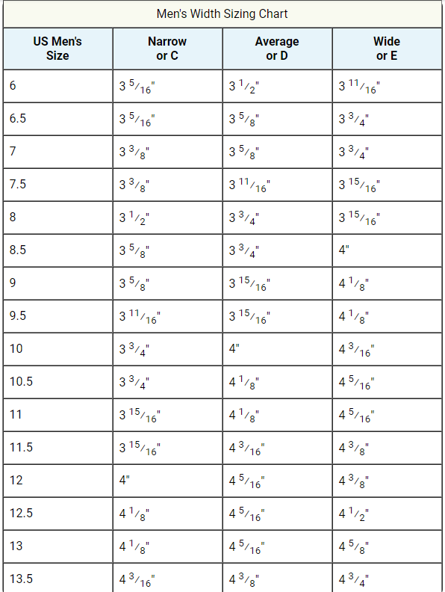
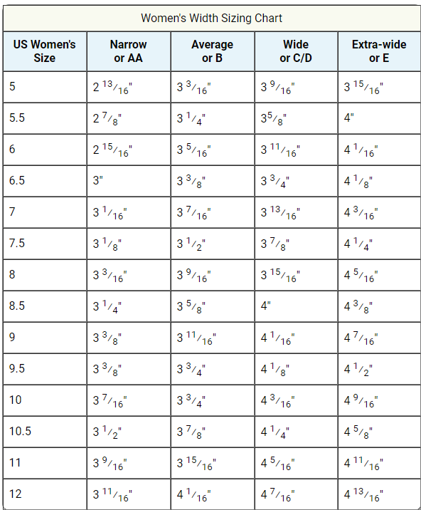
Fit - widths

Slide 13
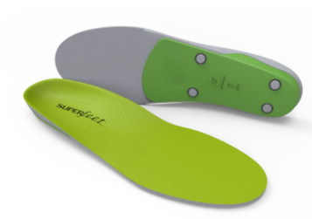
Buying Tips
Go in the evening when your feet are swollen;
Bring your “sock system” and insoles, it’ll vary with every person;
Bring a weighted pack and walk around the store;
Kick something solid, your toes should not bang the toe box;
Try several models; and
Try different lacing techniques.

Slide 14
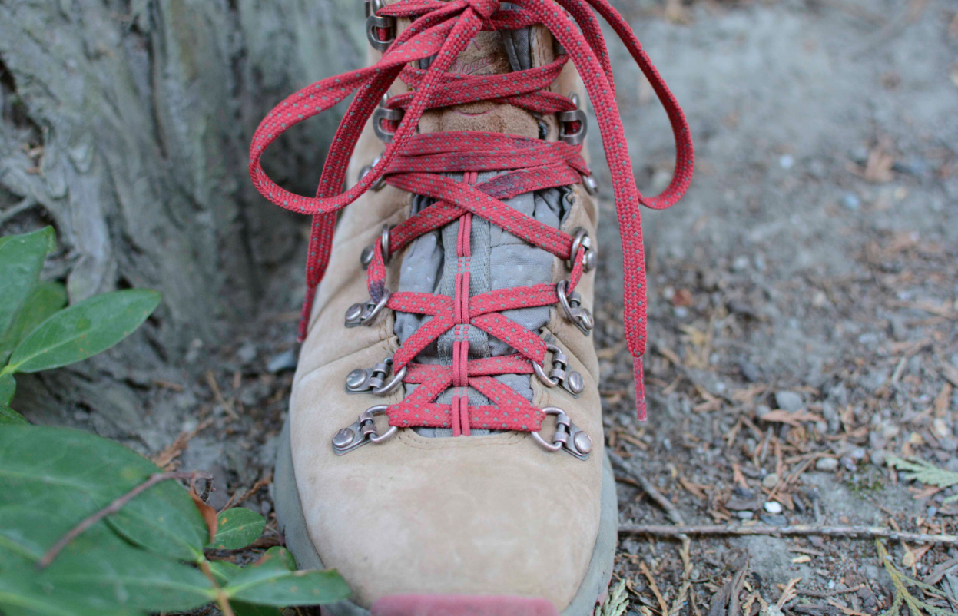
Window Lacing

Slide 15
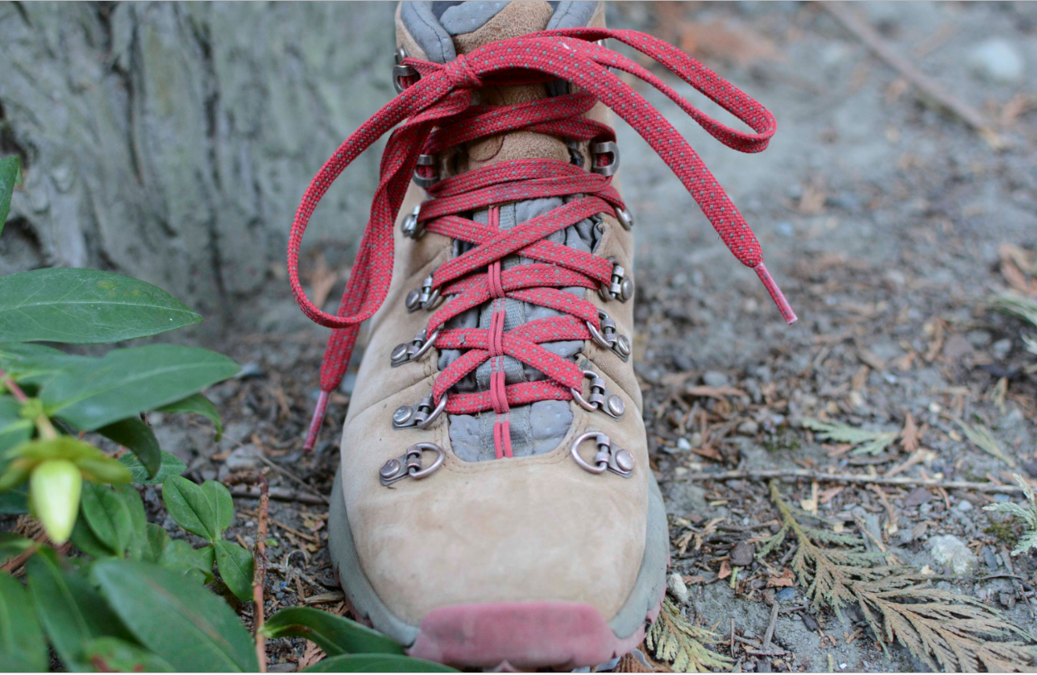
Toe Relief

Slide 16
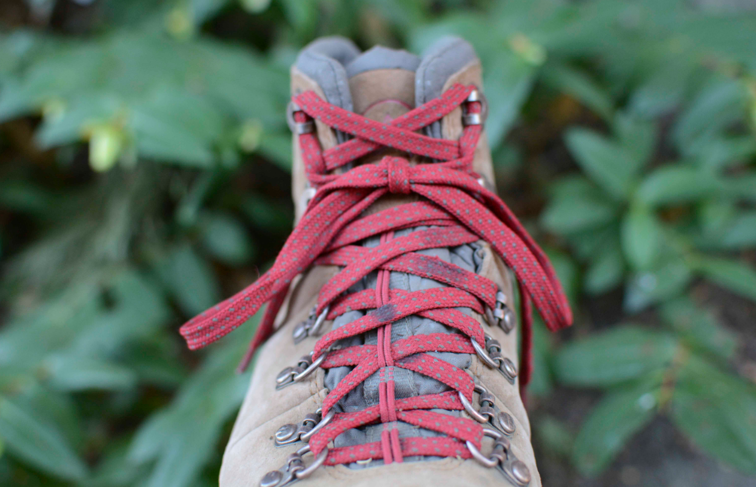
Heal Lock

