Slide 1
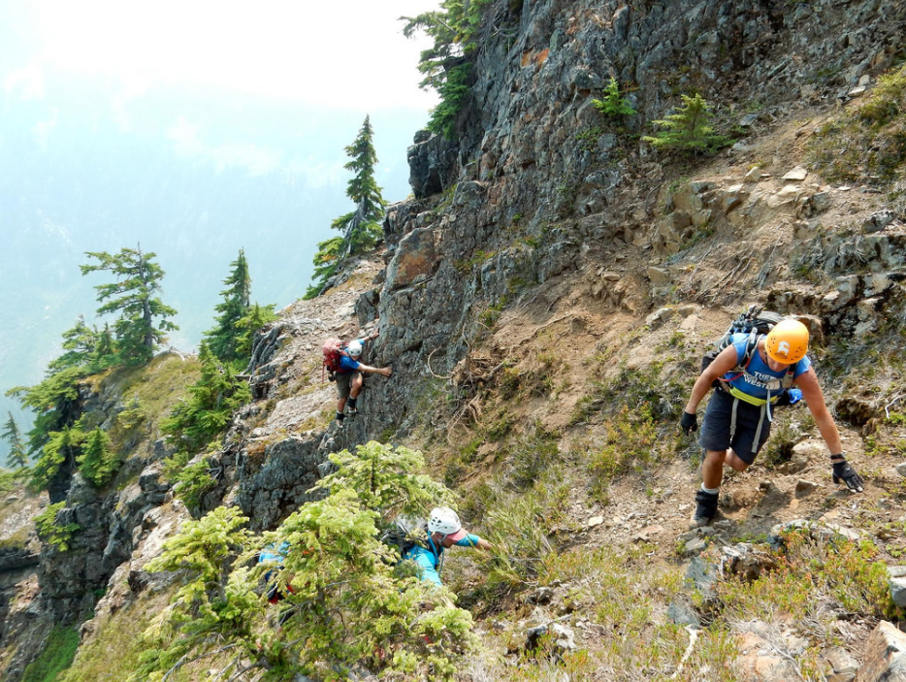
Alpine Scrambling Orientation
Presented By: Andy Tangsombatvisit, c/o 2014
Favorite Scramble: Helena Peak, Mountain Loop Highway

Slide 2
Orientation
Scrambling – non-technical off trail travel over snow, rock, or brush to a summit
- No technical equipment
- Still challenging both mentally and physically
- Still risky

Slide 3
Introductions
Instructor Intros:
Name
When did you take the course?
Favorite scramble
Student Intros:
Name
Your outdoor background

Slide 4
Graduation Requirements
Attend all 5 lectures
Attend 3 weekend field trips
Enroll in 3 additional classes (not included in course fees)
- Navigation
- Wilderness First Aid
- Wilderness First Aid Scenarios
Successful completed of three (3) scrambles
Participation in a stewardship event

Slide 5
Graduation Requirements
FIELD TRIP DATES
Rock (April 13): Navigation, rock travel techniques, bouldering, and simple use of handlines
Snow (April 27-28) : Snow travel, ice axe arrests, avalanche awareness, and snow shelters
Experience (May 18): Students plan and lead scramble in Snoqualmie Pass area

Slide 6
Graduation Requirements
COST FOR ADDITIONAL CLASSES
Navigation
- sign up for one date (Feb 23, Mar 3, or Mar 31)
- courses available through other branches or REI
- must cover how to use map and compass!
- Needs to be taken before Rock Field Trip
- $70 (Everett only)/ $60 (REI)

Slide 7
Graduation Requirements
COST FOR ADDITIONAL CLASSES
Wilderness First Aid and Scenarios
- must be completed before October 1, 2020
- courses available through other branches, Remote Medical Institute, CPR Seattle, or REI
- look for my email
- if taken through a different provider, you will need to apply for equivalency so you can sign up for the scenarios class
- $185 (Mountaineers)/ $200+ (other)

Slide 8
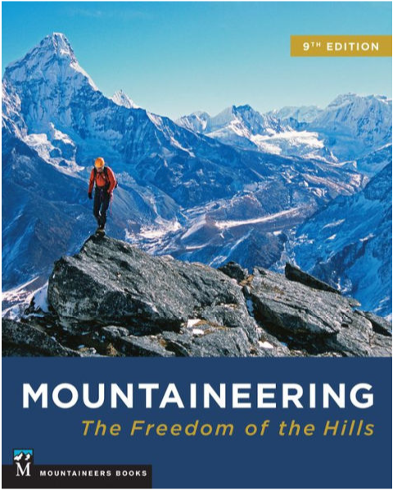
Graduation Requirements
READING AND QUIZZES
Please bring your student manual to class.
Purchase or borrow a copy of Freedom of the Hills, 9th edition
Please complete all reading assignments.
Practice your knots.
Do the quizzes assigned, we will go over it in class

Slide 9
Lecture Topics
Orientation, Off-trail travel, Boots
Proper Equipment, Fitness, Food & Nutrition
Knots, Low-impact recreation
Snow travel, Ice axe skills, Weather
Search & Rescue and Emergency Mitigation

Slide 10
Gear
Will be discussed at next lecture
Look for sales
Gear Night at Ascent Outdoors, Thu, March 14
Gear Night at Miyar Adventures, Thu, March 21
Main gear:
Mountaineering boots
Climbing helmet
Ice axe
Ten essentials
Technical clothing

Slide 11
Gear
Cost Breakdown
Minimum ($200) | Currently own most of the necessary clothing, backpacking gear and footwear. Only need to purchase scrambling gear and a few supplemental items.
Average ($500) | Must purchase scrambling equipment in addition to some backpacking gear (for example, better boots, a backpack, more suitable clothing, or outerwear.)
Maximum ($1500+) | Must purchase scrambling equipment and most backpacking gear and clothing. Or have a good start on the necessary equipment but feel the need to purchase newer/lighter/better/more equipment at a level that makes the rest of us envious.

Slide 12
Gear

Slide 13
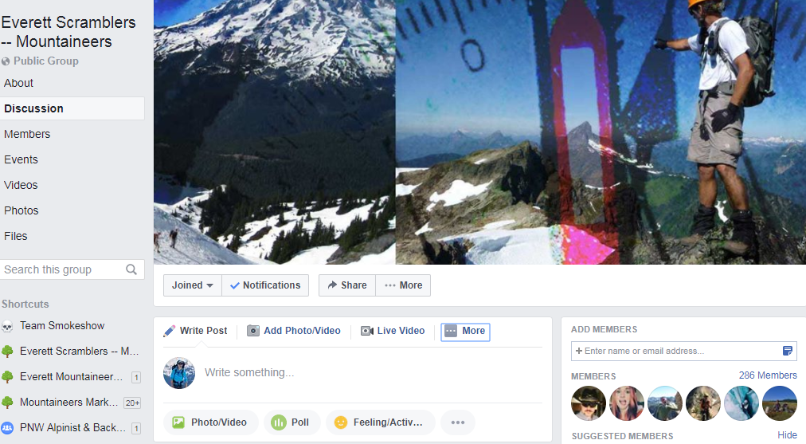
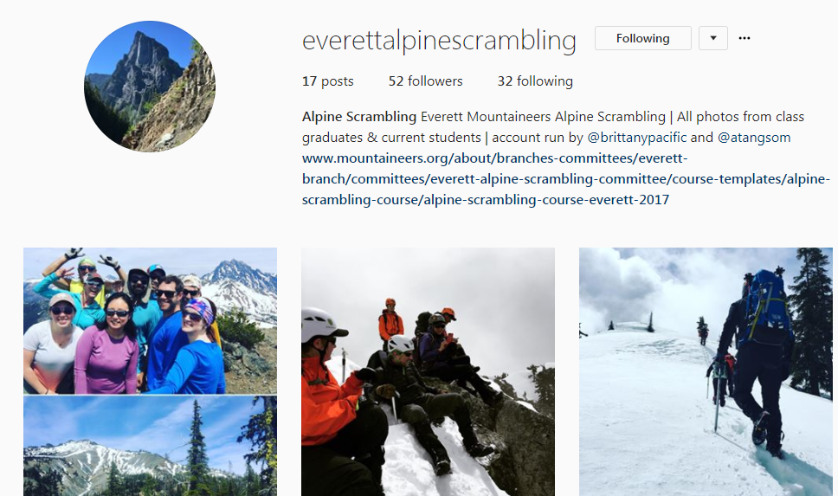
Social Media
This is your community, we are active on Facebook and Instagram.
You can use Facebook to:
Find out about scrambles before they are posted;
Request scrambles trips;
Ask questions; and
Post awesome photos of your scramble trip.

Slide 14
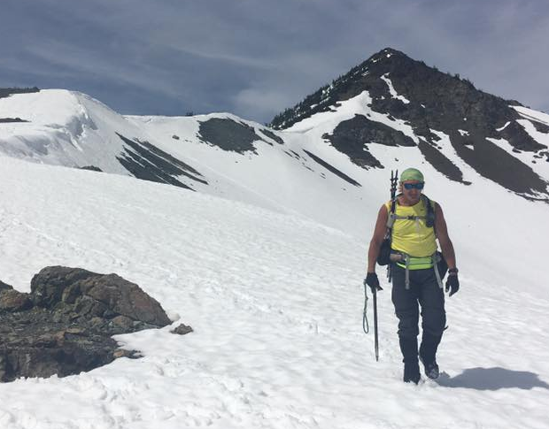
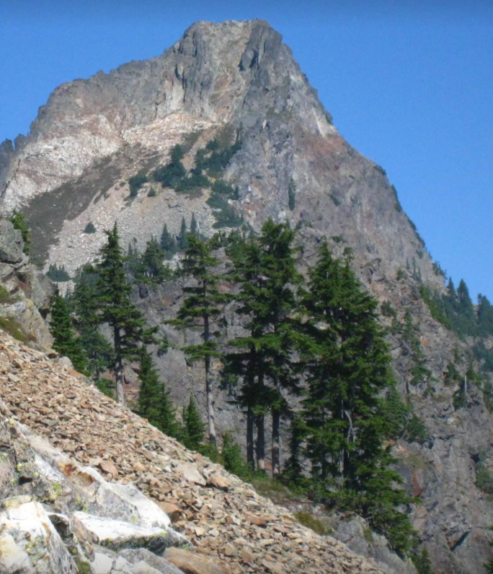
Why do all of this?
Notes:
Views
Exercise
Adventure
And to challenge yourself

Slide 15
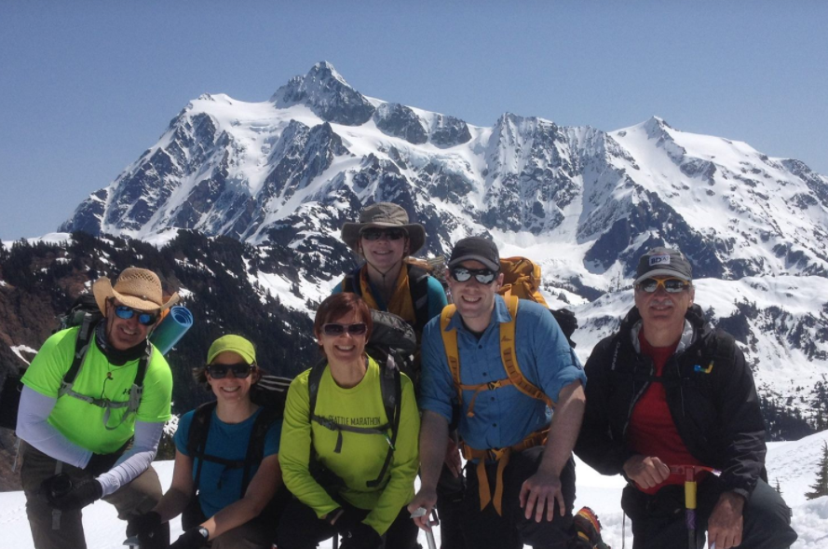
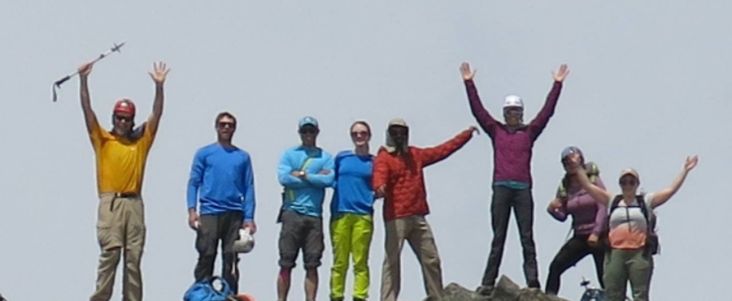
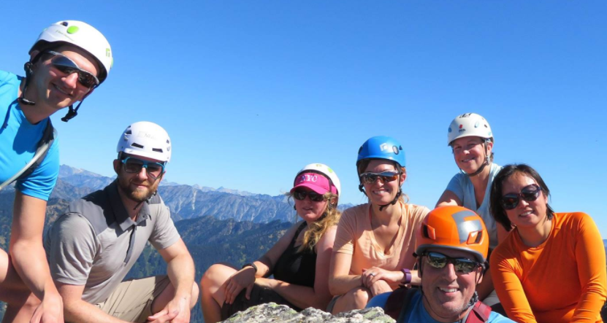
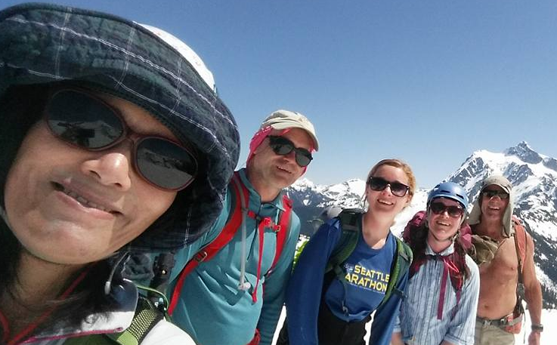
Why do all of this?
Notes:
Relationship you build suffering I mean scrambling together
Find scrambling partners

