Slide 1

The Mountaineers ~ Trail Running

Slide 2
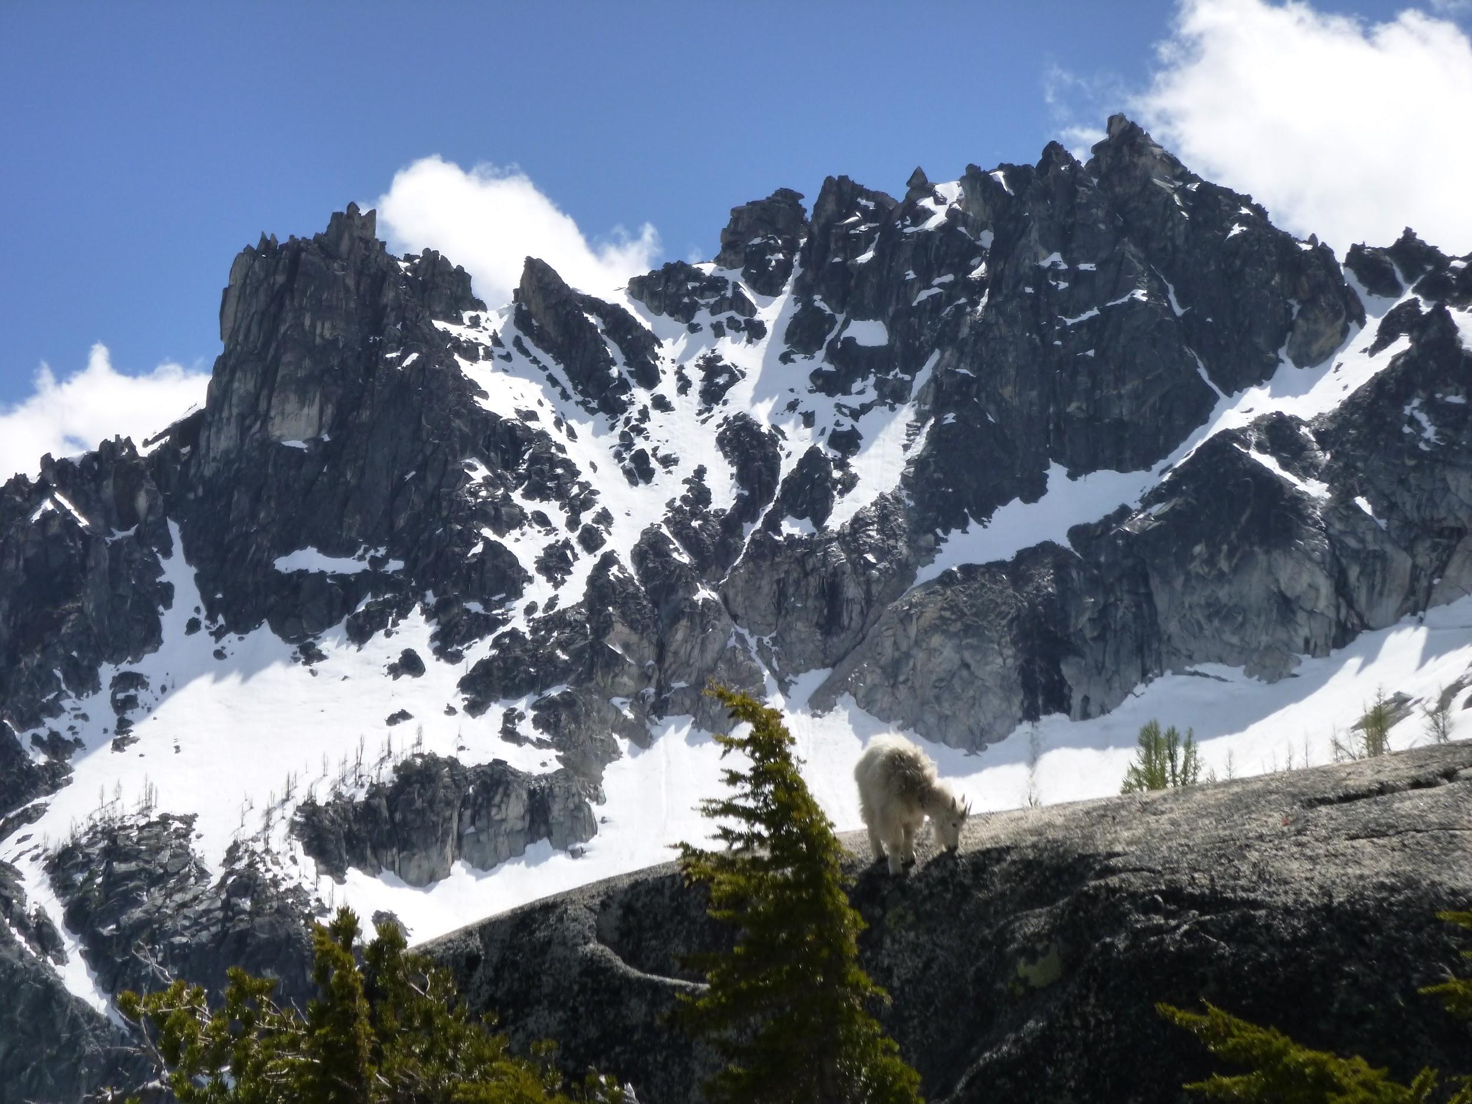
Introduction to Trail Running: Backcountry
Foothills Branch Trail Running Committee
Notes:
Instructors introduce yourselves.
Introduce the trail running committee and the course name.

Slide 3
Agenda
How to successfully complete this course
Field trip planning & registration; North Cascades weekend in September
Backcountry trail running, what is it?
Gear show & tell and the 10 essentials
First aid
Nutrition/hydration
Pace, anticipating how long and strenuous a trail run will be
Wrap-up

Slide 4
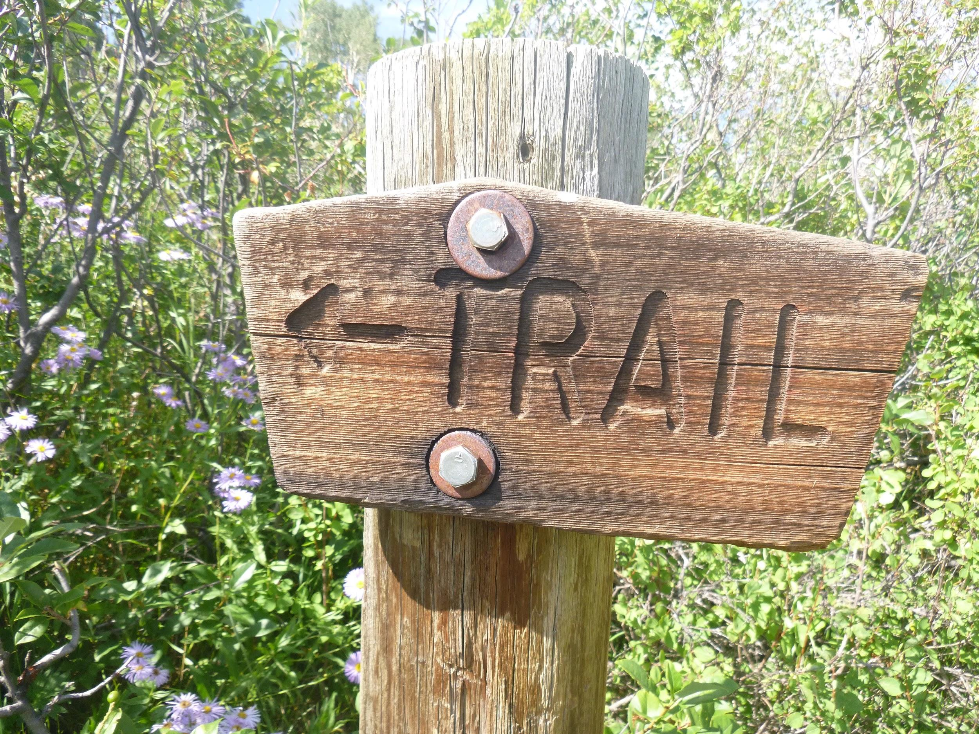
COURSE INFORMATION
Course Components:
  Classroom session (today!)
  Field trips (3 trail runs to graduate)
  Low impact recreation badge (online, free)
  Navigation badge or equivalent
  Wilderness first aid or equivalent
  Optional weekend of trail running in the North Cascades Sept. 6-8, 2019
Notes:
What is the class all about?
Talk about the trail running committee – newly formed, first of its type.

Slide 5
COURSE INFORMATION
Course learning outcomes
  Be able to plan and carry out wilderness trail runs by evaluating factors that impact trail running such as weather, terrain, and trail conditions, while accurately predicting time, effort, hydration, and nutrition required
  Be able to evaluate trail runs and races to determine if they are suitable for you, based on your interests and skill/fitness level
  Be familiar with safety concerns specific to trail running and best practices for safety and emergency preparedness; be able to assess safety during a trail run
  Demonstrate on-trail navigational competency
  Be familiar with gear specific to trail running and know how and when to use it, including micro-spikes, packs, and trekking poles
  Know how to travel in accordance with Leave No Trace principles as part of lower-impact recreation

Slide 6
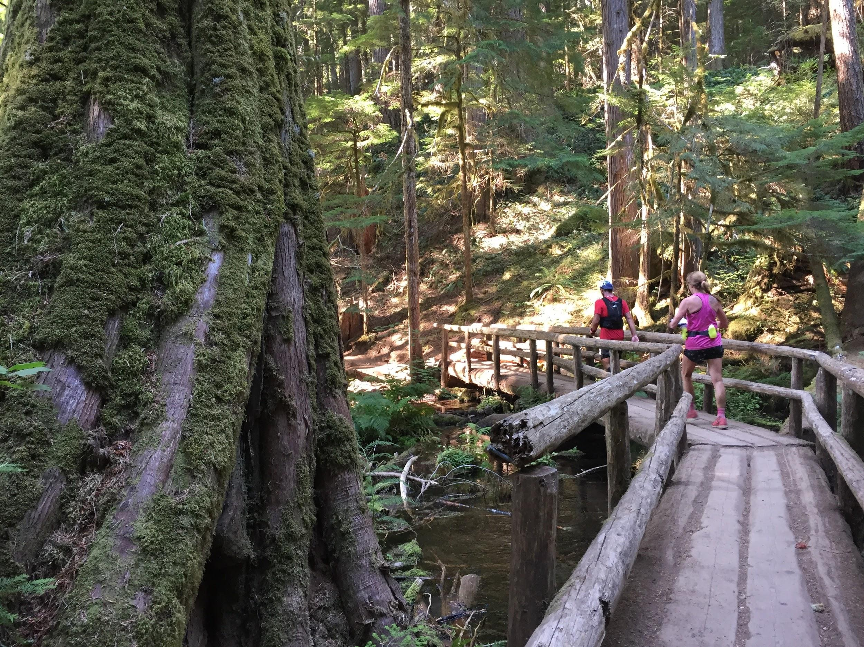
COURSE INFORMATION
Field trips
  Be sure to sign up for several field trips - you need 3 runs to graduate
  Research and plan as if you were going to run each trail yourself, without the course leaders
  Be prepared to share your preparation with the group at the trail
  Change/cancel registration for field trips from the course’s page

Slide 7
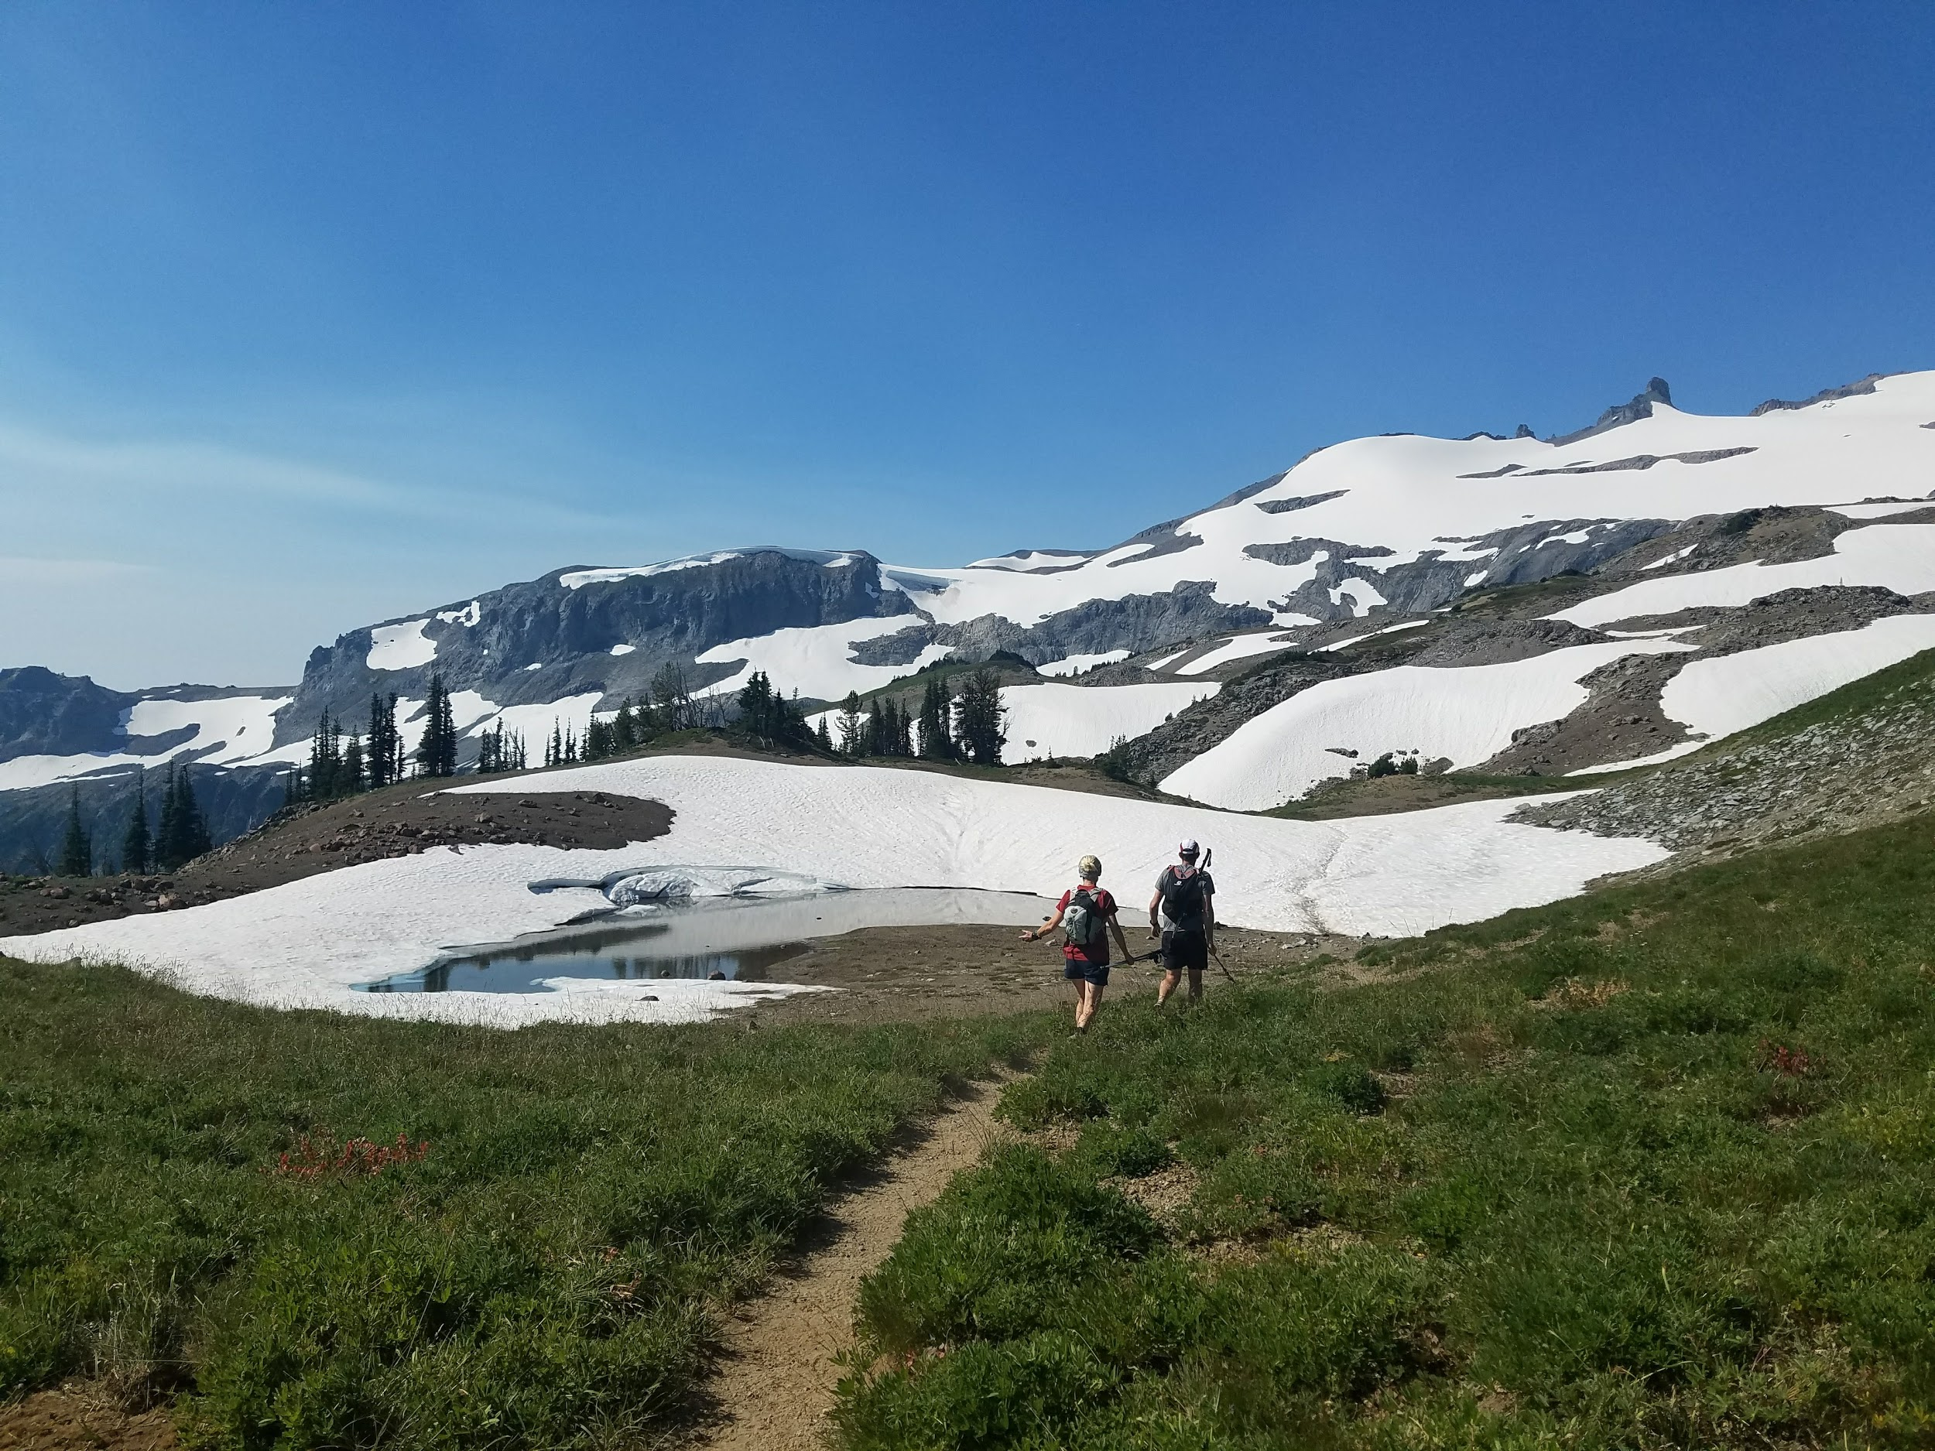
What is backcountry trail running?
Notes:
flip answer: not front country
mostly further from the trailhead, less crowds, help is not readily available, etc.

Slide 8
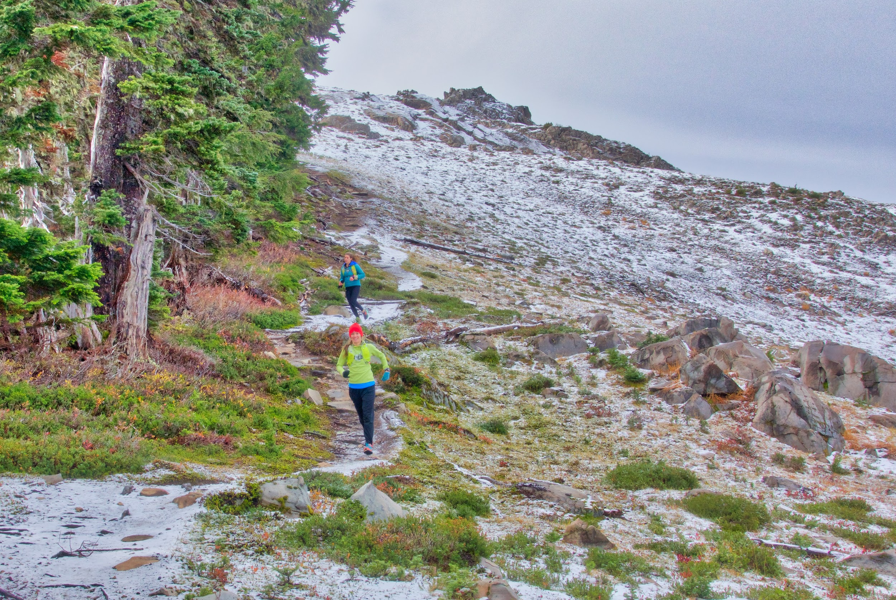
High Divide, 7 Lakes basin (Olympics)

Slide 9
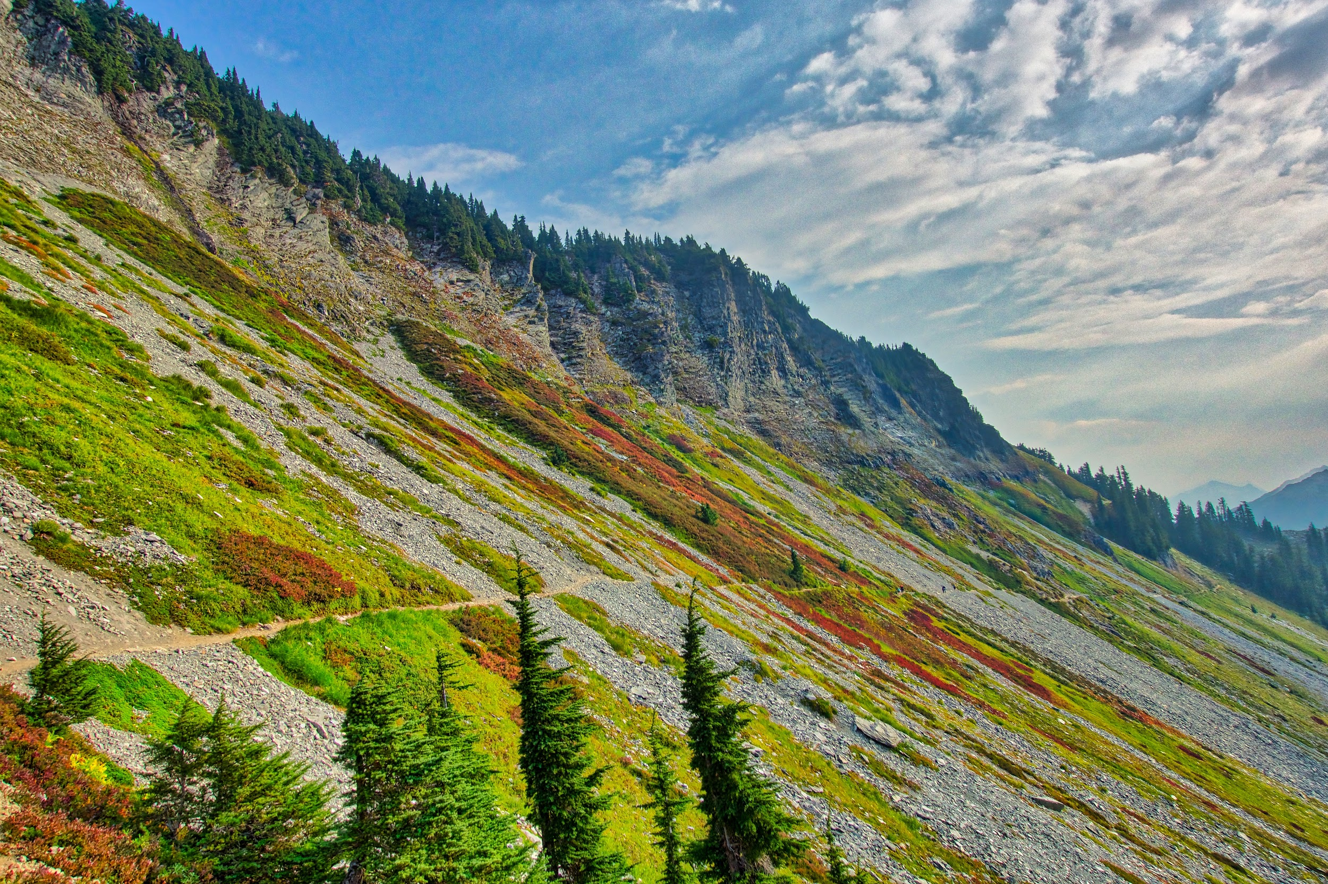
near artist point (Mt Baker area)

Slide 10
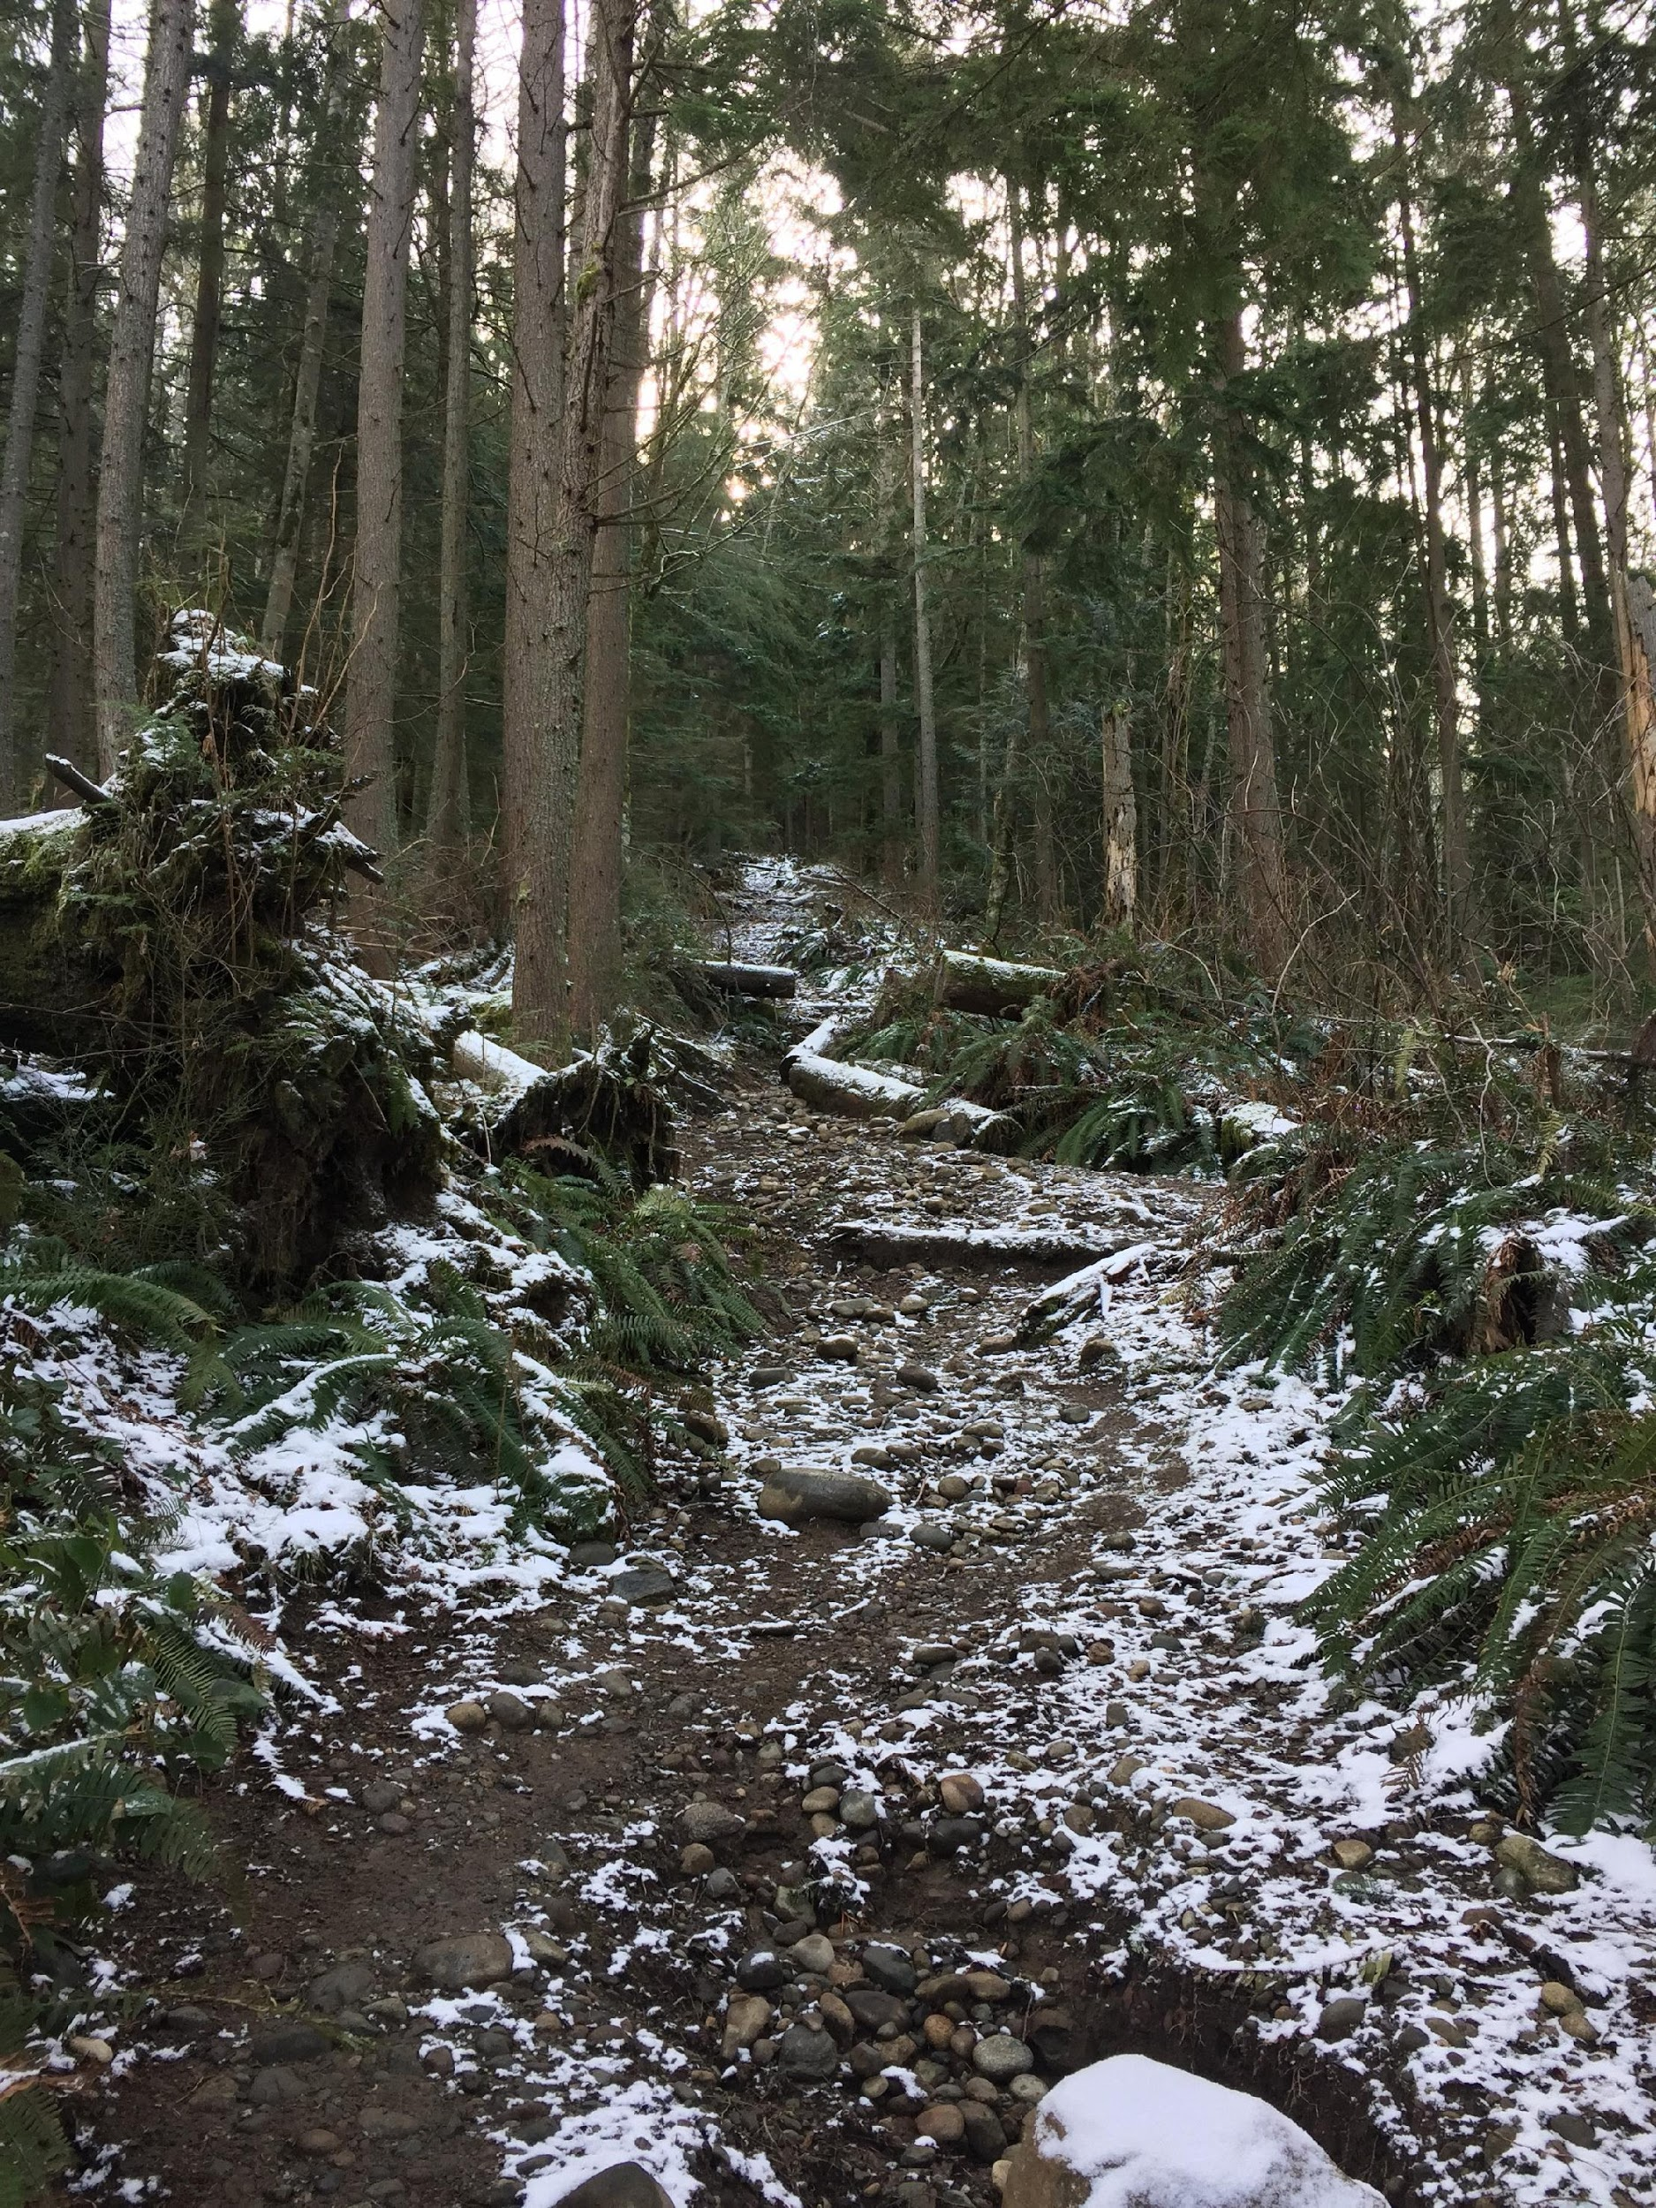
Mountaineers Trail Run Definition
Club-sponsored running trips
Restricted to trails/roads (maintained or unmaintained) with some exceptions:
  Snow OK unless potential for uncontrolled slide
  Brief off-trail OK
  Depends on the skills of each particular group

Slide 11
Trail Run Definition
Mountaineers Backcountry Trail Running Standards
Backcountry trail routes are established routes in wilderness areas and other remote areas where the following conditions apply:
help is not easily summoned;
the terrain is rugged and difficult;
the route may not be in frequent use by others;
exit points are far apart or not easily reached;
or in the leader’s judgment, the route does not qualify as a frontcountry route.
There should not be significant off-trail travel as part of the route.
Examples:
national parks and designated wilderness areas
long-distance trails which do not intersect with roads
primitive, unmaintained trails

Slide 12
Trail Run Difficulty Ratings
Mountaineers
Backcountry Trail Running Standards
Easy (E): Up to 5 miles roundtrip with less than 1000 feet of elevation gain or a moderate
trip with an average pace of 3-4 mph or slower. Easy runs are not held in darkness and do
not require equipment such as traction devices or poles.
Moderate (M): Up to 10 miles roundtrip or with 2,000 – 3,000 feet of elevation gain or a
strenuous trip with an average pace of 3-4 mph. Trail runs which would otherwise be
categorized as Easy (E) but that do require equipment such as traction devices or poles or
that are held in darkness should be listed as Moderate (M).
Strenuous (S): Up to 15 miles roundtrip or with 3,000 – 4,500 feet of elevation gain or a very strenuous trip with an average pace of 3-4 mph. Equipment may be required; the trail run may be held in darkness.
Very Strenuous (VS): 15 miles to 20 miles total; or with over 4,500 feet of elevation gain or a shorter mileage/smaller elevation trip with an aggressive pace. Equipment may be required; the trail run may be held in darkness.
Ultra; Advanced Ultra 1; Advanced Ultra 2: beyond 20 miles… Join us for a seminar on how to get started with ultrarunning this autumn!

Slide 13
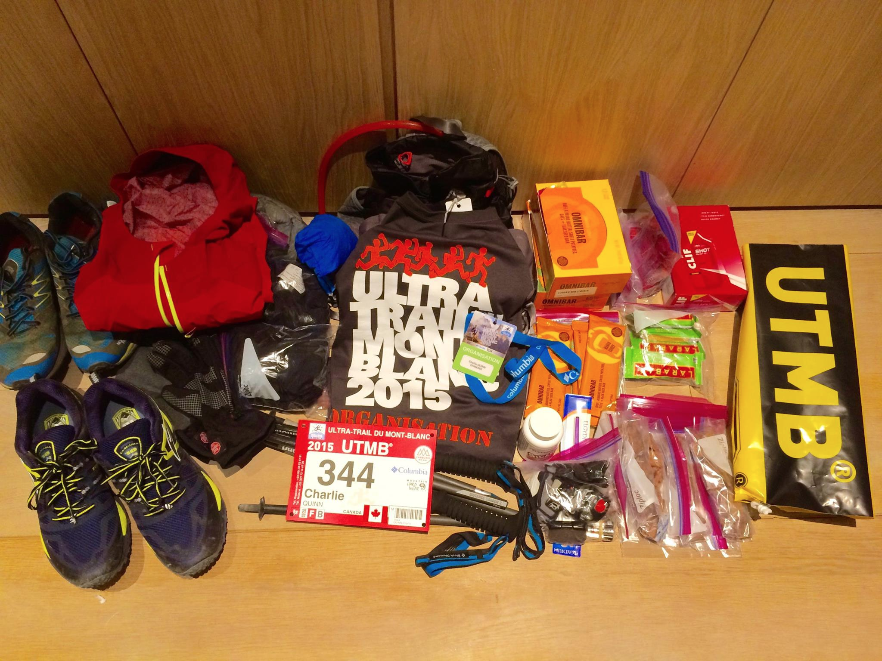
gear
Notes:
it’s a balance between those that want to take as little as possible and taking the kitchen sink, the answer is that it depends … depends on where, when, and how far

Slide 14
mandatory kit: UTMB
pack/running vest
mobile phone
drinking cup
ability to carry 1l of water
2 lights with spare batteries
whistle
elastic bandage
food reserve (min 800 kCal)
waterproof jacket with hood (taped seams)
long legged pants, or tights, or system to cover legs
waterproof pants
additional warm second layer
cap, bandana, or buff
waterproof gloves
ID
touque

Slide 15
mandatory kit: type 2 fun run
sleep system (sleeping bag + emergency shelter)
ability to carry 1L of water
light & batteries (or 2 lights)
compass
rain jacket (taped seams)
warm layers (top & bottom)
phone & charger
gps tracking device
first aid kit (or at least duct tape)
Strongly Suggested
A real first aid kit and knowledge of its contents
warm 3 season sleeping bag
sufficient food
gloves, warm hat, spare socks

Slide 16
mandatory kit: Whistler Alpine Meadows
waterproof jacket
emergency bivy (no space blankets)
whistle
gloves
touque or buff
full length pants or tights (it counts if you’re wearing them)
long sleeve shirt (arm sleeves do not count)
drinking cup (cupless race)
10 Essentials are suggested but not mandatory
North Shore Rescue: https://www.northshorerescue.com/education/what-to-bring/

Slide 17
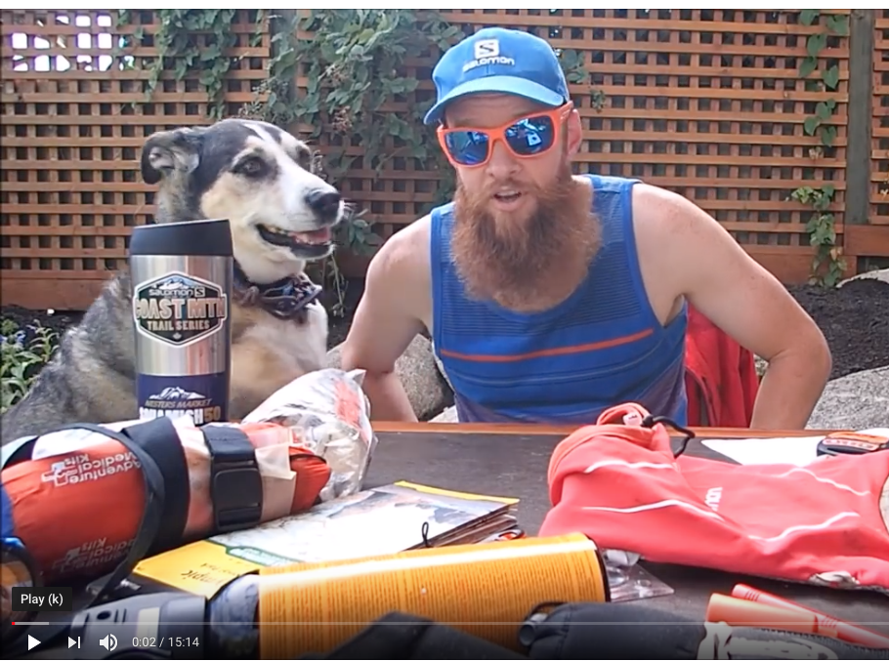
10 essentials: Gary’s take
https://www.youtube.com/watch?v=nUf1ea6JYYg

Slide 18
gear: walk through

Slide 19
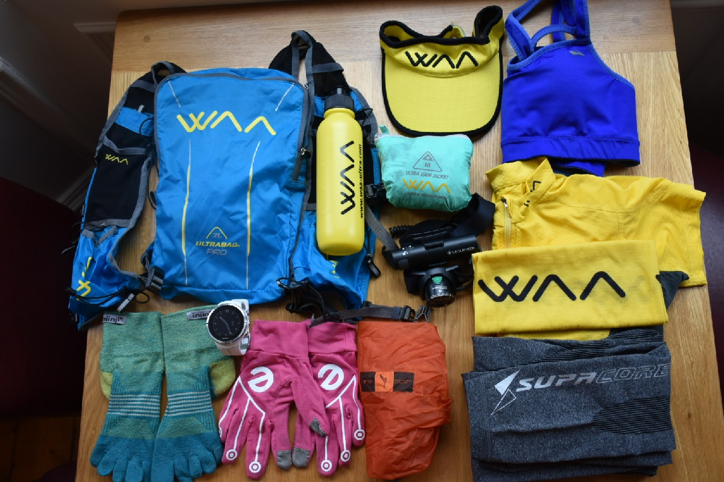
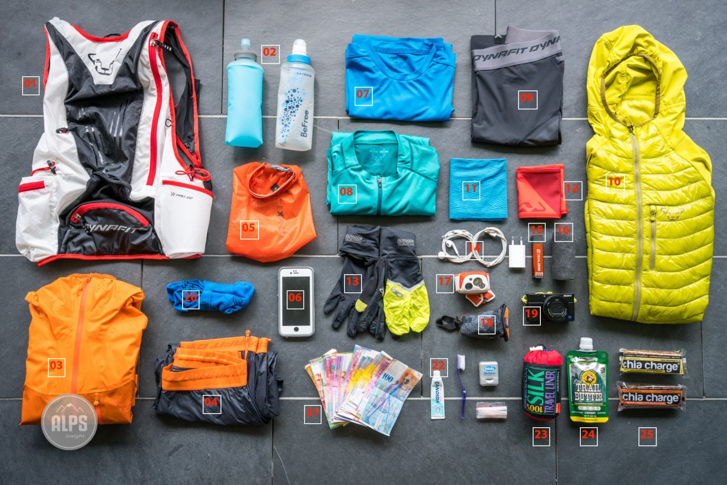
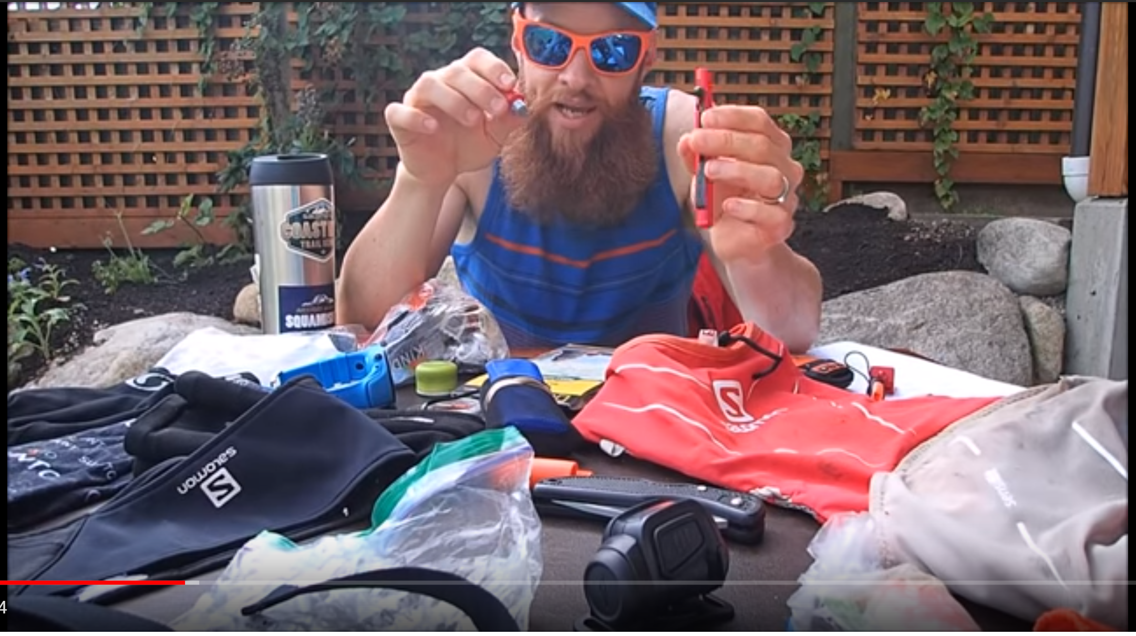
Gear Show & Tell
https://alpsinsight.com/stories/ultralight-trail-running-packing-list/
https://youtu.be/nUf1ea6JYYg

Slide 20
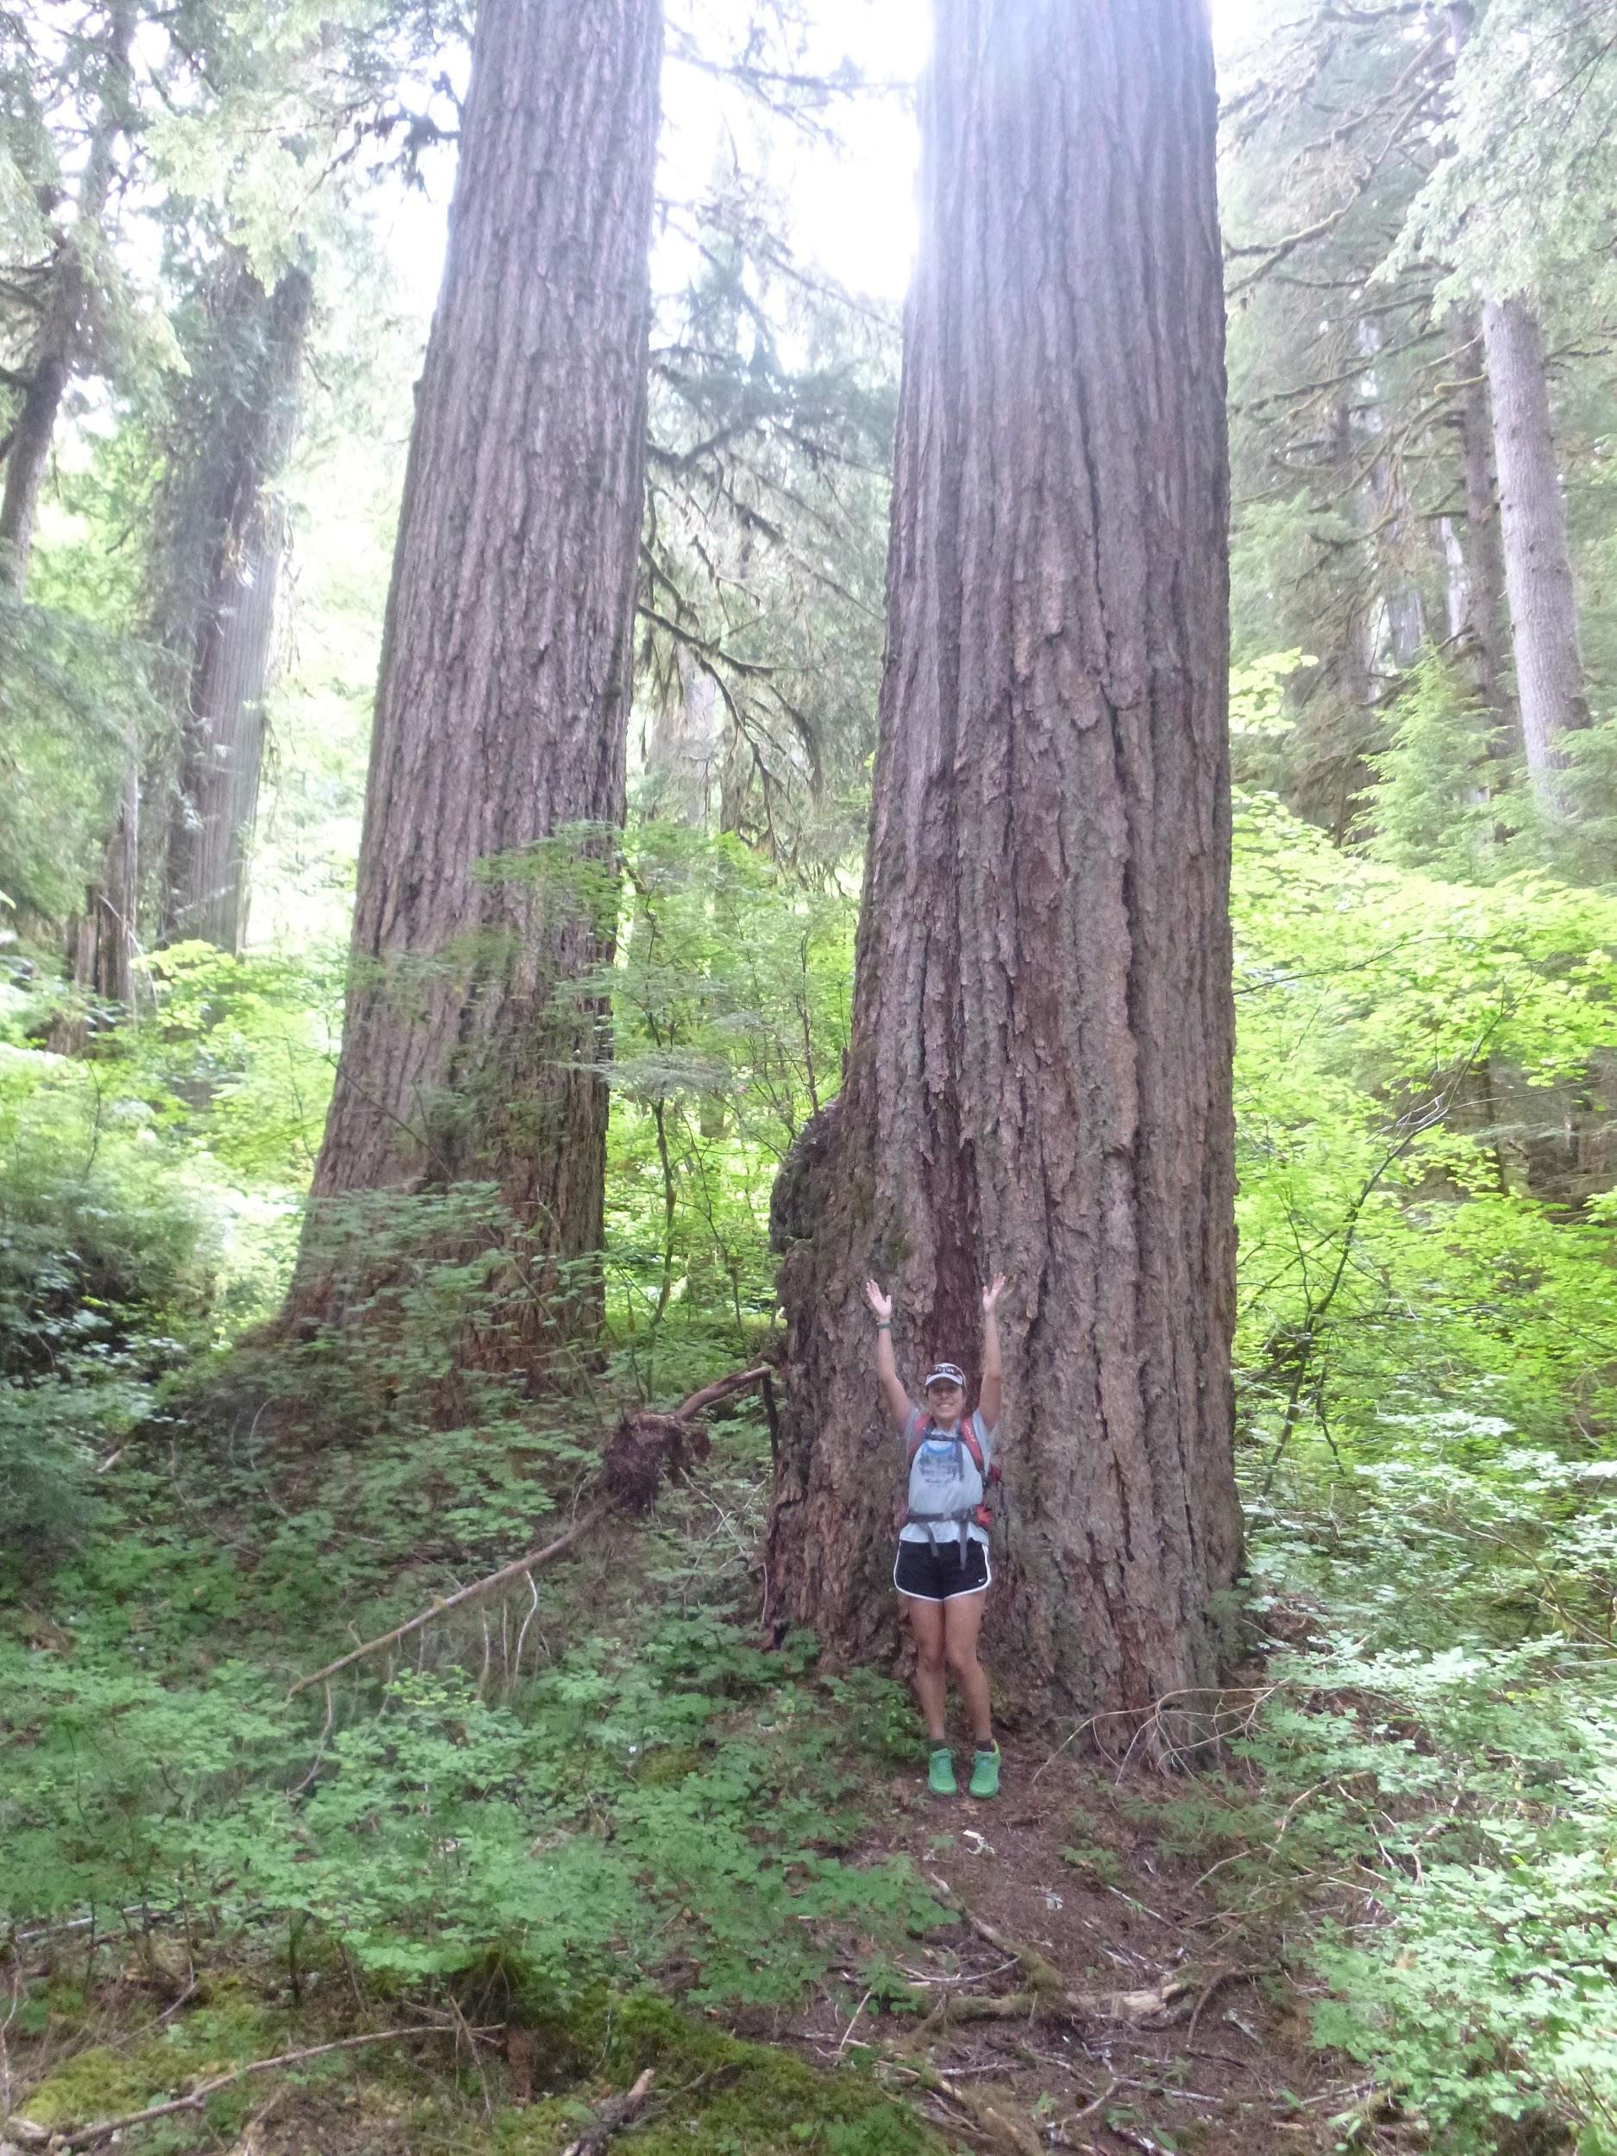
Trail Running Considerations
  Terrain challenges and effort level
  Pace and staying fueled, hydrated
  Weather, environment

Slide 21
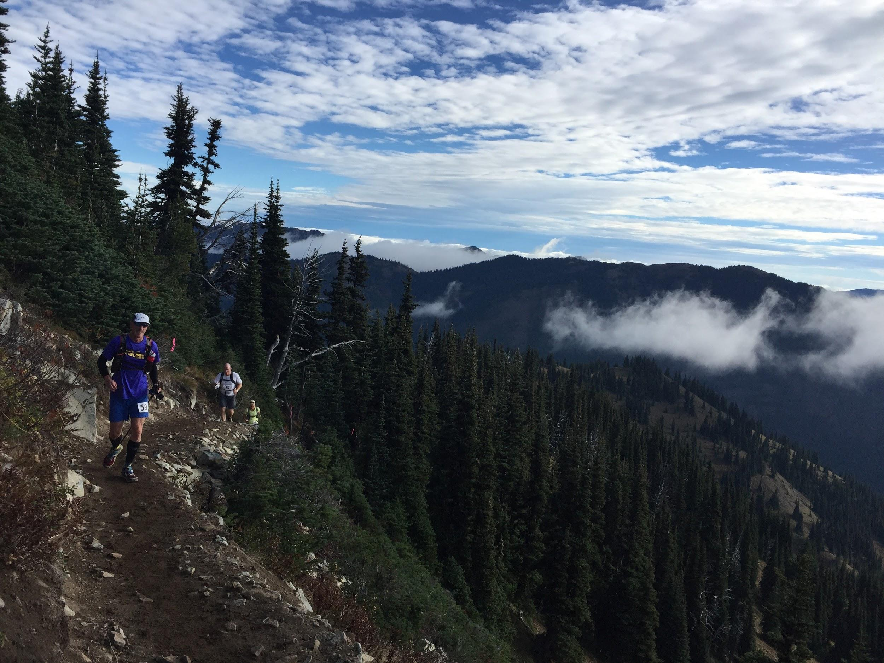
Planning a Run
Pick a trail
Research the route:
  Topo and aerial maps
  Wildlife
  Weather
Group, buddy or alone?
Get your gear together

Slide 22
Picking a Trail
  Think about terrain, distance and intensity
  Steep for a road runner = 7%
  Pick a route below your distance threshold – save some energy to get back to the trailhead just in case.
Trail | Main Climb Feet per mile | Distance | Gain | Grade
Mailbox Peak | 1850 | 2 | 3700 | 35%
Granite Mt | 920 | 3.8 | 3500 | 17%
Tiger 3 | 800 | 2.5 | 2000 | 15%
Squak Mountain | 730 | 2.4 | 1700 | 13%
Rattlesnake Mt | 650 | 1.7 | 1100 | 12%

Slide 23
Planning a Run
Topo and aerial maps
  gaia app & gaiagps.com (Mountaineers get free premium)
  Caltopo.com
  King County Parks: https://gismaps.kingcounty.gov/TrailFinder/
  Green Trails maps
WTA.org
  Recent conditions, trail descriptions
Land management, permits, parking
Trip plan template from Snohomish County Search & Rescue: https://scvsar.org/wp-content/uploads/2017/03/HikingPlan.pdf

Slide 24
Planning a Run - WALK THROUGH

Slide 25
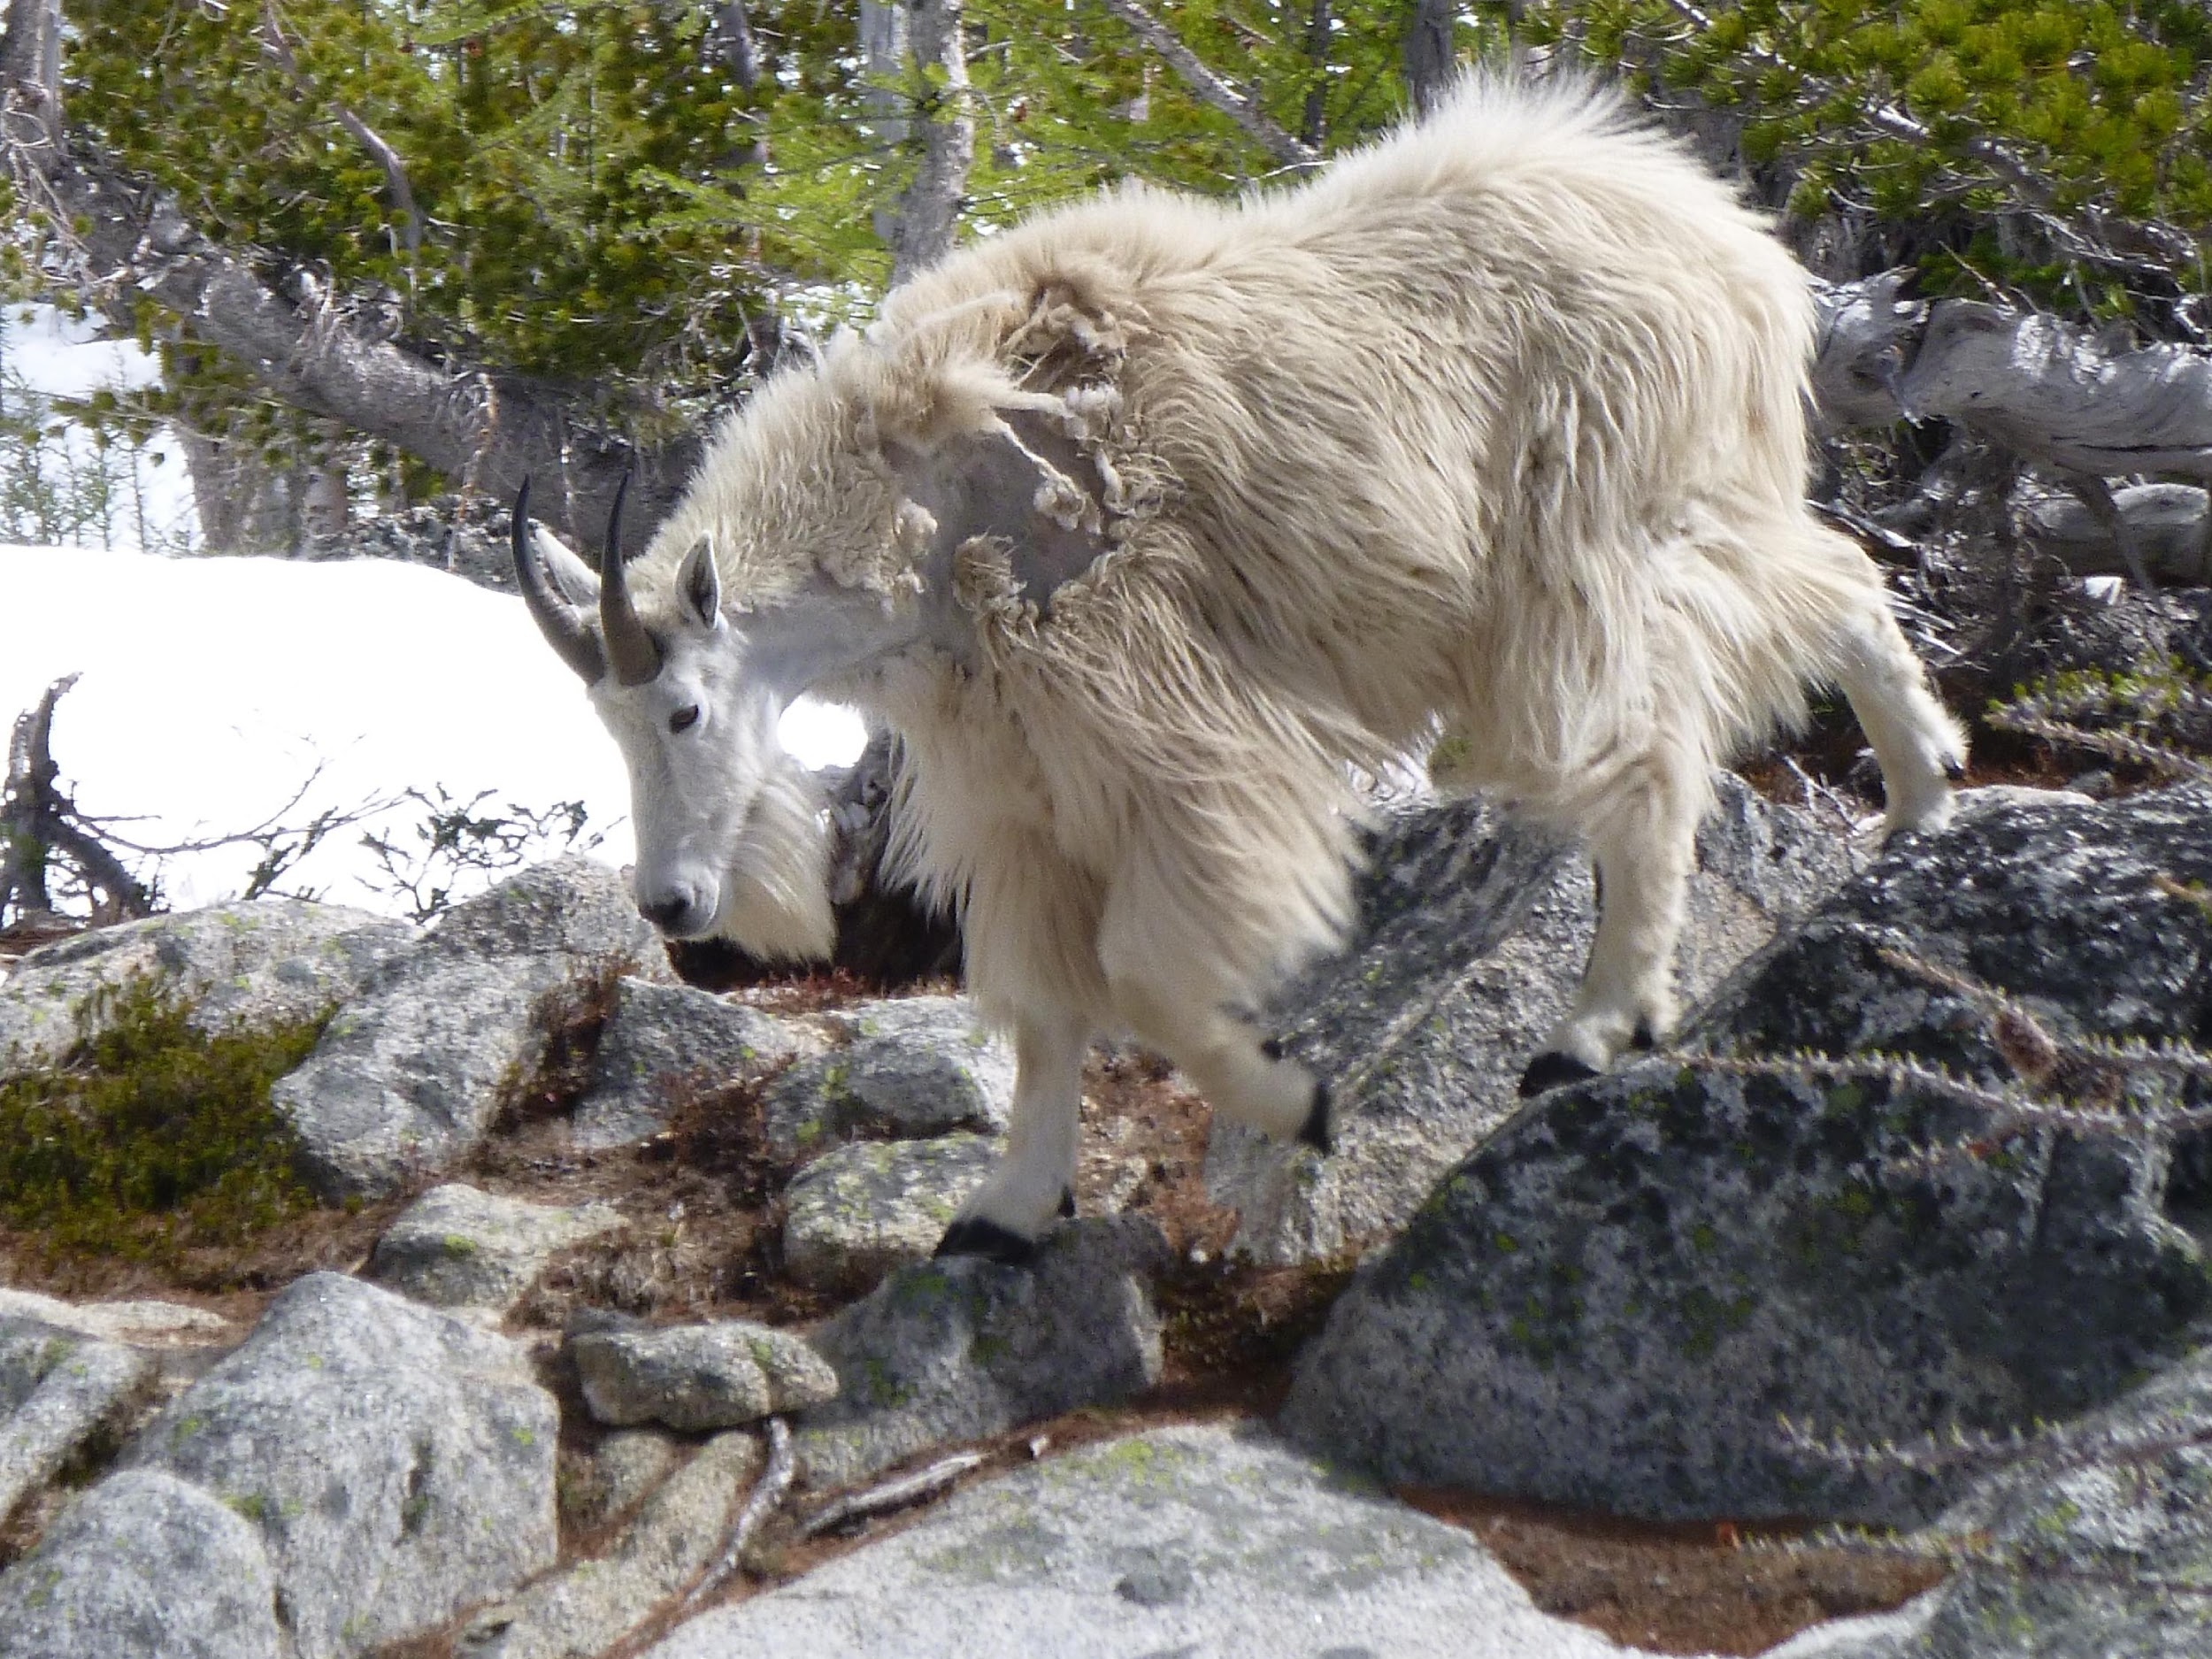
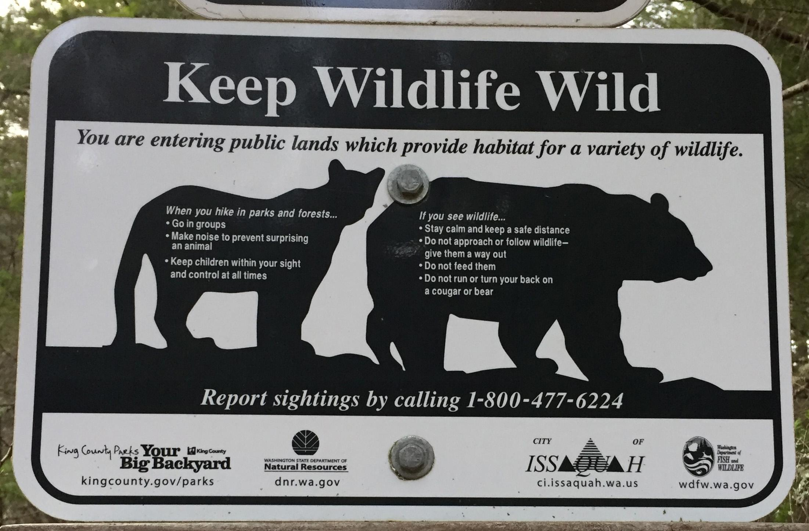
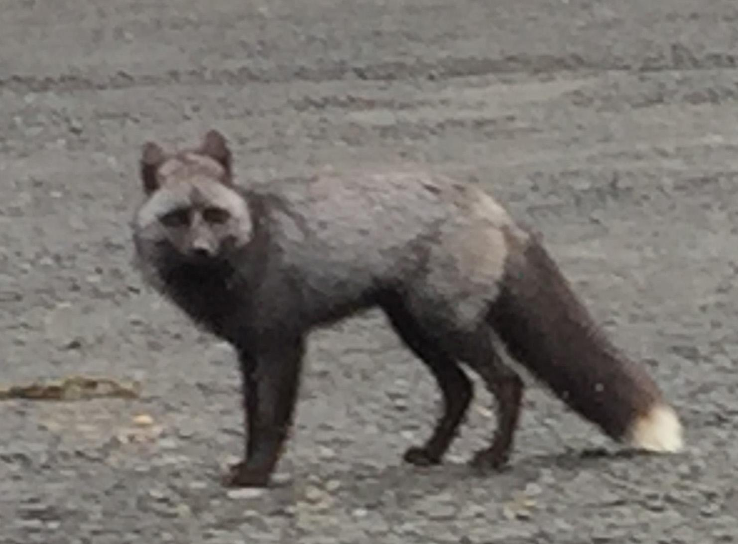
Planning a Run
  Wildlife

Slide 26
Other Planning Considerations
First aid kit in the car
Trip plan with someone
Running alone
Picking a partner
Land management agency / emergency preparedness

Slide 27
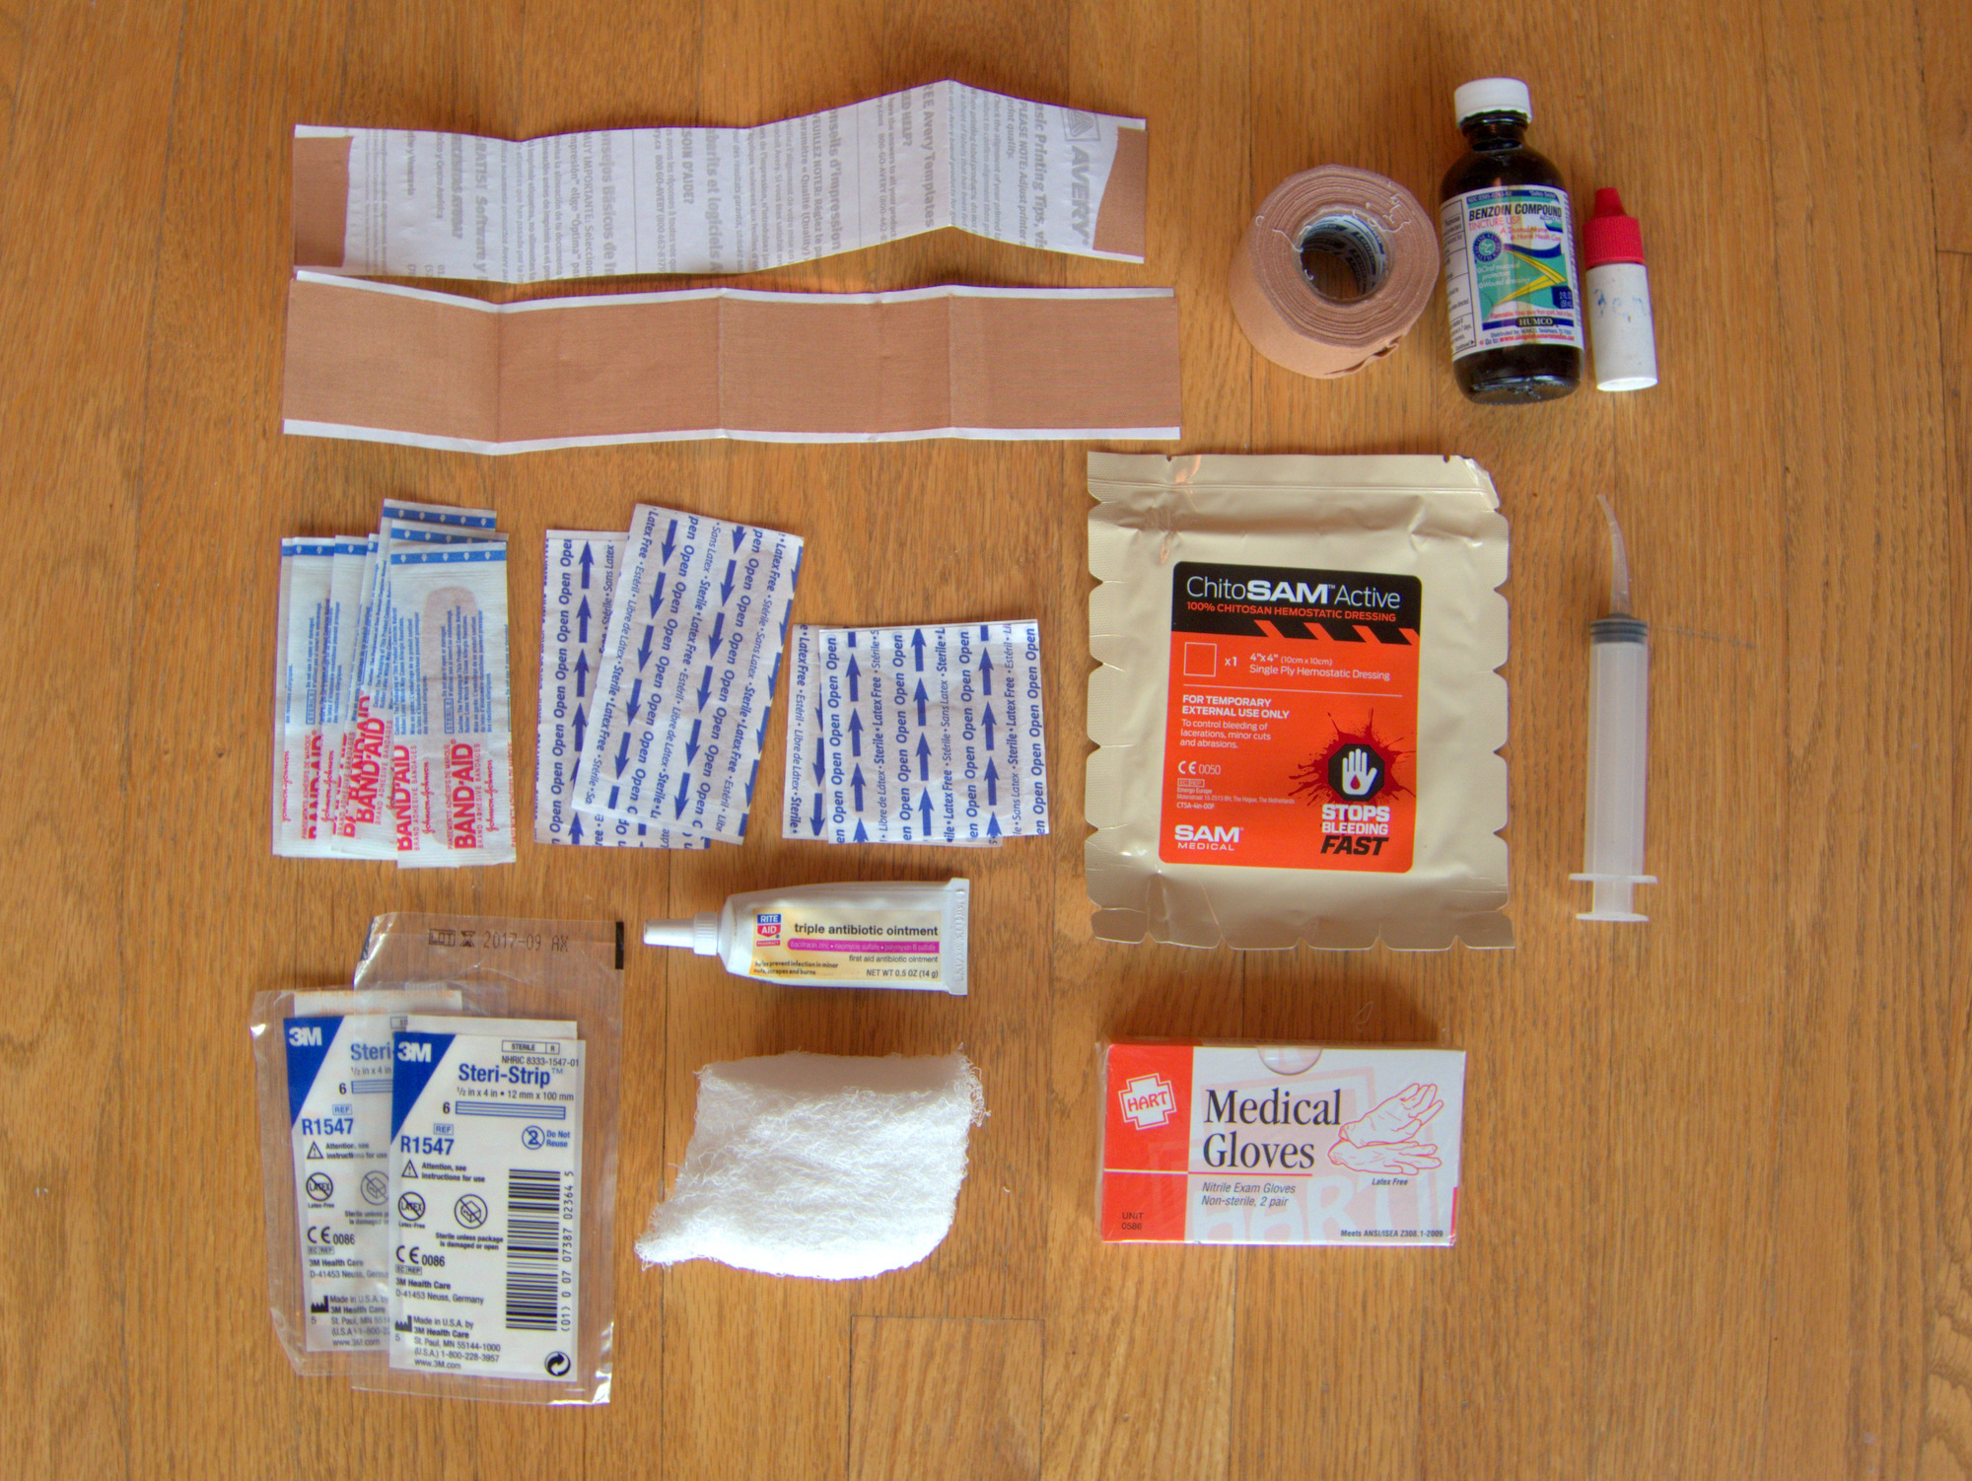
First Aid
We are not here to tell you how to build your first aid kit! (And therefore be held liable…) That being said, some things to aim for:
Find items with multiple uses
Don’t skimp on your life-saving items (prescription meds? Epipen? asthma inhaler?)
Keep weight in mind

Slide 28
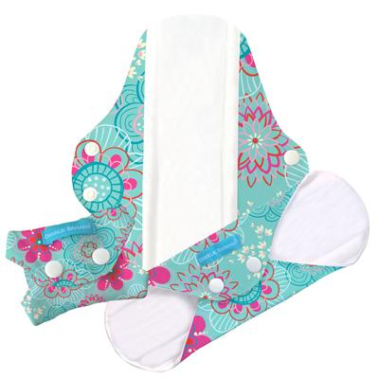
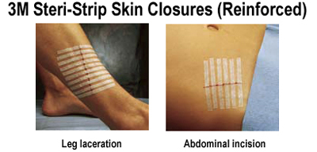

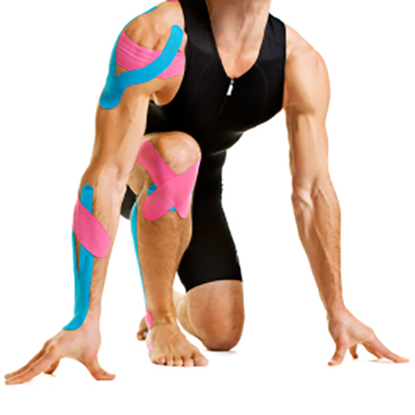
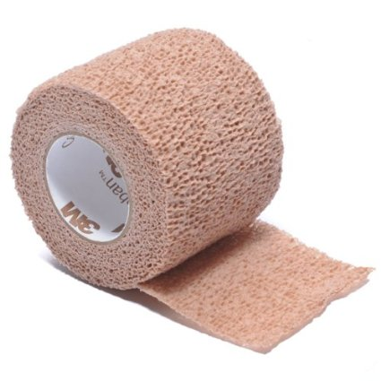
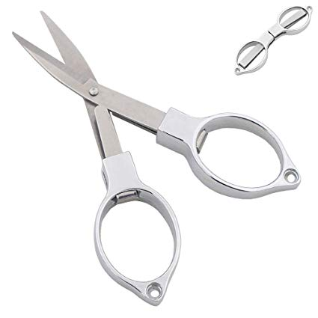
First Aid - Tricks
Feminine Hygiene Products
KT Tape
Moleskin
ACE Wrap
Steri-strips
Scissors
Sanitizing wipes/ointment

Slide 29
FIELD TRIP GOALS & TOPICS
Practice planning and executing a successful trail run
Test out gear, clothing, nutrition and hydration
Experiential learning topics:
  Gear, clothes
  Hydration, nutrition
  Uphills and downhills
  Pacing yourself
  Safety and emergency preparedness
  Weather and terrain awareness
  On-trail navigation
Meet other runners & have fun!

Slide 30
FIELD TRIP PLANNING CHECKLIST
Gear, clothing you would recommend
Your nutrition and hydration suggestions
Distance, elevation gain
Navigation, landmarks, map
Emergency preparedness
Sunset times/ how much daylight
Land management -- rules, parking permits, dog-friendly or not
Recent trip reports or other “beta”
Answering questions such as:
How long will this trail run take, start to finish?
How difficult will this trail run be for me and for my group?
What will the terrain be like?
What kinds of decisions might I be making along the way?
What issues might I encounter on this trail? Stream crossings, sun, exposure, wildlife?
What should I do in an emergency on this particular route?

Slide 31
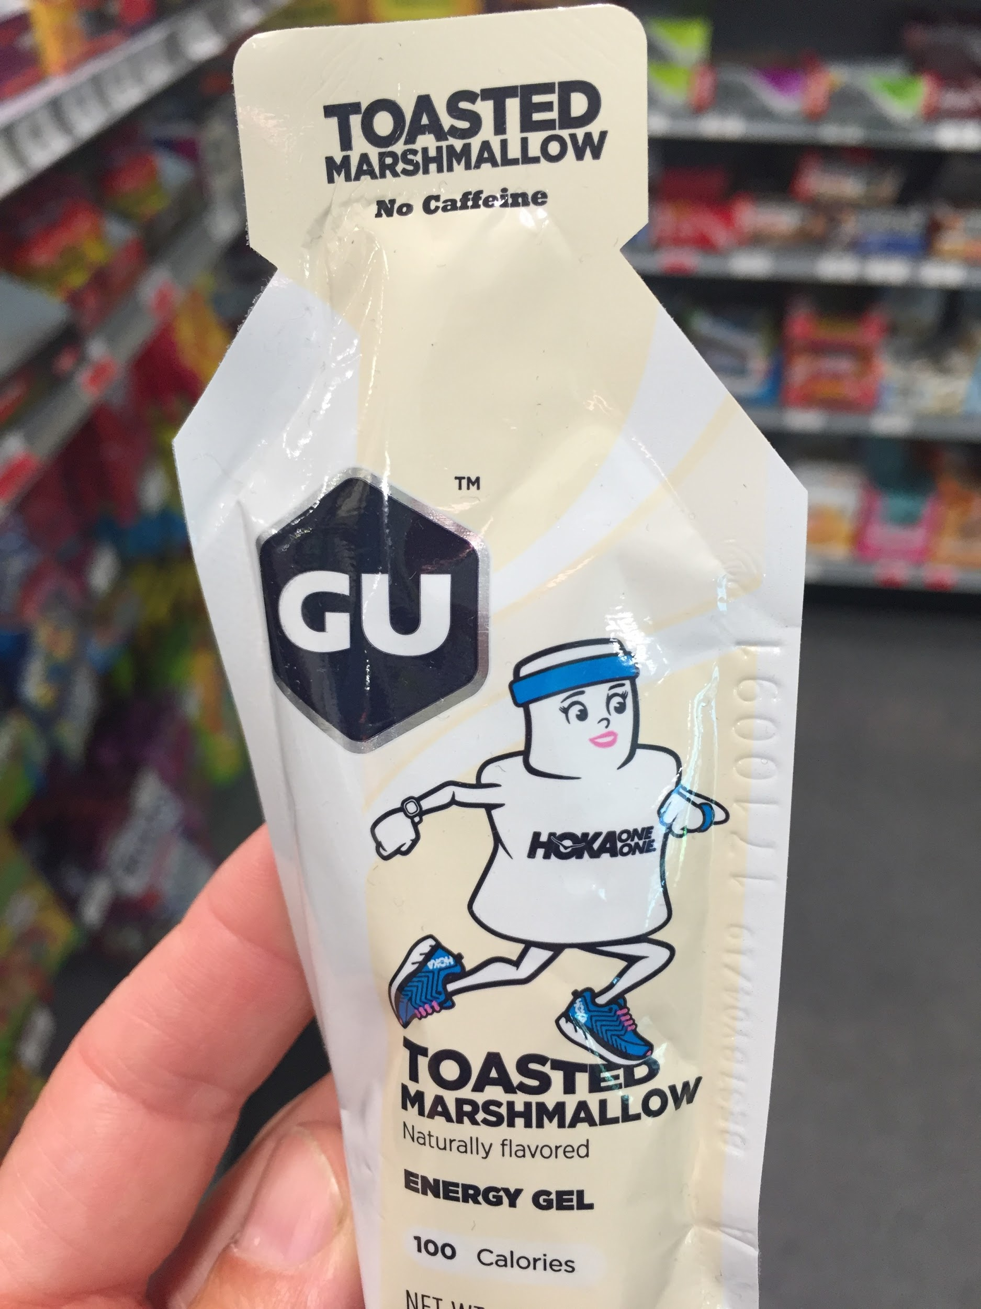
Nutrition and Hydration
Stomachs can be picky - find what works for you!
Experiment for yourself.
We’ll go over:
Nutrition basics
Creating a plan
Nutrition tips

Slide 32
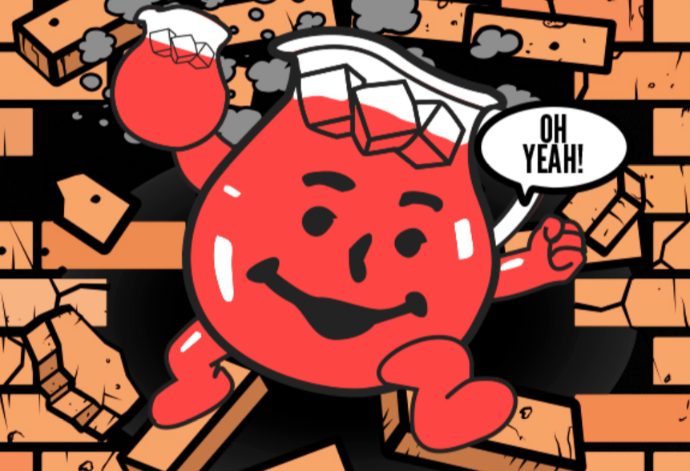
Nutrition and Hydration
When, what, how much?!
Not just important during the run.
Factors to consider:
Run time
Intensity
Your body’s specific needs
Guideline: 200 - 300 calories per hour (during)

Slide 33
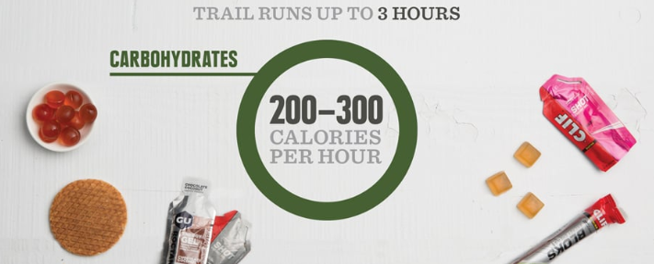
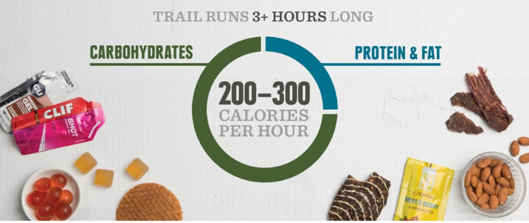
Nutrition and Hydration
What type of food?
Less than 3 hours:
Carbohydrates,
fast energy
More than 3 hours:
Add protein and fat,
steady energy for the long haul
image: Rei.com Nutrition Basics for Trail Running

Slide 34
Nutrition and Hydration
Night before: high carbs, low fiber
pasta, fruits and vegetables, lean meat
Day of (2 hrs before): mostly carbs
granola, oatmeal, bagels, fruit, peanut butter
If you are a coffee/tea drinker, try to stick to your usual amount of caffeine in the morning.
Don’t overeat, don’t eat foods you know will irritate your digestion.

Slide 35
Nutrition and Hydration
During, less than 3 hours: Easily digested carbs and sugar
energy gels, chews, fresh fruit
During, more than 3 hours: Mostly carbs, add protein/fat
nuts, nut butter, energy bars or drinks with protein
Trust your cravings, eat what tastes good!

Slide 36
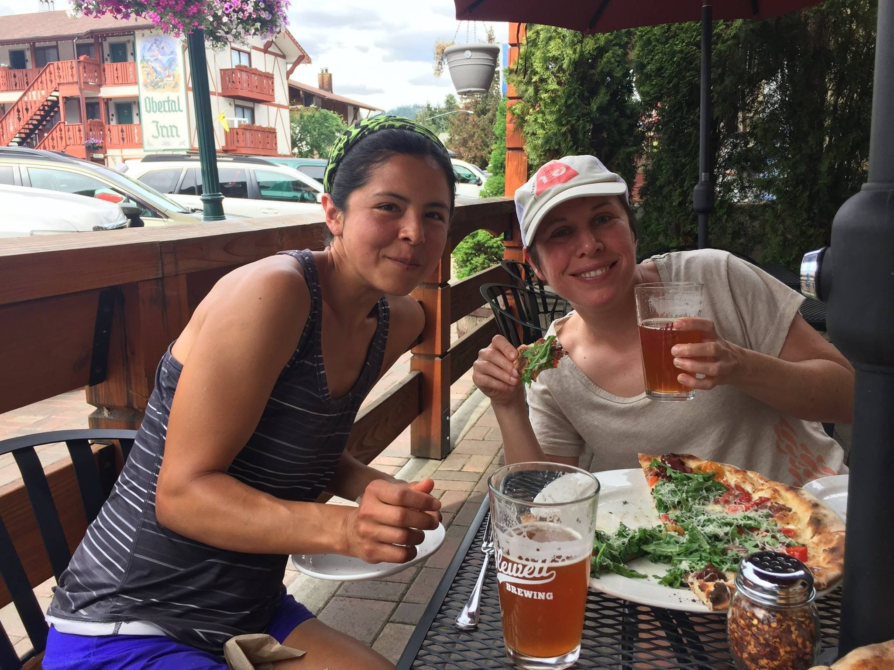
Nutrition and Hydration
After:
Eat within 1 hour
Hydrate, electrolytes
Refuel what you burned.

Slide 37
Nutrition and Hydration
Do I have to eat?
Less than 60 to 90 minutes, maybe not
I always feel sick!
You can train your stomach. Pick a gel or gummy you enjoy. After 60 minutes, consume a bit every 20 to 30 minutes. Develop a plan and stick to it.
Gels are gross…
Experiment with other foods. Potato chips, Reese’s peanut butter cups… Find what you enjoy and what works for you.

Slide 38
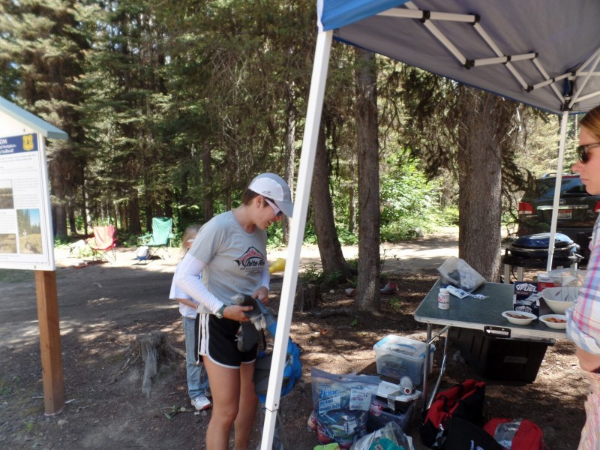
Nutrition and Hydration
Hydration:
Why?
Water carries nutrients in and waste away
You sweat!
When, How Much?
2-4 hours before, hydrate min 8 oz
Include some electrolytes during
After: 8-16 oz, with electrolytes
Guideline: 16 - 24 oz per hour, after the first hour

Slide 39
Nutrition and Hydration
In Summary...
Trial and error: personalized approach
Don’t forget before, during and after
Train the way you race, race the way you train (train your gut)
Be consistent and proactive - don’t wait until you’re hungry/thirsty

Slide 40
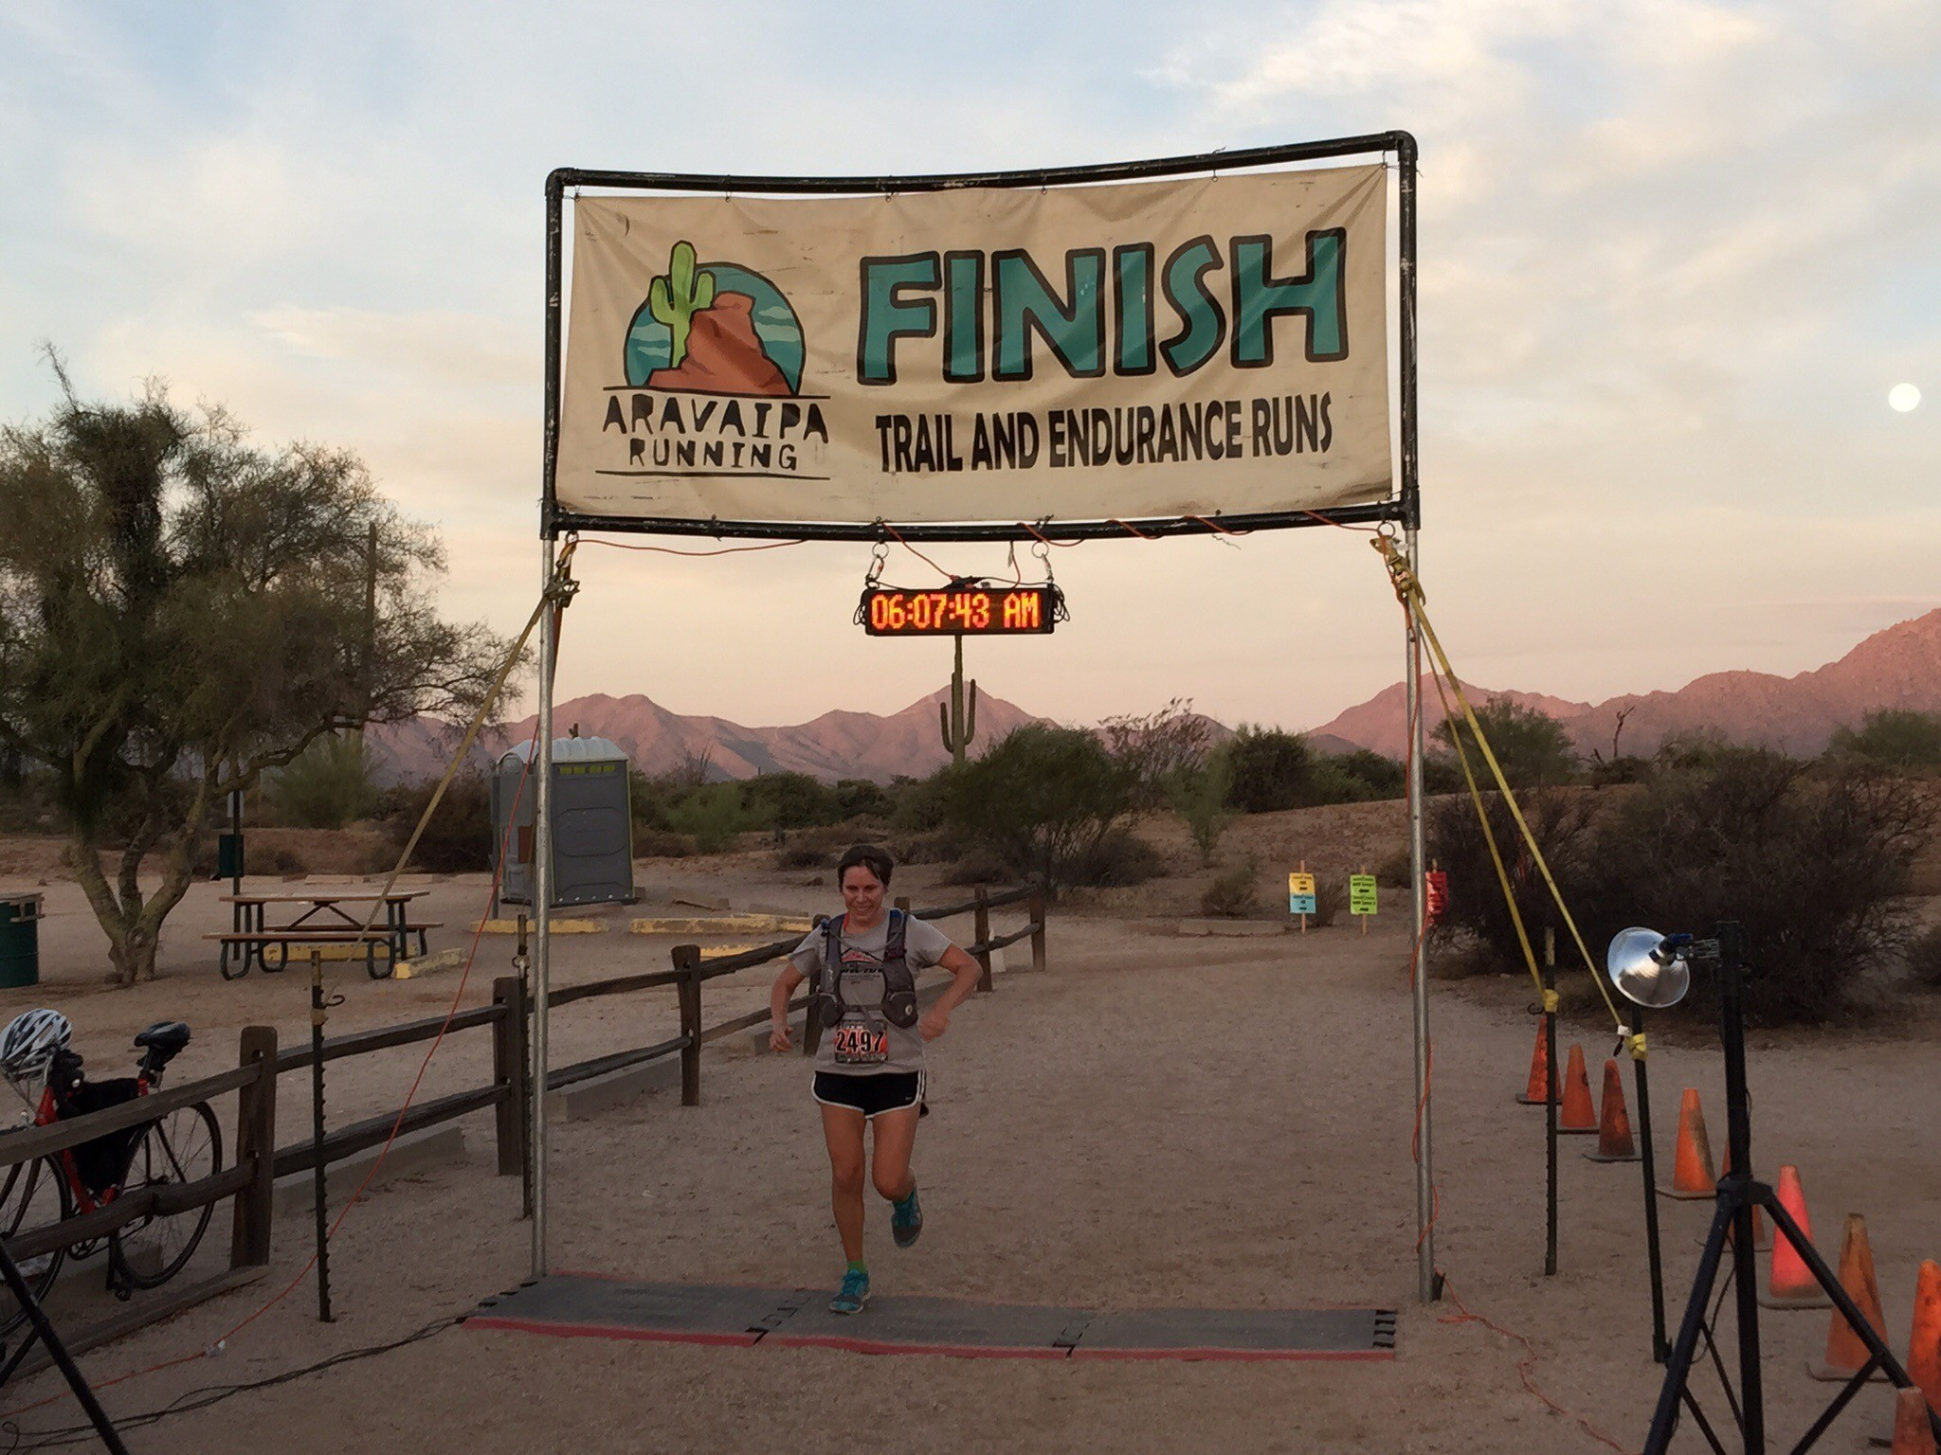
Wrap Up

