Slide 1
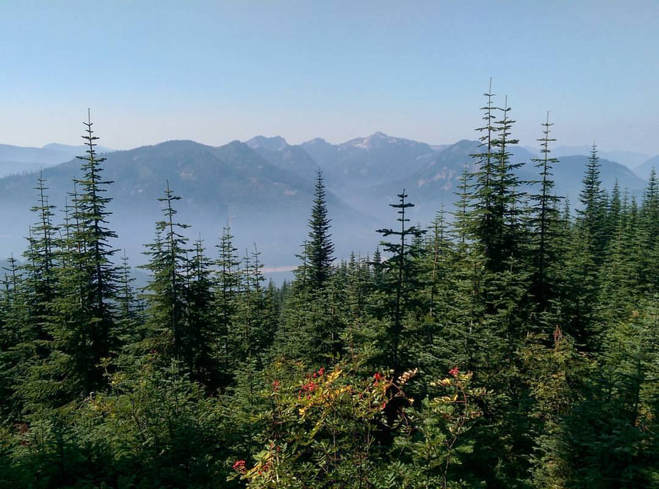
Trail Running
Foothills Branch of the Washington Mountaineers

Slide 2

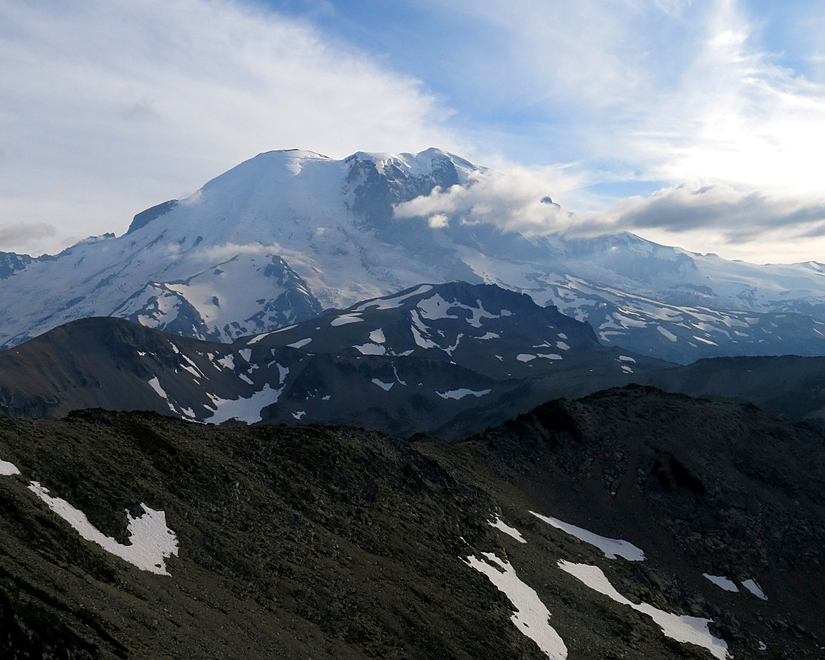
Content
Why the Foothills?
What is Trail Running?
  The who, what, when, where, and why’s
How does this pertain to the Mountaineers?
  What are the benefits?
  What do we expect from you?
  The Trail Running 10 Essentials
  Leader responsibilities
Where is our future headed?

Slide 3
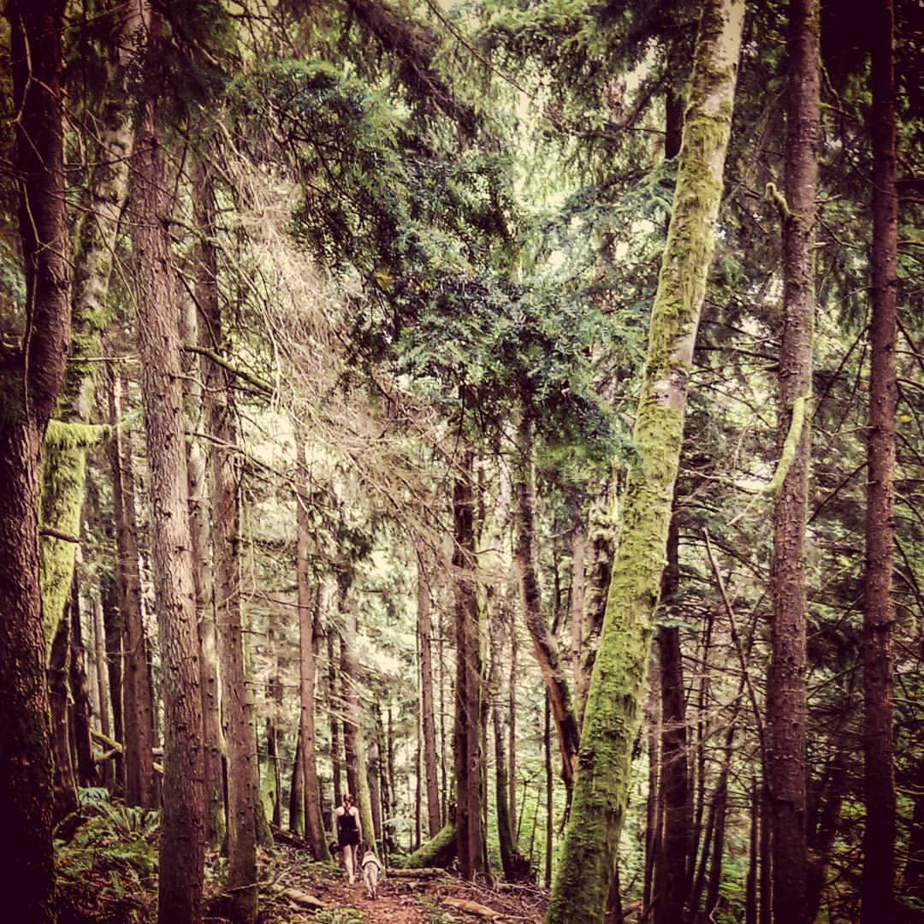
The Foothills Region
A trail runners paradise…
What separates this region from the other Mountaineers locations

Slide 4
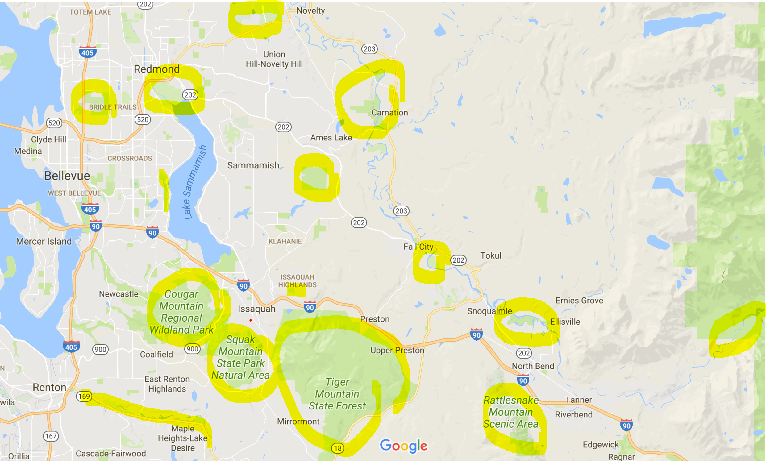

Slide 5
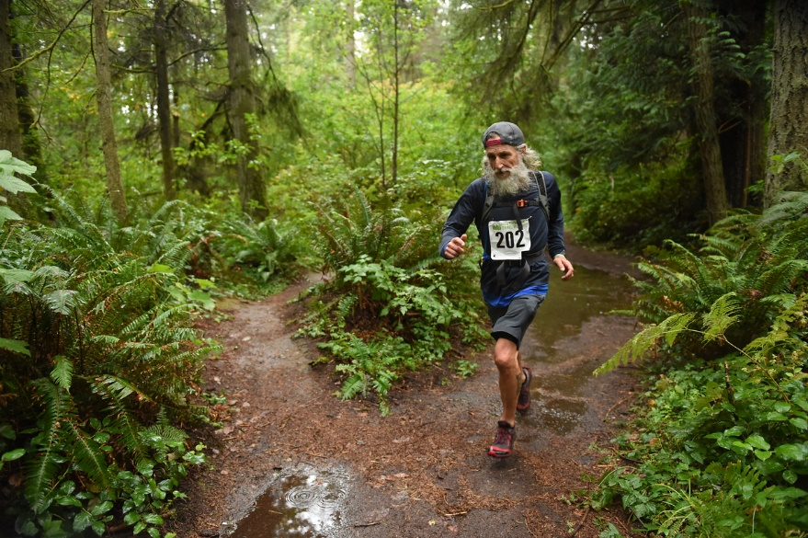

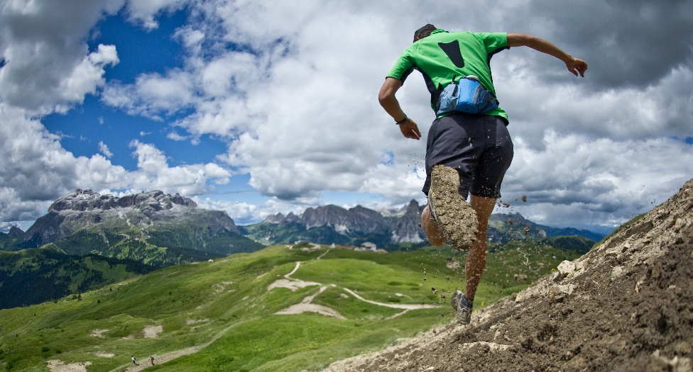
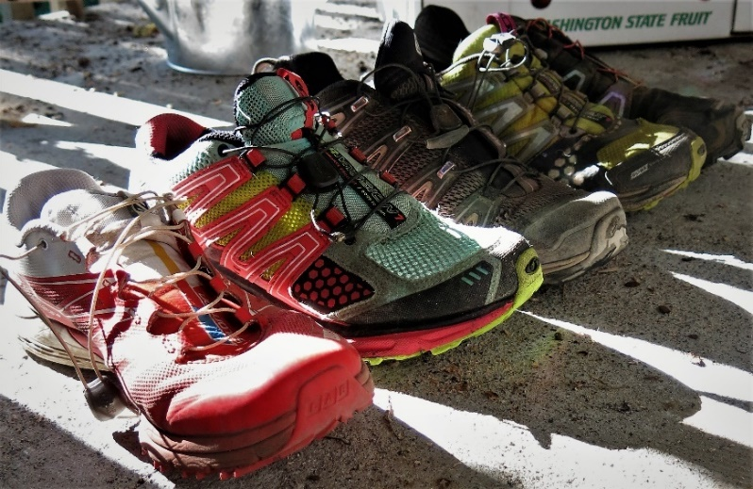
What is Trail Running?
WHO – Anyone wanting to enjoy the outdoors at a faster pace.
WHERE – Single-track, gravel, cross-county: can you hike it? Then you can run it…
WHEN – Provided you’re ready for mud, rain, and the occasional white stuff, this is a year around sport. However, inclement conditions will require additional research and preparedness.

Slide 6
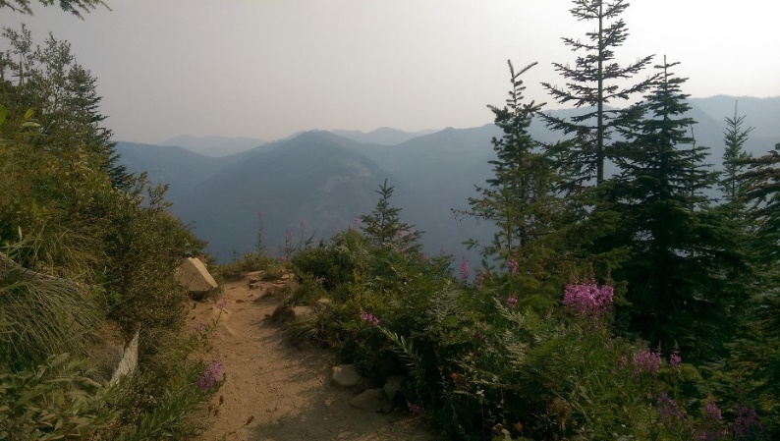
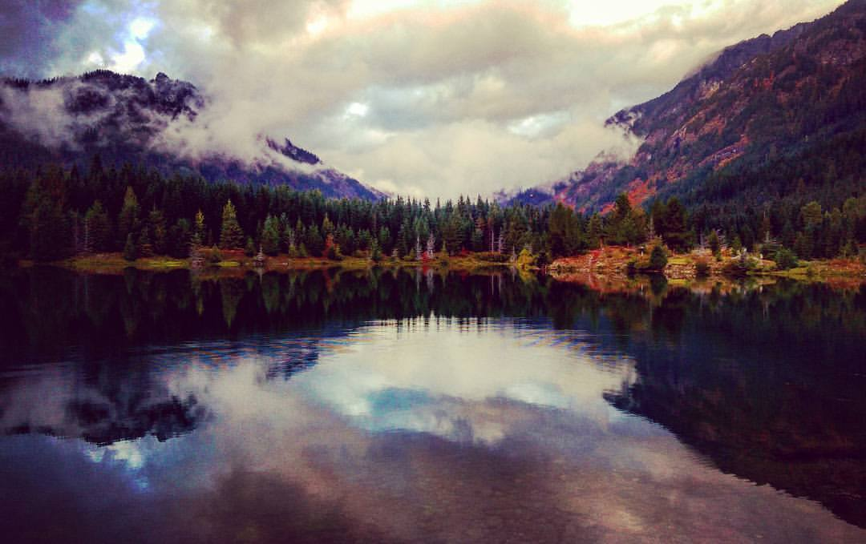
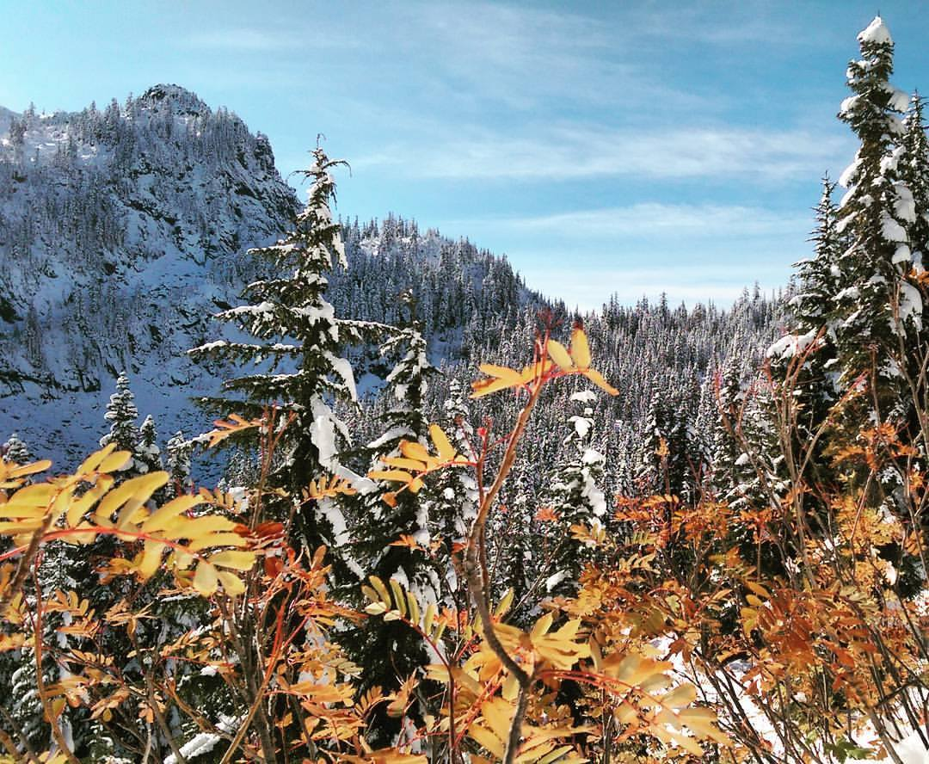
Why?
Explore
Health/Exercise
  Increased Calories Burned (557-900 calories/hour for 6 mph pace)
  Fewer Injuries
Better Running
  Improved Technique
  Cross training
  Builds Muscle Differently
Challenge
Unwind
  Thinking – Boredom = Feeling Better
  Relaxing Environment
It’s Fun!
Community
  People
  Places
  Food
Love the outdoors? Are you seeking to new challenges, access to more locations, great exercise? Come run with us.

Slide 7
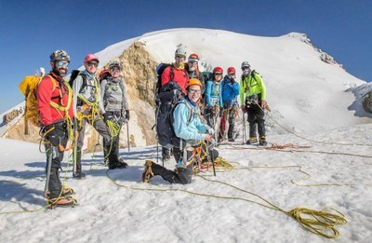

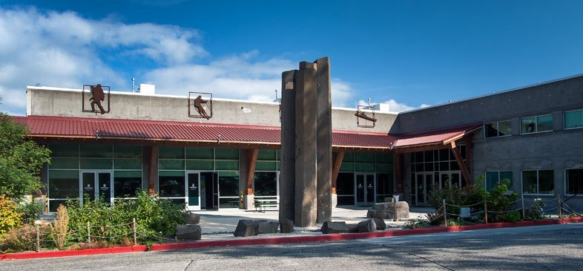
Trail Running and the Mountaineers

Slide 8
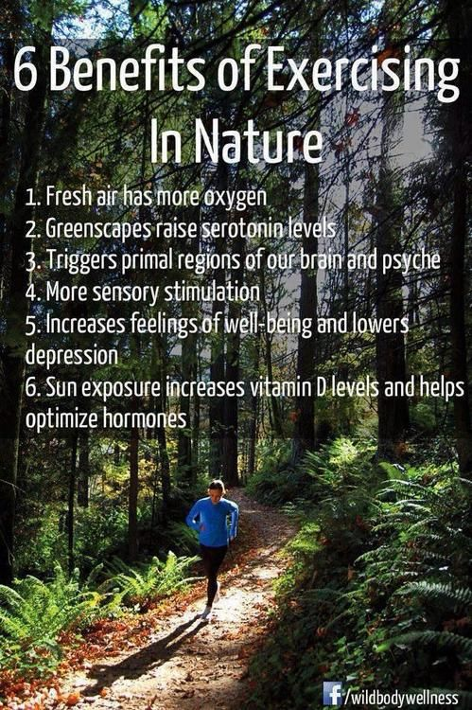
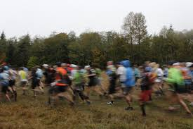
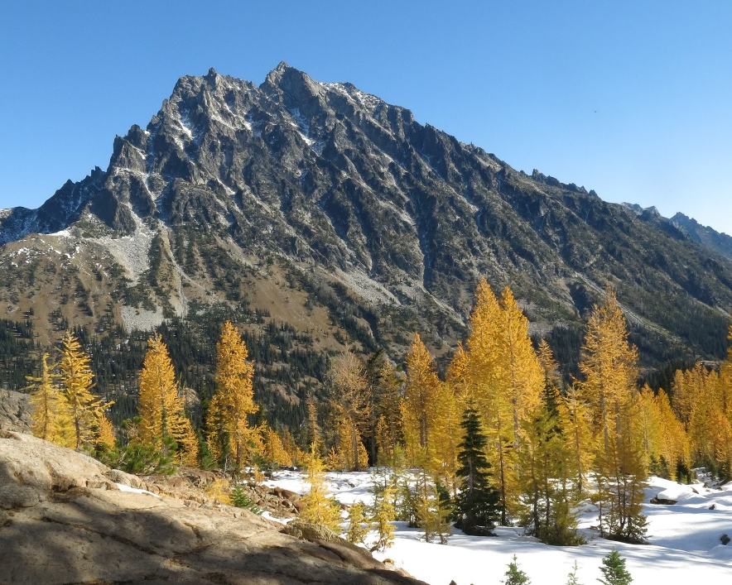
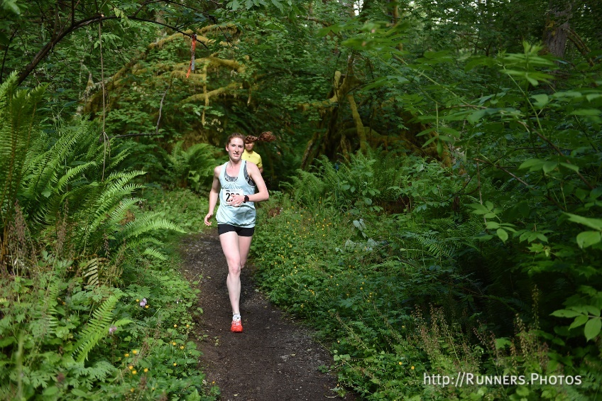
What You Expect of Us
Planning
  Events
  Routes
  Groups
Resources
Education
  Info Sessions
  1st Hand Experience
  Courses
Community!

Slide 9
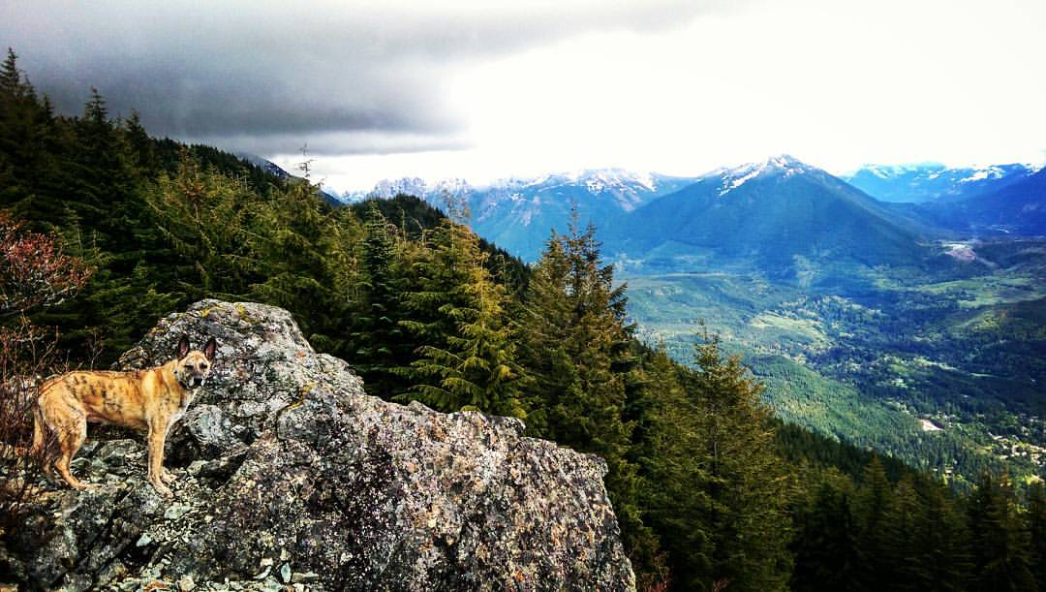
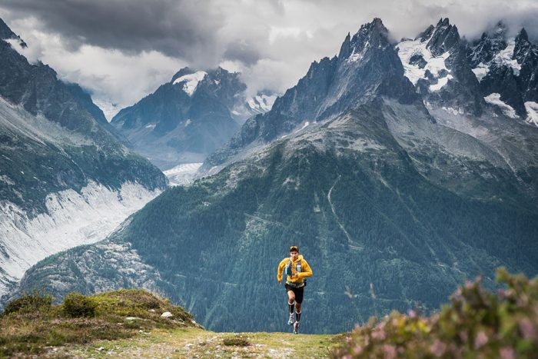
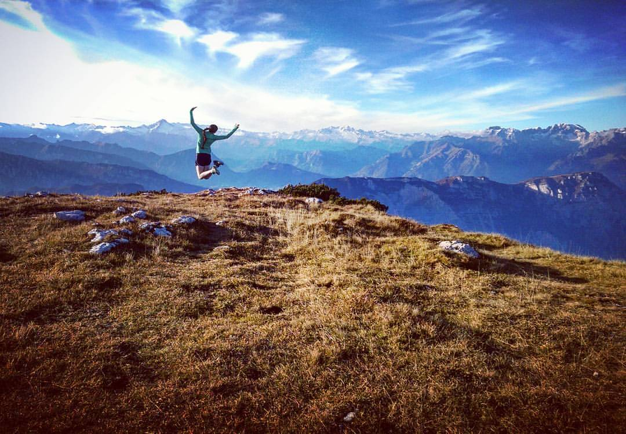
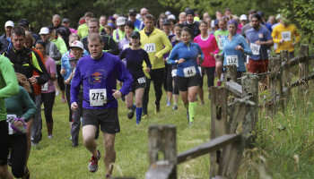
What We Expect of You
Be prepared
  Equipment
  Physical Fitness
Carpool Obligations
Trip documentation
  Registration/ canceling/wait-listing
  Waiver
Behavior and willingness to follow leader/consensus decisions

Slide 10
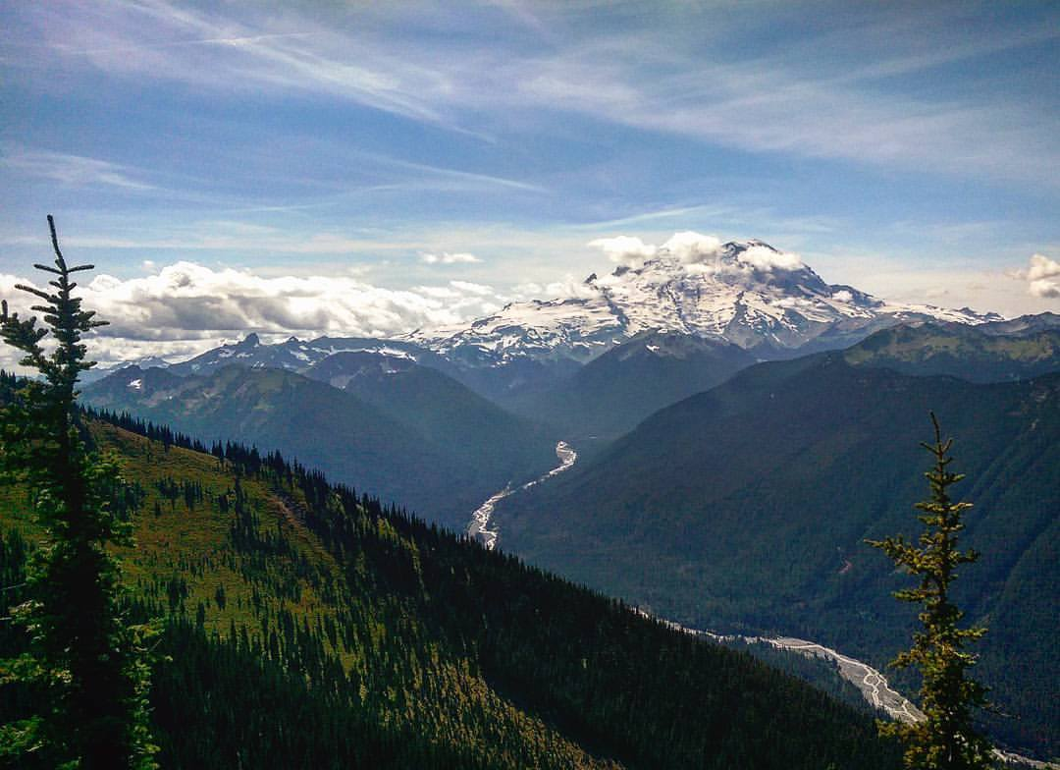
What to Expect
Rating | Description
Easy (E) | Up to 5 miles round trip with less than 1000 feet of elevation gain or a moderate trip with an average pace of 3-4 mph.
Moderate (M) | 5-10 miles round trip or with 1,000 – 2,000 feet of elevation gain or a strenuous trip with an average pace of 3-4 mph.
Strenuous (S) | 10-15 miles round trip or with 2,000 – 3,500 feet of elevation gain or a very strenuous trip with an average pace of 3-4 mph.
Very Strenuous (VS) | Over 15 miles round trip or with over 3,500 feet of elevation gain or a shorter mileage/smaller elevation trip with an extremely aggressive pace.

Slide 11
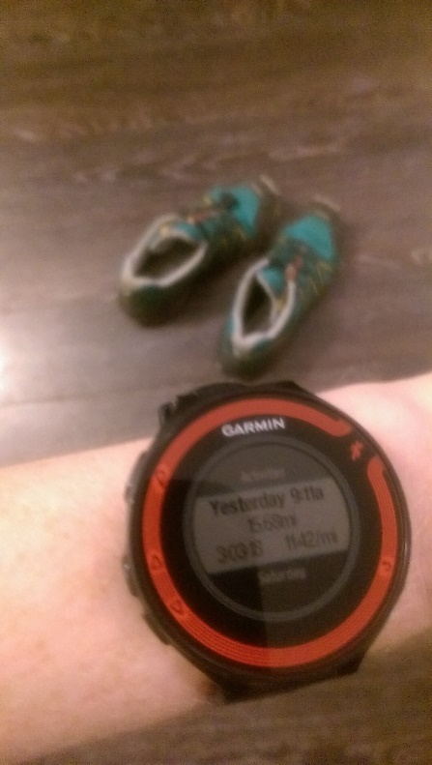
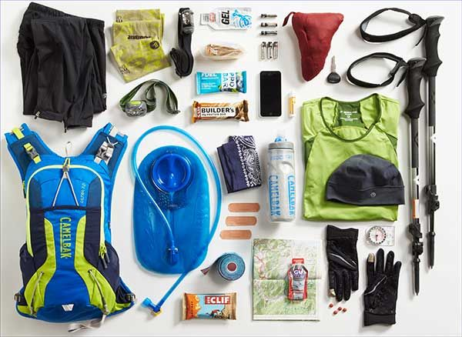
The Trail Running 10 Essentials
Trail running is similar to hiking, but at a faster pace. However, as a trail runner with a smaller pack and higher repetition it’s important to keep your ten essentials lightweight and compact to run more easily.
All of the following is chosen based on planning.
Navigation
Appropriate clothing & footwear
Whistle
Food
Hydration
First Aid
Multi-tool
Light
Firestarter
Sun Protection

Slide 12
What’s Next in Store?

Slide 13
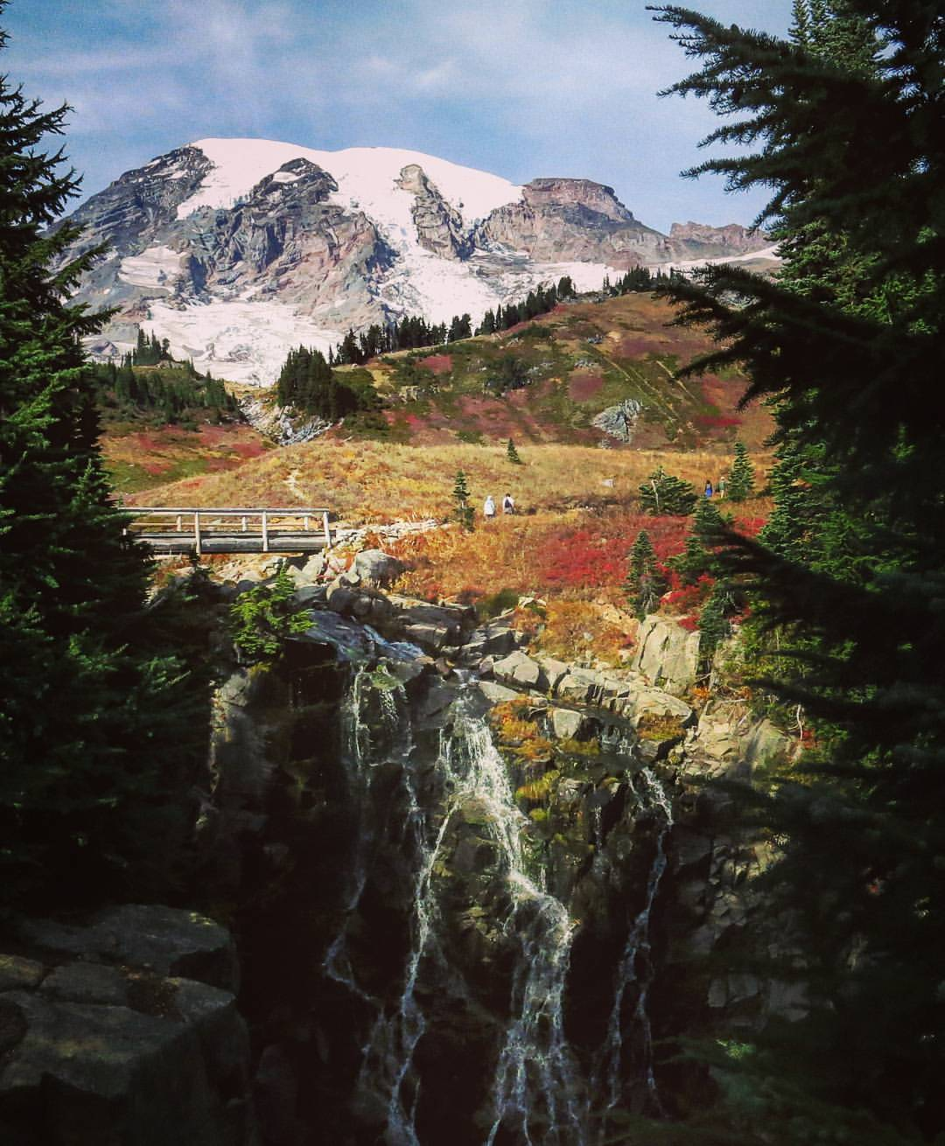
Basic Timeline
A rundown of our overall goals…
Info Session
What is Trail Running?
Recruitment
Participants
Existing Events
Cougar Mountain Trail Series
Winter Run Series
SRC Events…
Expert tips/tricks
Community suggestions
Leaders
Creating Events
Casual Runs
Training meetups
More Info Sessions
Fastpacking Trips
Committee Members

Slide 14
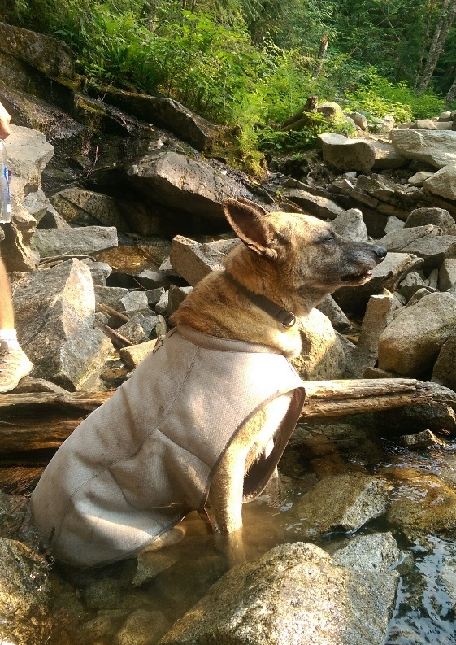
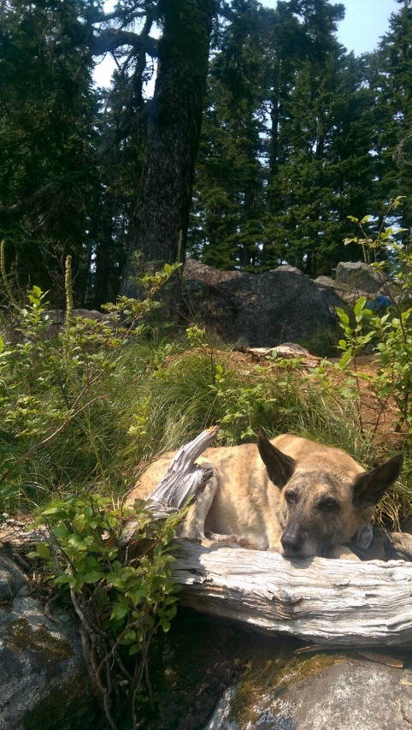

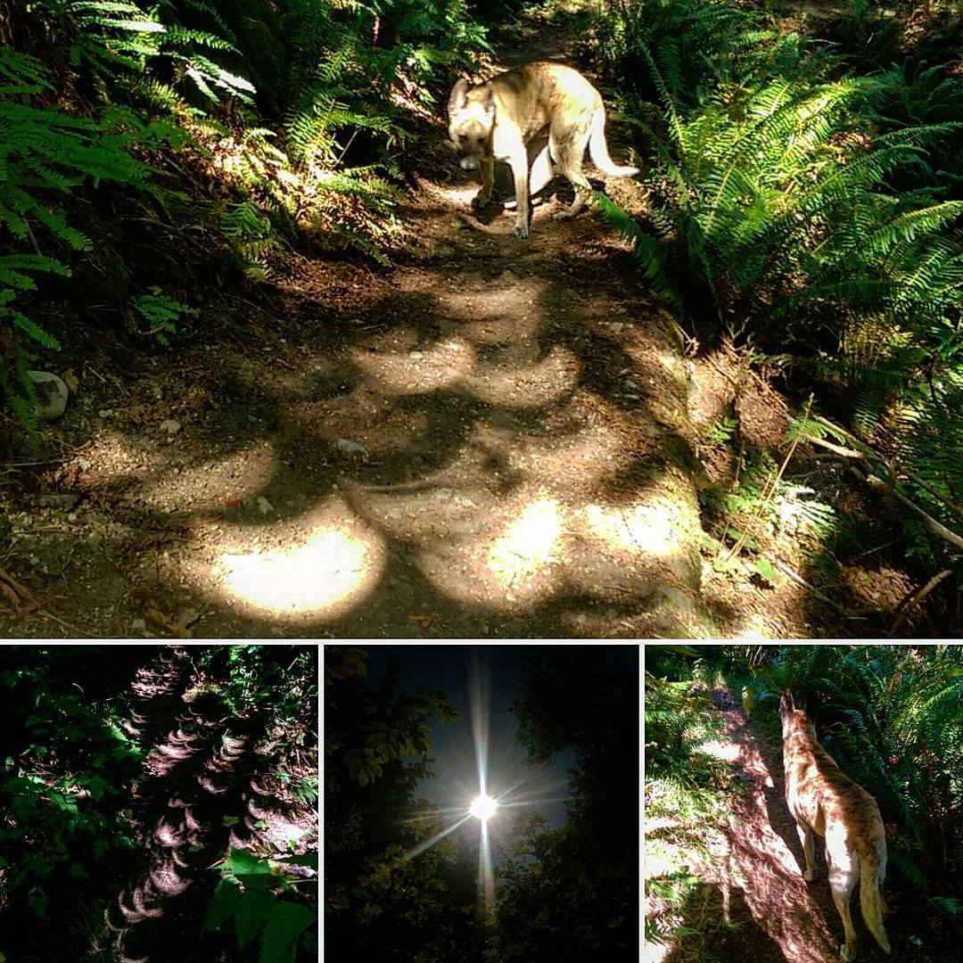
YOUR Trail Running Community
Sign-up
  Races
  Info Sessions
Getting Involved
  Participant
  Running Leader
  Committee Member
Give us your thoughts!
  What would you like to see?

Slide 15
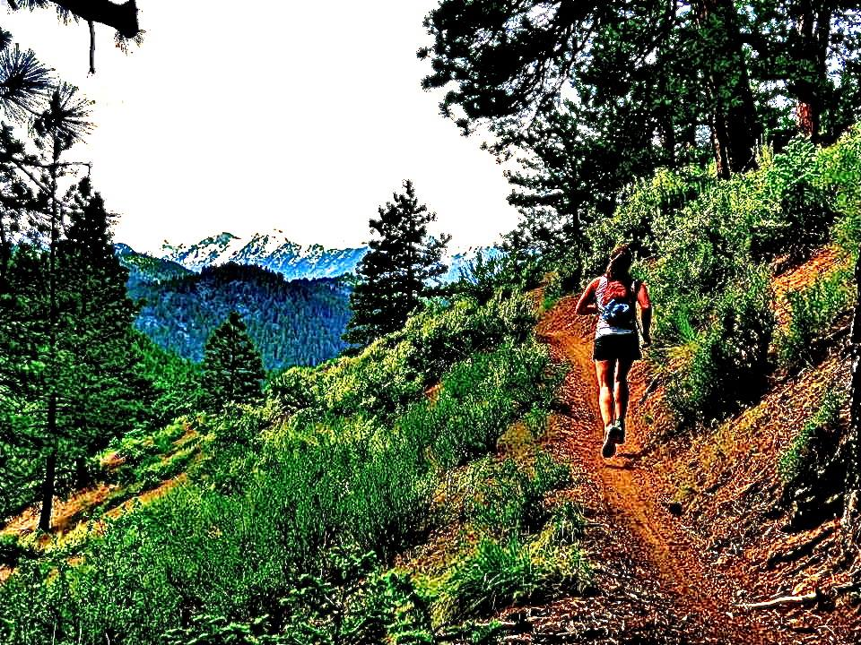
Leader Requirements
Leaders must be Mountaineers members of at least 18 years old, have an up to date waiver on file, and be approved by the committee.
Competence in:
  Group Leadership
  Use of topographical maps/compass/GPS
  First Aid
  Emergency Preparedness
  Trip Planning/Organization
Fulfill the further requirements as outlined in the Foothills Mountaineers Trail Running Leader’s Guide

Slide 16
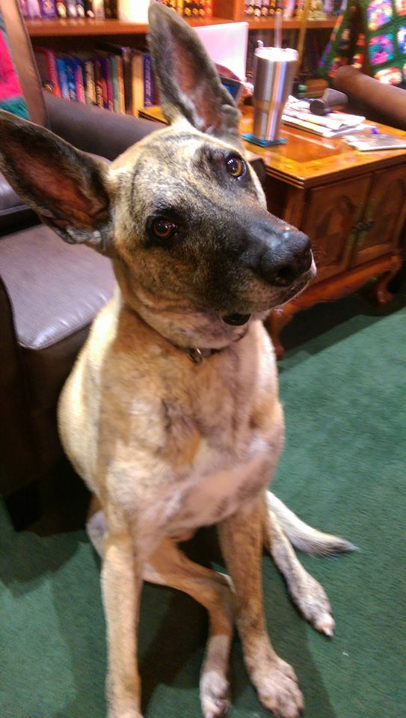
Questions?

Slide 17
Links
Facebook: https://www.facebook.com/groups/278321999325737/?pnref=story
Mountaineers:
  Committee page - https://www.mountaineers.org/about/branches-committees/foothills-branch/committees/foothills-branch-trail-running-committee
  This Sunday’s Brunch/Lunch - https://www.mountaineers.org/about/branches-committees/foothills-branch/events/post-cougar-mountain-trail-run-meetup-food
Events:
  Evergreen Trail Runs: http://www.evergreentrailruns.com/
  Northwest Trail Runs: http://nwtrailruns.com/events/series/winter-trail-series/
  Cougar Mountain Trail Series: http://www.seattlerunningclub.org/Events/Cougar/cougarmtn1.html

