Slide 1
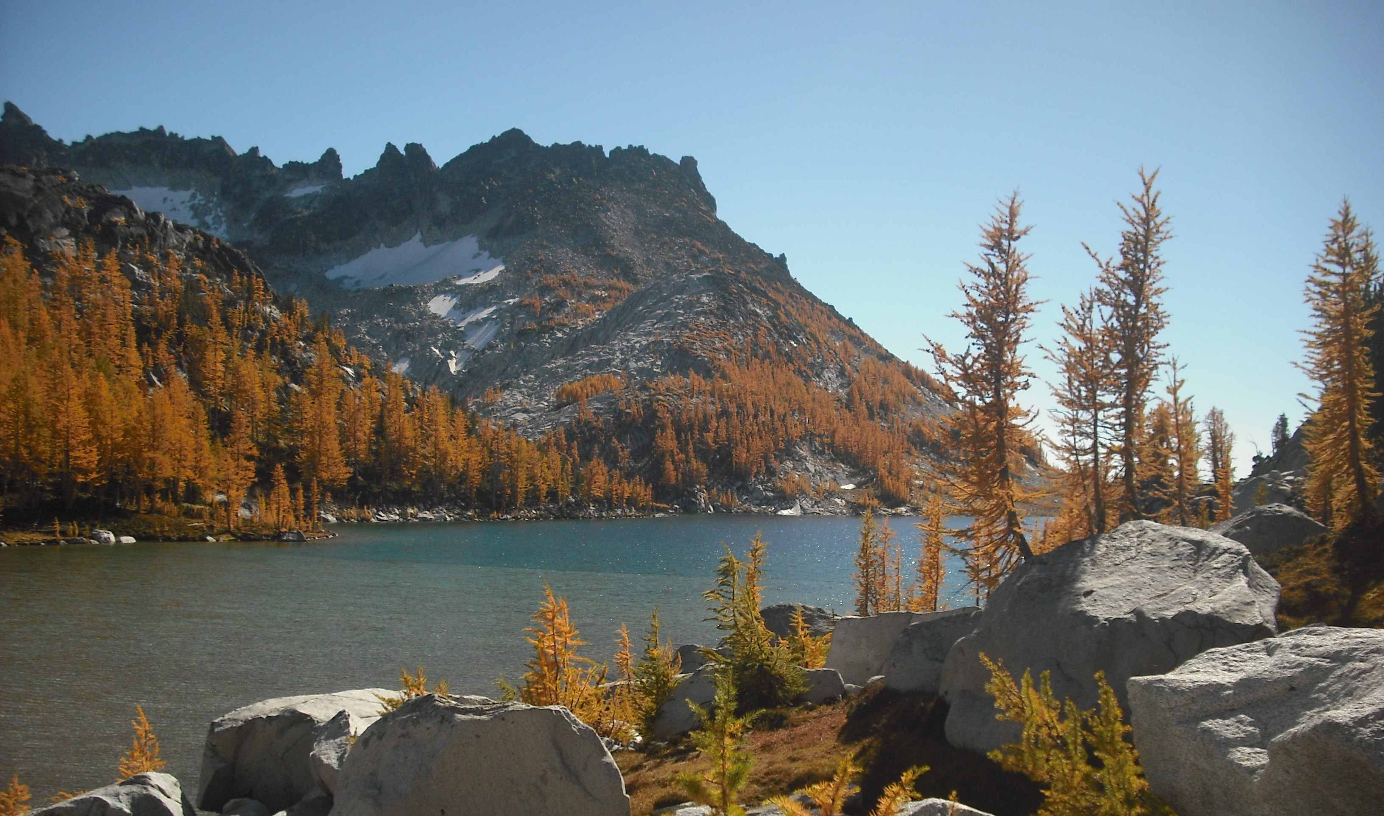
New Hike-Urban Walk-Backpack Leader Workshop
Sponsored by the Foothills Branch
Hiking-Backpacking Committee
The session will begin at 6:15PM.

Slide 2
Objectives
Understand the roles and objectives of a leader in the Mountaineers
Understand the expectations and best-practices of organizing and managing a Mountaineers group trip
Learn leadership best practices and apply them in scenarios
Review next steps to become a Leader for the Mountaineers

Slide 3
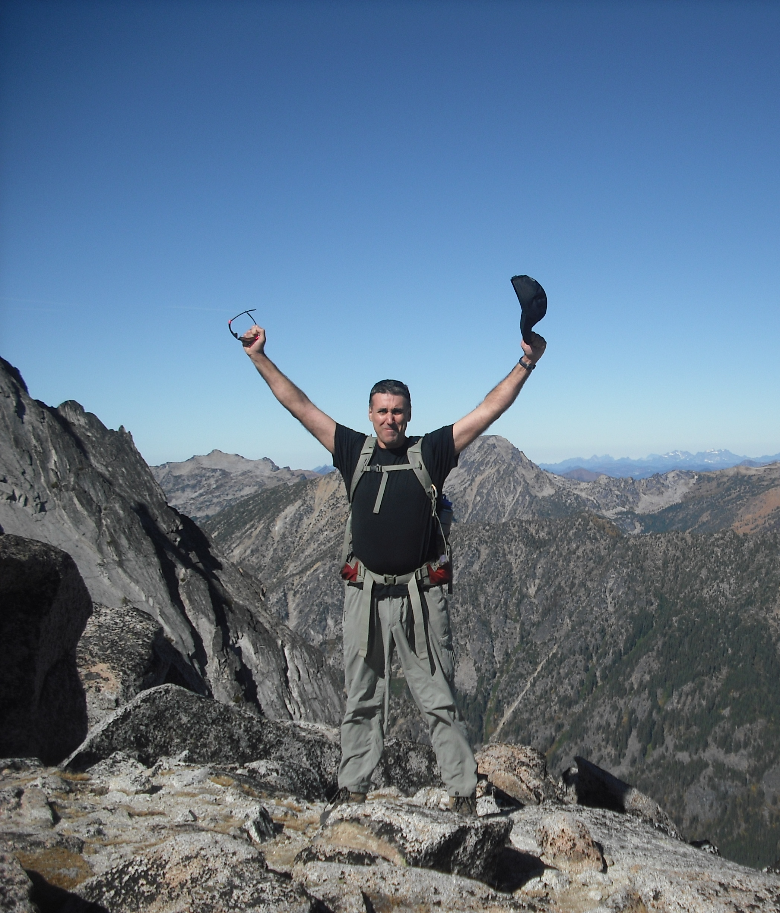
Leadership Roles and Expectations
for Hike, Urban Walk & Backpack Leaders

Slide 4
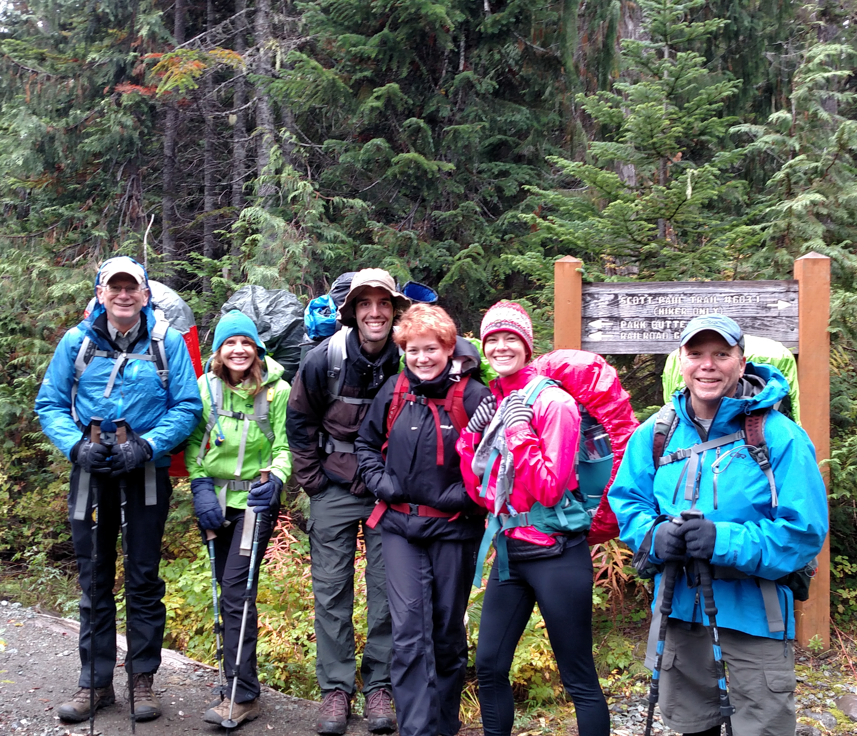
Why Lead?
Choose the where, when and pace for trips
Gain experience with group and people leadership that will carry over into other aspects of your life
“Pay it forward”
Above all, Leadership is a shift from a focus on individual success to a focus on group success.
Leaders should love helping people achieve their goals and learn new things.

Slide 5
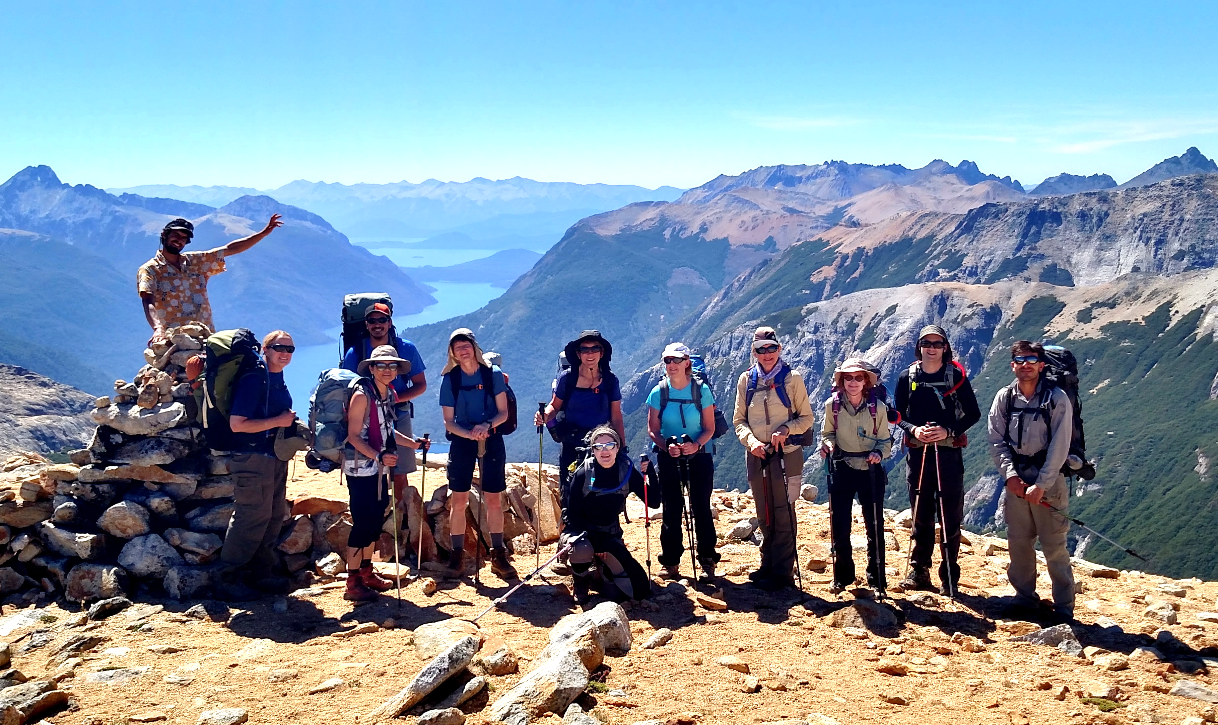
Role of the Leader
Plan, organize, and execute activities
Ensure your participants are capable and prepared to succeed on the posted itinerary
Authority and accountability for the SAFE RETURN of your group to the trailhead.
Help everyone enjoy the trip and build their outdoor community
Teach and role-model courteous and “leave no trace” trail behavior
Leave your participants and others you meet on the trail feeling great about their experience.

Slide 6
Requirements for Leaders
Current member, at least 18 years old
Caring, service-focused, respectful, empathetic, safety-oriented
Have participated in 3 Mountaineers hikes/urban walks/backpacks in the recent past
Must demonstrate working competence in:
Group Leadership: trip planning, group leadership and communication
Technical Skills: Hiking and/or backpacking skills including gear, ten essentials, trail and camp skills appropriate for the activity
Navigation: Route finding, use of maps, and tools to ‘stay found’
Safety: Identify and mitigate or avoid common hazards
First Aid and Emergency Preparedness: Ability to handle common on-trail first-aid and emergency situations
Knowledge of Standards and Policies: Mountaineers and land management agencies
Notes:
Sponsoring committees must be satisfied that leaders have competence in the above listed areas; but these courses are not formal requirements for hike leaders. Encourage participants to take navigation and Wilderness First Aid classes if they have not already done so.
Introduce the ‘caring leader’, what it means to be ‘service-focused’ and ‘safety focused’. Impatient, insensitive, self-centered or careless people will have trouble! Mike Sweeney comment: “It can take years to repair the damage that a single impatient, uncaring comment can cause.”
More on leadership behaviors in our scenario discussions later.

Slide 7
Requirements for Leaders (2)
Can show working competence through:
Application (required)
Completion of this seminar and a mentored trip (required in most cases)
Other Mountaineers leader badges or demonstrated leadership experience with other organizations
Course completion/certifications
Wilderness First Aid and Off-Trail or On-Trail Navigation or equivalent are required for backcountry hike and backpack leaders
Red Cross First Aid/CPR and Map and Compass plus a pedestrian safety seminar are required for Urban Walk leaders
More about next steps at the end of the seminar

Slide 8
Legal Considerations
Even as volunteers, we have a legal DUTY OF CARE to follow the STANDARD OF PRACTICE in our industry to keep participants safe and deliver what we promise.
Volunteers are protected from individual liability by Federal and state statutes and Mountaineers insurance as long as they are not ‘grossly negligent’ – but the club CAN be sued based on your actions (or lack of)
SO…

Slide 9
Managing Risk and Liability
Don’t lead until you have the basic competencies to do so safely.
Communicate the hazards in writing to participants before the trip, at the trailhead, and along the way.
Ensure that your participants are prepared, capable, and understand their responsibility to take care of themselves and others.
Follow the Mountaineers activity standards for the activity you’re leading.
Understand the ‘Seven Steps of Emergency Response’ and lead to the best of your ability in an emergency.
Bring your participants home safely.

Slide 10
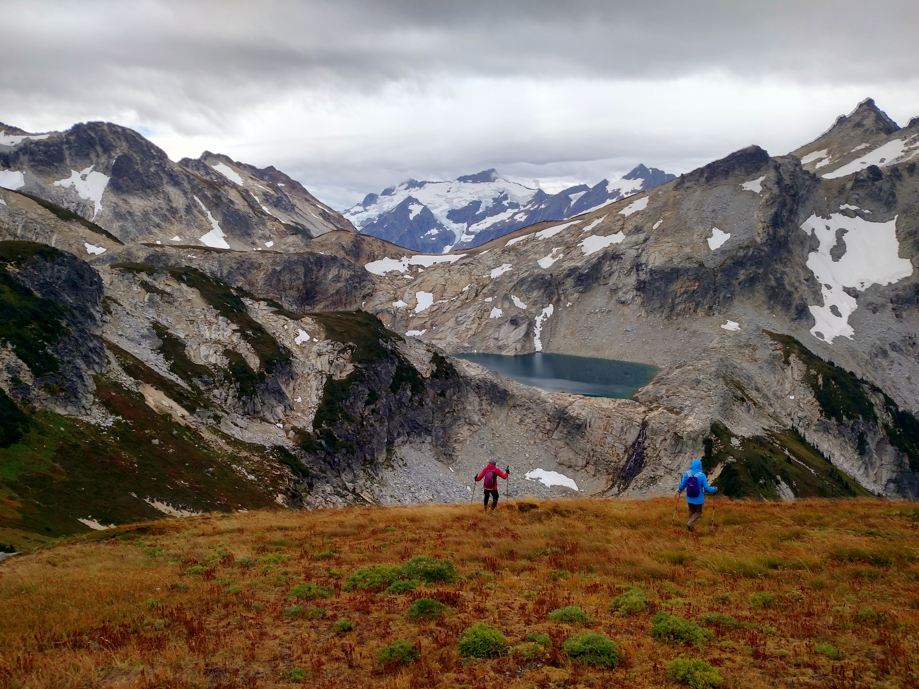
Running a Trip
Foothills Hike,Urban Walk & Backpack Leaders

Slide 11
Mountaineers Activity Definitions
Hikes: hiking trips of at least 2 miles that take place outside of city or suburban parks, streets or green-belts.
Backpacks: hikes that include overnight stays where participants carry in their shelter, food and water.
Urban Walks: hikes on city or suburban streets, parks or greenbelts - consistent cell phone service, nearby emergency access and egress.
Party size:
Minimum party size is 3 (safety)
Maximum party size is 12 (agency rules) unless lower limits apply.

Slide 12
Mountaineers Activity Definitions
Hiking and Backpacking trips are restricted to maintained and and unmaintained trails.
Some exceptions are allowed:
Snow sections OK unless ice axe and/or snowshoes required for safety on most of the route. Do not lead where potential for uncontrolled slide.
Off-trail sections OK unless safe travel requires helmet and/or scramble skills beyond putting your hands down
Running and fast-packing trips must be posted as Trail Runs and led by a Trail Running leader (cross-listing OK)
Depends on the skills of each particular group
DO NOT post a hike or backpack outside these boundaries, regardless of your skills.
Going outside published standards for the activity you’re posting creates legal liability for you and for The Mountaineers.

Slide 13
Mountaineer’s Hike and Backpack Ratings
Difficulty (Route)
Leader Rating
Easy (E) | Up to 8 mi. RT with <1,200 ft elevation gain
Moderate | Up to 12 mi. RT or 1,200 – 2,500 ft elevation gain
Strenuous (S) | Up to 14 mi. RT or 2,500 – 3,500 ft elevation gain
Very Strenuous (VS) | Over 14 miles RT or over 3,500 ft elevation gain
For beginners | Average pace <1 mph- no technical challenges or specific skills required.
Easy | Average pace 1-1.5 mph - no technical challenges or specific skills required.
Moderate | Average pace of 1.5-2 mph OR some route challenges OR an easy route with an overnight pack.
Challenging | Average pace >2 mph OR significant route challenges/specific skills required OR a moderate route with an overnight pack.
Rate backpacks based on the most challenging or ‘defining’ day of the trip
Rate trips conservatively, based on the average casual hiker….not based on how easy it would be for YOU. Regardless of the rating, once on the trail you must manage your hike for the success of the slowest/least skilled participant.

Slide 14
Leader Checklists
Before the hike
At the meeting place/trailhead
On the trail
In case of emergency
After the trip
I will review a few key elements but you are responsible for reviewing the detailed checklists before your first trip and applying as appropriate!

Slide 15
Mountaineers Covid-19 Policies and Guidelines for Outdoor Activities
A Code of Conduct governs leader and participant behavior and responsibilities
Masks no longer required, but leaders and carpool drivers can require them.
Leaders may ask about vaccination status and require vaccination, or not, if they wish.
Asking for proof of vaccination does not violate privacy laws.
his expectation should be clearly and respectfully communicated on the activity listing.
Leaders and carpool drivers may choose to request a negative COVID-19 self-test result in lieu of or in addition to vaccination for vaccine-required programs.
https://www.mountaineers.org/membership/the-mountaineers-covid-19-response
Notes:
Confirm expectations

Slide 16
Before the trip: Trip Planning
Choose a route that is well within your experience and ability, especially early in your trip leading journey, including seasonal conditions
Special considerations for coastal trips (tides, river crossings), swift-water crossings, travel on snow, bear canister requirements
Be aware that some land managers don’t allow fee-based trips, larger group sizes or pets or may require a permit.
Check on the land manager’s website or on the Mountaineers Route-Place listing
Early season trips may involve high water, snow/ice sections, washouts, blowdowns.
If no recent trip reports, scout the route to be sure of the hazards and skill requirements
On most Mountaineers trips, as the leader you will be responsible for vetting your participants, helping participants understand the conditions, hazards and fitness/skill requirements and get prepared to complete the trip safely.
Notes:
Clear communication and expectation setting will allow participants to “self-select”.

Slide 17
Before the trip: Screening Applicants
Ensure that your participants will be safe and successful and have fun on your planned activity. STRESSFUL BUT ESSENTIAL!!
If your trip requires certain skills and/or conditioning:
Consider ‘Leader Permission Only’ option
If you don’t know someone:
Check their activity and course history on the website.
Ask detailed but considerate questions to ensure that they are capable. (email, phone call)
Recent activities they’ve been on? Who led? Pace?
If they don’t know their pace, ask how long it took them to complete a recent trip
Be caring and respectful – explain that you want to be sure everyone will have fun, be successful, and stay safe. Suggest an alternate activity if yours isn’t a fit.
Notes:
Clear communication and expectation setting will allow participants to “self-select”.

Slide 18
Before the trip: Screening Applicants
Badges can provide valuable information:
Staying Found (on-trail) or Wilderness Nav (off-trail) badge will indicate training and field practice in navigation; likewise with Wilderness First Aid badge
GoHike course badge will indicate someone who has completed a season of regular easier social hikes
A CHS course badge will indicate completion of a season of increasingly strenuous hikes
A backpacking course badge will indicate completion of a set of in-depth lectures, gear introduction and basic backpack trips.
Basic Backpacking Skills badges will indicate basic competence with gear, trip planning and actual recent backpacking trip experience. (Advanced badge is being reworked)
Should not exclude people from consideration just because they don’t have one of these badges. Many people come with equivalent experience outside the Mountaineers.

Slide 19
Second Breakout Session - Screening Applicants 20 minutes
Start by introducing yourselves within your breakout group
Then two different role-play scenarios: Same hike, different applicants
One person is leader calling the other person who is the applicant
Scenario 1
Then new people as leader and applicant and do scenario 2
Report out:
What tactics worked well in the two scenarios?
What did you learn about the pitfalls and how to avoid them?

Slide 20
Before the Trip: Ten Essentials
Role-model responsible planning for and use of the Ten Essentials.
Emphasize critical items in description and pre-trip communications – and check for the critical items before you leave the meeting place.
Leaders have the leeway to specify different gear requirements based on the demands of the trip.
Emphasize what’s critical for safety but don’t be more rigid than the circumstances require.
If someone shows up without a piece of critical gear, can someone else share? Is it truly essential given the route and conditions?

Slide 21
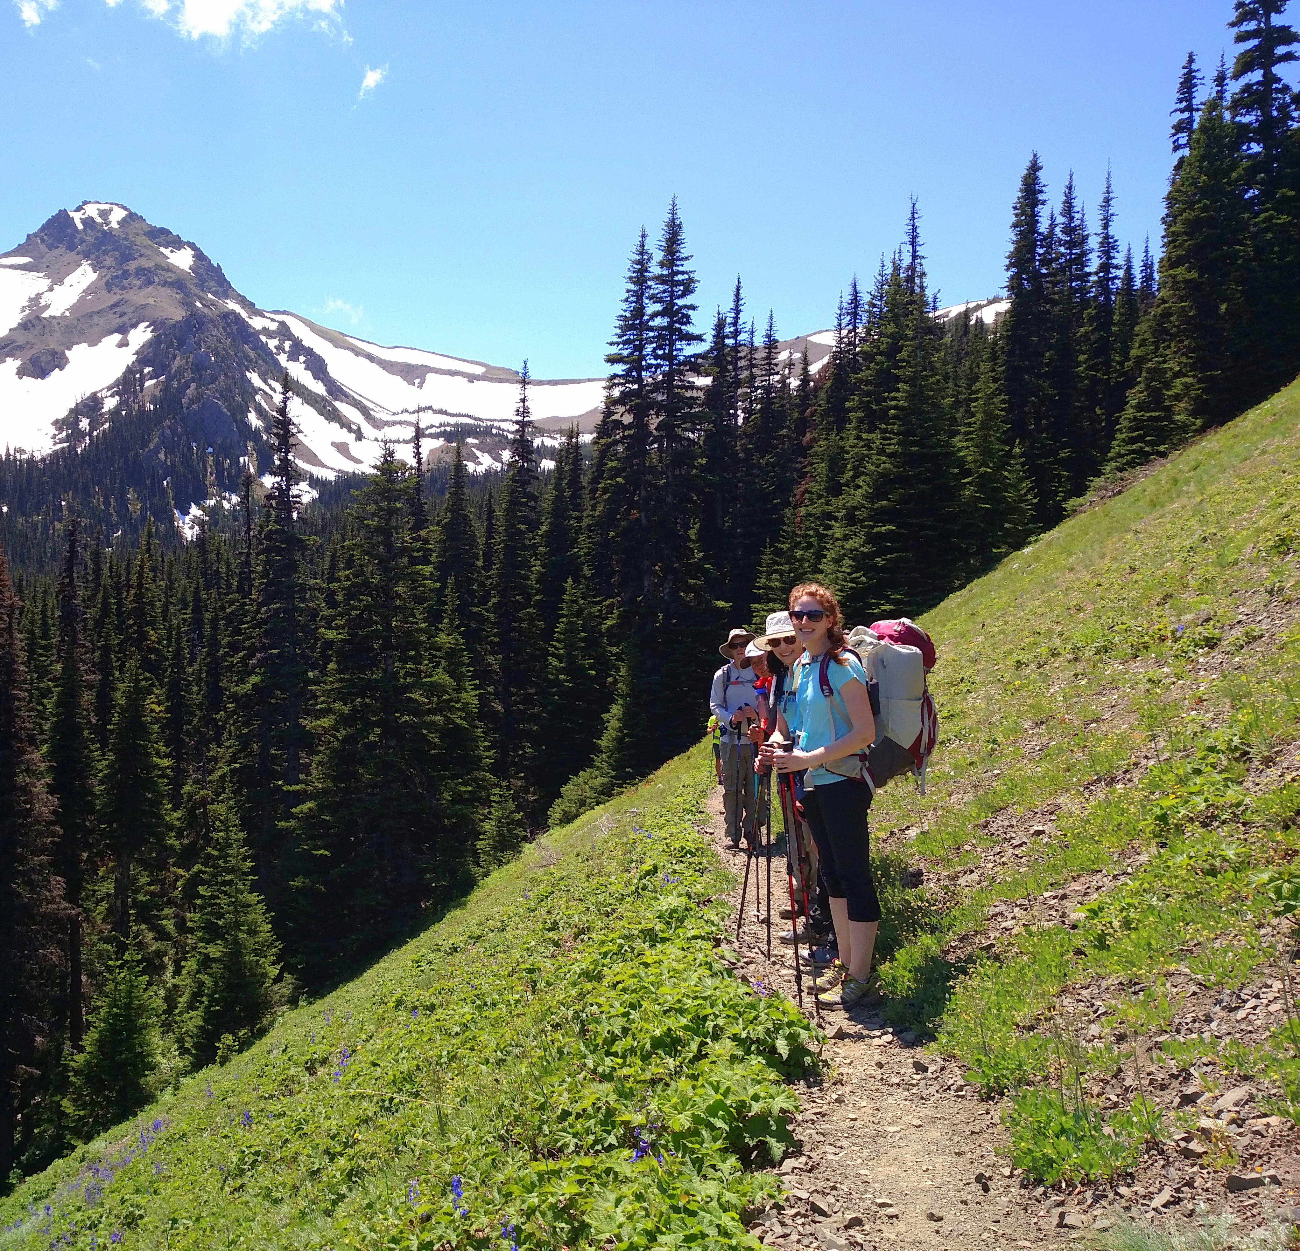
At the Trailhead: Begin Building a Cohesive Group
Be clear about the objectives and style of the trip in your trip description and pre-trip communications.
Set expectations about how Mountaineers groups work beginning with pre-trip communications
SUCCESS = having fun together, building community, helping each other succeed - getting everyone back safely
Begin at the trailhead to encourage building of relationships among the group members!
Break the ice by sharing special skills, each person’s objectives or reason for wanting to go on this trip
Explain how you’d like them to manage their pace to support each other, then reinforce with reminders and actions along the way

Slide 22
Other key trailhead messages
Define key supporting roles:
First Aid Leader
Sweep
Encourage communication of safety
concerns, illness or injury as you go along
Foster an atmosphere of emotional safety….
By you as the leader being humble and open with everyone
By treating everyone respectfully

Slide 23
Splitting the Group
The leader has the leeway to allow this as long as you are confident that everyone will get back safely.
If you turn people entirely over to a co-leader, do they have the training & experience to keep the group safe? Do they know what you expect? Do you have a plan for meeting back up?
Most cases of people getting lost come when groups split up. How will you communicate with the other group? How will you ensure the safety of those who are not with you?
Under what circumstances might it be OK to let someone wait alone or go back out alone?
Splitting the group can leave slower participants feeling ostracized and can send message that individual goals are more important than the group’s success and enjoyment.
What is the primary objective of your trip? Communicate ahead of time what you will do in this situation.
Shunning and antagonistic treatment of slower participants is unacceptable behavior.

Slide 24
During The Trip
Manage the pace for safety and morale of everyone in the group
Decide based on experience, conditions and trail hazards whether to keep the group together or let them spread out. Never leave someone alone.
At minimum wait at all junctions, significant stream crossings or hazards.
Stay vigilant for participant, weather, or route issues.
Stop and help struggling participants. Don’t go beyond the capabilities of the weakest or least skilled members.
Notes:
Struggling participants may not speak up. Drop back and ask them privately how they’re doing.
The trip you posted and described in your ‘hello hikers’ email is the trip you committed to. Do NOT add more demanding elements without prior warning that some participants may not be capable of. If conditions introduce a higher demand, evaluate need to turn around.
More ideas mean better solutions if you have time – but this is NOT a democracy if safety is at stake. Know that some people will not speak up or go against more forceful or ‘senior’ personalities even if they are very uncomfortable or not capable. Leadership requires real courage.

Slide 25
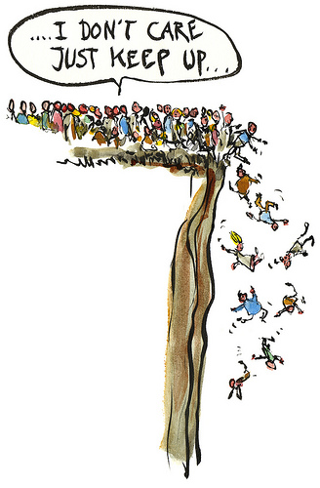
During The Trip (Cont’d)
If conditions change or the route proves more difficult than the weakest member can complete safely, find a safer alternative or turn around.
Lead the trip you posted.
Don’t be afraid to make an unpopular call -YOU are responsible for the group’s SAFE RETURN to the trailhead!

Slide 26
Making decisions in a group setting
When there really is flexibility for group engagement in a decision, it can bring the group together and add ownership!
Draw out the quiet people. Watch for the ‘herd mentality’.
Anticipate tendency for people to defer to the leader, and to avoid appearing incapable or weak in front of group members.
Sometimes the leader needs to make a command decision or use ‘veto power’ for the good of the group.
Get input if there is time, but if not, explain your rationale and relate it to the safety of the group.
“Majority rule” doesn’t have to be accepted if you don’t think it’s safe
Notes:
If you get communication and expectation setting right, this is mostly a non-issue!
Don’t put someone on the spot. A private conversation may resolve an issue that would be a battle in public, but if they are undermining your leadership then it may need to be public (at least the resolution).
Stand side-to-side not face-to-face when dealing with conflict (as the situation permits)
Stay calm and manage your emotional state
Start by building a common bridge (e.g. Mountaineers, outdoors, puppies, weather, etc.)
Listen to their issue/concern with an open mind
Reflect their comments back to them so they know you listened
If you can accommodate safely, do so. If not, explain your reasons and link it back to common objectives and Mountaineers policy (including, if necessary, documenting their behavior)
Often engaging the individual (giving them a task, asking them to share knowledge, etc.) can redirect them in a positive way

Slide 27
Dealing with a difficult participant and/or unacceptable behavior
If a group member’s behavior violates outdoor ethics or puts the enjoyment or safety of any other group member at risk, then you need to act promptly to stop that behavior.
Emotional safety and physical safety are both important!
Harassment, objectionable language, inappropriate conversations or touching are unacceptable on a Mountaineers activity.
The Mountaineers have your back when it comes to confronting such behavior!
First confront the behavior with the individual when it happens, firmly but privately and with consideration.
The Mountaineers have a problem-behavior reporting and follow up process for particularly bad or repeat problem behavior. Find the online report form at this link.
Notes:
If you get communication and expectation setting right, this is mostly a non-issue!
Don’t put someone on the spot. A private conversation may resolve an issue that would be a battle in public, but if they are undermining your leadership then it may need to be public (at least the resolution).
Stand side-to-side not face-to-face when dealing with conflict (as the situation permits)
Stay calm and manage your emotional state
Start by building a common bridge (e.g. Mountaineers, outdoors, puppies, weather, etc.)
Listen to their issue/concern with an open mind
Reflect their comments back to them so they know you listened
If you can accommodate safely, do so. If not, explain your reasons and link it back to common objectives and Mountaineers policy (including, if necessary, documenting their behavior)
Often engaging the individual (giving them a task, asking them to share knowledge, etc.) can redirect them in a positive way

Slide 28
Dealing with a difficult participant and/or unacceptable behavior
Don’t put it off!
Stay calm and manage your emotional state
De-escalate - don’t be aggressive or confrontational
Deal in private – don’t humiliate someone in front of others
Use active listening to understand their concerns/point of view
Explain what you observe and why it concerns you – how could it impact the trip and/or the group
Ask them to help you resolve the situation – but be firm and specific about changes that need to happen
Notes:
If you get communication and expectation setting right, this is mostly a non-issue!
Don’t put someone on the spot. A private conversation may resolve an issue that would be a battle in public, but if they are undermining your leadership then it may need to be public (at least the resolution).
Stand side-to-side not face-to-face when dealing with conflict (as the situation permits)
Stay calm and manage your emotional state
Start by building a common bridge (e.g. Mountaineers, outdoors, puppies, weather, etc.)
Listen to their issue/concern with an open mind
Reflect their comments back to them so they know you listened
If you can accommodate safely, do so. If not, explain your reasons and link it back to common objectives and Mountaineers policy (including, if necessary, documenting their behavior)
Often engaging the individual (giving them a task, asking them to share knowledge, etc.) can redirect them in a positive way

Slide 29
In Case of Emergency
We expect our leaders to have basic ‘working competency’ for how to handle common first aid and other emergencies in the field.
Internalize the Seven Steps
Wilderness First Aid badge or equivalent
Foothills offers a 50% subsidy to take the Mountaineers WFA class for leaders who have led at least 3 hikes, backpacks or urban walks for Foothills in a year
and 100% subsidy for leaders who have led 15 days or more of hikes, backpacks or urban walks for Foothills.
New leader? Need to pay for the class yourself, but can apply for reimbursement if you complete the required trips in the same season you took the class.

Slide 30
Reporting safety incidents on your trip
What? Any significant near-miss or actual injury/illness situation. Required if outside medical treatment, rescue or hospitalization.
Why?
To learn from others’ experiences! Outdoor activities have inherent risk; we strive to address risk through learning and practice
Incident descriptions let us visualize similar situations and learn how to avoid similar outcomes
Tracking trends helps us improve communication on reducing risk
When? As soon as possible after the trip, while the experience is fresh, but after debriefing with your group.
How? When closing your trip, click the button for submitting an incident report

Slide 31
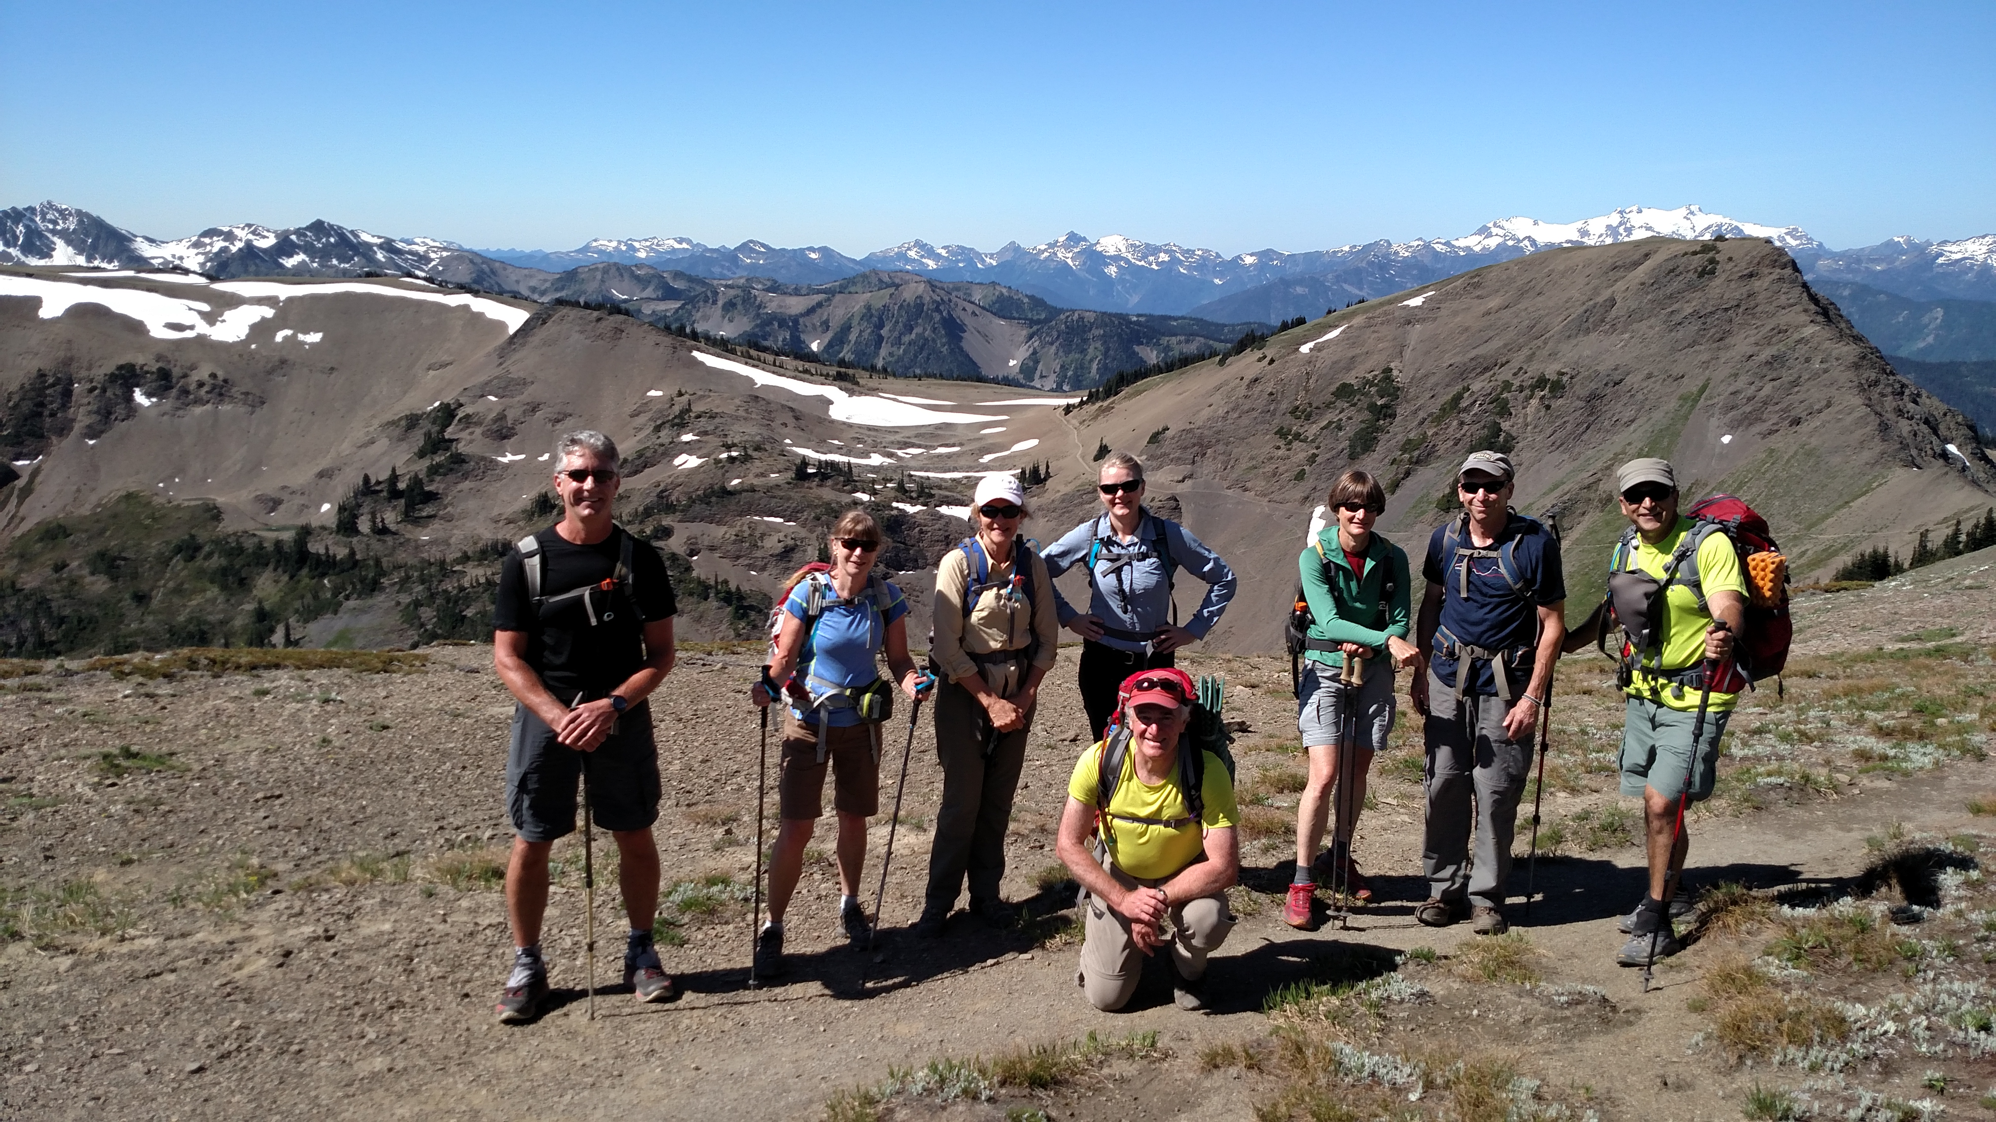
Putting It Into Practice
Foothills Hike, Urban Walk & Backpack Leaders

Slide 32
Leadership Scenarios
Injuries or trip problems often result from system failures or leader decisions that can be examined and addressed to prevent recurrence.
Let’s explore how to respond to some common ‘judgment’ situations using what you’ve learned today!
Notes:
15 minutes to discuss your scenario and answer the questions
5-10 minutes for each group to report out and larger group to comment
4 total scenarios – each group will discuss 1 or 2 scenarios depending on how many people are in attendance

Slide 33
Leadership Scenarios
You will move into a breakout group with 4-5 other students
and one facilitator.
Each group will be presented 2-3 real-life leadership challenge scenarios, and discuss the considerations and what they think the leader should do. (10 mins each)
Choose one to report out
Note taker who will share the group’s conclusions with the larger group
Extra scenarios and facilitator’s notes to take home and review
Notes:
15 minutes to discuss your scenario and answer the questions
5-10 minutes for each group to report out and larger group to comment
4 total scenarios – each group will discuss 1 or 2 scenarios depending on how many people are in attendance

Slide 34
Wrapping Up
Board Policies
Member privacy
Carpooling
Youth and family activities
Pets

Slide 35
Leader Responsibilities: Privacy
Trip leaders can see all the profile data of people on their rosters, even for those who have private profiles.
Leaders may extract and use even private participant profile data for planning and safety purposes relative to their trip or seminar.
However, the data of a person with a private profile cannot be shared with other members.
Ask for permission before sharing even email addresses with other participants.
Privacy policy explained

Slide 36
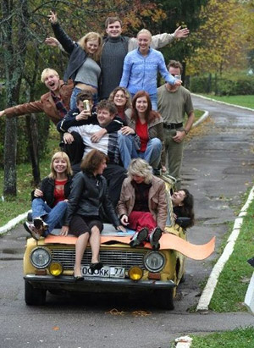
Leader Responsibilities: Carpooling
Mountaineers trips start at the trailhead – our insurance does not allow leaders or staff to assign or require carpools.
Carpool drivers are free to require masks, self-test, vaccination, or not, as they wish, but need to let all riders know in advance.
Leaders CAN encourage carpooling, and facilitate by sharing contact info (if authorized by hiker – check & respect privacy settings on profile)
Willing drivers are a precious resource.
Remind people that it’s an important courtesy to reimburse their driver. You can suggest a reimbursement rate
Tell hikers the round-trip mileage to trailhead

Slide 37
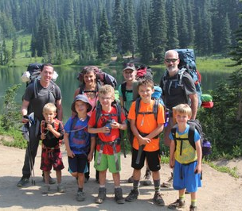
Leader Responsibilities: Youth
Special requirements for leader training and supervision for anyone under 18 (applies even with their parents on the trip)
https://www.mountaineers.org/youth/volunteer-with-youth
Seattle now has a Youth Committee that will certify aspiring youth & family hike and backpack leaders including youth-specific first aid and navigation training

Slide 38
Leader Responsibilities: Hikes with dogs:
Establish in advance as part of trip posting – don’t ‘spring’ it on the other participants after they’ve registered.
Service animals must be allowed to accompany a participant, and you can’t ask for medical proof. Communicate the situation to the other participants in advance so that they can opt out if they wish.
Follow posted trail rules!!
Don’t bring dogs in active wildlife areas
Be sensitive to dogs in camps with other people

Slide 39
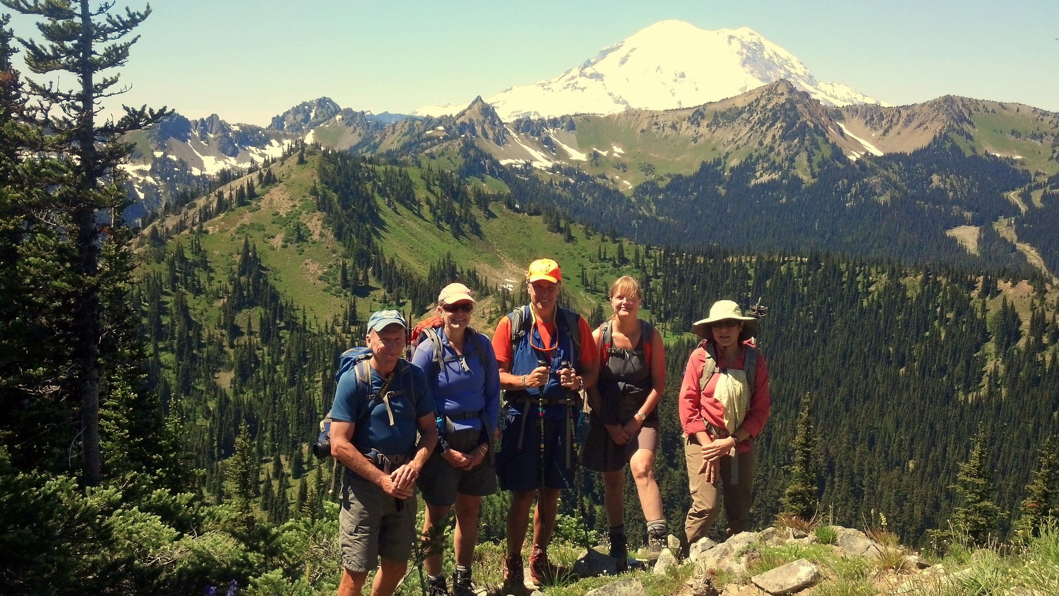
Wrap-up - Next Steps
Foothills Hike, Urban Walk & Backpack Leaders

Slide 40
Steps to certify as a hike, urban walk or backpack leader for The Mountaineers
New Leader seminar.
Recent experience on 2-3 Mountaineers hikes, urban walks or backpacks as a participant. (Aspiring youth leaders should get this experience with a youth group.)
First Aid, Safety and Navigation training:
To certify as an adult hike or backpack leader, need Wilderness First Aid and Wilderness Navigation/Staying Found or equivalent.
To certify as an Urban Walk leader, need at least Red Cross First Aid/CPR and Map and Compass course or equivalent, plus completion of the Urban Walk Safety seminar (pedestrian safety).

Slide 41
Steps to certify as a hike, urban walk or backpack leader for The Mountaineers
Submit application (goes to the activity chair of the specified committee).
You can lead for any Mountaineers branch, regardless of your ‘home branch’.
Request provisional leader status from that committee – then organize, post and lead a Mountaineers hike or backpack with an experienced Mountaineers leader as a mentor.
The mentor will complete and submit a mentor evaluation form. With favorable evaluation, committee will grant you full leader standing & badge.
Progressions:
Urban Walk leaders must gain the additional first aid and navigation training and lead a mentored backcountry hike before leading a backcountry hike.
Hike or backpack leaders who want to lead Urban Walks are encouraged to complete pedestrian safety training.
Hike leaders must lead mentored backpack to certify as a backpack leader.
Scramble or climb leaders still must complete the full certification process to become a hike or backpack leader.

Slide 42
Next Steps
Review all the class reference materials
Get enrolled for any pre-requisites you don’t already have
Submit application form – I’ll send this to you after this class.
The committee will prompt you to complete any needed requirements, and to help you organize your mentored lead.
Review instructions for posting an activity on the Mountaineers website and managing an activity roster – under “Volunteer” ➔ “Schedule and Manage”. Great video training can be found there.

Slide 43
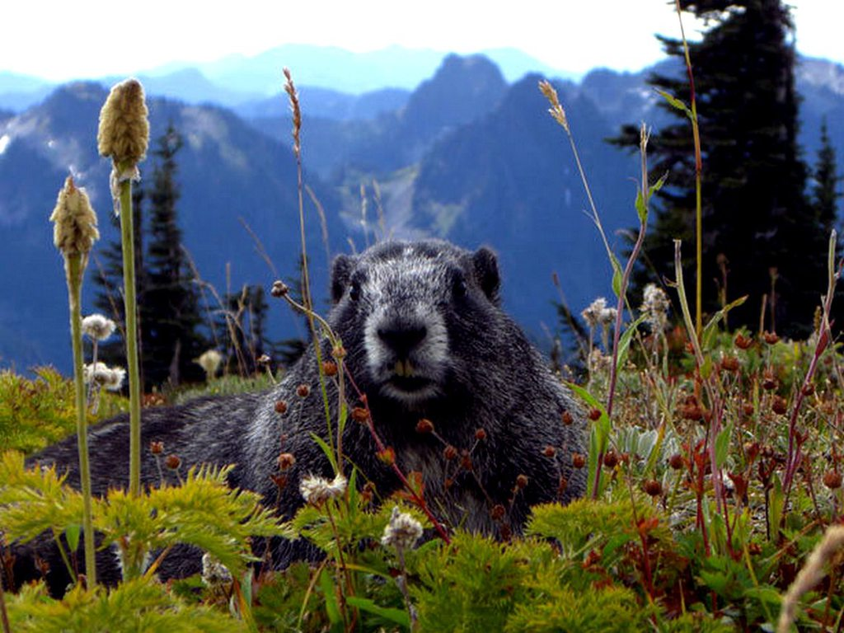
QUESTIONS?

