Slide 1
Coordinate systems and UTM
How the earth is broken up into pieces

Slide 2
Coordinate System
A way to identify and name any point on the earth.
There are several systems, but we care about two:
Latitude and Longitude
Universal Transverse Mercator or UTM

Slide 3
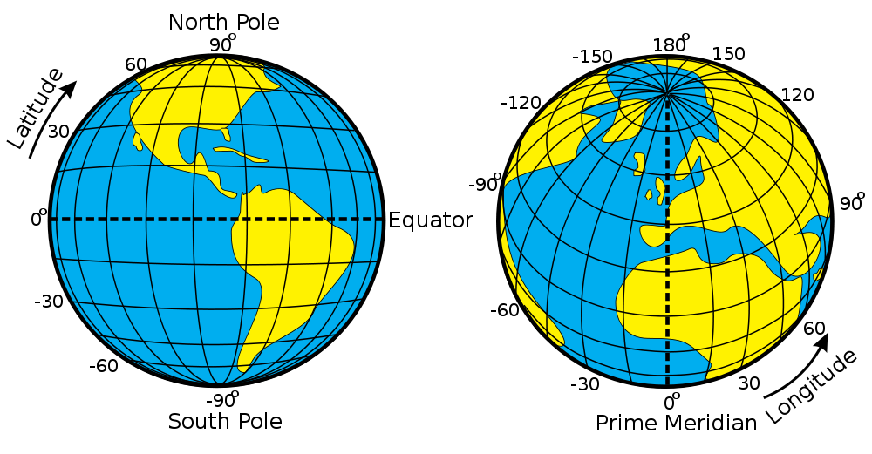
Latitude / Longitude
Meridians
Parallels

Slide 4
Latitude / Longitude
Expressed in:
Degrees °
Minutes ' (60 minutes in a degree)
Seconds " (60 seconds in a minute)
Also sometimes shown as decimal degrees
46.75° = 46°45'

Slide 5
Latitude / Longitude
Find latitude and longitude on your map
Note that only the corners show degrees.
The edges show minutes and seconds.
West
edge
South
edge
SW
corner

Slide 6
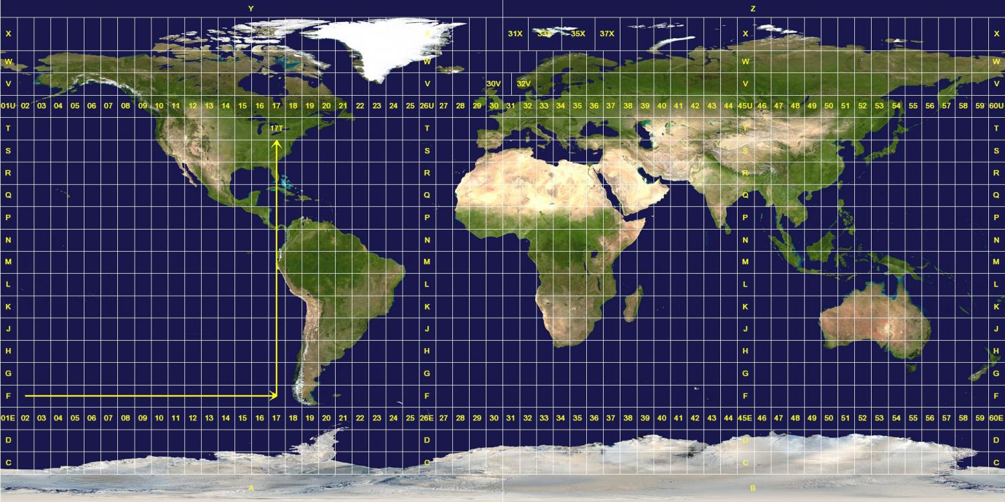
Universal Transverse Mercator (UTM)

Slide 7
Universal Transverse Mercator (UTM)
Expressed in:
Zone (a rectangle, e.g. 10T contains Olympia)
Easting (meters, increases toward the east or right)
Northing (meters, increase toward the north or up)
Lacey Comm. Center is at 10T 0515678E 5209579N
  Or zone 10T, 0515678 east by 5209579 north

Slide 8
Universal Transverse Mercator (UTM)
Find UTM on your map
West
edge
5179 = 5179000 northing (meters)
South
edge
5178 = 5178000 northing
SW
corner
596 = 0596000 easting

Slide 9
Map Datum
Map datum is a model of the shape of the earth for computing positions. Two common datum are:
WGS84
NAD27
Know your datum!

Slide 10
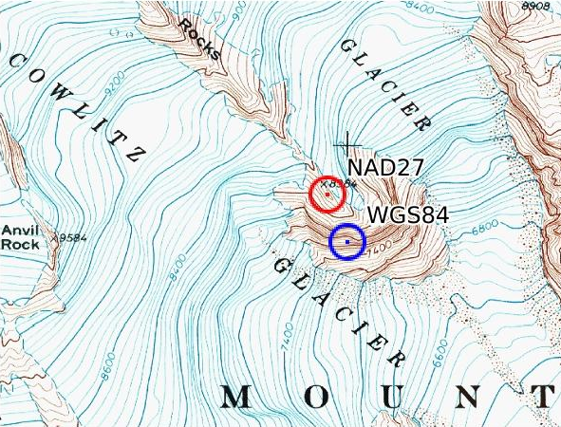
Datum Shift
Different datum compute to different coordinates. This difference is called “datum shift.” 10T 0598428E 5187029N is shown in the two datum, about 215m apart.

Slide 11
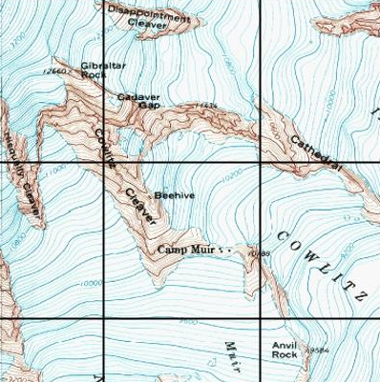
UTM Coordinates for Camp Muir
Draw horizontals above and below Muir on the UTM ticks. Draw verticals left and right of Muir on the UTM ticks.
Work from the box corner below and to the left, or southwest, of Muir.
Estimate easting from 596000, say three-quarters? Call that 596750E.
Estimate northing from 5187000, say half? Call that 5187450N.
Muir’s at 10T 596750E 5187450N.
5188000
2
3
5187000
1
596000
597000

Slide 12

Your Turn!
What is the UTM for the “B” in Beehive?
From the SW corner
Estimate easting
Estimate northing
5188000
3
10T 0596320E 5187800N
2
5187000
1
596000
597000

Slide 13
One More
Where is 10T 0596500E 5187500N?
From the SW corner
Estimate easting halfway between 0596 and 0597
Estimate northing halfway between 5187 and 5188
5188000
3
2
5187000
1
596000
597000

Slide 14
Questions?

