Slide 1
Notes:
In this lecture well discuss, kayaks, sprayskirts, PFDs, paddles, bilge pumps, paddle floats. We will go over their use and what to look for in them.

Slide 2
THE STUFF
SEA KAYAKING EQUIPMENT
Notes:
When starting in this sport it is easy to get overwhelmed by the amount and price of gear. Remember, you will use this gear over several years and the initial investment will pay off over time.

Slide 3
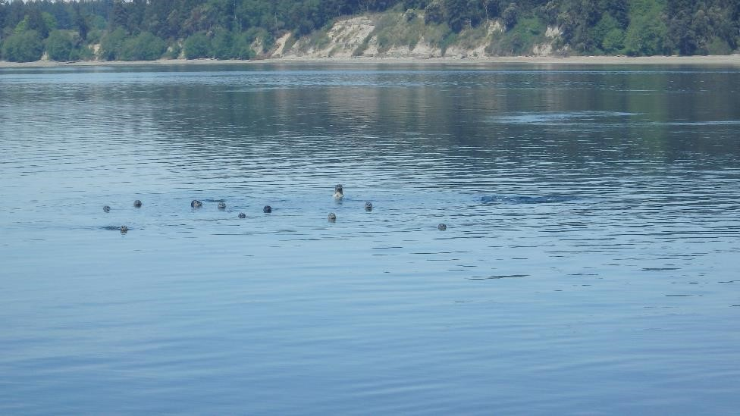

Slide 4
TERMINOLOGY
Other features:
Waterline length
Beam
Chine
Hard
Soft
Rocker
Keel
Skeg (Rudder)
Thighbrace
Backrest – back band

Slide 5
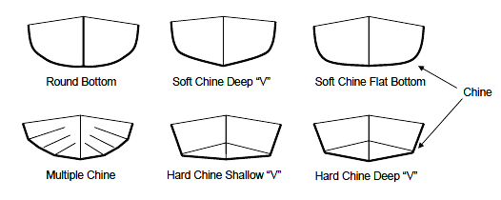
Chines

Slide 6
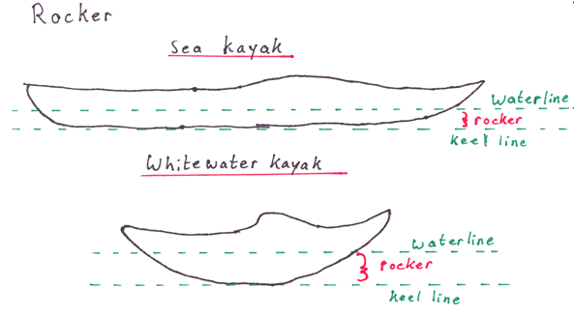
Hull Rocker

Slide 7
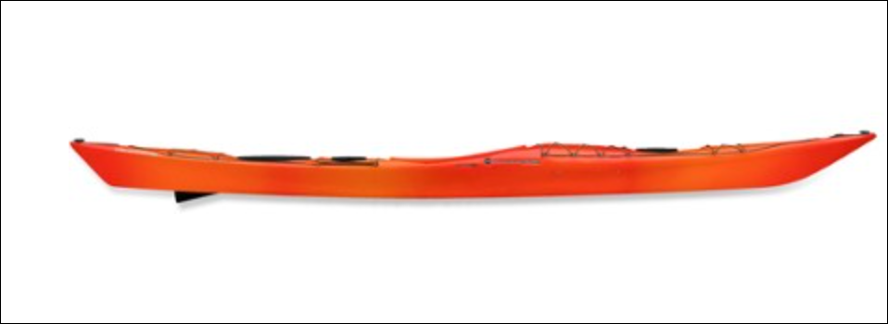
Hull Rocker
waterline
Keel line
waterline
keel line

Slide 8
Sea Kayak Rocker

Slide 9
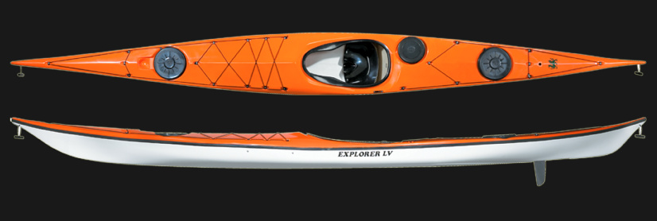
Rocker - Edging
Note how much more rounded (and easier to turn) the sea kayak above is when placed on edge

Slide 11
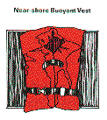
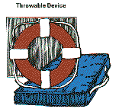
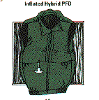
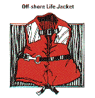
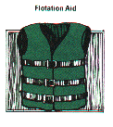
PERSONAL FLOATATION DEVICE (PFD)
Type 1
Type 2
Type 4
Type 5
Type 3

Slide 12
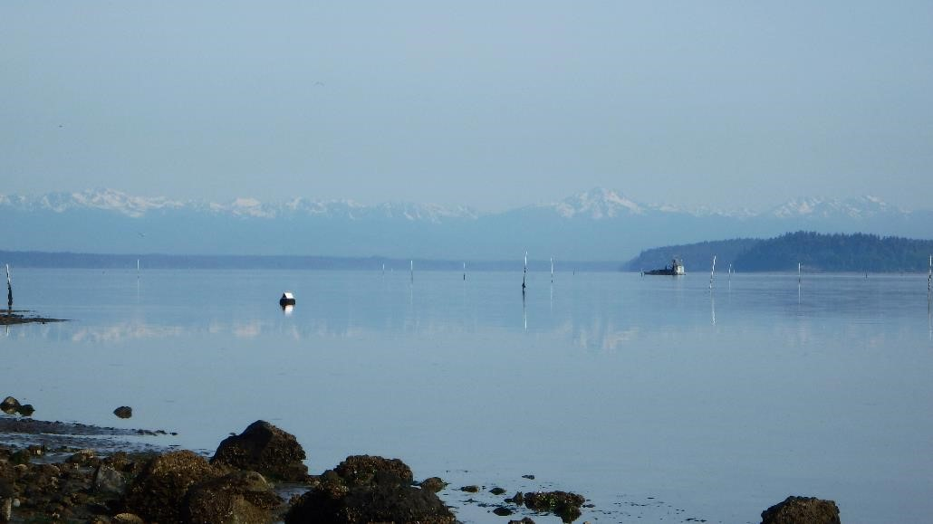

Slide 13
Type III
most applicable to sea kayaking
Fit low and tight – shouldn’t ride up around ears
Unrestricted arm movement
Will:
Help keep you on the surface
Allow you to set up for self or assisted rescue
Won’t:
Keep your face out of the water if you are unconscious
Keep your face from periodically going under in rough conditions

Slide 14
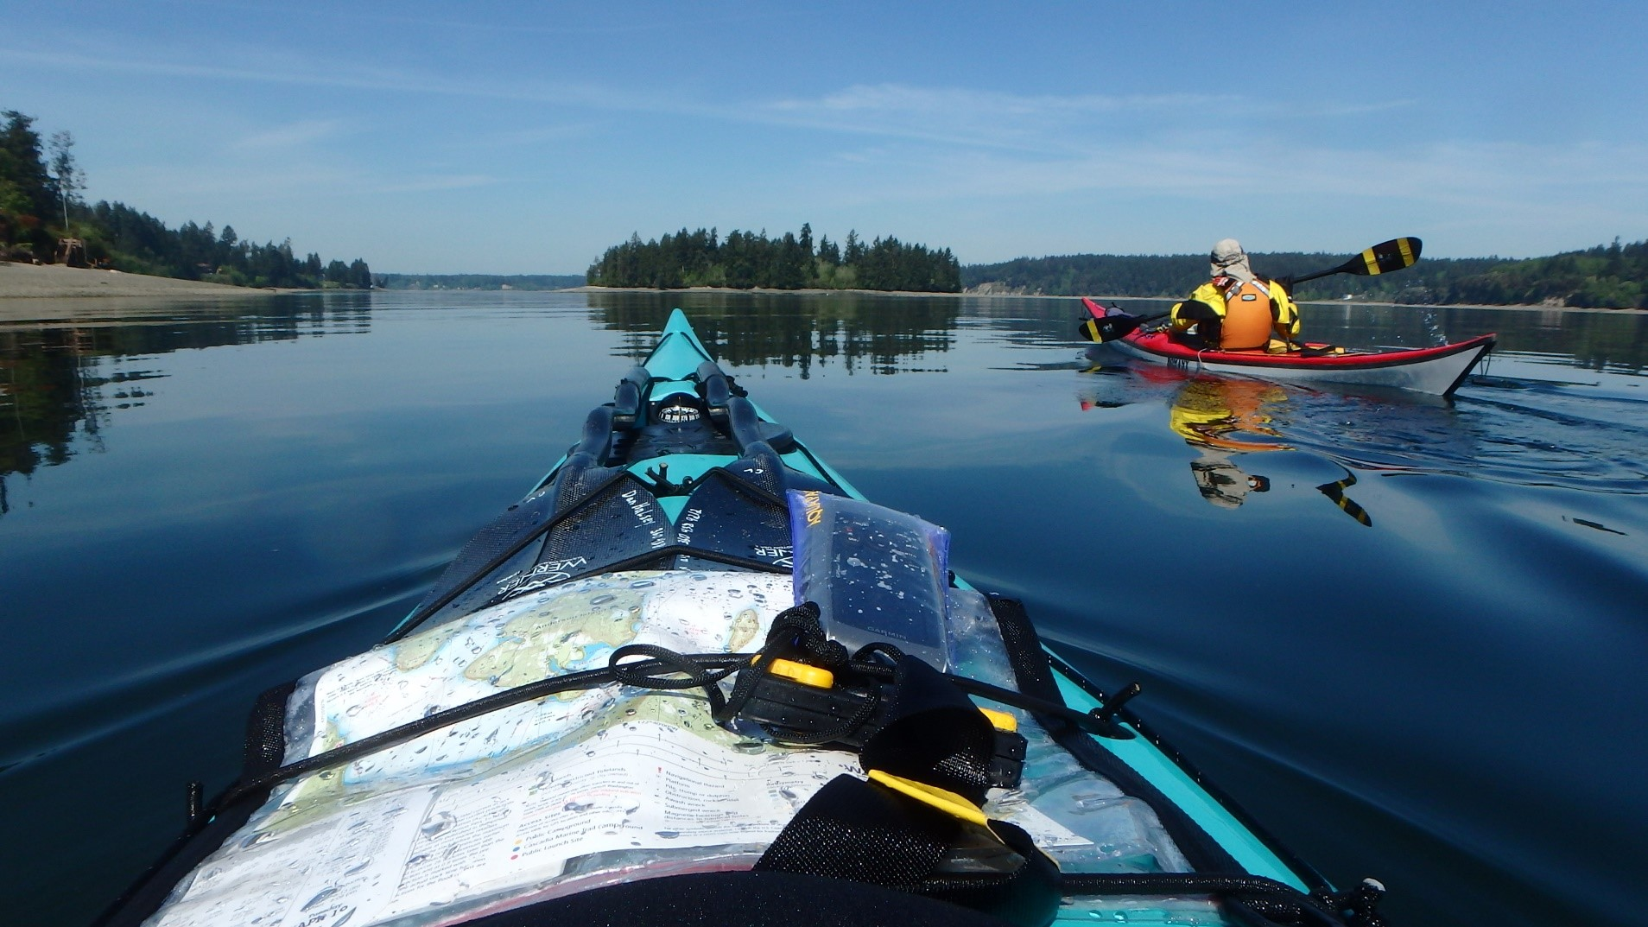

Slide 15
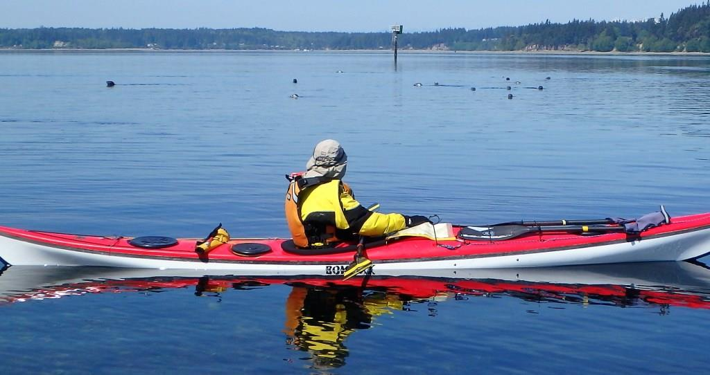

Slide 16
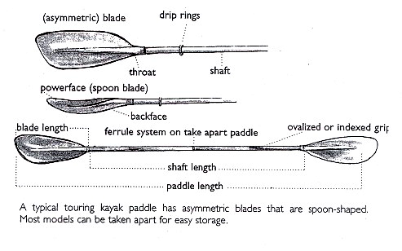
Characteristics of a Sea Kayaking Paddle
A Woman’s Guide to Sea Kayaking, Shelley Johnson, © 1998

Slide 17
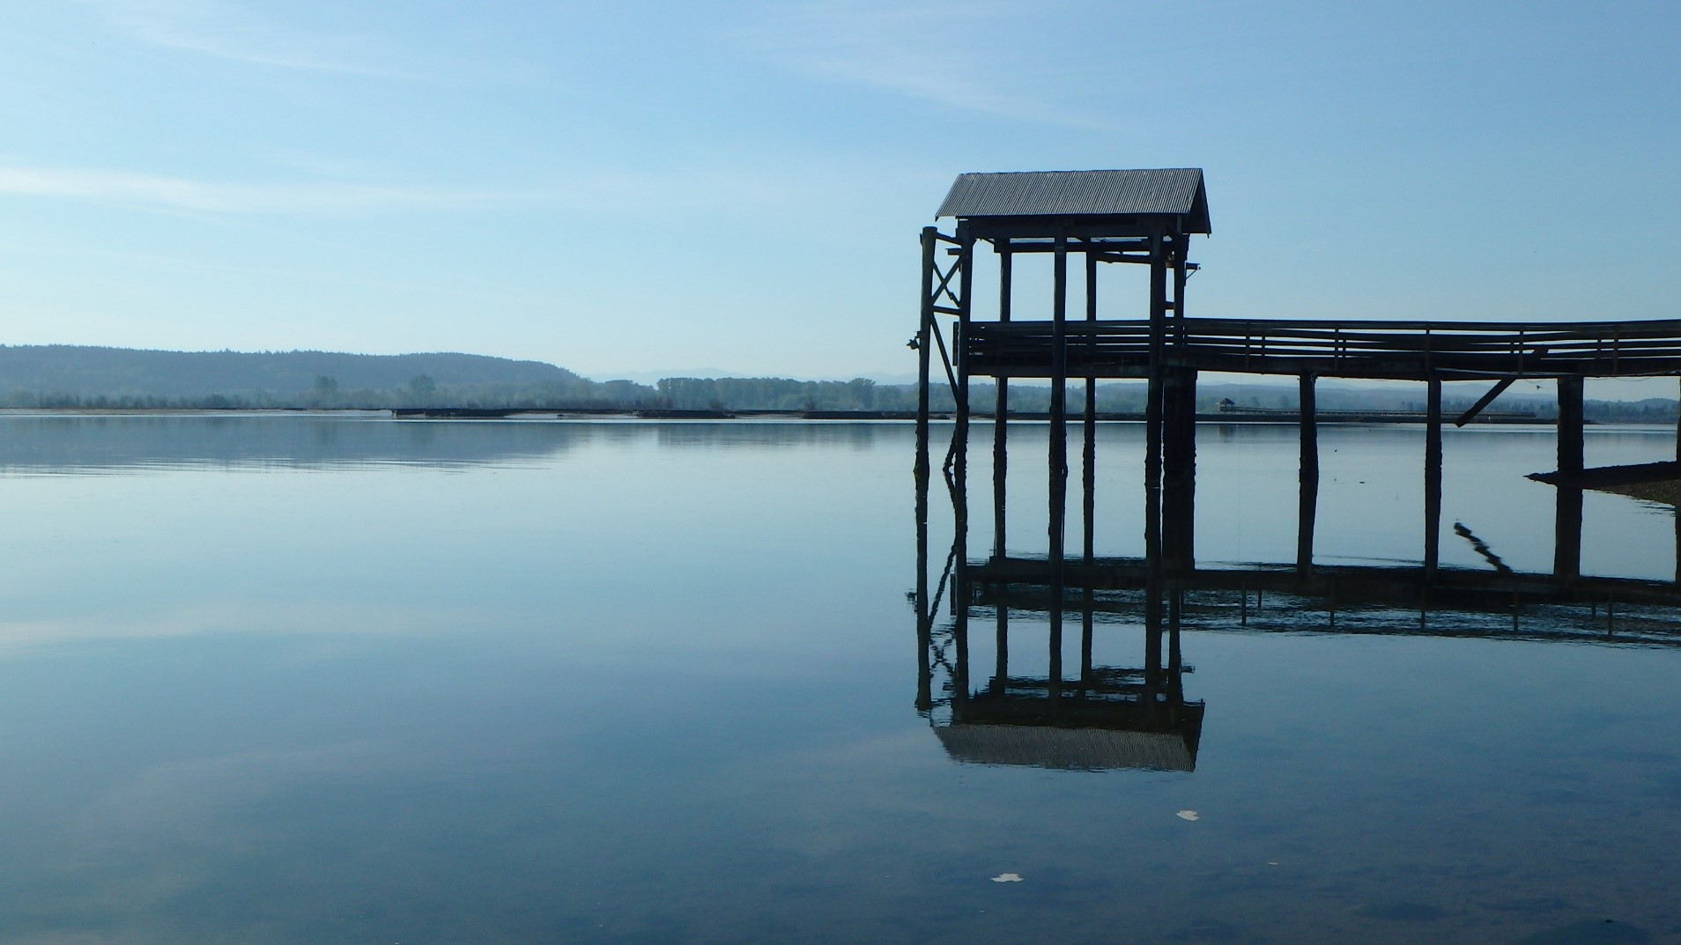

Slide 18
Immersion Protection
Drysuit: seals neck, wrists allowing for “dry” clothing underneath. Most protection, most cost.
Wetsuit and paddling jacket, drytop: sweater under. Adequate protection for some of year, less cost.
Paddling pants and paddling jacket : thick insulating clothing under. Least comfortable, least protection, least cost. For the summer only.
Dress to Swim
Dress per water temp. ,
not air temp.
Remember: Head, hands, feet warmth are important

Slide 19
Bilge Pump
Used to pump out water collected in cockpit or leaky compartment.
Hand carried bilge pump
Permanently mounted foot powered bilge pump
Mounted electric powered bilge pump

Slide 20
Paddle Float
Used as a stabilizer to act as an outrigger for re-entry into a swamped sea kayak after wet exiting.
Process when capsized:
Wet exit hanging onto boat and paddle
Apply paddle float to paddle blade FIRST, then inflate
Snug other free paddle blade under deck rigging making a T
Worm scramble over back deck on stomach until you can get feet into cockpit
Using paddle float outrigging set up to stabilize you twist around to sit in seat
Bail out cockpit using bilge pump
Notes:
The paddle float is used to act as a stabilizing outrigger when mounted on the blade of a paddle and then one places the other blade under the decklines to temporarily secure the paddle and paddle float so a kayakler alone can e-enter their cockpit, then use the bilge pump to bail out the cockpit. There are foam paddle floats, they are bulky and tend to offer less support. IMPORTANT: When using, apply to paddle BEFORE inflating.

Slide 21
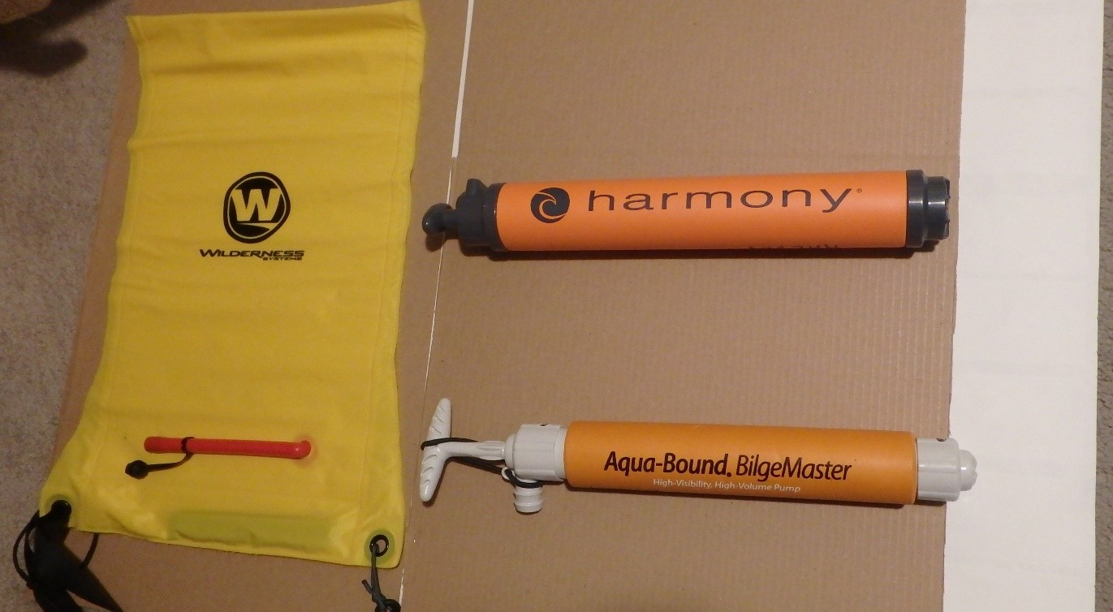

Slide 22
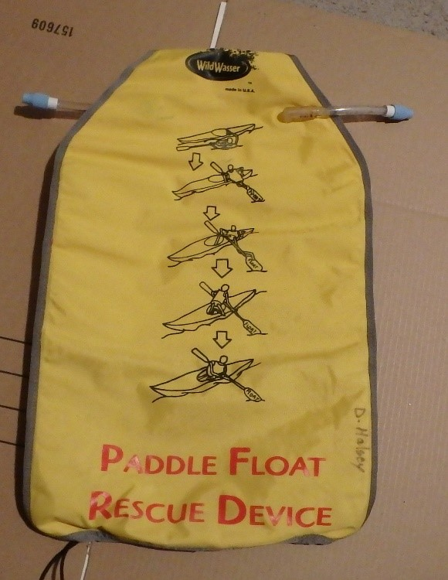
Notes:
The Float should have a means of easily attaching to the paddle shaft above the blade to prevent inadvertently kicking float off paddle. It is wise prior to using this stuff in the water to practice applying on land and placing paddle under deck lines.

Slide 23
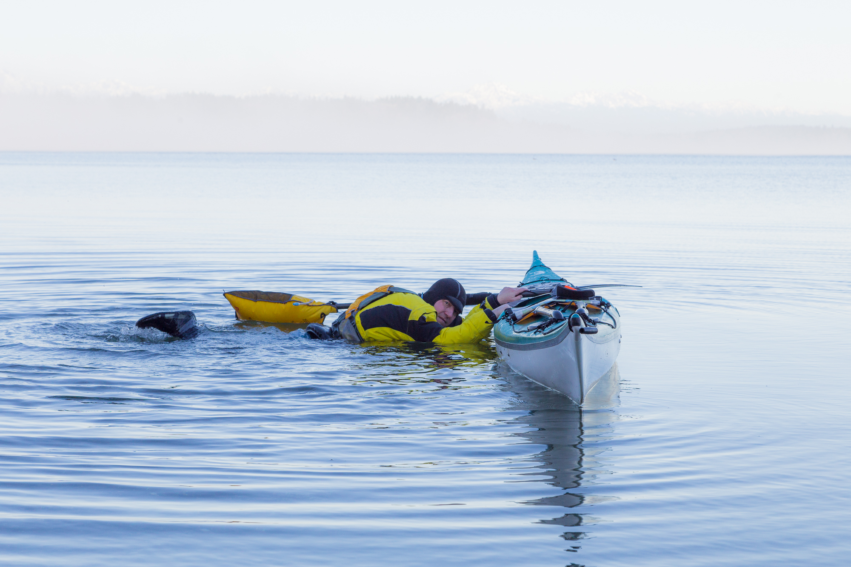
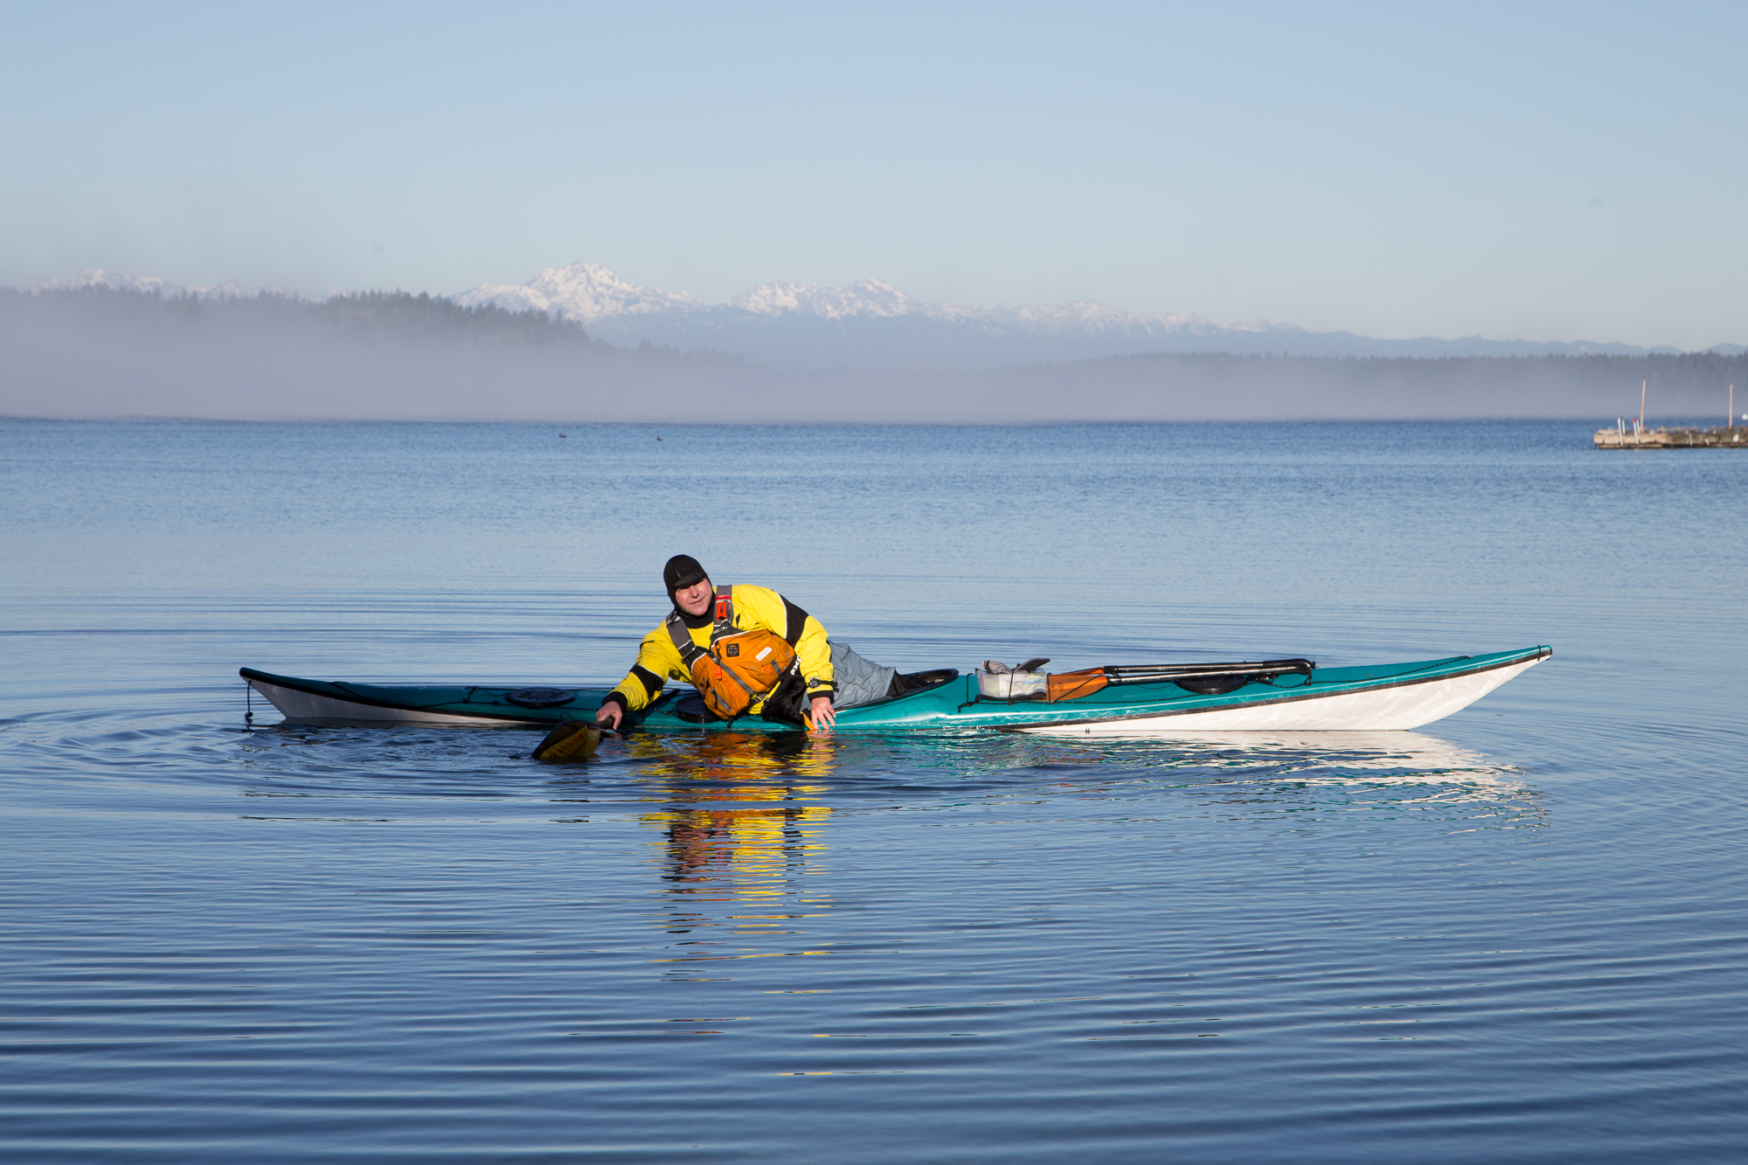
Notes:
Here you can see the outrigger set up, I am preparing to scramble into the cockpit here first , then shown twisting around to sit while leaning on the paddle float.

Slide 24
Spray skirts
Used to keep water out of cockpit. Can be nylon coated, neoprene, or a combination of both. IS NOT AN OPTIONAL ITEM
Important: Not all skirts fit all cockpits. When buying, ask expert advice for the right fit, You’ll need waist size and cockpit or deck size (recommend one step up from recommended )

