Slide 1
What is an alpine rock climb?
Use poll everywhere to submit your answer

Slide 2
Notes:
What is an alpine rock climb? https://www.polleverywhere.com/free_text_polls/2H5yxFObI5861er

Slide 3
Basic Lecture 3 Alpine Rock Climbing March 9th 2016
Agenda:
Alpine Rock Climbing Fundamentals
10 minute intermission
Multi-Pitch Climbing Demo
Case Study
Low Impact Recreation Skills
Liberty Bell,
North Cascade NP

Slide 4
Learning Objectives for Basic Lecture 3
Understand the difference between gym, sport, crag, and alpine rock climbing.
Understand the fundamentals of alpine rock climbing.
Understand the mechanics of an alpine rock climb (from sign up to celebration).
Discuss what constitutes “a successful trip?”
Understand low-impact skills for alpine climbing.

Slide 5
For each question, every group/table will designate a new…
Framework for Lecture 3
Scribe
Timekeeper
Speaker
Everyone should participate in every question to the best of their ability!
Remember, you’re a TEAM!
Notes:
Scribe-write clearly on the whiteboards
Timekeeper-use phone
Speaker-speak loudly, clearly, and slowly

Slide 6
Gym, Sport, Crag/Trad or Alpine?
Question 1 (4 minutes)
Type of climbing | Characteristics
Gym
Sport
Crag/Trad
Alpine
Type of climbing | Similarities | Differences
Gym
Sport
Crag
Alpine
Create a list of the characteristics between gym, sport, crag, and alpine climbing.

Slide 7
Gym, Sport, Crag/Trad or Alpine?
Question 1
Type of climbing | Characteristics
Gym | -Good for strength building -Top rope or lead climbing -Safest form of climbing -Least risk
Sport | -Good way to practice climbing technique -Don’t need a lot of gear -More risk
Crag/Trad | -Good way to practice techniques for alpine climbs -More risk
Alpine | -Best views! -Most remote -Wide range of skills needed -Most risk involved
Create a list of the characteristics between gym, sport, crag, and alpine climbing.
Notes:
Most objectives hazards
PLB? GPS? Navigation?
Have you communicated your plan?

Slide 8
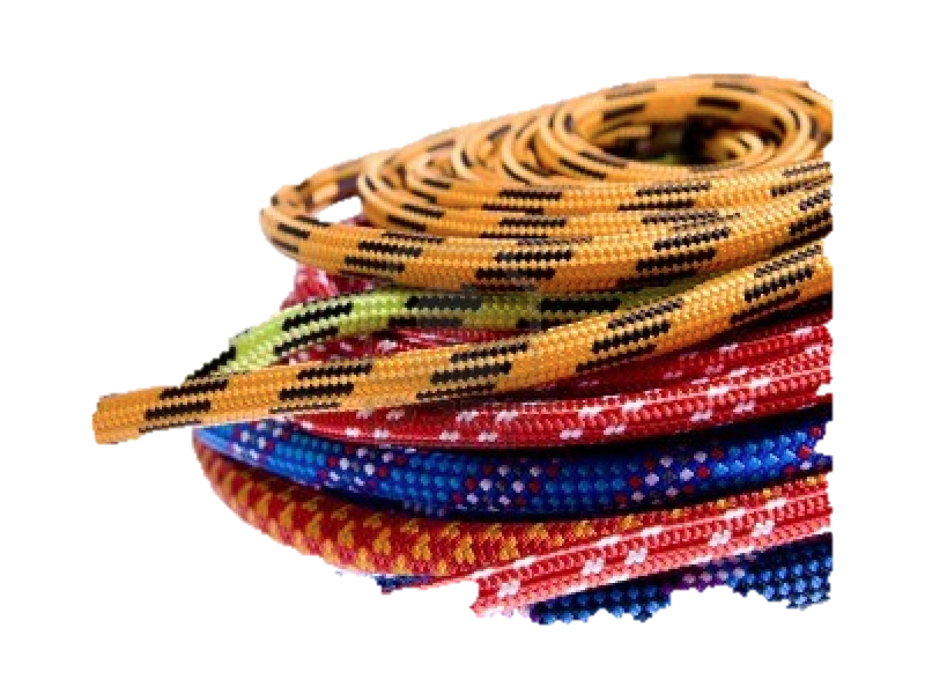
Know your Equipment
The rope symbolizes climbing and the climber’s dependence on another person.

Slide 9
Know your Equipment
Question 2 (60 seconds)
As a group…
Label the 2 main parts
of a rope.

Slide 10
Know your Equipment
Question 2
As a group…
Label the 2 main parts
of a rope.
CORE
SHEATH
Notes:
Kernmantle
nylon

Slide 11
Know your Equipment
Question 3 (3 minutes)
List the required equipment necessary
for most alpine rock climbs.

Slide 12
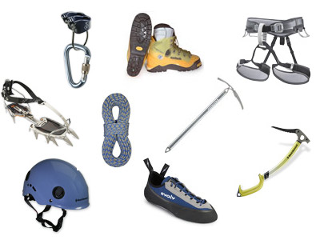
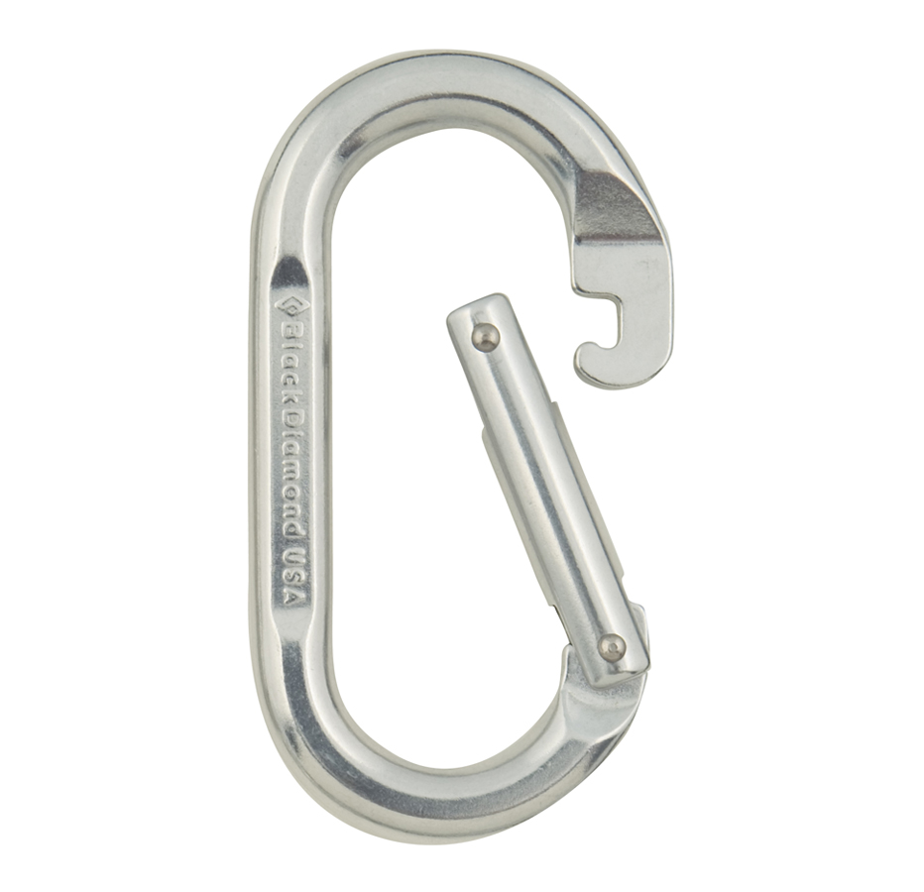
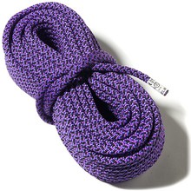
Question 3
10
Essentials
Equipment necessary for most alpine rock climbs.
Notes:
It is critical that you know how to use the gear that you bring.

Slide 13
Know your Equipment
There is no steadfast rule.
Make the decision based on individual skill, experience, and assessment of conditions.
What other equipment or clothing
should you bring for the climb?
Notes:
Clearly communicate with your trip leader!

Slide 14
Alpine Rock Climbing Fundamentals
Alpine rock climbing can range from moderate routes only a few hours from the trailhead to multiday climbs in remote settings.
~Freedom of the Hills
View from summit of Mt. Shuksan, WA

Slide 15
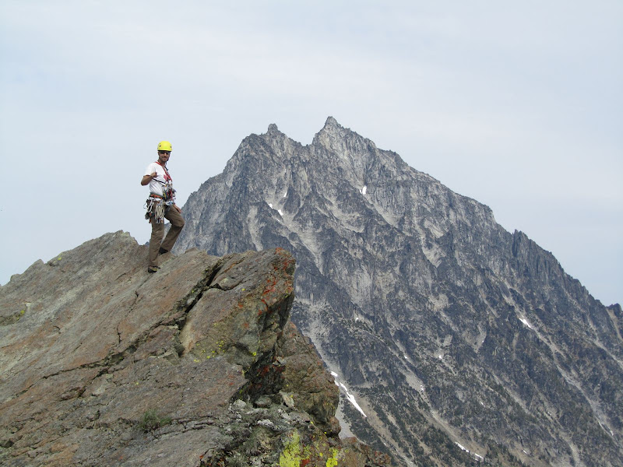
What happens on an alpine rock climb?
Before
During
After
View of Mt. Stuart
from summit of Ingalls Peak, WA
Notes:
Before you climb- things to think about
How is the climbing party composed (# climbers/team, # teams)
How to get there? What does the route look like? What to bring?
What is my role? What do I want to ask the leader?

Slide 16
Before the Climb
Sign up
The Plan
Leader’s responsibility
Your responsibility
The Tetons, WY
Notes:
Mounties website
Communication with trip leader
Getting there safely

Slide 17
As you plan for a climb, what should you consider?
Notes:
Use poll everywhere to ask audience?

Slide 18
Notes:
As you plan for an alpine rock climb, what should you consider? https://www.polleverywhere.com/free_text_polls/kgeGT9G00jQQgA3

Slide 19
As you plan for a climb, what should you consider?
Gear
Food
Conditioning / Pace
Weather / Avy forecast
Route / Grade of climb
Teams
Turn around time
Emergency contact info

Slide 20
During the Climb
Approach & Route Description
Hazards
Rope Teams
Cleaning gear
Anchors
Dorado Needle, WA
Notes:
When we are there?
What skills might I use on the approach? What will a route look like?
What happens when we get to the base of the route? What might the anchor set up be like?
Step through: Watching the leader climb. Getting ready to climb as a follower. Reaching the belay station. A transition. At the top

Slide 21
Terrain Considerations & Hazards
Question 4 (2 minutes)
As a group, list the hazards that may give you grief during an alpine rock climb?

Slide 22
Terrain Considerations & Hazards
Question 4
Unmaintained trails
Stream crossings
Steep snow gullies
Moats
Wildlife
Rock fall
What’s going to give you grief?
Notes:
Using caution when pulling on questionable rock.
Careful on ridges, cornices are unstable.
Slushy slopes make for slow travel.
Moats & bergschrunds present interesting challenges.
To avoid rock & ice fall, start early and stay to the edge of a couloir.

Slide 23
Party inflicted rock fall
Notes:
If you look at the statistics from Accidents in North American Mountaineering, published by the American Alpine Club, you'll notice a significant number of climbing accidents occur because of loose rock and rockfall. The 50-year statistics from 1951 to 2001 indicate that 680 accidents occurred as a result of "Falling rock, ice, or object" in the United States and Canada.

Slide 24
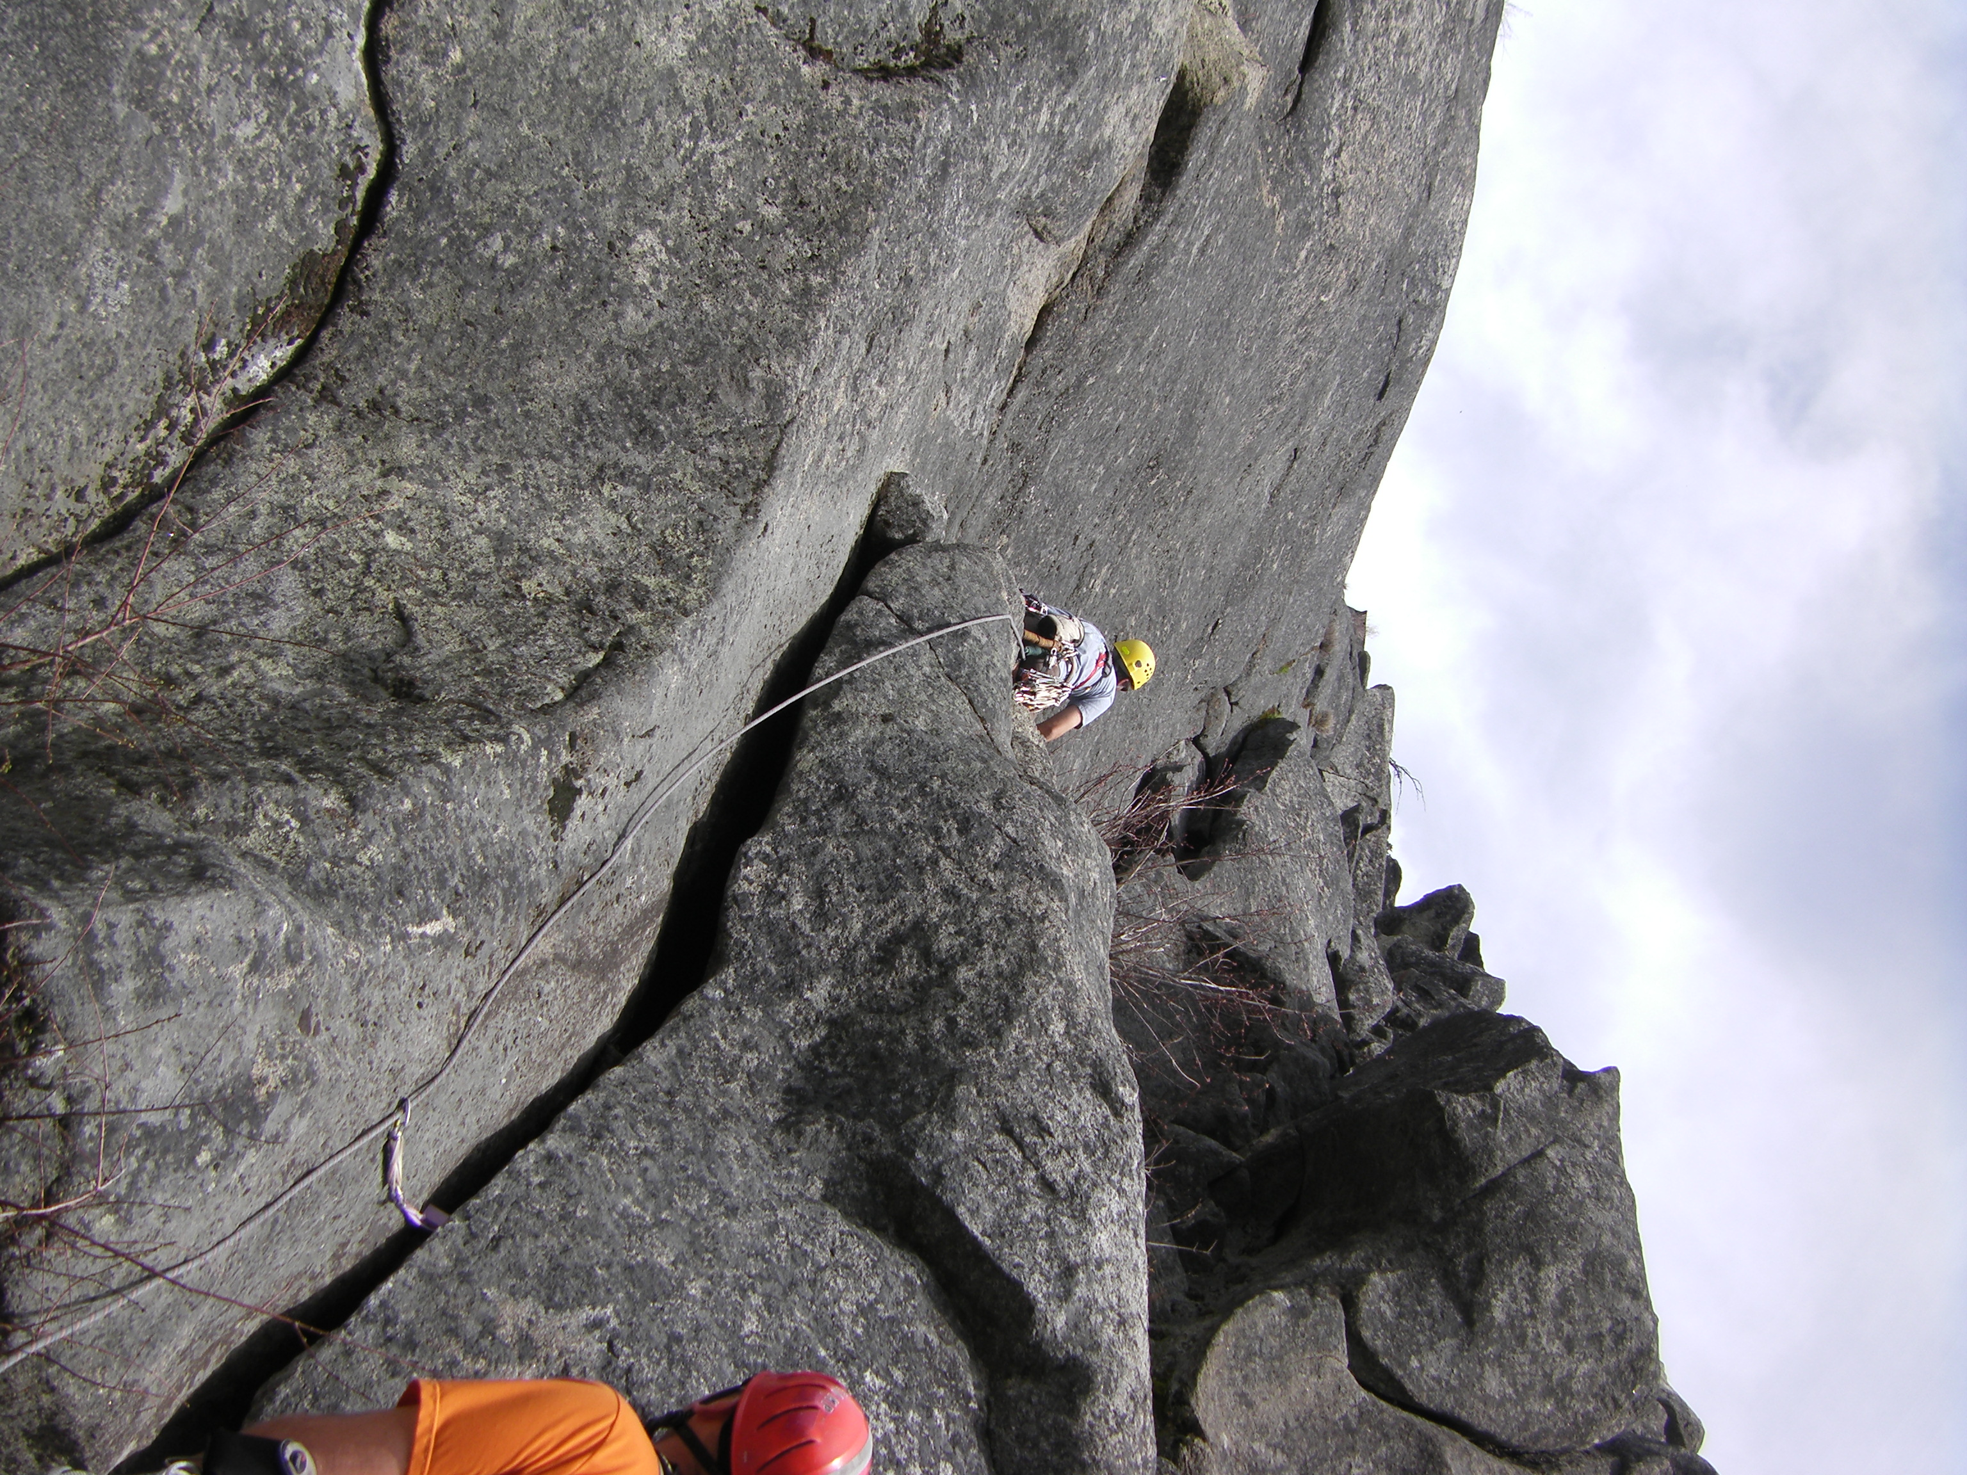
During the climb…
You are either on belay or attached to the anchor.
Icicle Canyon, WA

Slide 25
Rope Teams
Three-person team
Two-person team
Black Peak, WA
Notes:
Two two-person rope teams is standard. Three is okay, just slower.

Slide 26
“Following”
Make sure to:
Have a nut tool
Keep gear attached to rope
Rack efficiently
Notes:
Show people the steps of following.

Slide 27
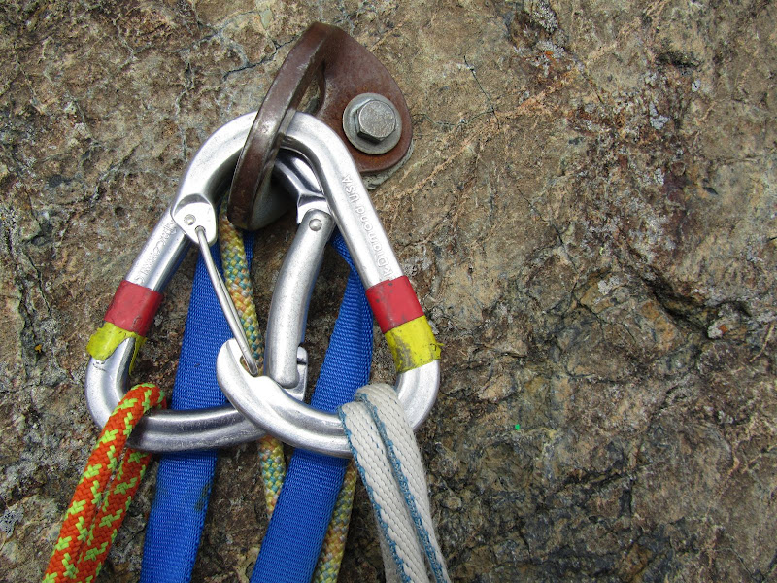
Anchors
You never know
what you are going to get.
Notes:
Anchor, tying in, what does the leader carry, what does the follower carry?

Slide 28
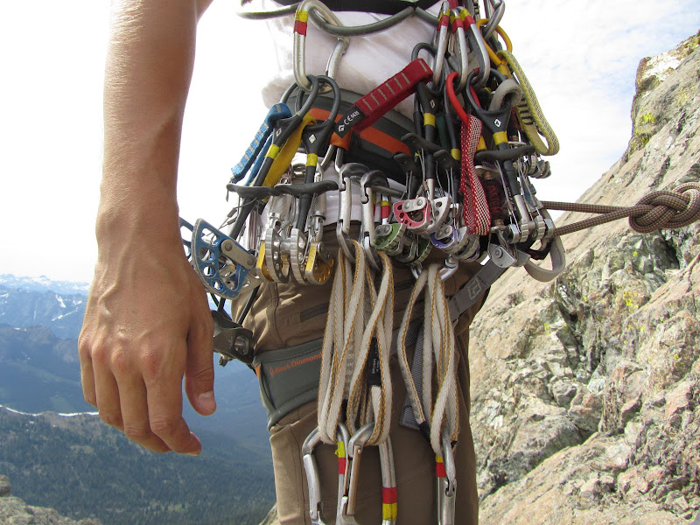
Possible Anchors
Live trees
Solid bolts
Gear
Boulders or rock horns
Attached to the rock of Ingalls via bolts on the second pitch.
Notes:
Initial anchor
Where do you clip in?
How do you clip in?
Give leader the gear back.

Slide 29
Remember, while climbing…
You are either on belay or attached to the anchor.
Icicle Canyon, WA

Slide 30
Although the leader in some ways incurs additional risk while “on the sharp end of the rope,” the belayer and leader both play a critical role in making each pitch safe and successful.
~Freedom of the Hills
Summit of Sahale Peak, WA

Slide 31
After the Climb (Post Summit)
Getting down
Back to the TH
Celebrating & Sharing
Rappelling from the summit of Mt. Something Awesome, WA.
Notes:
Coming down – rappelling skills and considerations
Hiking out
Staying together

Slide 32
Questions?

Slide 33
Rock Evaluation Field Trip
All day (7:30 am start), rain or shine
Gear: one day alpine rock climb
At 4 Stations, you will demonstrate your ability to:
tie all knots
safely belay
safely rappel
safely do belay escape

Slide 34
10 minute intermission
John & Matt simulate a few pitches of alpine climbing.
Notes:
Demo should take about 10 minutes. Talk through all steps, clearly & concisely.
-hike in (Leave no trace ethics)
Rope up & build anchor
Scramble up to base of 1st pitch
1-2 pitches of fifth class
Rappel

Slide 35
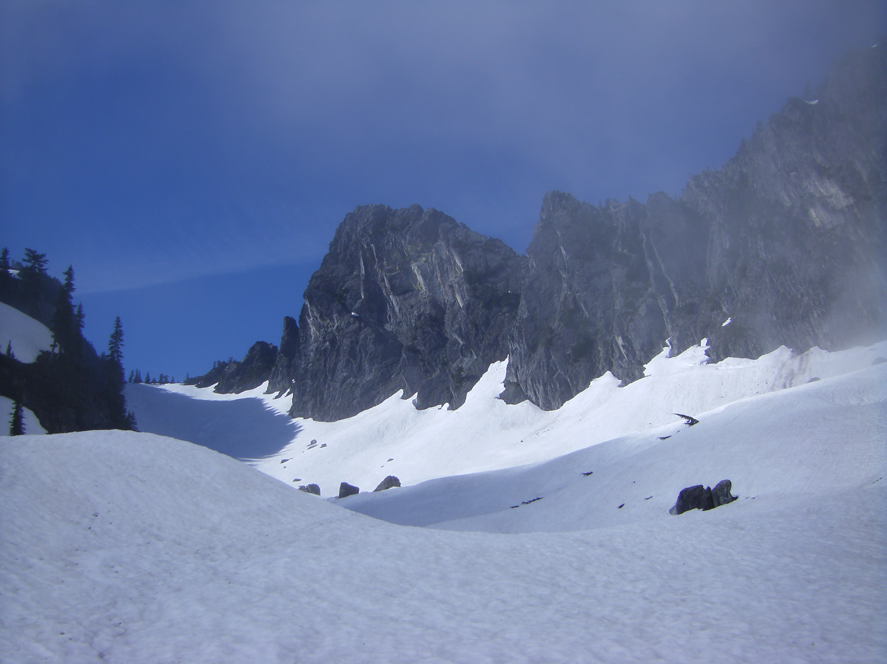
What happens on an alpine rock climb?
Case Study: The Tooth, WA
Notes:
Sign up on website.
Email from trip leader.
Carpool if possible.

Slide 36
Getting there
The Tooth – Snoqualmie Pass
Take I90 to the West Summit Exit for Snoqualmie Pass. Turn right towards the Snoqualmie Pass ski resort (lots of signs), then park at the end lot (if you have a parking pass) or the lot before that. Hike up the main trail, until a sign designating the start of the Source Lake Overlook trail. Take this trail, which avoids losing elevation, to the valley to the south below the east face of The Tooth. There is a good climbers path with cairns to guide you. The final approach involves scrambling up to the notch one south of Pineapple Pass then contouring around clockwise to get to the start of the climb. A direct scramble up to Pineapple Pass is not recommended, as this is the rappel route. The final portion of the contour around involves some class 3 to 4 scrambling, but it is short and unexposed. Some parties have elected to do a running belay here, but it is not necessary.
Notes:
Short discussion – what does this mean to them? What skills do they think they will use? How will skills differ depending on time of year?
Your input – what do you think when you read this? What skills do you want your climbers to have? What will you plan for?

Slide 37
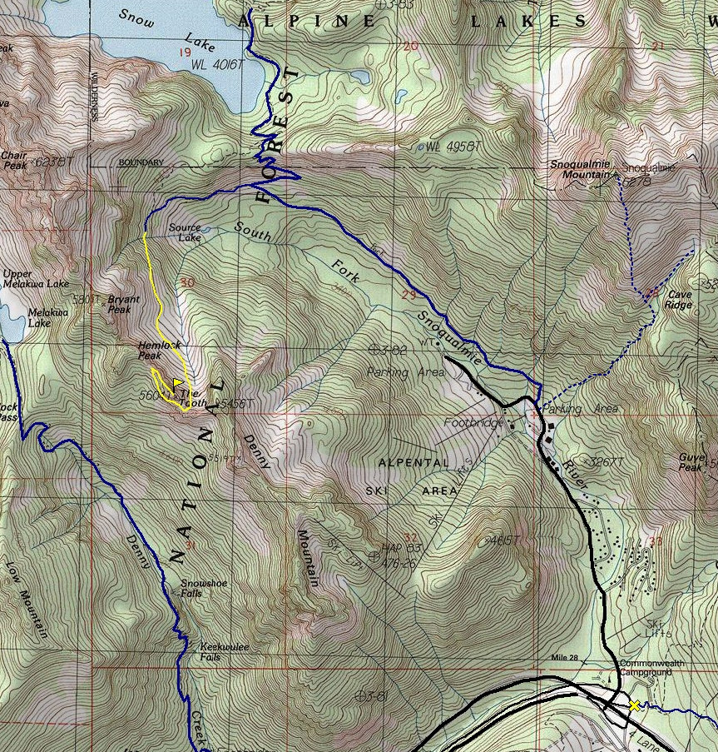
On trail
Off trail
Notes:
Why do we use trails? Keep our impact low!
Walk on the “obvious” climber’s path!!!
Bathroom? Pee-on rocks or snow, away from water sources. Poop-Blue bag it.

Slide 38
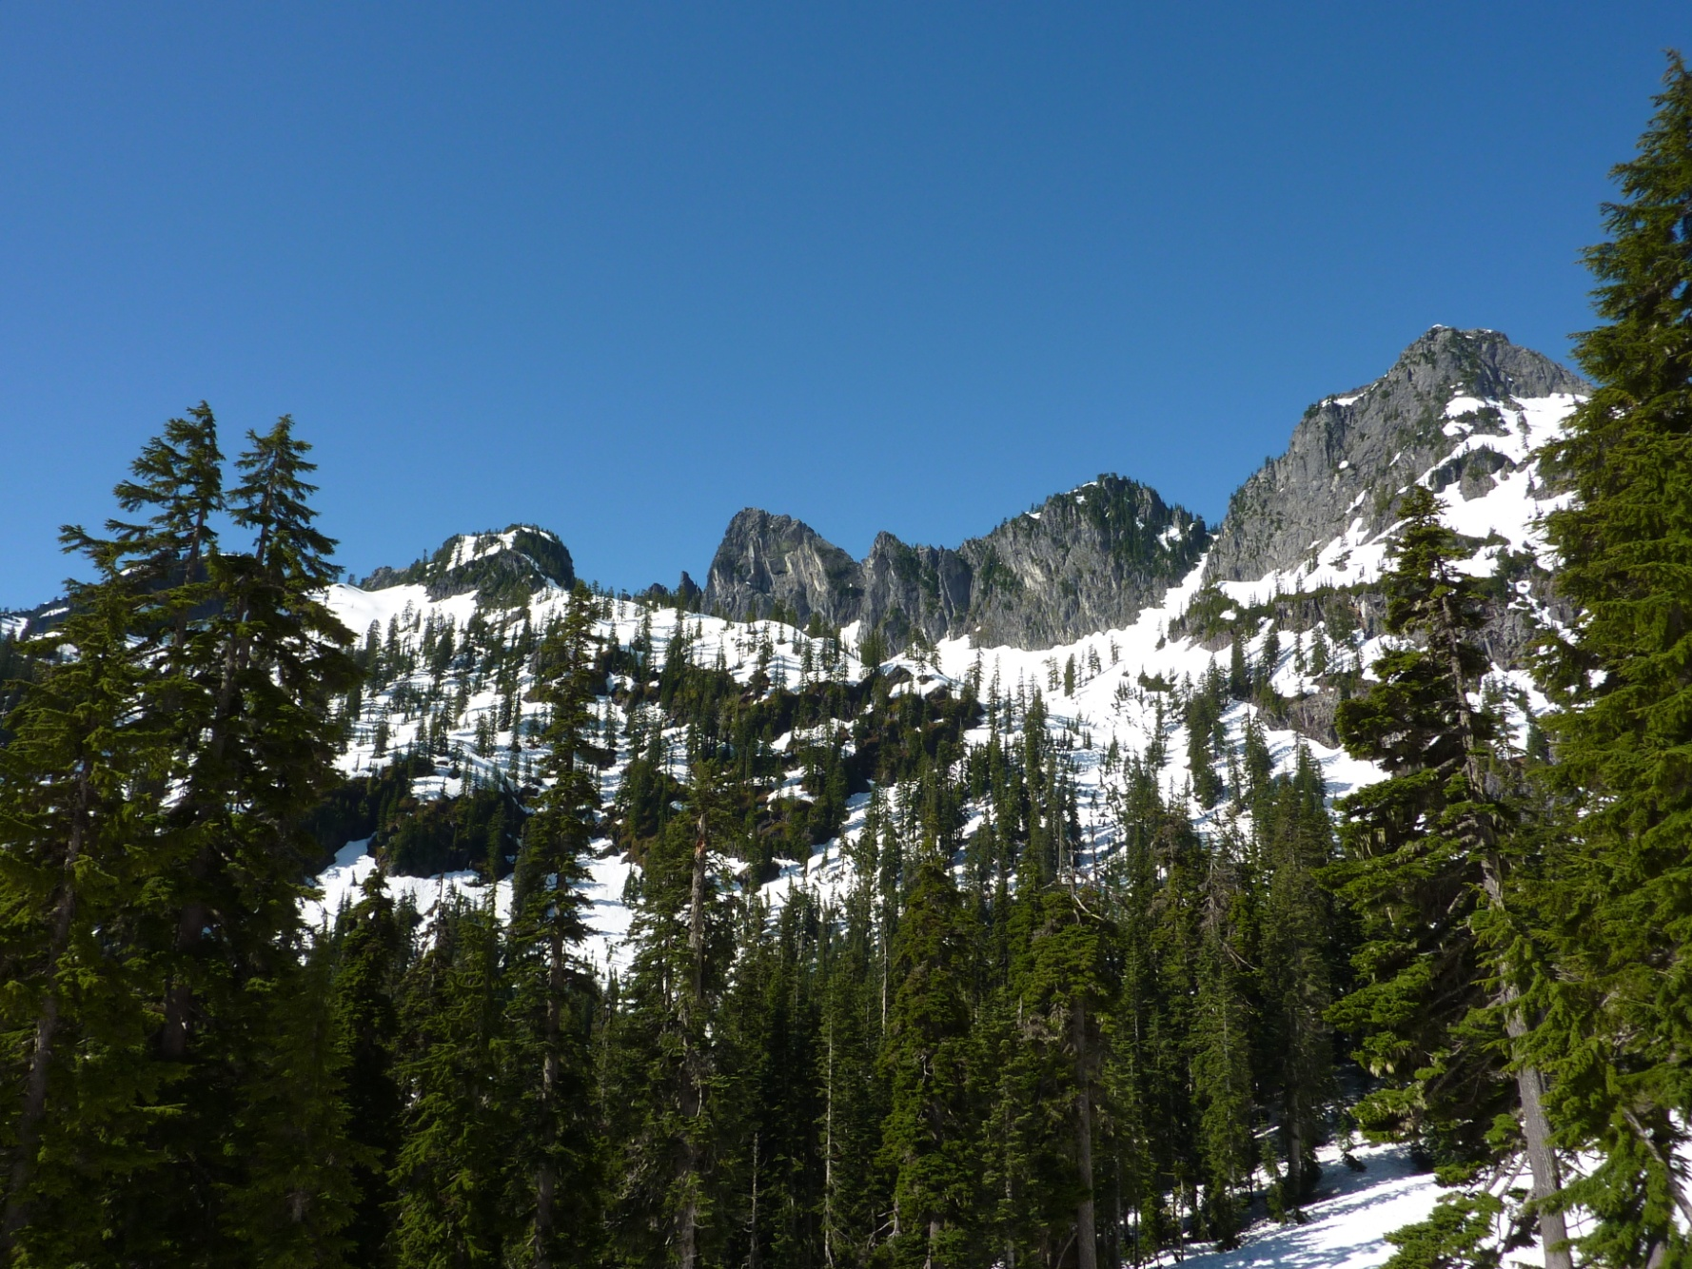
Walking on the trail towards the Tooth
Notes:
On the approach – so this is what the description meant?
Where is the Tooth?

Slide 39
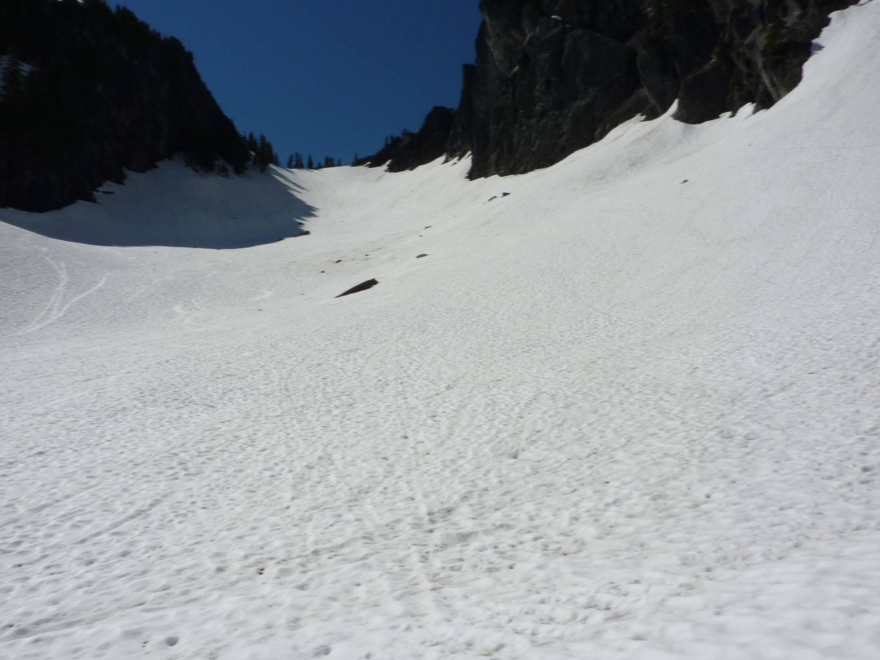
Walking up towards Pineapple Pass
Notes:
On the approach
I thought this was a rock climb!
Skills needed in June – ice axe!

Slide 40
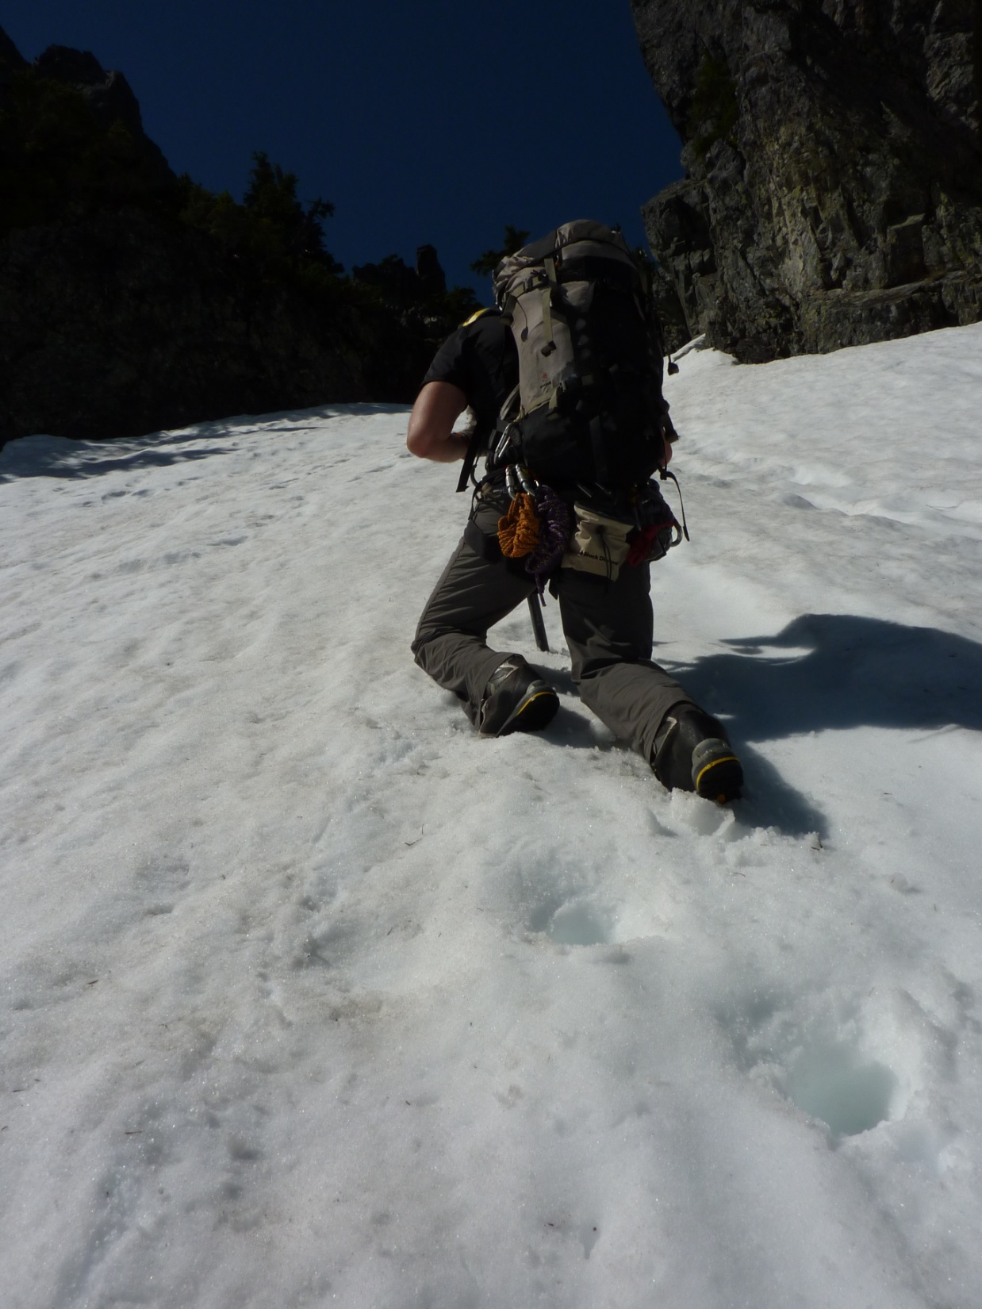
Kicking steps up steep, hard snow
Notes:
Hard work in sun-baked snow!

Slide 41
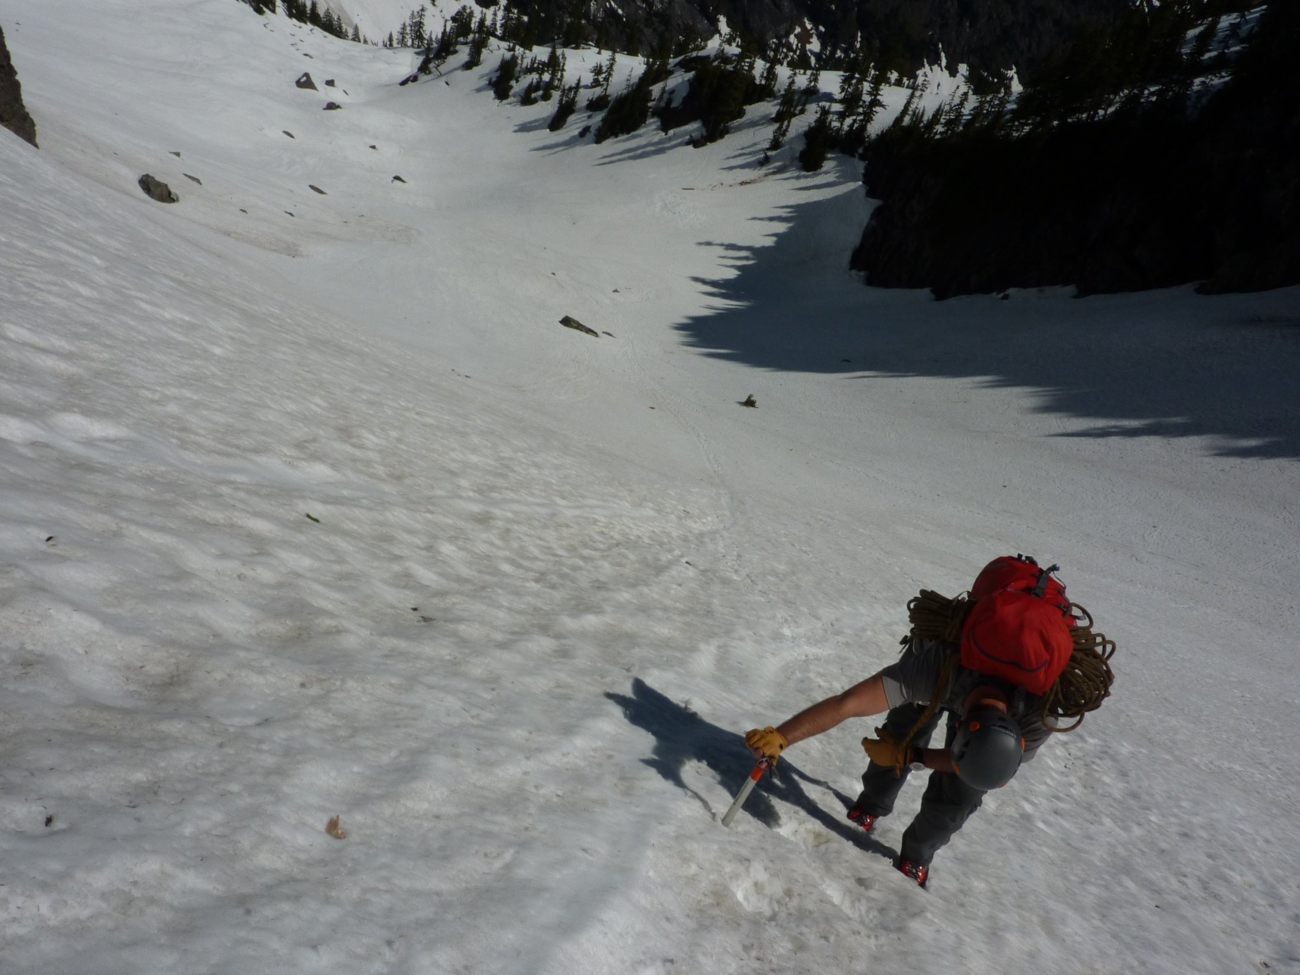
Looking down from Pineapple Pass
Notes:
Why do we practice self-arresting?!?

Slide 42
Route description
The Tooth – Snoqualmie Pass
From Pineapple Pass, start the route about 20 feet up at the first vertical crack with good pro for a directional. Climb cracks and slabs with lots of big holds making your way directly up the center of the face. Use slings to reduce rope drag. If you keep going until about 170 feet up, there is a really nice ledge with a large tree to belay from. From here, the summit can be reached with a long 190 foot pitch on moderate terrain. The finish is via ledges on the west side of the south face. Note: There are numerous places to belay on this face. Long pitches as described above, are not necessary. The rappel down can be done with one or two ropes. 4 raps with one rope, 2 with twin ropes. The rappel is on the east side of the south face. From the bottom, rappel off the east side of Pineapple Pass, down to the talus fields with one 60 meter rap, or 2 30 meters.
Notes:
Short discussion – what does this mean to them? What skills do they think they will use? How will skills differ depending on time of year?
Your input – what do you think when you read this? What skills do you want your climbers to have? What will you plan for?

Slide 43
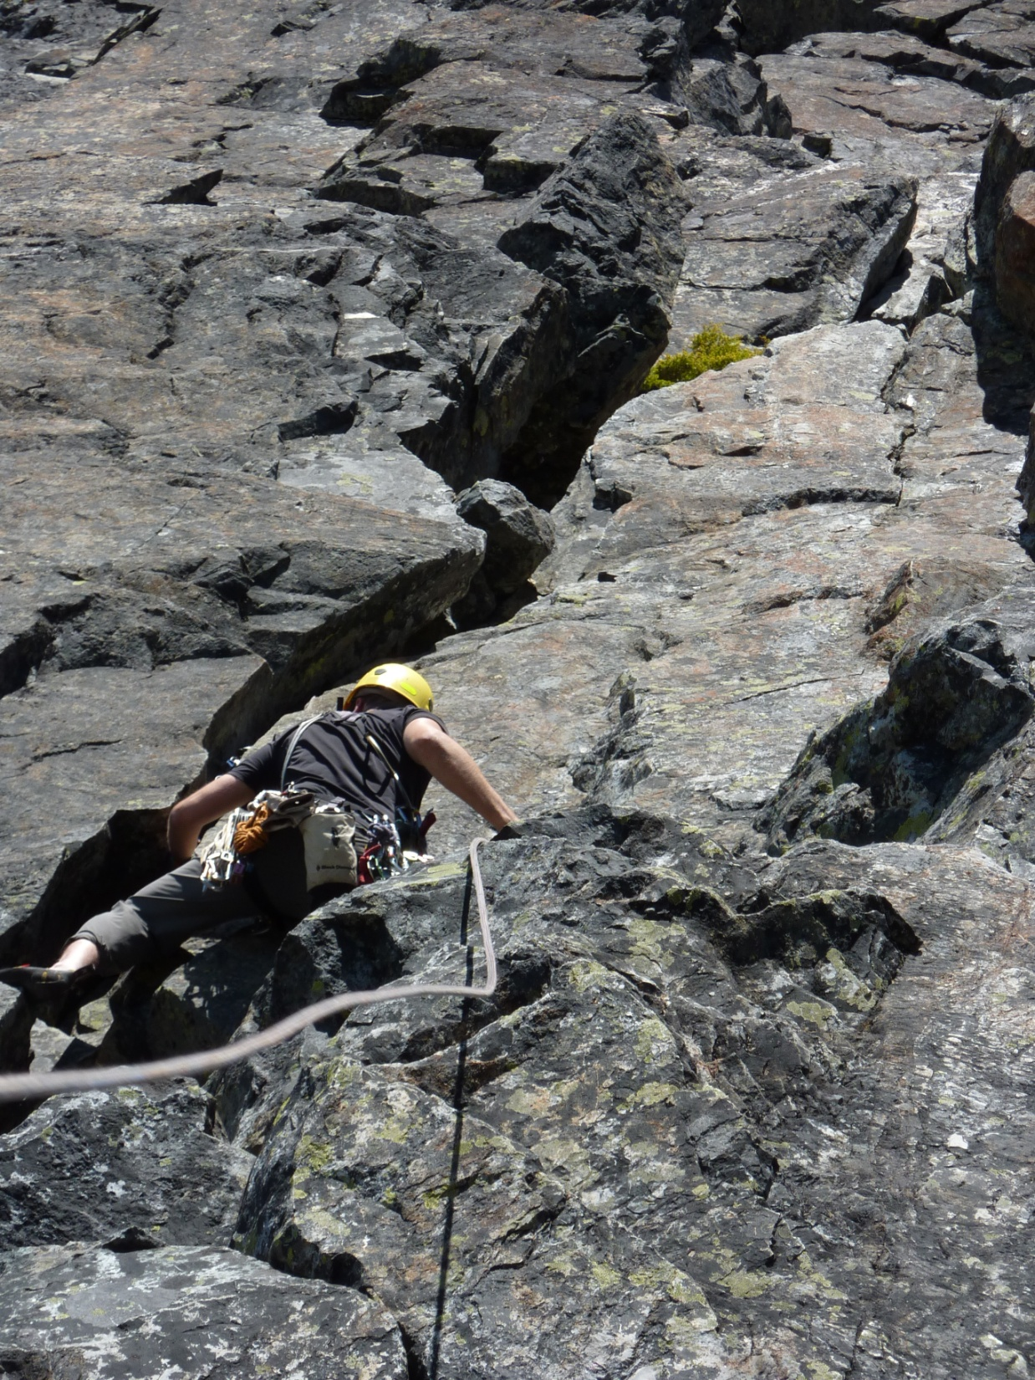
First pitch of the Tooth
Notes:
Watching the leader lead

Slide 44
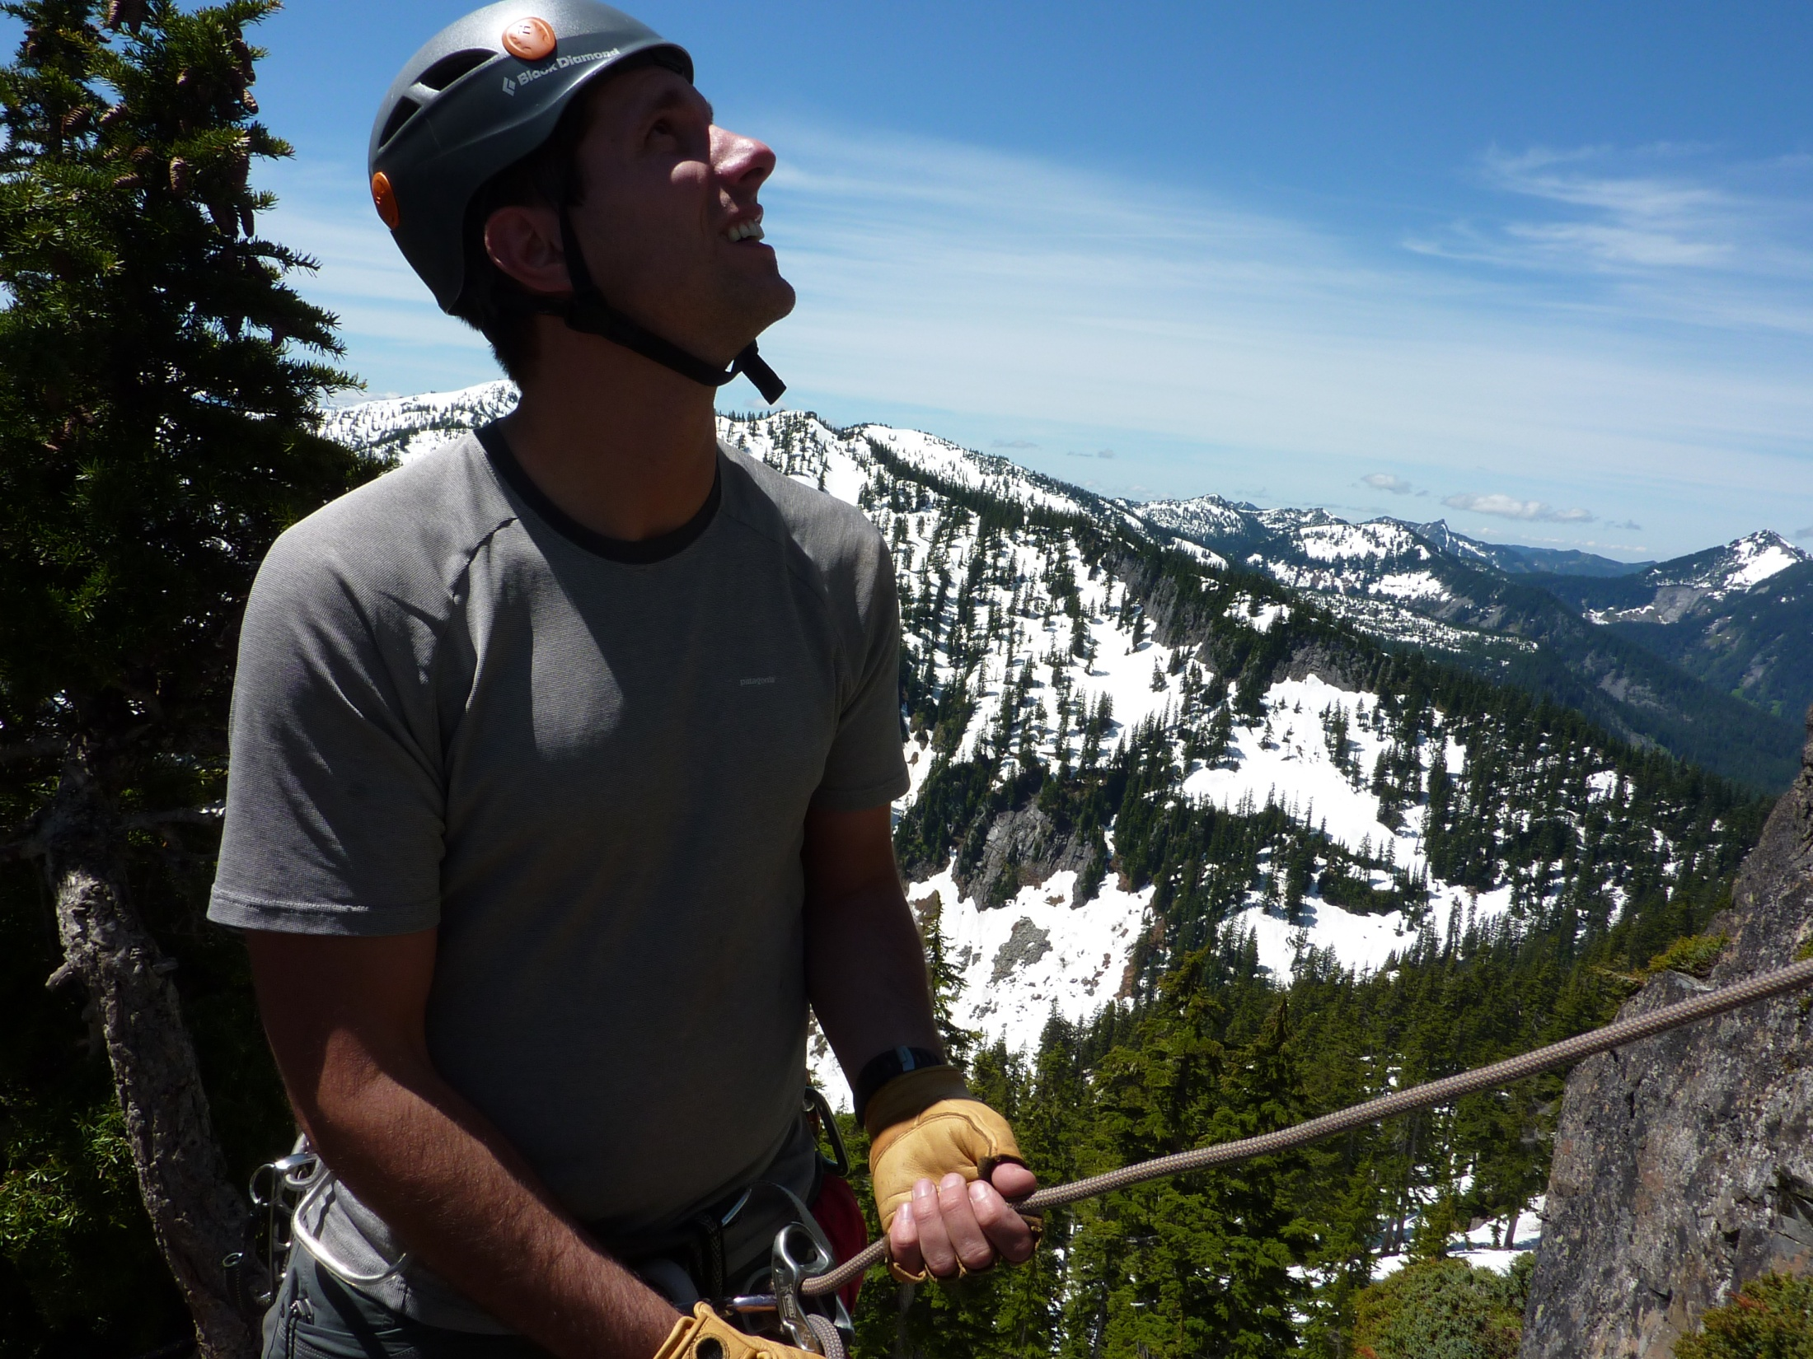
Belaying in the alpine:
Serious business
Notes:
Belaying the leader – things to think about

Slide 45
Question 5 (2 minutes)
List the proper belay techniques that appear in this photo.
Notes:
Belaying the leader – things to think about

Slide 46
Question 5
List the proper belay techniques that appear in this photo.
Helmet on snugly
Looking at lead climber
Hands in good position
Gloves on
Attached to anchor
Proper amount of slack
Notes:
Belaying the leader – things to think about

Slide 47
Celebrate at the Summit
…but remember, you are only half done!
Notes:
Celebrate, rest, eat, and drink at summit.
Be extra cautious on your way down!!!

Slide 48
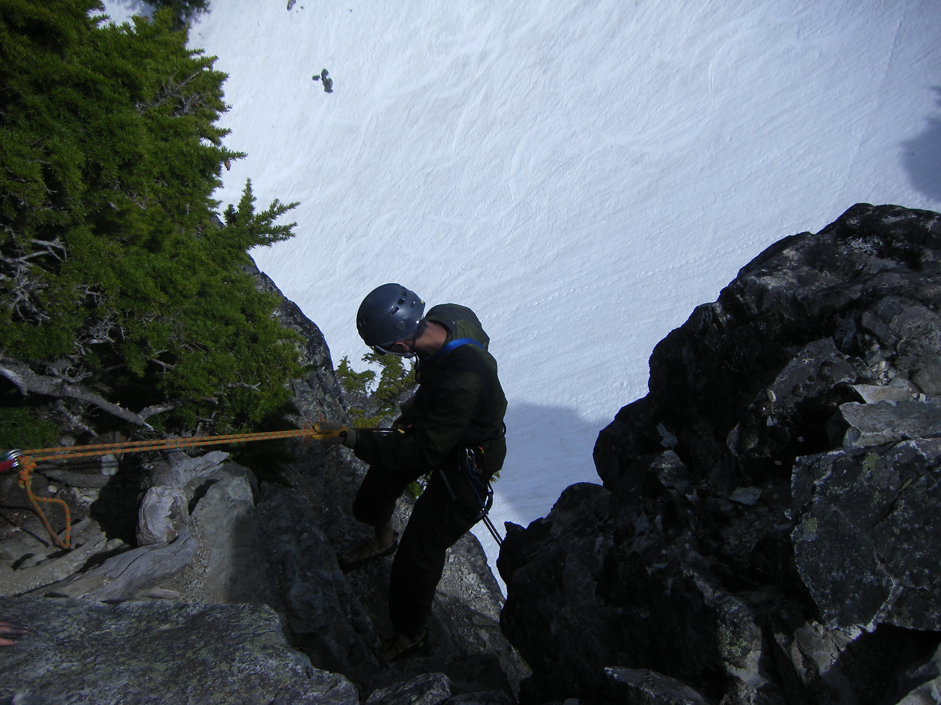
Rappelling in the alpine,
serious business!
Notes:
Describe good rappelling technique.

Slide 49
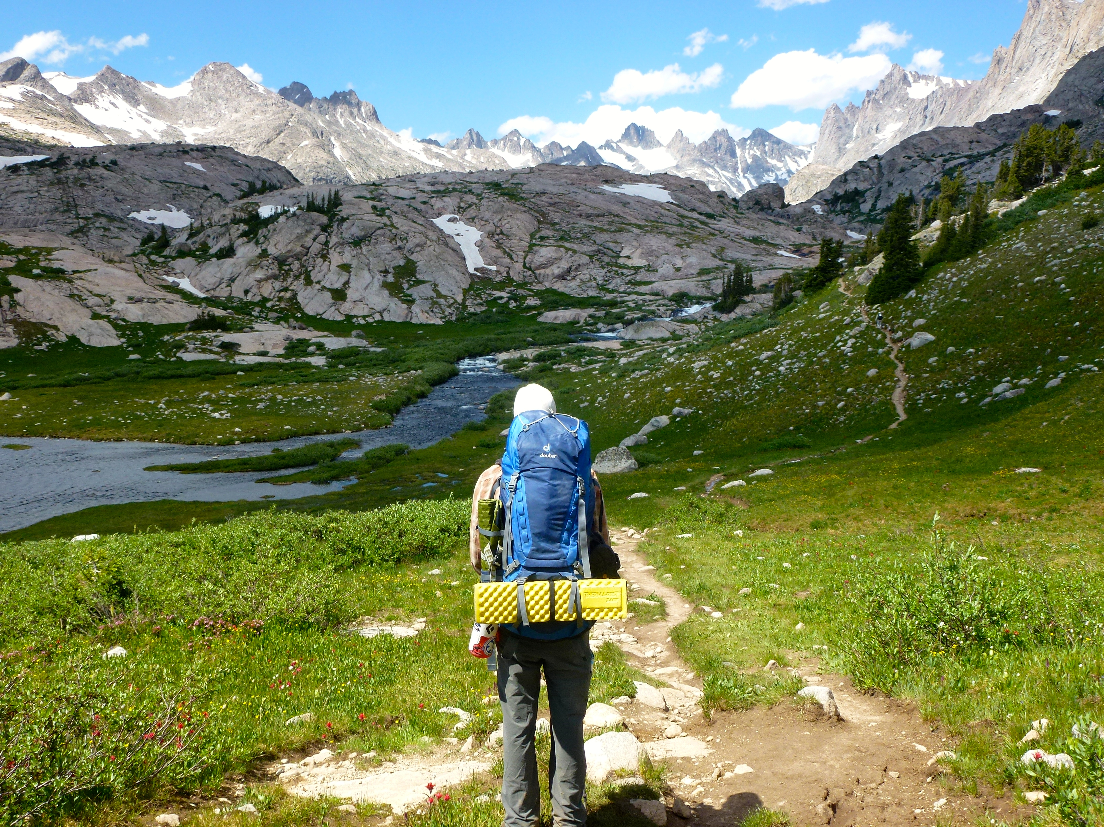
Getting back to the TH
Down-climbing
Scrambling
Hiking out
Notes:
If your ascent was difficult, your descent probably will be as well.

Slide 50
What constitutes a successful trip?
Use poll everywhere to submit your answer

Slide 51
Notes:
What constitutes a successful trip?
https://www.polleverywhere.com/free_text_polls/jlCzxk0stbQfJZs

Slide 52
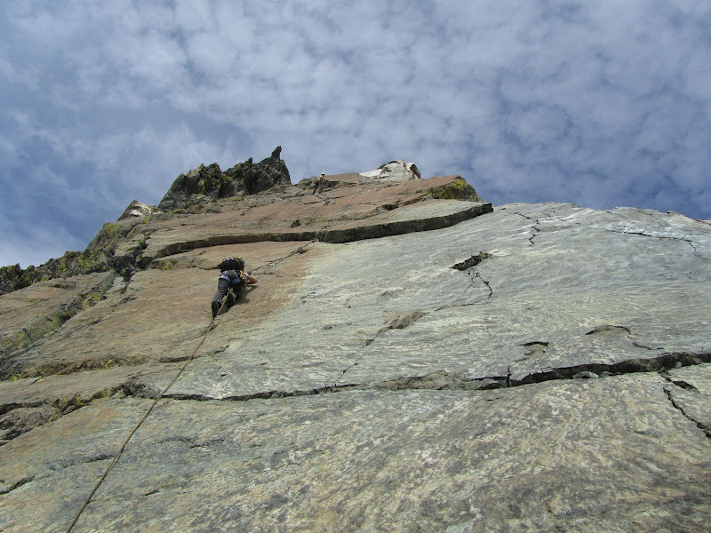
Questions?
Thank You for Your Participation!
Ingalls Peak, WA

