Slide 1
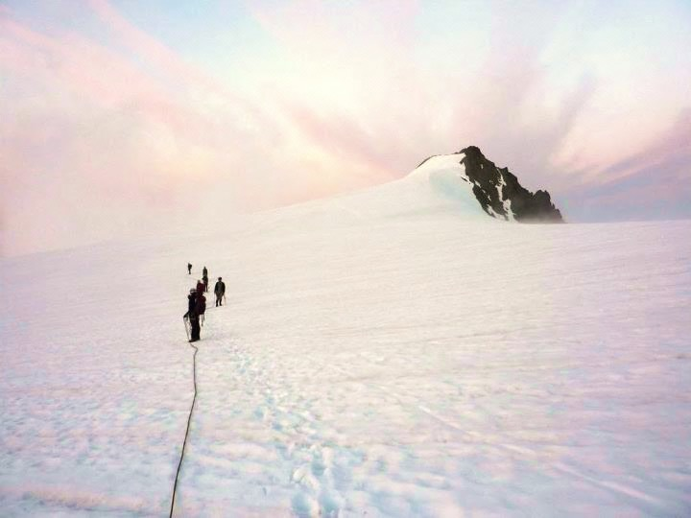
Climb the mountains and get their good tidings.
-John Muir
Basic Lecture #5

Slide 2
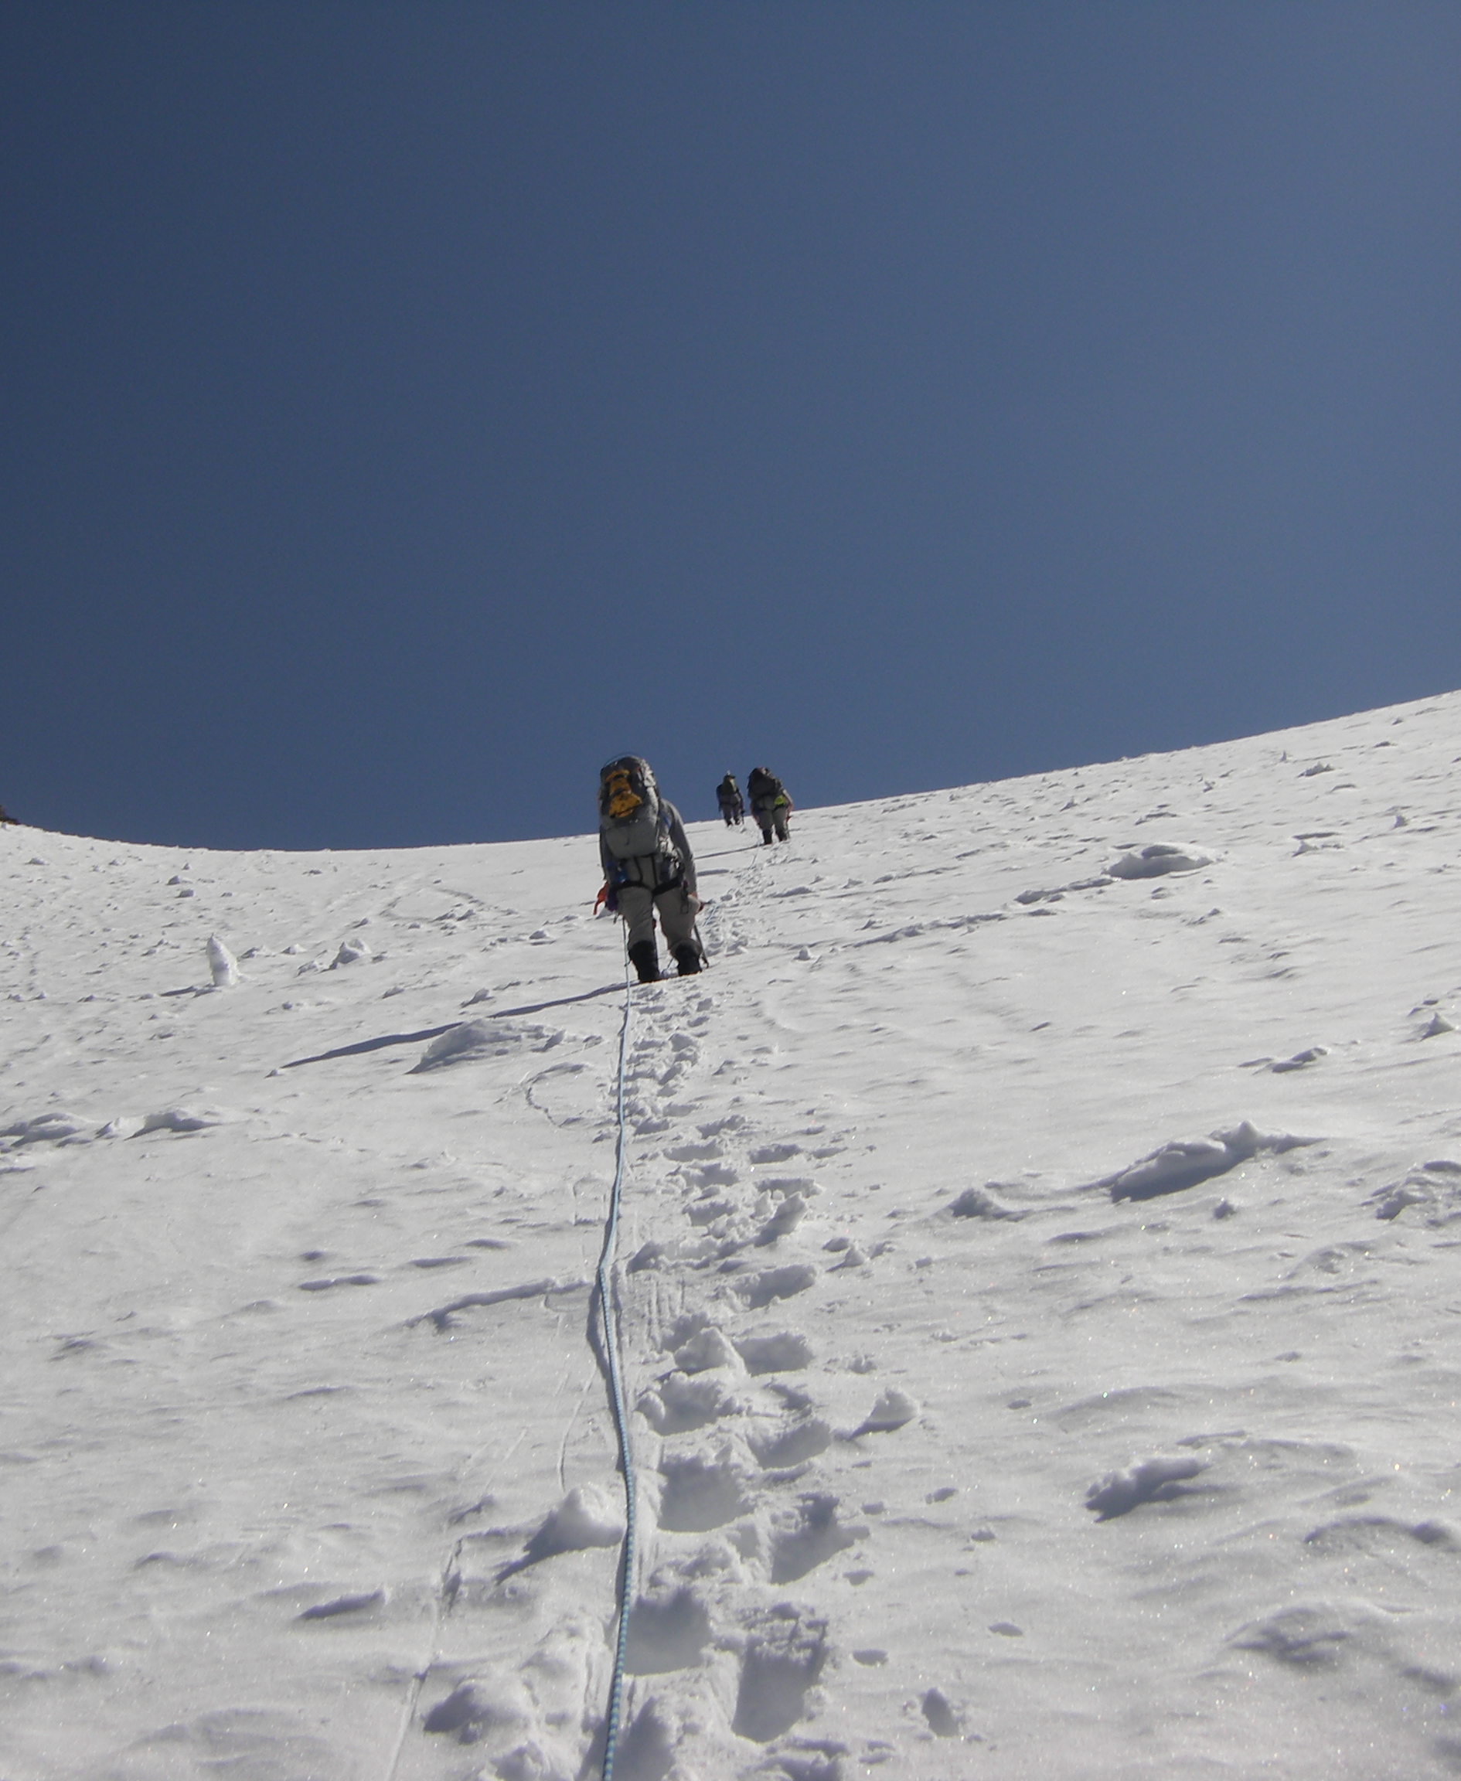
Basic Lecture #5
May 11th 2016
Agenda:
Glacier Travel – Matty P (45 min)
Intermission (10 min)
Announcements
The Climbing Party – Cebe W (45 min)
Announcements
Silver Star Glacier

Slide 3
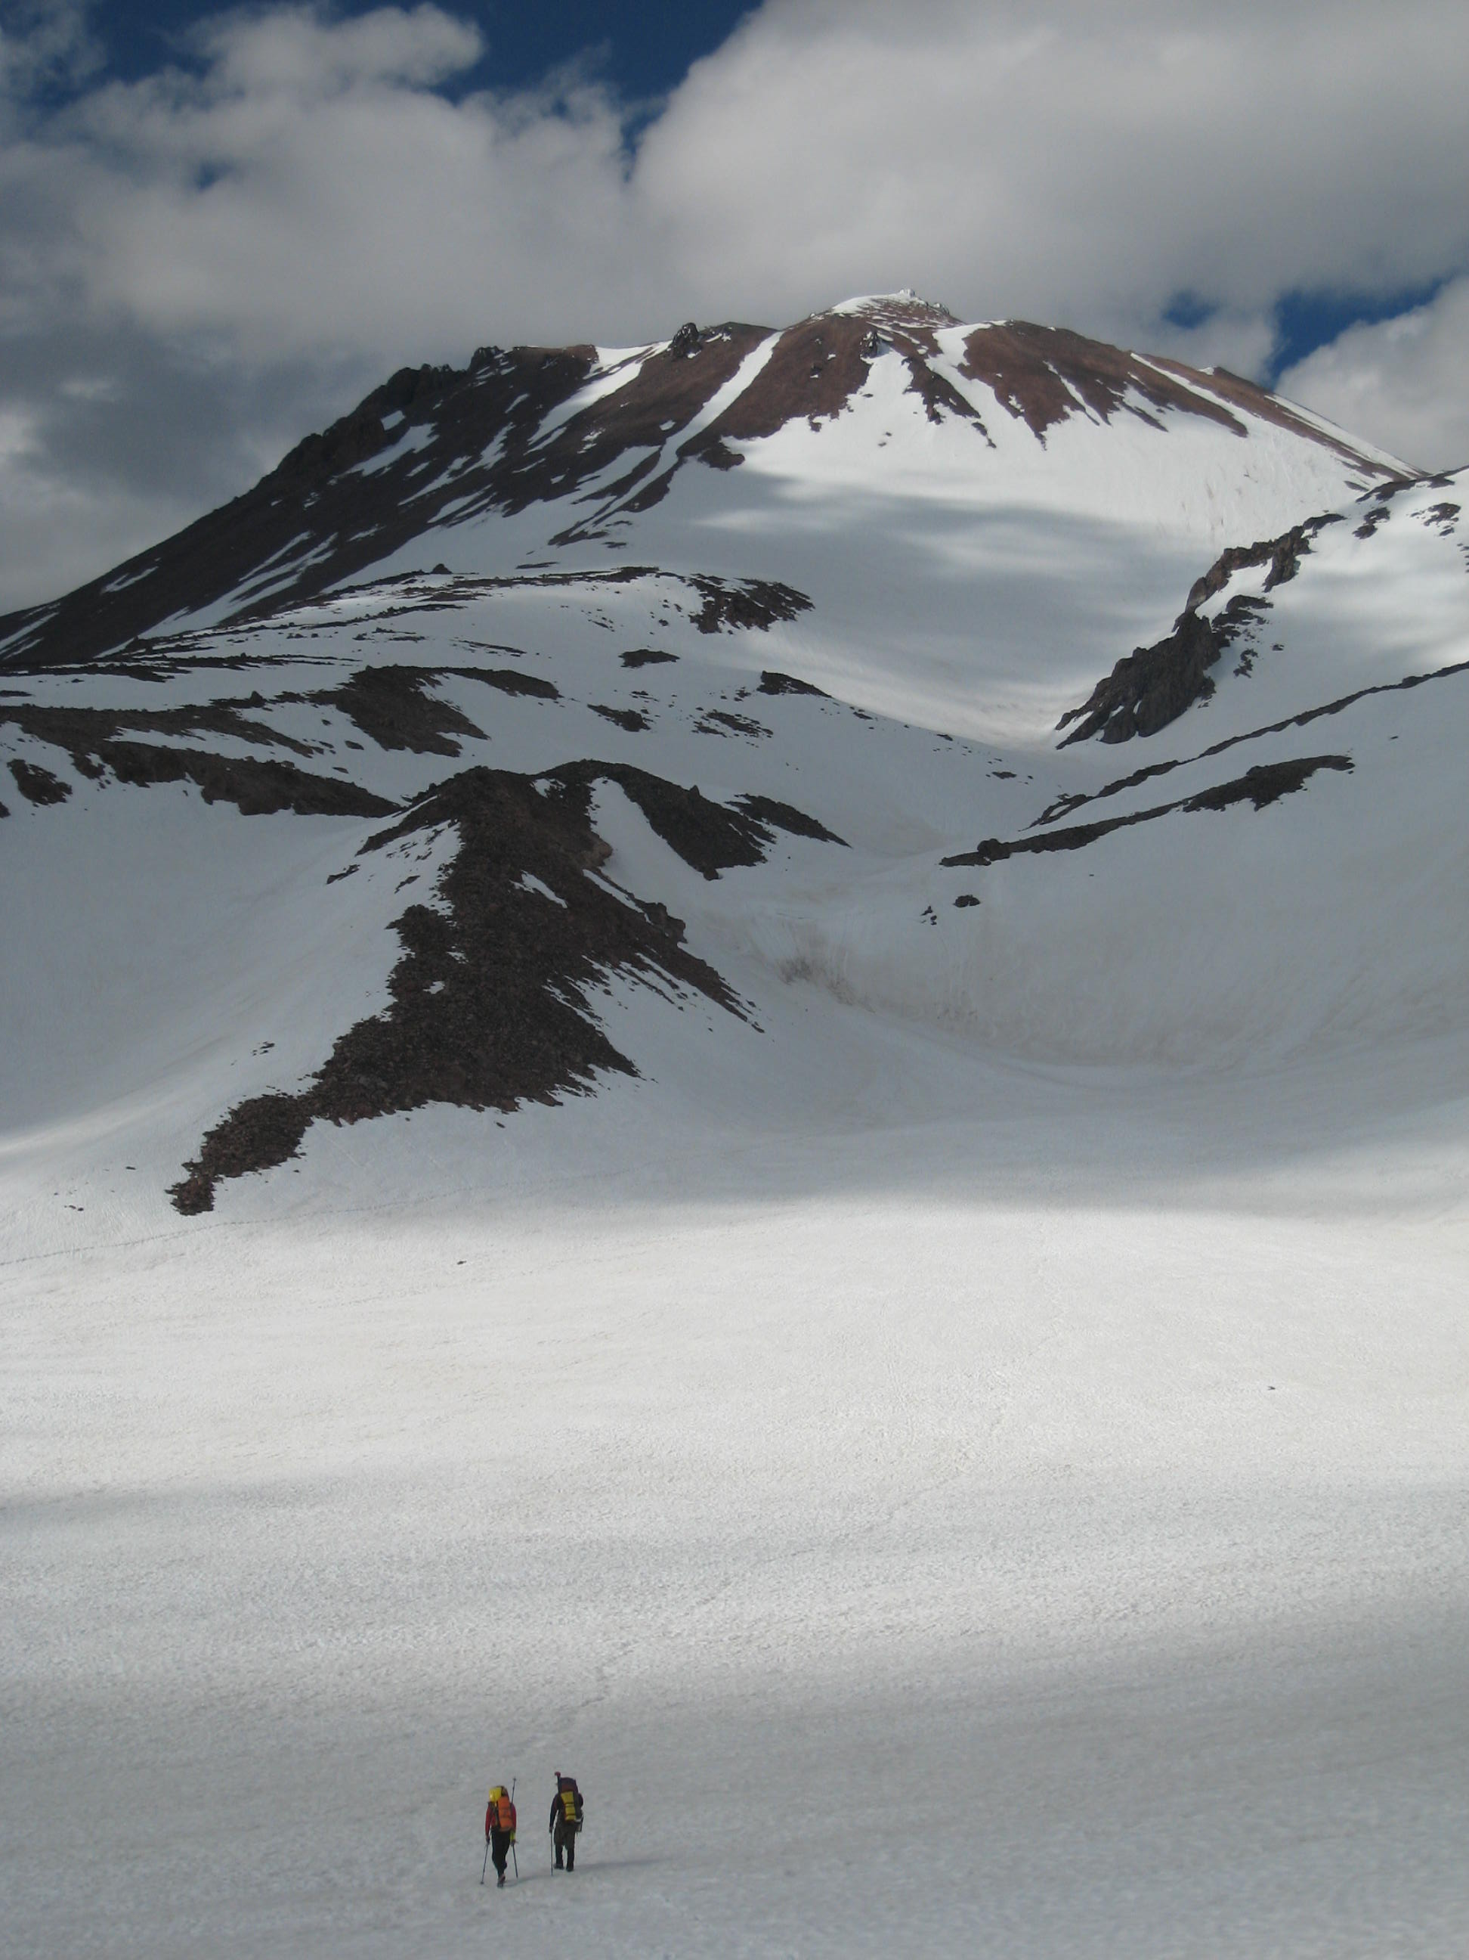
Steep Snow & Glacier Travel
Climbing in snow is fundamental
to mountaineering.
~Freedom of the Hills
Mt. Shasta (West Face)

Slide 4
As you plan for a multi-day glacier climb, what should your team consider?
As a group, submit one answer to poll everywhere.

Slide 5

Notes:
As you plan for a multi-day glacier climb, what should your team consider?
https://www.polleverywhere.com/free_text_polls/z1CNv0X77nFCrx5

Slide 6
Learning Objectives for Lecture #5
Understand the equipment necessary for safe travel on steep snow & glaciers.
Be able to recognize the hazards of steep snow & glacier travel.
Understand the fundamentals of steep snow climbing & glacier travel techniques.
Understand the crevasse rescue response.
Recognize the human aspects of the “Climbing Party.”

Slide 7
For each question, every group/table will designate a new…
Framework for Lecture #5
Scribe
Timekeeper
Speaker
…and everyone should participate in every question to the best of their ability!
Remember, you’re a TEAM!
Notes:
Scribe-write clearly on the whiteboards
Timekeeper-use phone
Speaker-speak loudly, clearly, and slowly

Slide 8
Know your Equipment
3 minutes
As a group, list the equipment necessary for safe travel during a steep snow and glacier climb.
Notes:
4 minutes

Slide 9
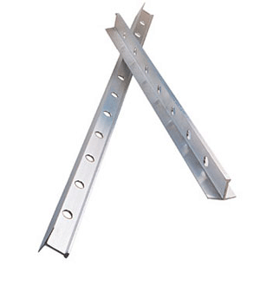
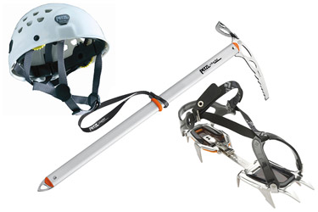
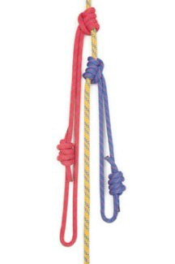
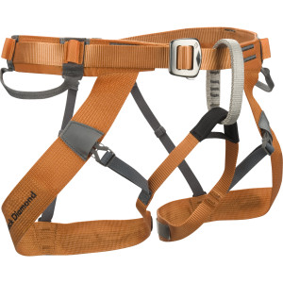
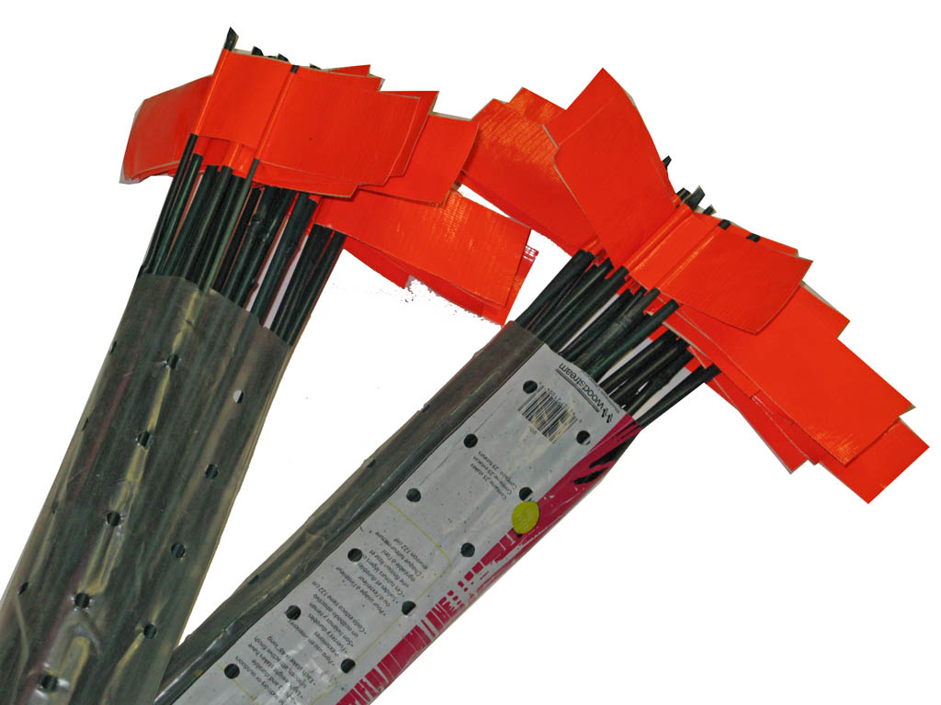
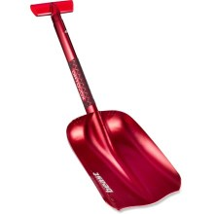
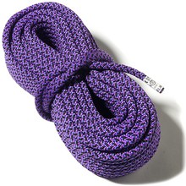
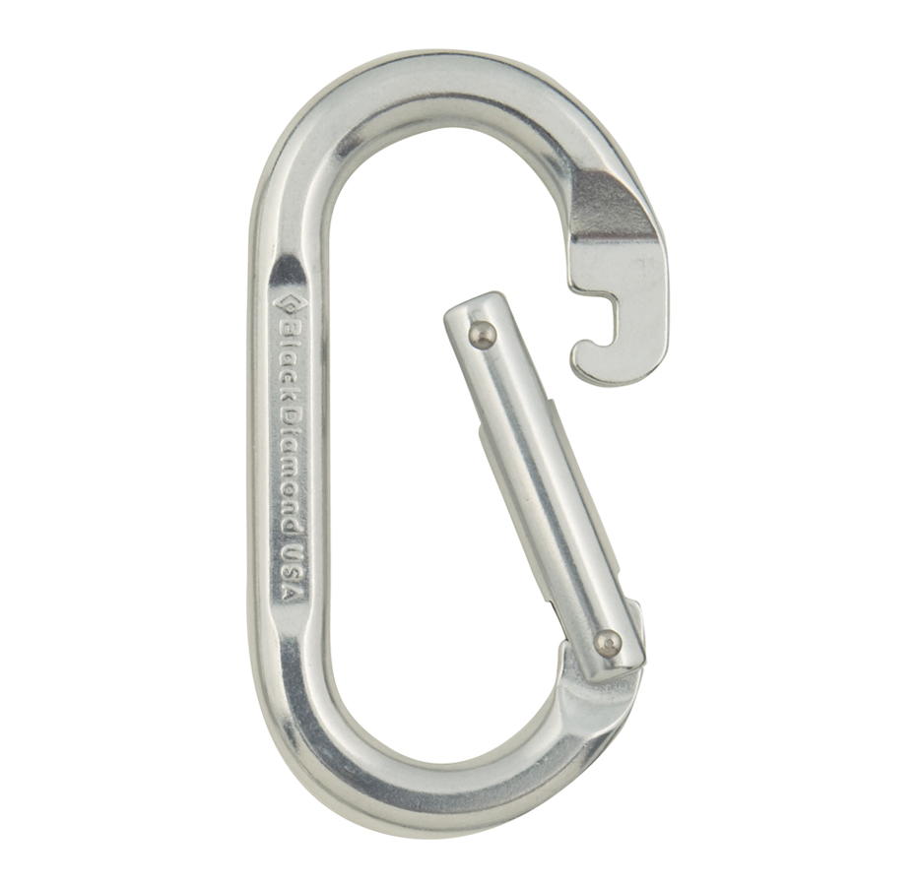
Know your Equipment
Equipment necessary during safe snow and glacier travel.

Slide 10
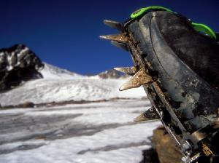
Know your Equipment
What terrain is the crampon designed for?

Slide 11
Know your Equipment
There is no steadfast rule.
Make the decision based on individual skill, experience, and assessment of conditions.
What terrain is the crampon designed for?
Notes:
It is critical that crampons fit boots perfectly.
Put them on before you need them!

Slide 12
Terrain Considerations & Hazards
Reading the alpine landscape.

Slide 13
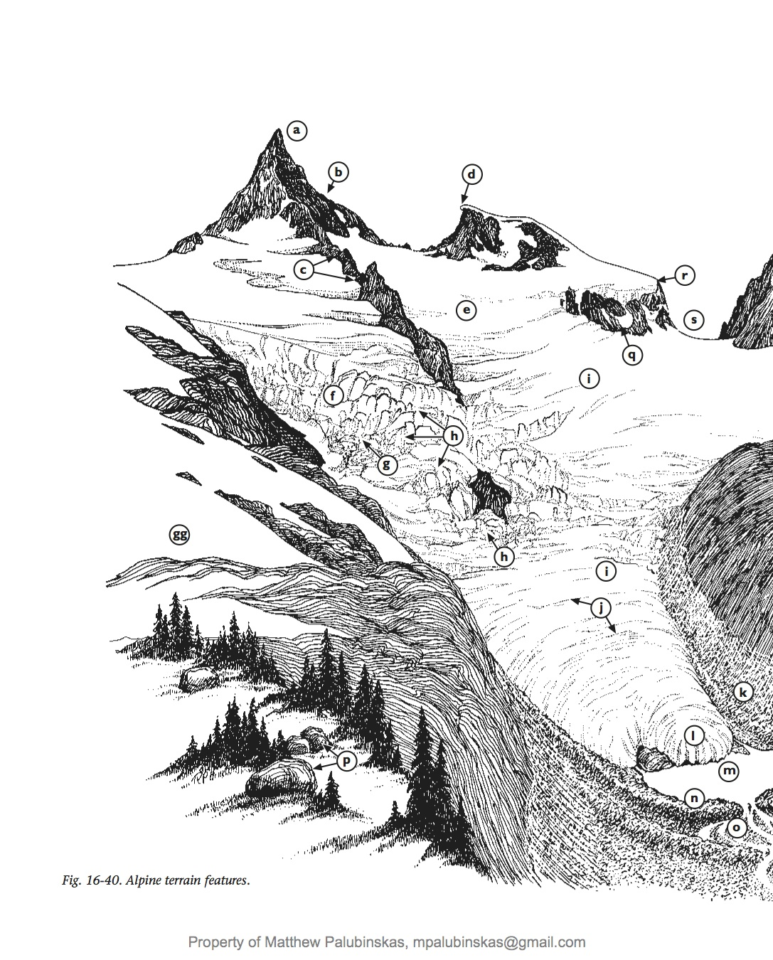
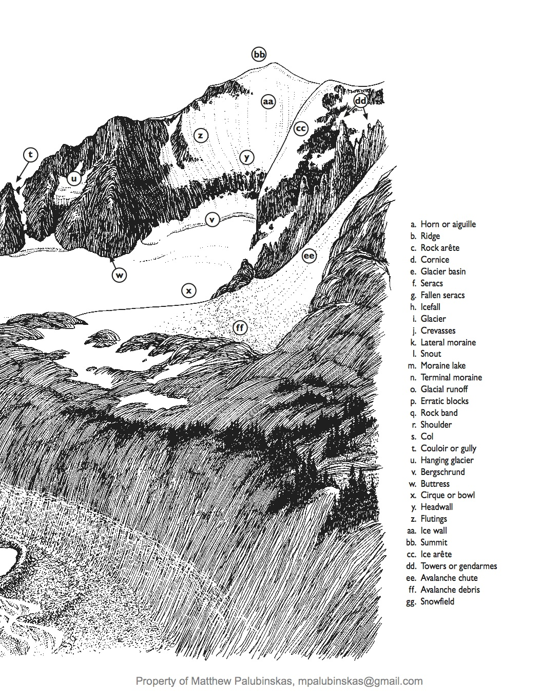
As a group, on the handout provided label the alpine terrain features.
5 minutes
Notes:
5 minutes

Slide 14
Alpine Terrain Features

Slide 15
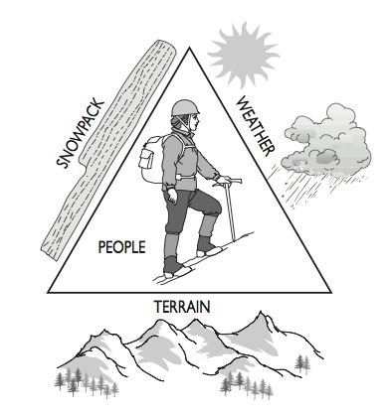
What do you know?
Notes:
Before you head out, check the past and current conditions in that area.

Slide 16
Terrain Considerations & Hazards
3 minutes
As a group, list the hazards that may give you grief while travelling in the snowy mountains?
Notes:
4 minutes

Slide 17
Terrain Considerations & Hazards
Cornices
Slushy slopes
Moats
Bergschrunds
Rockfall & icefall
Crevasses
Avalanches
What’s going to give you grief?
Notes:
Careful on ridges, cornices are unstable.
Slushy slopes make for slow travel.
Avalanches-listen to NWAC reports & take an AVY class.
Moats & bergschrunds present interesting challenges.
To avoid rock & ice fall, start early and stay to the edge of a couloir.
Crevasses-don’t fall in them!

Slide 18
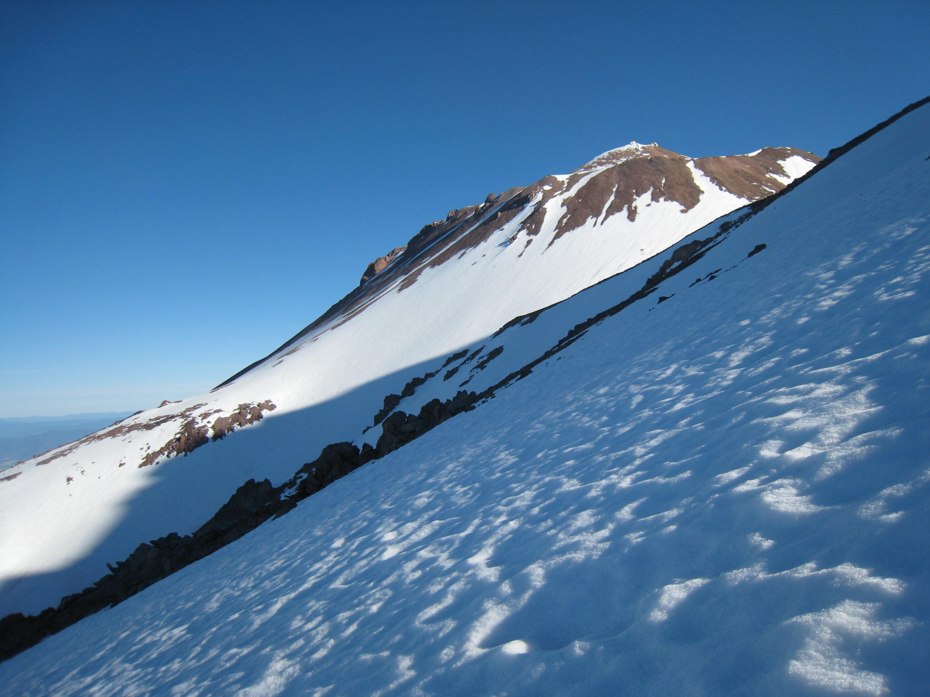
Steep Snow Travel
Going up is easy, it’s coming down that is hard!
Mt. Shasta (West Face)

Slide 19
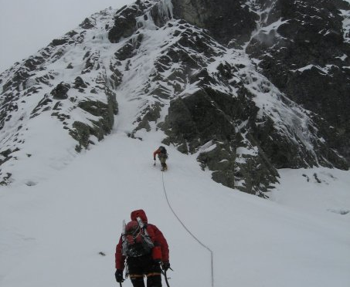
Options for descending
Individual or Team?
Plunge Stepping
Glissading
Belayed down-climbing
Chair Peak

Slide 20
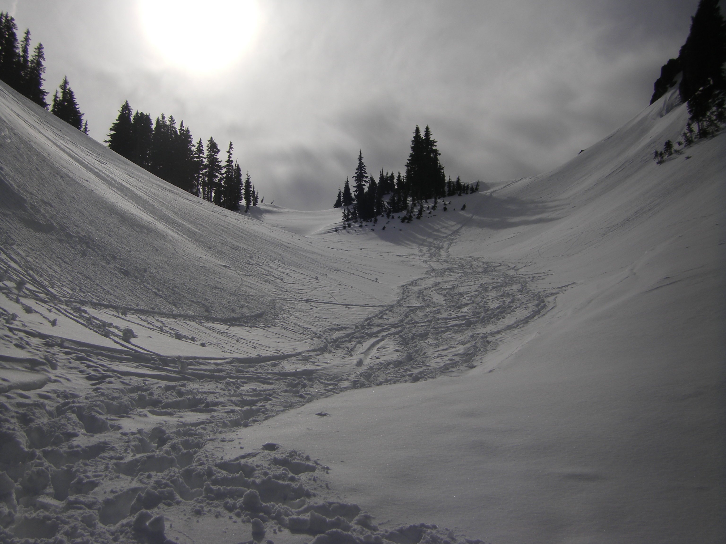
Descending Steep Snow as a Team
Crampons?
Most experienced in back
Communication
Lane Peak

Slide 21
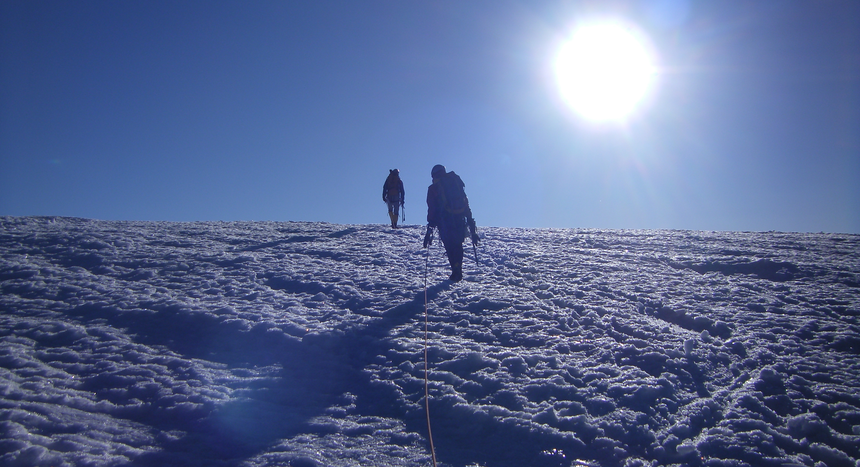
The magic of watching a sunrise from high on a mountain above a sea of clouds remains with a climber long after memories of the trip’s exertion have faded.
Mt. Baker

Slide 22
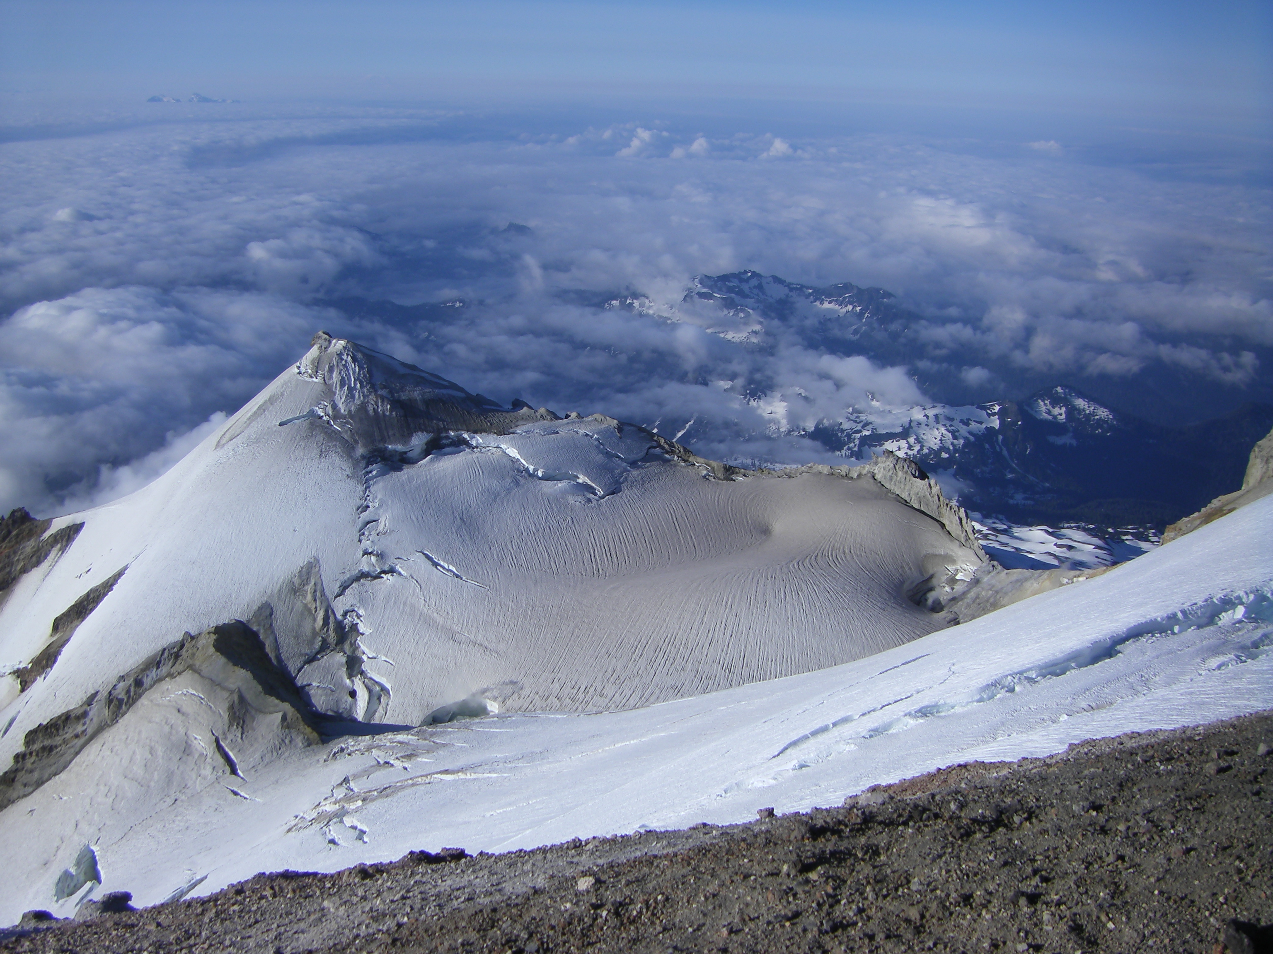
Fundamentals of
Glacier Travel
Rope Teams, Avoiding Crevasses, Crevasse Rescue
Mt. Baker

Slide 23
Roped Steep Snow &
Glacier Techniques
1 minute
Question:
When does the climbing party “rope up?”
Notes:
2 minutes
On Glaciers, the party always ropes up for protection from hidden crevasses.
On steep snow, climbers have to weigh several options…with or without belays? Weather conditions (keep group together in white-out)

Slide 24
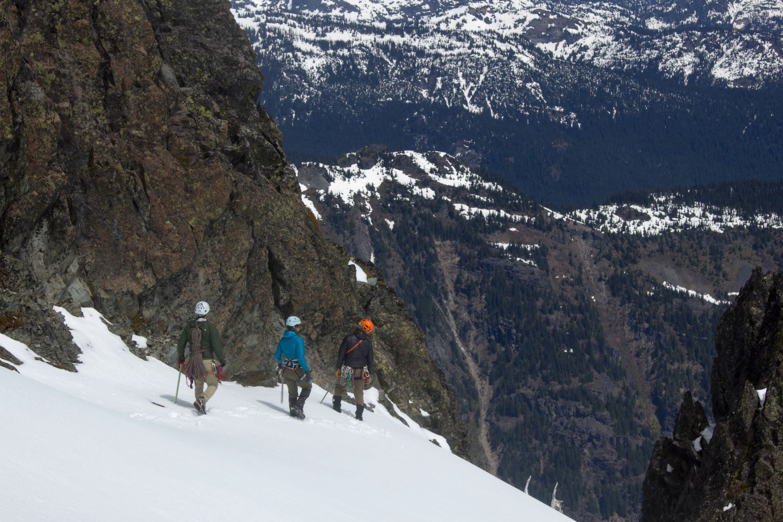
Answer:
On glaciers, the party always ropes up for protection from hidden crevasses.
On steep snow, climbers have to weigh several options.
Notes:
2 minutes
On Glaciers, the party always ropes up for protection from hidden crevasses.
On steep snow, climbers have to weigh several options…with or without belays? Weather conditions (keep group together in white-out)

Slide 25
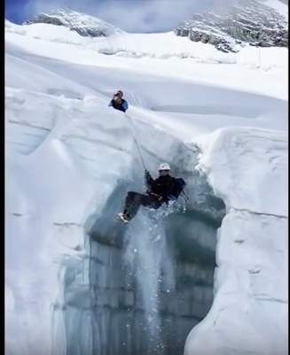
Glacier climbs: really fun, until this happens.

Slide 26
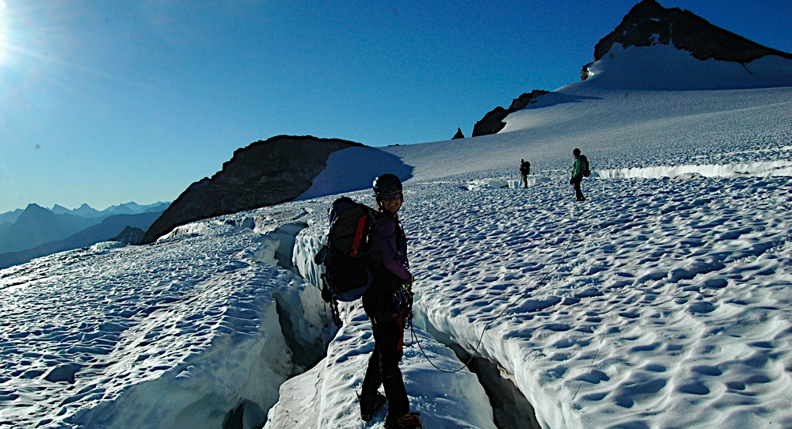
Rope Management
Snowfield Peak
Notes:
It will come with time and practice.
Rope downhill.

Slide 27
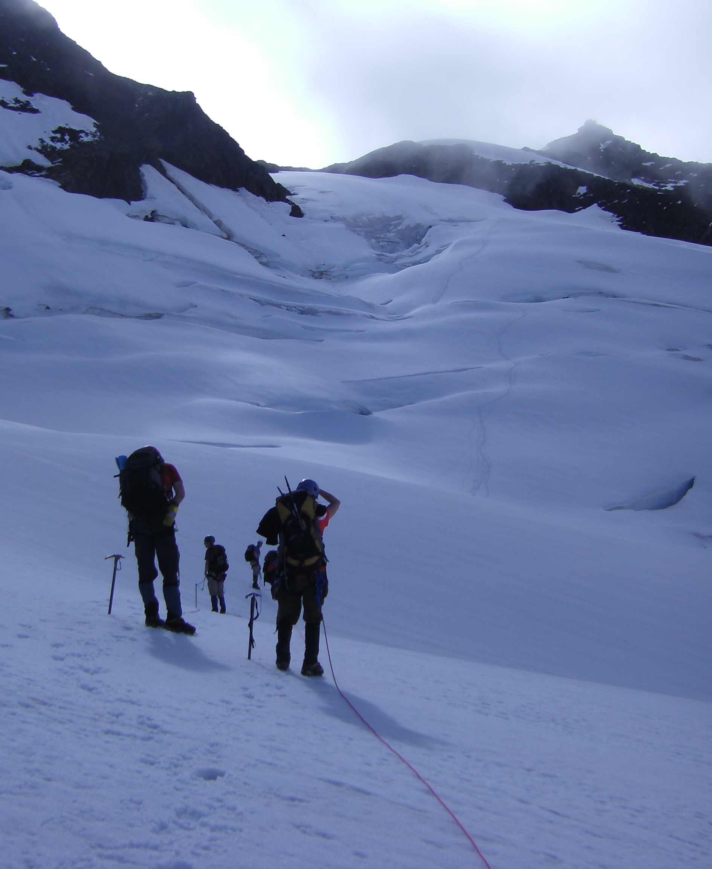
Rope Teams
Four-person team
Three-person team
Two-person team
Quien Sabe Glacier
Notes:
Three and four person rope teams are standard. Good to have two teams, beneficial for rescue and resources.
Skills and strengths.
Weight distribution.
You will “hate your team” until the summit.
Two person rope team, tie butterfly knots or overhand figure eights every 3 meters.

Slide 28
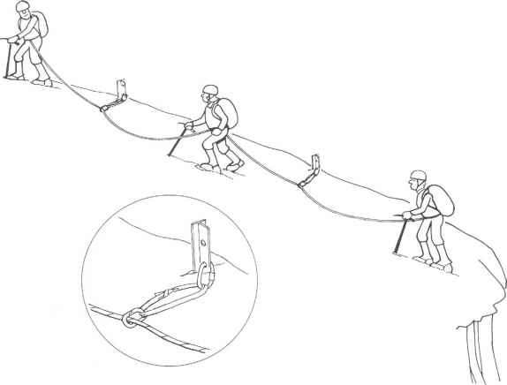
Running belays vs.
Unanchored travel
Notes:
How will you travel?
Human body belays?
What is the anchor situation?

Slide 29
Short-spacing vs. Far-spacing?
Notes:
Also called close-spacing and full-spacing.

Slide 30
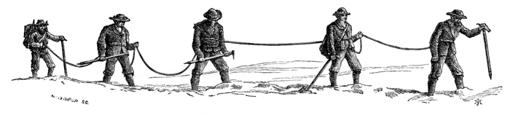
What are the possible benefits of each technique?
5 minutes
Close-Spacing
Full-Spacing
Climbers 25-30 feet apart on a 60m rope with coils
Climbers on 60m rope and no coils
Notes:
3-4 climbers for each team

Slide 31
Close-Spacing
Full-Spacing
1. Improved vocal communication in poor weather
2. Efficiency of movement when the route meanders or zig-zags
3. Easier to avoid rope slack or tugging on slower climbers
4. Preserves extra rope for crevasse rescue
5. Easier to travel across non-snow sections of a route
1. Better for navigating around really large (long) crevasses
2. Better for setting-up belays on steeper routes
3. Fewer wands needed to mark the route in poor weather
4. Perhaps a bit more advance notice (time) to stop a fall
5. Softer falls (less impact on pro) over longer sections of rope
Notes:
Read more: http://freedom9bestpractice.freeforums.net/thread/49/spacing-climbers#ixzz3yOApsuw1
Are you climbing in Alaska (really large glaciers) or Cascades (small glaciers)?

Slide 32
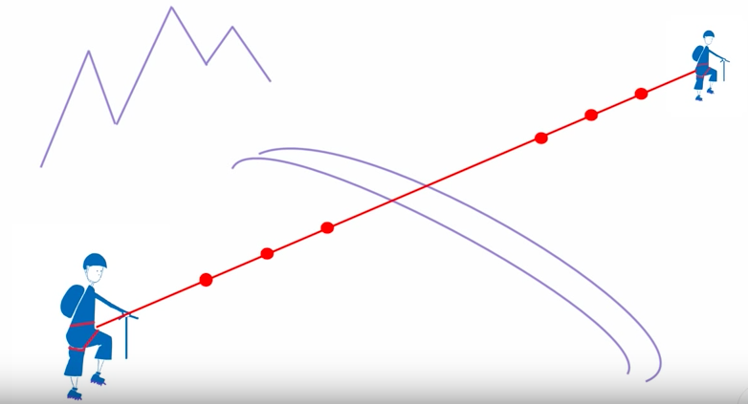
What about adding knots in the rope?

Slide 33
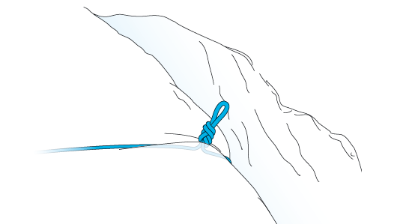
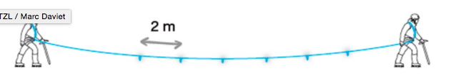

2-person team
Notes:
On a snow lip, the presence of knots in the rope is a valuable braking aid.
The rope cutting through the lip of the crevasse is a significant factor in braking a fall.
Tie knots every 2 m along the rope (figure eight, overhand, butterfly...).
Note: the knots in the rope make the hauling system more complicated to set up after a crevasse fall.

Slide 34
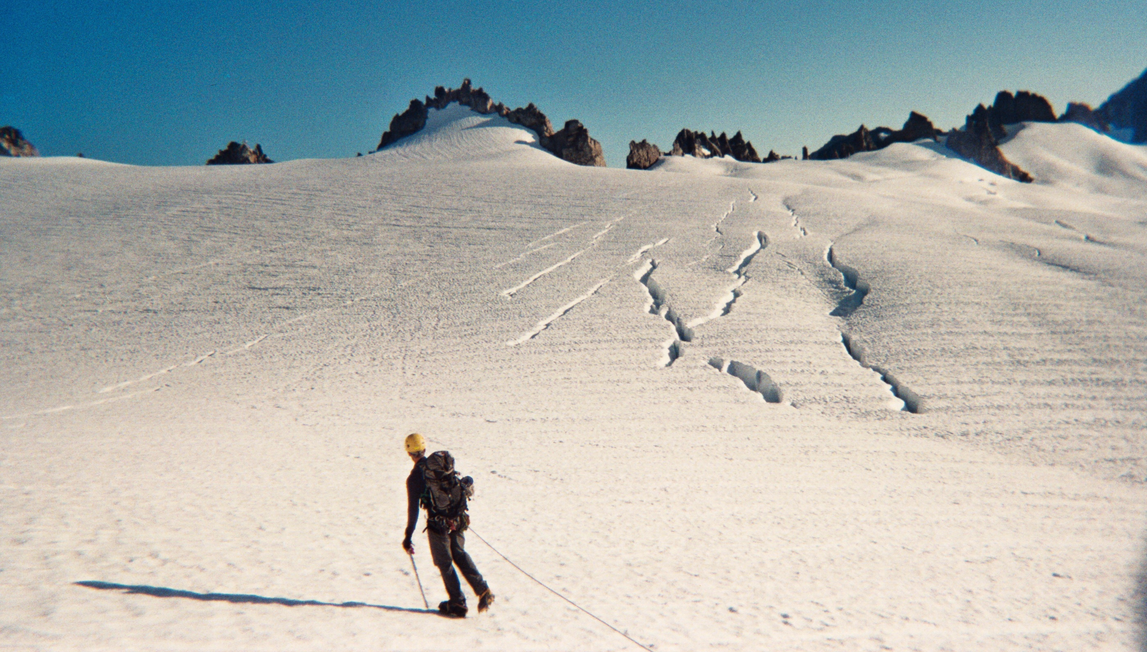
Avoiding Crevasses
Klawatti Glacier

Slide 35
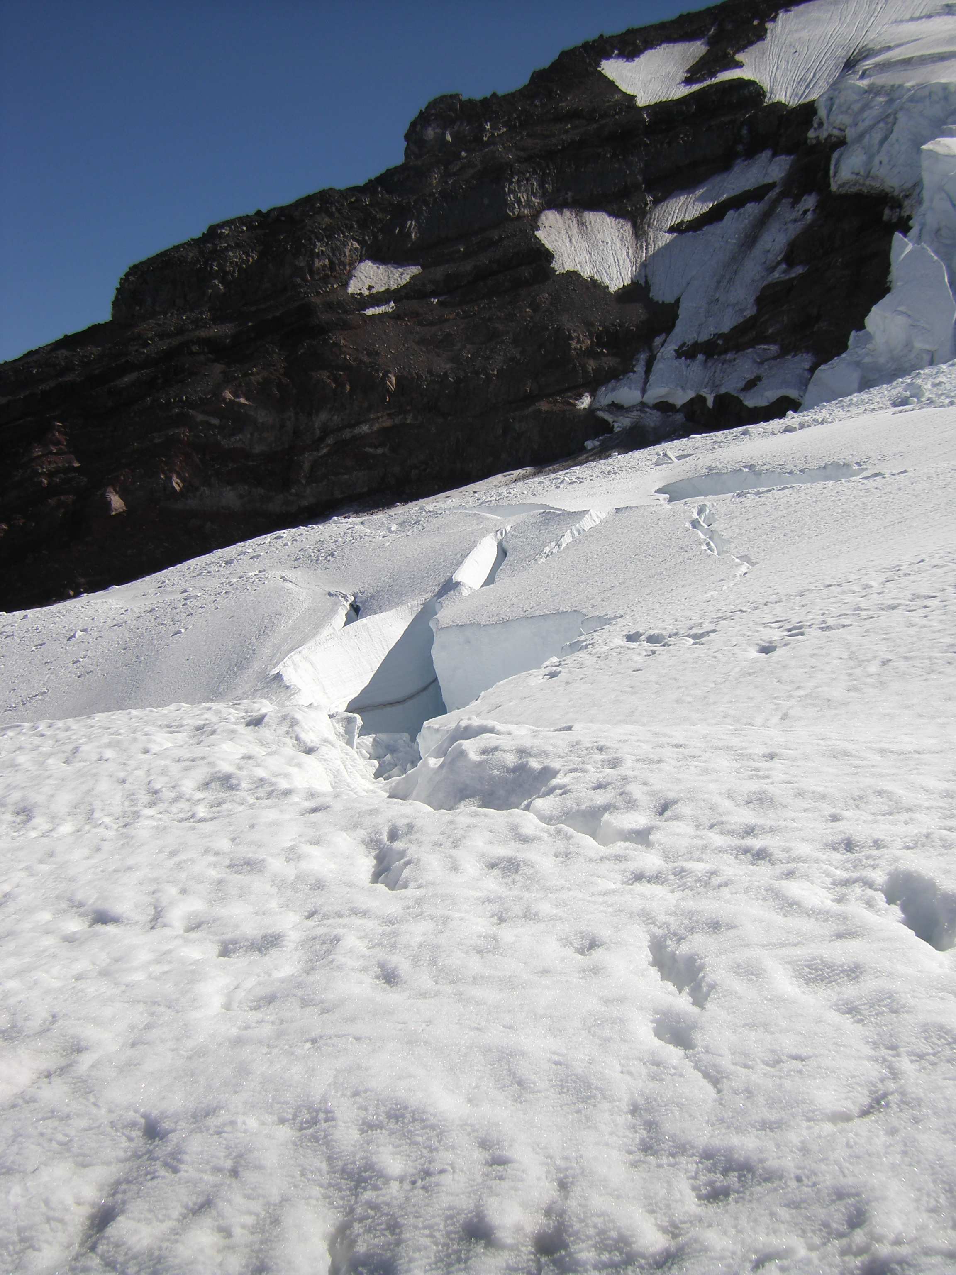
Tips for Avoiding Crevasses
Look for sagging trenches in the snow
Be wary after a storm
Sweep your eyes from side to side
Where there is one, there are probably more!
Mt. Baker

Slide 36
Crevasse Rescue Response
5 minutes
Question:
What would you do if a person in your rope team fell into a crevasse?
Notes:
4 minutes

Slide 37
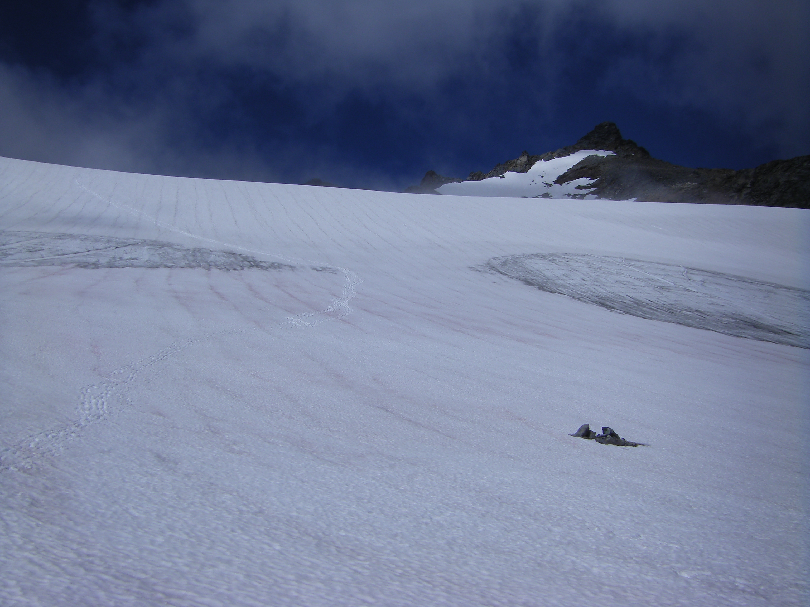
Crevasse Rescue Response
Arrest
Anchor System
Communicate
Devise a Rescue Plan
Carry out the Plan
Sahale Glacier
Notes:
ARREST!
Initial anchor and second “bomber” anchor
Talk to the fallen climber, can he/she prussik?
What resources do you have? Another team to help?
Drop a loop and a pulley? Can another team set up a z-pulley?
Initiate rescue!

Slide 38
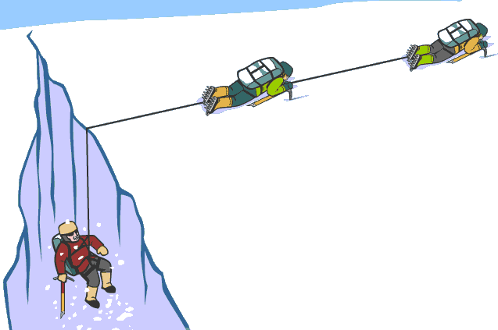
The classic z-pulley
The Mountaineers: Crevasse Rescue

Slide 39
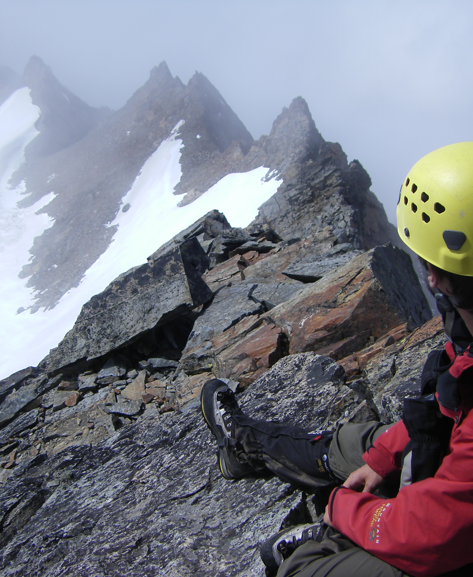
Climbers who seek the freedom of the glaciated peaks must master the techniques for dealing with hazards and minimize exposure.
Summit of Sahale

Slide 40
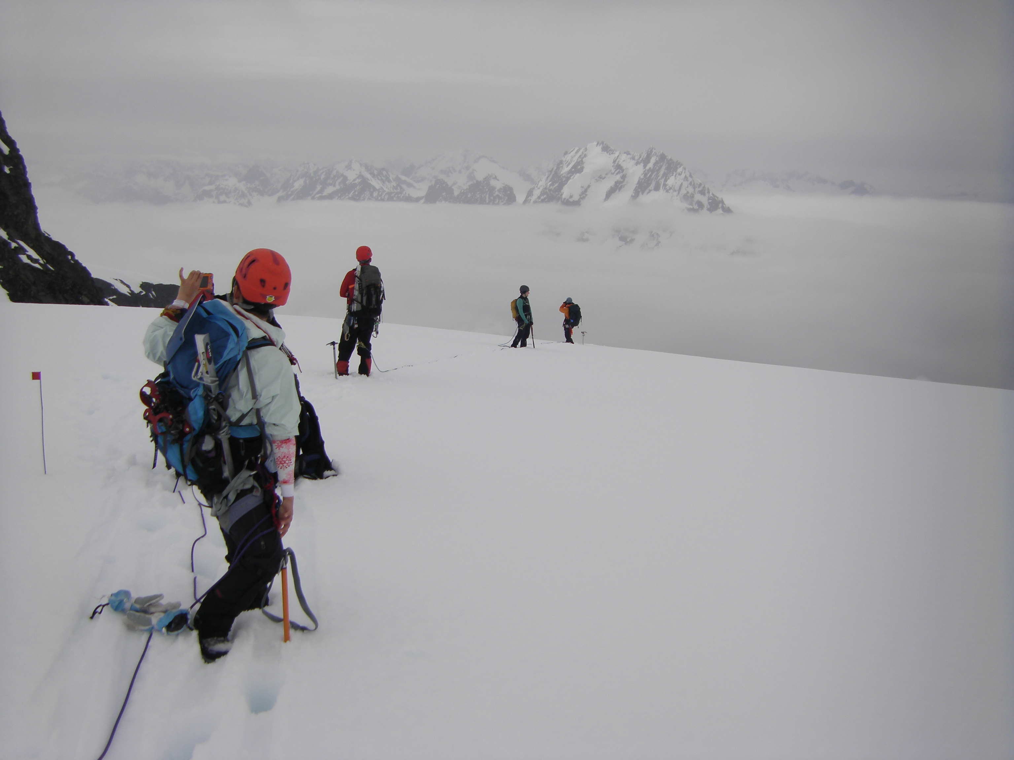
Questions?
Thank You for Your Participation!
El Dorado Glacier

Slide 41
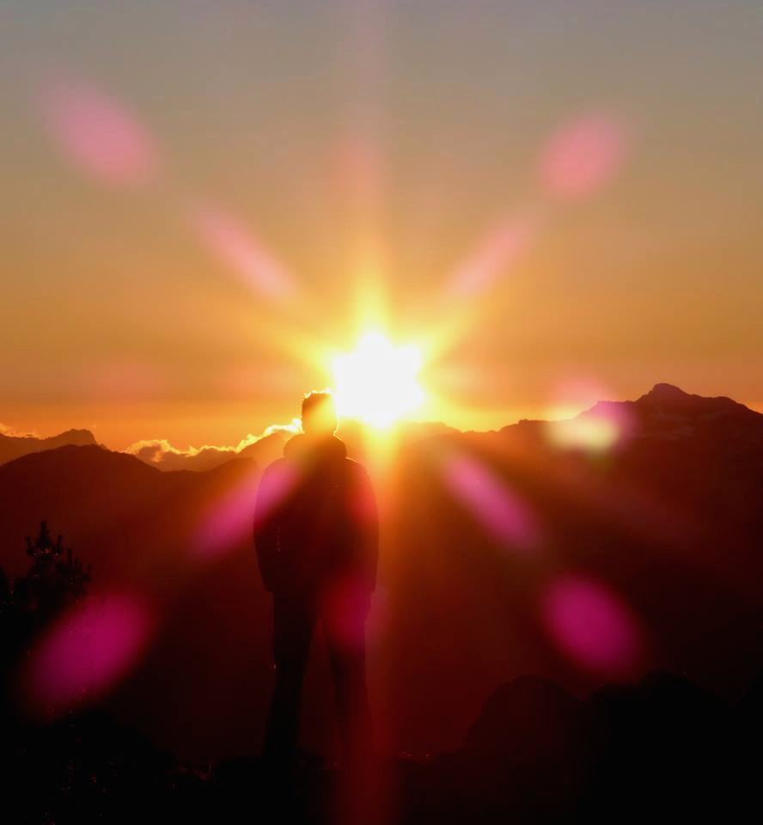
10 minute Intermission

Slide 42
Crevasse Rescue Evaluation Information
Sign up on Mountaineers website
You will demonstrate your ability to set up and operate the 3:1
Z-Pulley system without assistance
Alpine climbing gear & appropriate clothing necessary
Each student will have a turn as the lead climber (lead rescuer), the middle climber (assistant rescuer), and the subject
Link to Student Handout is online in event description

Slide 43
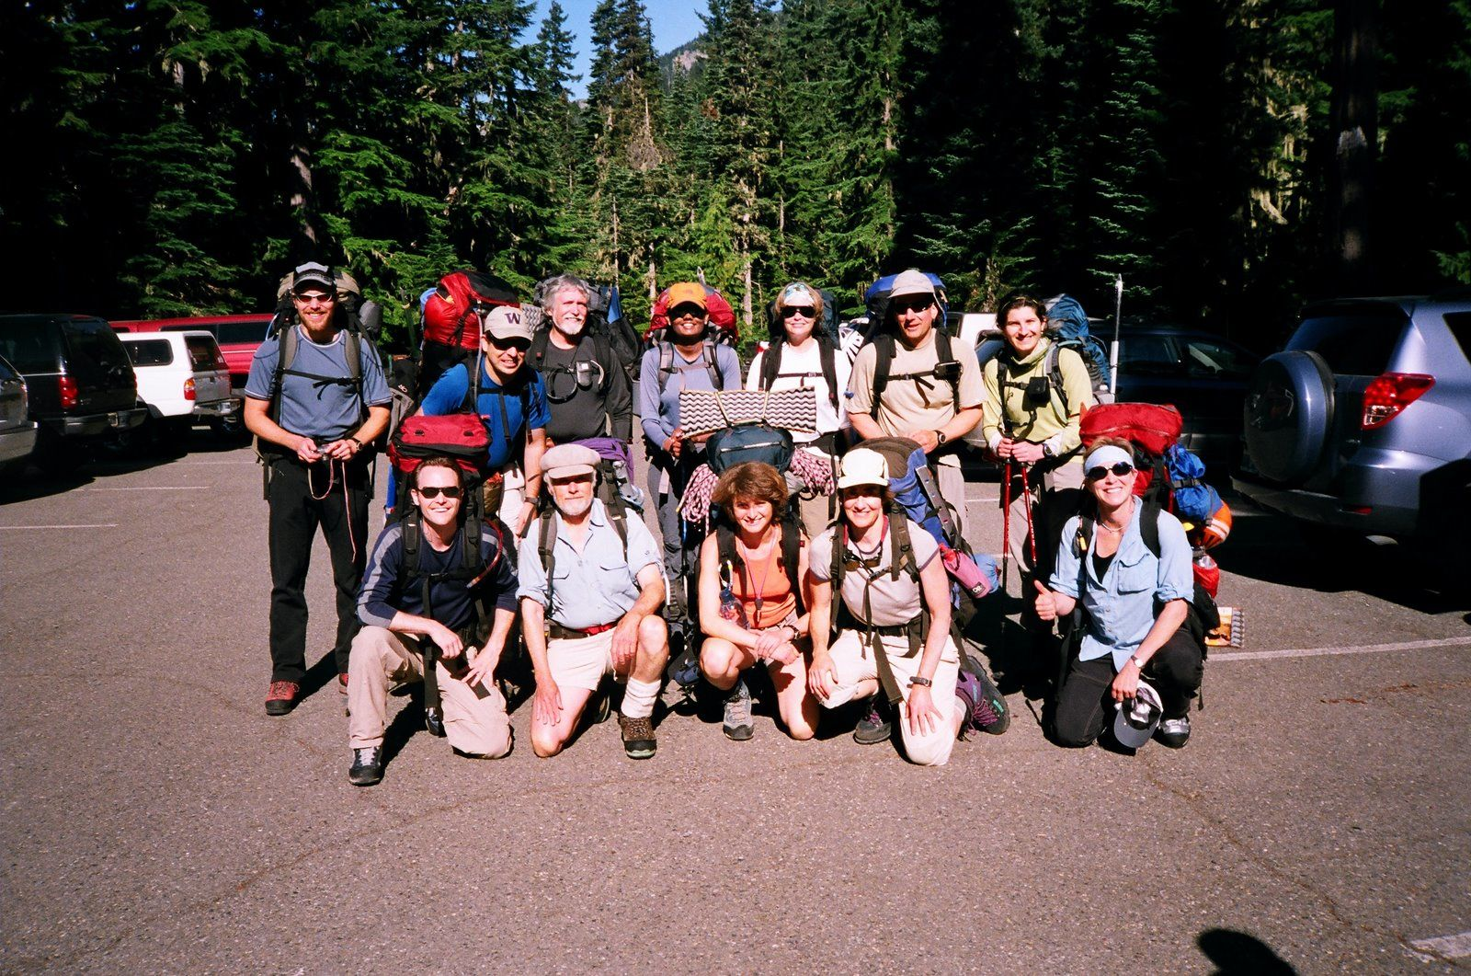
THE CLIMBING PARTY
and Your Role In It
Notes:
Most of our course is TECHNICAL
This will be different
We thought SOMEWHERE we ought to address fact that climbing is …

Slide 44
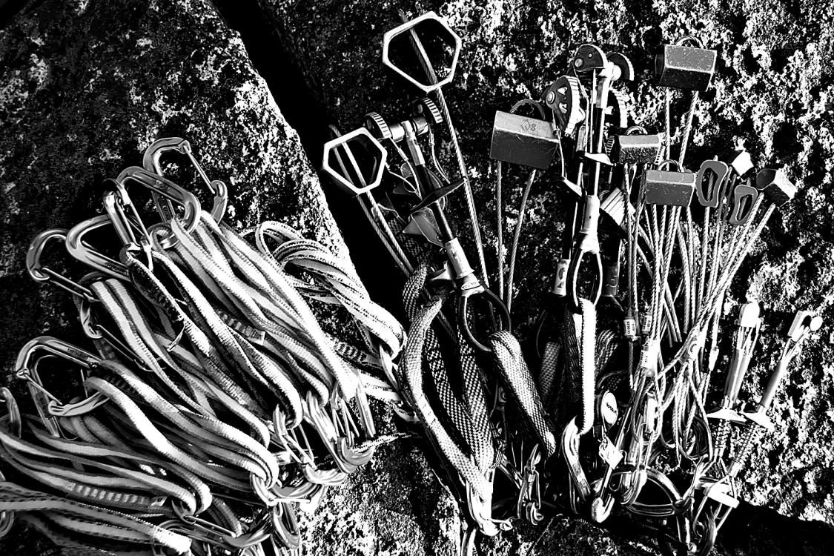
It’s NOT all about knots
and carabiners
Notes:
… NOT just about knots and carabiners!
Also about attitude, emotion, aesthetics, and gaining some wisdom about mountain travel.

Slide 45
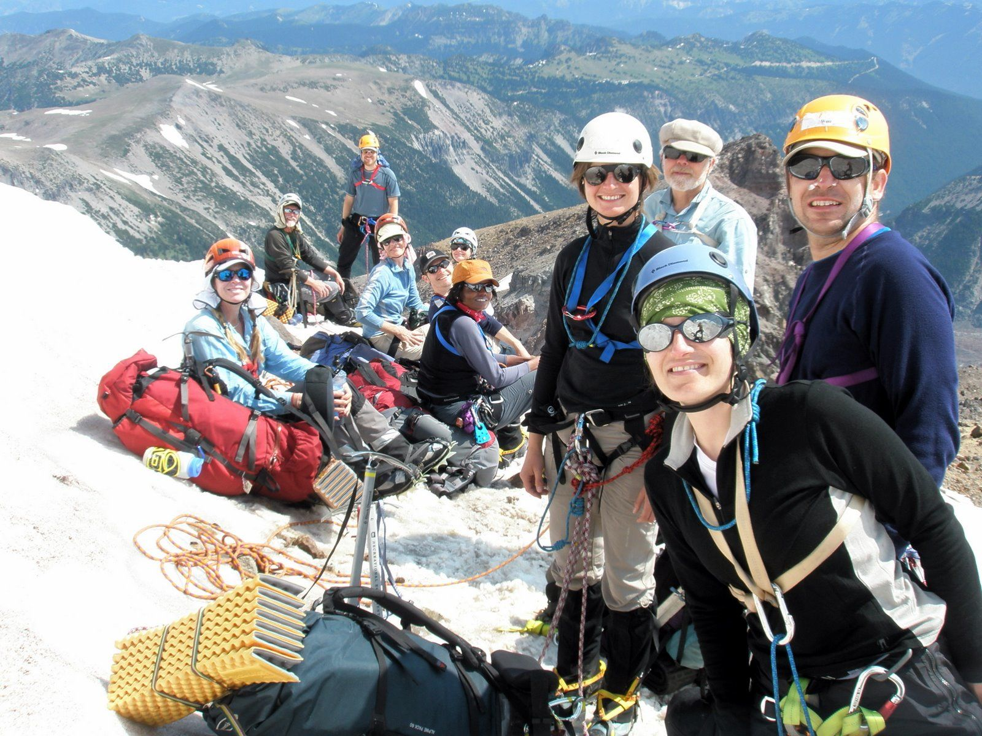
Notes:
And above all, it’s about PEOPLE • [on approach, Emmons]
HERE for ½ hour, not talking about how to CLIMB
But about how to BE a CLIMBER. •The soft skills needed
Mostly about the social part – Also some non-technical skills (wisdom)

Slide 46
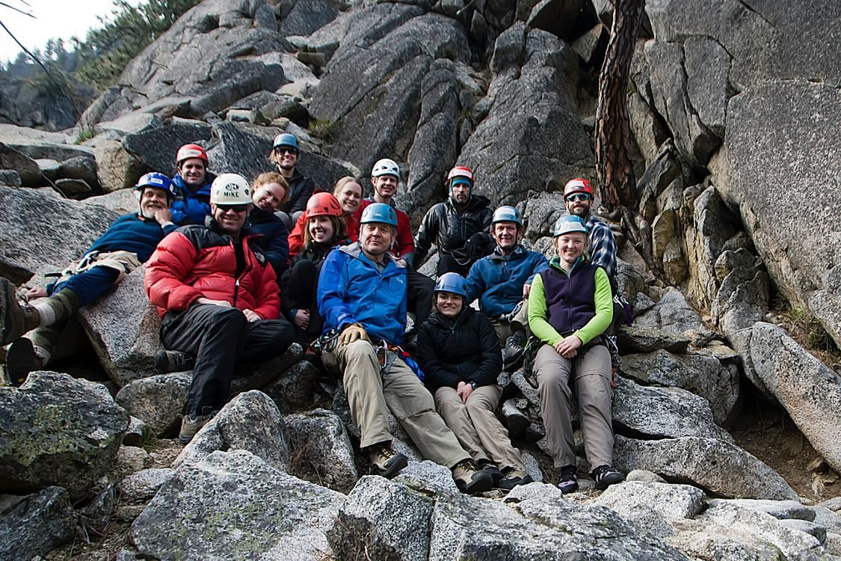
Notes:
[SIG @ Mountaineers Dome]
Note that ch 21 was assigned - Leadership Some of you – our future leaders, but a few years off, so Why?
Because it is about how a PARTY functions- as a group of interdependent people
Last section of Chapter – “Everyone a Leader”
Handbook, p.1, “Not a guide service” You’ll hear that a lot
Means everyone is a fully responsible member
Means everyone needs to think about the party – as a leader does.

Slide 47
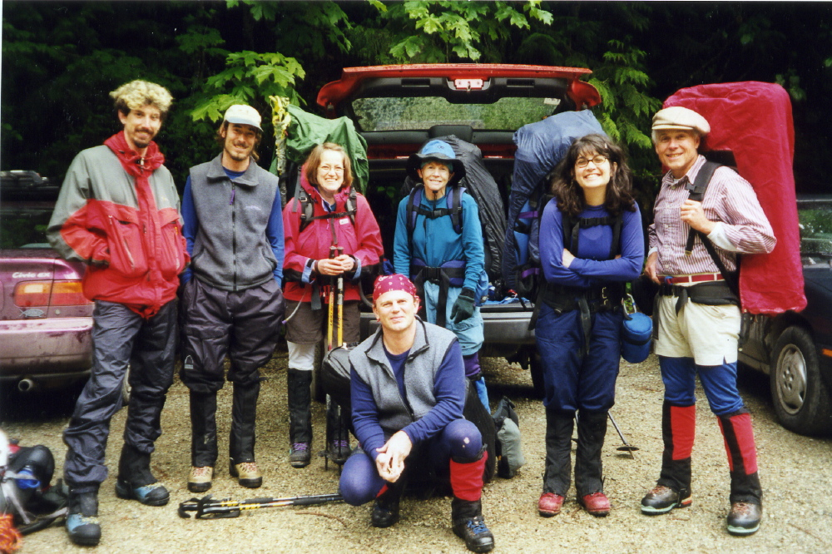
The Happy Climbers (before)
Notes:
[Sahale]
Going on imaginary climb Illustrated with a slides … and a few war stories. Here we are at the trailhead
For this day or this weekend, these are the most important people in the world to you. Your family. Treat them like it.

Slide 48
Clothing & Equipment
• Matrix in your Handbook
• Trade-off:
- Comfort & safety v weight
- How do you know?
• Study your pack after climbs
What to take?
Notes:
GETTING READY – What to take? Matrix in your Handbook
We’ll tell you to take lots of stuff
Most take too much – But how do you know?
Individual matter. Let experience tell you:
Be archaeologist of your own pack. Check what you DON’T use
[STORY] 2nd pair wool pants But … [STORY] …pile pants

Slide 49
What to take?
Food
• Take some extra
• Most take too much
• Take food you like
Notes:
Exertion suppresses appetite – so take food you like
My favorite – Oatmeal Cookies . Nature’s perfect food
About to go on imaginary climb
To enhance vicarious experience
>>>>[H/O COOKIES] <<<<

Slide 50
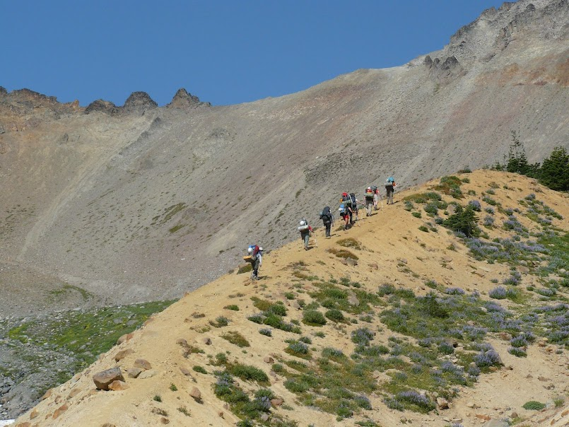
The Approach
Navigation
Notes:
[Moraine on Emmons approach] NOW going up trail
Memories: following boots up trail •Participate! Don’t wait to be led
ORIENT at trailhead •See self from above
Practice. Get map & route description. Try to follow on map
More than one leader has been saved from error … alert student

Slide 51
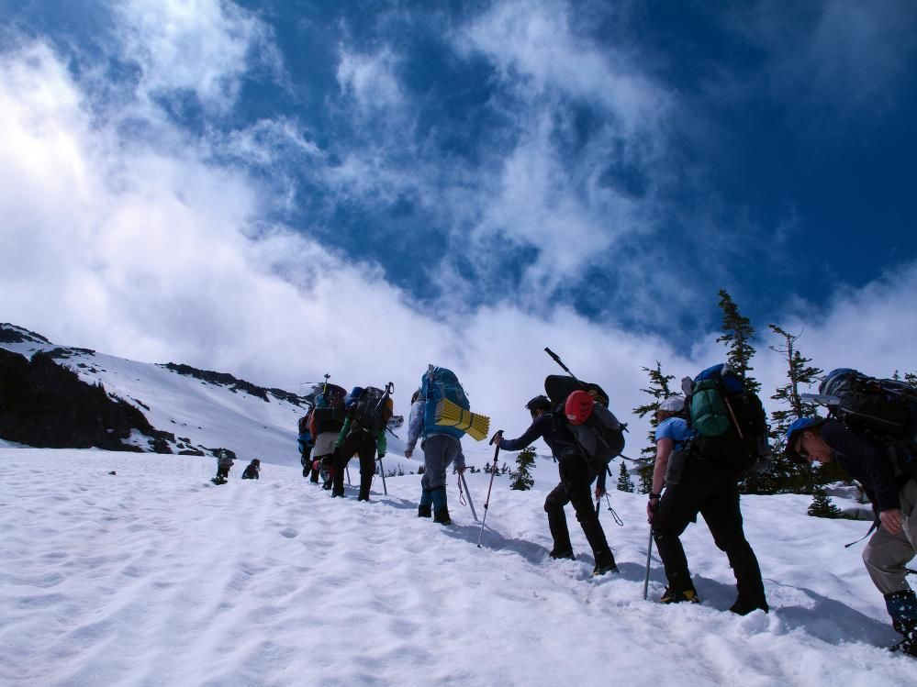
The group comes together
Notes:
[Approach to Little T] Getting to know each other. Group of strangers
[my History – Now group is best part]
Marvel how they pull together – Everyone on best behavior. Party is little social miracle
BUT, don’t take for granted. WORK at it
Talk – introduce – Look for ways to help
Everybody take on leadership duties • Cohesion adds hugely to party strength
[STORY Dr. on Rainier (dead guy – snarky). So take responsibility

Slide 52
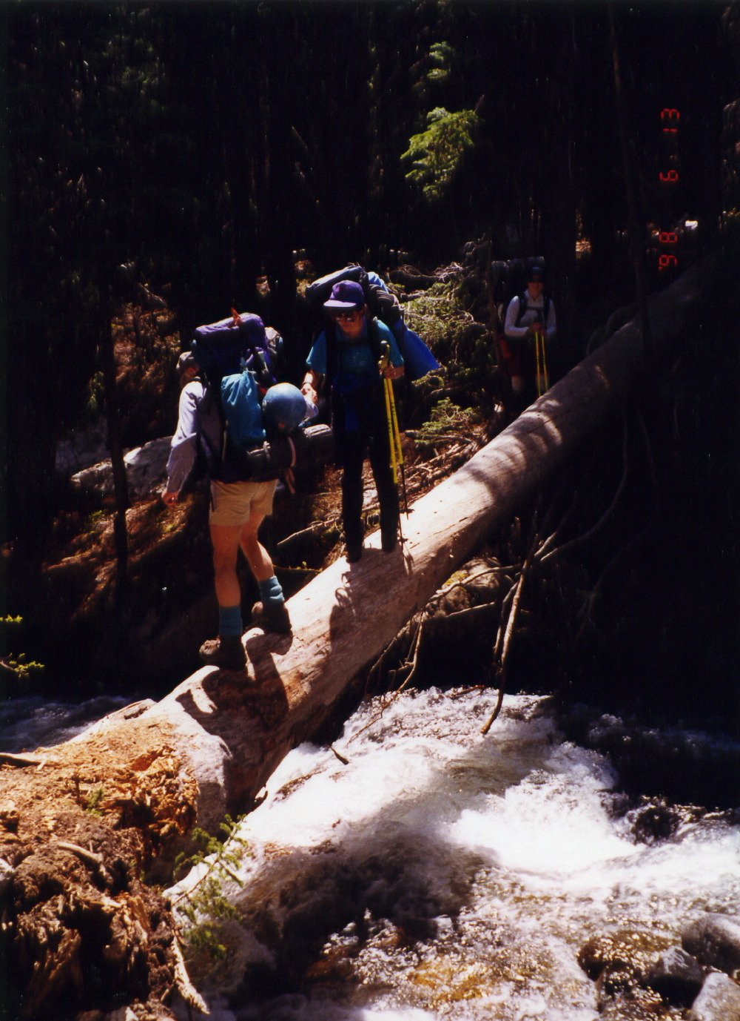
Careful Here!
Not all the danger is at high elevation
Notes:
[Approach to Silver Star]
Help keep party together – especially going OUT
Stronger tend to jet ahead – Leaving weakest alone, just as accidents most likely.
Good rule: Regroup at trail junctions & difficult places.

Slide 53
EFFICIENCY
Is Not Necessarily Speed
• Organize
• Think ahead
• Keep moving
Notes:
SPEED – can be important – Safety
• Off technical terrain before dark • Out of couloir before sun hits (Erica)
SECRET FEAR: Will I be the party wimp? [our little morality play]
What is speed? • NOT how fast you walk, but how well you use your time.
[NOW PROGRESS SLIDE BULLETS]
Breaks: Organize Pack – Eat/ Drink/ Clothing. What’s on top of pack?
DON’T move faster than you can sustain – But DO Keep Moving
That’s what rest step is about.

Slide 54
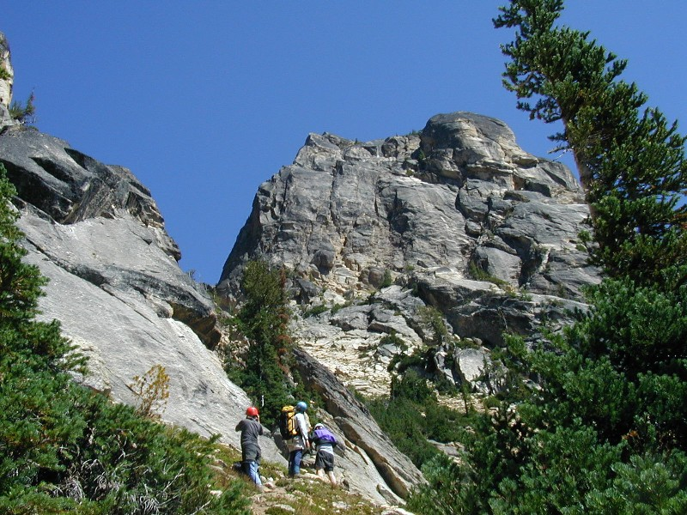
First View of Kangaroo Temple
Notes:
NOW we rejoin our climb.
[SHOW route on slide]
Note: Helmets on already. Why??

Slide 55
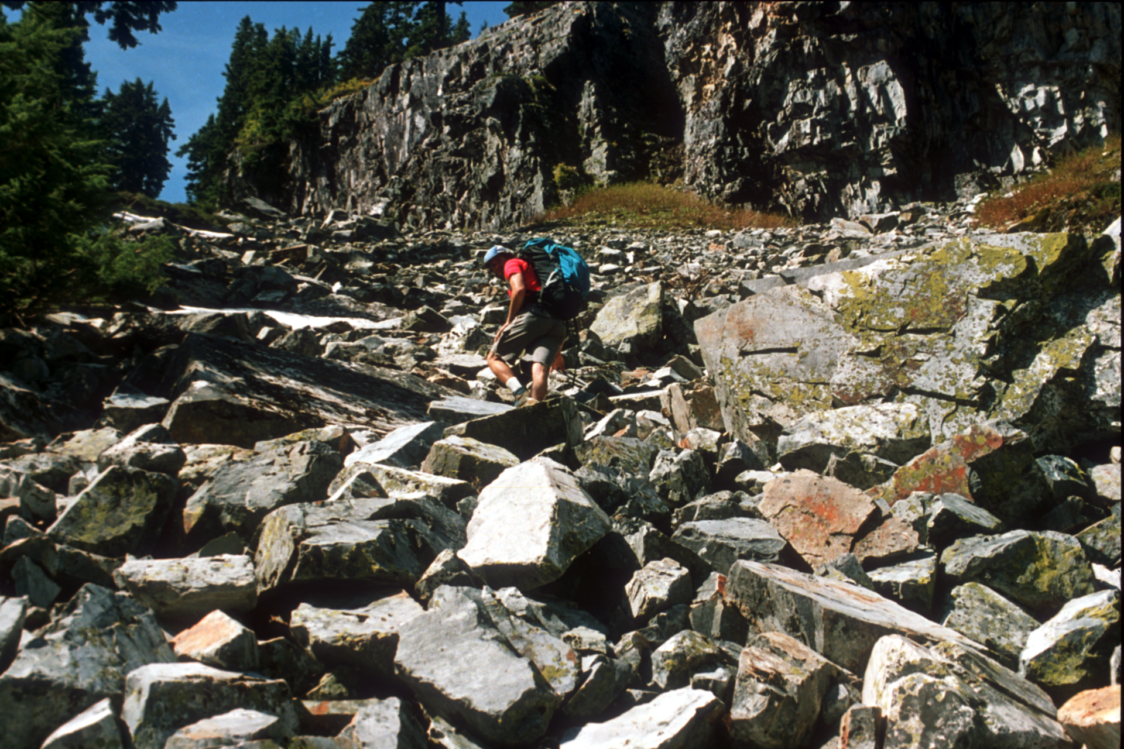

Talus
Notes:
[Approach to The Tooth]
Talus – Sharp, uneven footing, may roll – Test footing
Wear helmet – protects from rockfall – Also from YOU falling on rock.

Slide 56
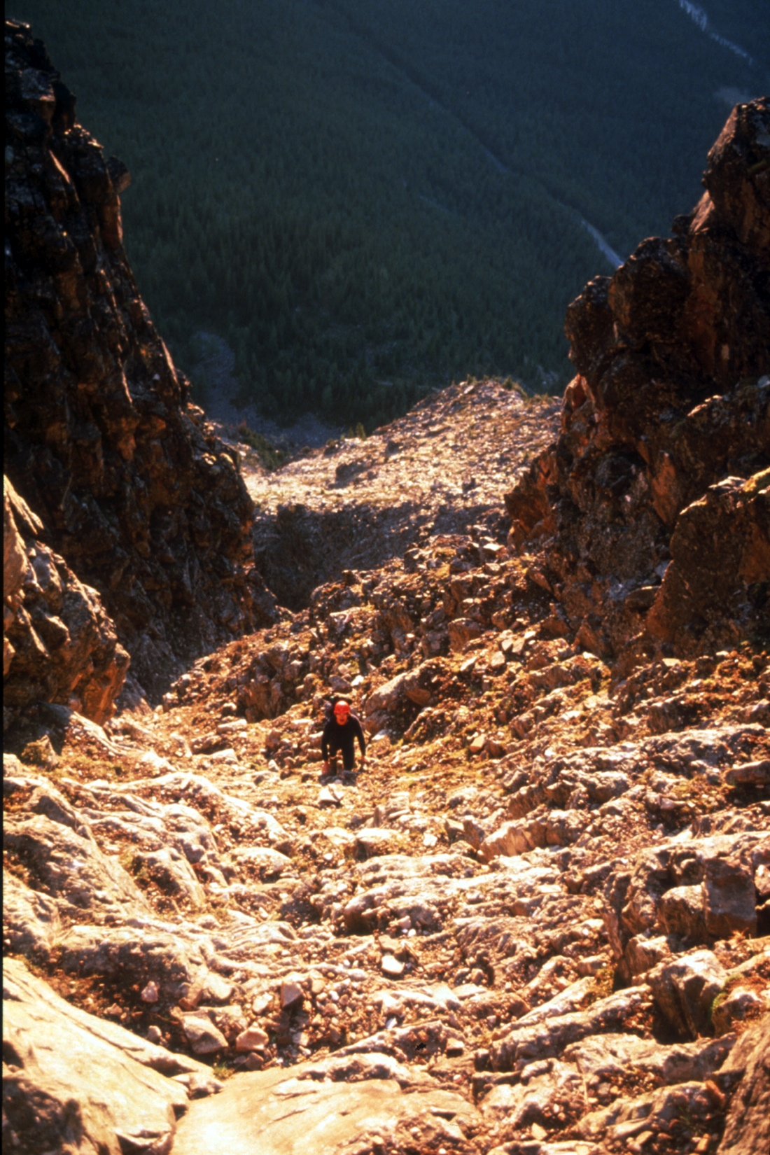
The Couloir - a dangerous place
Notes:
The COULIOR (French for ugly gully) [Mt Temple, in Canada]
Geology – less competent rock
Soft, low angle LOOSE STUFF = DANGER
Rockfall actually injures more climbers than falling
Rules of Engagement: Helmet!
Move CAREFULLY – Difference between experienced and novice
Believe it or not, IS a skill – LEARN IT

Slide 57
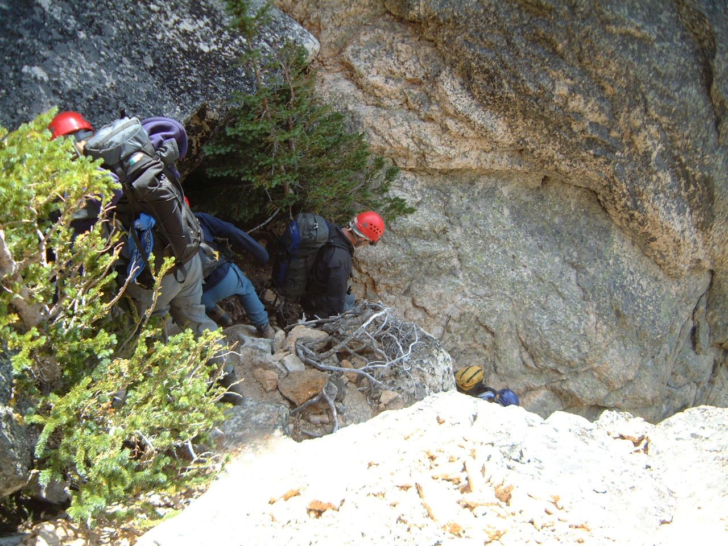
Notes:
[DESCENT FROM KANGAROO TEMPLE]
STRATEGY: • Bunch up nose to tail/ • In groups (look at the loose rock!)
ROPE in the couloir? Maybe, but … May dislodge loose rock
… and where will it go ??
On Descent, rappel of downclimb the couloir? A trade-off…

Slide 58
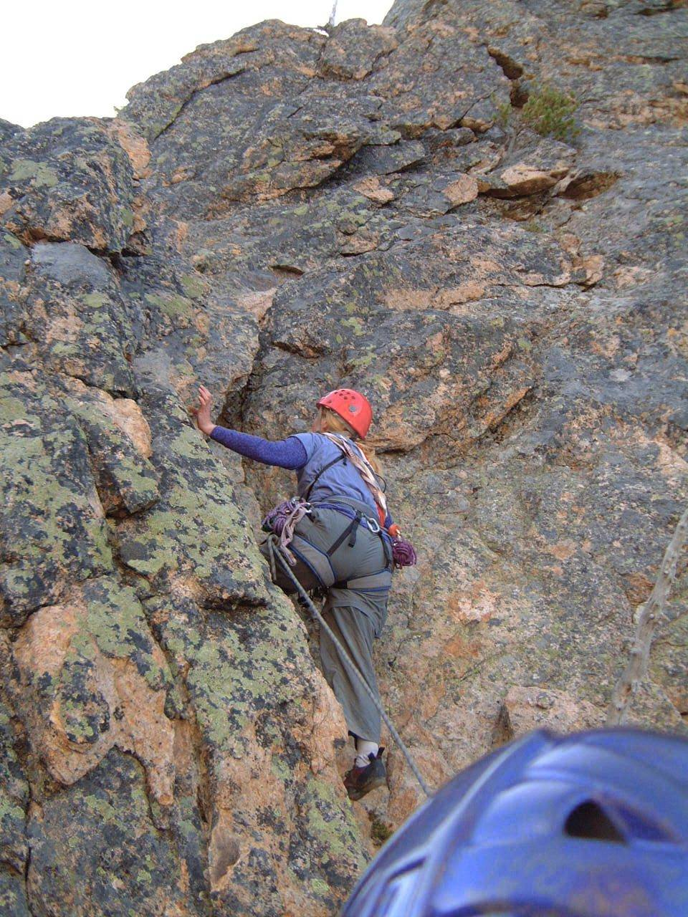
Leader Starts Up
Notes:
[First Pitch, Kangaroo Temple]
Now, finally starting the CLIMB.
LEADING OUT
Test holds • YELL!! Rock, Rock, Rock!!

Slide 59
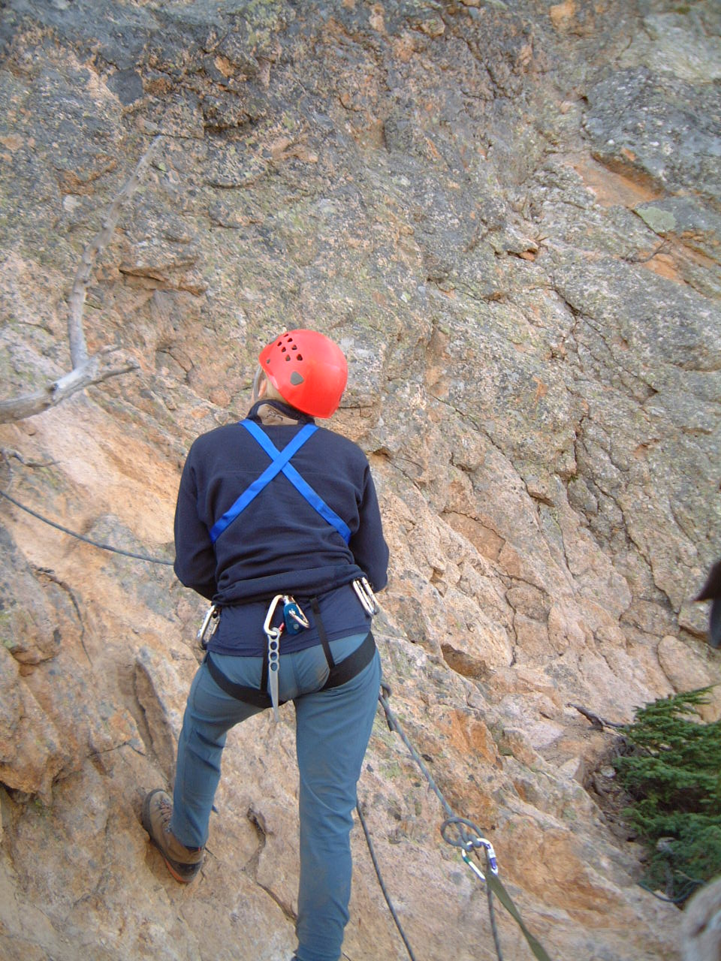
Put Yourself in This Picture
Notes:
Exemplary belay here
In F/Ts it’s been rules and procedures
Now, it’s about you taking care of your friend – with good, alert technique.

Slide 60

Leader setting pro
Notes:
[First pitch on Midway, Castle Rock]
Leader goes first, places pro

Slide 61

Notes:
You will follow, top-roped, cleaning and collecting pro
Probably you will climb with pack – for the two of you.

Slide 62
Exposure,
Fear,
& Danger
Let us consider:
Notes:
Define Exposure
Anxiety is GOOD – last rope partner I want is a Fearless one!
But should not be Paralyzing • One of the Wisdoms
For most people after experience, something “clicks”

Slide 63

Kangaroo Temple
----
Starting Around the Corner
Notes:
[KANGAROO TEMPLE – the infamous step-around]

Slide 64

Exposure
(It’s 500’ straight down)
Yikes!! ------
Guaranteed to get your attention
You
Notes:
THIS is what’s around the corner. Gasp!
Surprisingly, we need to LEARN difference between fear and danger
Industry – 30’= fatal. So does it really mater 300’ or 3,000 ?
But 10’ unprotected and fall on broken rock …
YOU will be top-roped-
So little actual danger IF everyone does what you’ve been taught

Slide 65

BUT… Look at this system.
Will it hold the climber’s weight?
Scary, sure!
But how dangerous?
Notes:
So let’s look again at the” fearsome” move
Climber is SAFE
Could hold car!

Slide 66

Rockfall did this
Notes:
My accident
Rock the size of average basic student
After two years of surgeries, shoulder is OK, but will never be normal
NOT to elicit your sympathy, but … after 30 years of climbing
WHERE?

Slide 67
Did the accident happen in a scary place like this?

Slide 68

Or …
In an ordinary- looking place like this?
Notes:
Class 2 gully on a crummy little peak you never heard of
The POINT: Scary & Dangerous NOT the same
And learning to RECOGNIZE danger is a SKILL you need to learn, a WISDOM you need to acquire – an important one
Not part of how to climb
But definitely part of How to BE a Climber.

Slide 69

Nearing the Summit
Notes:
[North Ridge of Stewart]¡

Slide 70

Notes:
[West Ridge, Mt Stewart]
SOME SUMMIT SHOTS

Slide 71

Notes:
[Volcan Lanin, Chilean-Argentine border, Patagonia]

Slide 72

Notes:
[Rainier]

Slide 73

Summit Euphoria
--------
Phase 1
Notes:
[Rainier]

Slide 74

Summit Euphoria
Phase 2
----
Tough Climb
…and we still have to go DOWN !
Notes:
[Mt Jefferson, Oregon]

Slide 75
and inevitably …
The Descent

Slide 76

Rappelling Off Whitehorse
Notes:
Rappelling is fun .. But unforgiving.
Recall “Toast”

Slide 77

Kangaroo Temple
Notes:
You have been drilled on the technique
But there is also a PEOPLE part of rappelling (our topic tonight)

Slide 78

Looks vertical
Because it IS
Notes:
Buddy System – Check each other out – OUT LOUD
… and don’t wait to be asked. Step up like a friend and DO IT.

Slide 79

The Descent
Notes:
[Kangaroo Temple]
Descent can be a DANGEROUS time
Downclimbing can be difficult
Tired/ Darkness/ In a hurry
Be careful – don’t rush
Watch your buddies – this is when they really need you.

Slide 80

Heading Down
Notes:
[Mt Constance]
Now down, unroped, headed back
To civilization with its comforts and its discontents
Can only be brief visitors in this alpine world
Mountains are sublime • And Summits are thrilling

Slide 81
Heading Down
Notes:
[Mt Constance]
You are embarking on great adventures you will never forget
I wish you great joy
Climb safely, please
And I look forward to climbing with many of you this year and in years to come. ###

Slide 82
As the climbing season begins, please remember…
Climb leaders are volunteers, not guides.
Pick climbs that are appropriate for your level of comfort, experience, and fitness.
Commit to the climbs for which you sign up.

Slide 83
We need your help!
Please help us stack and place tables & chairs at the end of the lecture.
Many hands make light work.

