Slide 1
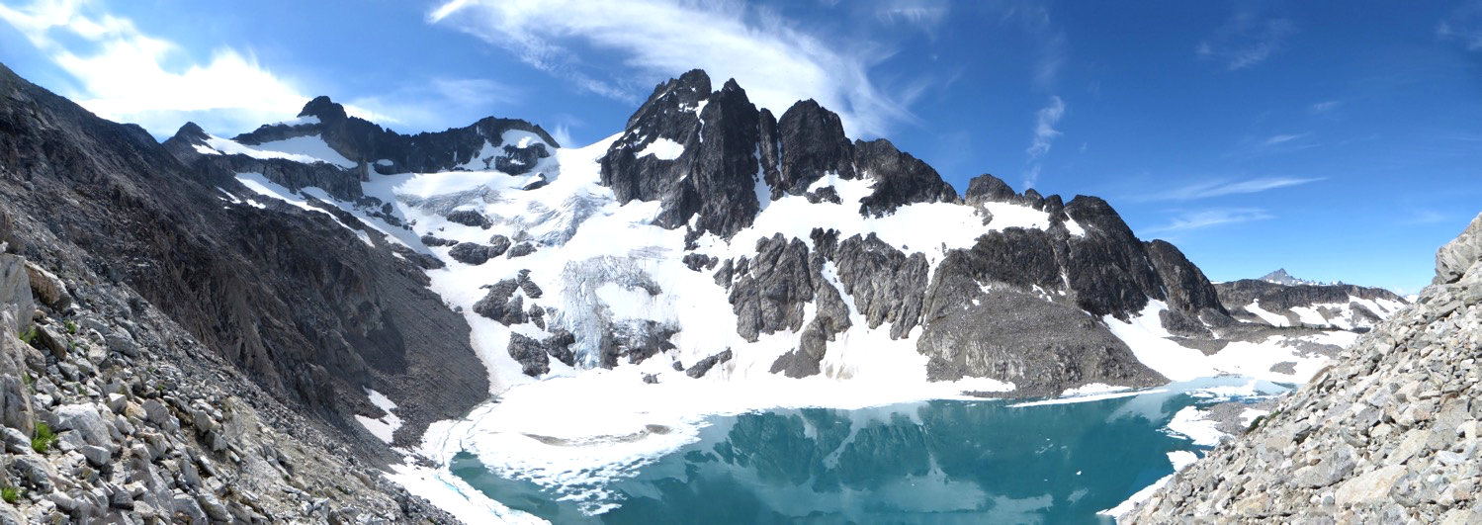
Seattle Basic Climbing
Lecture #5
2018-May-02
Glacier Travel – Jan Abendroth
The Climbing Party – Cebe Wallace
Logan Pk / Banded glacier

Slide 2
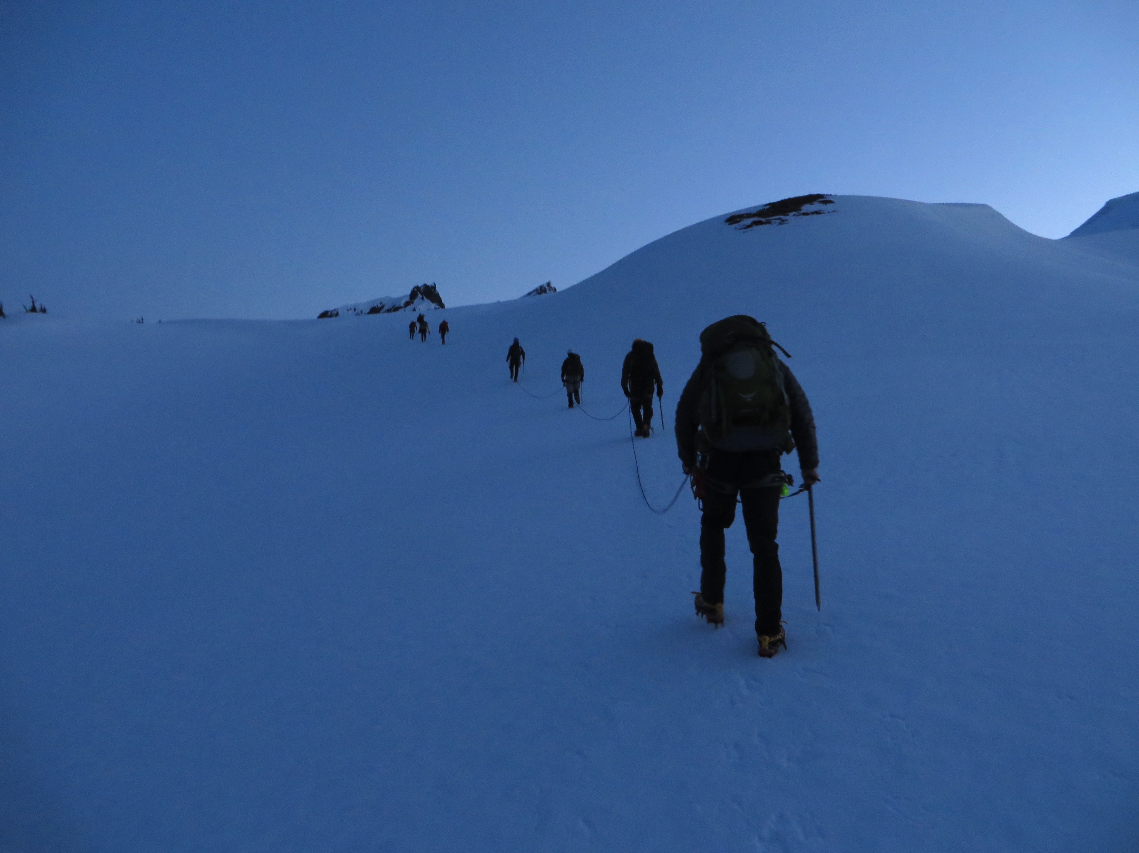
Agenda
Glacier Travel
45min
Break – 10min
The Climbing Party
45min
Announcements
Mt. Baker snow FT

Slide 3
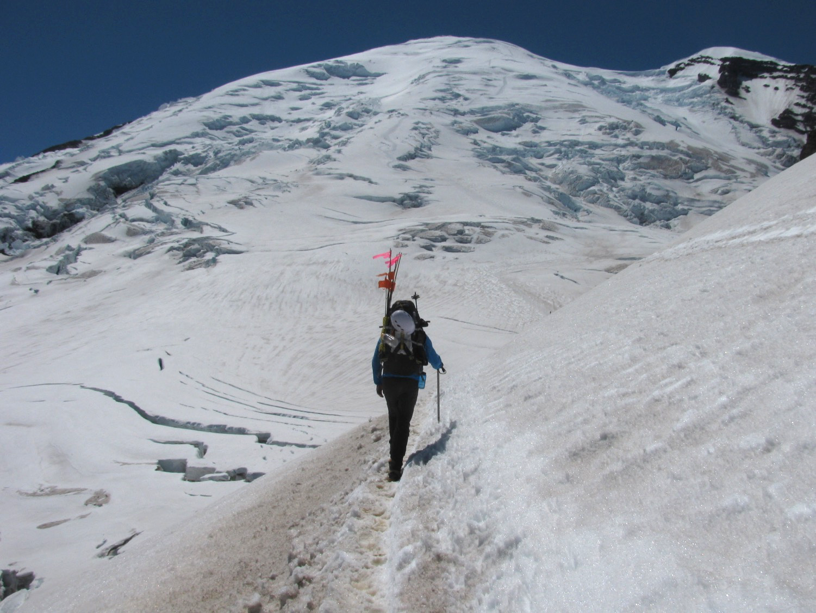
Glacier travel
Mt. Rainier / Emmons

Slide 4
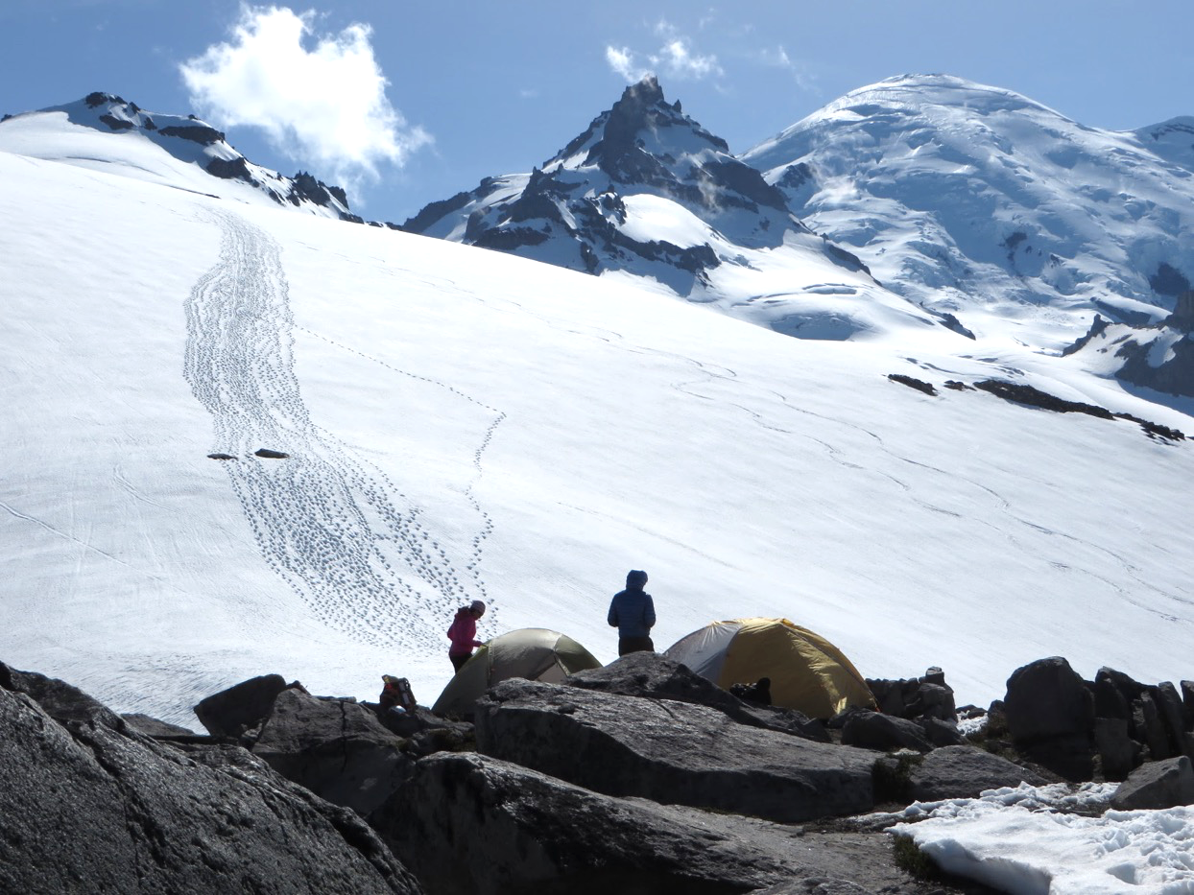
Glacier travel … beautiful
Little
Tahoma

Slide 5
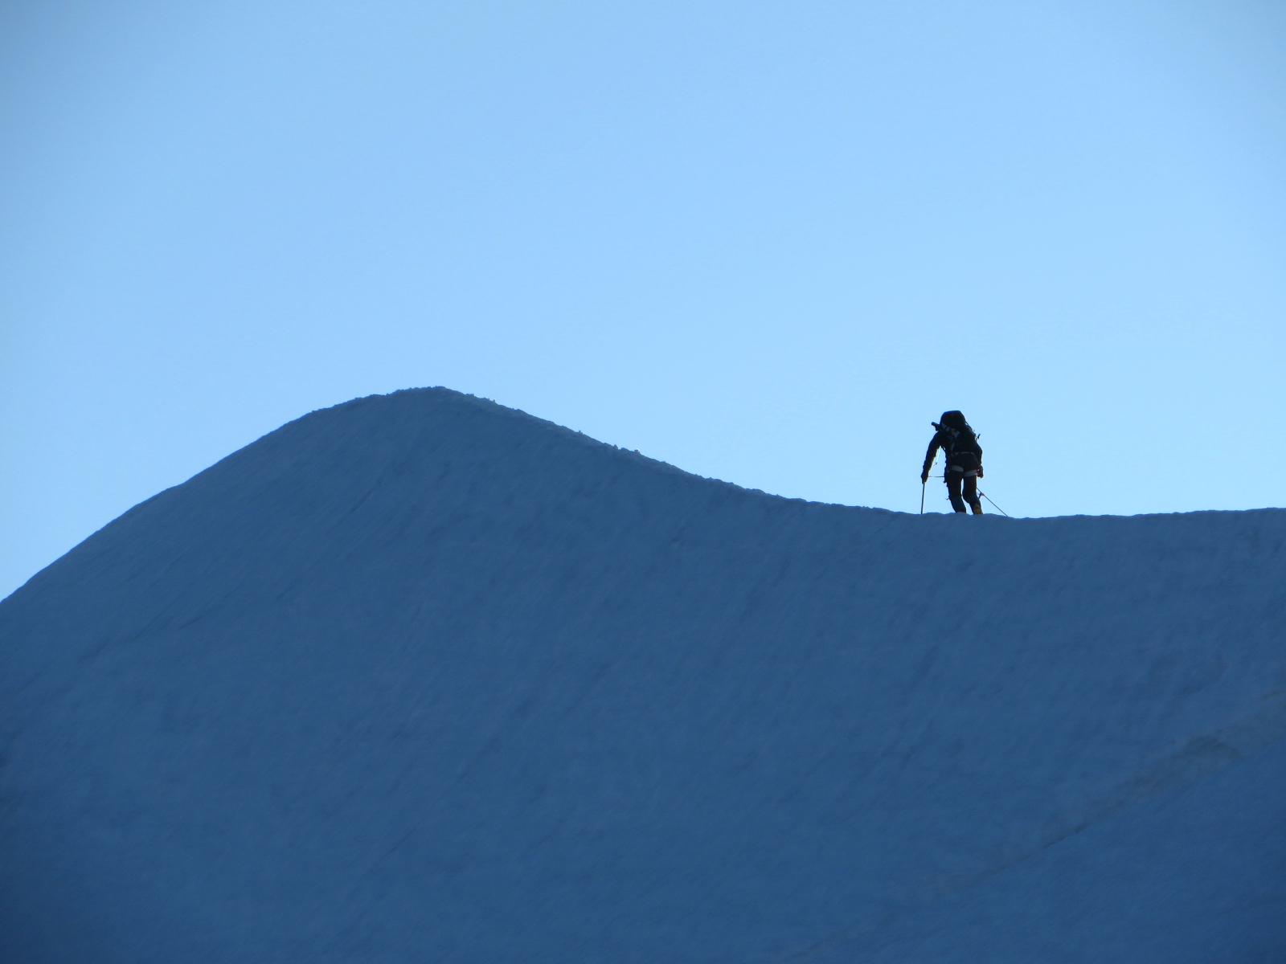
Glacier travel … breathtaking
Eldorado Pk.

Slide 6
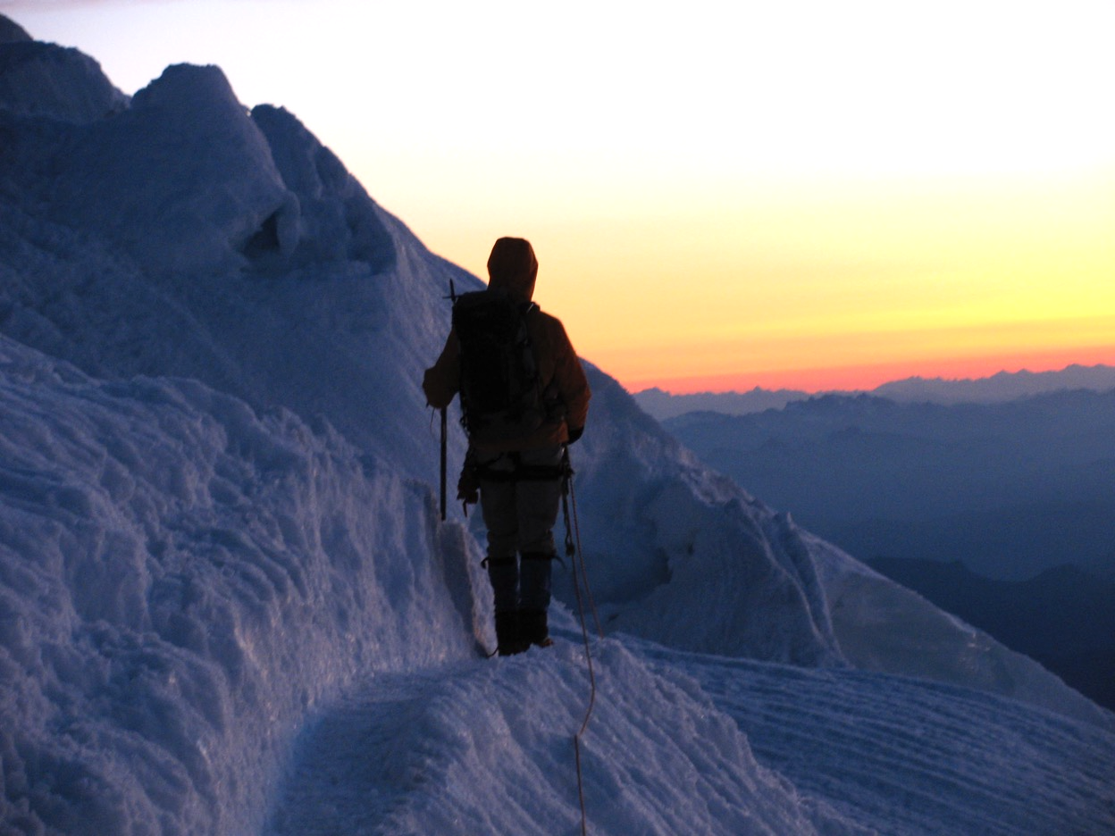
Glacier travel … sunrises
Mt Rainier
DC

Slide 7
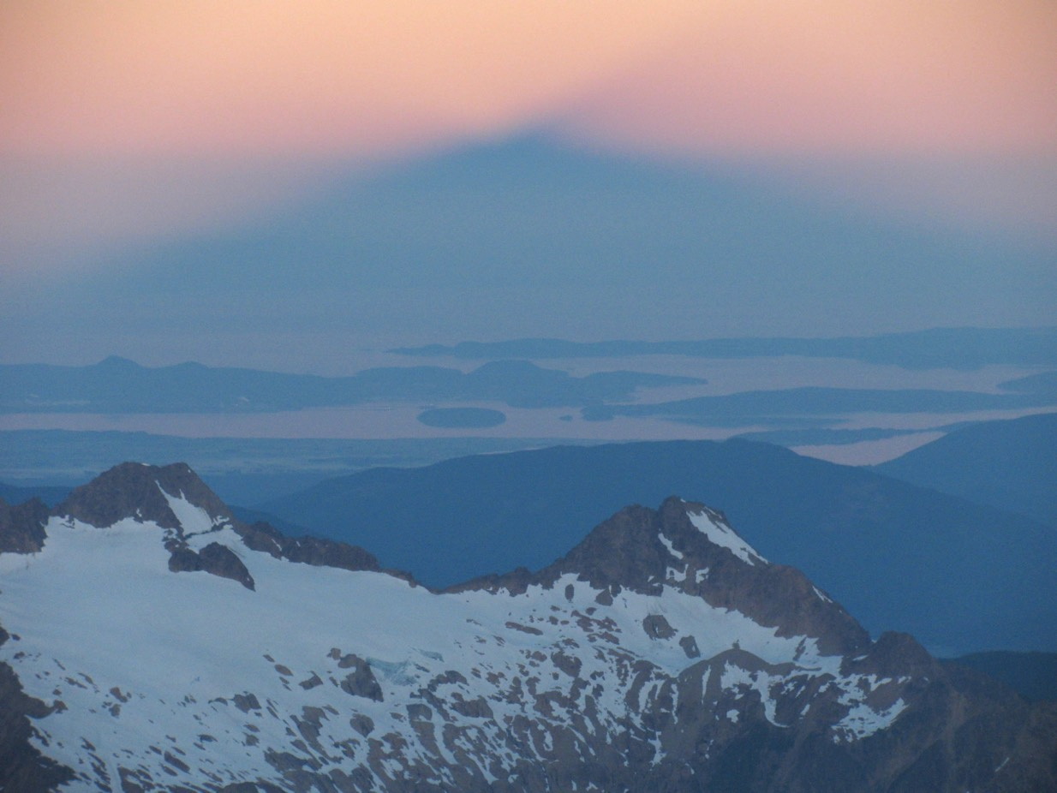
Glacier travel … mountain shadow
Mt. Baker
Easton

Slide 8
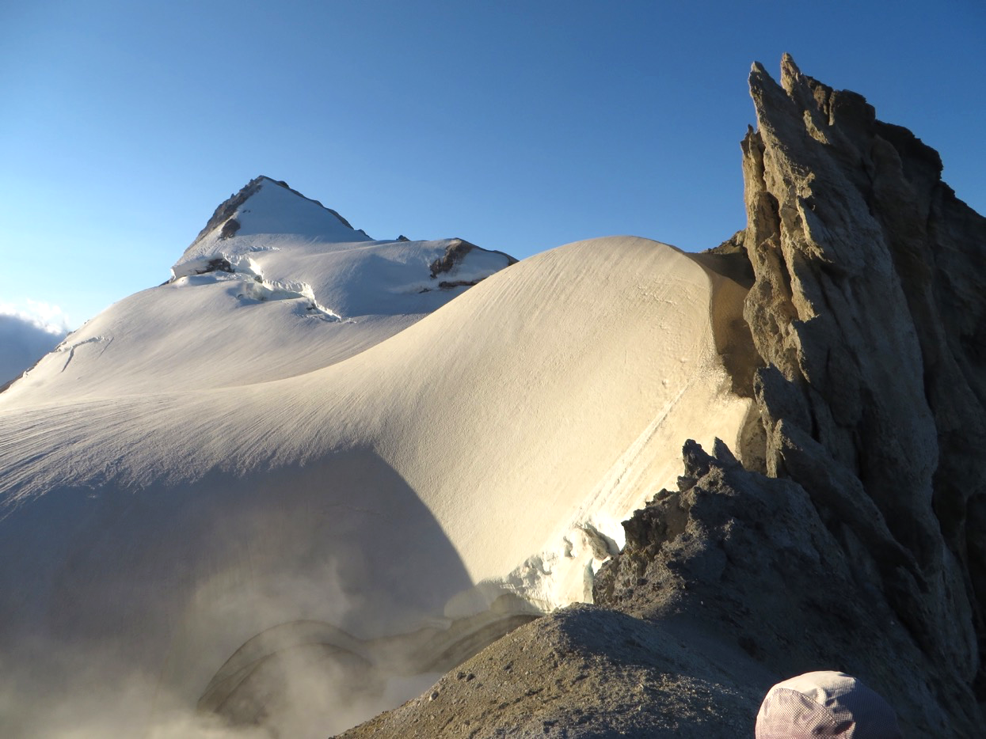
Glacier travel … fuming craters
Mt. Baker
Easton

Slide 9
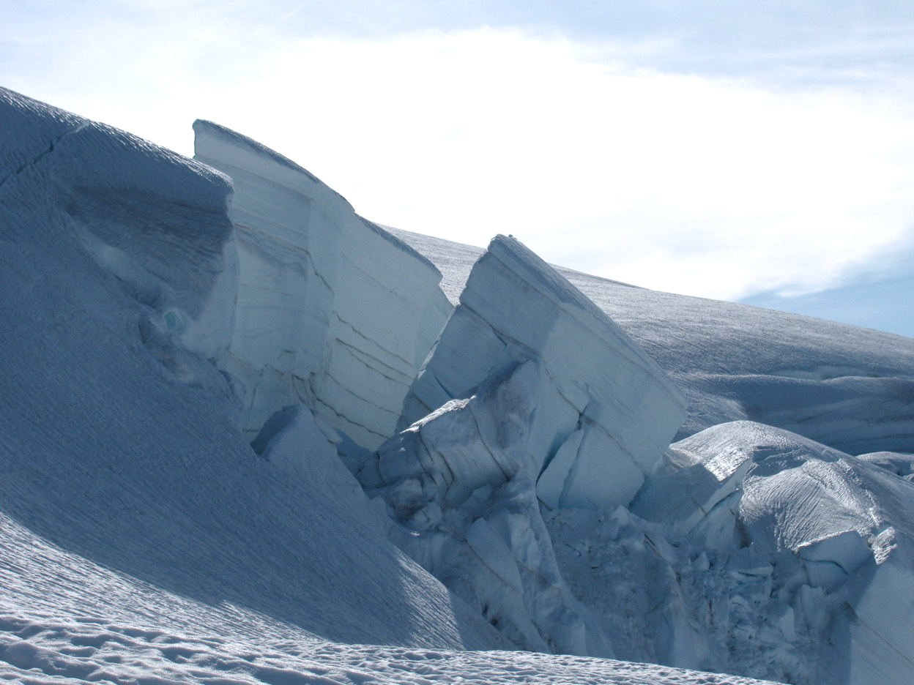
Glacier travel … ice falls
Mt. Baker
Easton

Slide 10
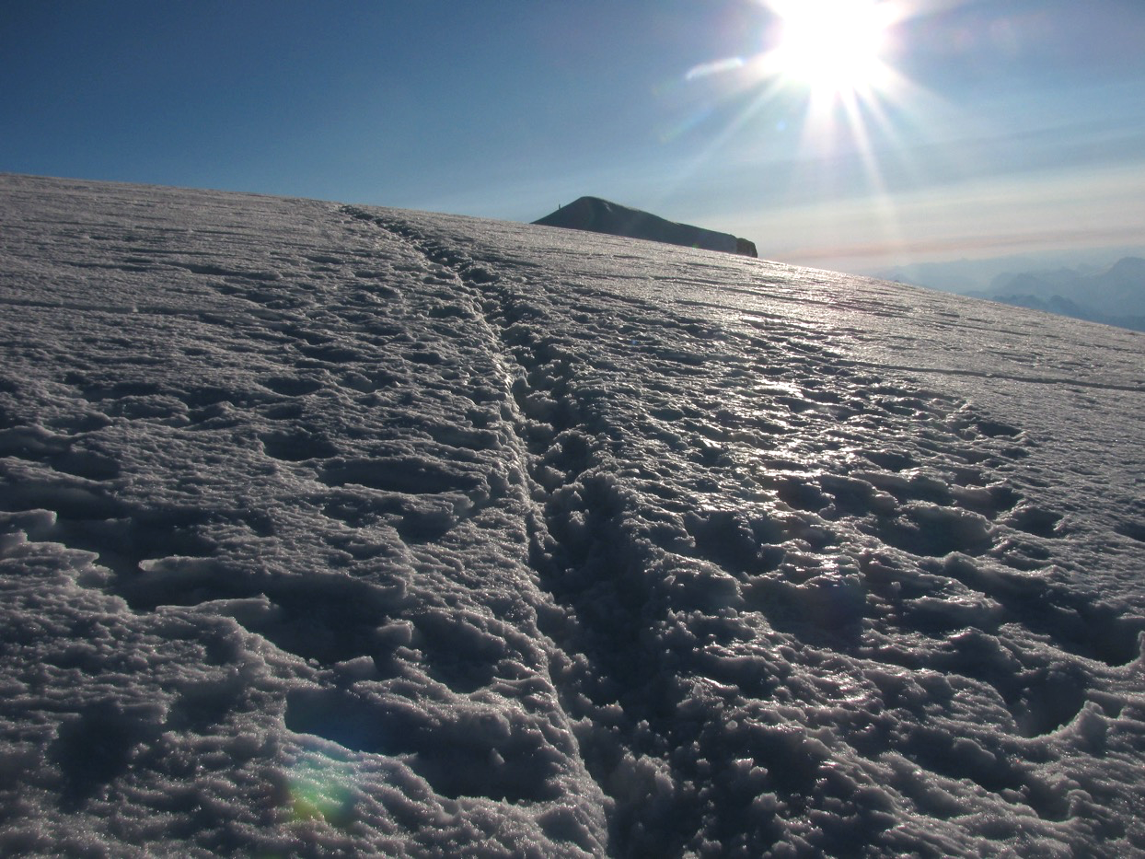
Glacier travel … summits
Mt. Baker
Easton

Slide 11
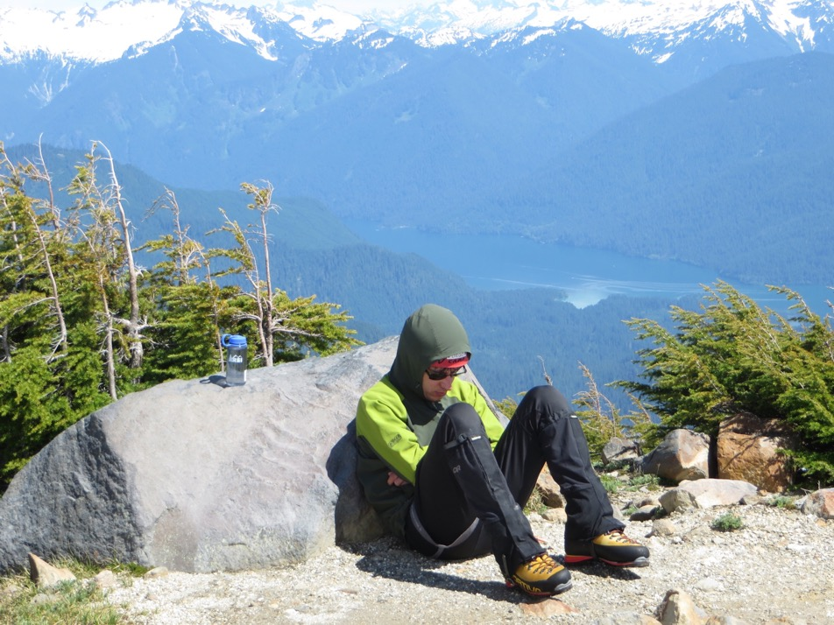
Glacier travel … strenuous
Mt Si fitness test:
Due May 15th, check with your SIG leader if not done yet!
Pictured climber is strong and an excellent rope lead!
Mt. Baker
Boulder

Slide 12
Safety on Glacier trips
Crevasse rescue
Notes:
Ask audience what else is important – conclusion, way more that just crevasse rescue.

Slide 13
Safety on Glacier trips
Route
Team (Cebe’s lecture)
Weather
Current conditions
Gear
Camp
Route choice
Safe glacier travel
…
Crevasse rescue

Slide 14
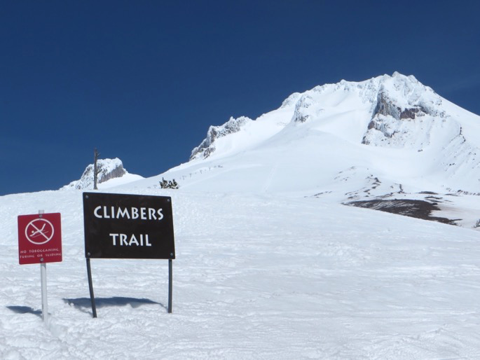

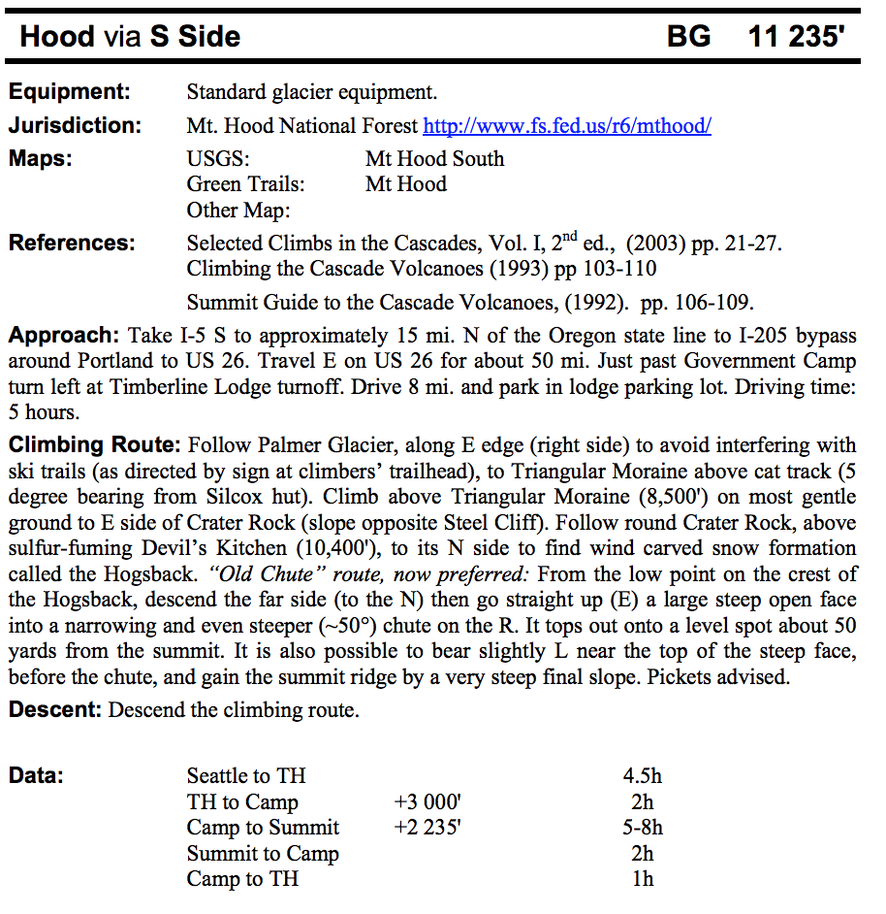
Route - Mt. Hood, next weekend?
Basic climbing guide
Resources:
Basic climbing guide (Course materials)
Mountaineers webpage
https://www.summitpost.org/
https://cascadeclimbers.com/
Fred Beckey guides and other books

Slide 15

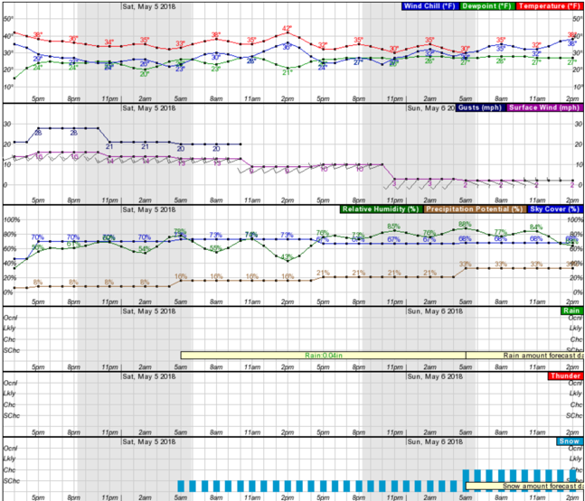
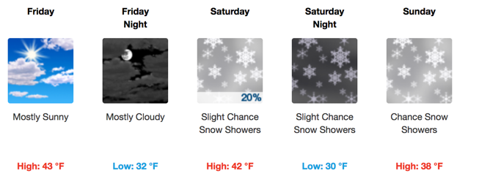
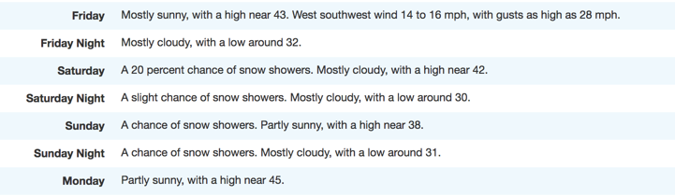
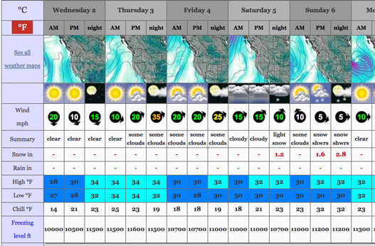
Weather - Mt. Hood, next weekend?
Resources:
NOAA: https://forecast.weather.gov/
https://www.mountain-forecast.com/
Michael Fagin weather reports
sent to SIG and climb leaders
JA’s preference:
Set weather expectations and stick with them, eg.
<30% precipitation, <0.2” precipitation, <20mph wind

Slide 16
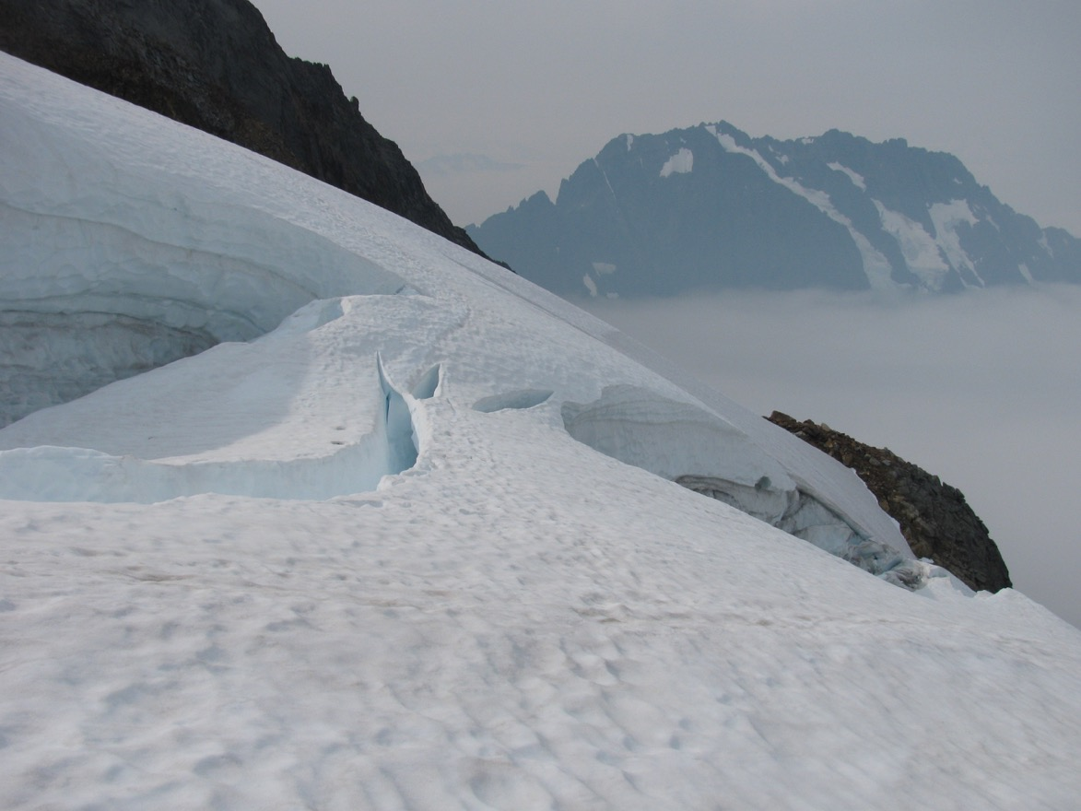
Current route conditions
Late season climb
Thin snow bridge
Sahale Pk
Qien Sabe

Slide 17
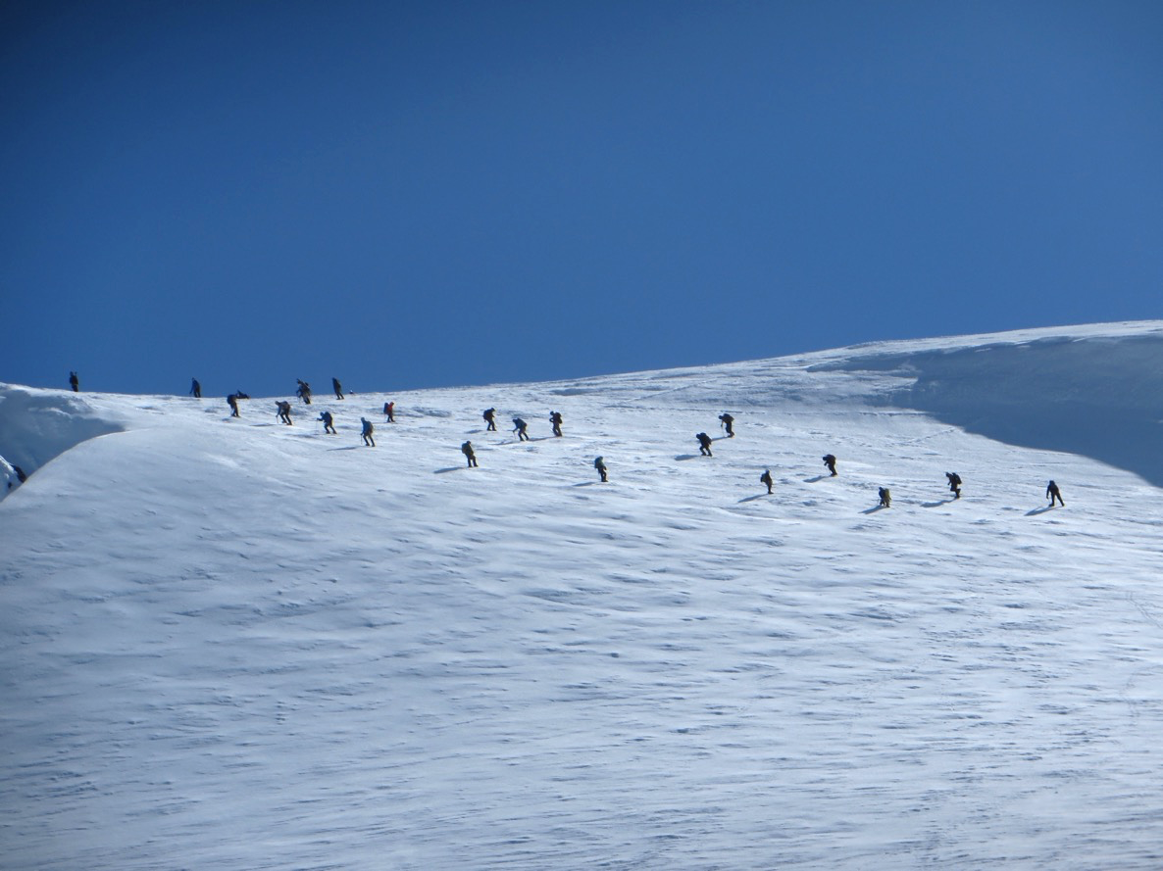
Current route conditions
Busy weekend.
Safety in numbers?
Mt. Baker
Coleman

Slide 18
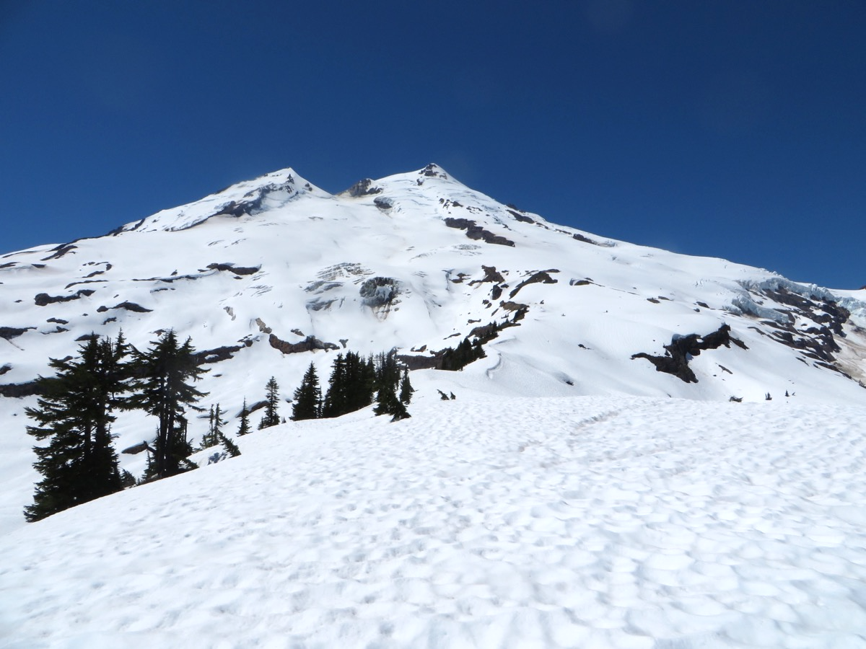
… another weekend, different route on the same mountain

Slide 19
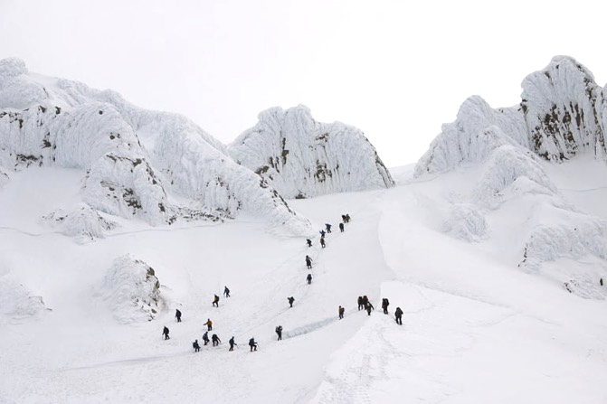
Current route conditions
Road access?
Is the route ‘in’?
Day of the week?
Any current dangers?
River crossings?
Rock fall?
Best time to start?
Mt. Hood, DanielArndt.com
Resources:
Mountaineers webpage: trip reports,
Facebook, climbers like to post!
http://www.peakbagger.com
many recent posts, GPS tracks

Slide 20
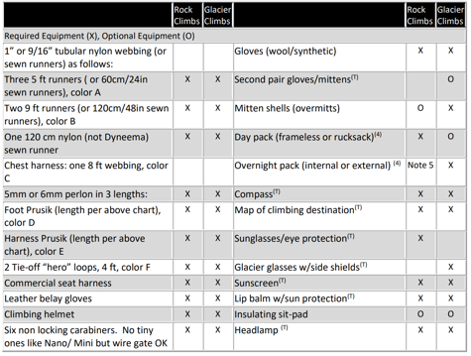
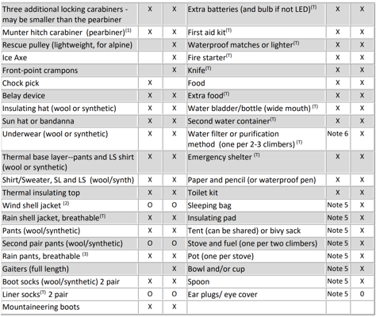
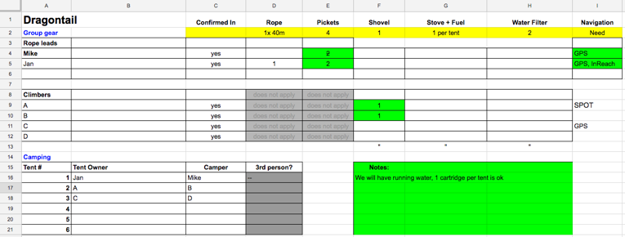
Gear –
Technical personal gear
dependent on climb, see gear matrix
Technical group gear
organized by trip leader
Personal gear
very dependent on conditions,
length and difficulty of approach,
personal comfort tolerance
Resources:
Basic climbing handbook
Discuss with SIG
JA’s climb google sheet.
Every leader handles this differently

Slide 21
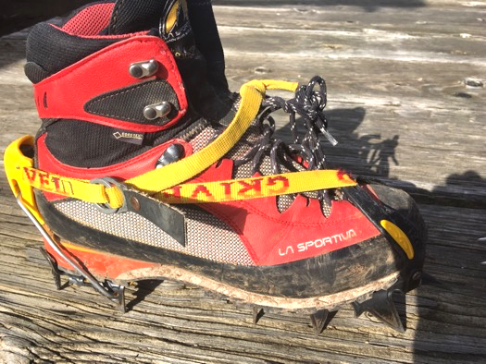
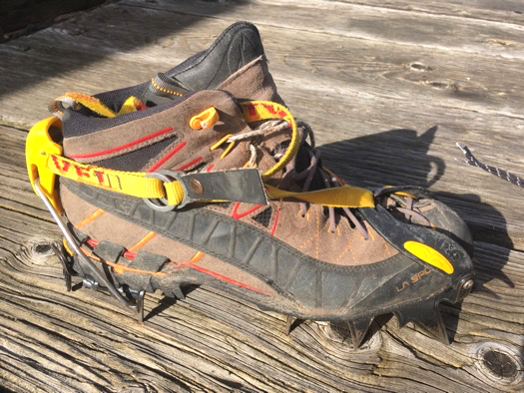
Crampons – make them fit!
YES!
Snug fit
semi-automatic crampon requires ledge at heel
Horizontal front points ok
Steel vs. aluminum – both work for Basic climbs, check with leader if in doubt
Very loose fit
No heel ledge
Hiking boots are too flexible
Check your crampon fit
esp. if you change boots!
NO!

Slide 22
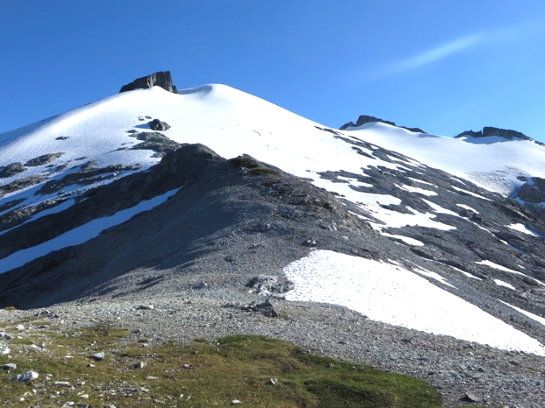
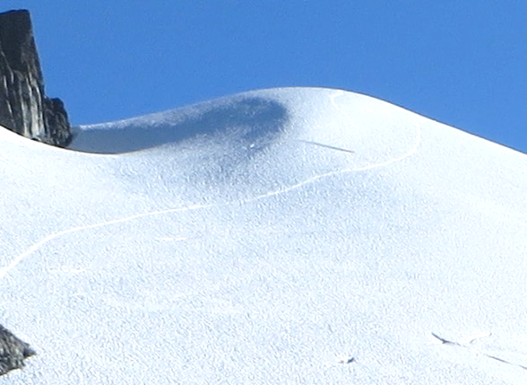
Packing thoughts
Any gear you need right now
will be at the bottom of your pack ;-)
Travel as light as you wish, don’t rely on other people’s gear.
Think if you can double purpose gear.
Technical gear needed on approach?
Mt. Ruth/Icy Peak

Slide 23
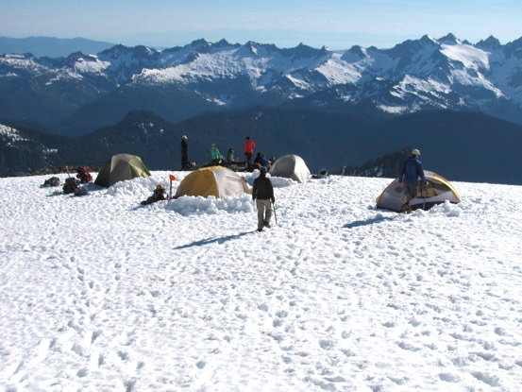
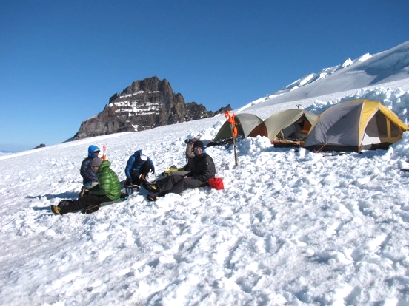
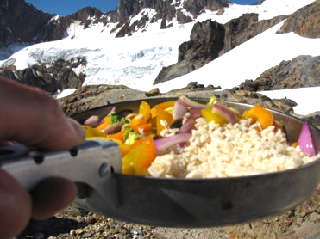
Camp
Glacier trips often 2+ days
Safety – rock fall, avalanche
Shelter – wind exposure
Convenience
location on route,
running water
Gear up for alpine start,
enjoy the view
Mt. Baker / Easton
Mt. Rainier / Emmons

Slide 24
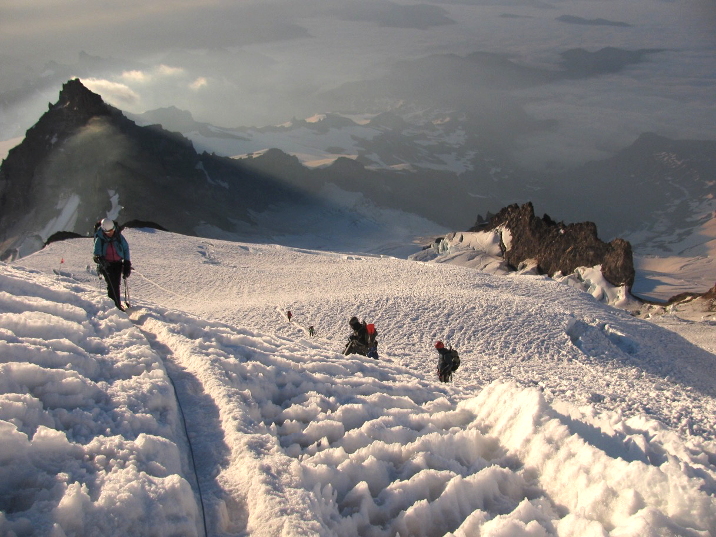
Route decisions – sometimes straightforward
Don’t blindly follow a route though!
Mt. Rainier / DC

Slide 25
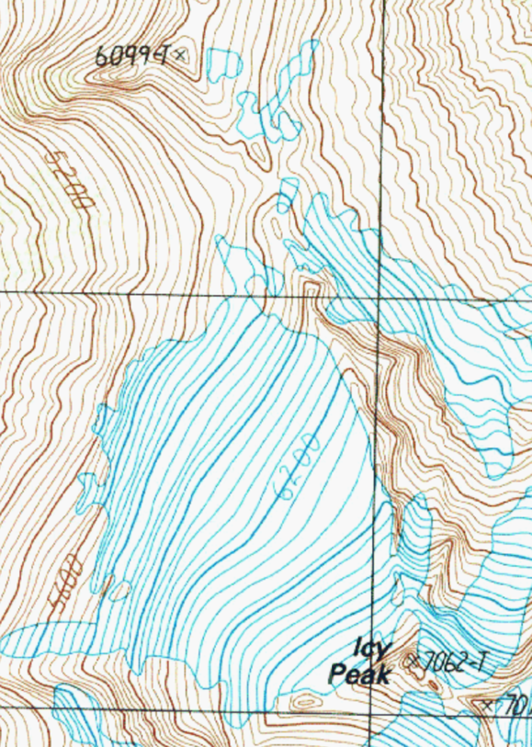
Route decisions – example Ruth/Icy
Climbing Route:
Rope up and traverse glacier S to first notch right (NW) of Ruth summit. Camp on other side of notch on snow if possible, to minimize impact (6,600'): A shovel may be of some use. Traverse W-facing snow slope to S facing ridge leading down to the Ruth-Icy saddle. Rather than going down the normal steep gulley of loose scree and rock leading directly to the saddle area, stay left of the gully and descend a leftwards slanting slope to saddle area (5,800’).
(A) Climb gradual glacier on Icy's NW slope in general SE direction, keeping rock ridge on left and crevasses on right. At about 6,500', head S and traverse top part of glacier at the W face of Icy. (B)
Skirt Icy's W notch and turn up the S side of Icy through talus and snow. Find first prominent gulley and climb to top where rap slings are around a horn. (Fixed line recommended). Summit is a couple steps above and left. Watch for loose rock and wear helmets!
Mount
Ruth
(A)
(B)

Slide 26
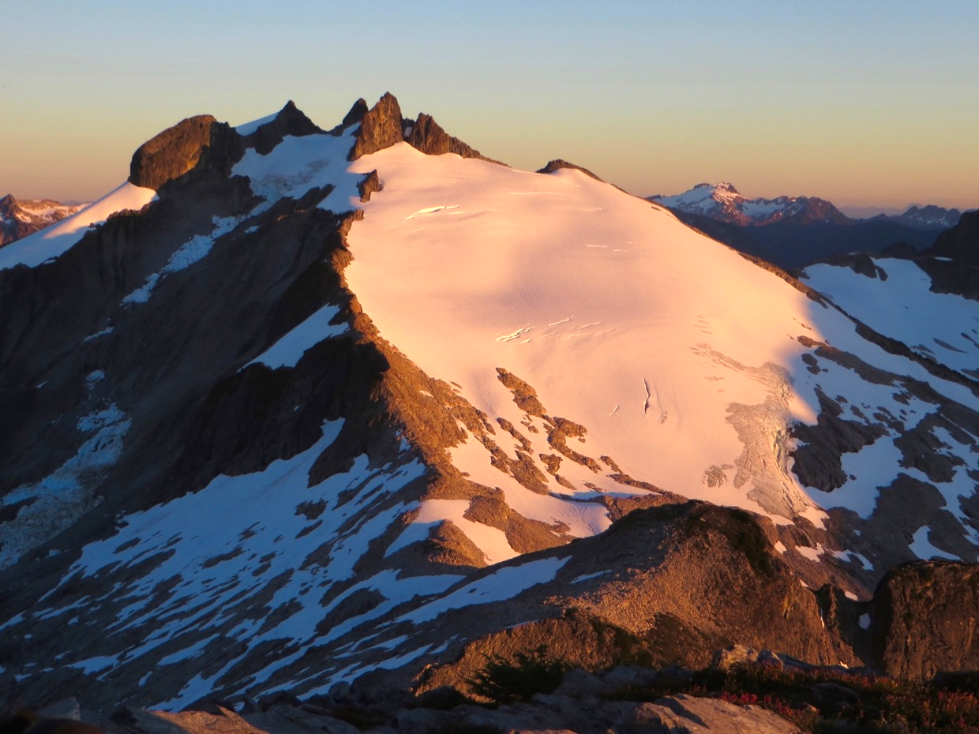
Route decisions – example Ruth/Icy
E
S
(B)
N
W
(A)
Icy peak

Slide 27
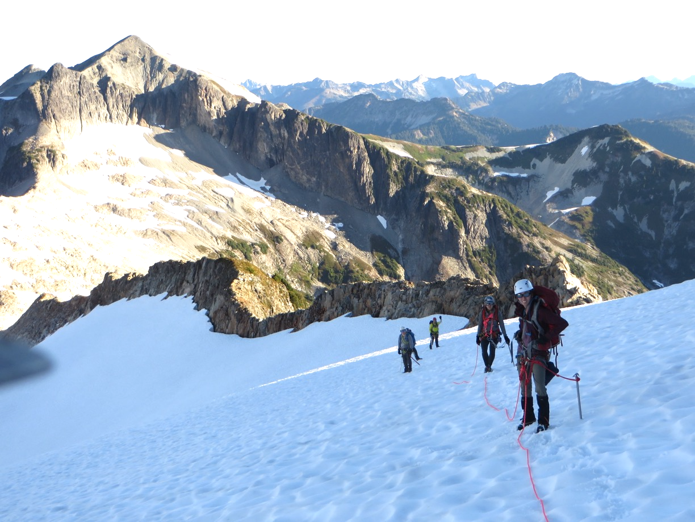
Route decisions – example Ruth/Icy
Icy peak

Slide 28
Route decisions – example Ruth/Icy
E
S
(B)
N
W
(A)

Slide 29
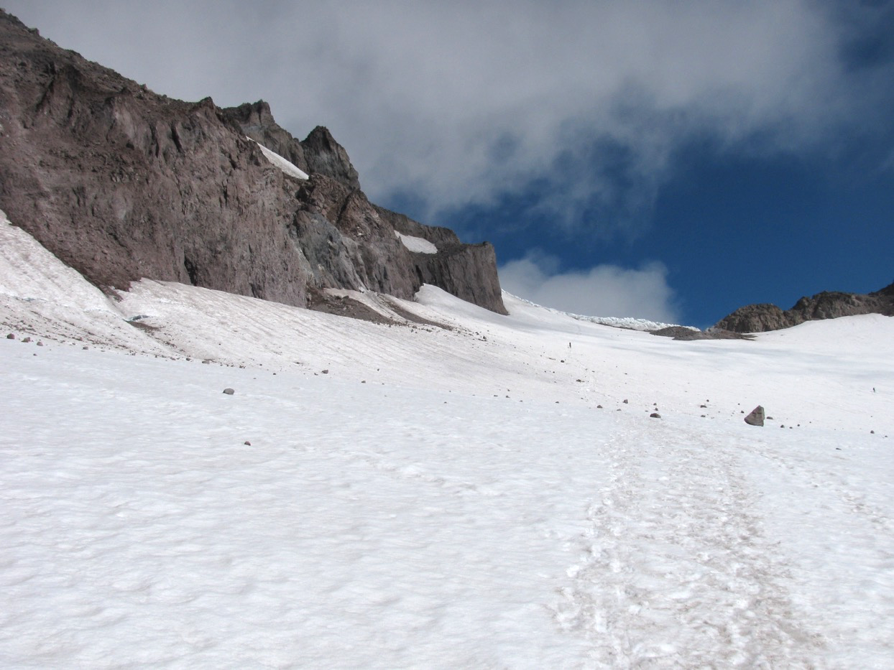
Route decisions – rock / ice fall
Try to avoid obvious rock fall zones.
Sun exposure might increase rock fall.
Try to travel early.
Move fast!
Glacier
peak

Slide 30
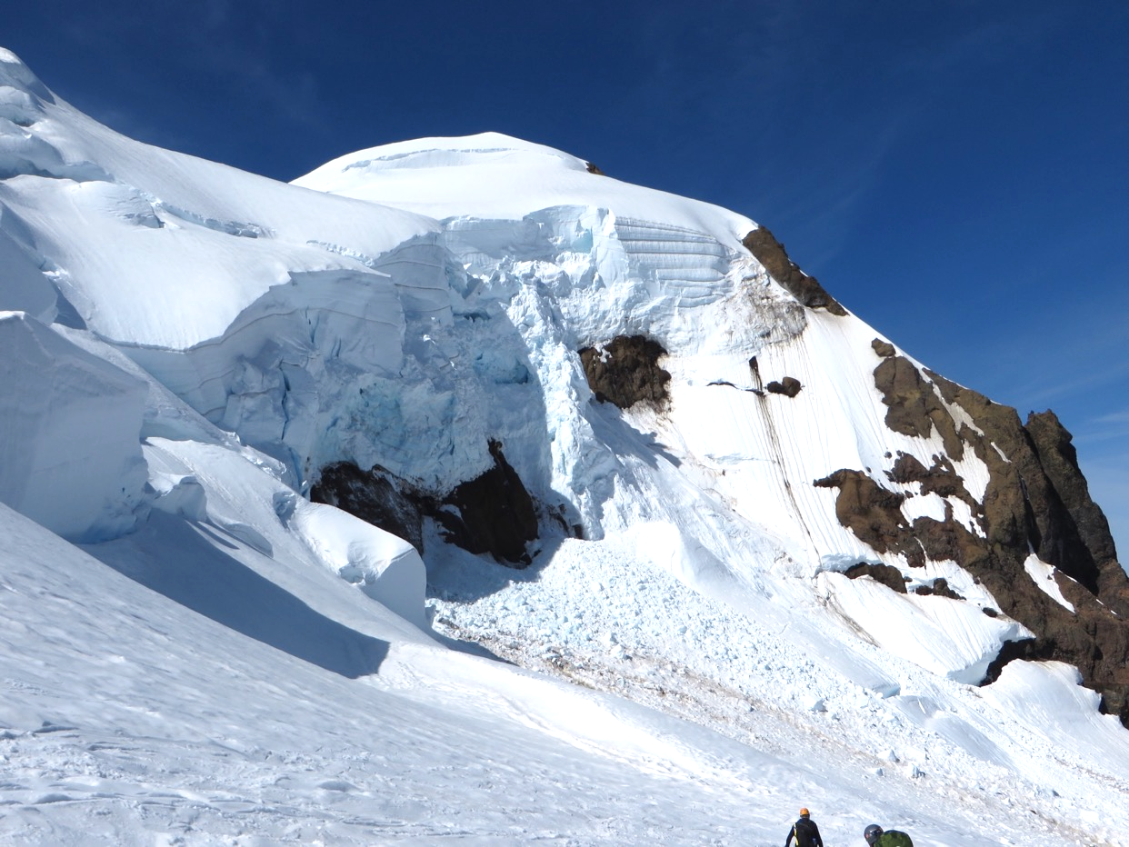
Route decisions – rock / ice fall
Try to avoid obvious ice fall zones.
Sun exposure might increase rock fall.
Try to travel early.
Move fast!
Mt. Baker
Coleman

Slide 31
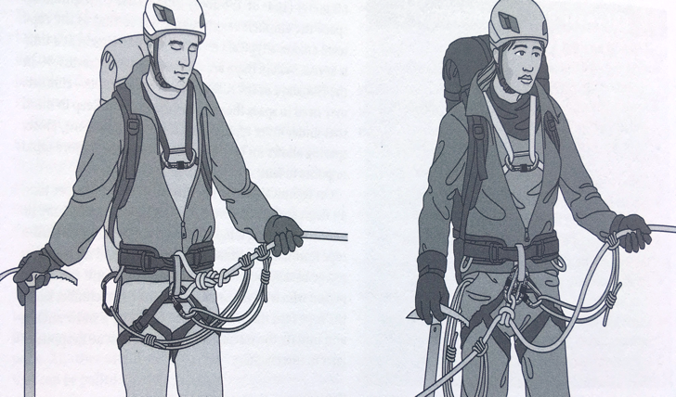
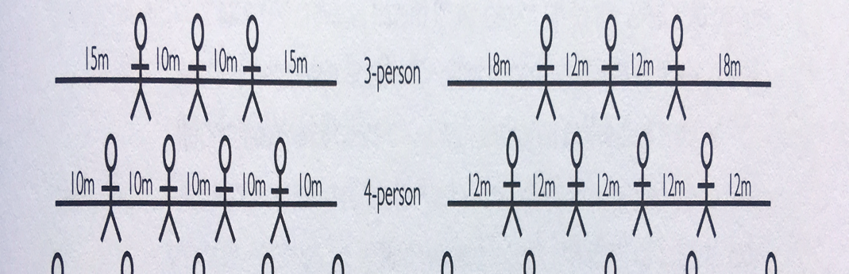
Rope teams – tie in
Tie in with figure 8 or butterfly.
Backup carabiner for butterfly.
Consider extra rescue rope for climbers at the end.
Prusik slings.
Partner check!
FoTH 9
Andy Selters,
Glacier travel and crevasse rescue

Slide 32
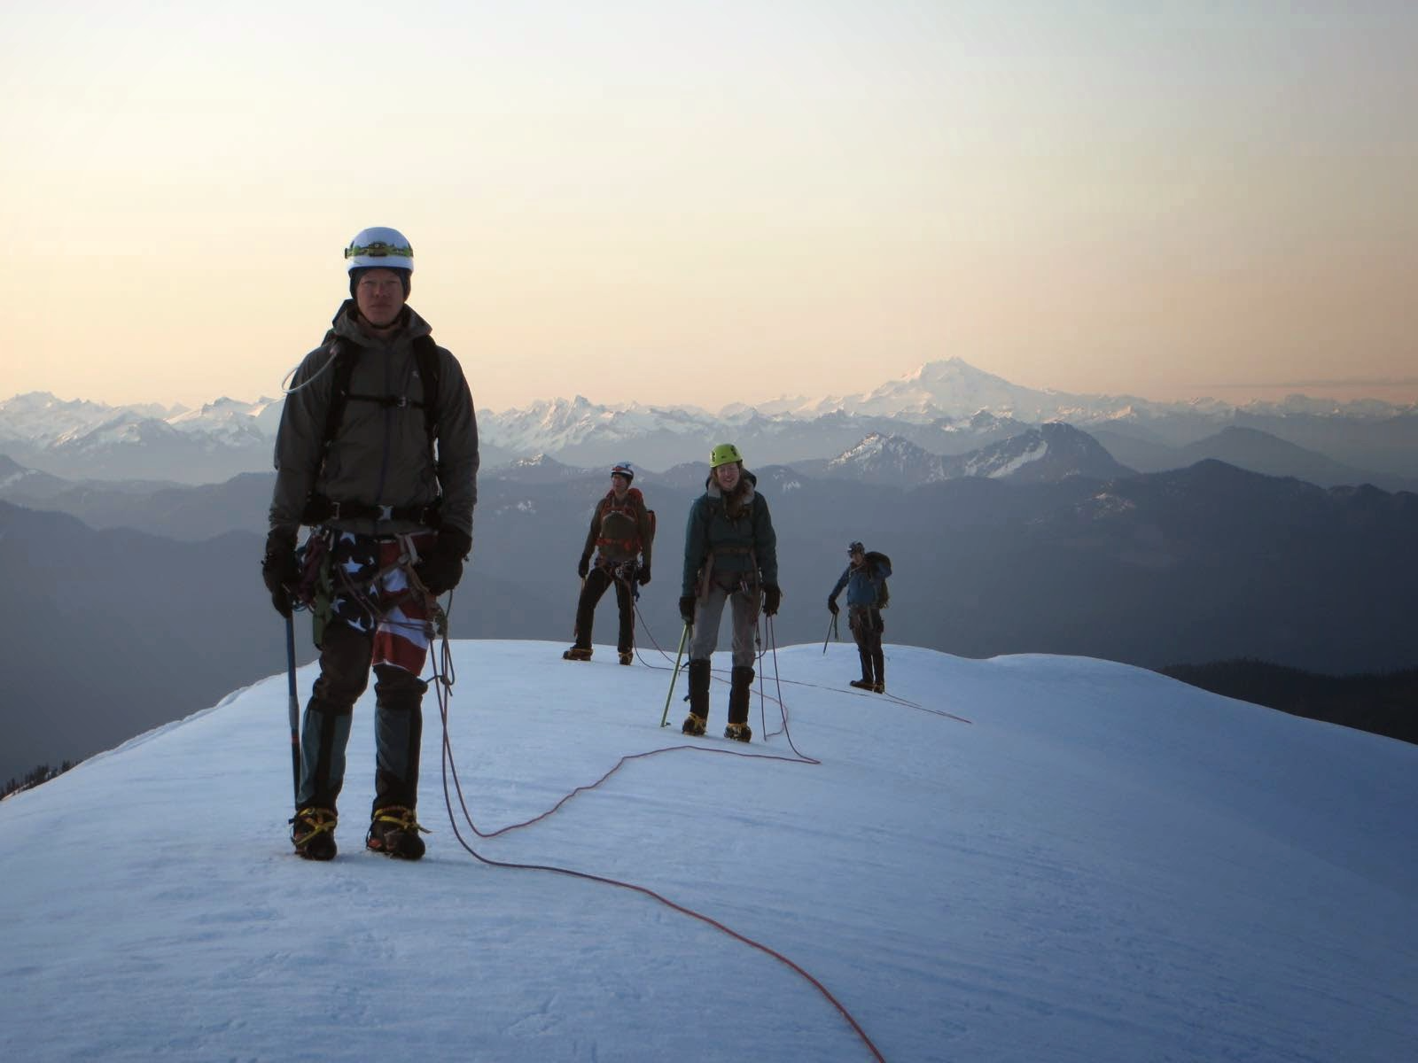
Rope teams – keep the slack out!
Lots of slack in ropes.
Imagine fall
Try to avoid this.
Picture taken during snow field trip, no students hurt ☺
Mt. Baker

Slide 33
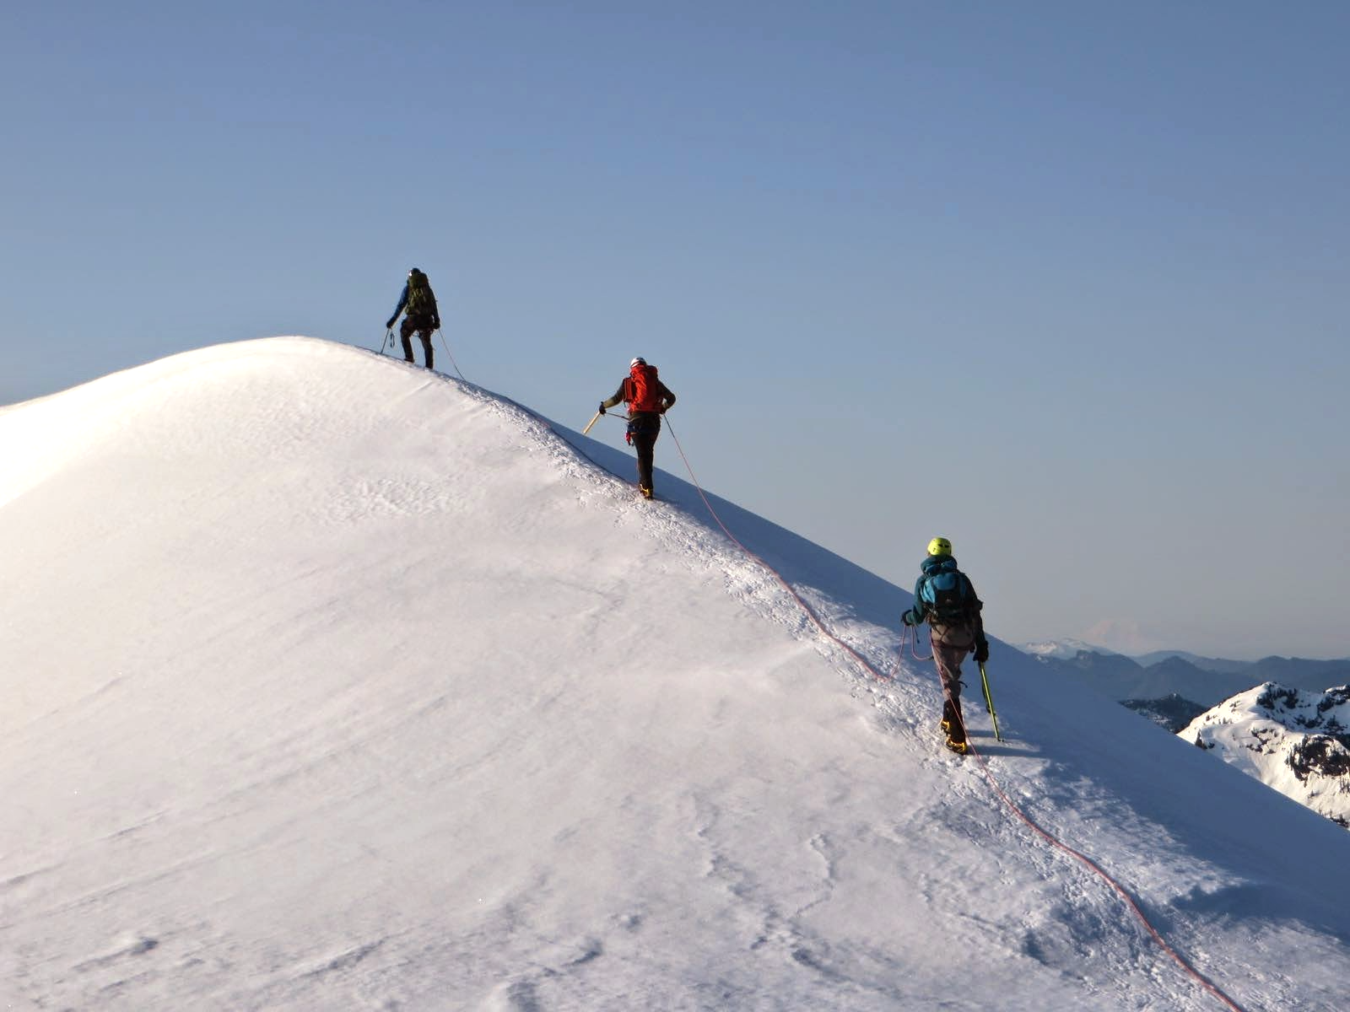
Rope teams – keep the slack out!
Same FT
Better rope management
Mt. Baker

Slide 34
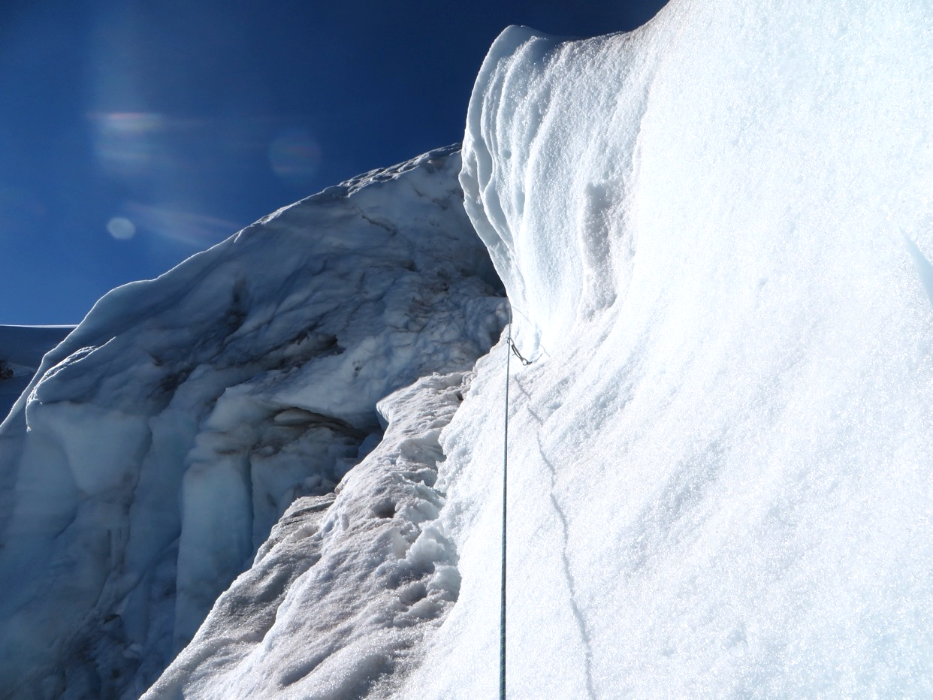
Rope teams – running belay
Exposed travel, steep snow/ice, traverses
Arrest not likely,
Picket, ice screw, rock protection.
This picture shows a belayed pitch on an ice climb
Mt. Baker
N Ridge

Slide 35
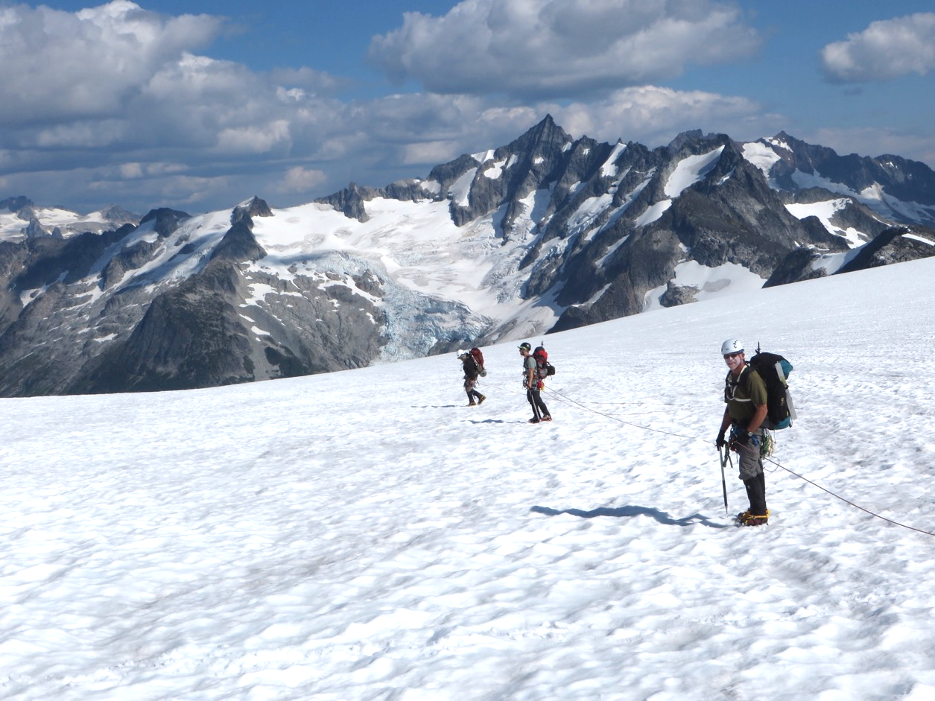
Rope teams – Echelon
Crevasses along direction of travel.
Fall could lead to pendulum.
Rope team travels perpendicular to crevasses.
Eldorado Pk.
Inspiration
glacier

Slide 36
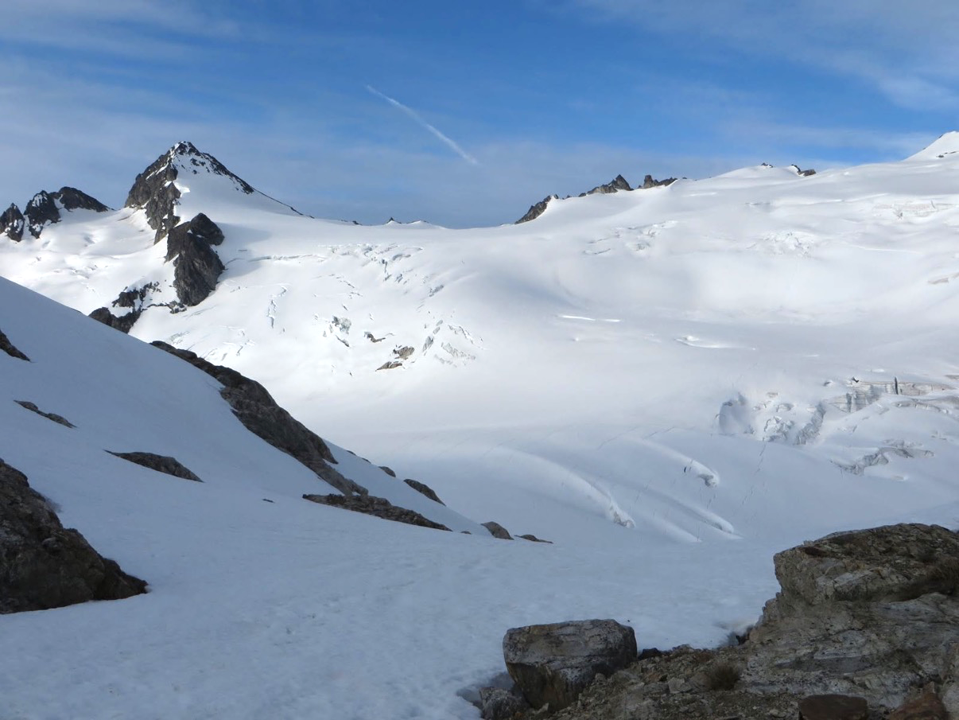
Crevasses!
Good decisions needed.
Snowfield peak

Slide 37
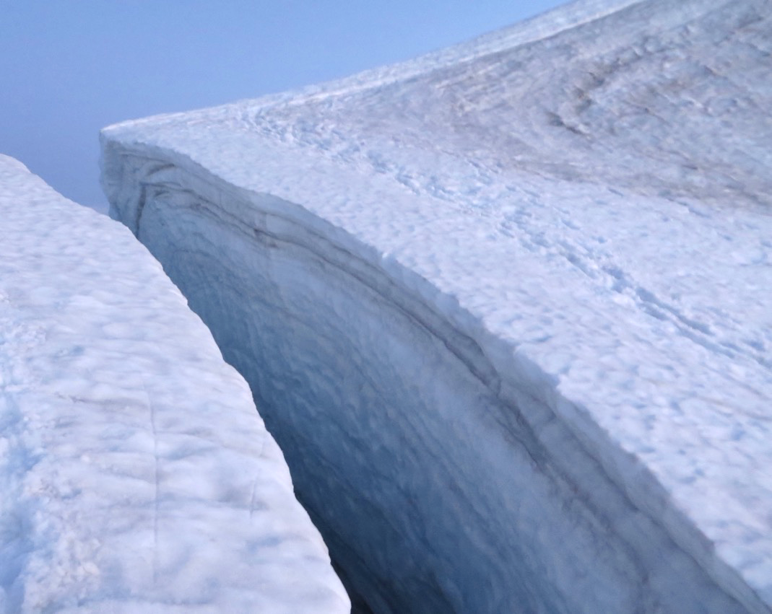
Crevasses!
Stay clear of huge ones!
Eldorado peak

Slide 38
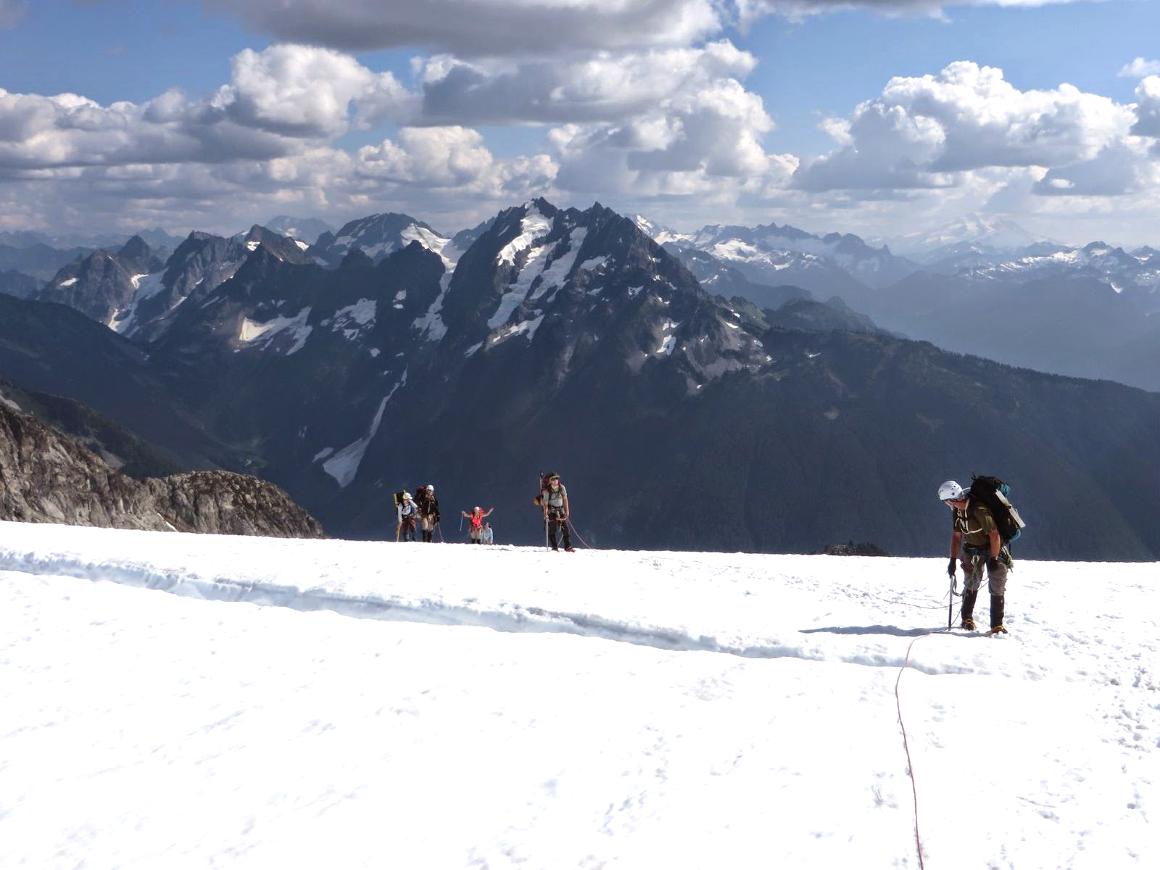
Crevasses!
Step over little ones.
Narrower on climbers left.
Eldorado
peak

Slide 39
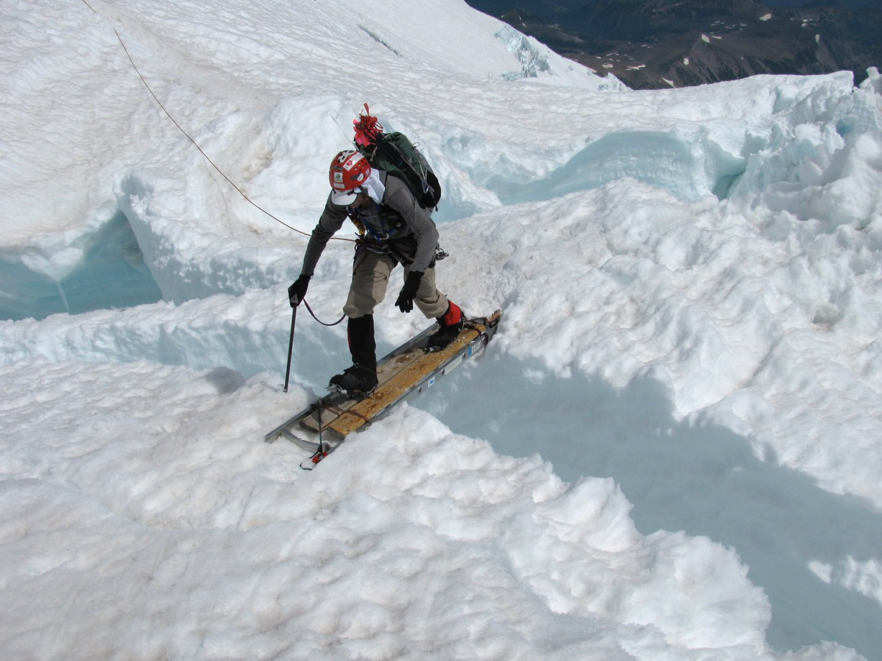
Crevasses!
Ladders on Rainier
Mt. Rainier
via DC

Slide 40
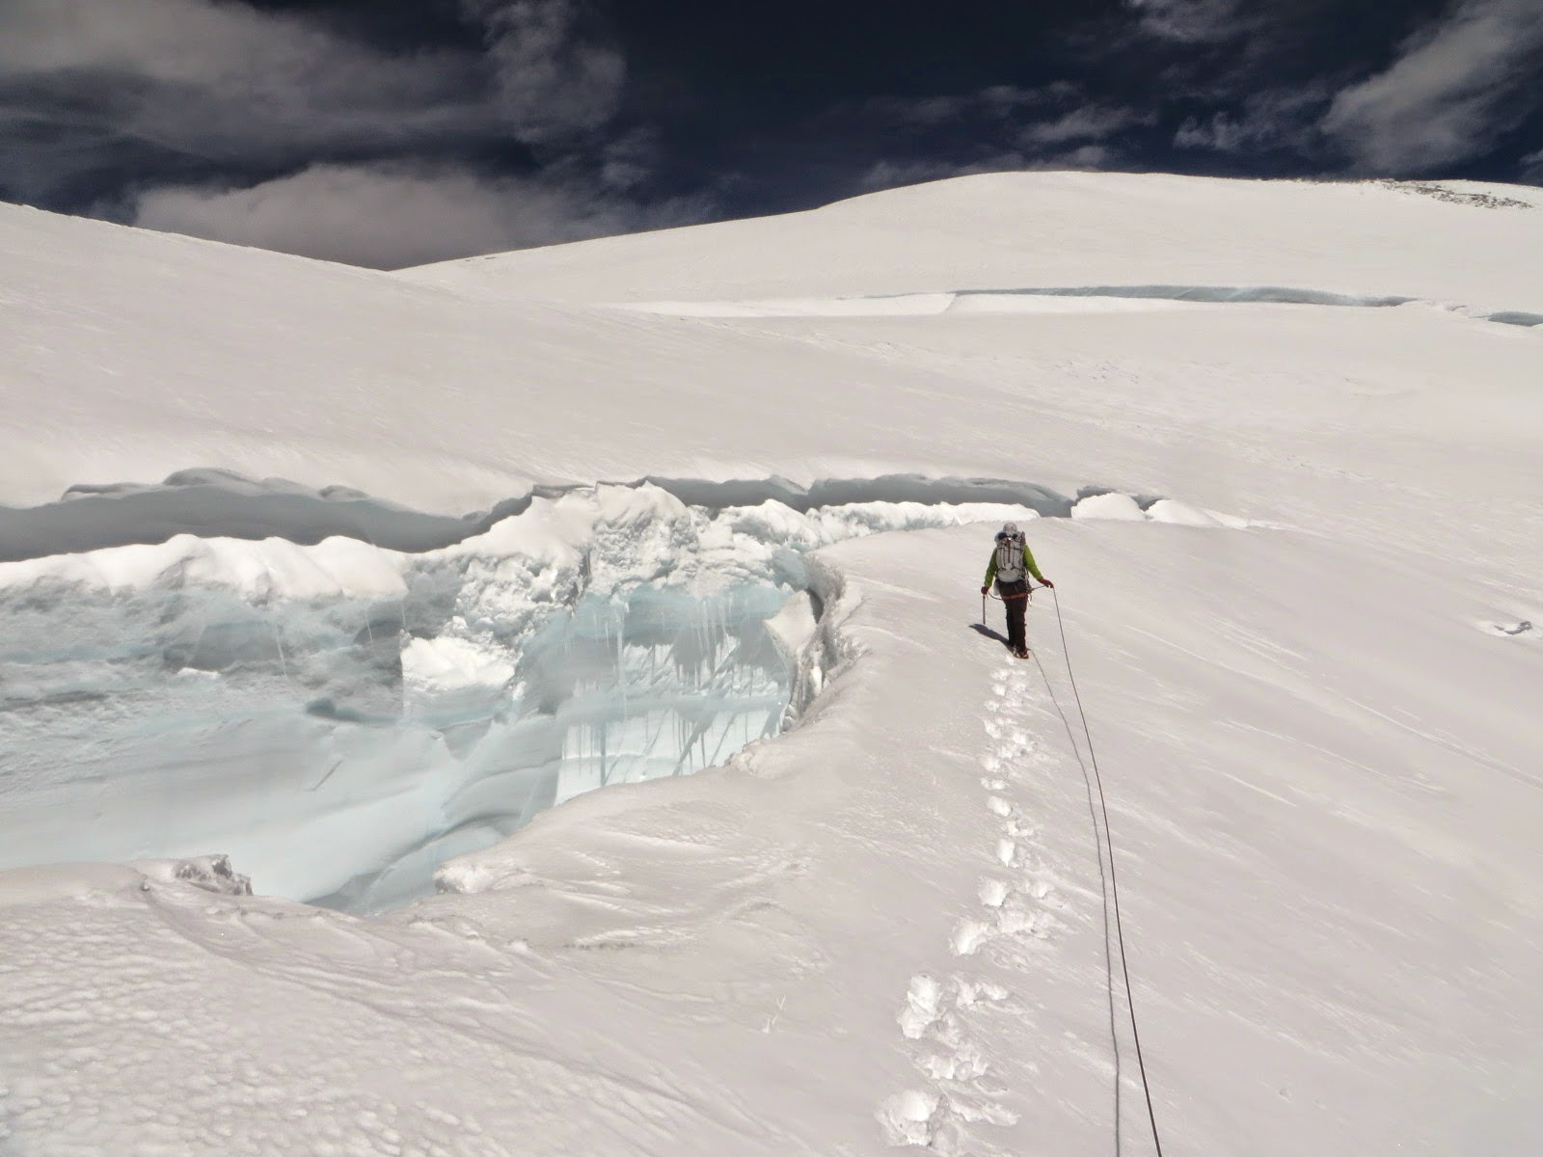
Crevasses!
End run a large one.
Mt. Rainier
Kautz

Slide 41
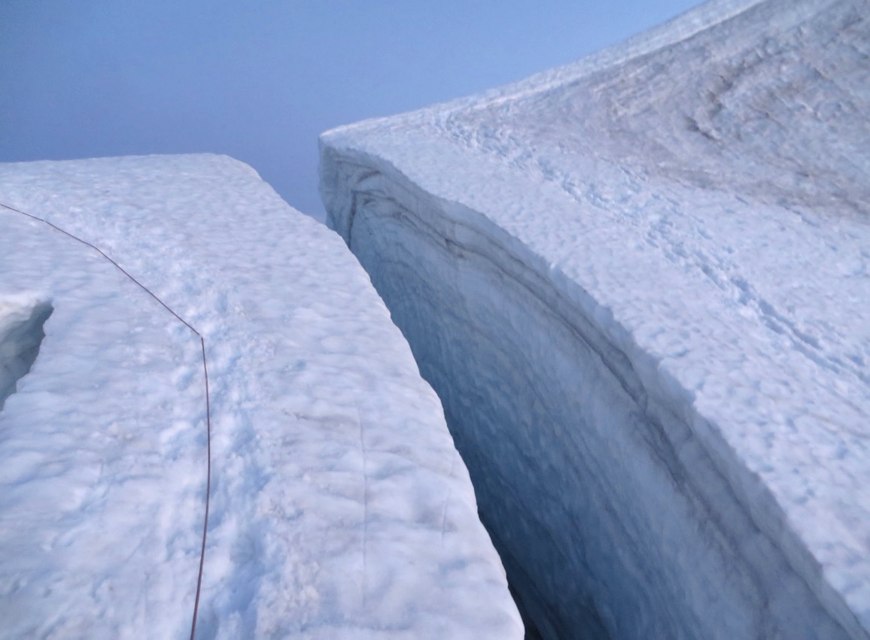
Crevasses!
Tricky one!
Try to keep slack out of rope!
Eldorado peak

Slide 42
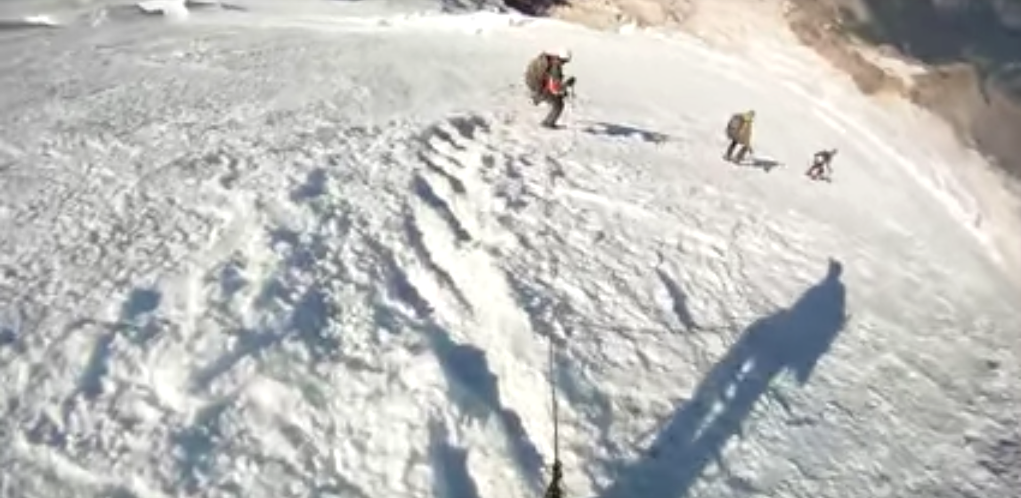
Holding a fall – fairly benign case
https://www.youtube.com/watch?v=CNmRqwsggws

Slide 43

Holding a fall – worst best case!
https://www.youtube.com/watch?v=TkMDUGqiB4A

Slide 44
Crevasse rescue
Rope up for glacier travel
Hold the fall
Anchor the rope, including backup.
Communicate with fallen climber.
Safely approach crevasse, communicate.
Make a plan how to extract fallen climber. Emergency help needed?
Extract fallen climber – Texas prusik, team pull,
set up raising system, consider rope entrenchment.

Slide 45

Crevasse rescue illustrated
Check out Deling Ren’s
An Illustration to Crevasse Rescue (link)

Slide 46

Title
Be safe and
enjoy your glacier trips!
Bullet

