Slide 1
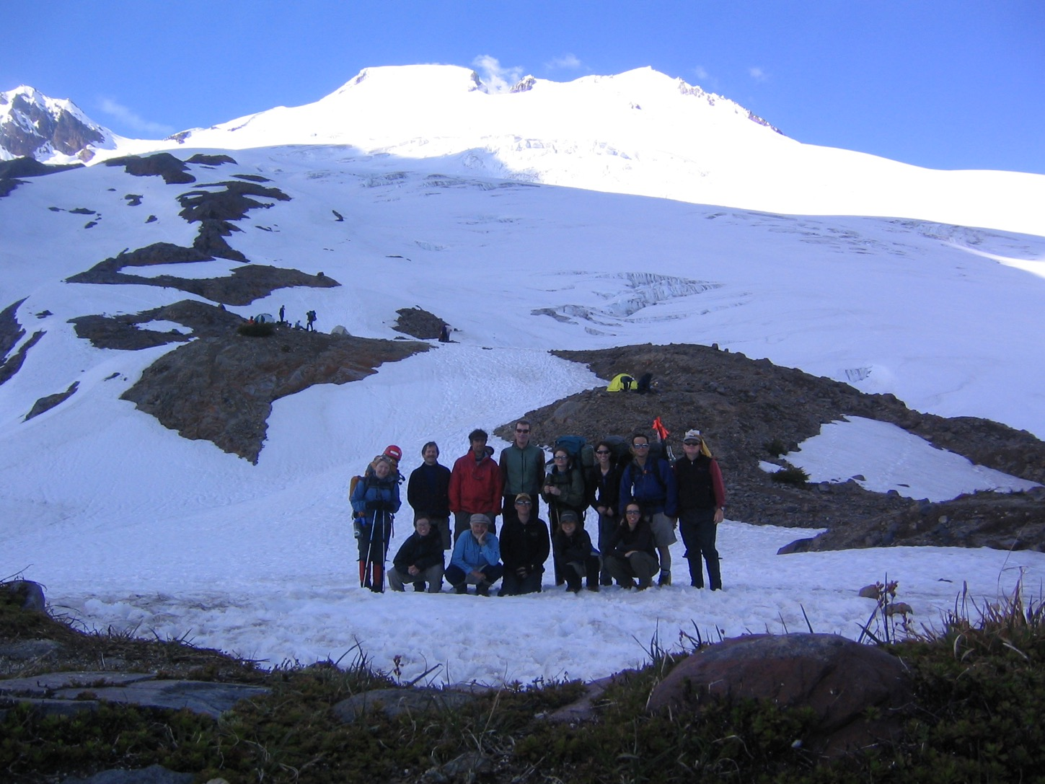
THE CLIMBING PARTY
and Your Role In It
Notes:
Most of our course is TECHNICAL
This will be different
We thought SOMEWHERE we ought to address fact that climbing is …

Slide 2
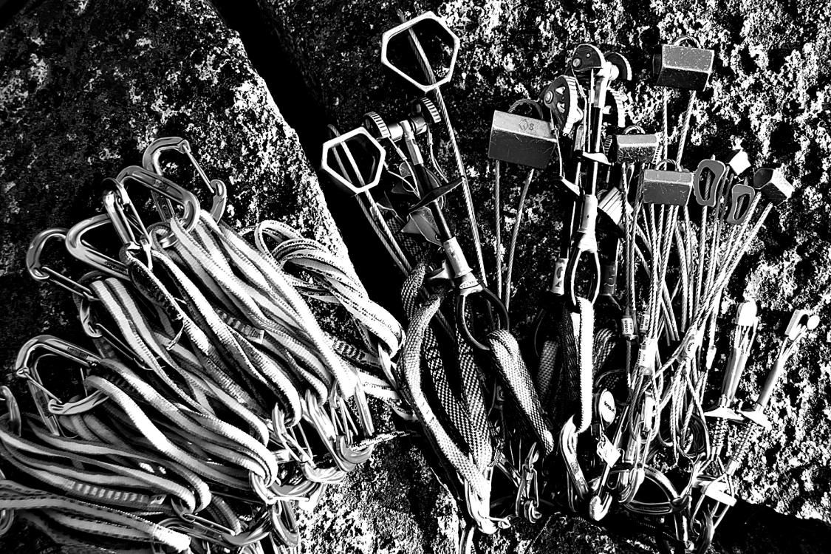
It’s NOT all about knots
and carabiners
Notes:
… NOT just about knots and carabiners!
Also about attitude, emotion, aesthetics, and gaining some wisdom about mountain travel.

Slide 3
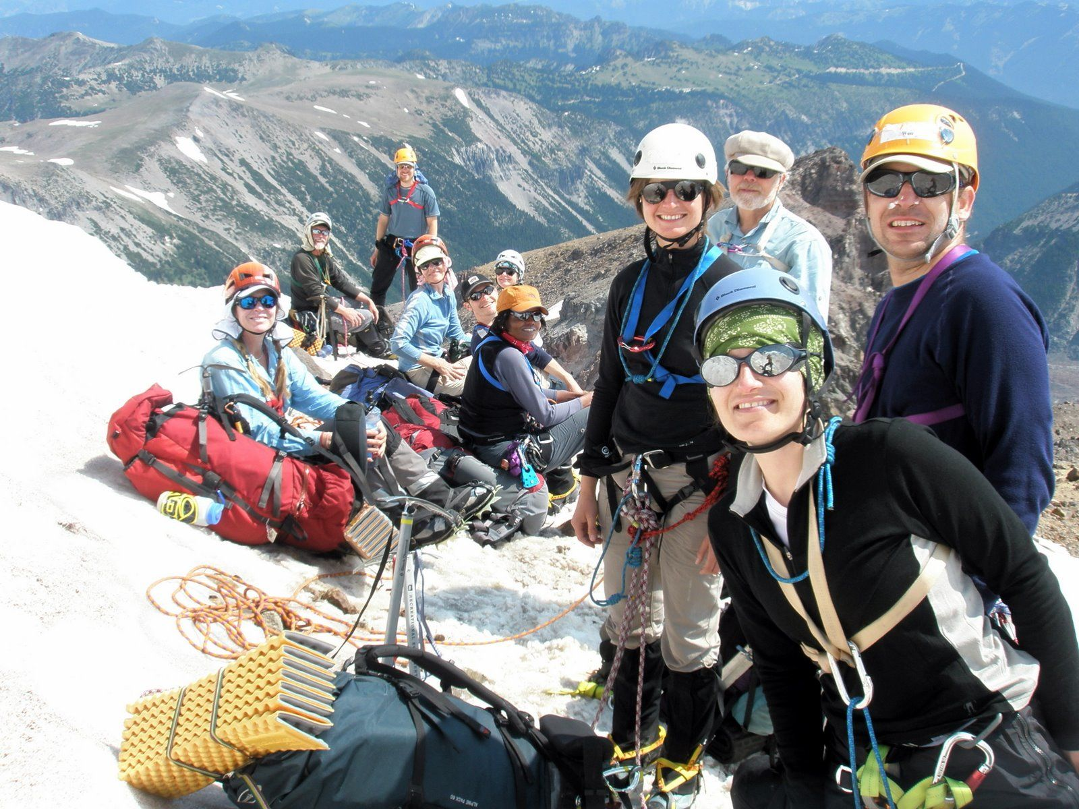
Notes:
And above all, it’s about PEOPLE • [on approach, Emmons]
HERE for ½ hour, not talking about how to CLIMB
But about how to BE a CLIMBER. •The soft skills needed
Mostly about the social part – Also some non-technical skills (wisdom)

Slide 4
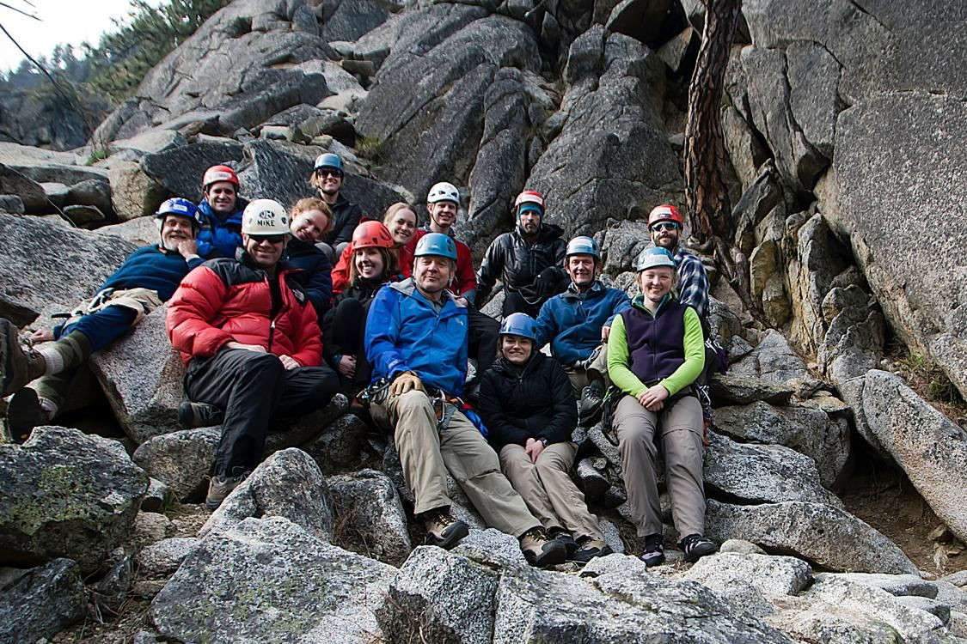
Notes:
[SIG @ Mountaineers Dome]
Note that ch 21 was assigned - Leadership Some of you – our future leaders, but a few years off, so Why?
Because it is about how a PARTY functions- as a group of interdependent people
Last section of Chapter – “Everyone a Leader”
Handbook, p.1, “Not a guide service” You’ll hear that a lot
Means everyone is a fully responsible member
Means everyone needs to think about the party – as a leader does.

Slide 5
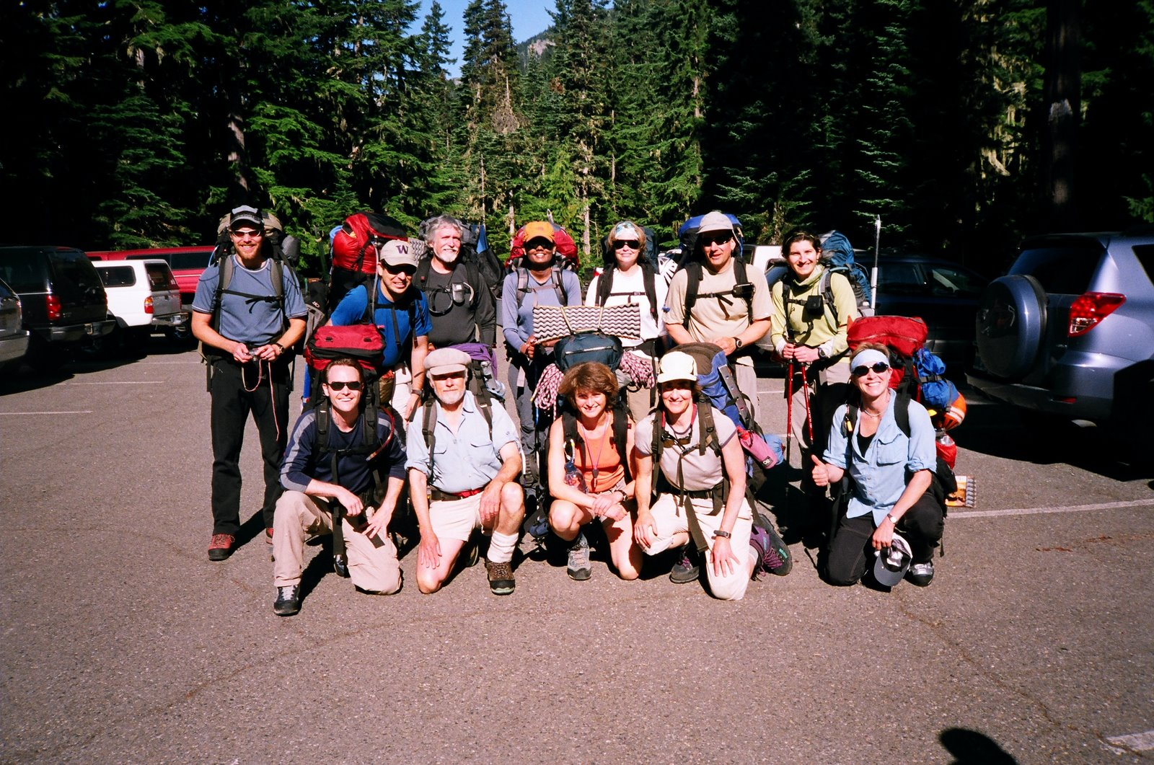
The Happy Climbers (before)
Notes:
[Sahale]
Going on imaginary climb Illustrated with a slides … and a few war stories. Here we are at the trailhead
For this day or this weekend, these are the most important people in the world to you. Your family. Treat them like it.

Slide 6
Clothing & Equipment • Matrix in your Handbook • Trade-off: - Comfort & safety v weight - How do you know? • Study your pack after climbs
What to take?
Notes:
GETTING READY – What to take? Matrix in your Handbook
We’ll tell you to take lots of stuff
Most take too much – But how do you know?
Individual matter. Let experience tell you:
Be archaeologist of your own pack. Check what you DON’T use
[STORY] 2nd pair wool pants But … [STORY] …pile pants

Slide 7
What to take?
Food • Take some extra
• Most take too much
• Take food you like
Notes:
Exertion suppresses appetite – so take food you like
My favorite – Oatmeal Cookies . Nature’s perfect food
About to go on imaginary climb
To enhance vicarious experience
>>>>[H/O COOKIES] <<<<

Slide 8
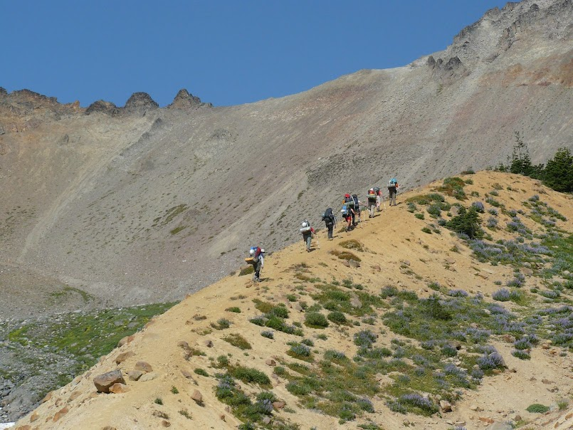
The Approach
Navigation
Notes:
[Moraine on Emmons approach] NOW going up trail
Memories: following boots up trail •Participate! Don’t wait to be led
ORIENT at trailhead •See self from above
Practice. Get map & route description. Try to follow on map
More than one leader has been saved from error … alert student

Slide 9
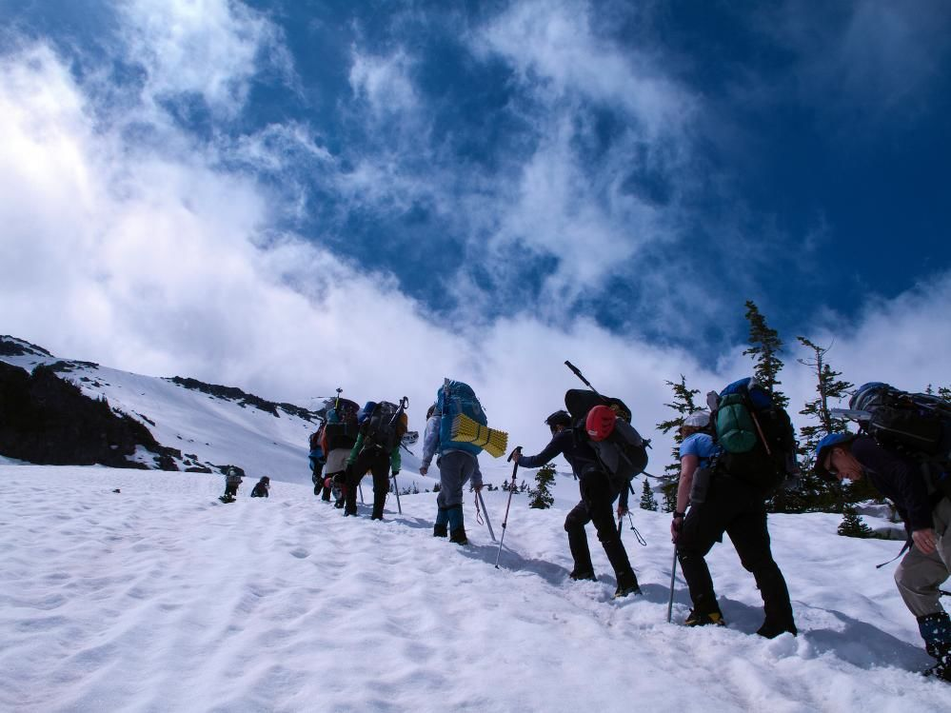
The group comes together
Notes:
[Approach to Little T] Getting to know each other. Group of strangers
[my History – Now group is best part]
Marvel how they pull together – Everyone on best behavior. Party is little social miracle
BUT, don’t take for granted. WORK at it
Talk – introduce – Look for ways to help
Everybody take on leadership duties • Cohesion adds hugely to party strength
[STORY Dr. on Rainier (dead guy – snarky). So take responsibility

Slide 10
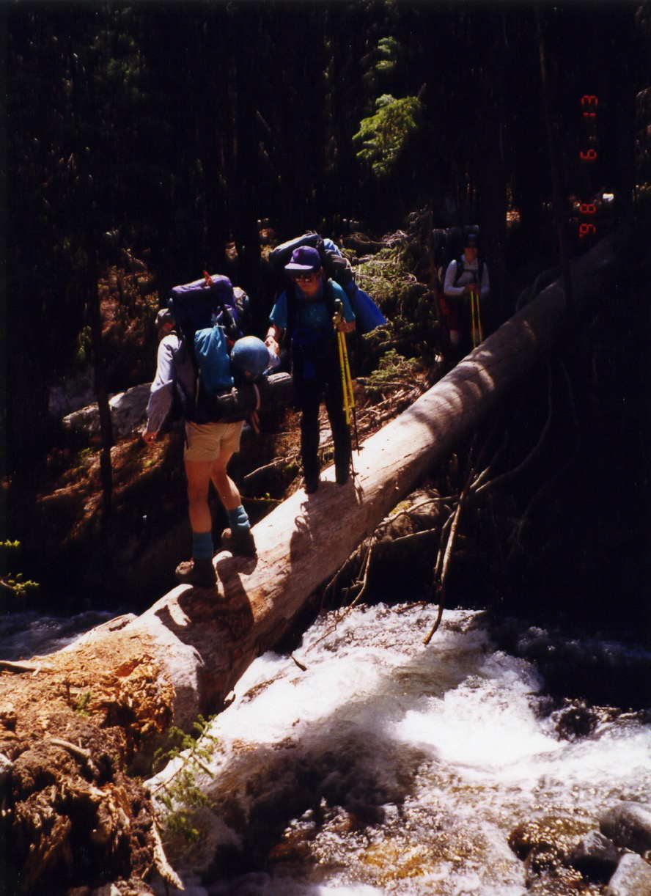
Careful Here!
Not all the danger is at high elevation
Notes:
[Approach to Silver Star]
Help keep party together – especially going OUT
Stronger tend to jet ahead – Leaving weakest alone, just as accidents most likely.
Good rule: Regroup at trail junctions & difficult places.

Slide 11
EFFICIENCY
Is Not Necessarily Speed
• Organize
• Think ahead
• Keep moving
Notes:
SPEED – can be important – Safety
• Off technical terrain before dark • Out of couloir before sun hits (Erica)
SECRET FEAR: Will I be the party wimp? [our little morality play]
What is speed? • NOT how fast you walk, but how well you use your time.
[NOW PROGRESS SLIDE BULLETS]
Breaks: Organize Pack – Eat/ Drink/ Clothing. What’s on top of pack?
DON’T move faster than you can sustain – But DO Keep Moving
That’s what rest step is about.

Slide 12
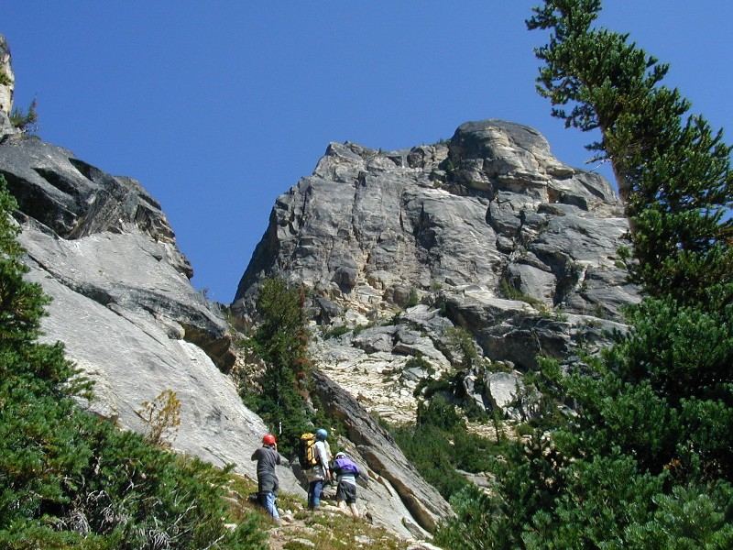
First View of Kangaroo Temple
Notes:
NOW we rejoin our climb.
[SHOW route on slide]
Note: Helmets on already. Why??

Slide 13
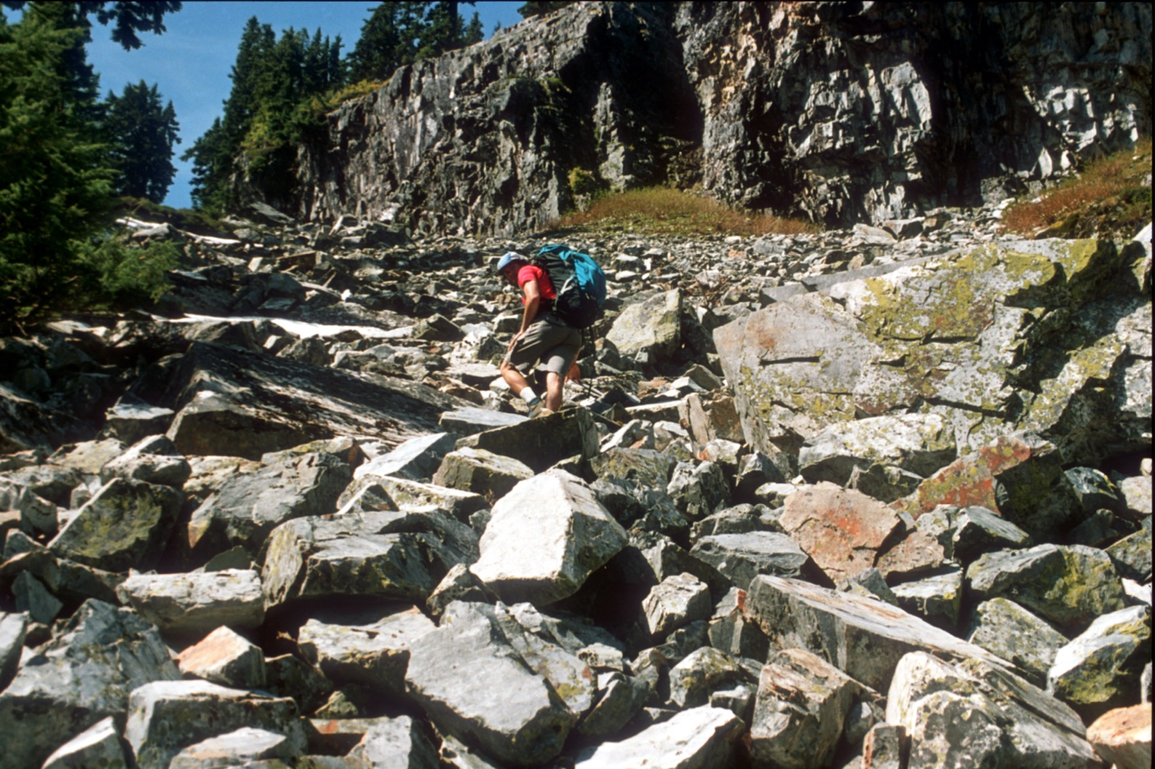
Talus
Notes:
[Approach to The Tooth]
Talus – Sharp, uneven footing, may roll – Test footing
Wear helmet – protects from rockfall – Also from YOU falling on rock.

Slide 14
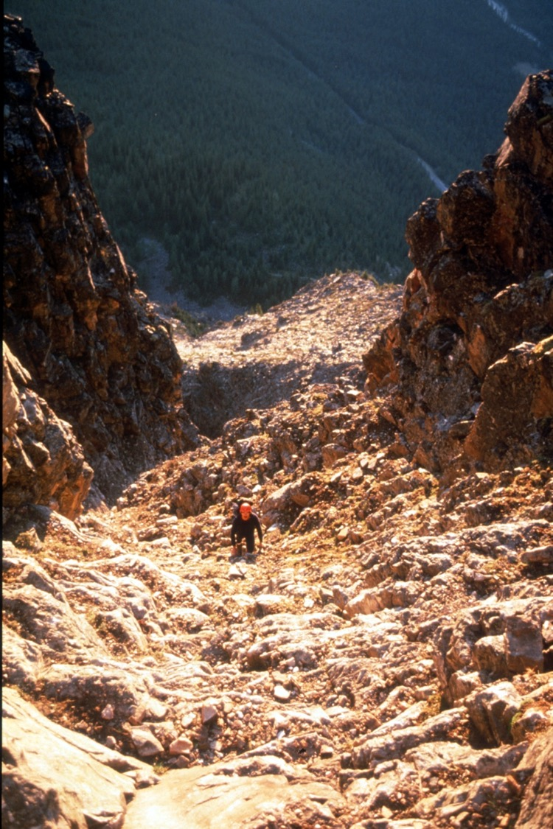
The Couloir - a dangerous place
Notes:
The COULIOR (French for ugly gully) [Mt Temple, in Canada]
Geology – less competent rock
Soft, low angle LOOSE STUFF = DANGER
Rockfall actually injures more climbers than falling
Rules of Engagement: Helmet!
Move CAREFULLY – Difference between experienced and novice
Believe it or not, IS a skill – LEARN IT

Slide 15
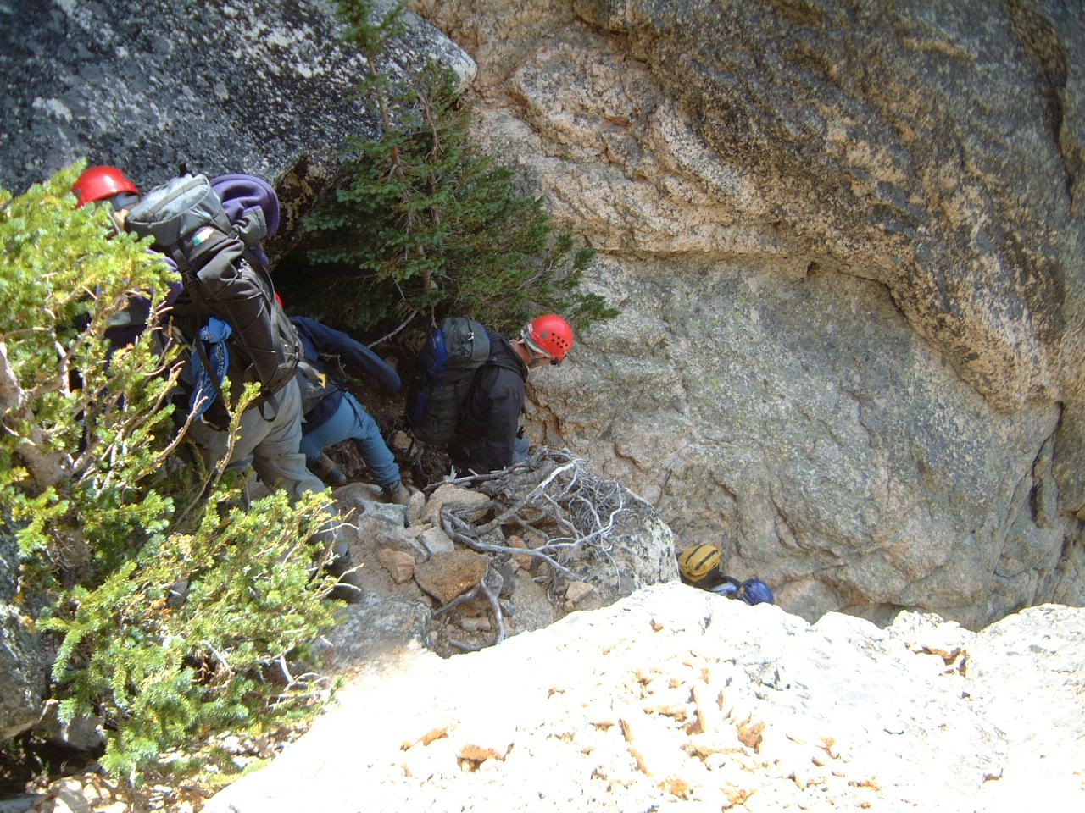
Notes:
[DESCENT FROM KANGAROO TEMPLE]
STRATEGY: • Bunch up nose to tail/ • In groups (look at the loose rock!)
ROPE in the couloir? Maybe, but … May dislodge loose rock
… and where will it go ??
On Descent, rappel of downclimb the couloir? A trade-off…

Slide 16
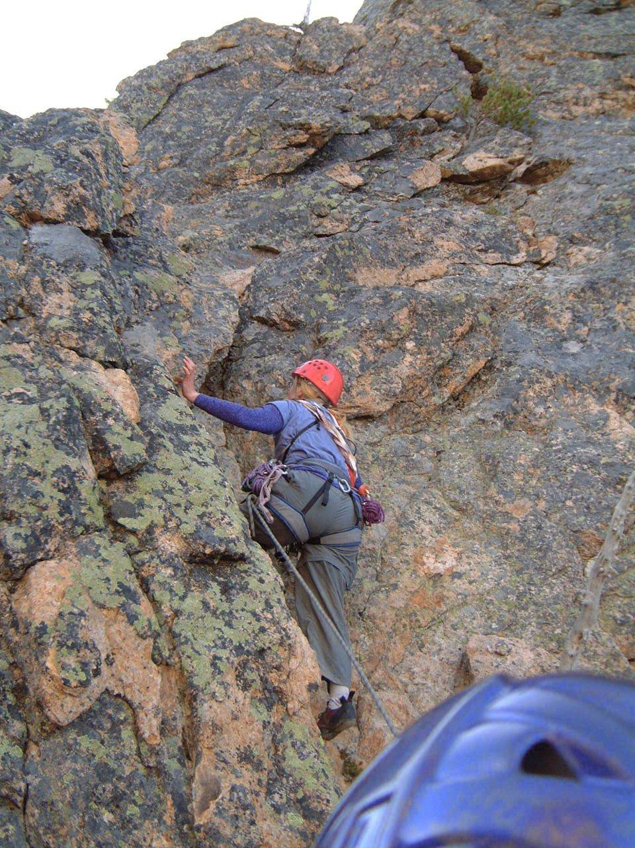
Leader Starts Up
Notes:
[First Pitch, Kangaroo Temple]
Now, finally starting the CLIMB.
LEADING OUT
Test holds • YELL!! Rock, Rock, Rock!!

Slide 17
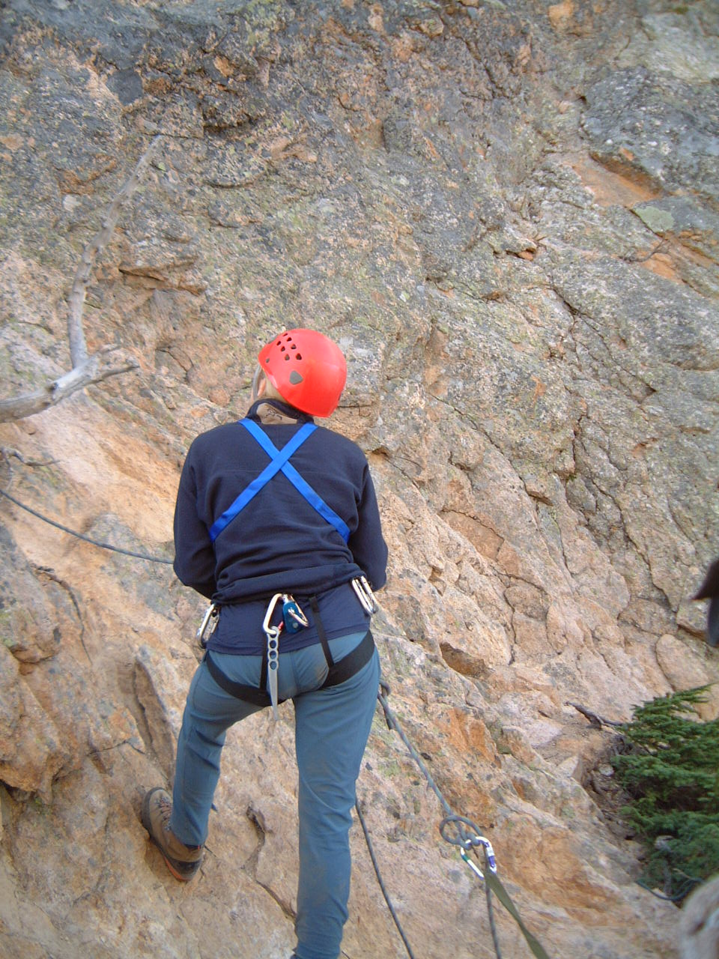
Put Yourself in This Picture
Notes:
Exemplary belay here
In F/Ts it’s been rules and procedures
Now, it’s about you taking care of your friend – with good, alert technique.

Slide 18
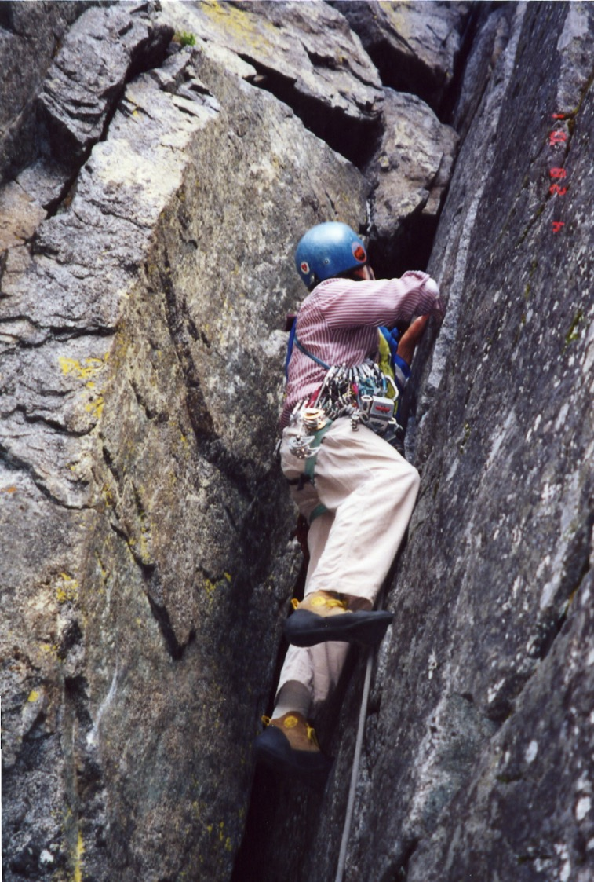
Leader setting pro
Notes:
[First pitch on Midway, Castle Rock]
Leader goes first, places pro

Slide 19
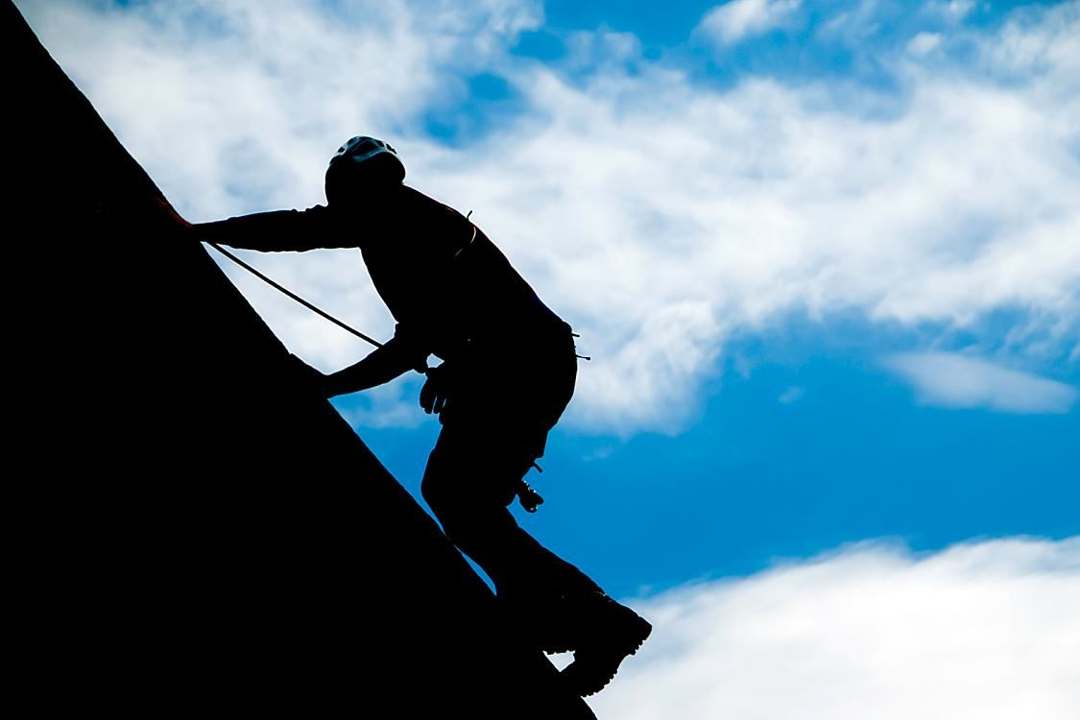
Notes:
You will follow, top-roped, cleaning and collecting pro
Probably you will climb with pack – for the two of you.

Slide 20
Exposure, Fear, & Danger
Let us consider:
Notes:
Define Exposure
Anxiety is GOOD – last rope partner I want is a Fearless one!
But should not be Paralyzing • One of the Wisdoms
For most people after experience, something “clicks”

Slide 21
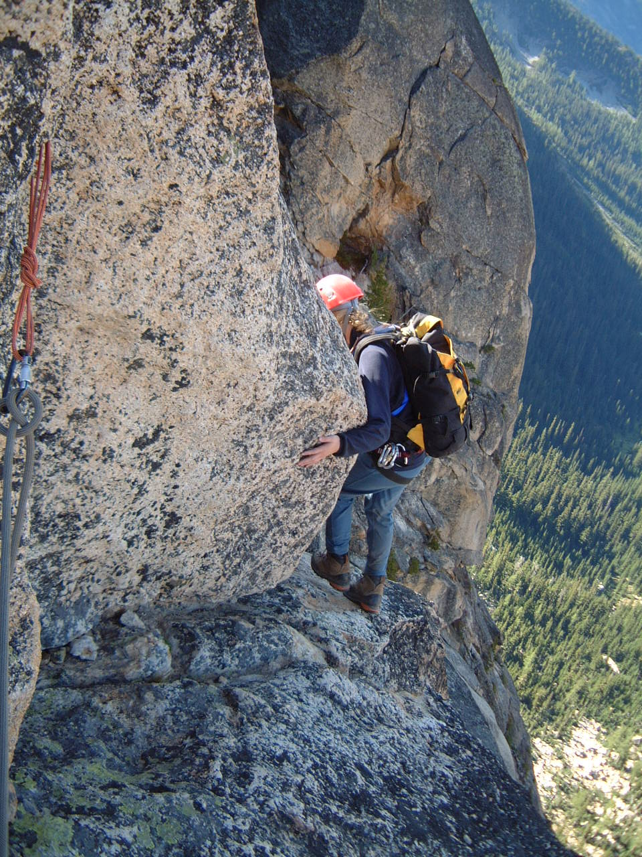
Kangaroo Temple ---- Starting Around the Corner
Notes:
[KANGAROO TEMPLE – the infamous step-around]

Slide 22
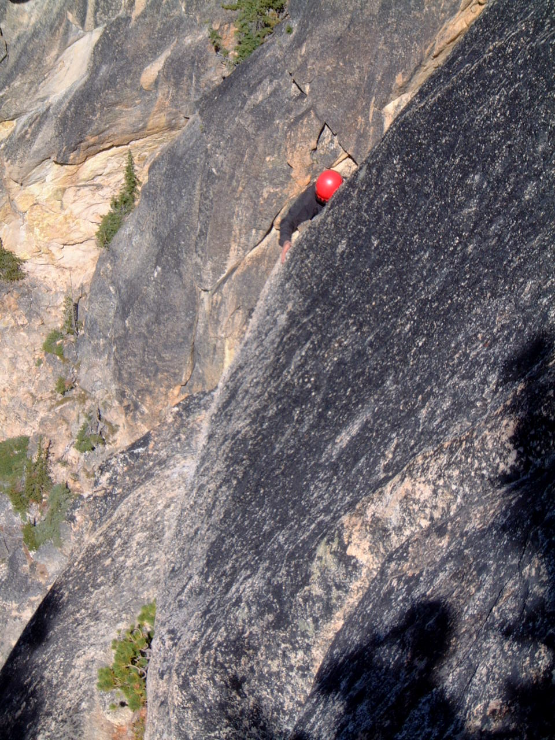
Exposure (It’s 500’ straight down) Yikes!! ------ Guaranteed to get your attention
You
Notes:
THIS is what’s around the corner. Gasp!
Surprisingly, we need to LEARN difference between fear and danger
Industry – 30’= fatal. So does it really mater 300’ or 3,000 ?
But 10’ unprotected and fall on broken rock …
YOU will be top-roped-
So little actual danger IF everyone does what you’ve been taught

Slide 23
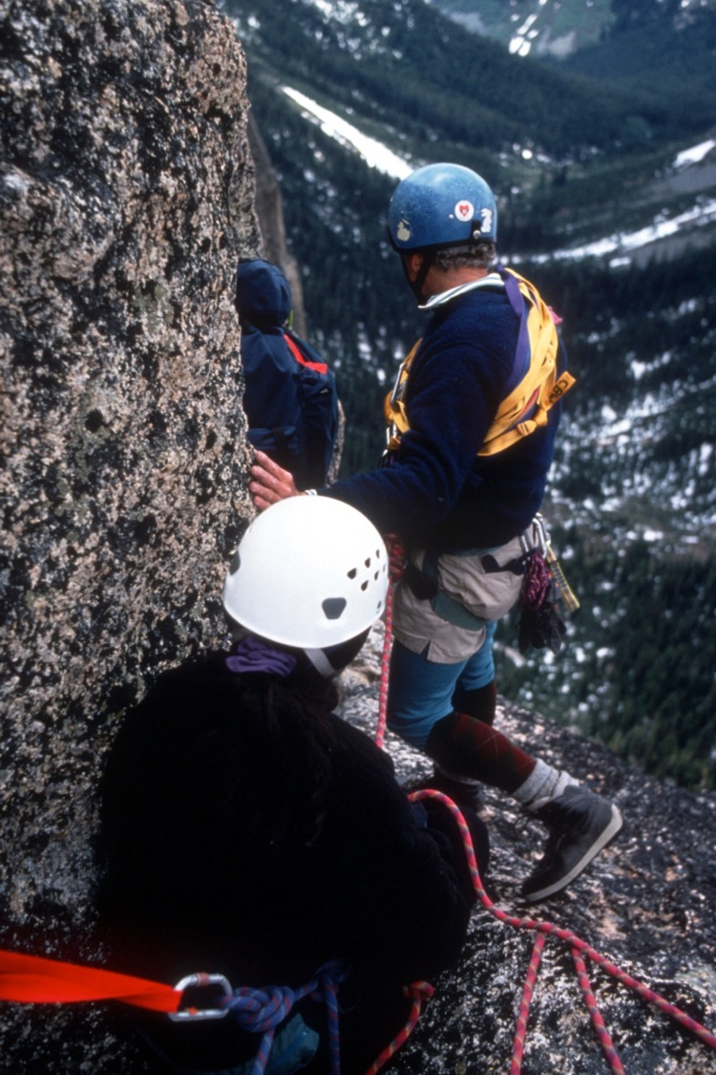
BUT… Look at this system.
Will it hold the climber’s weight?
Scary, sure!
But how dangerous?
Notes:
So let’s look again at the” fearsome” move
Climber is SAFE
Could hold car!

Slide 24
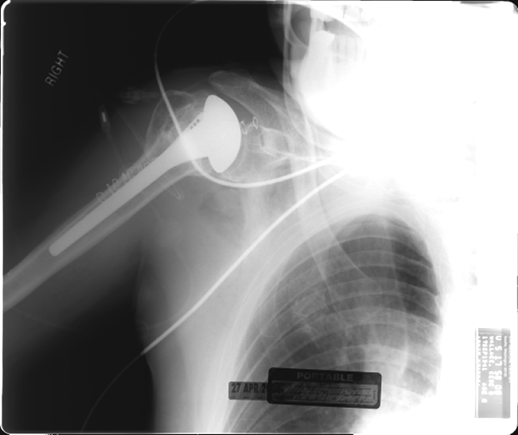
Rockfall did this
Notes:
My accident
Rock the size of average basic student
After two years of surgeries, shoulder is OK, but will never be normal
NOT to elicit your sympathy, but … after 30 years of climbing
WHERE?

Slide 25
Did the accident happen in a scary place like this?

Slide 26
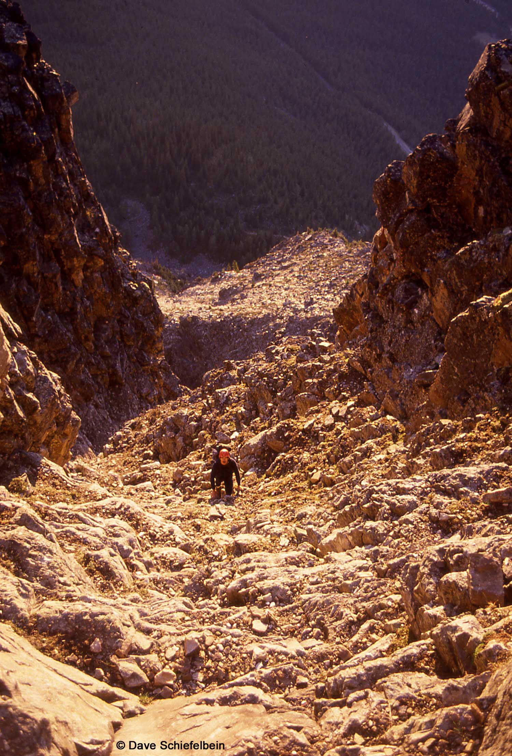
Or … In an ordinary- looking place like this?
Notes:
Class 2 gully on a crummy little peak you never heard of
The POINT: Scary & Dangerous NOT the same
And learning to RECOGNIZE danger is a SKILL you need to learn, a WISDOM you need to acquire – an important one
Not part of how to climb
But definitely part of How to BE a Climber.

Slide 27
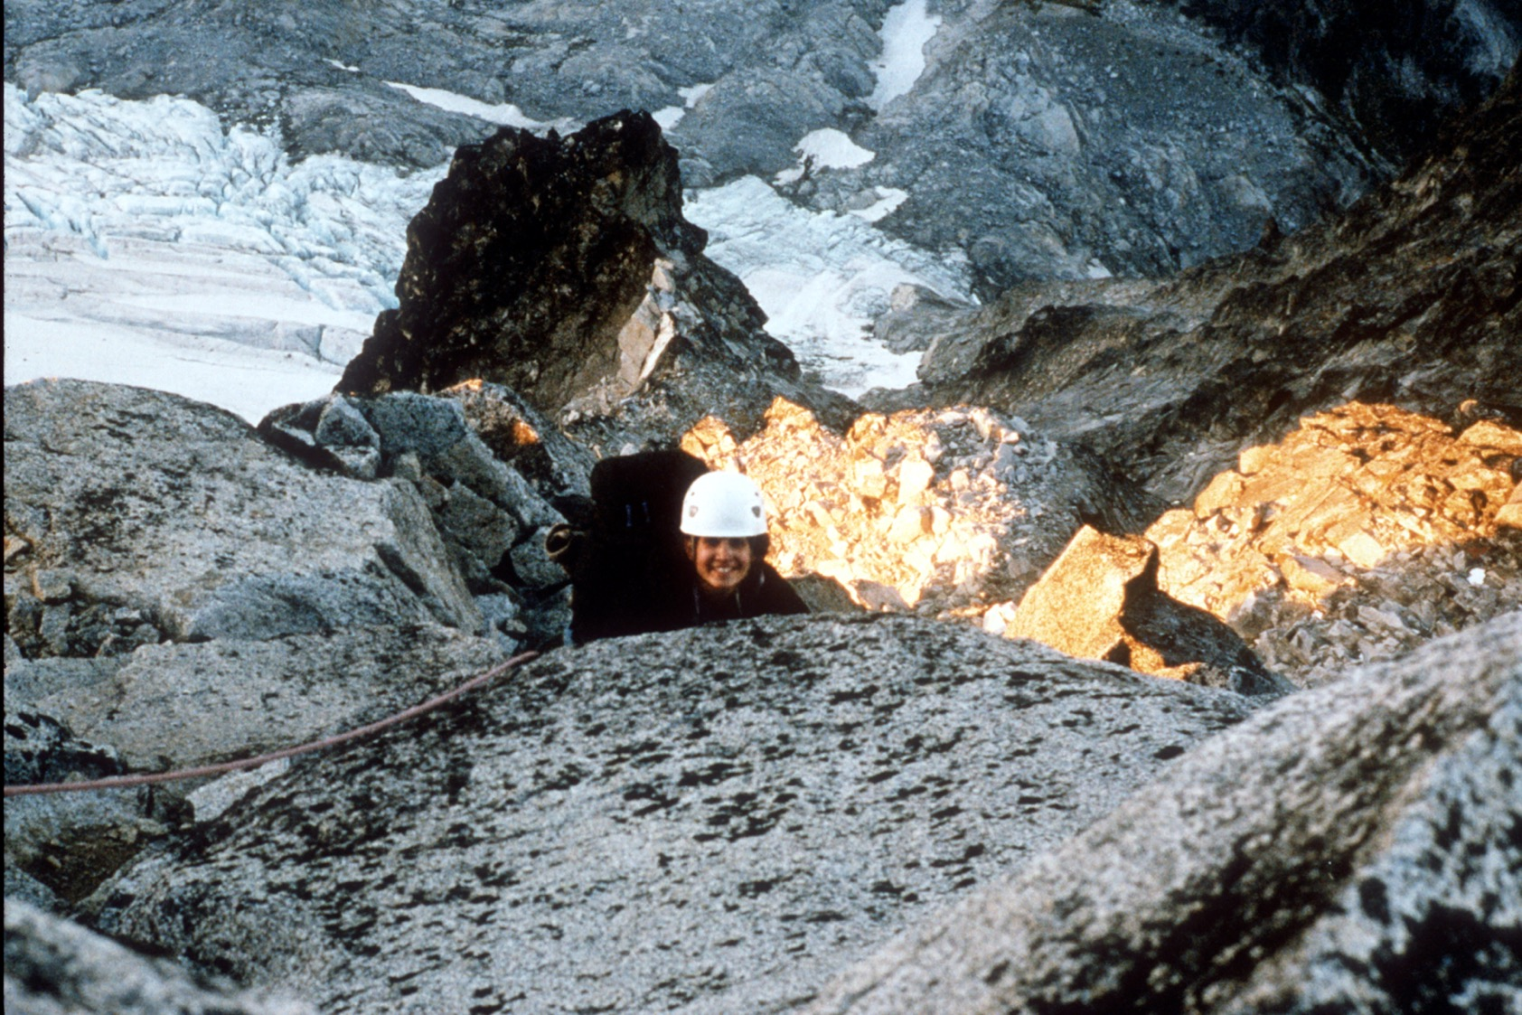
Nearing the Summit
Notes:
[North Ridge of Stewart]¡

Slide 28
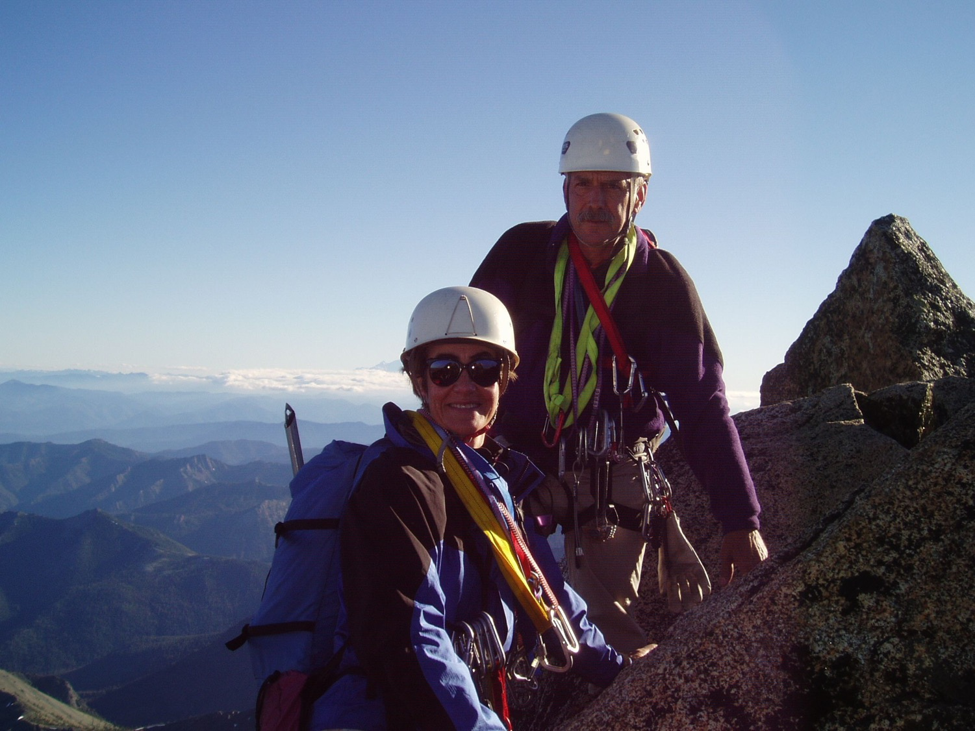
Notes:
[West Ridge, Mt Stewart]
SOME SUMMIT SHOTS

Slide 29
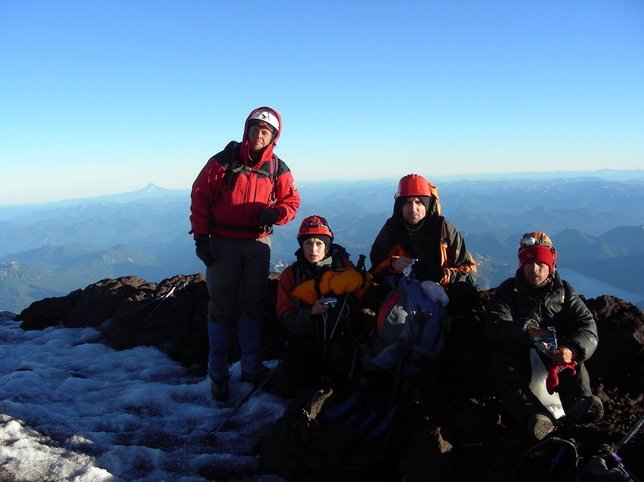
Notes:
[Volcan Lanin, Chilean-Argentine border, Patagonia]

Slide 30
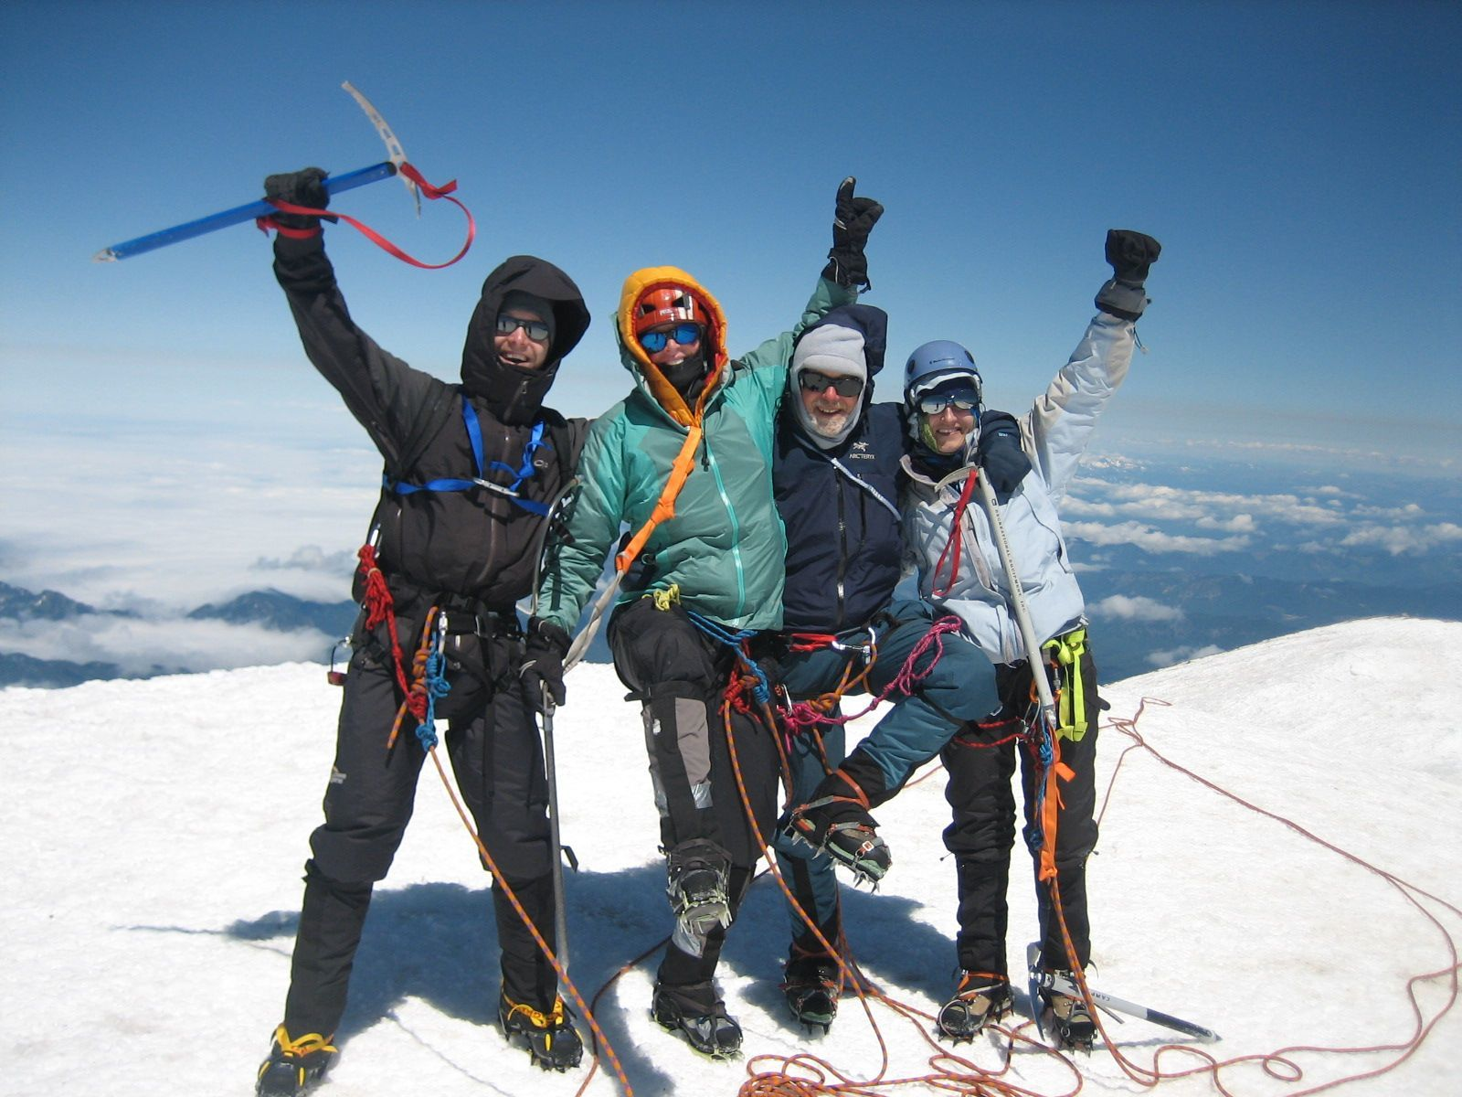
Notes:
[Rainier]

Slide 31
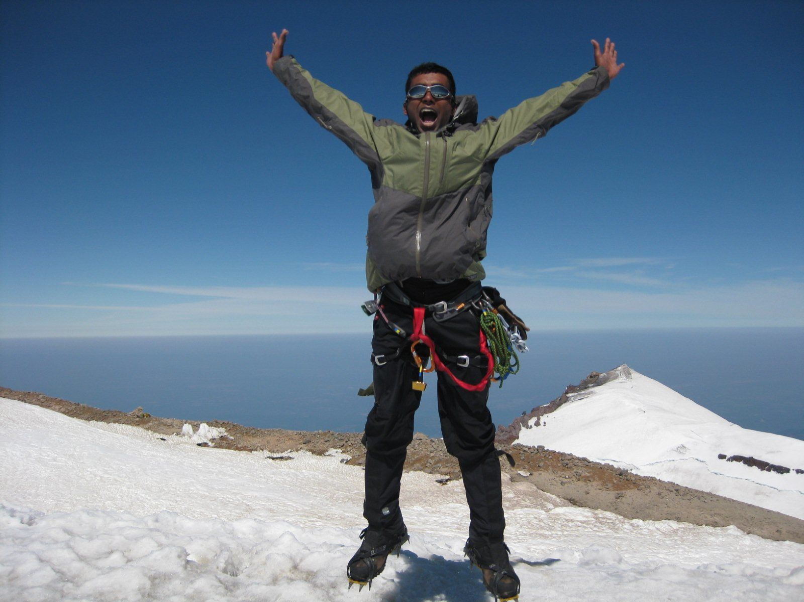
Summit Euphoria --------
Phase 1
Notes:
[Rainier]

Slide 32
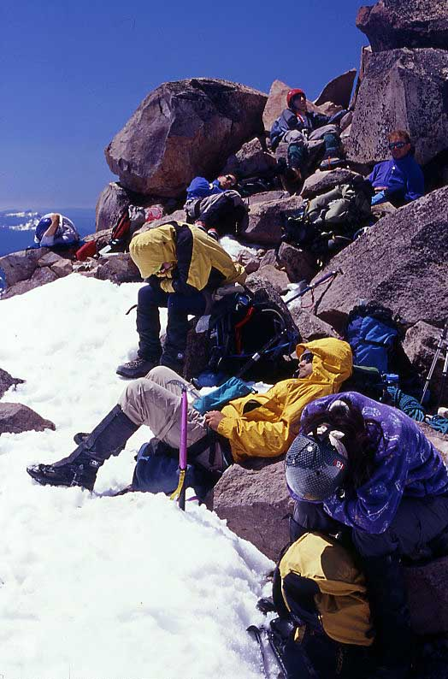
Summit Euphoria Phase 2 ---- Tough Climb …and we still have to go DOWN !
Notes:
[Mt Jefferson, Oregon]

Slide 33
and inevitably … The Descent

Slide 34
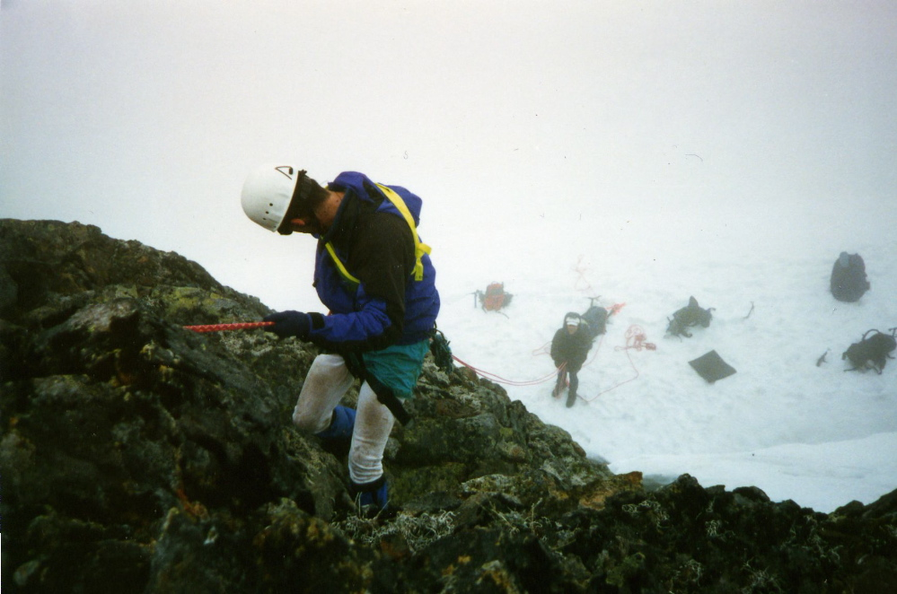
Rappelling Off Whitehorse
Notes:
Rappelling is fun .. But unforgiving.
Recall “Toast”

Slide 35
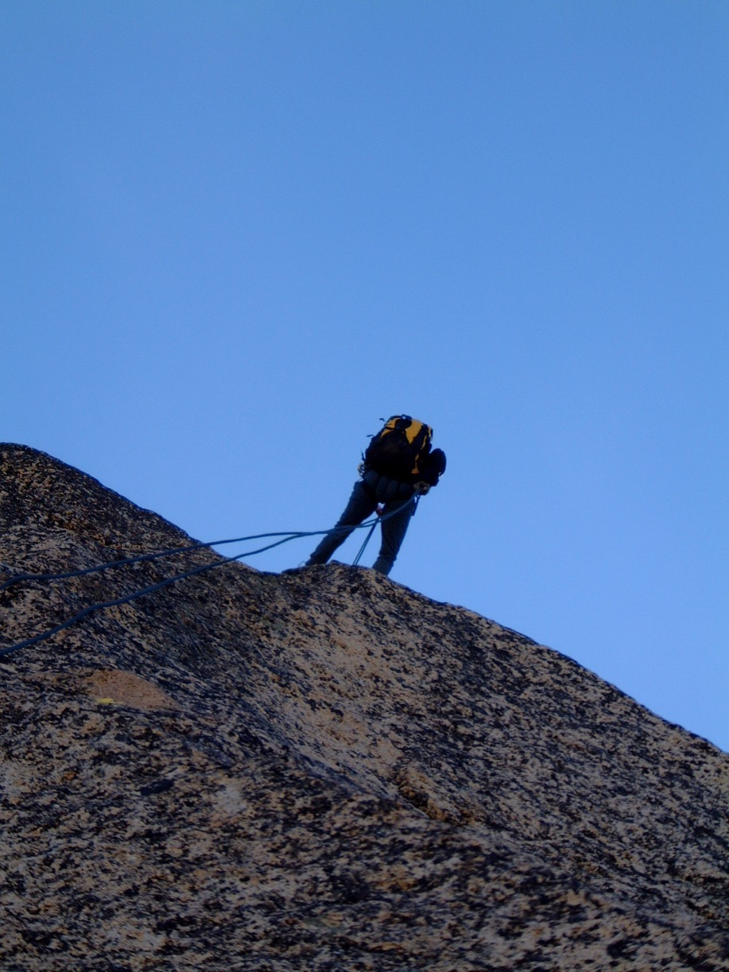
Kangaroo Temple
Notes:
You have been drilled on the technique
But there is also a PEOPLE part of rappelling (our topic tonight)

Slide 36
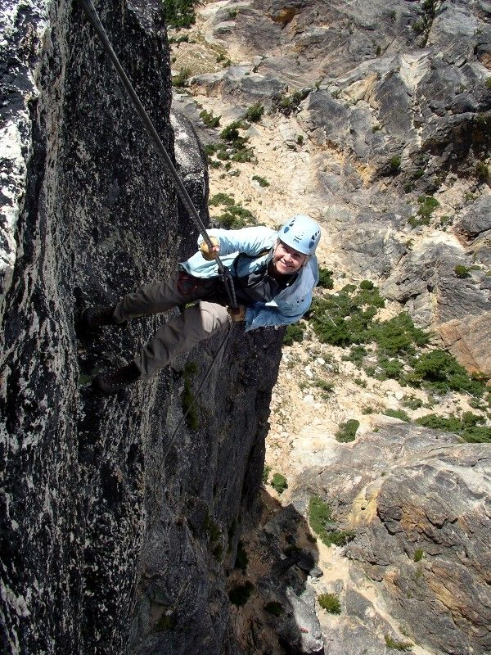
Looks vertical
Because it IS
Notes:
Buddy System – Check each other out – OUT LOUD
… and don’t wait to be asked. Step up like a friend and DO IT.

Slide 37
The Descent
Notes:
[Kangaroo Temple]
Descent can be a DANGEROUS time
Downclimbing can be difficult
Tired/ Darkness/ In a hurry
Be careful – don’t rush
Watch your buddies – this is when they really need you.

Slide 38
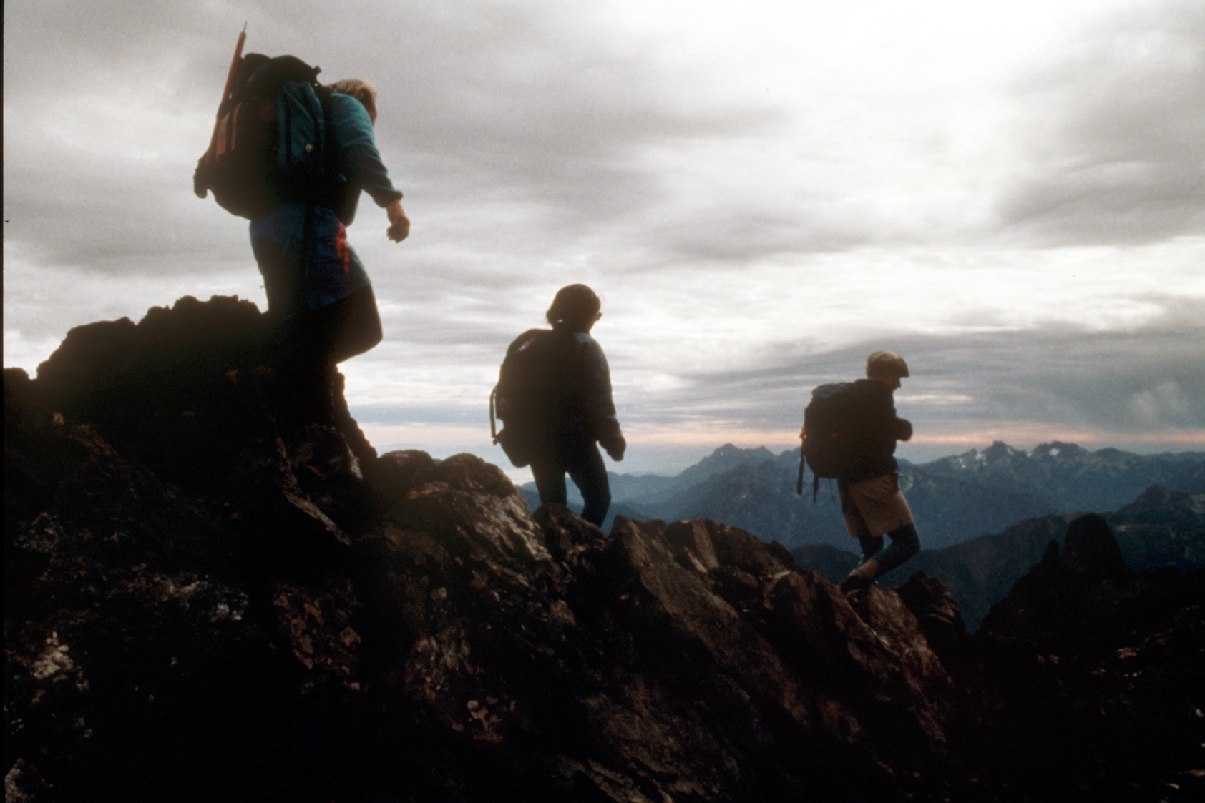
Heading Down
Notes:
[Mt Constance]
Now down, unroped, headed back
To civilization with its comforts and its discontents
Can only be brief visitors in this alpine world
Mountains are sublime • And Summits are thrilling

Slide 39
Heading Down
Notes:
[Mt Constance]
You are embarking on great adventures you will never forget
I wish you great joy
Climb safely, please
And I look forward to climbing with many of you this year and in years to come. ###

