Slide 1
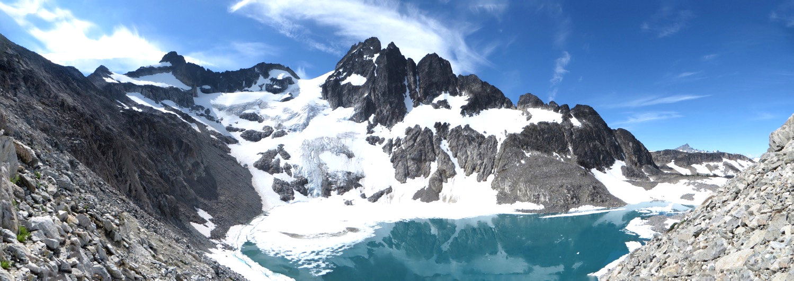
Seattle Basic Alpine Climbing
Lecture #5
2019-May-01
Glacier Travel – Jan Abendroth
The Climbing Party – Cebe Wallace
Logan Pk / Banded glacier

Slide 2
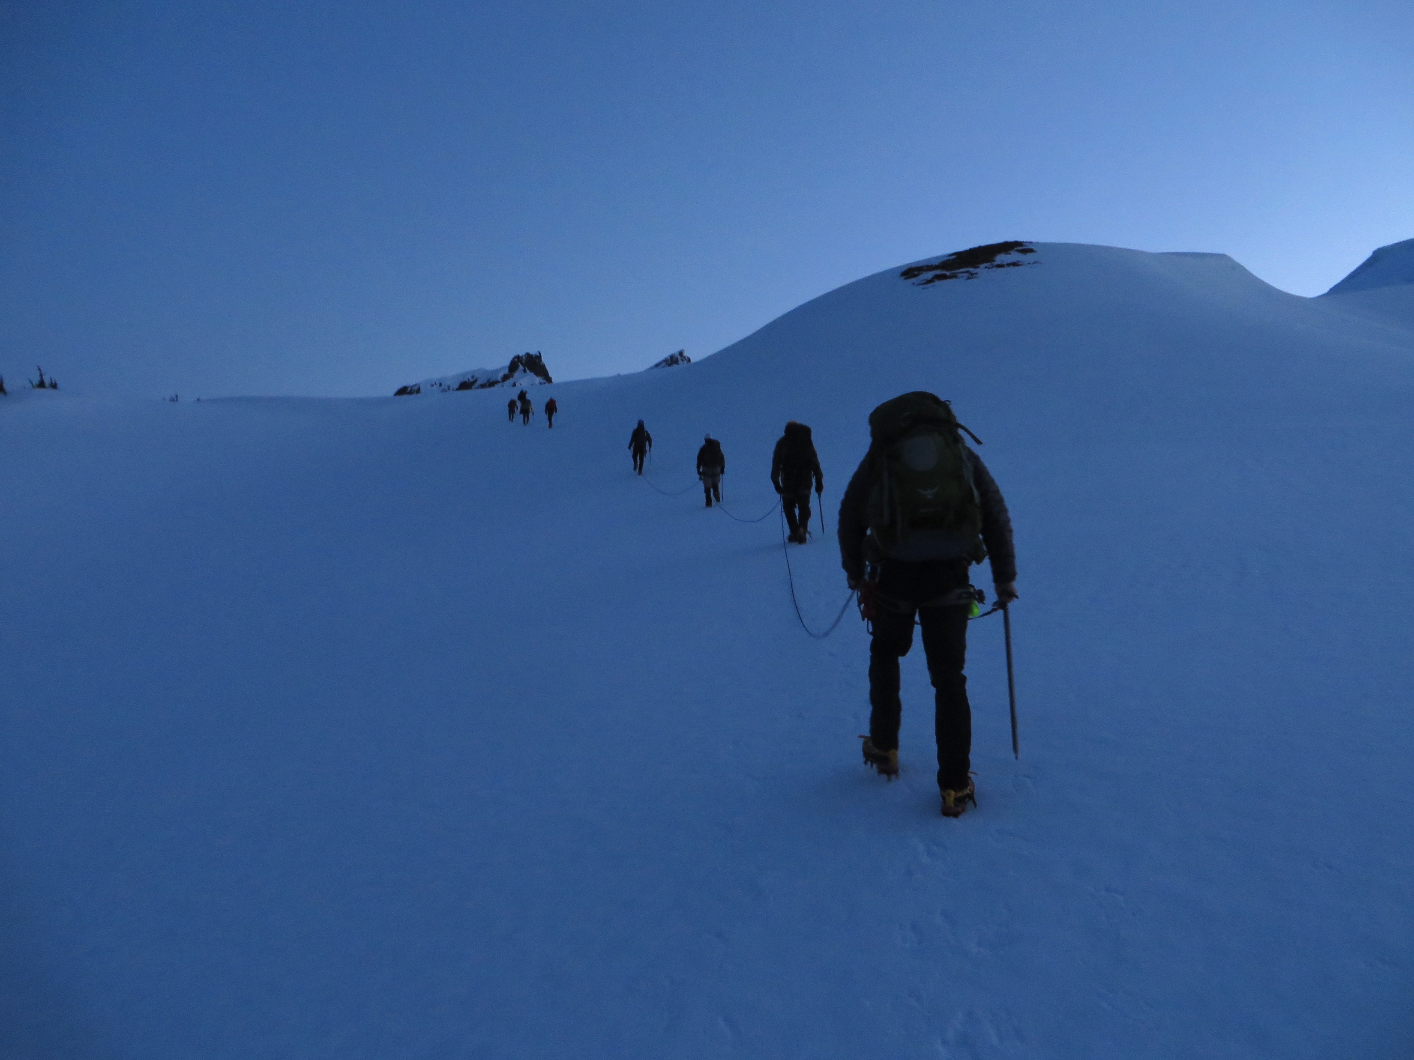
Agenda
Glacier Travel
45min
Break – 10min
The Climbing Party
45min
Announcements
Mt. Baker snow FT

Slide 3
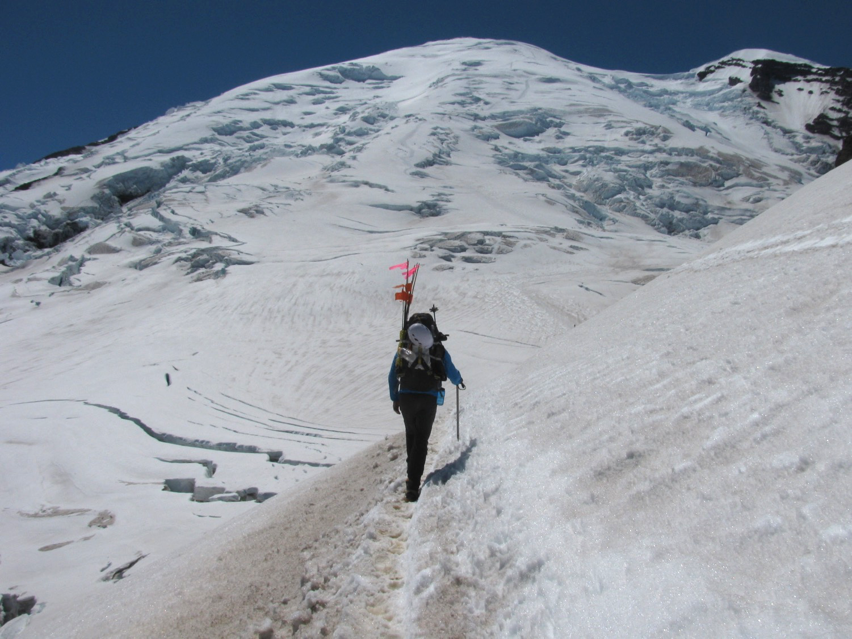
Glacier travel
Mt. Rainier / Emmons

Slide 4
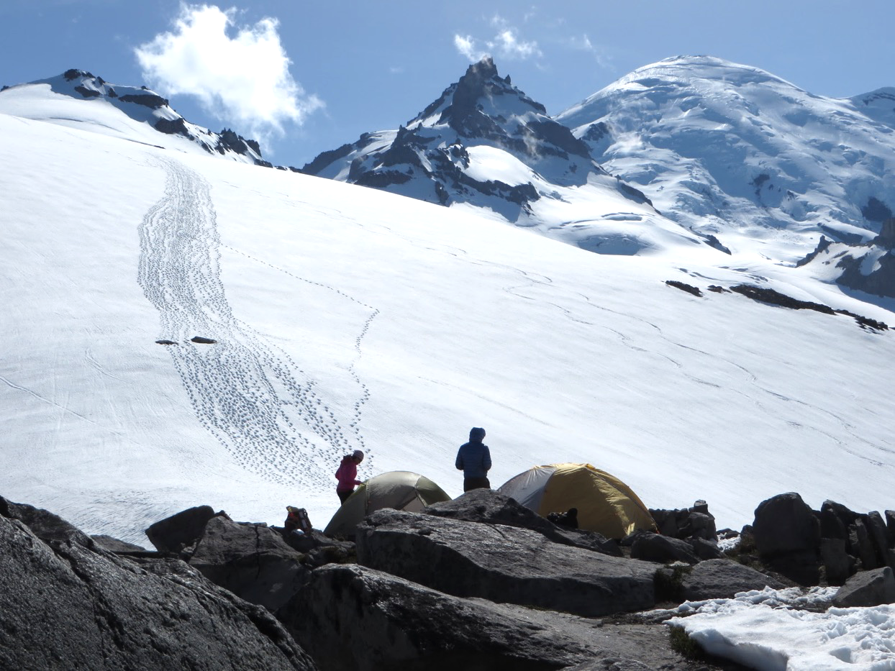
Glacier travel … beautiful
Little
Tahoma

Slide 5
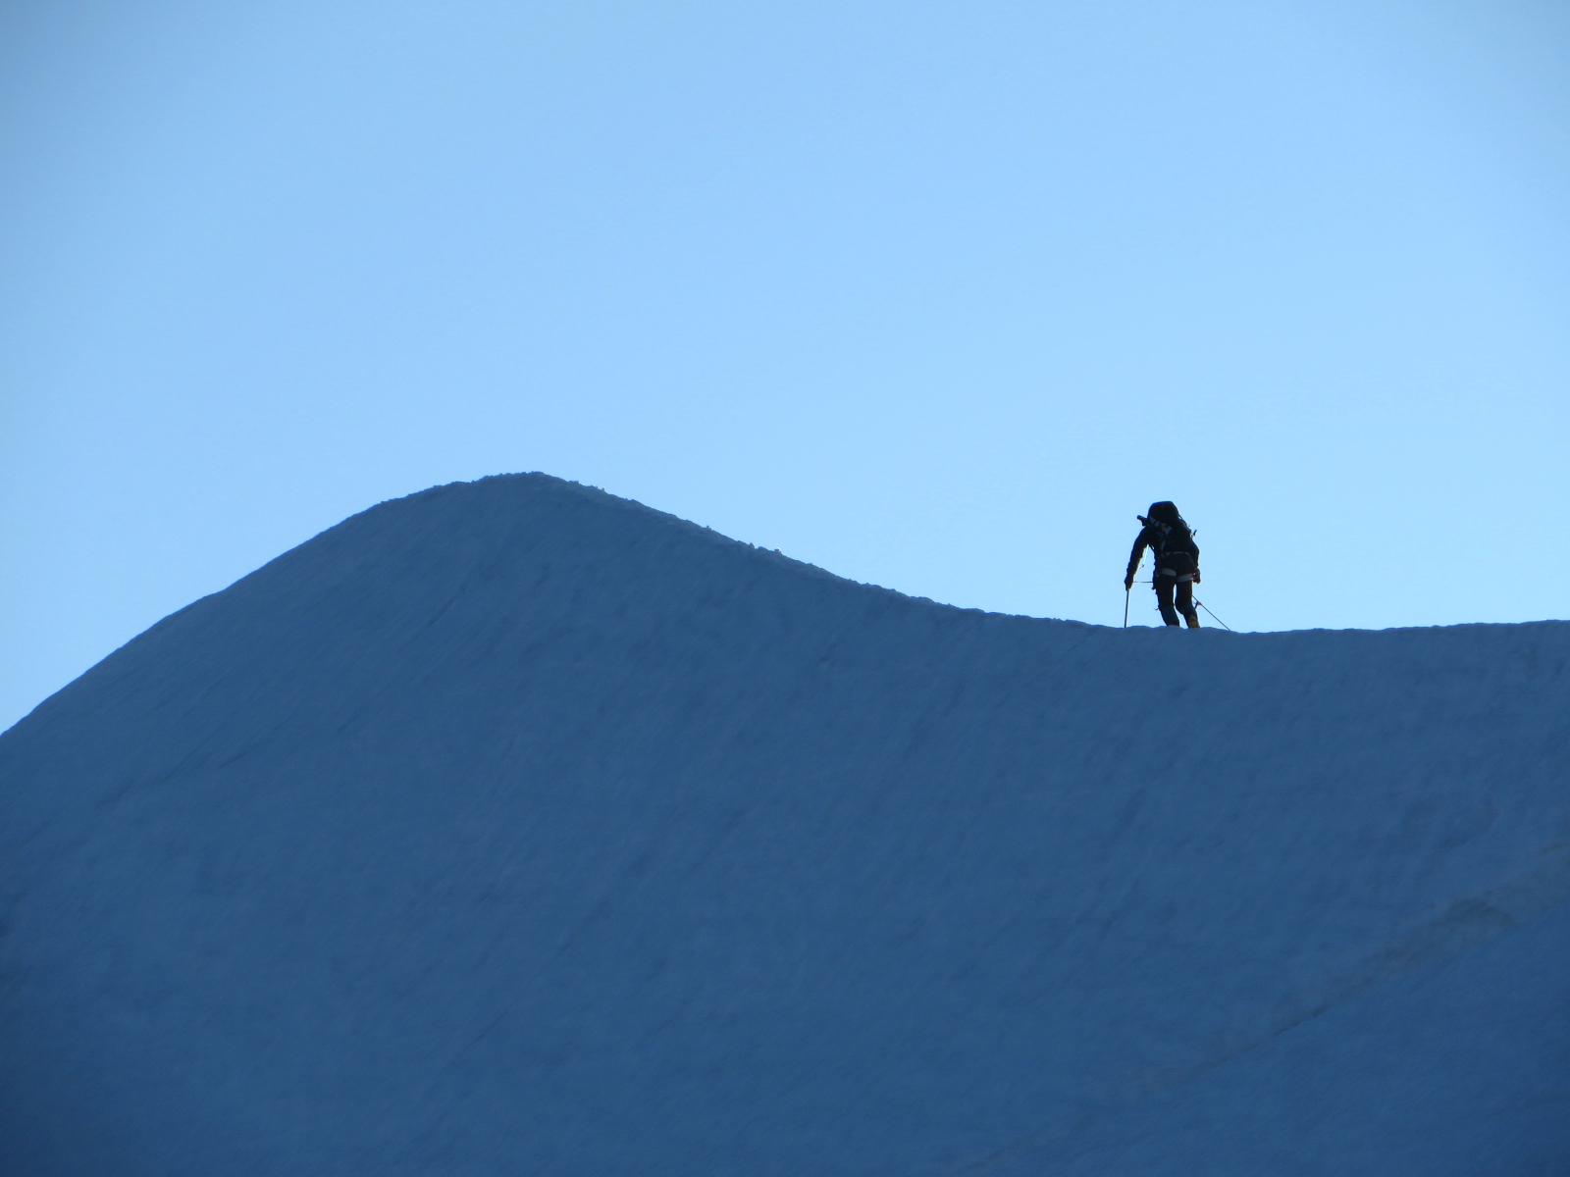
Glacier travel … breathtaking
Knife Edge
Eldorado Pk.

Slide 6
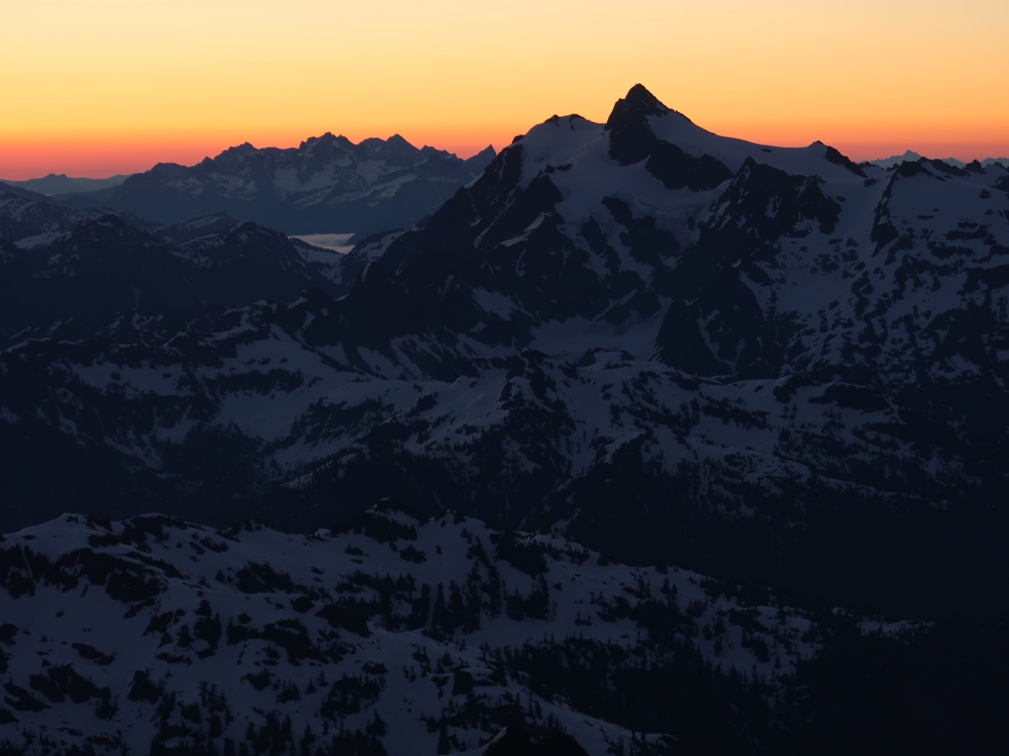
Glacier travel … dawn
Mt. Shuksan
from Baker

Slide 7
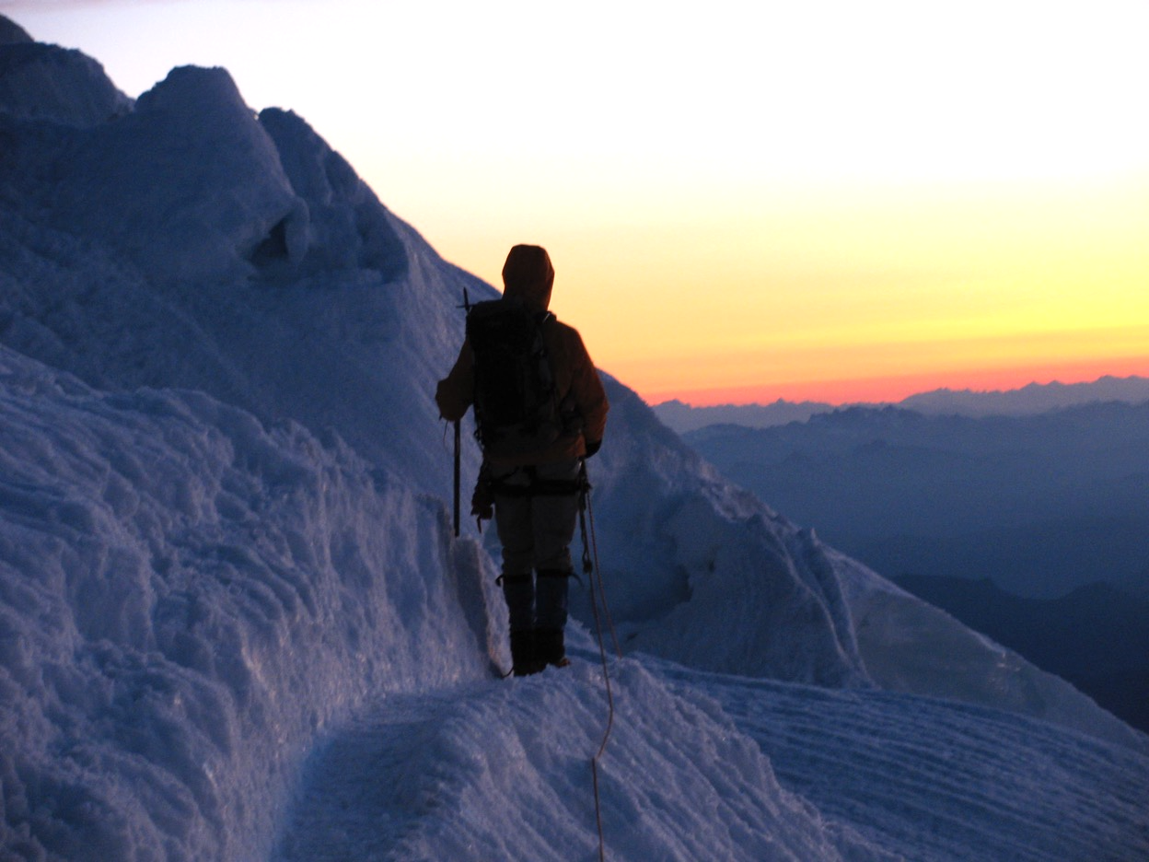
Glacier travel … sunrises
Mt Rainier
DC

Slide 8
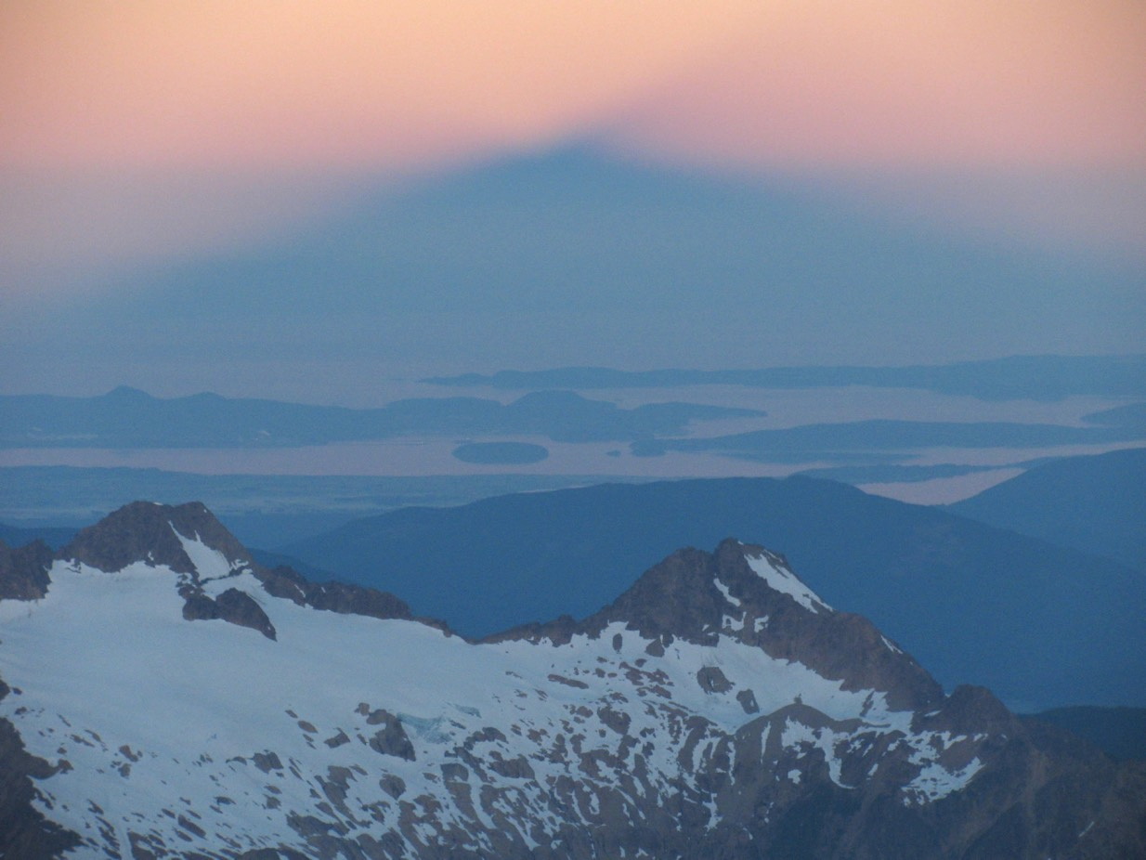
Glacier travel … mountain shadow
Mt. Baker
Easton

Slide 9
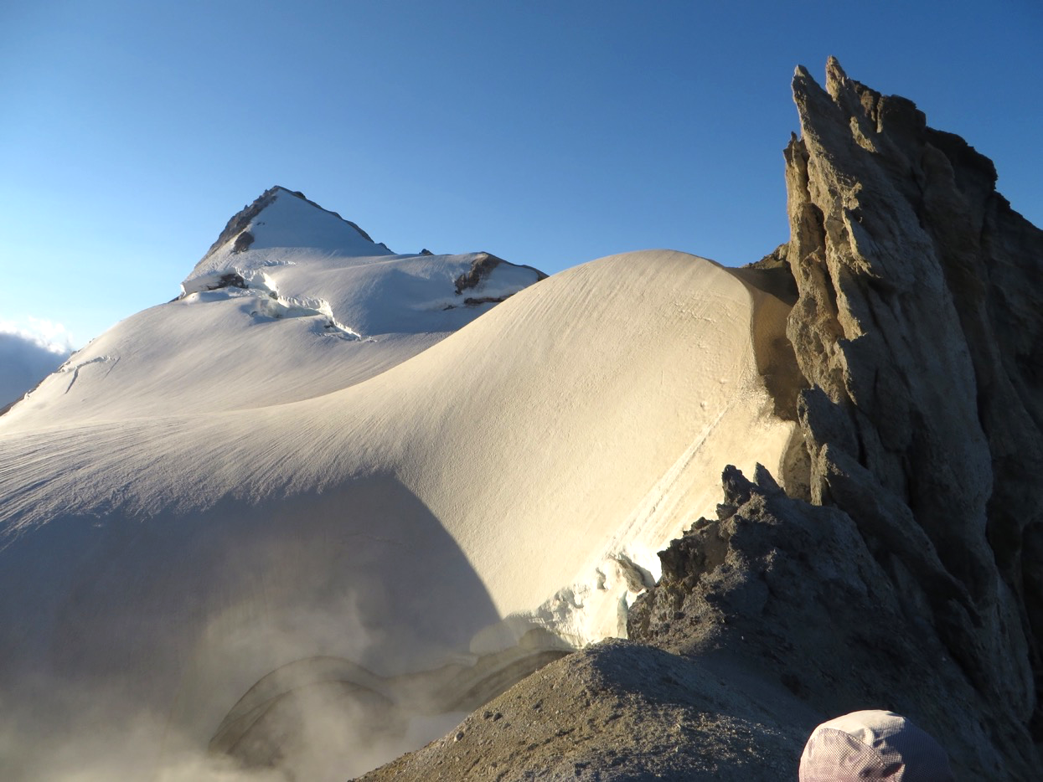
Glacier travel … fuming craters
Mt. Baker
Easton

Slide 10
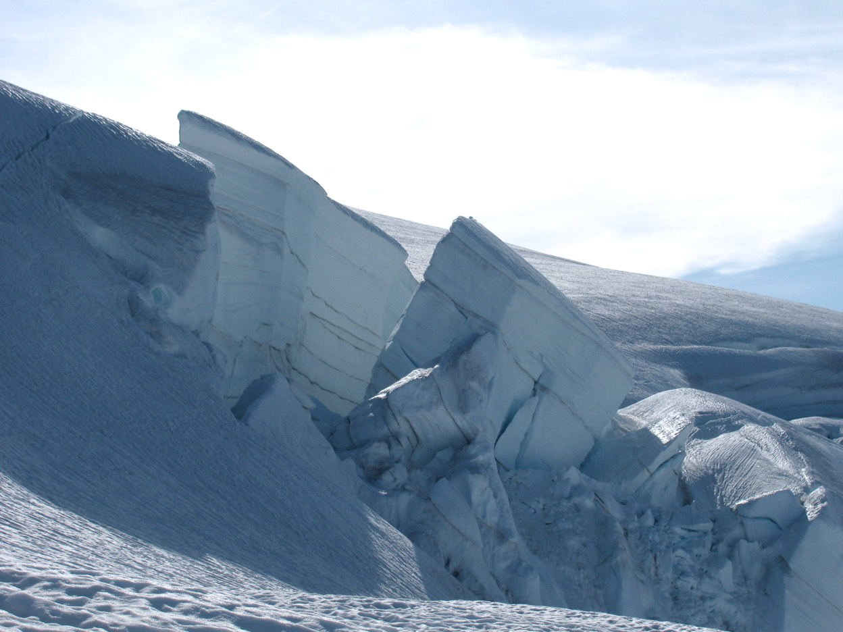
Glacier travel … ice falls
Mt. Baker
Easton

Slide 11
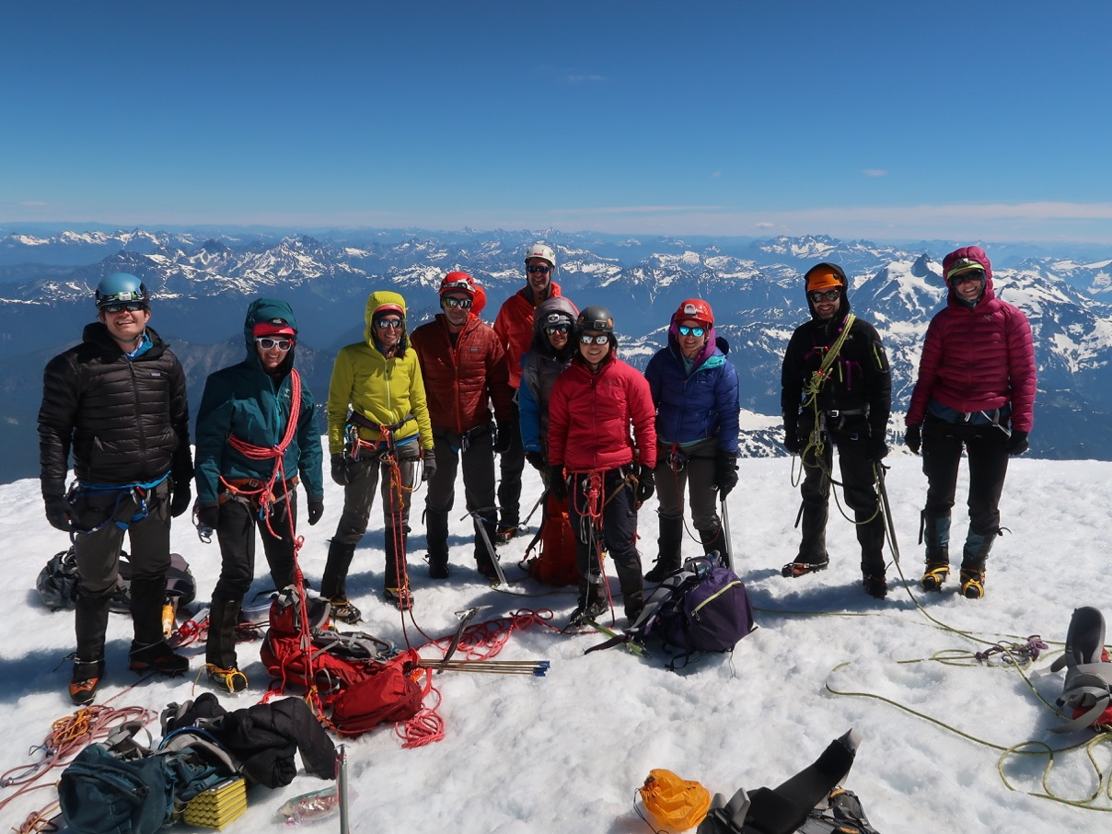
Glacier travel … summits!
Mt. Baker
Easton or
Coleman

Slide 12
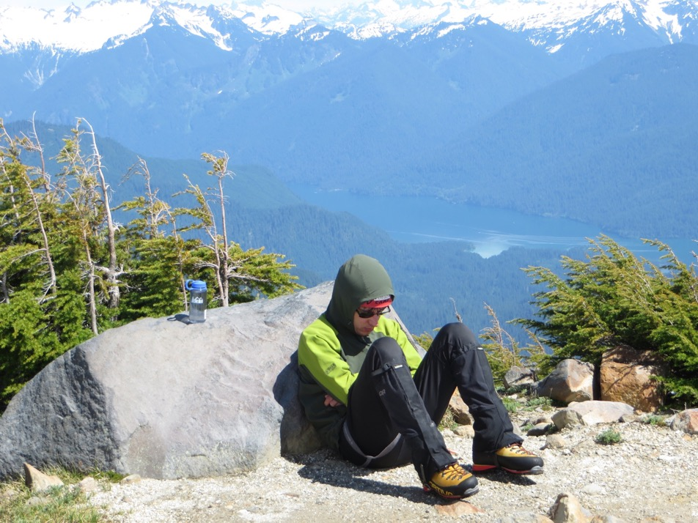
Glacier travel … strenuous
Mt Si
Time trial:
Due May 16th, check with your SIG leader if not done yet!
Pictured climber is strong and an excellent rope lead!
Mt. Baker
Boulder

Slide 13
Safety on Glacier trips
Crevasse rescue: hauling system (3:1, 2:1)
Notes:
Ask audience what else is important – conclusion, way more that just crevasse rescue.

Slide 14
Safety on Glacier trips
Route
Team (Cebe’s lecture)
Weather
Current conditions
Gear
Camp
Route choice
Safe glacier travel
…
Crevasse rescue

Slide 15
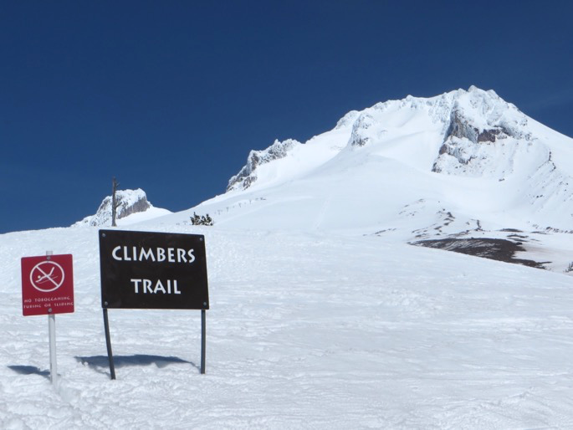

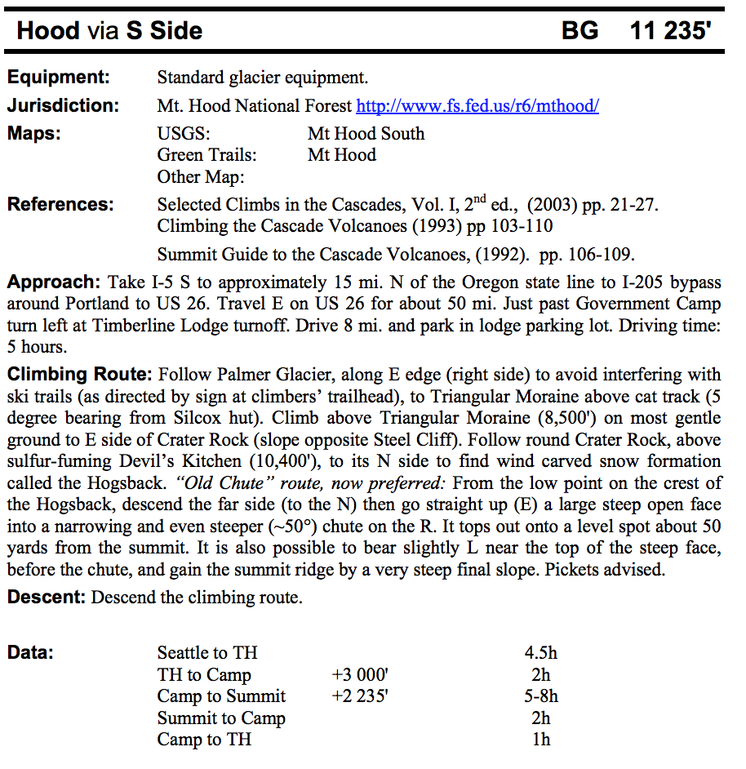
Route - Mt. Hood, next weekend?
Basic climbing guide
Resources:
Basic climbing guide (Course materials)
Mountaineers webpage
https://www.summitpost.org/
https://cascadeclimbers.com/
Fred Beckey guides and other books

Slide 16

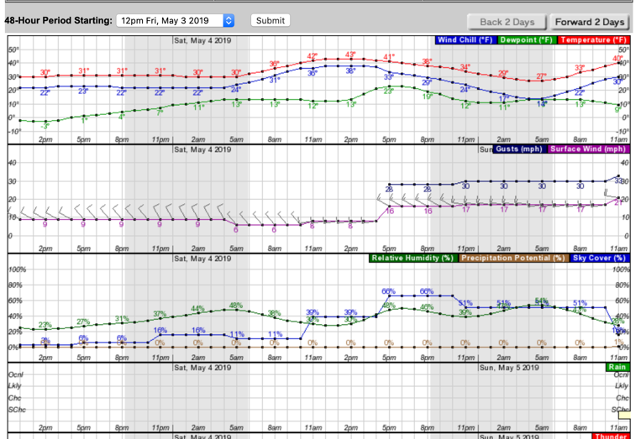
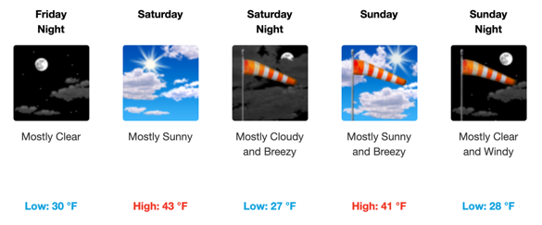
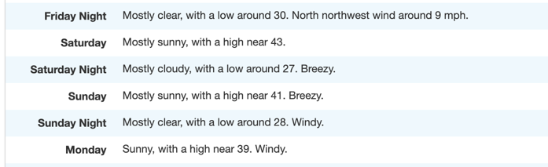
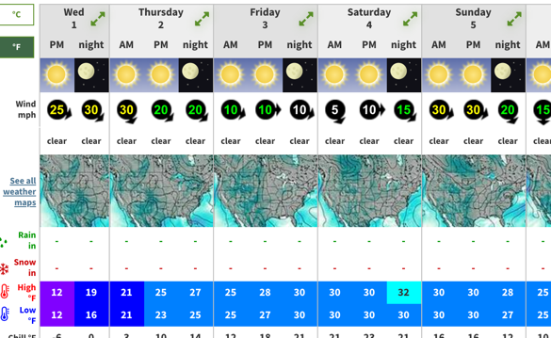
Weather - Mt. Hood, next weekend?
Resources:
NOAA: https://forecast.weather.gov/
https://www.mountain-forecast.com/
Michael Fagin weather reports
sent to SIG and climb leaders
JA’s preference:
Set weather expectations and stick with them, eg.
<30% precipitation, <0.2” precipitation, <20mph wind

Slide 17
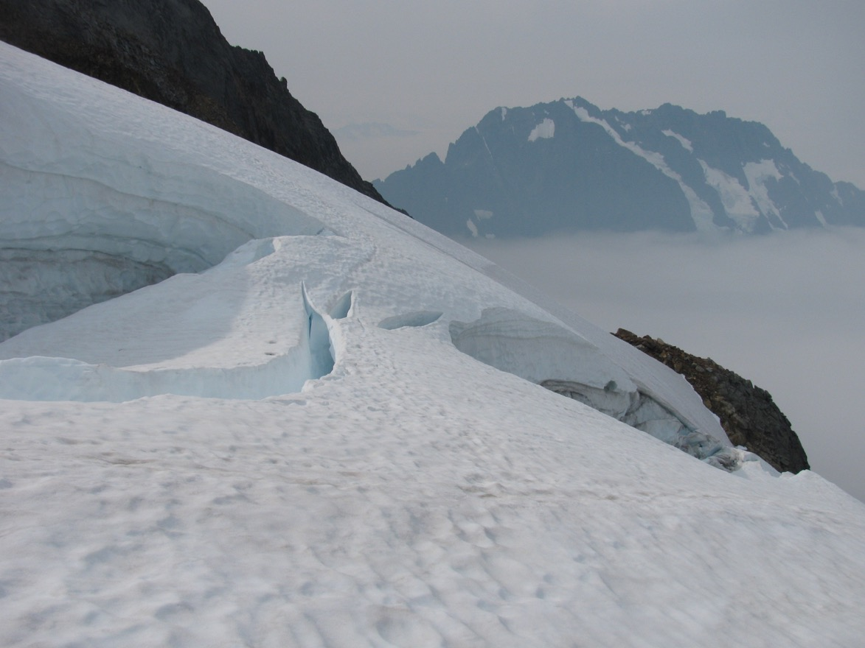
Current route conditions
Late season climb
Thin snow bridge
Sahale Pk
Qien Sabe

Slide 18
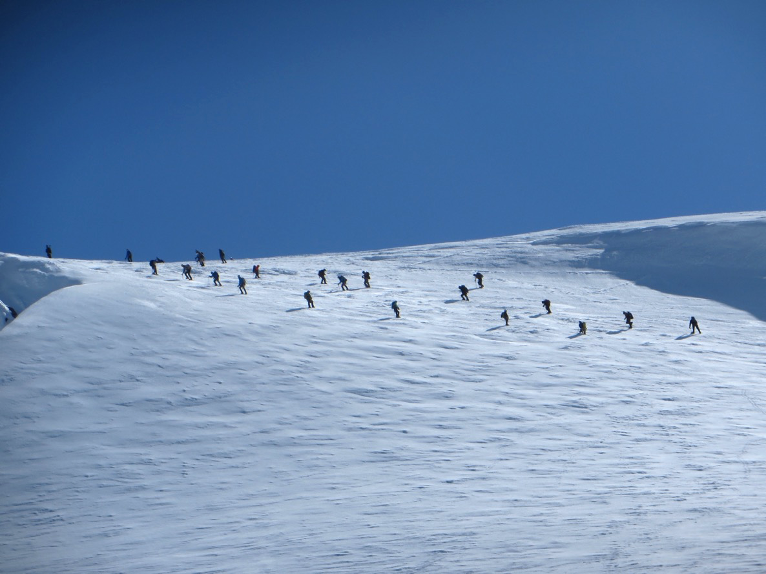
Current route conditions
Busy weekend.
Safety in numbers?
Mt. Baker
Roman Wall
Coleman

Slide 19
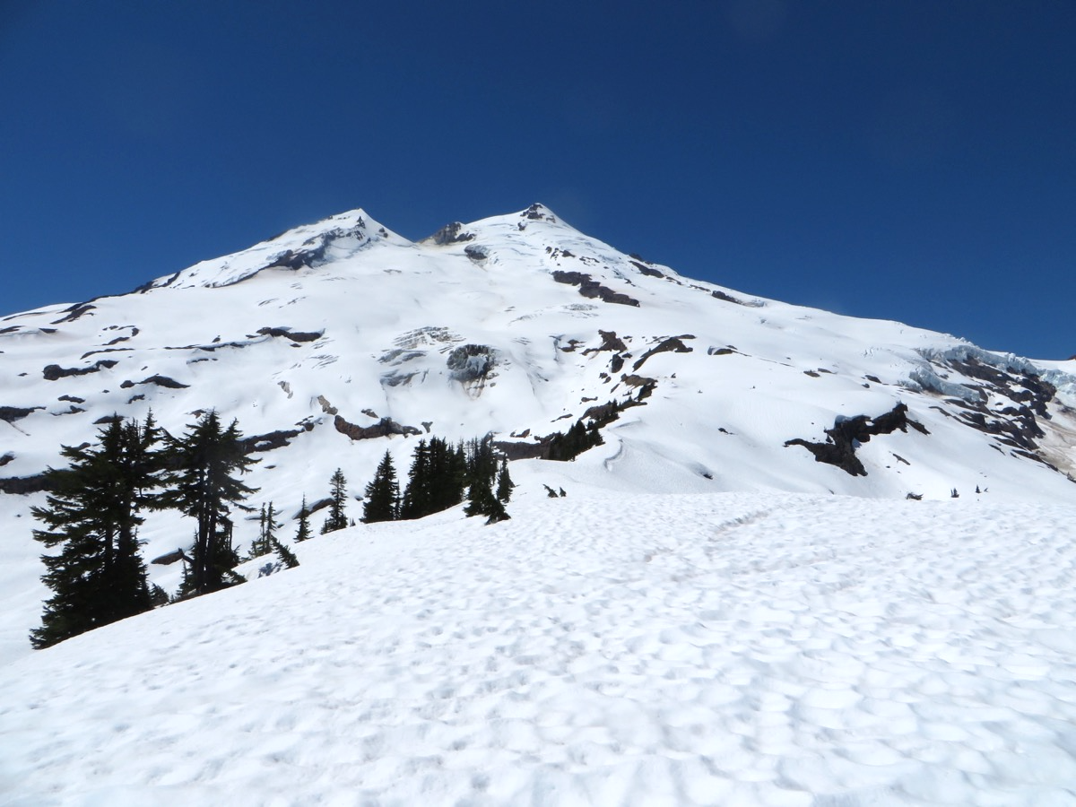
… another weekend, different route on the same mountain

Slide 20
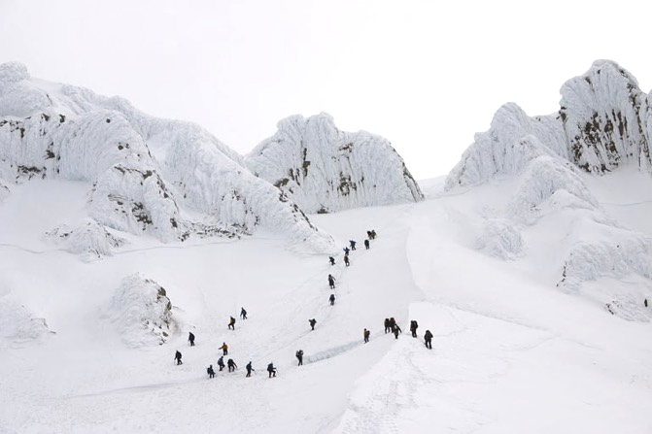
Current route conditions
Road access?
Is the route ‘in’?
Day of the week?
Any current dangers?
River crossings?
Rock fall?
Best time to start?
Mt. Hood, DanielArndt.com
Resources:
Mountaineers webpage: trip reports,
Facebook, climbers like to post!
http://www.peakbagger.com
many recent posts, GPS tracks

Slide 21
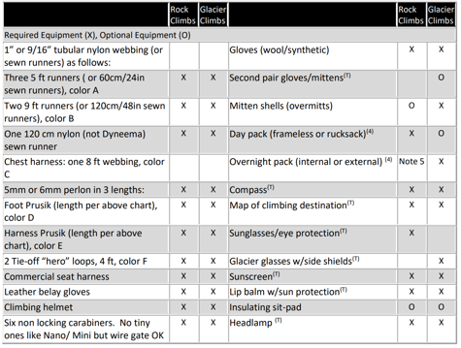
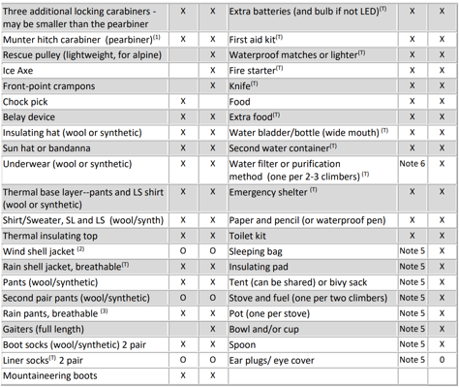
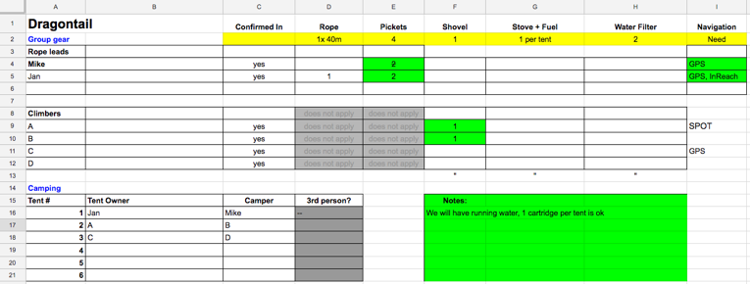
Gear
Technical personal gear
dependent on climb, see gear matrix
Technical group gear
organized by trip leader
Personal gear
very dependent on conditions,
length and difficulty of approach,
personal comfort tolerance
Resources:
Basic climbing handbook
Discuss with SIG
JA’s climb google sheet.
Every leader handles this differently

Slide 22
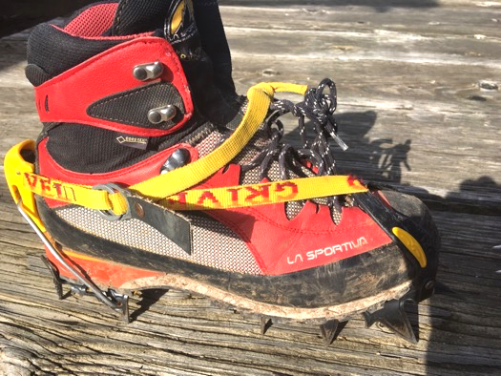
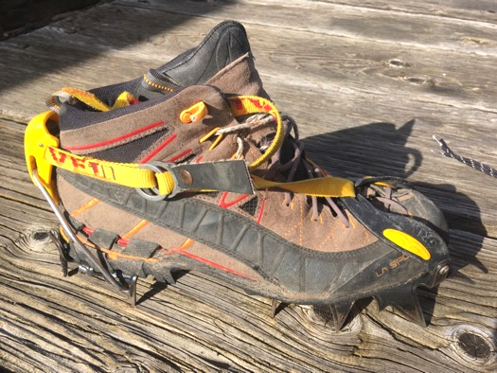
Crampons

Slide 23
Crampons – make them fit!
YES!
Snug fit
semi-automatic crampon requires ledge at heel
Horizontal front points ok
Steel vs. aluminum – both work for Basic climbs, check with leader if in doubt
Very loose fit
No heel ledge
Hiking boots are too flexible
Check your crampon fit
esp. if you change boots!
NO!

Slide 24
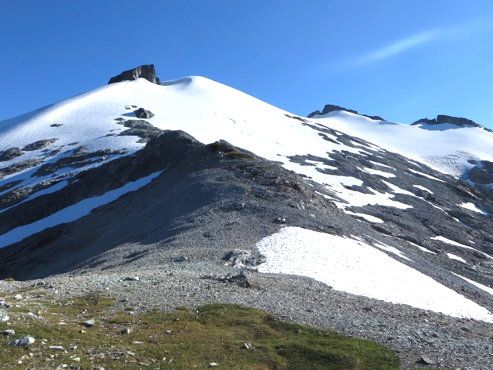
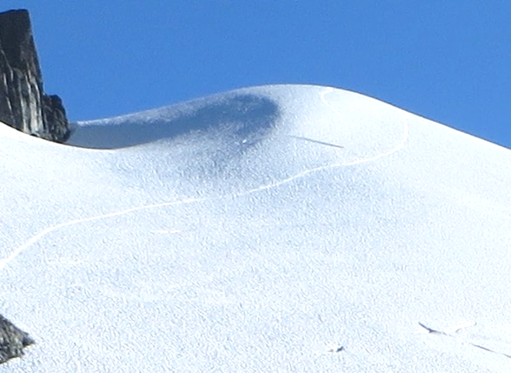
Packing thoughts
Any gear you need right now
will be at the bottom of your pack ;-)
Travel as light as you wish, don’t rely on other people’s gear.
Think if you can double purpose gear.
Technical gear needed on approach?
Mt. Ruth/Icy Peak

Slide 25
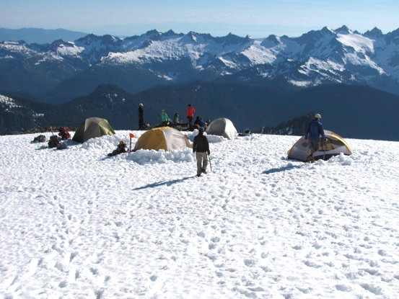
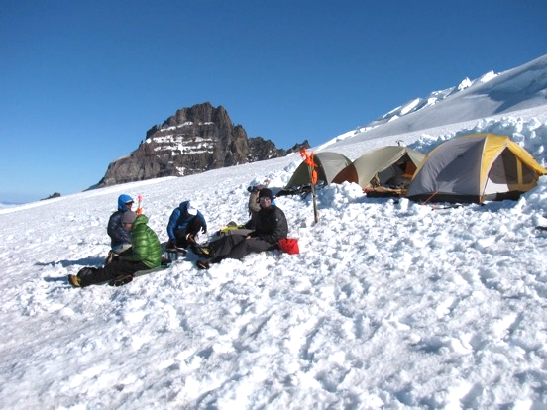
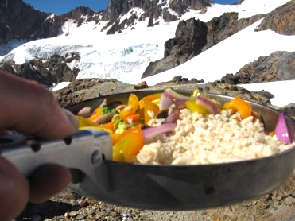
Camp
Glacier trips often 2+ days
Safety – rock fall, avalanche
Shelter – wind exposure
Convenience
location on route,
running water
Gear up for alpine start,
enjoy the view
Mt. Baker / Easton
Mt. Rainier / Emmons

Slide 26
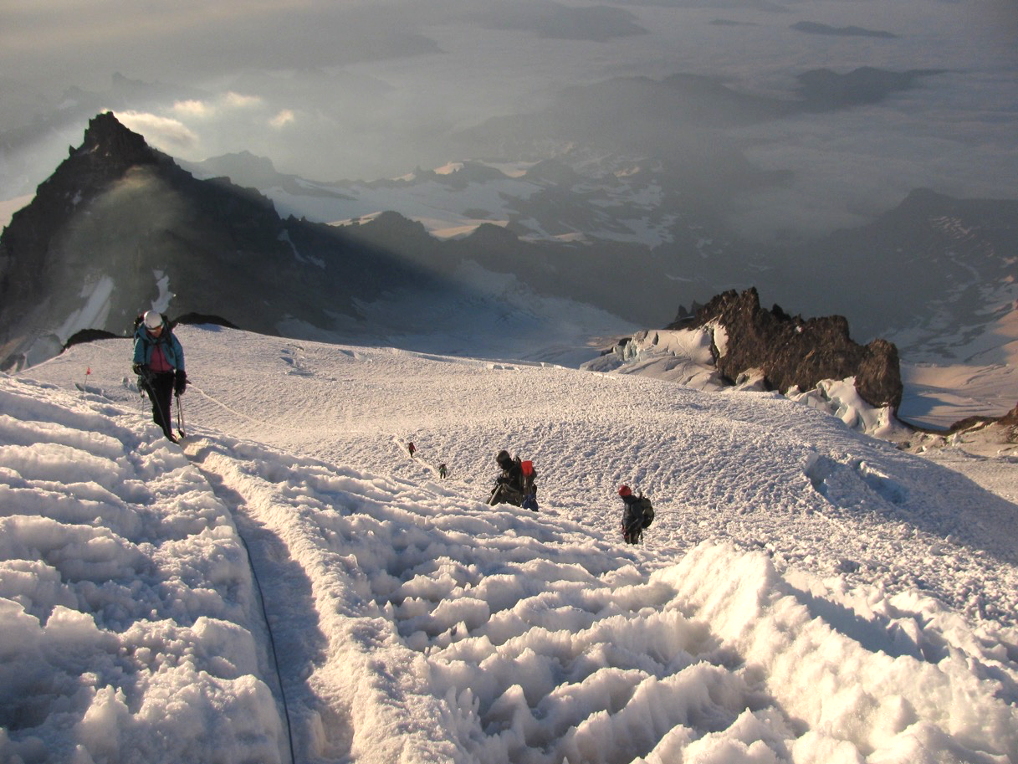
Route decisions – sometimes straightforward
Don’t blindly follow a route though!
Mt. Rainier / DC

Slide 27
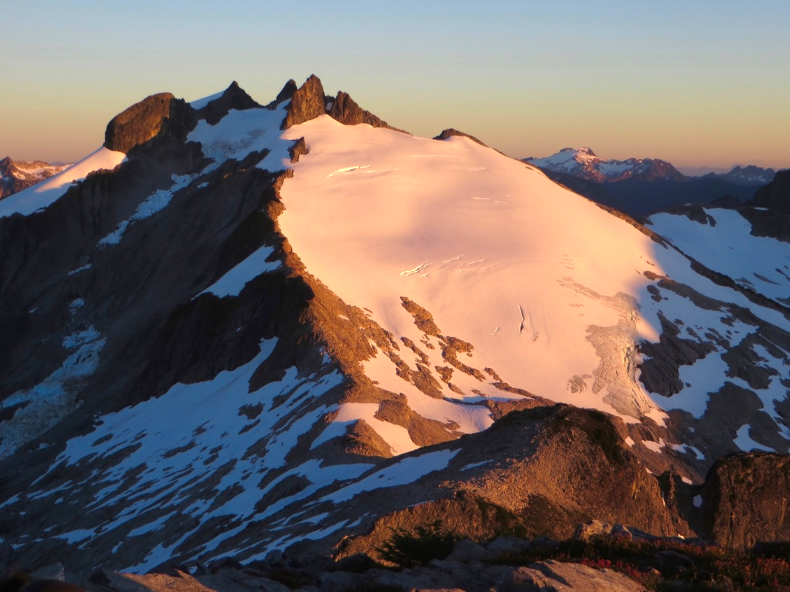
Route decisions – example Ruth/Icy
E
S
N
W
Icy peak

Slide 28
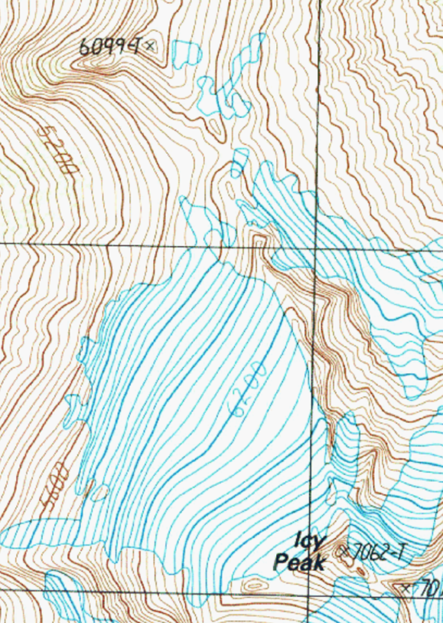
Route decisions – example Ruth/Icy
Climbing Route:
Rope up and traverse glacier S to first notch right (NW) of Ruth summit. Camp on other side of notch on snow if possible, to minimize impact (6,600'): A shovel may be of some use. Traverse W-facing snow slope to S facing ridge leading down to the Ruth-Icy saddle. Rather than going down the normal steep gulley of loose scree and rock leading directly to the saddle area, stay left of the gully and descend a leftwards slanting slope to saddle area (5,800’). (A)
Climb gradual glacier on Icy's NW slope in general SE direction, keeping rock ridge on left and crevasses on right. At about 6,500', head S and traverse top part of glacier at the W face of Icy. (B)
Skirt Icy's W notch and turn up the S side of Icy through talus and snow. Find first prominent gulley and climb to top where rap slings are around a horn. (Fixed line recommended). Summit is a couple steps above and left. Watch for loose rock and wear helmets!
Mount
Ruth
Camp
(A)
(B)

Slide 29
Route decisions – example Ruth/Icy
E
S
(B)
N
W
(A)
Icy peak

Slide 30
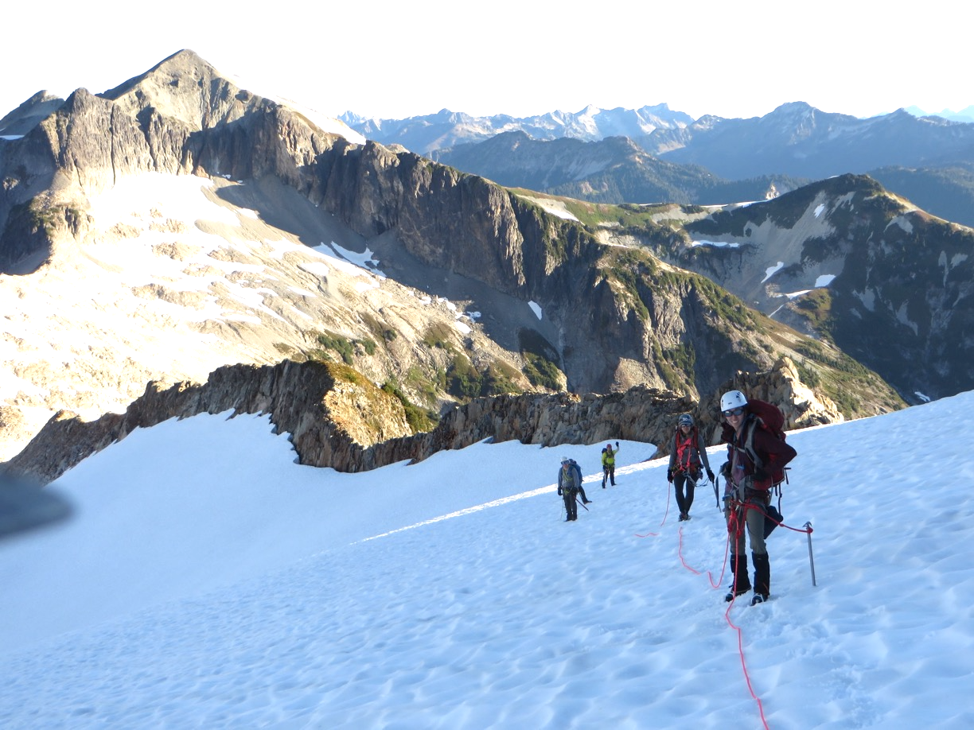
Route decisions – example Ruth/Icy
Icy peak

Slide 31
Route decisions – example Ruth/Icy
E
S
(B)
N
W
(A)

Slide 32
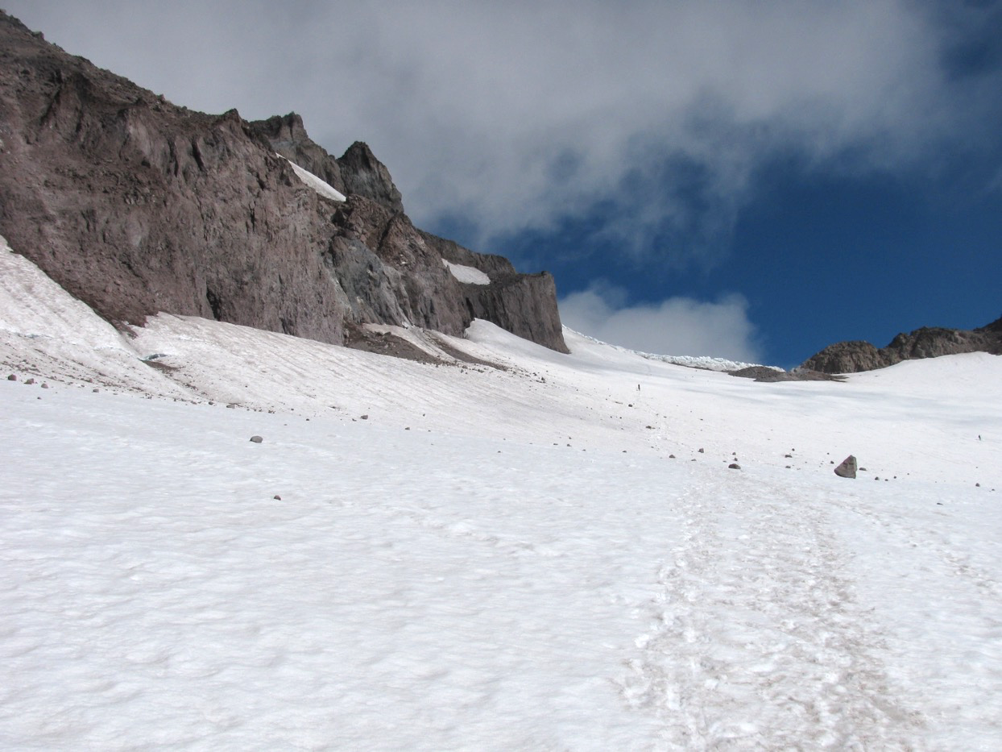
Route decisions – rock / ice fall
Try to avoid obvious rock fall zones.
Sun exposure might increase rock fall.
Try to travel early.
Move fast!
Glacier
peak

Slide 33
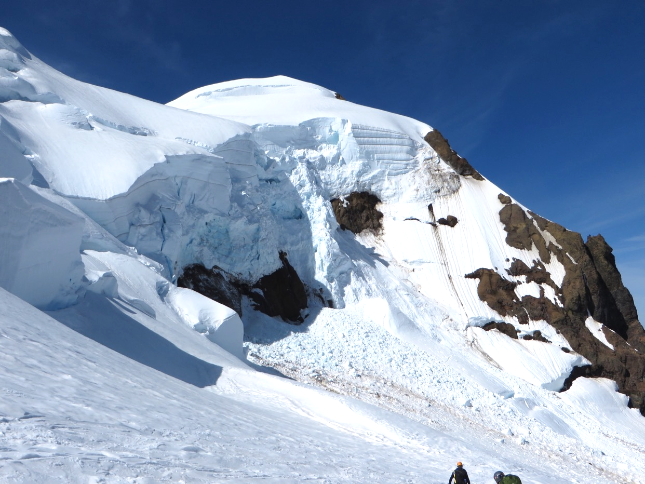
Route decisions – rock / ice fall
Try to avoid obvious ice fall zones.
Sun exposure might increase rock fall.
Try to travel early.
Don’t linger in rock / ice fall areas
Mt. Baker
Coleman

Slide 34
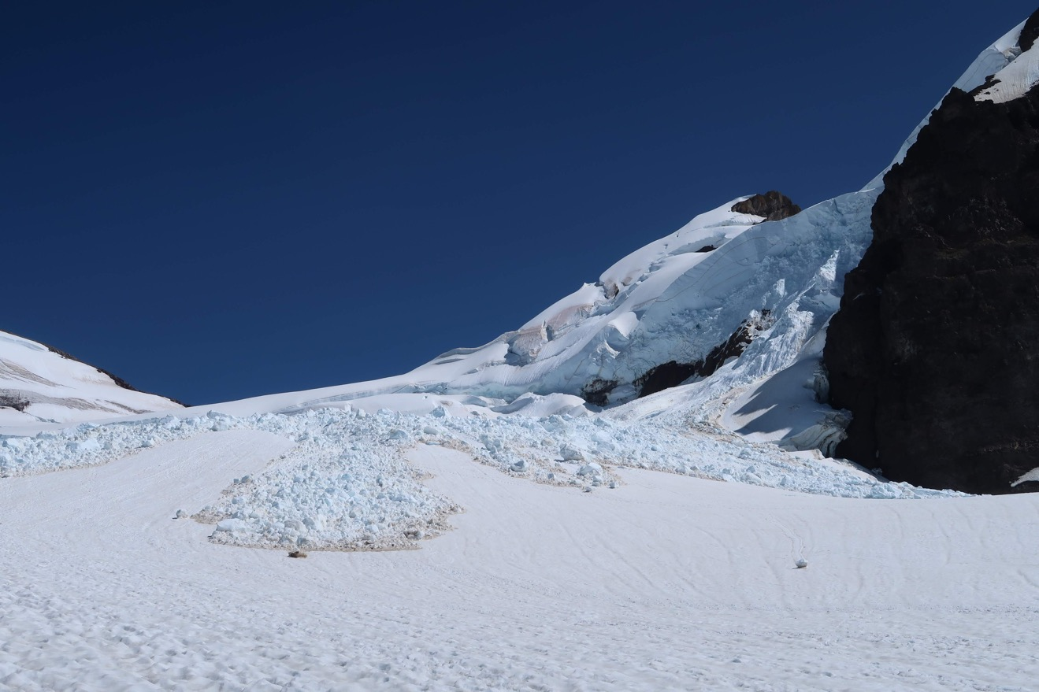
Route decisions – rock / ice fall
Similar place
July 2019
Mt. Baker
Coleman

Slide 35
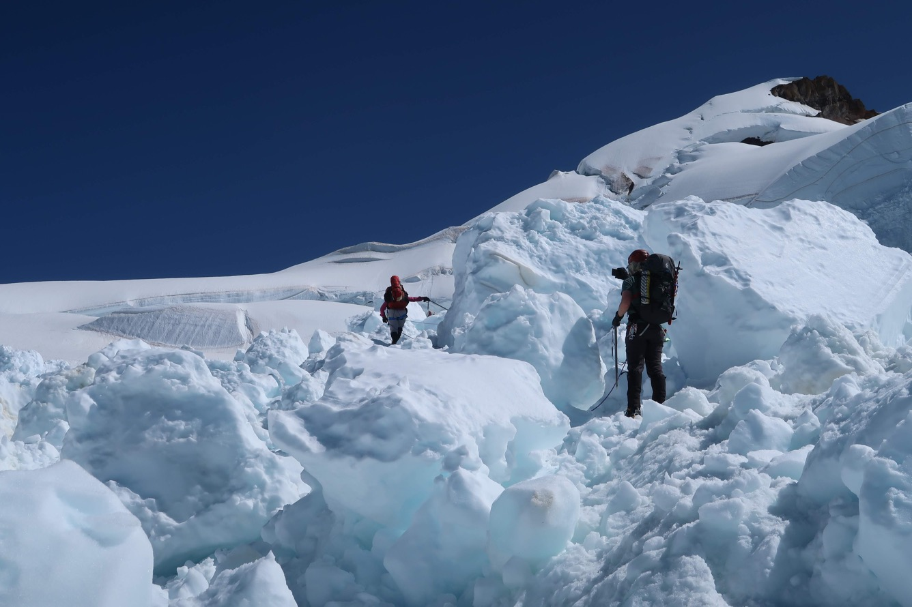
Route decisions – rock / ice fall
This could have been very bad!
Mt. Baker
Coleman

Slide 36
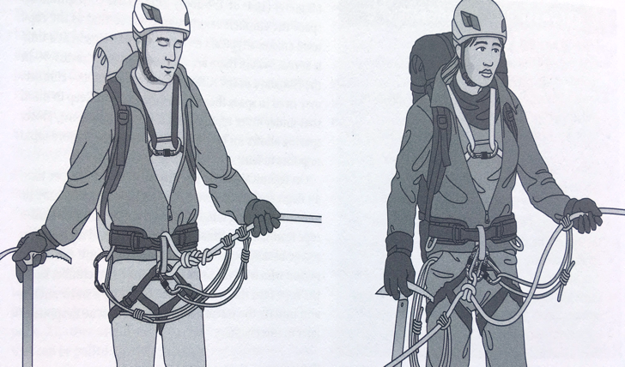
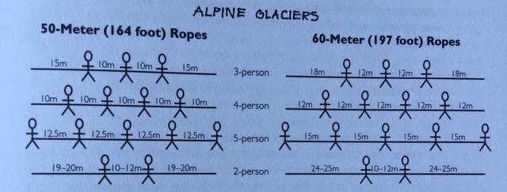
Rope teams – tie in
Tie in with figure 8 or butterfly.
Backup carabiner for butterfly.
Consider extra rescue rope for climbers at the end.
Prusik slings.
Partner check!
FoTH 9
Andy Selters,
Glacier travel and crevasse rescue

Slide 37
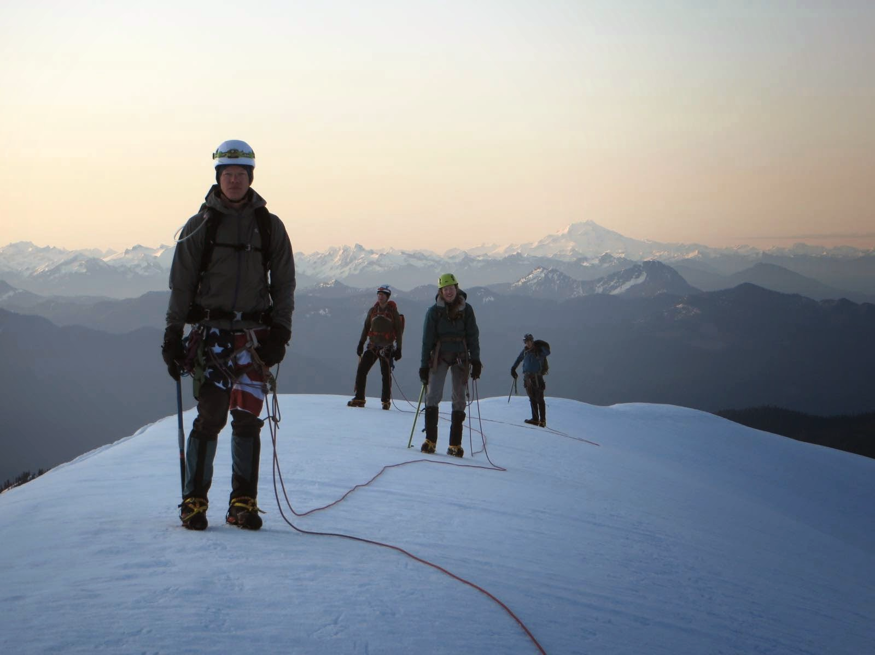
Rope teams – keep the slack out!
Lots of slack in ropes.
Imagine fall
Try to avoid this.
Picture taken during snow field trip, no students hurt ☺
Mt. Baker, Sandy camp

Slide 38
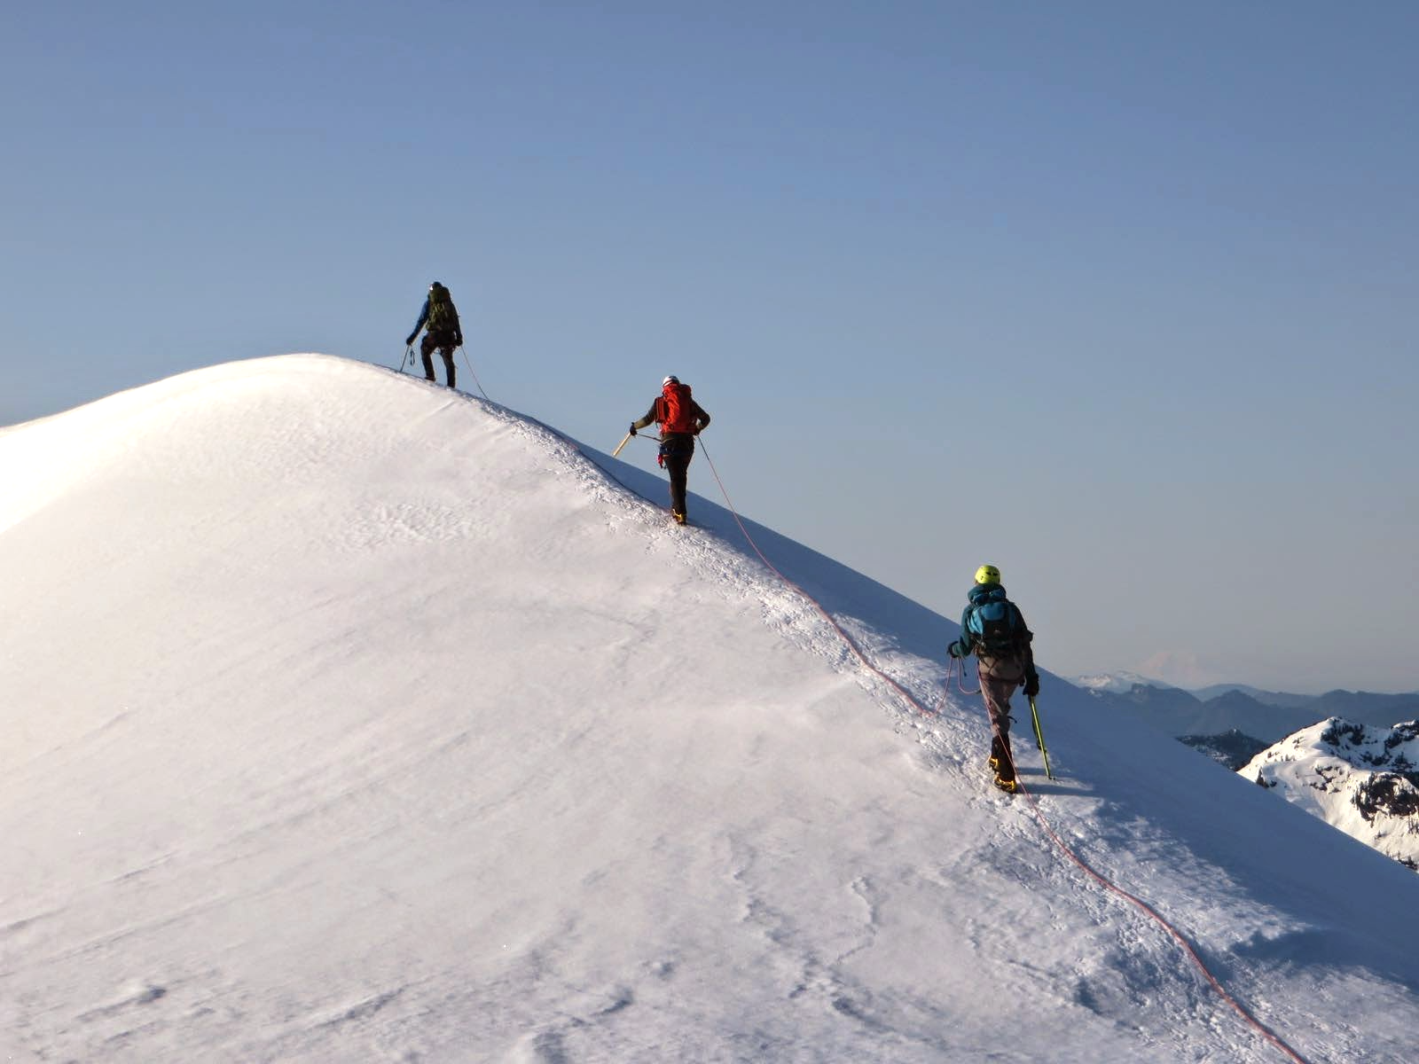
Rope teams – keep the slack out!
Same FT
Better rope management
Mt. Baker
Sandy Camp

Slide 39
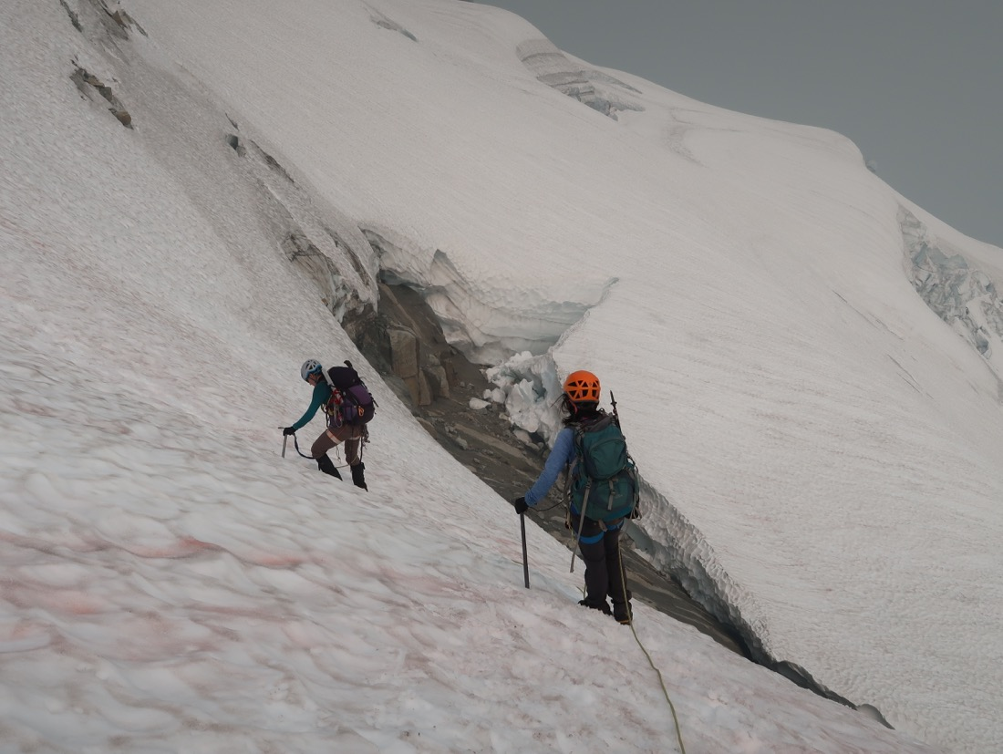
Rope teams – running belay
Exposed travel, steep snow/ice, traverses
Arrest not likely,
Picket, ice screw, rock protection.
Sloan Peak

Slide 40
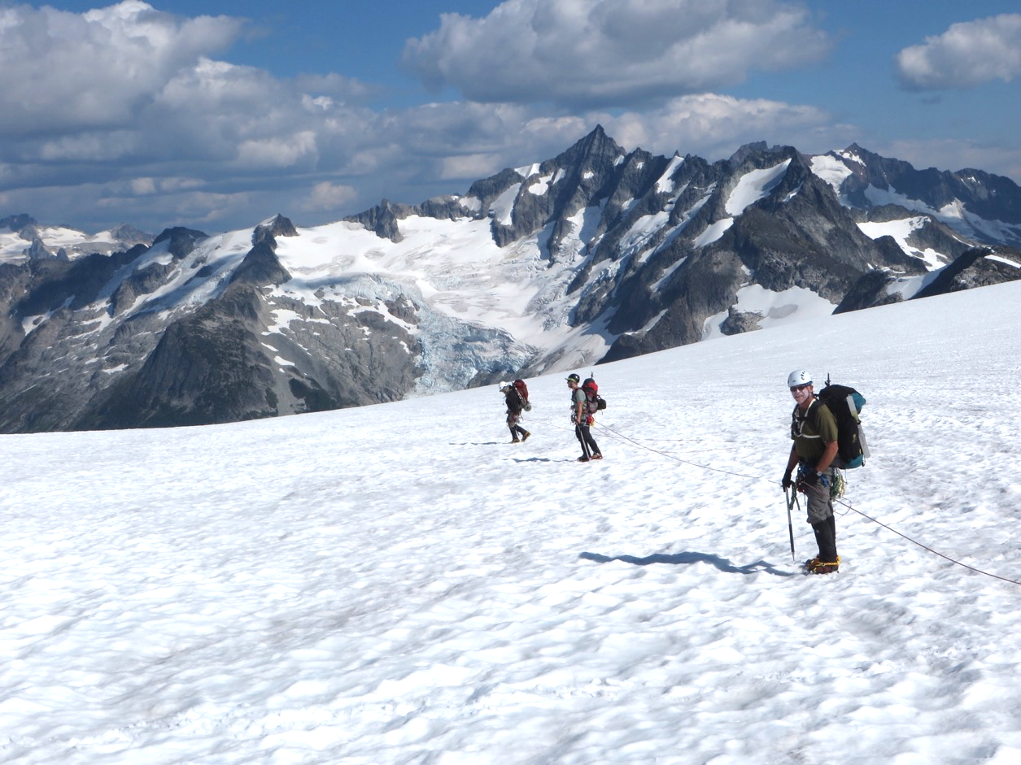
Rope teams – Echelon
Crevasses along direction of travel.
Fall could lead to pendulum.
Rope team travels perpendicular to crevasses.
Eldorado Pk.
Inspiration
glacier

Slide 41
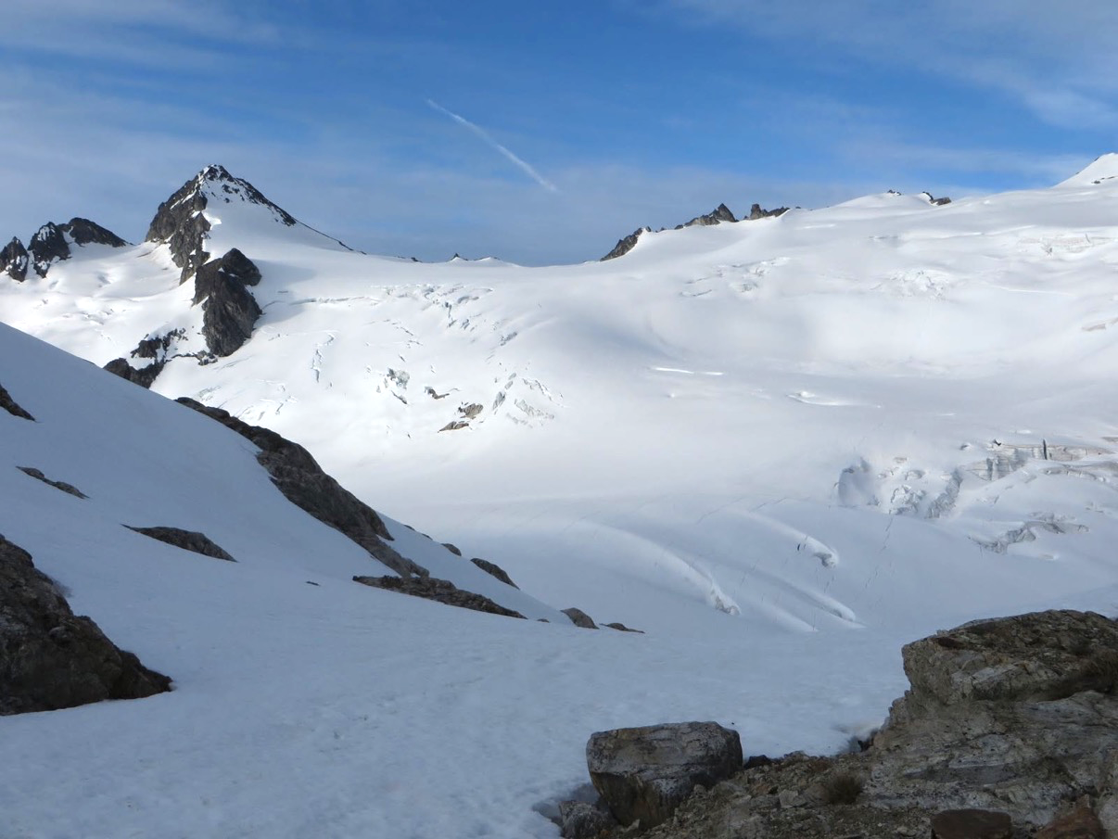
Crevasses!
Good decisions needed.
Snowfield peak

Slide 42
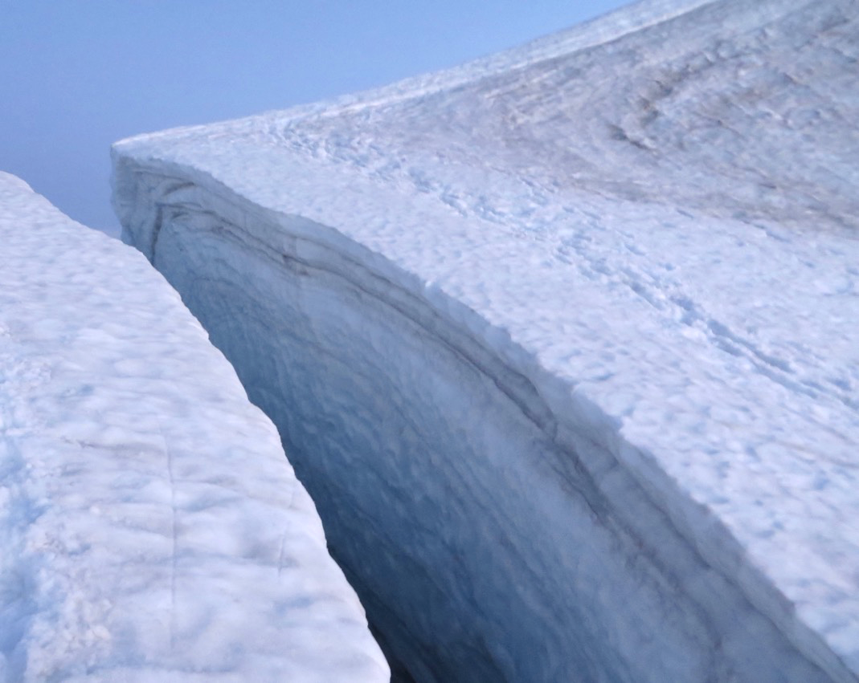
Crevasses!
Stay clear of huge ones!
Eldorado peak

Slide 43
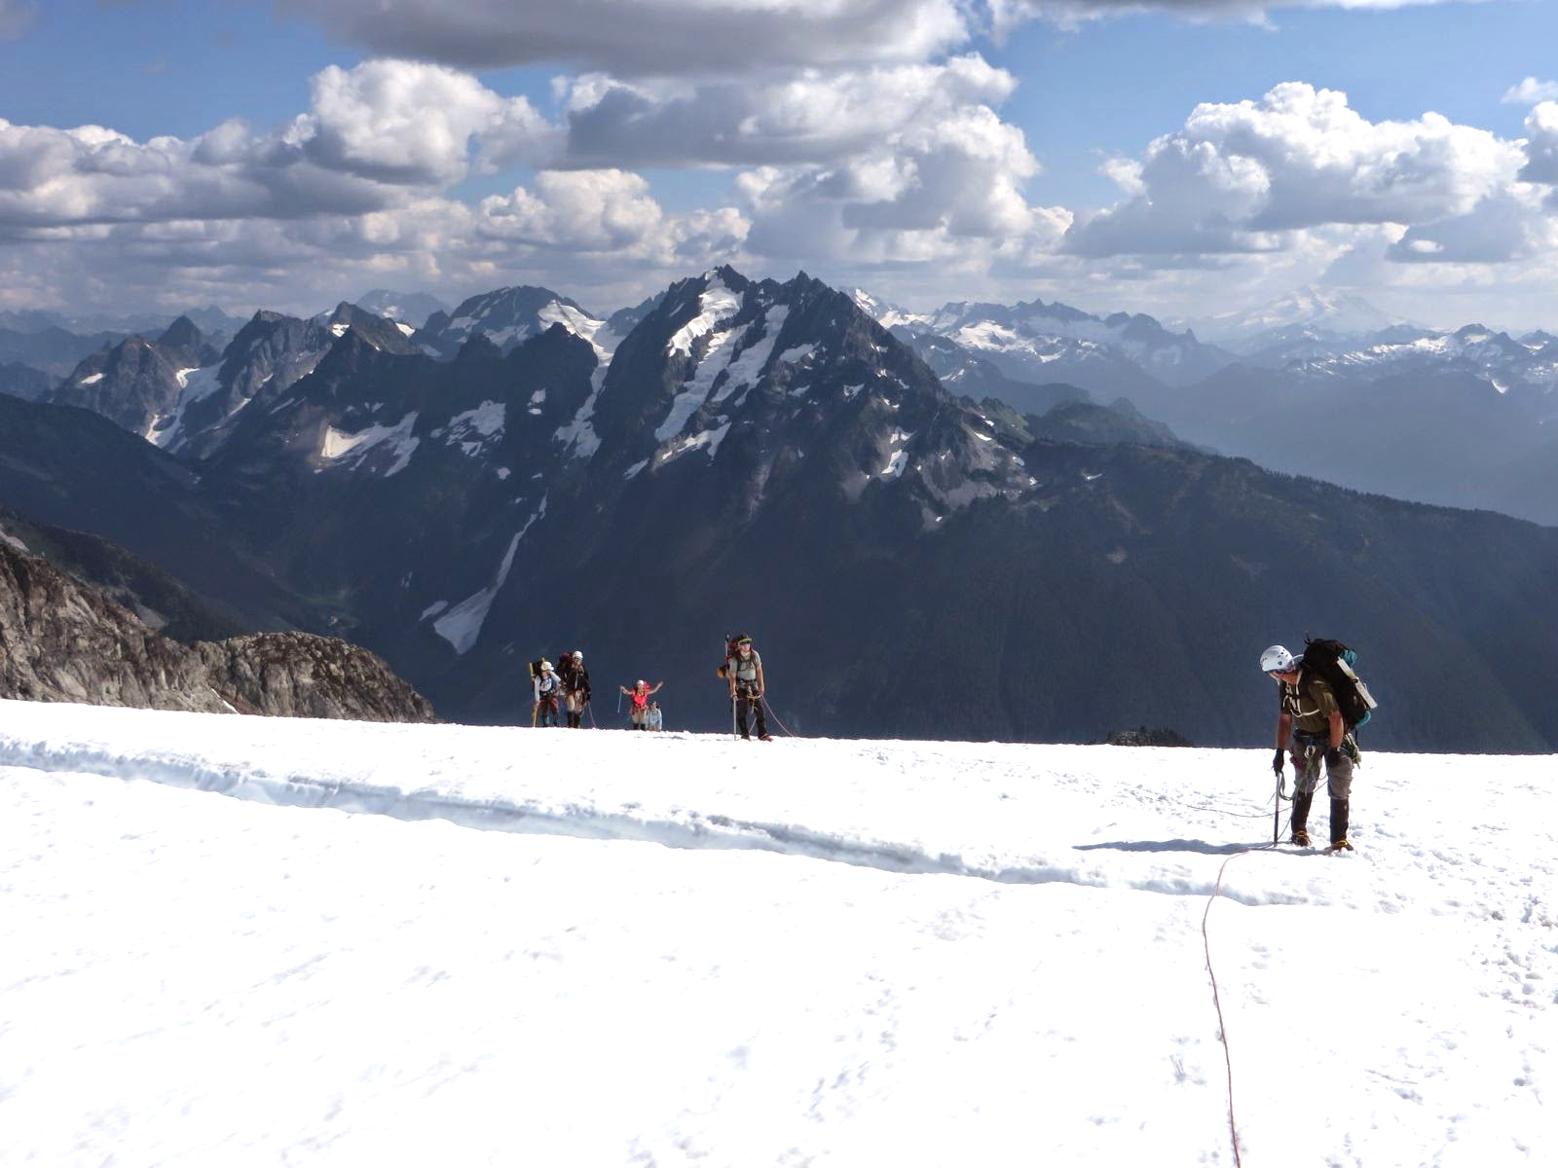
Crevasses!
Step over little ones.
Narrower on climbers left.
Eldorado
peak

Slide 44
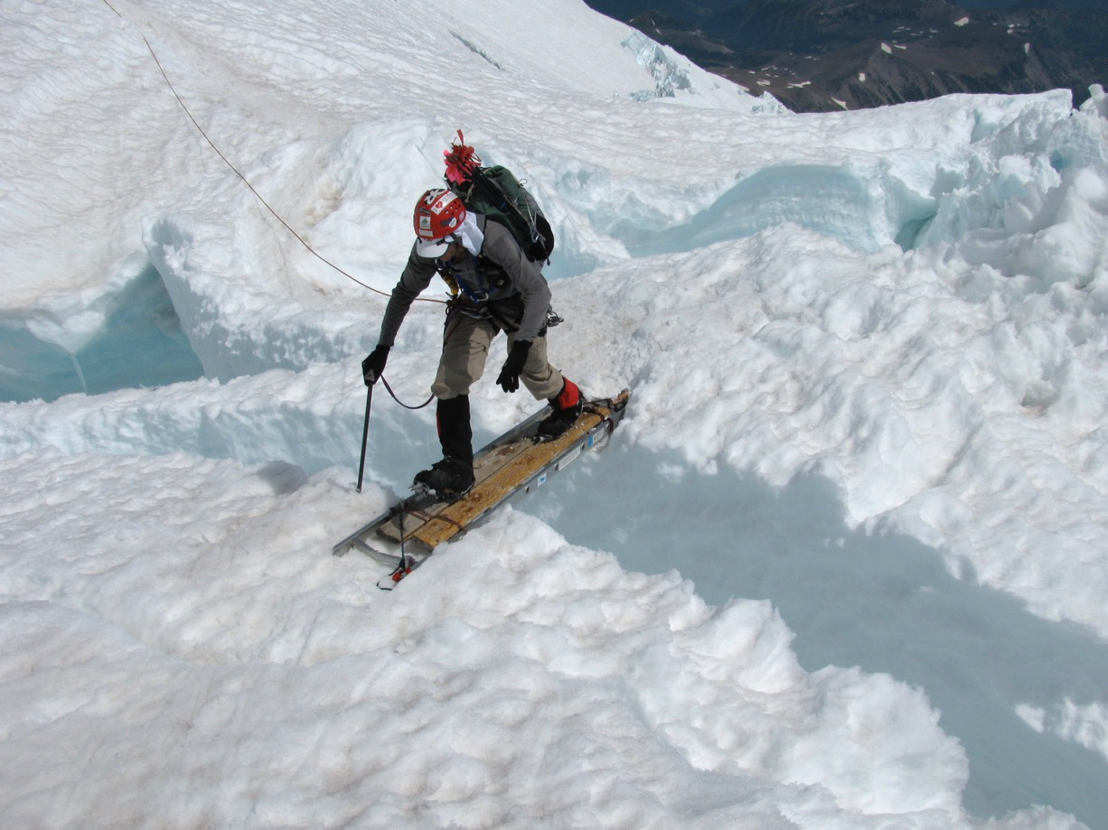
Crevasses!
Ladders on Rainier
Mt. Rainier
via DC

Slide 45

Crevasses!
End run a large one.
Mt. Rainier
Kautz

Slide 46

Crevasses!
Tricky one!
Try to keep slack out of rope!
Eldorado peak

Slide 47

Holding a fall – fairly benign case
https://www.youtube.com/watch?v=CNmRqwsggws

Slide 48

Holding a fall – worst best case!
https://www.youtube.com/watch?v=TkMDUGqiB4A

Slide 49
Crevasse rescue
Rope up for glacier travel
Hold the fall
Anchor the rope, including backup.
Communicate with fallen climber.
Safely approach crevasse, communicate.
Make a plan how to extract fallen climber. Emergency help needed?
Extract fallen climber – Texas prusik, team pull,
set up raising system, consider rope entrenchment.

Slide 50

Crevasse rescue 3:1 vs 2:1
https://www.mountaineers.org/locations-lodges/seattle-branch/committees/seattle-climbing-committee/course-templates/alpine-climbing-courses/basic-alpine-climbing-course/course-materials/crevasse-rescue-illustrated-2018/at_download/file

Slide 51

Crevasse rescue 2:1 hauling
Excellent step-by-step illustration by Deling Ren:
An Illustration to Crevasse Rescue (link)
https://www.mountaineers.org/locations-lodges/seattle-branch/committees/seattle-climbing-committee/course-templates/alpine-climbing-courses/basic-alpine-climbing-course/course-materials/crevasse-rescue-illustrated-2018/at_download/file

Slide 52
Crevasse rescue videos
AMGA (American Mountain Guides Association) has published a set of excellent videos on Galcier techniques and Crevasse rescue:
Snow anchors:
https://vimeo.com/264670274
Roping up:
https://vimeo.com/264670737
Anchor set up and transferring the load to an anchor:
https://vimeo.com/265007409
Backing up a picket anchor:
https://vimeo.com/265009761
Approaching and preparing the lip of the crevasse:
https://vimeo.com/265008195
Rappelling down to the fallen climber:
https://vimeo.com/265010472
Note that the different rope ascending technique.
Hauling via C-loop and variations:
https://vimeo.com/265012079
Note: Instead of a micro traxion we can use a pulley with a Prusik

Slide 53

Title
Be safe and
enjoy your glacier trips!
Bullet

