Slide 1
Basic Climbing Course Lecture 2
anchors, belays, belay escape, rappel
Jan 29th, 2020
Deling Ren

Slide 2
Where We Are Now
Lecture 1 (Course Intro, Knots, Top-rope Belay, Rope Ascending)
Lecture 2 (Anchors, Belays, Belay Escape, Rappel)
Lecture 3 (Alpine Rock)
Lecture 4 (Snow Travel, Avalanche)
Lecture 5 (Glacier Travel)

Slide 3
Lecture 2 Learning Targets
Field Trip 2
Anchor Evaluation
break (anchor inspection)
Lead Belay
Belay Escape
Rappelling
Notes:
Tonight’s goal is to provide context for the upcoming field trip. (i.e. to explain why students are about to learn the skills in the next field trip, how they will use these skills, and what is most important to know about these skills.
Timeline

Slide 4
Field Trip 2

Slide 5
What to expect
Just like a climb:
Be on time and be present (i.e. don’t check your phone every 5 minutes)
Bring food, water, and clothing appropriate for the weather conditions
Full-day event, includes climbing on outside/South Wall. Don’t count on getting home early (just like a climb)
Thank your instructors

Slide 6
Gear (check your handbook for details!)
Helmet
Harness
Carabiners
Slings
Belay/rappel device & nut tool
Pack
Mountaineering Boots

Slide 7
Racking Gear
Know your harness. 1 waist buckle vs 2; w/ or w/o leg buckle, double back vs auto double back (aka speed adjustment), etc
Harness without a belay loop (alpine bod): needs a dedicated locking biner
Rack runners, carabiners & hero loops on harness
Easily accessible
Not hanging too low
Not in your way
Consistent
Gear up when you arrive at an event, including field trips and Monday skills nights
Notes:
Read the instructions that came with it (usually sewn on the inside or your harness belt)
For field trips and practice night: please consider helping set up ropes and coiling ropes / helping take down at the end of the night!

Slide 8
Anchor Evaluation

Slide 9
Essentials of a good belay
A method of applying stopping force to the rope
A stance with an anchor strong enough to stop the fall.
A skilled belayer.

Slide 10
To anchor or not to anchor
Reasons for anchoring
Exposed terrain where a fall is consequential
To protect the belayer from being pulled into something
Big weight difference
Belay escape
Reasons for not anchoring (or not anchoring in tight)
Freedom to move for adjusting belay position or dodge falling rocks
Soft catch for leader
Chossy rock

Slide 11
Or if you’re Alex Honnold
No need for anchor when you’re free soloing (or harness, rope, or helmet)

Slide 12
Belay and Rappel Anchors 101
Solid (or Strong)
Equalized
Redundant
Efficient
No Extension
Other acronyms
Equalized, Angle, Redundant, No Extension, Solid (or strong), Timely
Solid, Redundant, Equalized, No Extension
Notes:
We don’t teach placement of rock anchors at Basic, but it is imperative that all members of a climbing party have the knowledge to rig and inspect anchors (if you care about your life and building a foundation of climbing competency).
These are guidelines rather than golden rules. Some are at odds with each other (e.g. equalized vs no extension)

Slide 13
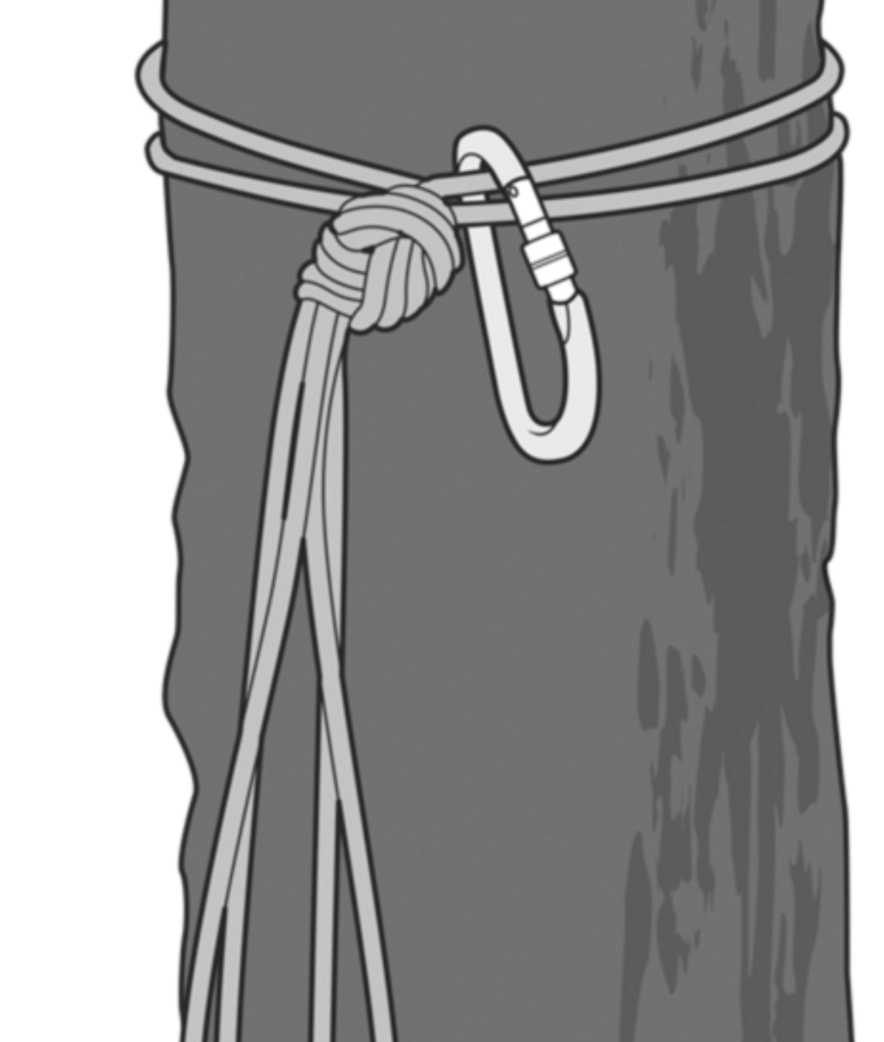
Solid (or Strong)
Notes:
Trees and large rocks can be deceiving. Dead, poor roots, slanting down slope… But note that a good tree can be a perfect anchor even though it doesn’t follow the acronym. Be mindful of “rules” in climbing. It all depends on a given situation.

Slide 14
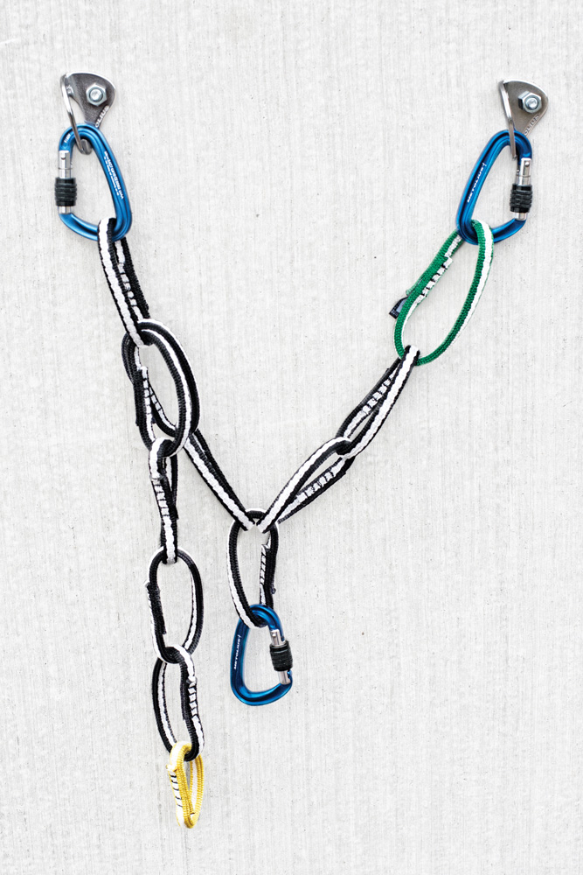
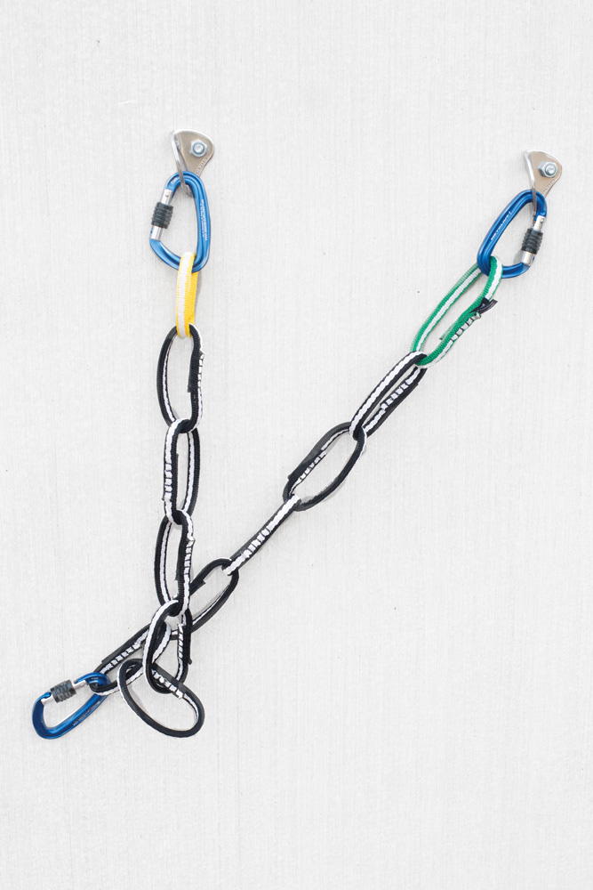
Equalized
Load is evenly distributed among anchor points
Notes:
Equalized. Each piece in the anchor should share the load of the anchor force equally. If there is slack to any single piece, that means that that piece is not loaded, and the anchor is not equalized.

Slide 15
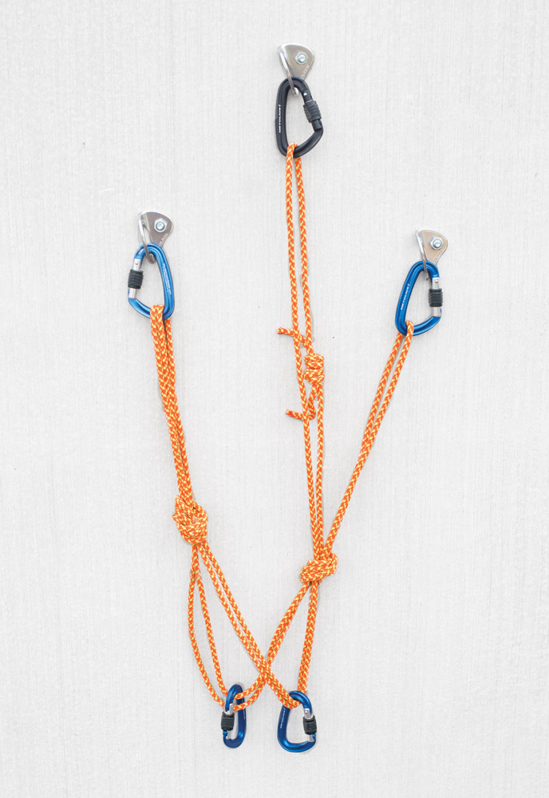
Redundant
Two excellent anchor points or three good ones
Notes:
Redundant. There should be more than one piece for the anchor. Common anchor examples are two bolts, three pieces of rock gear, etc. One exception is a single rock or tree that can be counted as sufficiently reliable on its own.

Slide 16
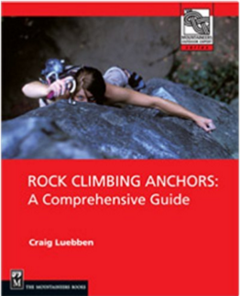
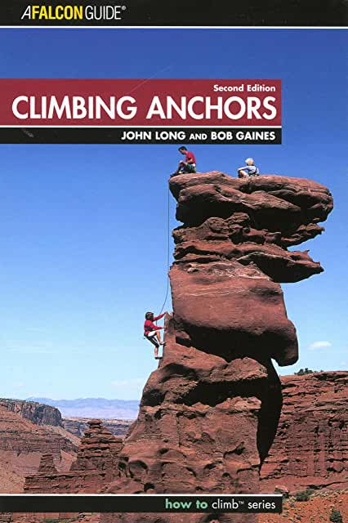
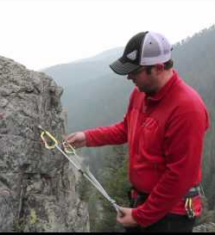
Efficient
Fast to build
Easy to evaluate
Read, observe, and practice
Notes:
John Long’s book is excellent. If it’s taking you two hours to build a “bomber anchor”…

Slide 17
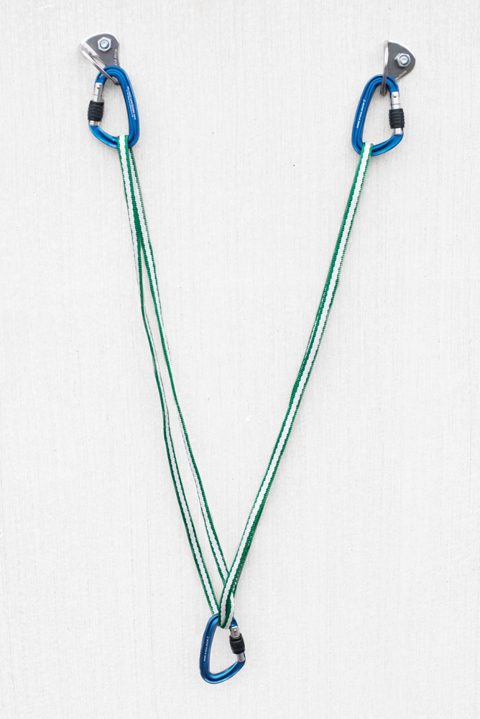
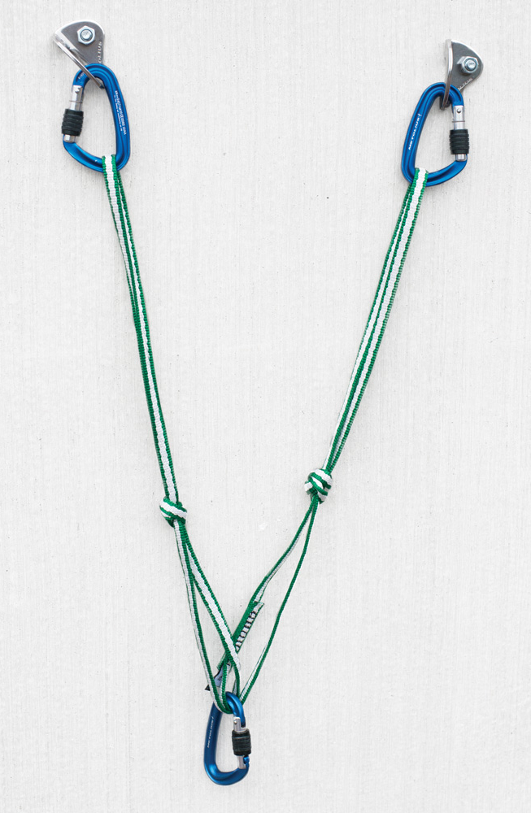
No Extension
How far would the anchor extend should a piece fail?

Slide 18
Recap
Strong or Solid
Equalized
Redundant
Efficient
No
Extension

Slide 19
Anchor Evaluation Activity
Quickly tour the anchors throughout the room.
Evaluate them. Are they all SERENE?
Would you trust your life with them?
Discuss with peers, take notes, take pictures...
Notes:
Ignore the bolts and the carabiners. Assume these are good and focus on the building of the anchor (soft goods)
AB: this is also the break time? So break + check out anchors for some amount of time (15 min)?
45 minute check, 15 minute break
Reconvene and discuss

Slide 20
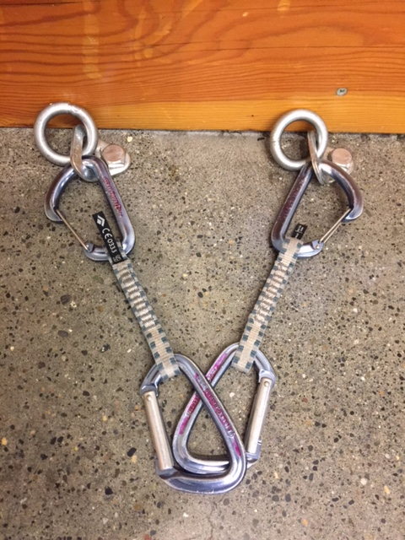
Anchor Activity Review
Quickdraws

Slide 21
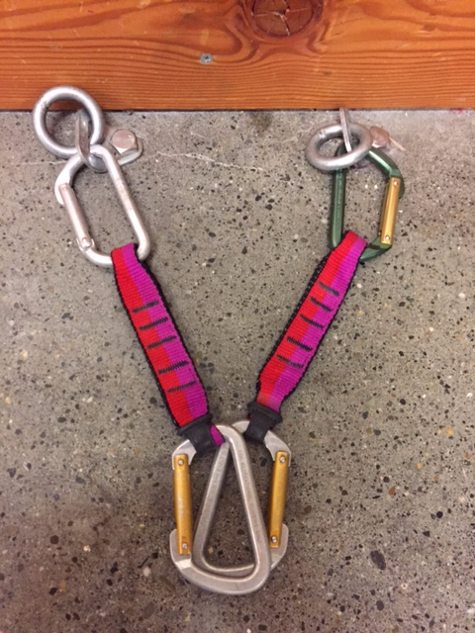
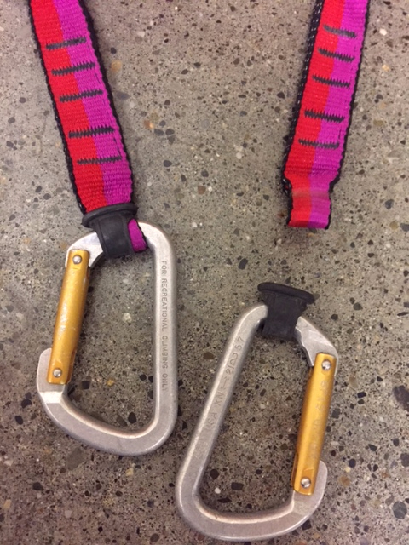
Anchor Activity Review
Quickdraws
Notes:
get hands on. know your gear. not only was the quickdraw put together incorrectly (yes, it does happen), but the fabric of these qds is way too old. likely 15+ years!

Slide 22
Anchor Activity Review
The Sliding X
Notes:
Sliding x has some advantages, but be extremely mindful of the possibility of extension! Let’s look at a better way to set this up.

Slide 23
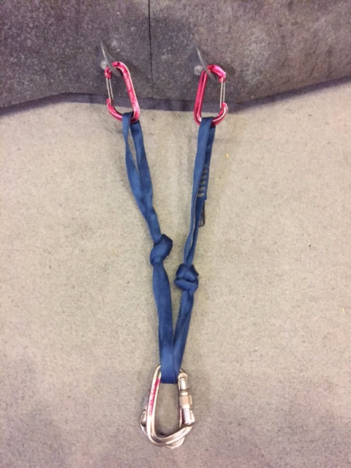
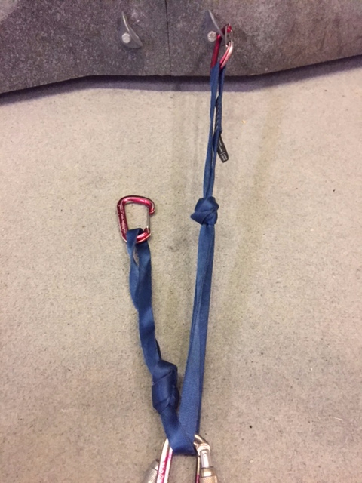
Anchor Activity Review
The Sliding X w/ limiting knots
Notes:
much better with limiter knots. preferred knot is an 8 rather than an overhand.

Slide 24
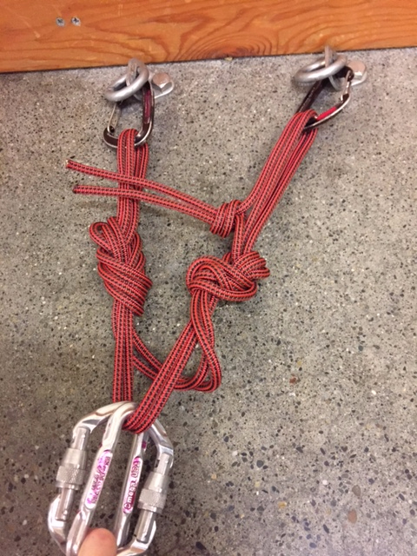
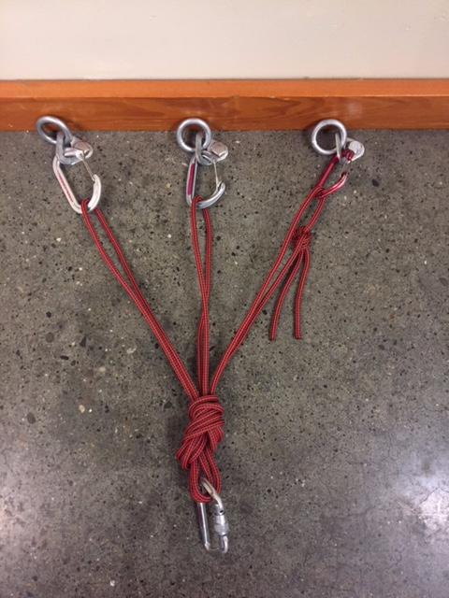
Anchor Activity Review
Notes:
Quad is a great option for two-piece anchors, esp for top rope settings or multi-pitch with bolted anchors. Some questions came up about the knots here: If these cordelettes were dyneema or tech cord then a triple fisherman’s would need to be used. Advantage of the overhand is that the cordelette can be easily untied and reconfigured depending on need. Again, preffered limiter knots are 8s.

Slide 25
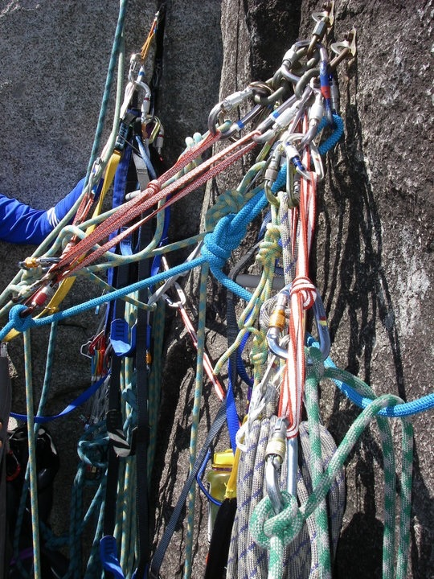
Notes:
sloppy and loose overhand knots will slide out. Always check knots. Should be water knots with webbing.

Slide 26
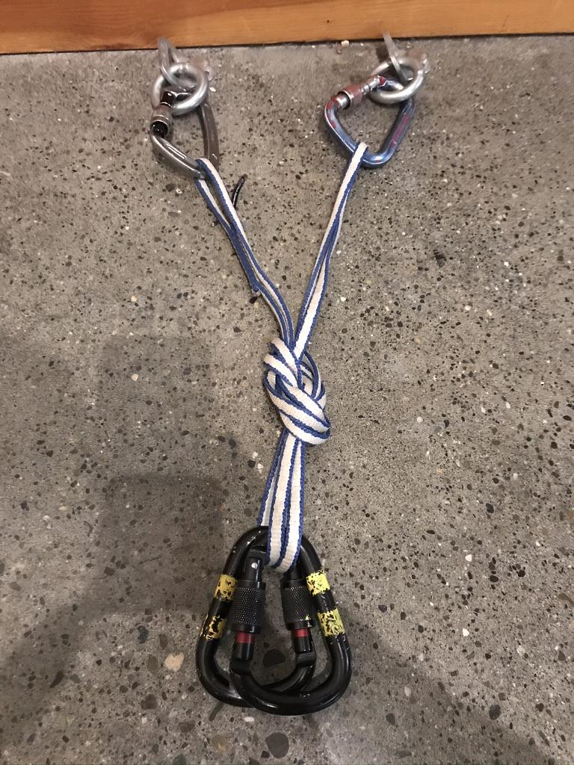
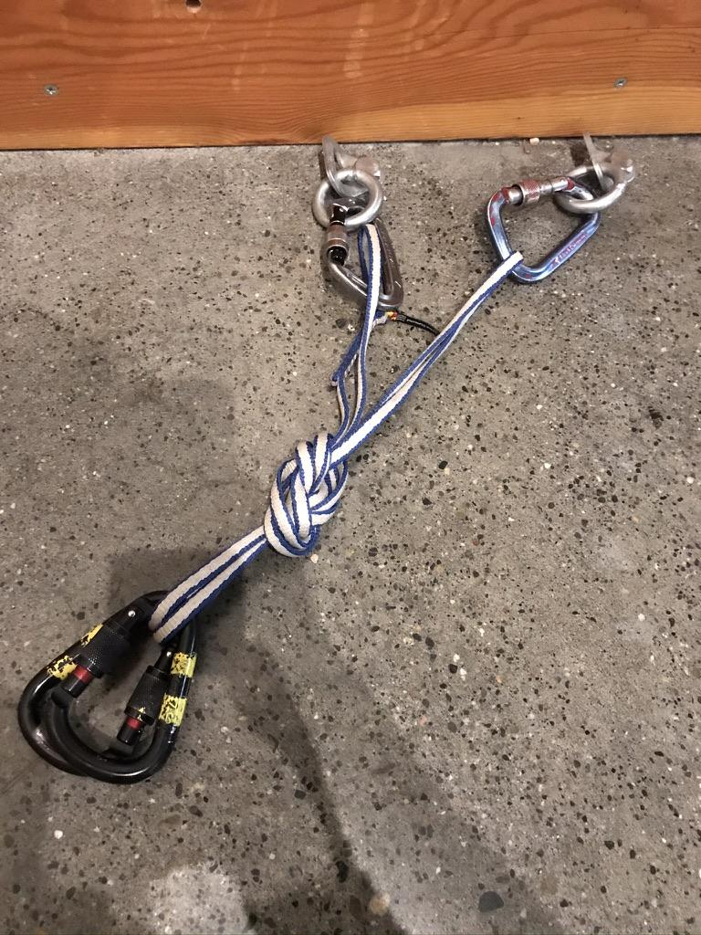
Anchor Activity Review
What you will see at your FT
Notes:
Good if direction of pull doesn’t move; otherwise you will load one arm more than the other.

Slide 27
Lead Belay

Slide 28
Three types of belaying
Slingshot top rope belay
Belaying a leader
Belaying a follower
Notes:
Briefly explain the three scenarios. Let’s elaborate a little of 2 today. 3 is very much irrelevant for this course.

Slide 29
Basic Lead Belay Setup
Observations
Anchor at comfortable belay stance
Helmets
Neatly flaked dynamic rope
Attentive brake hand
Non-brake hand is feeding out rope
Belayer is watching lead climber
*This scene is of a multi-pitch trad climb; the climbers are on an exposed ledge
Notes:
Be sure to note that this is a multi-pitch trad climb and on exposed terrain. Make mention of tying into the anchor with a clove hitch.
Discussion on the observations

Slide 30
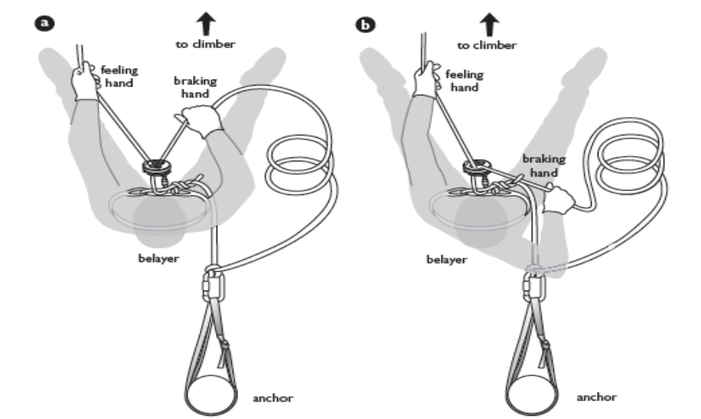
Braking hand and feeling hand
Brake with braking hand
Take and give slack with feeling hand
Notes:
Belaying a Leader. Very similar to top-rope belay (partner check, rope handling, position, etc.) BUT much higher force if there is a fall. Position of body and brake hand becomes much more important (it’s always important).

Slide 31
Instruction Videos
Rock Climbing Basics: Toprope Belay Technique
Rock Climbing Basics: Belaying the Leader

Slide 32
What would you do differently?
Notes:
AB: If time allows, this could be another good slide for students to discuss in their table groups (2 minutes might suffice), then share with the entire room.
Move closer to the base of the route 2) anchor the belayer to prevent impact upon upward pull
This presents a scenario where an anchor is called for. Tie-in with rope, clove hitch (easy adjust) or bight. Room to move if
necessary (e.g. falling rock). Not tied in tight except for situations necessary to protect belayer from something. A roof is a good illustration
example. Anticipate and prepare for direction of force.Make mention of multi-pitch and exposed terrain and move along to belaying a follower.

Slide 33
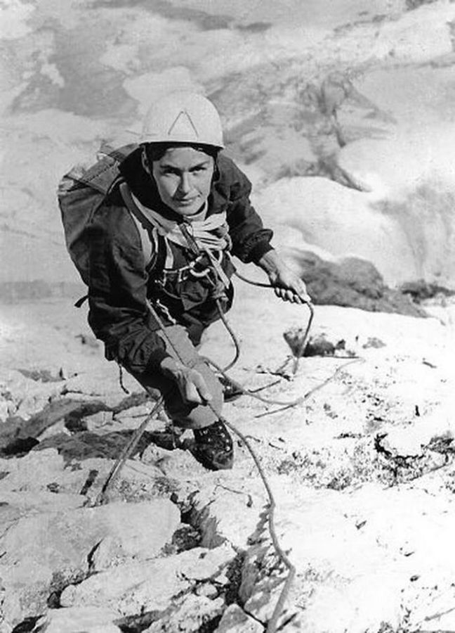
Belay Commands
“On Belay?”
“Belay on.”
Use names if not alone
“Yui, Climbing”
“Bill, Climb on.”
“Wanda, Off Belay”
“Por, Belay is off”
Use a loud clear voice and consider Walkie Talkies or Rope Signals
Notes:
AB: added names to the last four commands. These are most useful when said first, so your partner can pay attention to what’s coming next. Use your “outside voice,” as you will have to shout over the wind, other climbers, etc.
(this is Wanda Rutkiewicz, the first woman to climb K2)

Slide 34
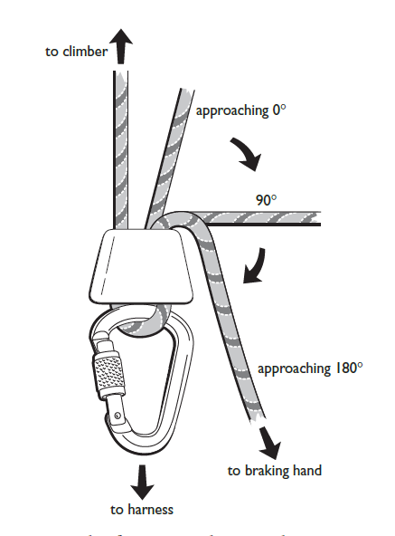
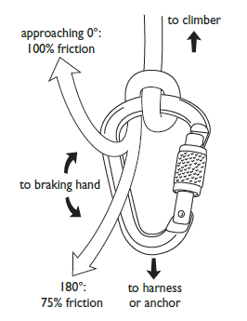
Numerous ways to belay…
Munter
tubular device
body belay
Notes:
Body belay—note the difference in the brake hand.
Munter—note that the braking position has you move away from the harness or anchor
Tubular—review that this is what they will most frequently use. PBUS for TR belay, and similar braking position for lead belay
MAKE MENTION HERE OF NOT CROSS LOADING THE BINER

Slide 35
Belay Escape
Notes:
Alina, I’d like to pause for Table Discussion after posing the question.
What if the leader is unresponsive? What if the nature of the injury is uncertain (neck/back)?
What if an obstacle is in the way (tree, ledge, cliff, etc.)?
What if there isn’t enough rope to lower the leader back to the belay?

Slide 36
Belay Escape Considerations
Fallen Climber. Responsive? Unresponsive?
Can you see the climber?
Are other climbers around?
How much rope is available?
Nature of the injury
Belay escape is a judgement call and requires serious thought.

Slide 37
Belay Escape – in stages
Stage One – get hands free
Stage Two – prepare load transfer
Stage Three – transfer the load
Stage Four – escape the belay

Slide 38
Belay Escape—DISCLAIMER!!!
There are multiple ways to escape the belay. The Basic course will show you a fundamental way. As you continue with your climbing, there will be additional methods to learn.
A clip showing you how to go hands free: https://youtu.be/4JtcxIQGKBs?t=50s
An Illustration: https://1drv.ms/b/s!FjL5vMRx18wDgcA3NktMbVQ5bkhHUHckDA
Notes:
Stopping at 2:18 Tell 10 sec story of Sarah. ???

Slide 39
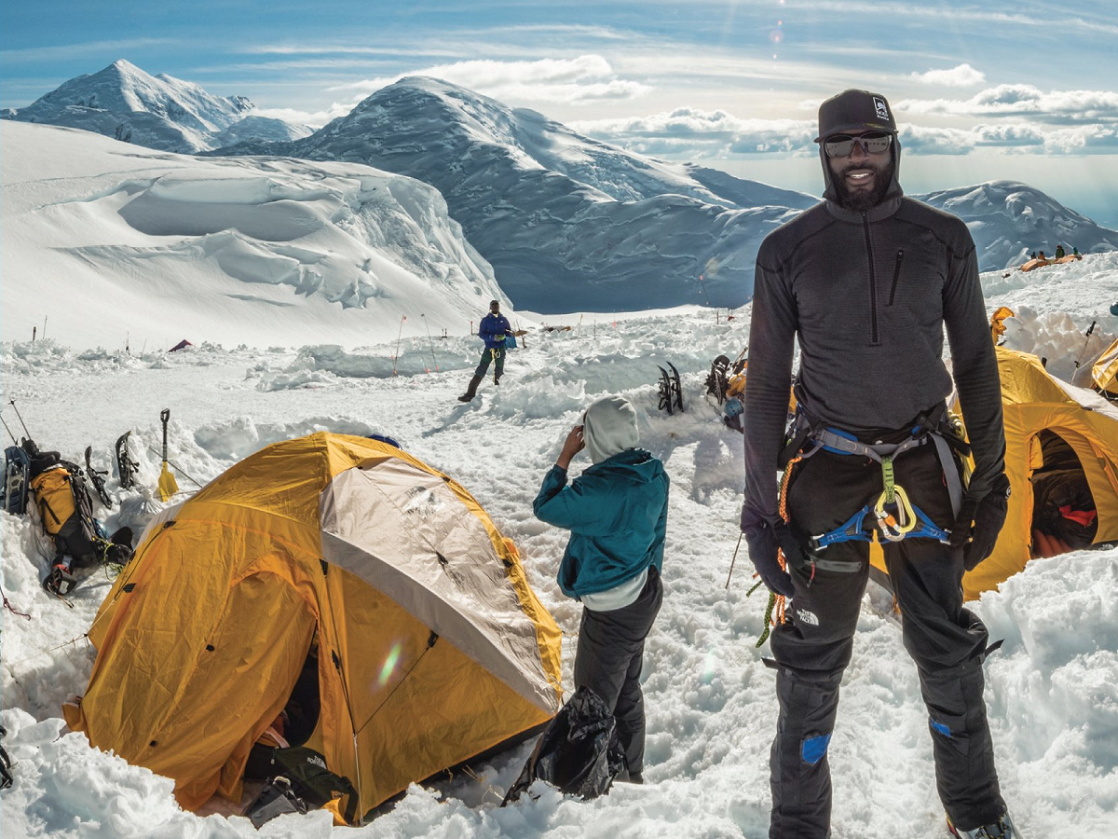
Questions?
Notes:
1:25 check

Slide 40
Rappelling

Slide 41
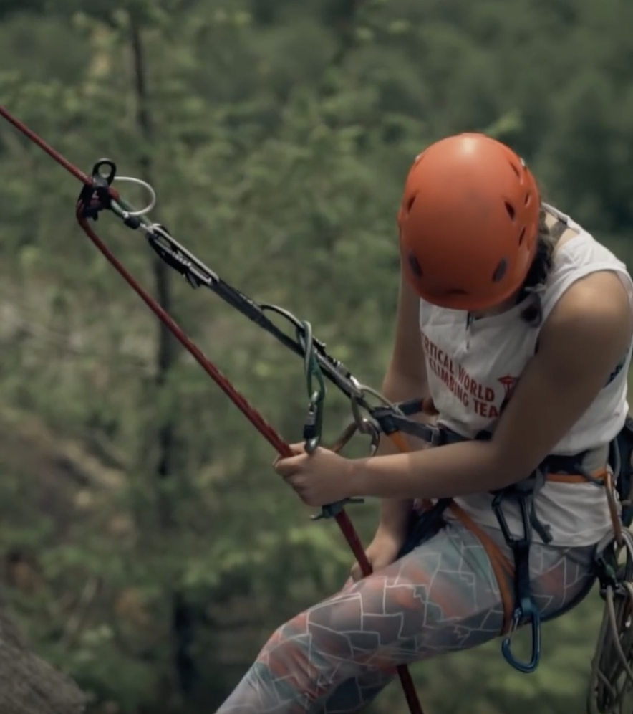
Factors to consider
Rappelling vs down climbing
Anchor quality
Terrain hazards
Where does the rappel end?
Gear management
Agreed upon plan
Backup
Notes:
Anchor quality - emphasize importance. Ask: Can I downclimb?
Terrain hazards - falling rock, pendulum, overhanging—note that rap lines can differ from ascent routes. Mention that a glove is helpful for novice rappelers, esp as they are unfamiliar with how a rope will handle (thin and fast or thick and sluggish), the terrain, and managing a rappel
Always close the system! Knots at the end of the rope OR tie into the ends and saddle bag the lines or throw the lines
Gear management - keep it clean!
Plan - communication is hard between two ends of a rappel
Backup -autoblock or fireman’s

Slide 42
Rope Management
Length of Rappel (one 60m rope=30m rappel)
Single rope vs double rope
Does the rope have a middle mark?
How to tie two ropes together? (flat overhand, aka EDK): video
Close the system (bulky knots at both ends): video
Notes:
Talk about pros and cons of single and double rope rappels
Note that most routes (esp Basic) in the Cascades favor short 30m rappels due to blocky rope eating terrain
Speak to advantages of the EDK (and misnomer of the name): easier to tie and untie, flips and glides over edges when being pulled—note to leave plenty of tail 12-18 inches

Slide 43
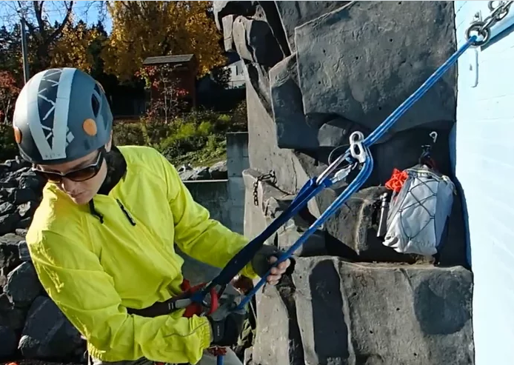
Overview of the extended rappel
Why extend?
Easier to auto-block
Higher center of gravity (helpful when you’re top heavy)
More natural position for brake hand
Use either hand to brake
video
blog post

Slide 44
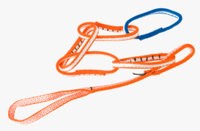
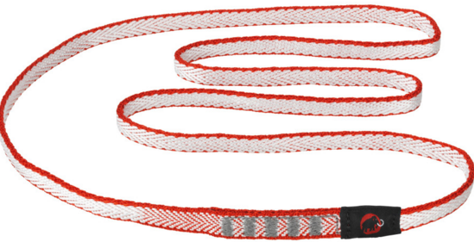
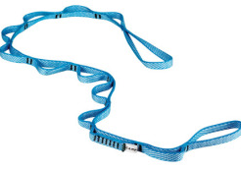
Your Personal Tether
NYLON=GOOD
PAS=OKAY
DYNEEMA=CAUTION
DAISY=BAD
Notes:
Never climb above the anchor when connected with Personal Anchor vs the climbing rope. Why?
Explain nylon compared to dyneema=slight give, lower melting point, doesn’t weaken as much when knots are tied (btw—use a figure 8 instead of overhands when tying knots in tethers)
PAS: more suitable for cragging since it’s less versatile and heavier and bulkier
Daisy: intended for one purpose: aid climbing. Just say no.

Slide 45
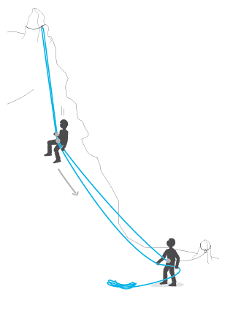
Efficiency and Safety Points
Tidy your harness
Agree upon a plan
Double Check!
Stay anchored in unless on rap
BACK IT UP!
Resist the urge to bounce! ☺
Notes:
Pack away what you don’t need; keep out what you might need—esp. gear in case of emergency
Will everyone use an autoblock or will you all (after first rappel) use a fireman’s---can you see the base? Known hazards?

Slide 46
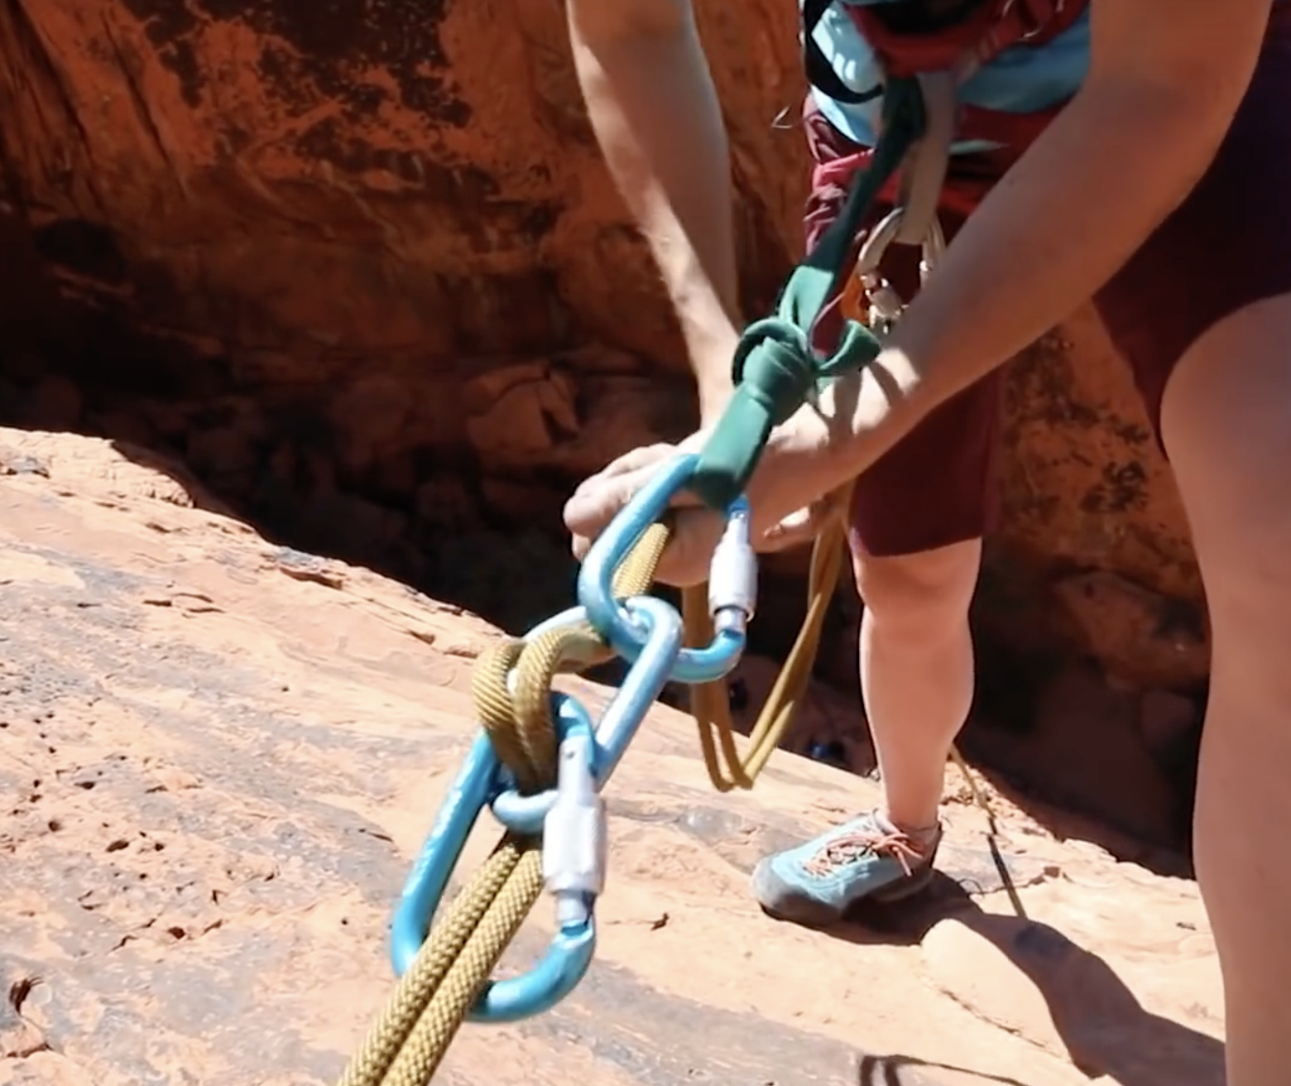
What if I drop my rappel device?
Carabiner brake setup with 3 lockers: video
Notes:
Smack your head really hard to remind you never to do it again
Check if anyone has an extra device
Use an alternative method
Extension and autoblock can be applied as well

Slide 47
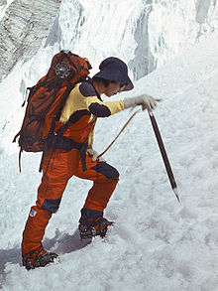
Questions?
Notes:
AB: this is Junko Tabei, the first woman to climb Everest

Slide 48
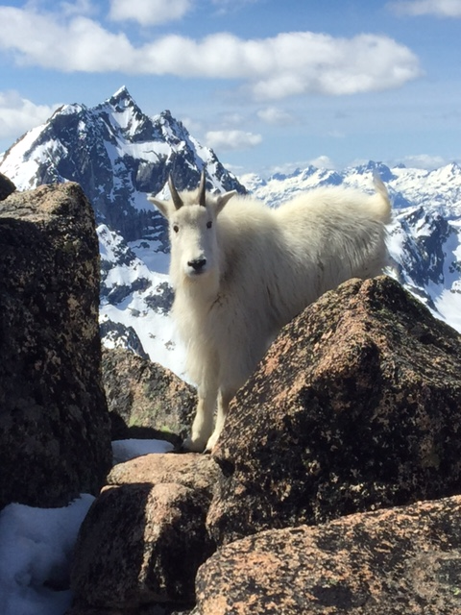
Climb On!
Notes:
And rap off. This is Billie the goat

