Slide 1
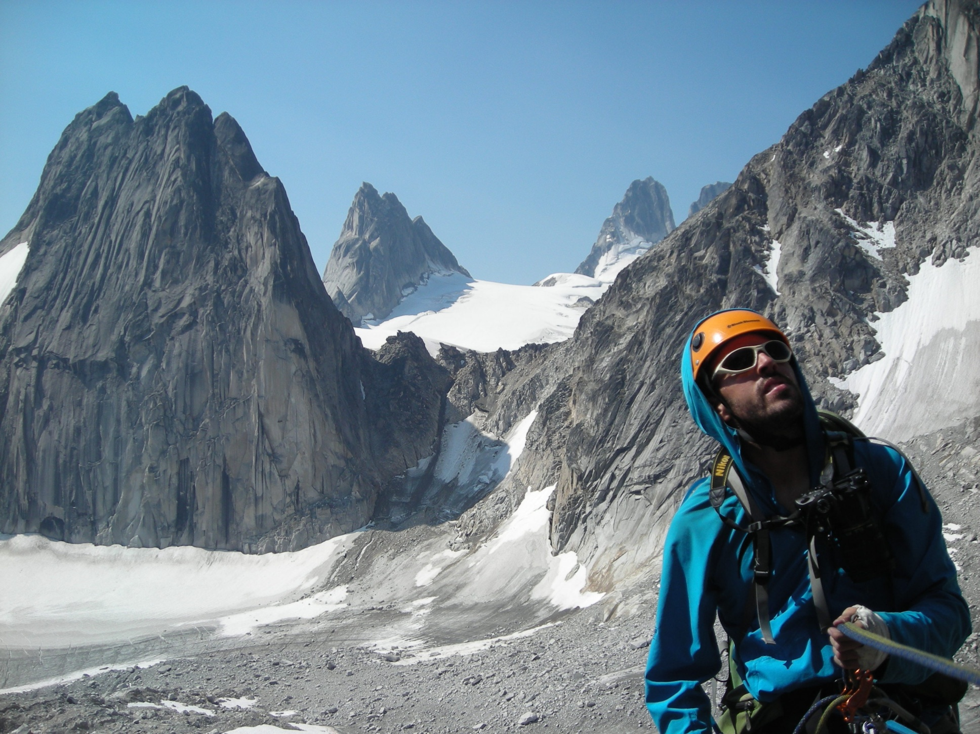
Welcome to Lecture 2! Have a seat and get to know your future climbing partners!
Notes:
Briefly speak to the intentional word choice of neighbors vs partners vs classmates, etc.

Slide 2
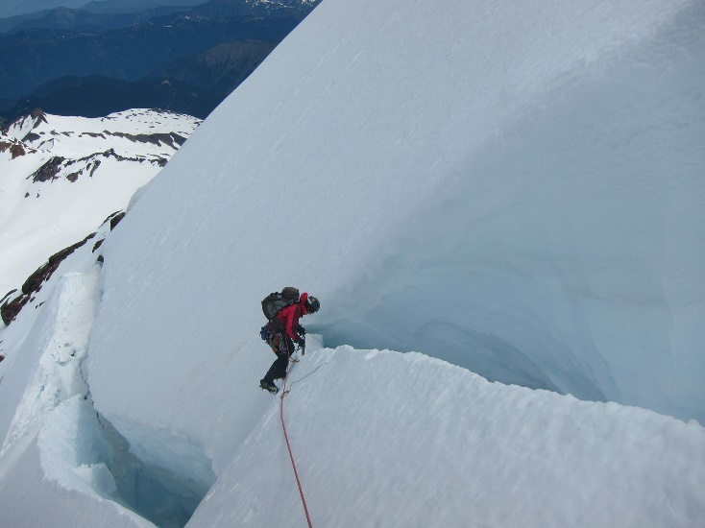
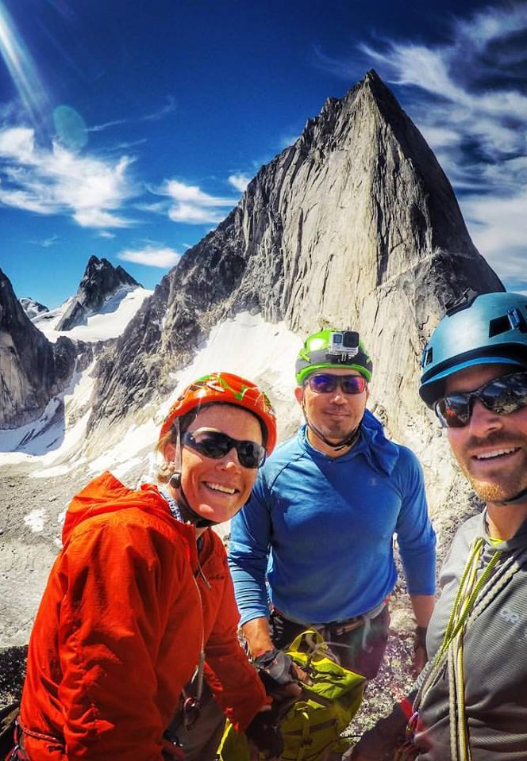
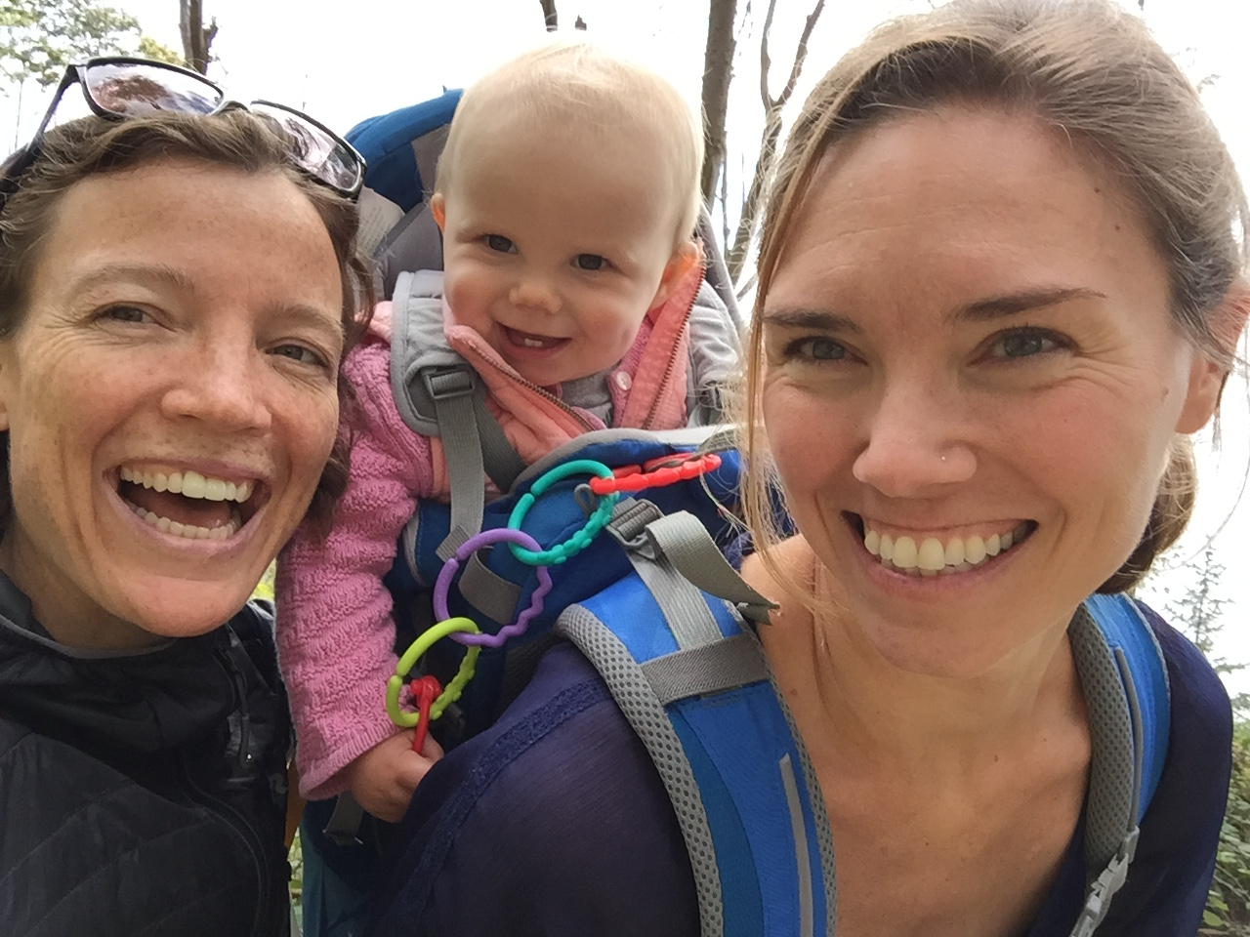
Abby Hunt Mountaineers Climb Leader Co-leader of Alpine Rock Course AMGA SPI Certified Instructor
Notes:
Quick intro. Talk about observing, trying, failing, seeing things with beginner’s eyes. I’m not going to scare folks tonight with statistics or stories, but you should research and read these. Rather I want to cover some essential skills that folks might need while climbing.

Slide 3
Perspective
Lecture 1 (Course Intro., Knots, Top-rope Belay, Rope Ascending)
Lecture 2 (Anchors, Belays, Belay Escape, Rappel)
Lecture 3 (Alpine Rock)
Lecture 4 (Snow Travel, Avalanche)
Lecture 5 (Glacier Travel)

Slide 4
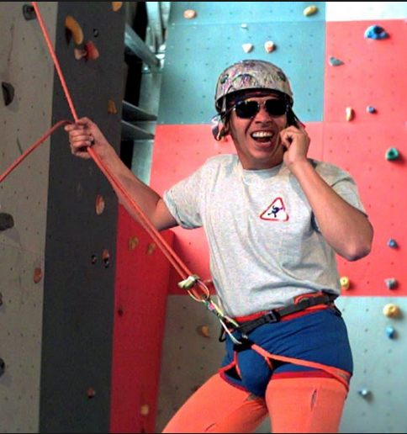
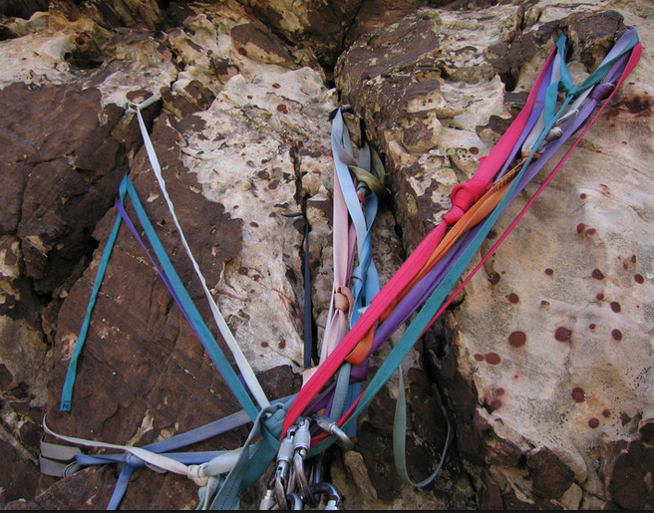
Lecture 2 Learning Targets The prepared and engaged student will begin to understand (conceptually) how to...
--Prepare for Field Trip 2
--Evaluate belay and rappel anchors for rock
--Lead Belay
--Escape the belay
--Rappel safely
Notes:
Tonight’s goal is to provide context for the upcoming field trip. (i.e. to explain why students are about to learn the skills in the next field trip, how they will use these skills, and what is most important to know about these skills.

Slide 5
Bivy Spot?
Notes:
Point out where students can get up and write down questions at any point through the night. I will stop and answer questions at natural breaks in the presentation.

Slide 6
Are you prepared?

Slide 7
Pop Quiz!
If you have a smart phone or a computer, please get it out now and go to www.kahoot.it
Notes:
Quiz only works if there is a facilitator with a kahoot account. I have made the quiz public. Look up “mountaineers” and look for the cover image on this presentation.

Slide 8
Field Trip 2
Just like a climb…
Be on time and be present
Bring food, water, and clothing appropriate for the
weather conditions
Gear: Helmet Harness
Carabiners
120cm sewn nylon sling
Belay/rappel device
Pack
10 essentials
Do your HW and pay attention at tonight’s lecture!

Slide 9
Lecture 2 Learning Targets The prepared and engaged student will begin to understand (conceptually) how to...
Prepare for Field Trip 2
Evaluate belay and rappel anchors for rock
Lead Belay
Escape the belay
Rappel safely
Notes:
Tonight’s goal is to provide context for the upcoming field trip. (i.e. to explain why students are about to learn the skills in the next field trip, how they will use these skills, and what is most important to know about these skills.

Slide 10
Belay and Rappel Anchors for Rock
When are they necessary?
-Exposed terrain that is beyond
“safe” un-roped climbing ability
-To protect the belayer from being pulled into something
-Belay escape vs. extra people to assist
Reason for not anchoring (or anchoring in tight)
-Freedom to move for adjusting belay position,
or dodge falling rocks
-Chossy rock
-You are Alex Honnold

Slide 11
Belay and Rappel Anchors 101
Solid (or Strong)
Equalized
Redundant
Efficient
No…
Extension
OTHER ACRONYMS EXIST, e.g. Equalized
Angle Redundant No Extension Solid (or strong) Timely
Solid
Redundant
Equalized
No
Extension
Notes:
We don’t teach placement of rock anchors at Basic, but it is imperative that all members of a climbing party have the knowledge to rig and inspect anchors (if you care about your life and building a foundation of climbing competency).

Slide 12
Solid and strong
Notes:
Trees and large rocks can be deceiving. Dead, poor roots, slanting down slope… But note that a good tree can be a perfect anchor even though it doesn’t follow the acronym. Be mindful of “rules” in climbing. It all depends on a given situation.

Slide 13
Equalized
Notes:
Equalized. Each piece in the anchor should share the load of the anchor force equally. If there is slack to any single piece, that means that that piece is not loaded, and the anchor is not equalized.

Slide 14
Redundant
2
1
3
Notes:
Redundant. There should be more than one piece for the anchor. Common anchor examples are two bolts, three pieces of rock gear, etc. One exception is a single rock or tree that can be counted as sufficiently reliable on its own.

Slide 15
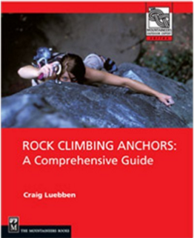
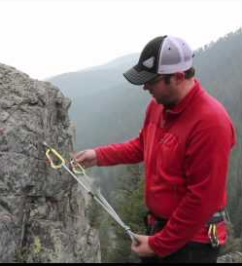
Efficient
Study, learn, practice, practice, practice

Slide 16
No Extension
How far would the anchor extend if the left arm were to fail?

Slide 17
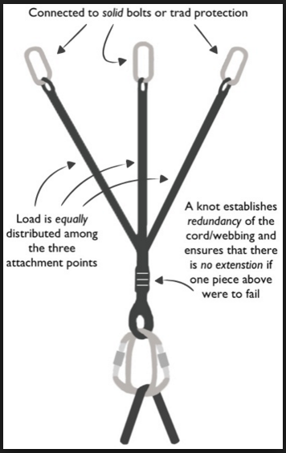
Recap
Strong or Solid
Equalized
Redundant
Efficient
No
Extension
Questions?

Slide 18
Anchor Activity
Quickly tour the anchors throughout the room.
Evaluate them. Are they all SERENE?
Would you trust your life with them?
Discuss with peers, take notes, take pictures, add questions to the bivy spot!
Notes:
Ignore the bolts and the carabiners. Assume these are good and focus on the building of the anchor (soft goods)

Slide 19
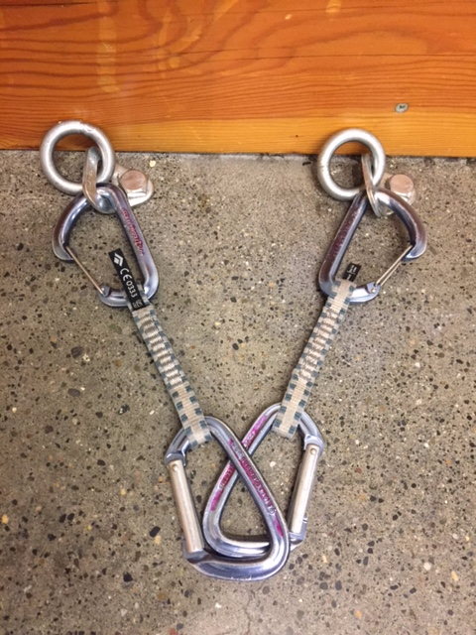
Anchor Activity Review
Quickdraws

Slide 20
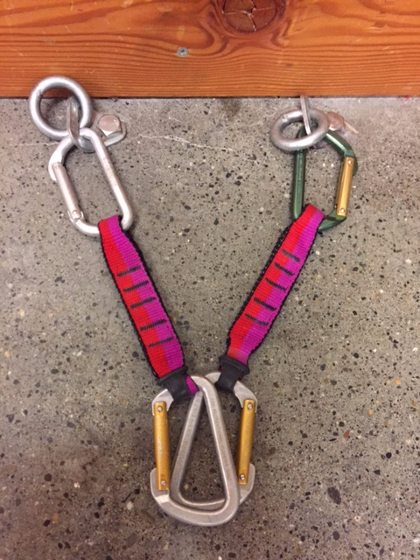
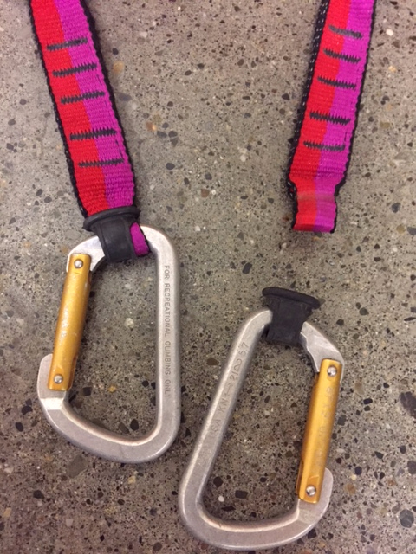
Anchor Activity Review
Quickdraws
Notes:
get hands on. know your gear. not only was the quickdraw put together incorrectly (yes, it does happen), but the fabric of these qds is way too old. likely 15+ years!

Slide 21
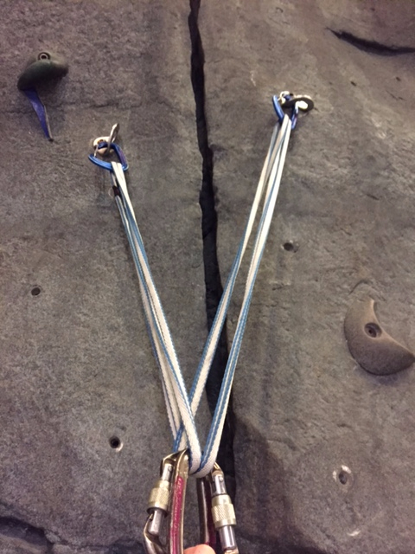
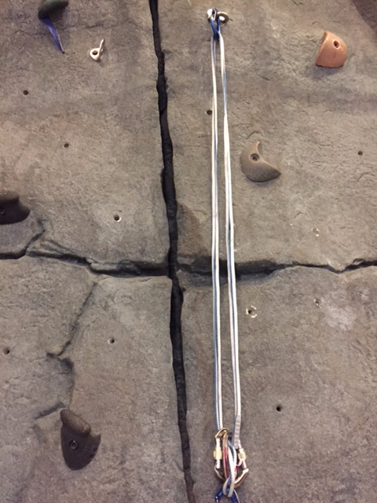
Anchor Activity Review
The Sliding X
Notes:
Sliding x has some advantages, but be extremely mindful of the possibility of extension! Let’s look at a better way to set this up.

Slide 22
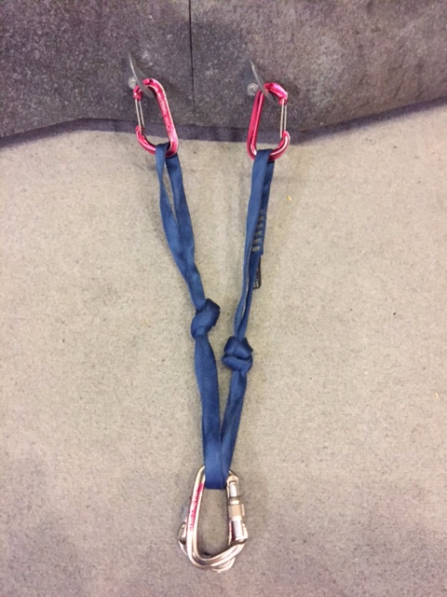
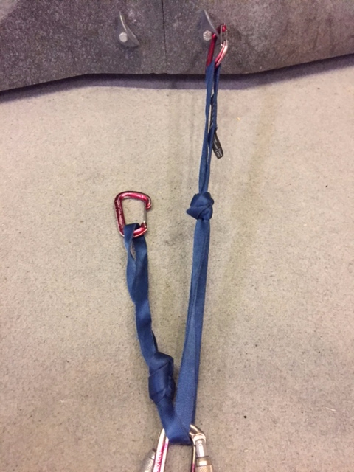
Anchor Activity Review
The Sliding X w/ limiting knots
Notes:
much better with limiter knots. preferred knot is an 8 rather than an overhand.

Slide 23
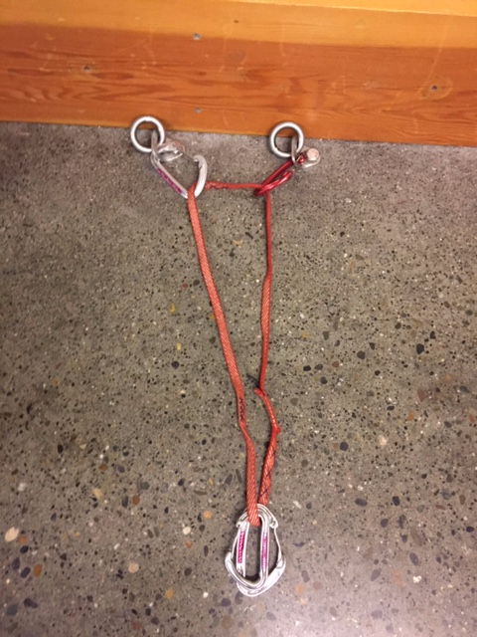
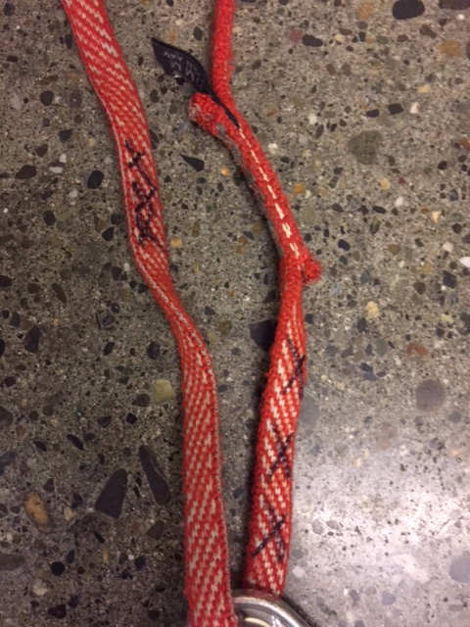
Anchor Activity Review
American Death Triangle
Notes:
Not only is the construction of this anchor horrid (catastrophically equalized), but the material has been retired. triple x does not mean oohlala here.

Slide 24
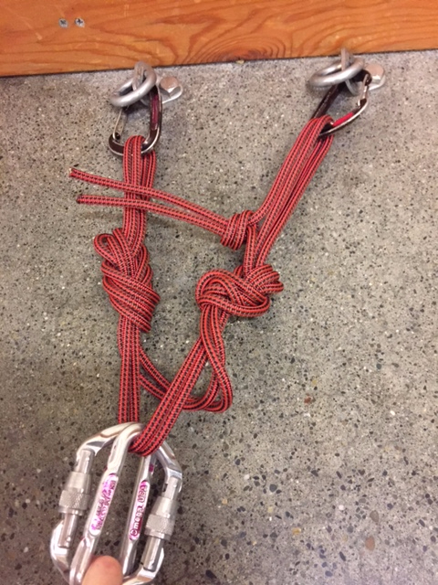
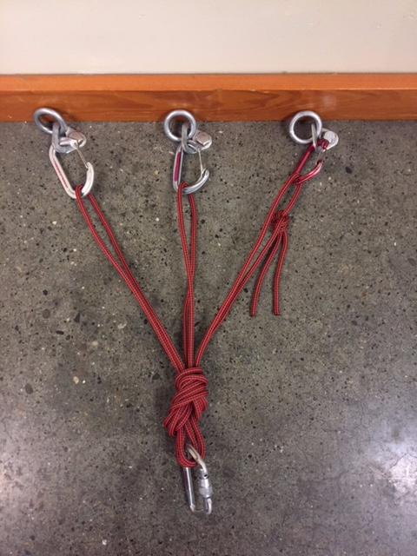
Anchor Activity Review
Notes:
Quad is a great option for two-piece anchors, esp for top rope settings or multi-pitch with bolted anchors. Some questions came up about the knots here: If these cordelettes were dyneema or tech cord then a triple fisherman’s would need to be used. Advantage of the overhand is that the cordelette can be easily untied and reconfigured depending on need. Again, preffered limiter knots are 8s.

Slide 25
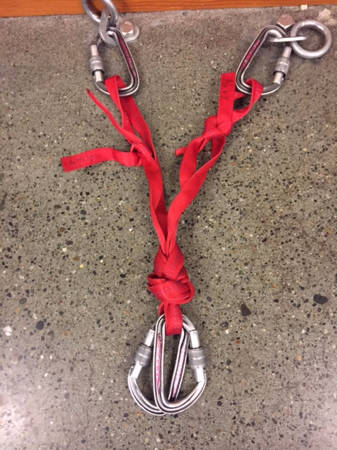
Anchor Activity Review
What
about
this
one?
Notes:
sloppy and loose overhand knots will slide out. Always check knots. Should be water knots with webbing.

Slide 26
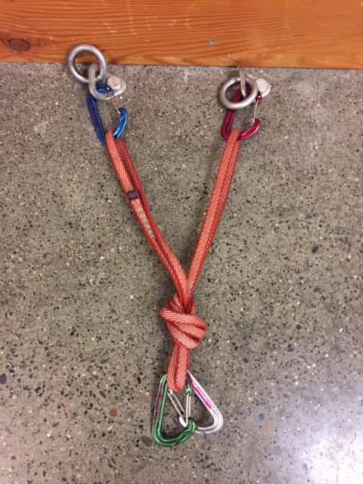
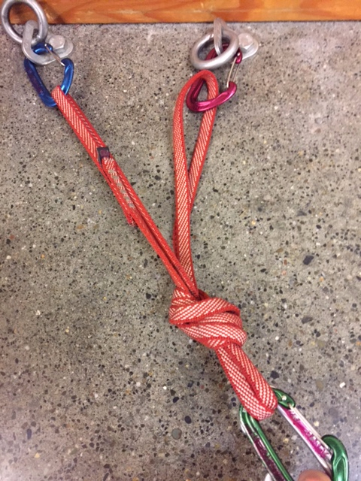
Anchor Activity Review
What you will see at your FT
Notes:
Good if direction of pull doesn’t move; otherwise you will load one arm more than the other.

Slide 27
Questions?
Notes:
Is our bivy man cold and lonely? ☺

Slide 28
Lecture 2 Learning Targets The prepared and engaged student will begin to understand (conceptually) how to...
Prepare for Field Trip 2
Evaluate belay and rappel anchors for rock
Lead Belay
Escape the belay
Rappel safely
Notes:
Tonight’s goal is to provide context for the upcoming field trip. (i.e. to explain why students are about to learn the skills in the next field trip, how they will use these skills, and what is most important to know about these skills.

Slide 29
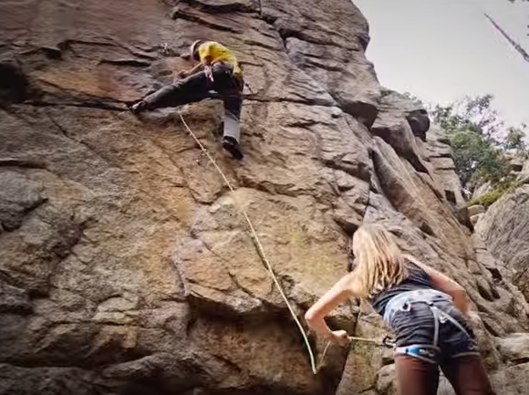
How to Lead Belay
https://youtu.be/YvEQrKOtUZg?t=1m9s
Notes:
Be sure to note that she isn’t wearing a glove (optional—but she is also very experienced and is making an informed decision). No helmet—again, a decision based on terrain. No anchor—why?

Slide 30
Basic Lead Belay Setup
Observations
-Anchor at comfortable belay stance
-Helmets
-Neatly flaked dynamic rope
-Glove on brake hand
-Non-brake hand is feeding out rope
-Belayer is watching lead climber
*This scene is of a multi-pitch trad climb; the climbers are on an exposed ledge
Notes:
Be sure to note that this is a multi-pitch trad climb and on exposed terrain. Make mention of tying into the anchor with a clove hitch.

Slide 31
Lead Belaying feeling hand and braking hand
Notes:
Belaying a Leader. Very similar to top-rope belay (partner check, rope handling, position, etc.) BUT much higher force if there is a fall. Position of body and brake hand becomes much more important (it’s always important).

Slide 32
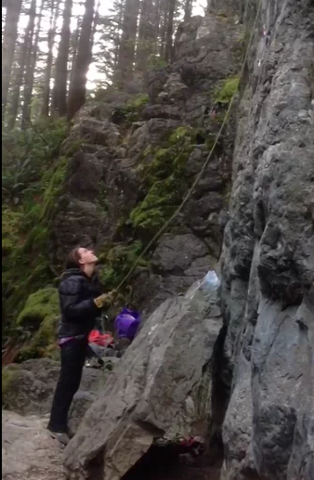
Lead Belaying--terrain and style of climbing will dictate nature of the belay
Observations
-Anchor at comfortable belay stance
-Helmets
-Neatly flaked dynamic rope
-Glove on brake hand—even w/ grigri
-Non-brake hand is feeding out rope
-Belayer is watching lead climber
https://player.vimeo.com/video/127939980
How was the force absorbed?
See page 157—stopping distance
Notes:
How was the force absorbed? Through belayer movement, rope stretch, tightening of the climbers tie-in knot).This is called a soft catch. Without this, the climber would have dropped and swung into the wall on a tight pendulum. This video is of a very high end climb. It is being shown to you as an example of how much force the belayer has to absorb.
Questions: Why wasn’t she anchored? Not a multi-pitch climb, others around to help if lead climber injured. To allow for the soft catch. Why no helmet? Reason given is that the climbers know the pitch well, very trafficked, no loose blocks. This video is merely being shown to give a sense of how much force can be absorbed by the belayer. All Basic climbs will have ledgy falls, so this sort of belay is not what you’d do. This video is merely shown to give a sense of how much force is involved in a fall so you can consider what you need to do to absorb it—good blay stance, good anchor with an appropriate tie in, glove, readiness, making sure you and your climber are tied in properly

Slide 33
Which climber would you trust with your life?
https://youtu.be/XeL5NC7Mp0o?t=8s
Notes:
A lot of what makes a good lead belay is simply thinking ahead, making a plan, communicating, paying attention, and being realistic about your skills. The human factor is often the cause of accidents. Inattentiveness, lack of preparation, poor communication.

Slide 34
What would you do differently?
Notes:
Move closer to the base of the route 2) anchor the belayer to prevent impact upon upward pull
This presents a scenario where an anchor is called for. Tie-in with rope, clove hitch (easy adjust) or bight. Room to move if
necessary (e.g. falling rock). Not tied in tight except for situations necessary to protect belayer from something. A roof is a good illustration
example. Anticipate and prepare for direction of force.Make mention of multi-pitch and exposed terrain and move along to belaying a follower.

Slide 35
Review--Basic Lead Belay Setup
Observations
-Anchor at comfortable belay stance*—why?
-Helmets—why?
-Neatly flaked dynamic rope—why?
-Glove on brake hand—why?
-Non-brake hand is feeding out rope—why?
-Belayer is watching lead climber—why?
*This scene is of a multi-pitch trad climb; the
climbers are on an exposed ledge
Notes:
Have tables briefly answer the whys. Six tables will be asked to briefly share their responses. Questions?
Using the image on this slide, talk about how at times the Basic students will sometiimes be the “lead climber” or perhaps the middle person on a 3-person rope team and they will be belaying a follower. So in lecture 1 we discussed PBUS for a toprope belay, today we’ve discussed lead belaying, and now we will briefly touch on belaying a follower.

Slide 36
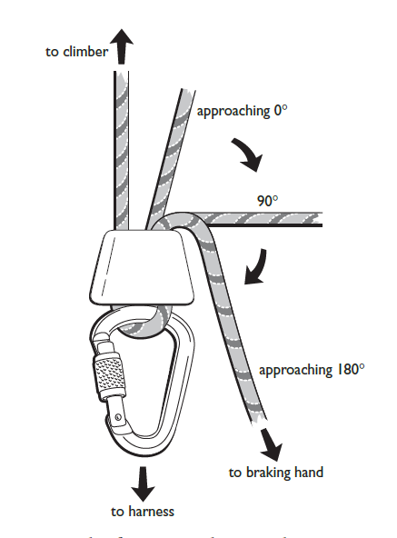
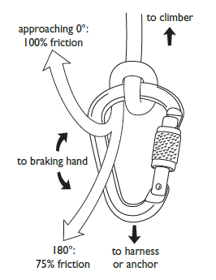
Numerous ways to belay…
Munter
tubular device
body belay
Notes:
Body belay—note the difference in the brake hand.
Munter—note that the braking position has you move away from the harness or anchor
Tubular—review that this is what they will most frequently use. PBUS for TR belay, and similar braking position for lead belay
MAKE MENTION HERE OF NOT CROSS LOADING THE BINER

Slide 37
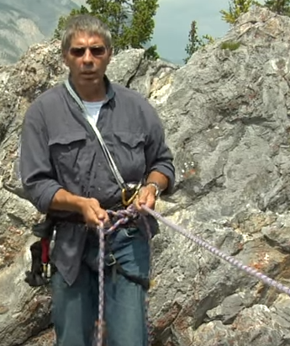
Belaying a follower with a body belay
Advantages
-Efficient set up
-Rope can be taken in quickly
-Allows for a dynamic belay—
important for some terrain and
anchor situations, e.g. snow
Considerations
-Not intended to hold massive forces
-Exposure of terrain
-Difficult to escape
https://youtu.be/Tw6CHiFHXZI?t=1m11s
Notes:
Most realistic to many of the belays you will use on terrain encountered on Basic climbs.

Slide 38
Belaying a follower with a Munter off of the anchor
SERENE Anchor
Tied in w/ clove
Munter hitch
Brake hand on
Notes:
Anchor must be high! Pros you are not in the system. Easy to escape. IF YOU ARE TO LOWER ONCE IN THIS SETUP THEN THEY SHOULD PUT AN AUTOBLOCK ON. Clarify Direct vs Indirect belay here.

Slide 39
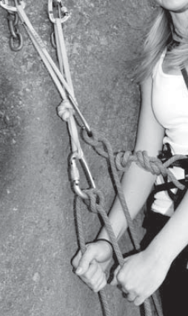
Good
BAD
Notes:
Why? Brake out of position.

Slide 40
Belaying a follower off the body with a tubular device
Advantages
-Efficient set up
-Rope can be taken in quickly
-Allows for a dynamic belay—
important for some terrain and
anchor situations, e.g. snow
Considerations
-Not intended to hold massive forces
-Exposure of terrain
-Difficult to escape

Slide 41
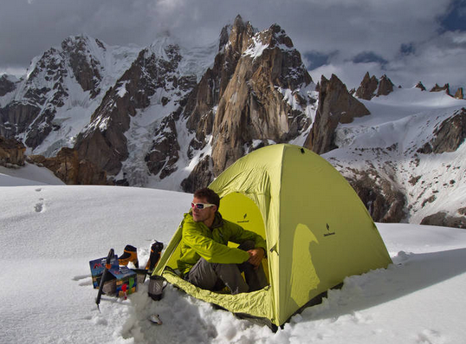
Questions?
Munter
off anchor
tubular device
body belay
Notes:
Body belay—note the difference in the brake hand.
Munter—note that the braking position has you move away from the harness or anchor
Tubular—review that this is what they will most frequently use. PBUS for TR belay, and similar braking position for lead belay

Slide 42
Lecture 2 Learning Targets The prepared and engaged student will begin to understand (conceptually) how to...
Prepare for Field Trip 2
Evaluate belay and rappel anchors for rock
Lead Belay
Escape the belay
Rappel safely
Notes:
Before moving to next slide, talk about reasons why belay escape might be necessary:
What if the leader is unresponsive? the nature of the injury is uncertain (neck/back)?
What if an obstacle is in the way (tree, ledge, cliff, etc.)?
What if there isn’t enough rope to lower the leader back to the belay?
Tonight’s goal is to provide context for the upcoming field trip. (i.e. to explain why students are about to learn the skills in the next field trip, how they will use these skills, and what is most important to know about these skills.

Slide 43
Belay Escape—DISCLAIMER!!!
There are multiple ways to escape the belay. The Basic course will show you a fundamental way. As you continue with your climbing, there will be additional methods to learn.
Included here are clips from two videos.
This first video does a great job showing you how to go hands free. https://youtu.be/4JtcxIQGKBs?t=50s Stop at 2:18
This second video has a few lapses and should not be studied in full. I am showing it to you tonight so that you have a complete picture of how to tie off the load in its most simple and basic way—note this way is arguably not the *best* way. It all depends on the scenario. https://youtu.be/wetMWQEbPC0?t=1m47s Stop at 3:56
Notes:
Tell 10 sec story of Sarah.

Slide 44
Belay Escape—Step 1: Go Hands Free (when belaying with a device)
Notes:
Emphasize getting it tied off as close to the device as possible.

Slide 45
Belay Escape—Step 1 Go Hands Free (when belaying with a Munter)

Slide 46
Notes:
Recap

Slide 47
Notes:
Holy crap! Showing this slide just to let them know that this is in FOTH and they can study this more advanced way if they want or have their SIG instructors show them; otherwise, move on!

Slide 48
Questions?
Notes:
Is our bivy man cold and lonely? ☺

Slide 49
Lecture 2 Learning Targets The prepared and engaged student will begin to understand (conceptually) how to...
Prepare for Field Trip 2
Evaluate belay and rappel anchors for rock
Lead Belay
Escape the belay
Rappel safely
Notes:
Tonight’s goal is to provide context for the upcoming field trip. (i.e. to explain why students are about to learn the skills in the next field trip, how they will use these skills, and what is most important to know about these skills.

Slide 50
Rappelling
Factors to Consider
-Anchor quality
-Terrain hazards
-Where does the rappel end?
-Gear management
-Agreed upon plan
-Backup
Notes:
-Anchor quality—emphasize importance. Ask: Can I downclimb?
-Terrain hazards—falling rock, pendulum, overhanging—note that rap lines can differ from ascent routes. Mention that a glove is helpful for novice rappelers, esp as they are unfamiliar with how a rope will handle (thin and fast or thick and sluggish), the terrain, and managing a rappel
-Always close the system! Knots at the end of the rope OR tie into the ends and saddle bag the lines or throw the lines
-Gear management—keep it clean!
-Backup—autoblock or fireman’s

Slide 51
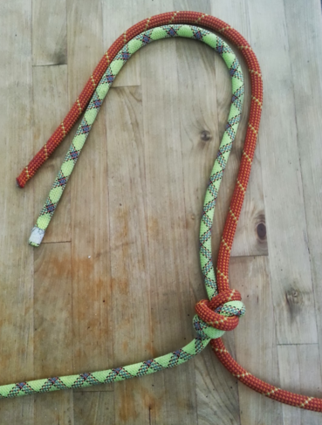
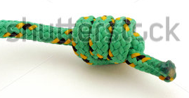
Rope Management
Length of Rappel?
-one 60m rope=30m rappel
-does the rope have a middle mark?
-two 60m ropes=60m rappel
tie ropes together with
an overhand (aka EDK)
Close the system!
triple barrel or tie in
Notes:
Note that most routes (esp Basic) in the Cascades favor short 30m rappels due to blocky rope eating terrain
Speak to advantages of the EDK (and misnomer of the name): easier to tie and untie, flips and glides over edges when being pulled—note to leave plenty of tail 12-18 inches

Slide 52
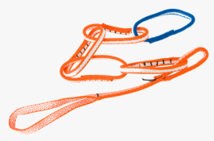
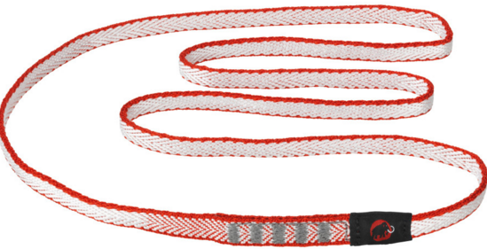
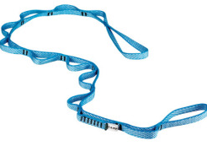
Your Personal Tether
NYLON=GOOD
PAS=OKAY
DYNEEMA=BAD
DAISY=BAD
Notes:
Never climb above the anchor when connected with Personal Anchor vs the climbing
rope. Why?
Explain nylon compared to dyneema=slight give, lower melting point, doesn’t weaken as much when knots are tied (btw—use a figure 8 instead of overhands when tying knots in tethers)
PAS can work, but in the alpine they aren’t as practical. Weight of item that is primarily used for only one thing. Some can now be used at TR anchors, but most won’t be able to tell diff. and in the alpine we aren’t toproping
Daiy—we aren’t aid climbing, people don’t know how to use them, they are easy to mess up and fail. Just a bad idea.

Slide 53
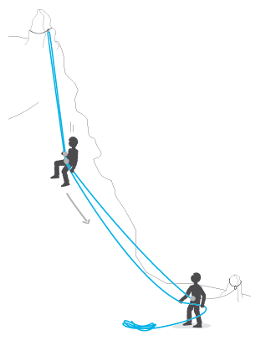
Efficiency and Safety Points
-Tidy your harness
-Agree upon a plan
-Double Check everything
-Stay anchored in unless on rap
-BACK IT UP!
-Resist the childlike urge
to bounce ☺
Notes:
Pack away what you don’t need; keep out what you might need—esp. gear in case of emergency
Will everyone use an autoblock or will you all after first use a fireman’s---can you see the base? Known hazards?

Slide 54
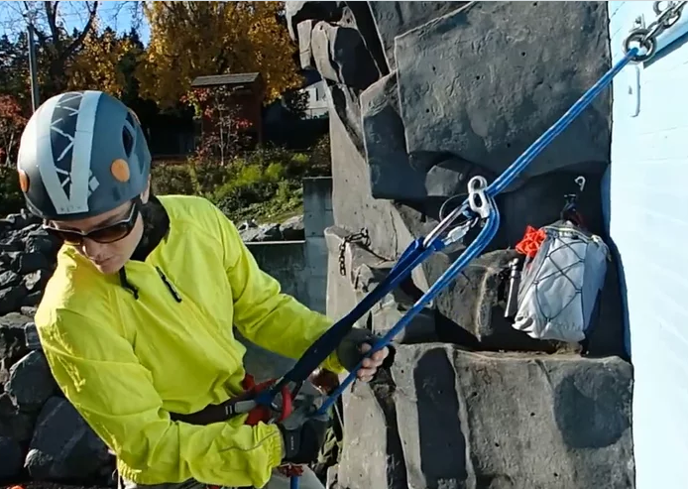
Overview of the extended rappel
https://vimeo.com/113362076#t=47s
https://www.mountaineers.org/learn/how-to/extended-rappel-and-updated-belay-techniques
Key Points
-Must have good anchor
-Connect yourself to anchor
-Set up rappel
-Back up?
-Test your system
-Communicate
Notes:
Full resource + video link: https://www.mountaineers.org/learn/how-to/extended-rappel-and-updated-belay-techniques
Direct video link: https://player.vimeo.com/video/113362076

Slide 55
Rappelling off the belay loop
If your rappel is off of your belay loop, then where is your backup?
Notes:
When and why would you do this?
Single pitch, quick easy, no need to set up extension. Fireman’s belay.
With Munter--Dropped rappel device. But why not extend??? Mixed views on this topic, but general idea is 1) braking position is away from you—harder to do w/ extension, and 2) the Munter is known for creating twists in the rope when under tension, such as when rappeling, so it is thought that with extension, twists would get transferred into the extension sling thus creating friction of soft on soft materials.

Slide 56
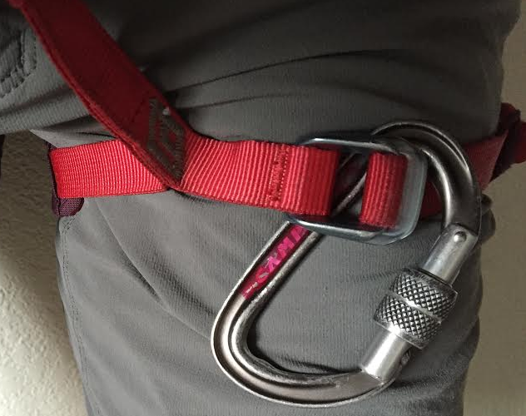
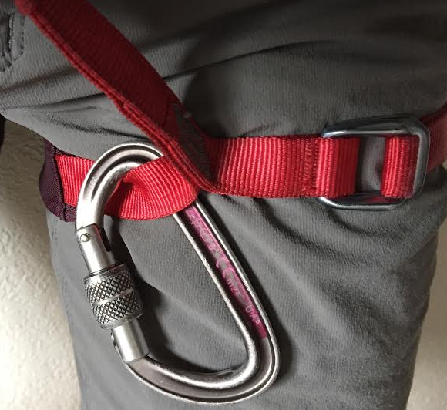
Backup options for rappel off of belay loop
Three options: Fireman’s belay, autoblock, or…
Good?
Any concerns?
Much safer!
Notes:
Fireman’s belay if safe for partner to provide.
If not extending, then the autoblock needs to be kept well below the device (which is now on the belay loop!)…so load another bearing part of the harness is the leg loop!

Slide 57
Rappelling off of the belay loop with an autoblock
Look closely:
What advice would you give?
We learn from our mistakes--question dated practices
Gear and how we use it is constantly evolving!

Slide 58
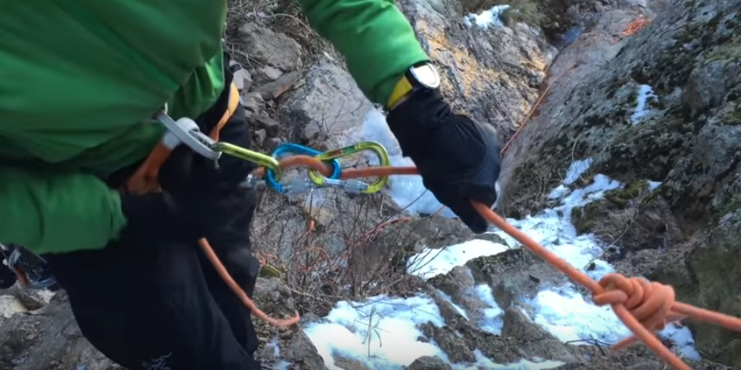
What if I drop my rappel device?
https://www.youtube.com/watch?v=lslG-Clp2qA
Carabiner brake setup with 3 lockers
Notes:
What advice would you have for this person? Consider using an autoblock. From what we can see gully doesn’t look steep. But it is obviously steep enough to rappel, so given the decrease in friction with this setup I’d use an autoblock.

Slide 59
Questions?

Slide 60
Lecture 2 Learning Targets The prepared and engaged student will begin to understand (conceptually) how to...
Prepare for Field Trip 2
Evaluate belay and rappel anchors for rock
Lead Belay
Escape the belay
Rappel safely
Thank you and see you in the mountains!
Notes:
Tonight’s goal is to provide context for the upcoming field trip. (i.e. to explain why students are about to learn the skills in the next field trip, how they will use these skills, and what is most important to know about these skills.

Slide 61
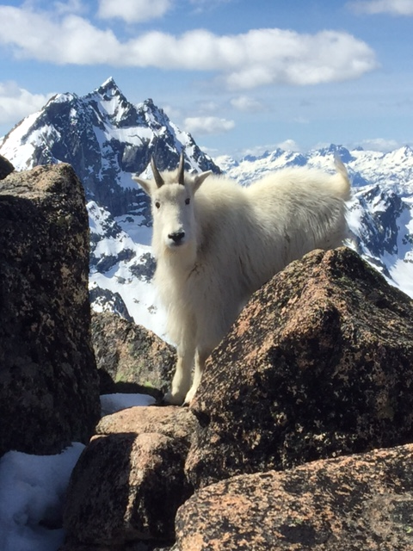
Climb On!
Notes:
obligatory mountain goat shot

