Slide 1
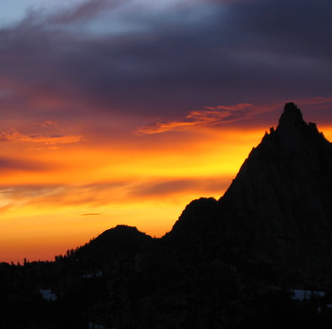
The Mountaineers
Backcountry Impact Series:
Climbing
Notes:
Best practices for different environments.

Slide 2
When you hear conservation, what do you think?
(1 minute)
Notes:
Start with this question, then follow up with ‘does what you think change if I say conservation and recreation’

Slide 3
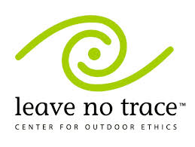
Leave No Trace
7 Principles
Plan Ahead and Prepare
Travel and Camp on Durable Surfaces
Dispose of Waste Properly
Leave What You Find
Minimize Campfire Impacts
Respect Wildlife
Be Considerate of Other Visitors
Notes:
Learning tonight skills that you can – and should – implement in tandem with the technical skills you are learning in this course. To be a well-rounded, responsible climber, you need to be able to implement these low-impact skills just like you need to be able to belay well.
BISkills are based on LNT

Slide 4
4 Low-Impact Skills for climbing in Washington
Traveling in Different Environments
Human Waste
Wildlife
The Human Experience

Slide 5
Different Environments One might climb in Here in Washington
Alpine
SubAlpine
Rock
Wet
Semi-Desert
Crags
Wilderness
And how to travel in them…

Slide 6
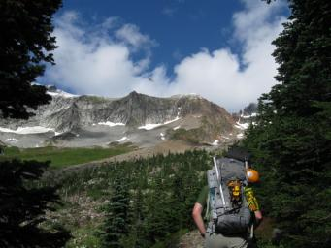
ALPINE ENVIRONMENTS
Notes:
North Cascades
Alpine environments have shallow soils and unique plant communities and are characterized by cold weather and short growing seasons. Because of the short growing season, if the area is damaged, it takes even longer to recover.
Even more, this short reproductive season (when they are particularly vulnerable), usually July to August, coincides with some of the most popular hiking months. A show of yellow glacier lilies and other brightly flowered plants quickly follow melting snow. Plants just getting their growing tips up get smashed.
Picture Right: Indian Paintbrush and other wildflowers on Cascade Pass

Slide 7
Alpine Communities (subalpine)
Some alpine heather communities on Mt. Rainier have been carbon dated to 10,000 years old.
Notes:
Mountain heather thrives in a subalpine environment. It is a short, woody evergreen shrub with pink blooms.
Even still, heather and other woody species such as huckleberry are considered vulnerable. Their stems seem hard, but the stems and growing tips easily break under boots and discarded backpacks.

Slide 8
Alpine Fell Field
A community of widely scattered dwarfed vegetation that grows in the barren land above the timberline.
Notes:
flat, rocky areas with small discrete clumps of plants growing among the rocks
Shallow soils, exposed rocks, no organic matter
Often in places where it is too cold and windy for trees, plants live under a blanket of snow for months
Low, herbaceous perennials growing amongst rocks
Protect the aesthetic but also helps with erosion on steep slopes.

Slide 9
Don’t Bust the Crust
Important for the ecosystem! It holds desert sands together, absorbs moisture, produces nutrients, provides seedbeds for other plants to grow…
Cryptobiotic soil is a mixture of cyanobacteria, mosses lichen, fungi and algae.
Notes:
Who’s climbed at Vantage?
Also found in moab, UT
-one footstep (or dog paw) can wipe out years of growth
-take the trail
Cryptobiotic crusts can be found in the desert (think the sage steppe of Vantage) as well as in alpine areas (often among huckleberry & heather).
Vantage has semi-desert (shrub-steppe) vegetation which has just as short of a growing season as alpine environments (so recovery takes a long time)
-A mixture of cynobacteria, mosses, lichen, fungi and algae “living soil”
-Holds the desert sands together, absorbs moisture, produces nutrients, provides seedbeds for other plants to grow
-Fragile: one footstep (or dog paw) can wipe out years of growth. In ideal conditions it can takes as long as five years for a thin veneer to appear. In places of higher rainfall, recovery may take 20 years. In places of low rainfall, up to 250 years.
-Also, interestingly, layers of cryptobiotic organisms on soil surfaces are found not only in desert environments but also in semi-arid grasslands, arctic and alpine communities. They may be harder to spot than the mature crust pictured above, even more reason to stay on the trail!
This picture shows a mature environment, easier to spot than the immature crust which are usually flat and the color of the soil.
How well does your dog stay on designated trails?

Slide 10
travel
“Durable Surfaces” are areas that are hardly affected by the passage of humans.
Includes established trails, sand, gravel, snow, dry grasses and more.
Notes:
When off-trail, tread on durable surfaces

Slide 11
Tread lightly
Thick snow
Patchy snow
Notes:
Travelling on snow covered ground is already lower impact than stepping on and compacting bare ground. A thick blanket of snow will protect vegetation and soil.
But in the snowmelt season when the snow cover is thin and patchy, vegetation and soil are vulnerable. Mud means it is very easy for you and ten other buddies to make a completely new trail. Collect at trailhead to start… circling up at parking lot versus at a thinner spot in the trail.
The shorter the growing season for plants, the longer it takes for areas to recover from damage. Cold temperatures shorten the growing season, so while the area is more resistant to damage because of the snow, if damage does occur, it has longer recovery periods.
Be particularly careful if the trailhead has snow-free soils that are saturated with melt water, footsteps can be fatal to plants. Plants pressed in the mud have little chance of survival and the plants can be easily uprooted by a boot.

Slide 12
Paradise, Mt. Rainier National Park
Notes:
Paradise, on the southern slopes of Mt. Rainier is one of the most popular snowshoe destinations with 16 superb snowshoe trails and spectacular views.
In 2011, it was designated as a Leave No Trace “Hot Spot” due to impacts of recreation such as off trail travel, wildlife conflicts which we will discuss.
The picture on the right shows the consequence of snowshoers and hikers avoiding mud and patchy snow.
People (snowshoers and hikers) as the snow is melting are creating erosion. People going off mark trailed, not knowing where the trails are when there is snow cover, not enough snow cover to protect veg.

Slide 13
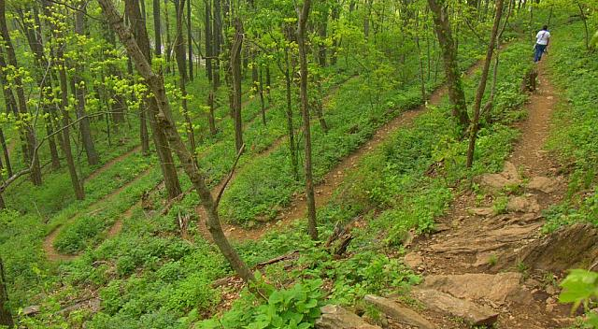
Trail braiding and social trails can lead to: soil loss, soil compaction, erosion, trail widening, vegetation trampling
Trail Braiding
Social Trails
Social Trails
Photo credit: NPS/Lucy Lieberman
Yay for Switch Backs!
Notes:
These pictures show some of the consequences of not following the recommended best practices. Mailbox Peak trail.
These pictures show some trail braiding, which is a result of people walking on the edges of the trail. Over time a new parallel trail develops, and this happens over and over, widening the trail and causing more erosion.
You also see social trails, these develop as people make repeated visits to destinations that are not serviced by existing trail systems. They are often the simplest or quickest route to the site, but do not always take into consideration the fragile vegetation that may be along the path.
In some places, as little as 25 footsteps per year can make a discernable trail.
Pictures: from the Sahale Arm Trail (the Cascade Pass Trail leads to this trail).

Slide 14
Best Practices (2 minutes)
In pristine areas…
On established trails…
Notes:
Review some points about best practices for on trail and off trail travel.
If a trail is available, you should always stick to it. They have been designed to absorb high impact.
-It is recommended to walk single file.
-Walk in the center of the path, even if that means walking through mud and rocks.
If there is no designated trail and you cannot avoid crossing vegetation, spreading out will have less of an impact than walking in a single file line.
-a distinct trail is less likely to form
-no single plant will receive multiple footfalls
If you are walking across boulder fields, this is a durable surface and there is no vegetation to worry about, so you can walk single file or spread out.
Balance with safety, and group and conditions, group decision making. Risk management, integrate these skills during your regularly scheduled travel. First step is planning and preparing remember!

Slide 15
Urine
Minimize interaction with wildlife
Consider the social impacts of urine
Notes:
-does anyone remember the hiker that was killed in olympic national park by a goat in 2010?
Animals with salt deficient diets are attracted to urine. When we go on the vegetation the animals defoliate the plants. By going on rocks in more open areas it more easily evaporates and is washed away.
Urine is not generally a health issue.
- Well off trail; rock better then plant
But there is a major social issue you may want to consider: Smell
-The smell can impact other users experience. Especially in arid environments where the smell can be more obnoxious.
-If you urinate out in the sun instead of in a dark nook, the sun will quickly dry out the urine and keep odor to a minimum.

Slide 16
When nature calls…
Avoid polluting water source
Eliminate contact with animals and insects
Maximize decomposition
Minimize the chances of social impacts
Notes:
Picture: cat hole; group gear, shovel isn’t on any list; have this convo with your group/group leader about bring a shovel
Rate your ‘bathroom’ by stars (1= whatever, 3= view)…
Traditional method. Dig 6-8 inches into the soil 200 feet (about 75 adult steps) from water. The microbes in the soil break down the feces and the pathogens they contain. If you use toilet paper, it is best practice to pack it out with you.
If done correctly in an appropriate location it does meet the four objectives
BUT in alpine regions and arid lands there is a low amount of organic soil, and therefore not enough activity to support decomposition.
Also in alpine regions and arid lands the soils are thin and precipitation is scarce so decomposition is slow. When it does rain, because the soil is thin, shallowly buried waste is often flushed directly into water sources.
In these areas, and in the snow, be prepared to pack out your waste!

Slide 17
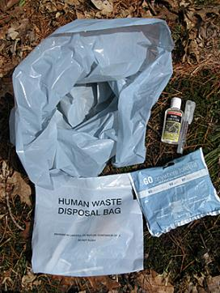
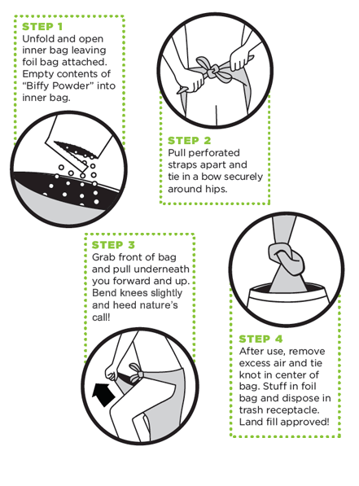
When nature calls…
Pack it in, Pack it out.
Notes:
Where is digging a hole not an option?
-snow (why)
-alpine/rock (why)
WAG (waste alleviation gelling) bag and Biffy Bag
What is really neat about these products is you can throw them in the trash.
Poo-powder (kitty litter type powder) deodorizes and neutralizes your waste.
DIY WAG bag
Can buy bulk poo-powder
Can use flushable kitty litter (but then have to deal with flushing it) because it is not neutralized to be thrown in the garbage.

Slide 18
When nature calls… Pack it in, pack it out.
Notes:
Pic: Mt. Rainier
They contain one clear bag, one blue bag, and twist ties.
To use the "Blue Bag," defecate on the snow away from the climbing route and rest areas. Collect the waste using the light blue bag like a glove. Turn the blue bag inside-out and secure with a twist tie. Place the blue bag in the clear bag and secure with a twist tie.
Comparable to picking up after your dog
- Deposit them in labeled collection barrels. DO NOT DROP USED BLUE BAGS IN TRASH CANS!

Slide 19
Food
Notes:
What doesn’t belong in this picture?

Slide 20
“Fed is Dead”
Notes:
Most of you arent going to be intentionally feeding wildlife, the majority of wildlife feeding is unintentional.
-Food scraps: apple cores, fruit peels, dropped m&ms, human food left behind.
-Marmots and ground squirrels have been known to chew through packs.
Animals habituated to food offerings from humans often end up starving when faced with finding food on their own. Feeding wildlife damages their health, alters their natural behaviors and exposes them to predators and other dangers.

Slide 21
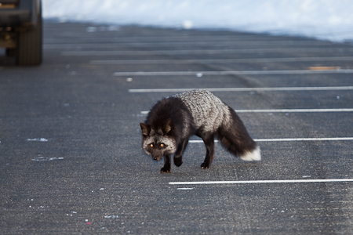
Cascade fox
Photo credit: Lee Rentz Photography
Notes:
Wildlife conflicts at paradise—silver phase red fox (endemic to the area) reports that the fox actually goes into snow caves and getting food that was not stashed properly.
Habituated, relying on food in the winter. Begs for food in the parking lot and

Slide 22
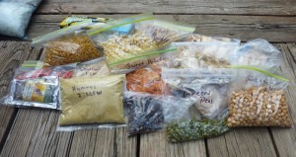
Tip: repackage your food
Notes:
Planning your meals can significantly reduce waste. Think about exactly how much you will need to eat to avoid having leftovers.
Granola bar wrapper in pocket then ‘working its way out’
Repackage commercial food in reusable containers and plastic bags. Get rid of wrappers and twist ties in advance so you wont risk leaving them in the wilderness.
Examples of microtrash: stickers on apples, labels on water bottles…
Aside from the potential negative impact micro trash can have on wildlife, it can have a negative impact on other users experience and the environment.
(I usually tell a personal story: I never hike without my twix bar. When I need a sugar boost I open in it up. I usually put the corner of the wrapper and wrapper in my pocket but often by the time I get back to my car the corner wrapper has fallen out of my pocket so now I put my candy in a plastic bag)

Slide 23
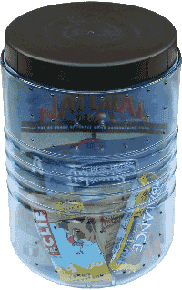
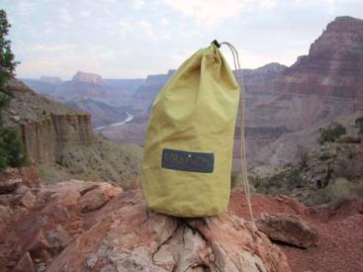
Tip: secure your food
Grubpack
Notes:
The bear canister is the ultimate in food protection, especially when you are above treeline and cannot hang food. Also its particularly difficult to hang food in the northwest!
If you are going on a day hike or a short backpacking trip and just want to keep the snacks in your backpack safe from critters:
Grubpack: stainless steal mesh food bag. Flexible and durable. Perfect for day hikers who don’t want to carry a bear canister. Protects food from animals and rodents. (about $30)
Ursack: teeth resistant “bullet proof” fabric
If you are in bear country you will want to take more precautions.

Slide 24
The human experience
Charred rocks
Destroy organic matter and sterilize the soil up to 4 inches deep
Damage to trees
No downed wood
Notes:
-One site with destroyed or altered organic matter may not seem like a bit deal, but as fires multiply it is important
-Downed wood is habitat for wildlife and it is an important source of nutrients for the soil.

Slide 25
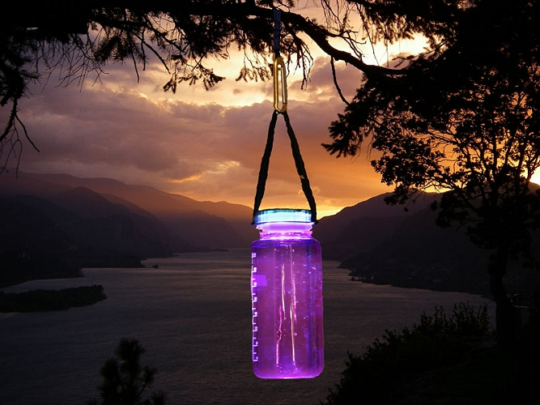
Get creative!
Notes:
Using the stove, but miss the light? Use a candle lantern or this neat alternative!
Can bring tea lights

Slide 26
Remember the scout maxim, “leave it better than you found it”
Notes:
If you see any old webbing, do future visitors a favor and pack it out with you.
Rappel slings: if you place one, it is best practice to remove one or more.

Slide 27
Learn More/Next steps
Leave No Trace Center for Outdoor Ethics
www.lnt.org
Stewardship Opportunities:
https://www.mountaineers.org/explore/activities#b_start=0&c4=Stewardship
Notes:
This is just a short introduction to Leave No Trace and wilderness ethics.
* There is value in discussing personal ethics and thinking of different ways to share low-impact information with those less knowledgeable.
Leave No Trace Trainer Course: 2 day workshop
Delves into principles with more detail
Learn how to share information with others

Slide 28
Resources
http://www.mountaineers.org/ CONSERVE
Conservation Currents
http://www.mountaineers.org/source/amembers/subscription.cfm

