Slide 1
Pulleys, Hauling Systems, and How They Work
Understanding the WHY (not just memorizing the what)

Slide 2
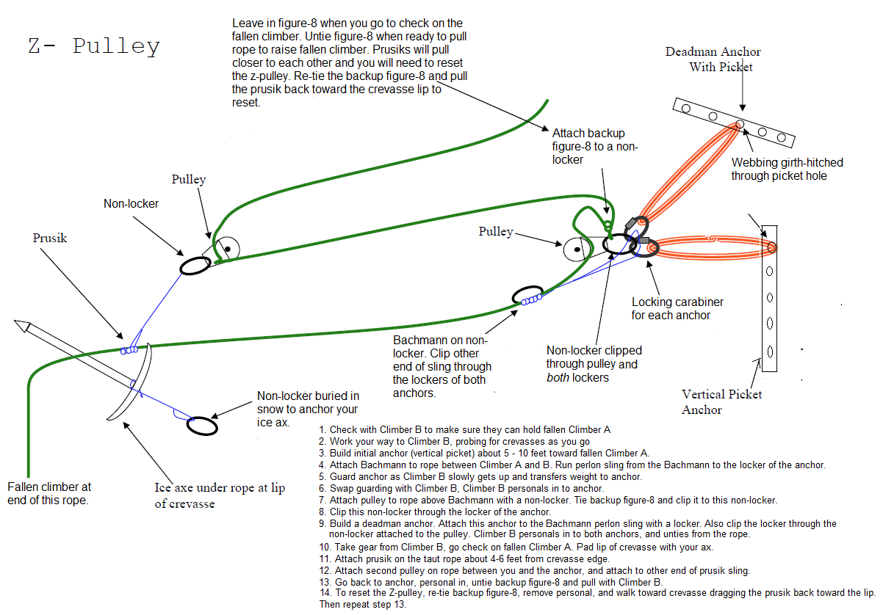

Slide 3
Goal of this lecture
Understand that there are two sides of this system: Functional vs. Safety
Gain an understanding of how the Functional side works

Slide 4
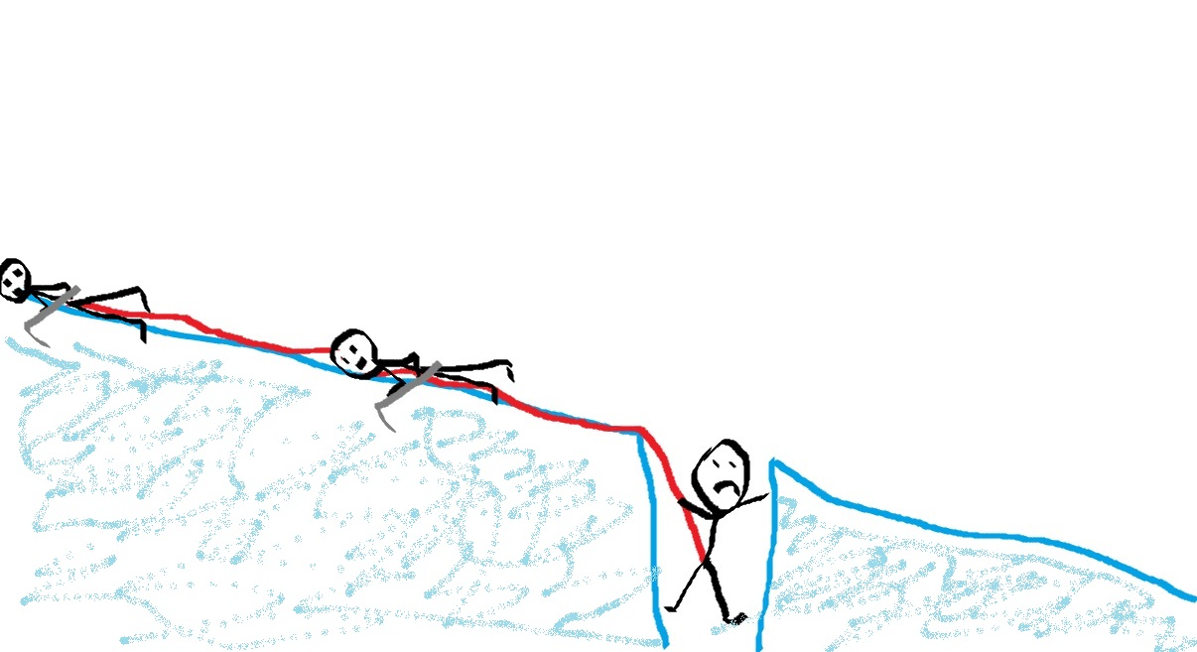
Some context
Put it into context....

Slide 5
Options?
Fallen climber climbs out or prusiks out
Direct Pull
C-pulley
Z-pulley

Slide 6
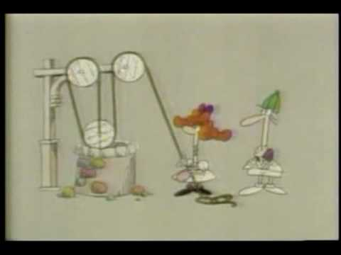
How do pulleys help?
Bill Nye:
(click to watch video)

Slide 7


Slide 8
Parts of the Hauling System
LOAD
ANCHOR
PROGRESS CAPTURE
FIXED PULLEY
MOVABLE PULLEY
HAUL

