Slide 1
Climbing Clothing and Gear Essentials
Mountaineering is dynamic and ever changing. Physical Conditioning, Weather, Terrain and Altitude all play into what you WEAR, CARRY AND USE.

Slide 2
Going to focus on the Mountaineering aspects.
The same principles apply to Rock climbing clothes minus rock specific footwear.

Slide 3
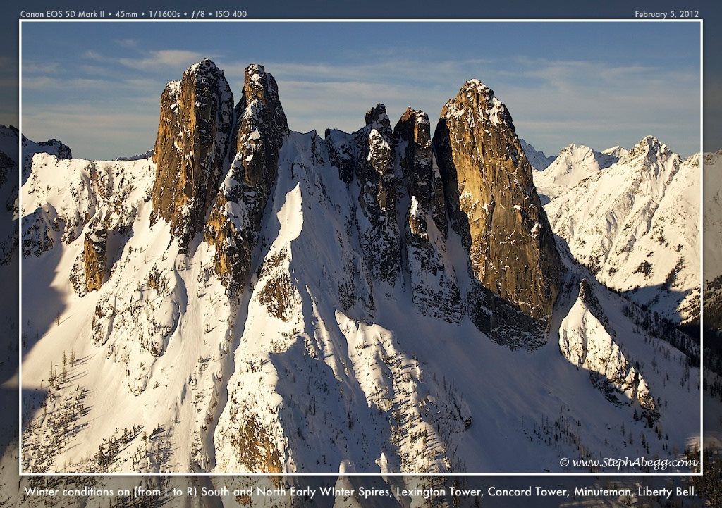

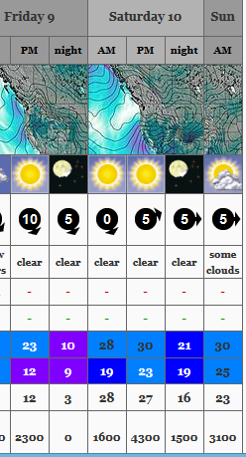
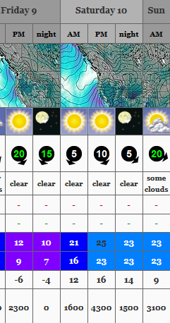
Early Season Rock Climb (Typically April-Mid June)
Washington Pass – Liberty Bell Group
Weather for the climb:
Mountain Weather Forecast
https://www.mountain-forecast.com/
Elevation: 4922 ft
Elevation: 7720 ft

Slide 4
Early Season Rock Climb (Typically April-Mid June)
Washington Pass – Liberty Bell Group
Weather:
Morning: Elevation 4922 ft
Sunny 30°F Wind 5 mph
Afternoon: Elevation 7720 ft (summit)
Sunny 50°F Wind 7 mph
Late Afternoon: Elevation 4922 ft
Sunny 57°F Wind 5 mph
Personal Gear:
Ten Essentials
Appropriate clothing for the day
Mountaineering boots
Rock shoes
A day pack
Webbing and accessory cords
PAS
Locking carabiners
Non locking carabiners
Belay device
Climbing harness
Helmet
Chock pick (nut tool)
Belay gloves
Ice Ax
Crampons
Gaiters
Trekking Poles
Snowshoes
Clothes for the car

Slide 5
Climbing Gear
Ten Essentials
In your book
Don’t skimp – Might save your life
Carry Always

Slide 6
Climbing Ropes
You don’t need one yet !

Slide 7
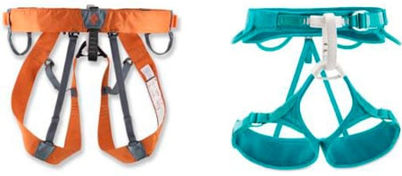
Climbing Harness
*Key Points*
Tested and Safe
Belay loop
Tie in Points
No more than a 2-finger gap in slack between your waist-harness
Notes:
A standard rock climbing harness can be used while mountaineering, but one designed specifically for mountaineering will be more comfortable and convenient.
A harness designed for mountaineering is often made from flat webbing and features low-profile gear loops to keep the harness lightweight, compact and comfortable while wearing a pack.
And unlike standard rock climbing harnesses, mountaineering harnesses typically feature leg loops that unbuckle so you can put the harness on or take it off while wearing skis or crampons.

Slide 8
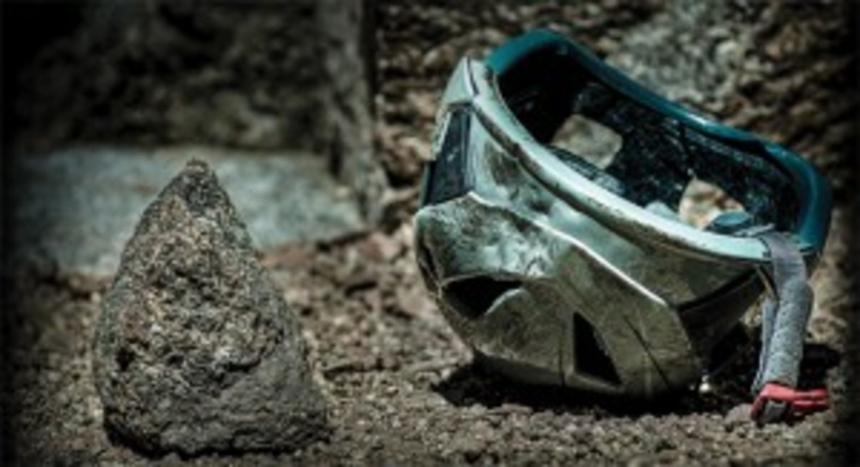
Climbing Helmet
*Key Points*
Tested and Safe
Snug
Not Used - Dents and Cracks

Slide 9
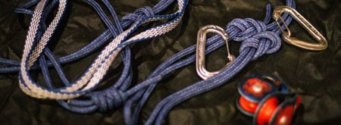
Climbing Hardwear
Carabiners, Pulley, Webbing, Cord, Pickets
Tested and Safe

Slide 10
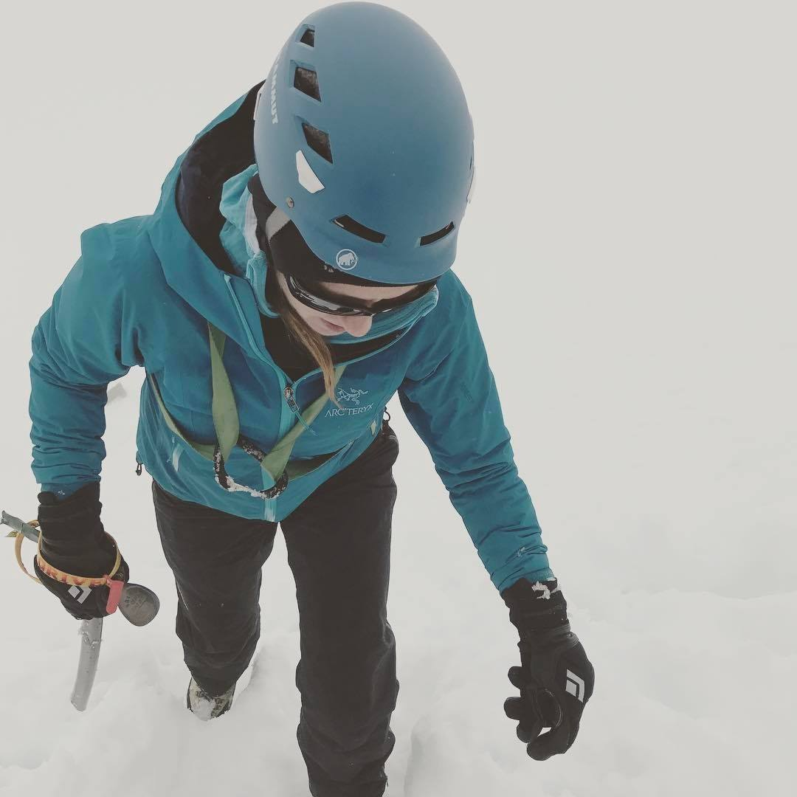
Climbing Hardwear
Ice Axe
Type
Weight
Length
Crampons
Type
Steel vs. Aluminum

Slide 11
Tents and Sleeping Gear
Tents:
Waterproof vs. Not
Weight – You are not carrying all of it
Wind, Wind and Wind
    Sleeping Bag:
Weight to Warmth
Down vs. Synthetic
Length
        Sleeping Pads:
Foam and Air Mats

Slide 12
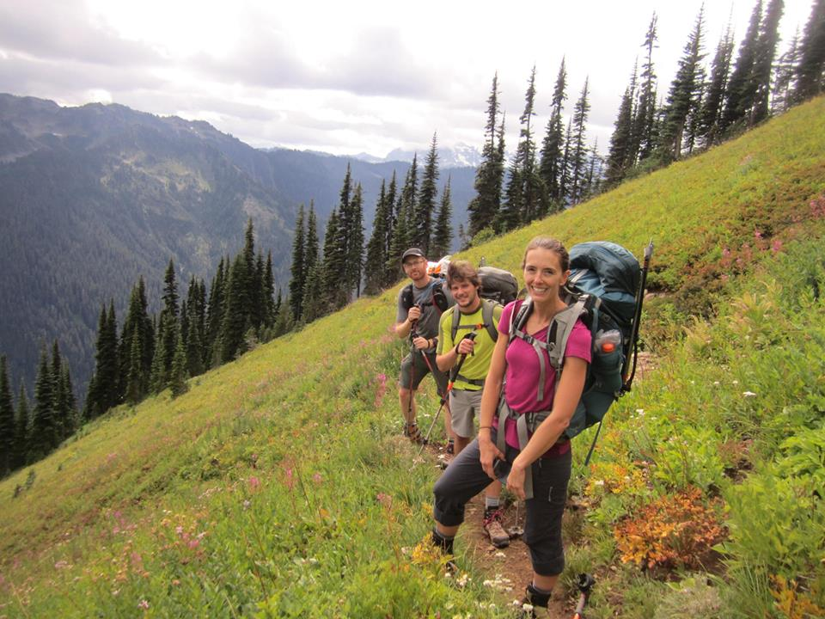
Climbing Packs
Just One Pack?
Good all around size is 55-65 Liters
Fits all your gear without
being a S-show
Ok maybe a little, lightweight summit pack

Slide 13
Clothing
Hat?
Gloves?
Base Layers?
Mid Layers?
Insulations Layers?
Shell Layer (Wind and Water)?
Monster (Puffy) Layer?

Slide 14
Mountaineering Boots
Leather vs. Plastic
Summer vs. Winter
RENT vs. BUY
Rock Shoes - Ask us later

Slide 15
Mountaineering Gear
Head Lamps
Glacier Glasses
Neck Gaiter
Leg Gaiters
Stoves
Filters

Slide 16
Mountaineering Clothing and Gear
If you are not sure - Don’t Buy it.
You should borrow gear until you are sure - Make sure it works/Fits
Ask us - We are here for you.
rangerjoe8845@yahoo.com
Shop around - There are great websites with good gear.
No used Safety Gear - Harness, Webbing or Cord

