Slide 1
Tacoma Mountaineers Basic Alpine Climbing 2018
What have you gotten yourself into?

Slide 2
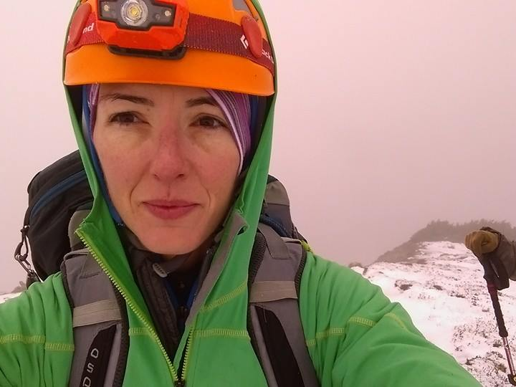
Climbing is hard.

Slide 3
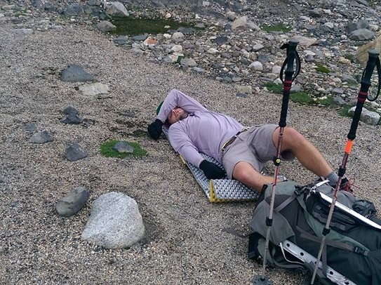
It means long days,

Slide 4
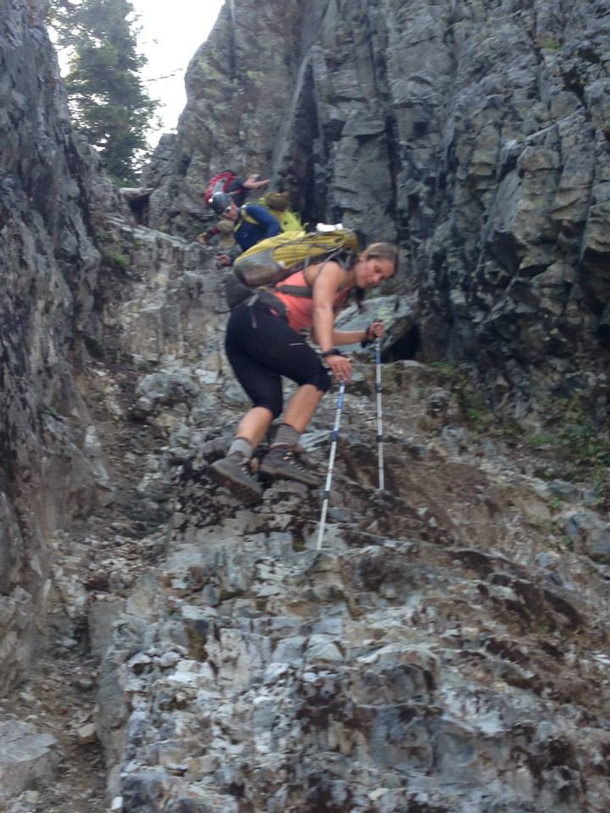
steep, rugged trails,

Slide 5
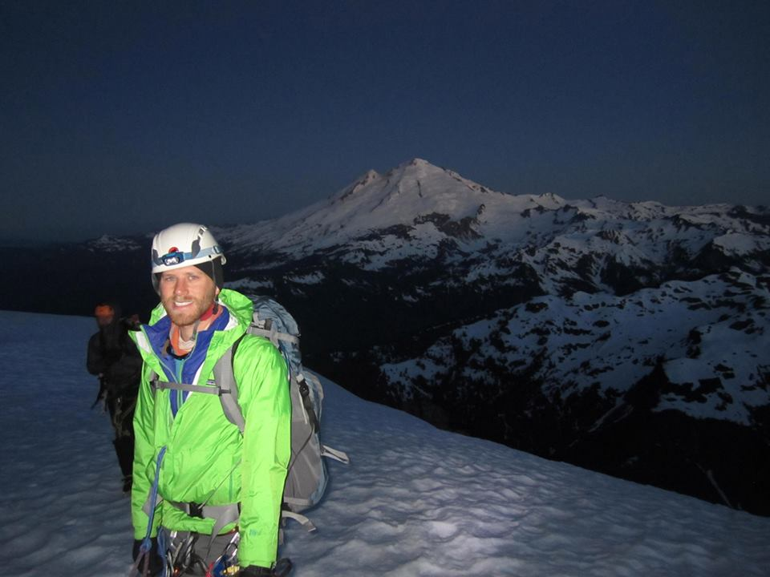
early wake-ups,
early wake-ups,

Slide 6
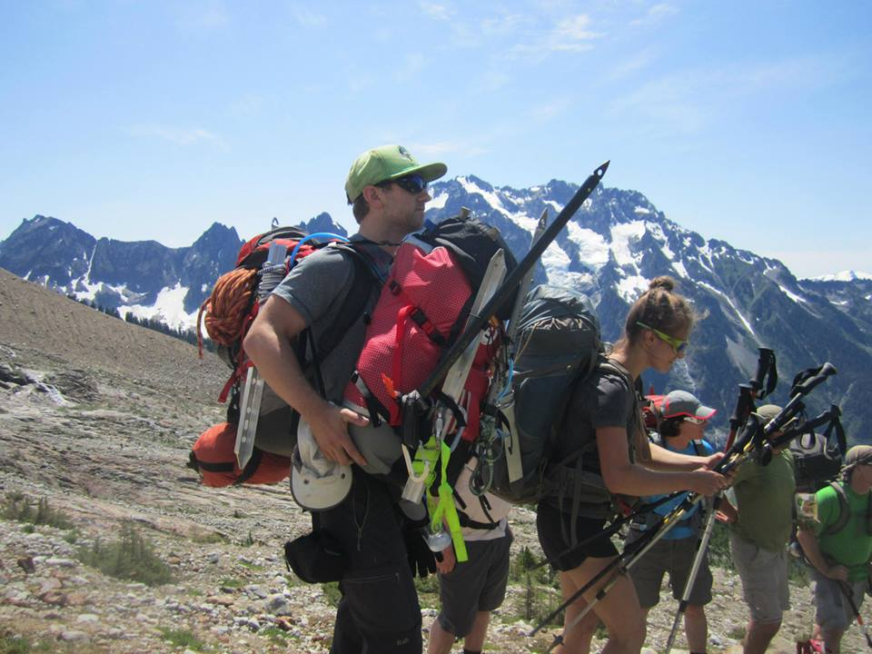
and heavy backpacks.

Slide 7
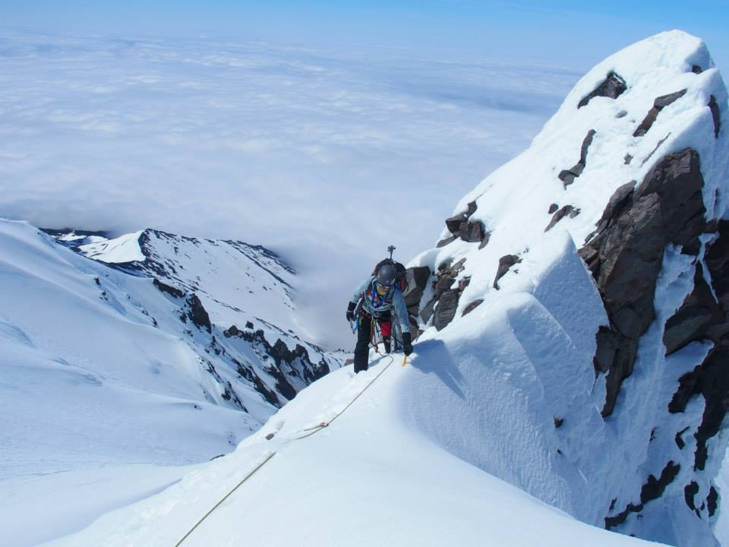
Climbing is dangerous.
Climbing is dangerous.

Slide 8
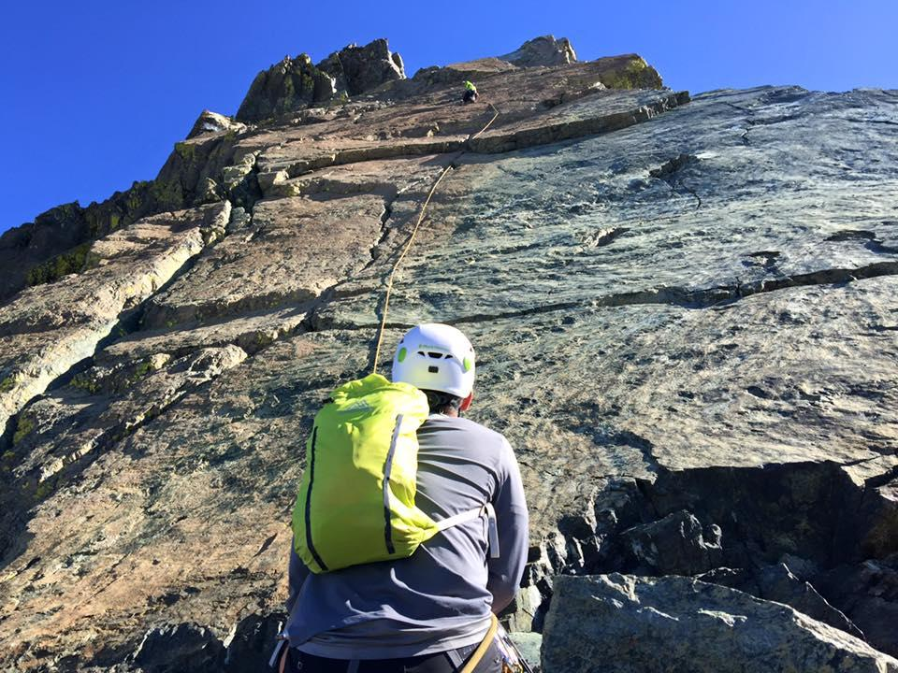
There are heights and exposure,

Slide 9
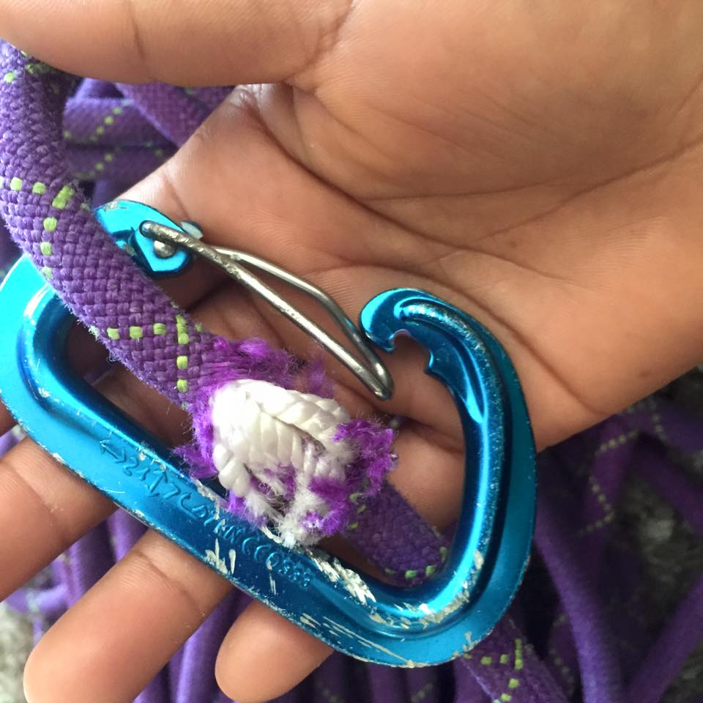
falling rocks,

Slide 10
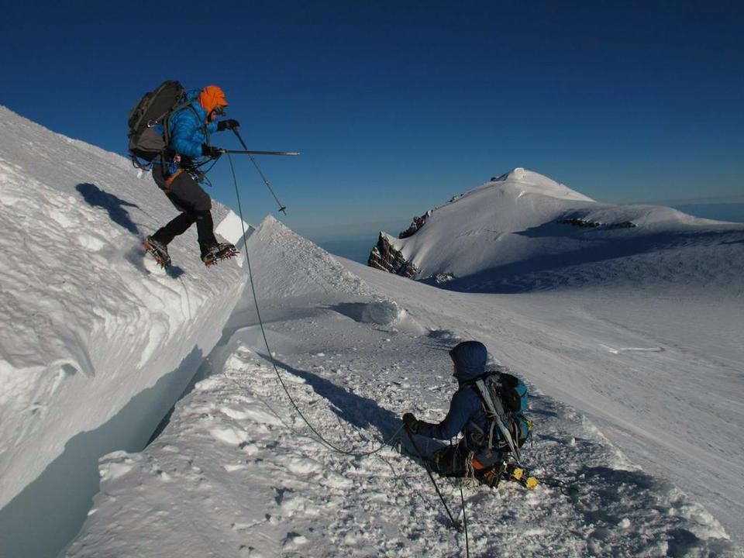
crevasses,

Slide 11
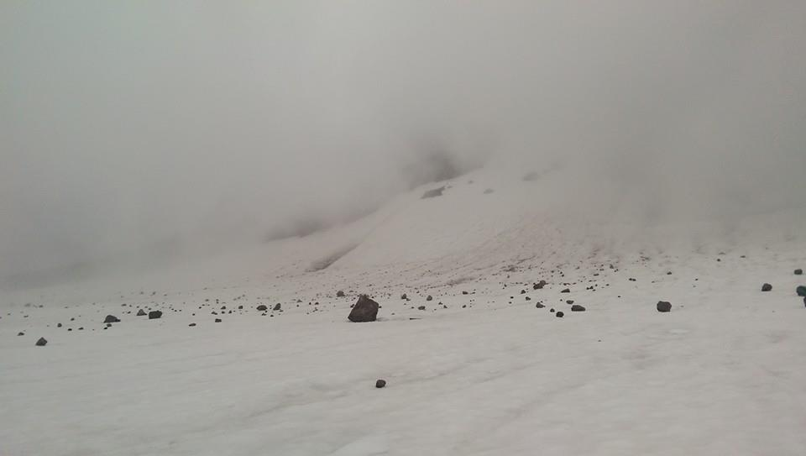
and sometimes bad weather.

Slide 12
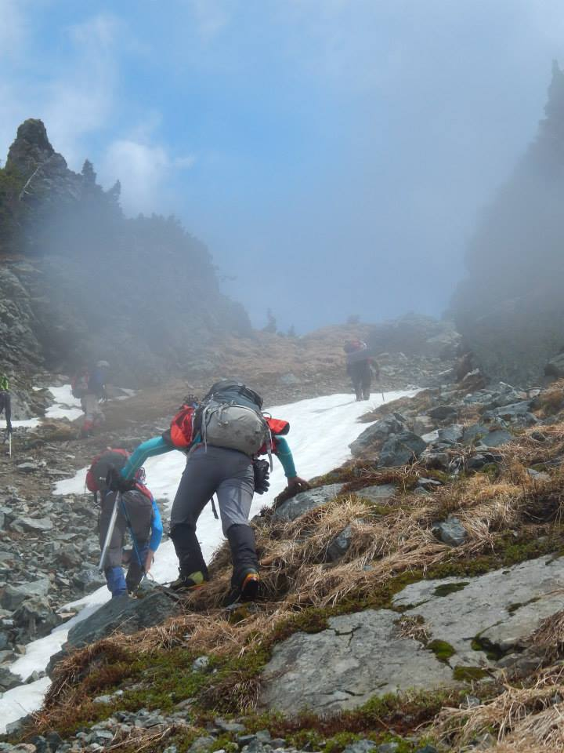
However...

Slide 13
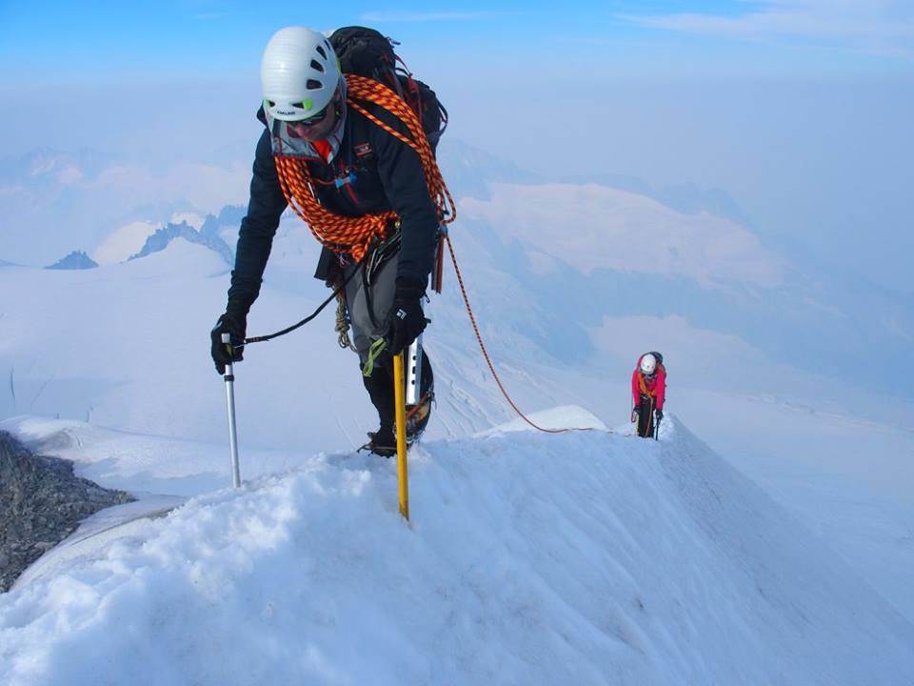
climbing can be one of the most spectacular and unforgettable experiences of your life.
climbing can be one of the most spectacular and unforgettable experiences of your life.

Slide 14
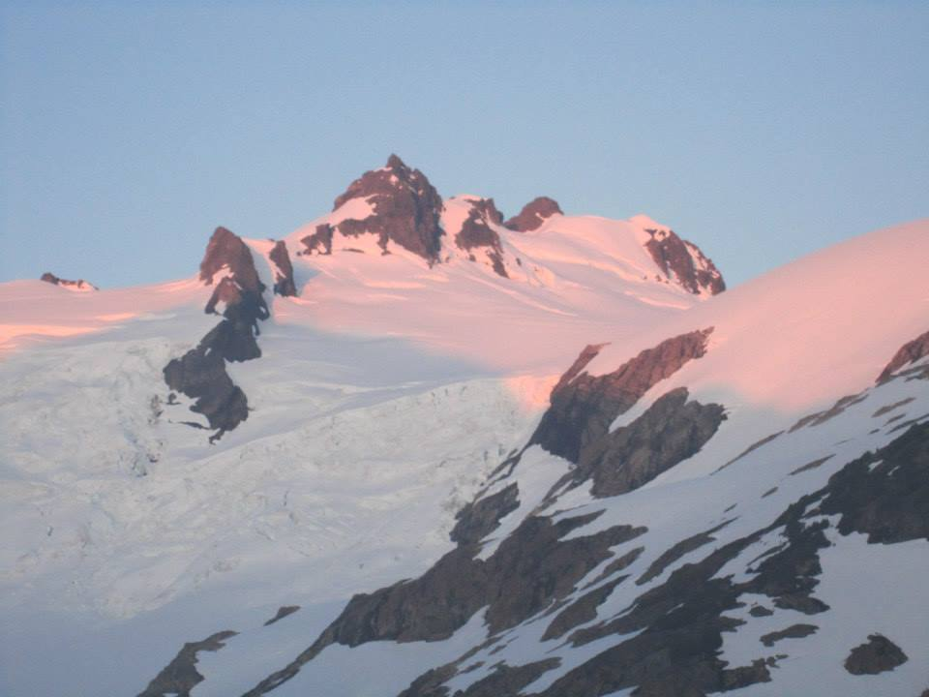
The scenery is incredible...
The scenery is incredible...

Slide 15
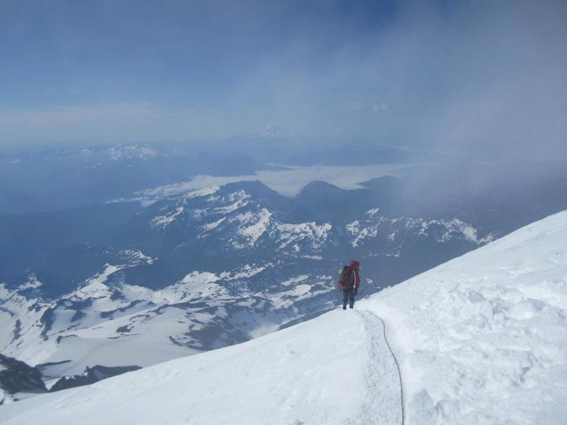
you’ll test your limits,
you’ll test your limits,

Slide 16
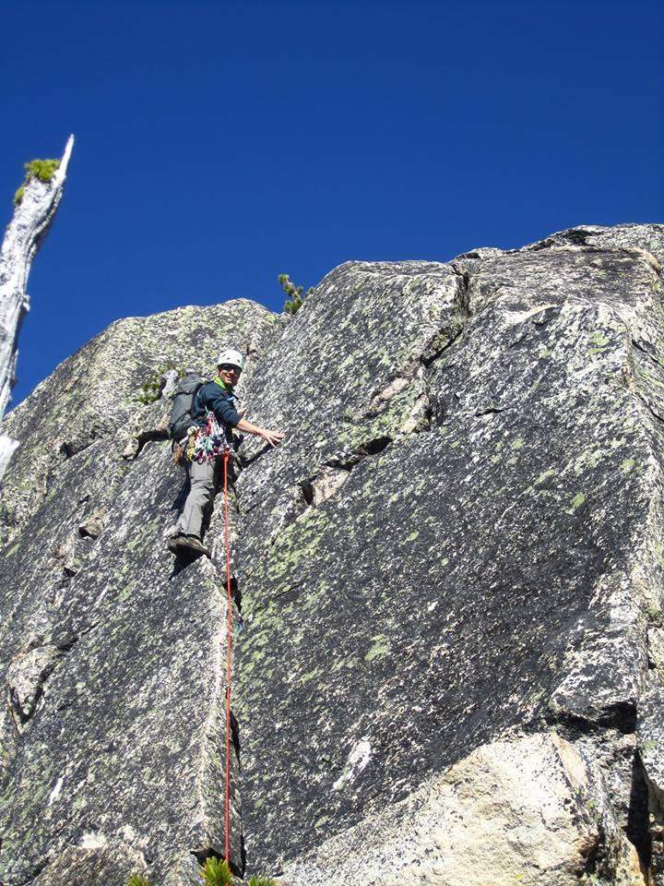
and find out what you’re made of.

Slide 17
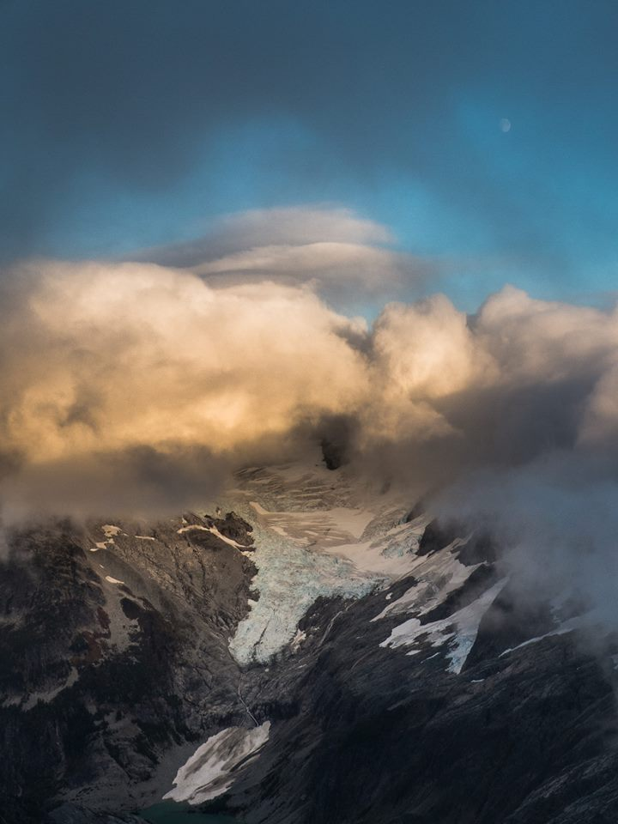
You’ll visit the majestic and wild places of the Great Northwest.

Slide 18
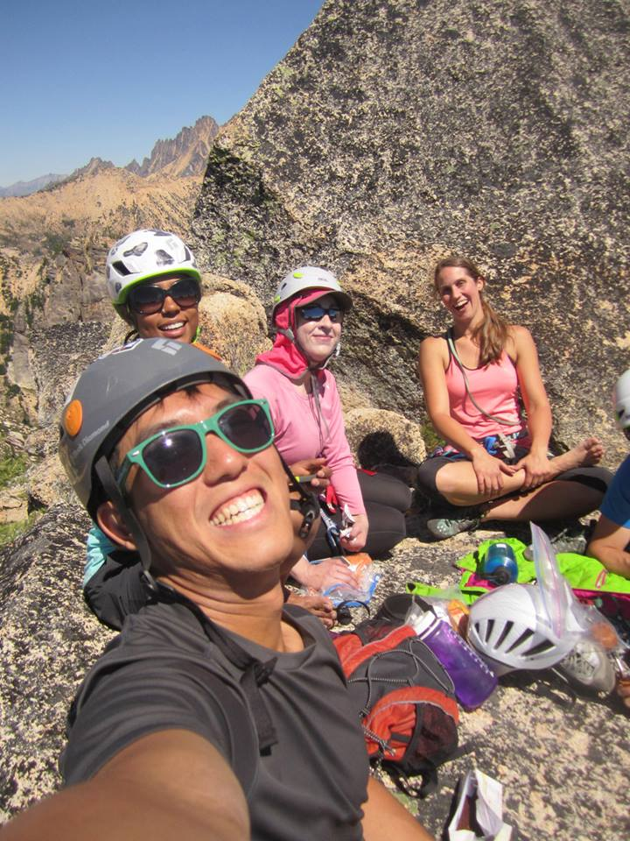
You’ll make lasting friendships,

Slide 19
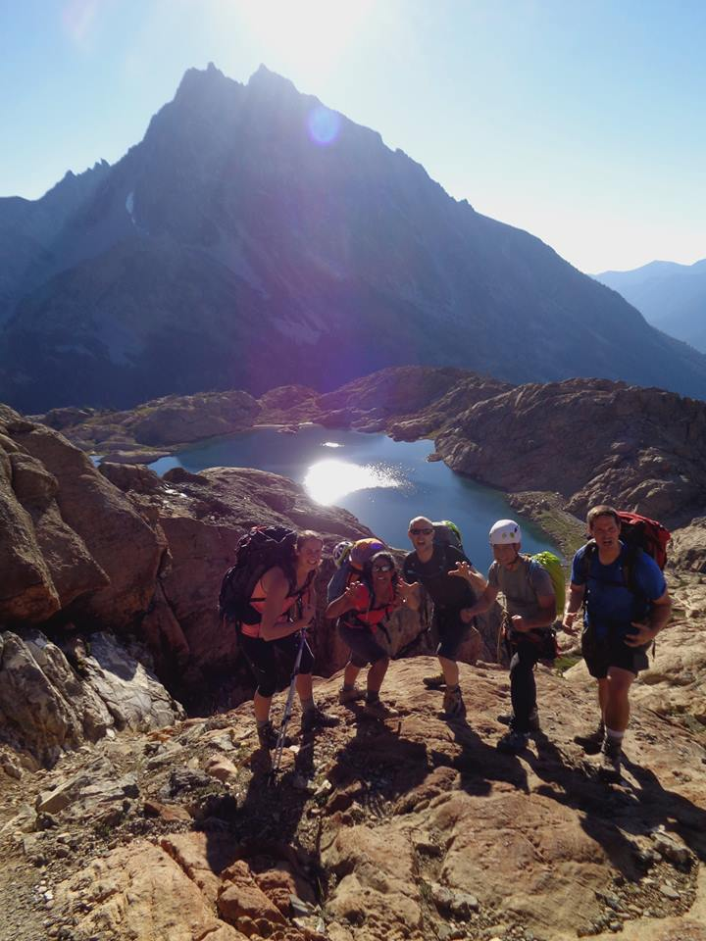
and strong bonds,

Slide 20
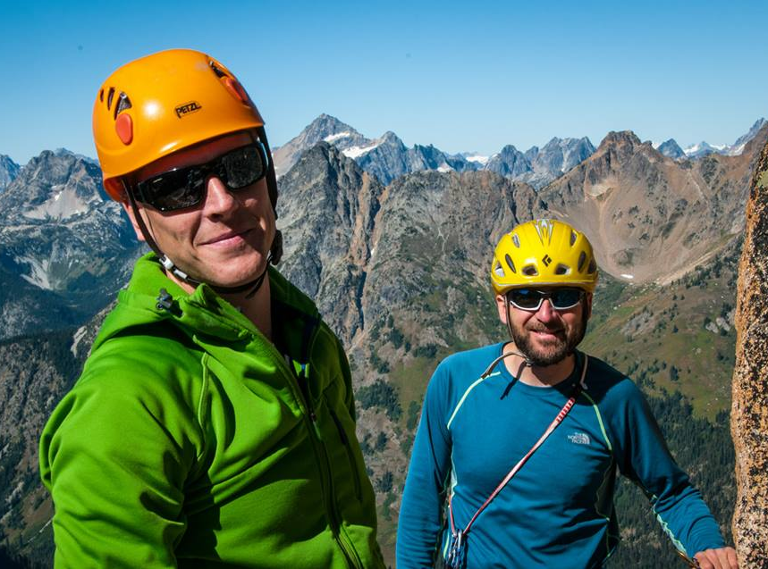
forged through shared triumph,
forged through shared triumph,

Slide 21
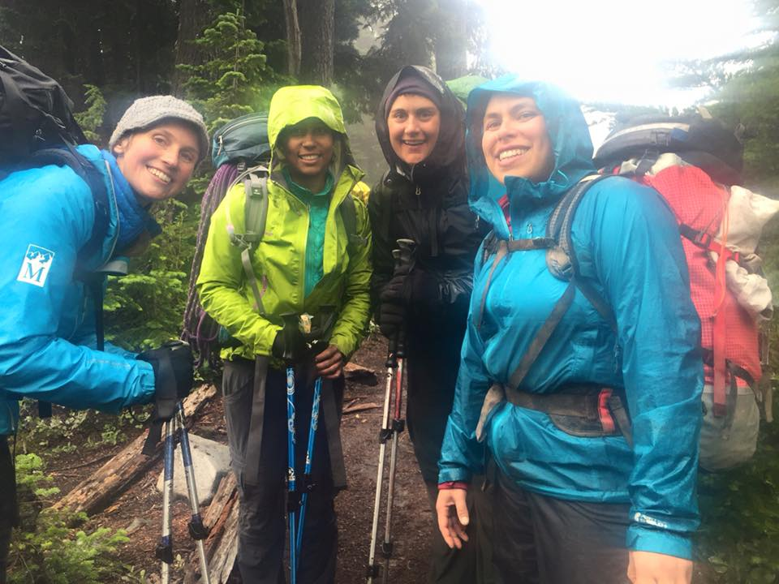
and sometimes shared misery...
and sometimes shared misery...

Slide 22
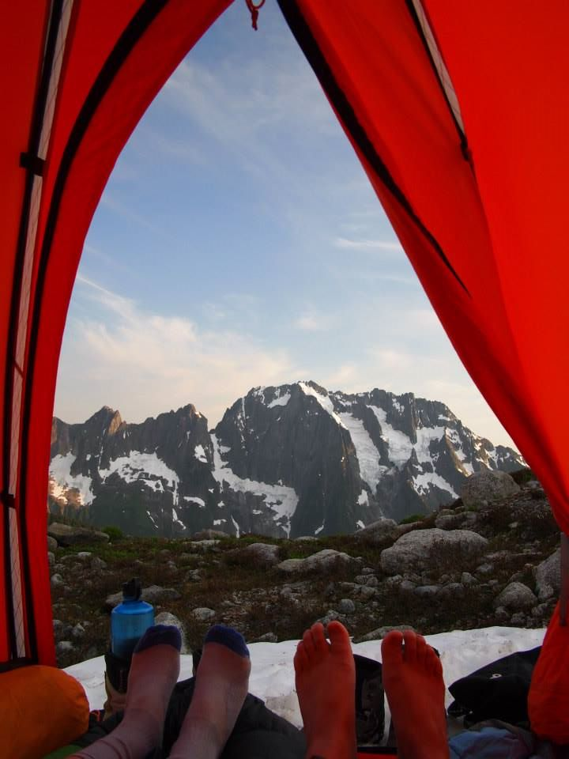
and you’ll experience the kind of trust that can only be formed

Slide 23
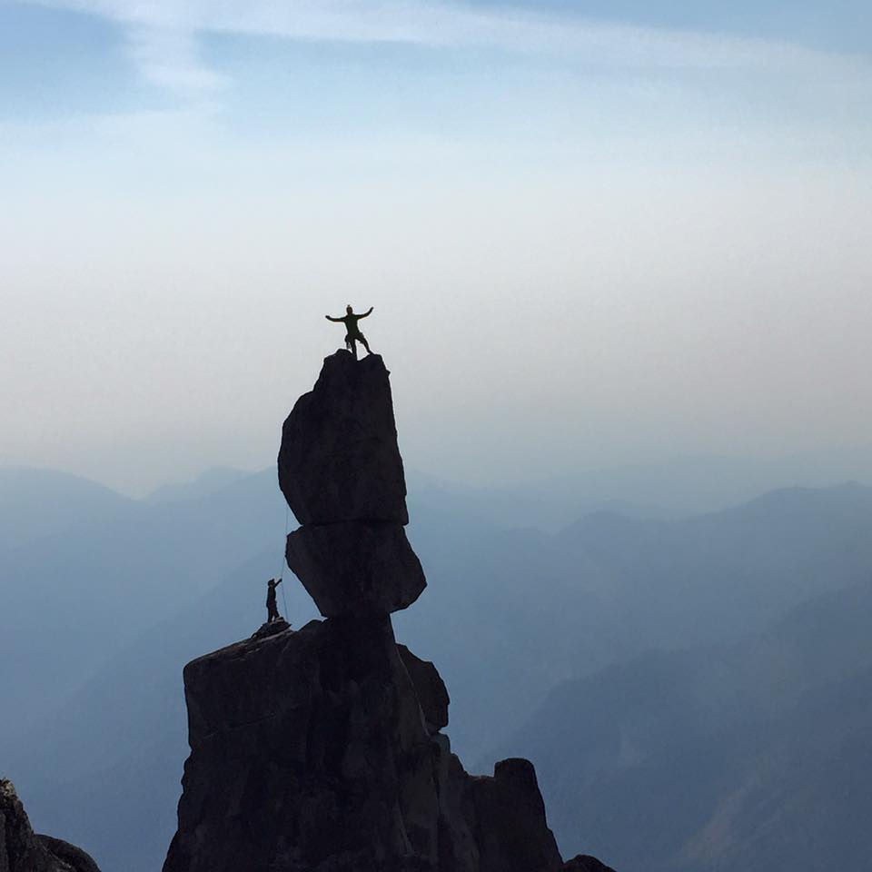
by putting your life in another person’s hands.

Slide 24
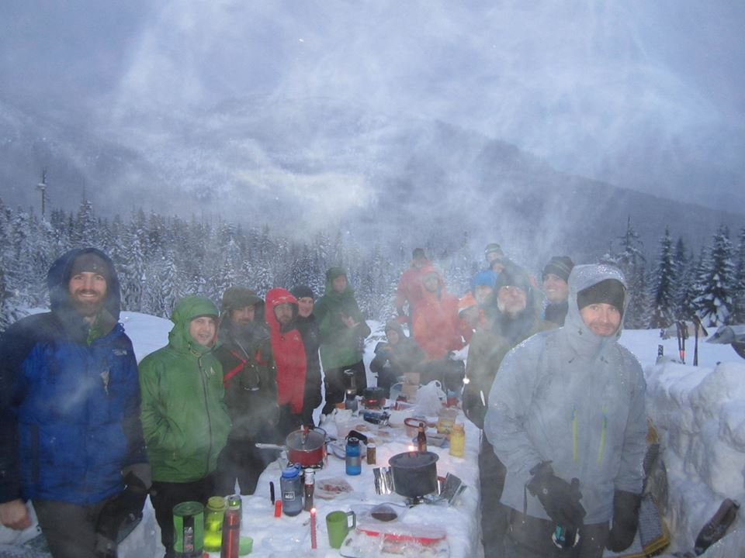
Our volunteers will be there, to share their knowledge and wisdom, and guide you along the way...

Slide 25
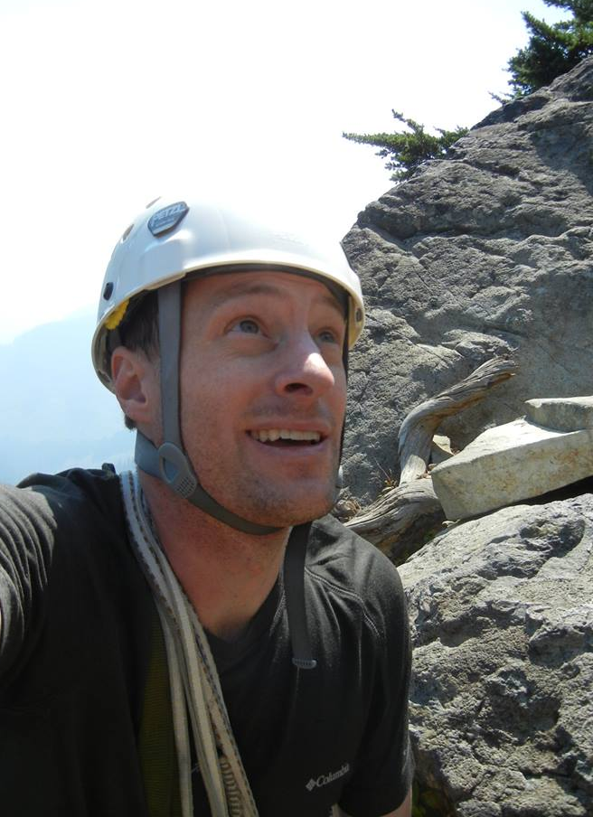
but ultimately it comes down to you.

Slide 26
In 5 months of training, you will literally tie yourself to another person

Slide 27
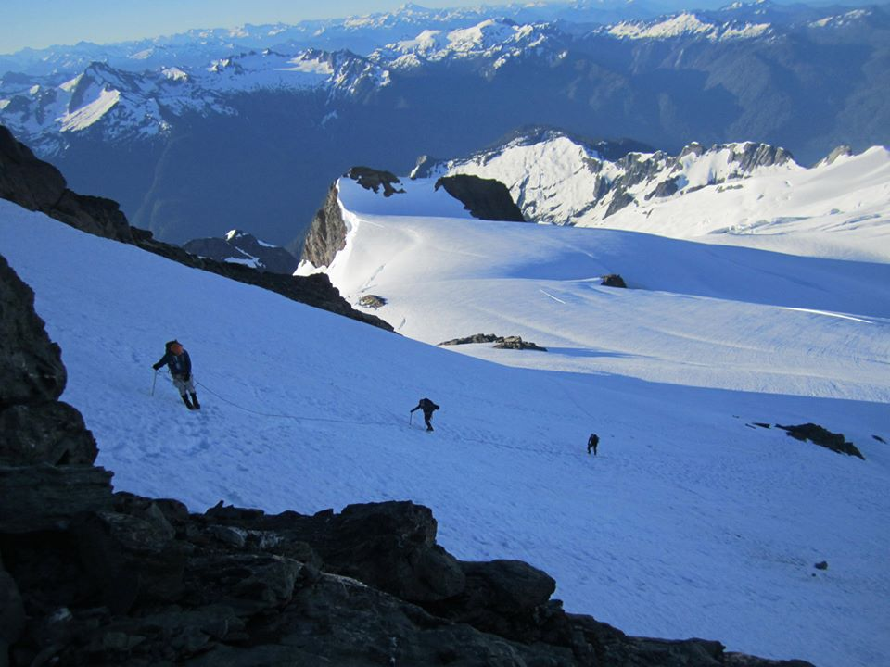
and climb a mountain.
and climb a mountain.

Slide 28
WILL YOU BE READY?

Slide 29
Intro to the Basic Alpine Climbing Course
What you will learn in this course
What kind of climbs you will go on
How is the course organized?
Time commitment required
Conditioning
Being prepared & course expectations
Meet your Basic Climbing Committee Members

Slide 30
What will you learn in this course?

Slide 31
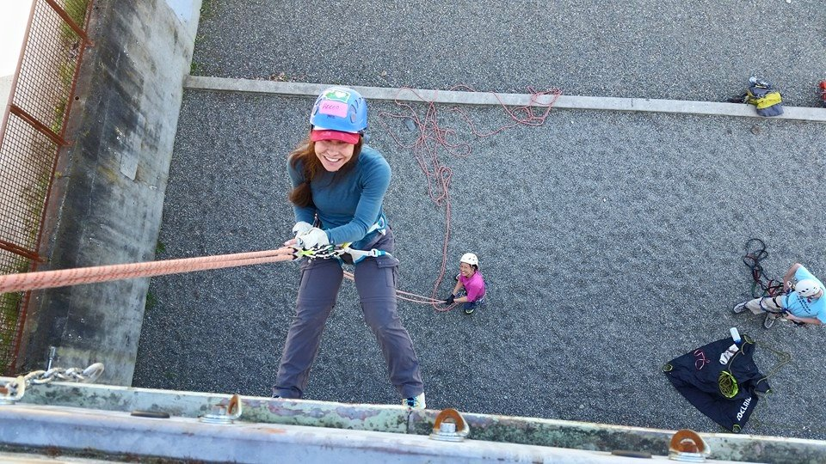
The skills needed to safely climb the rocky and glaciated peaks of the Northwest and beyond, including:
Roped Glacier Travel
Use of crampons and ice ax
Crevasse rescue
Snow anchors
Climbing knots and how to use them
Belaying and rappelling
Rock Climbing
Following and cleaning trad climbs
Snow camping skills
Wilderness Navigation (additional course)
Wilderness First Aid (additional course)
Prusiking (ascending a rope)
And a lot more….

Slide 32
What kind of climbs will you get to go on?
All climbs for credit will be alpine climbs (i.e. real mountains)
Climbs are FREE
3 types: Basic Glacier, Basic Rock, and Basic Alpine
Need 2 successful climbs to graduate
  Basic Glacier Climb
  Basic Rock Climb
  Do the Alpine climbs because they are fun and good for conditioning. If you want to do Intermediate, you’ll need more than 2 anyways.

Slide 33
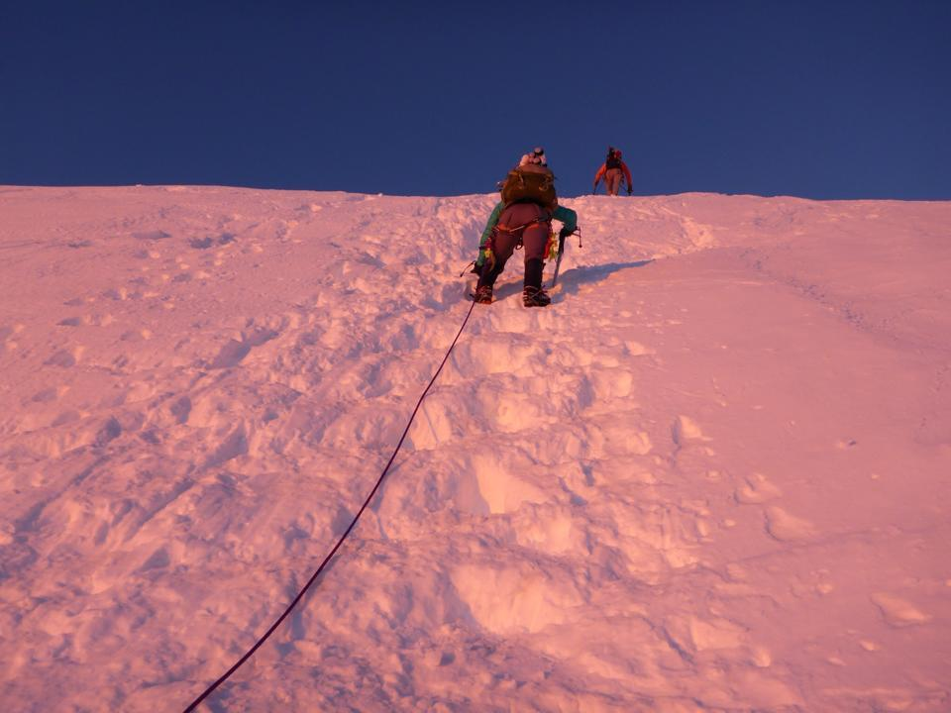
1.Basic Glacier Climbs
Multiple days, significant elevation gain, several hours of roped glacier travel, crevasses.

Slide 34
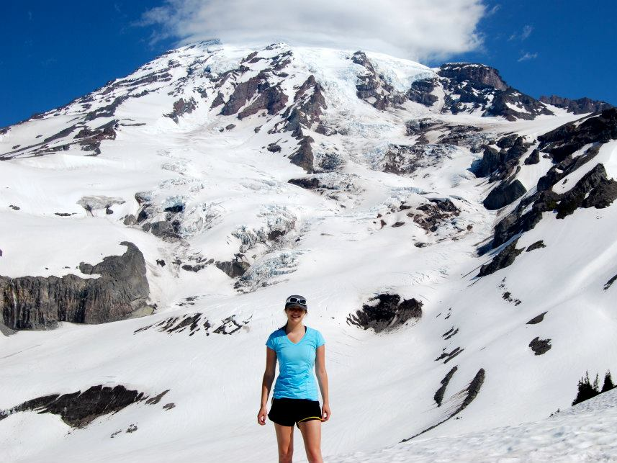
Mt. Rainier - Disappointment Cleaver or Emmons Glacier routes

Slide 35
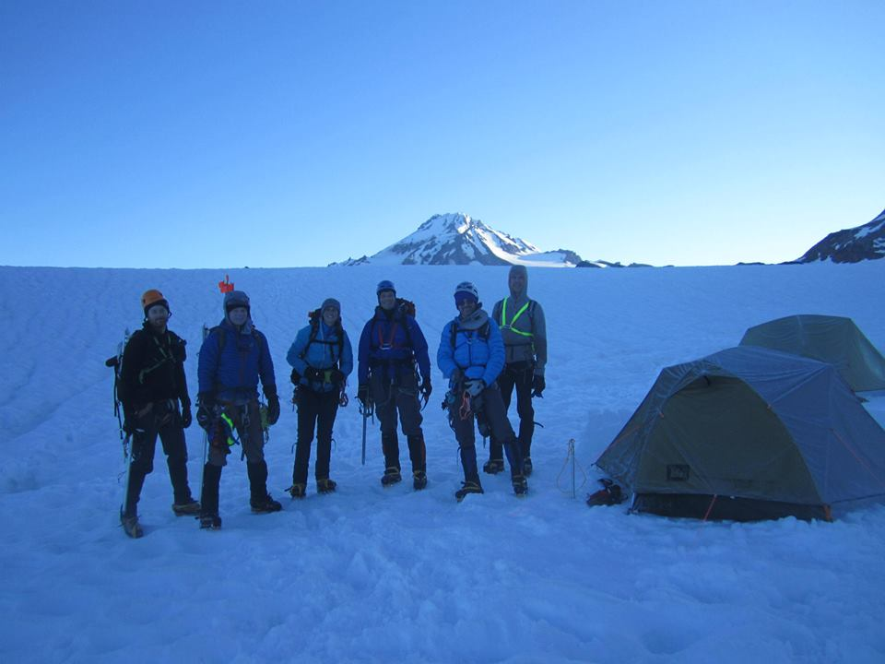
Glacier Peak
Glacier Peak

Slide 36
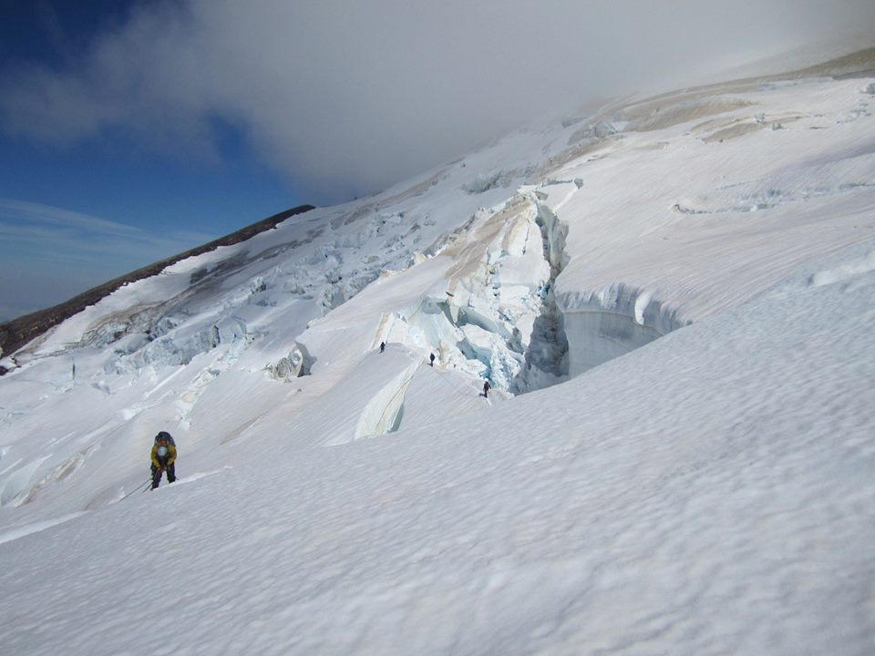
Mt. Baker
Mt. Baker

Slide 37
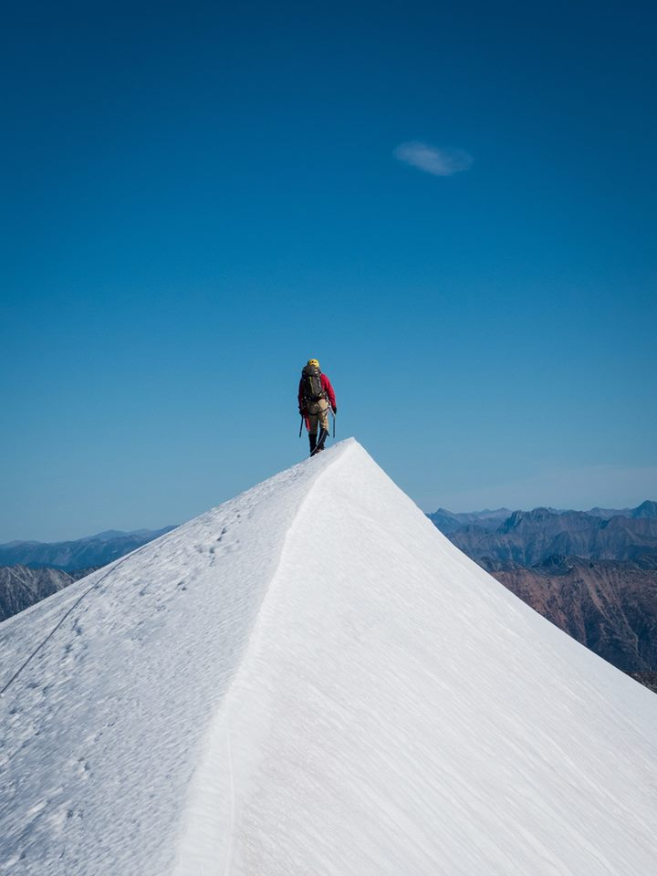
Eldorado
(North Cascades)

Slide 38
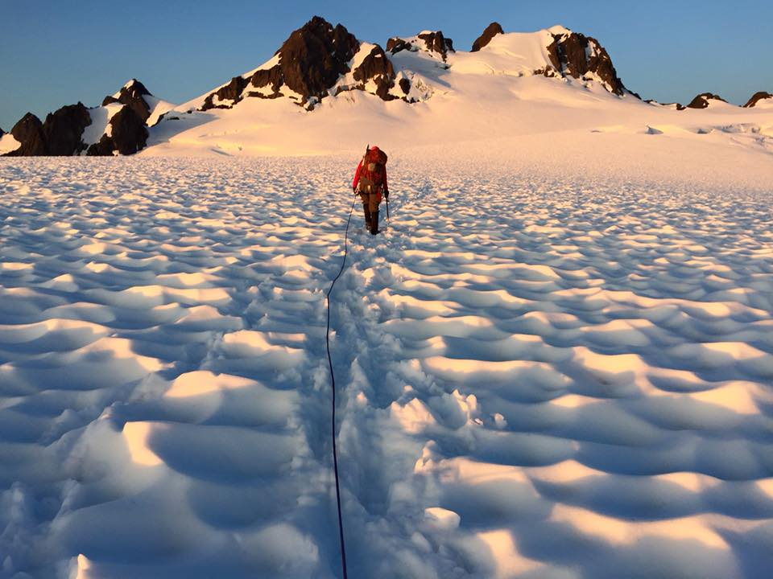
Mt. Olympus
Mt. Olympus

Slide 39
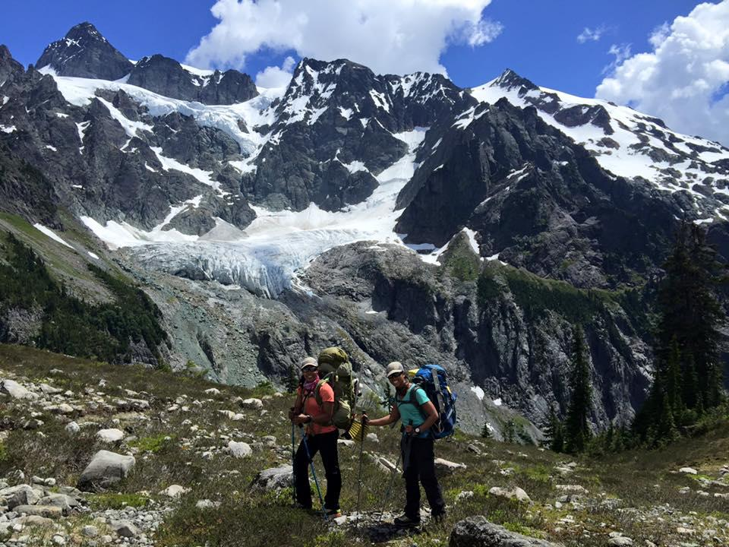
Mt. Shuksan

Slide 40
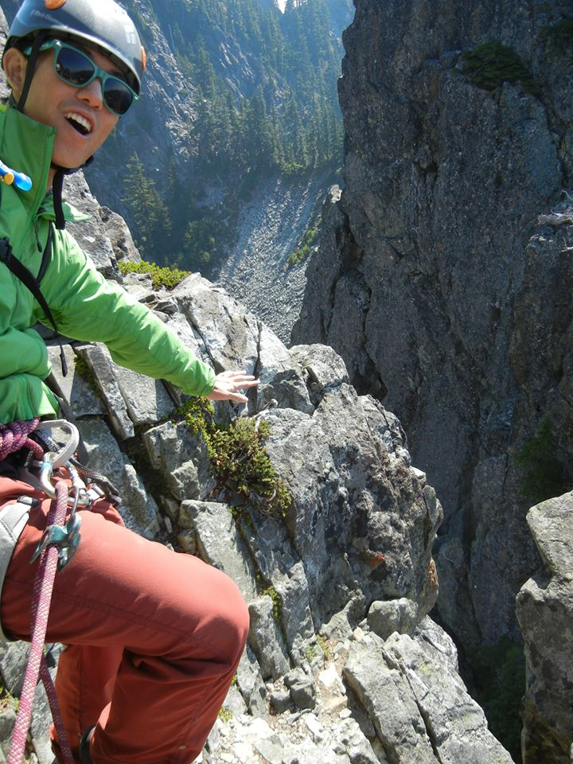
2. Basic Rock Climbs
2-4 pitches of belayed rock climbing, from 5.0 to 5.6 in difficulty.
Descents may involve rappelling or downclimbing.
Difficulty and length of approach may vary - many can be done in one day.

Slide 41
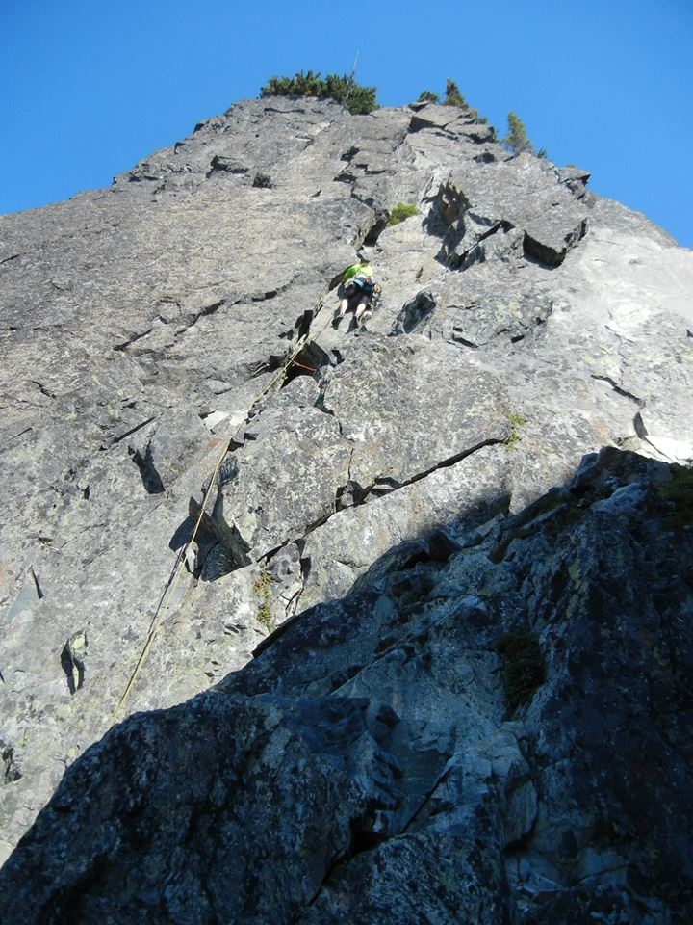
The Tooth - South Face

Slide 42
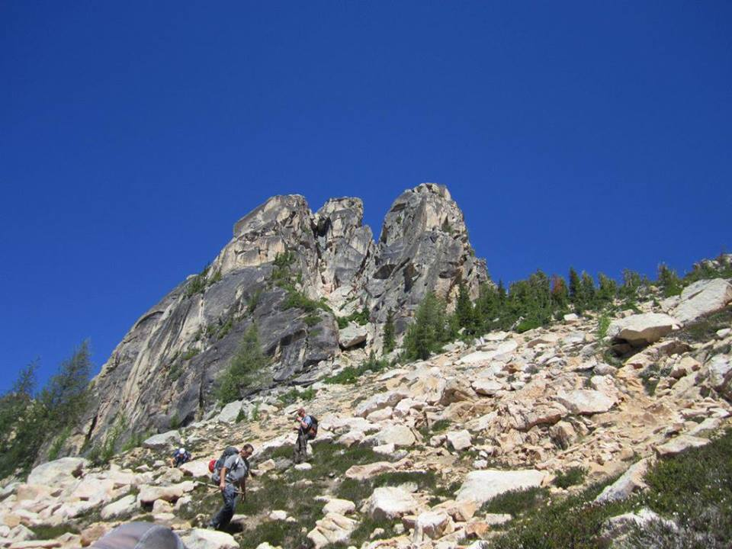
South Early Winter Spire –
South Arete
South Early Winter Spire - South Arete

Slide 43
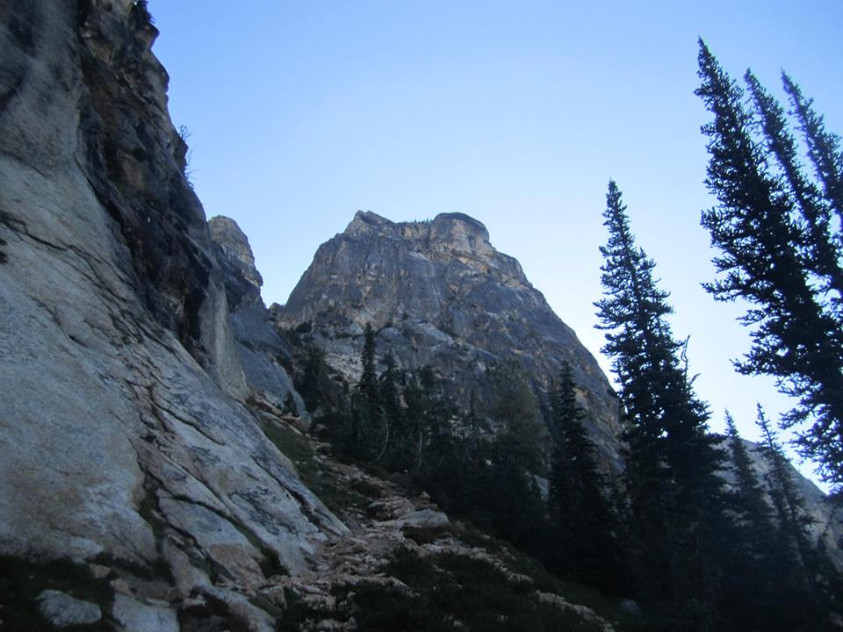
Kangaroo Temple - North Face

Slide 44
Ingalls Peak – South Ridge

Slide 45
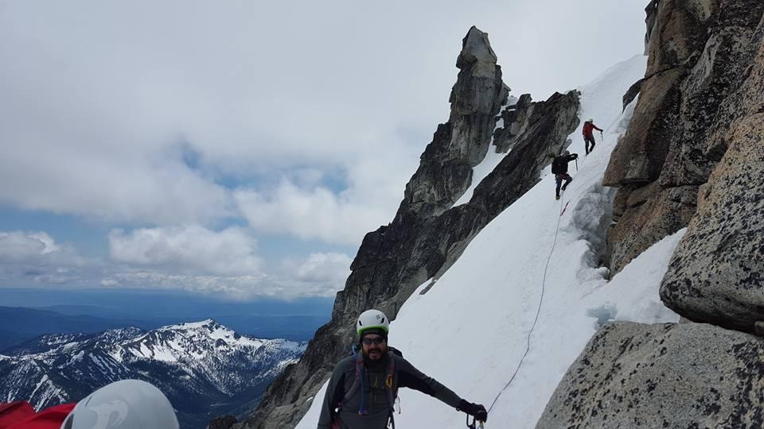
3. Basic Alpine Climbs
Short amount of either glacier or rock climbing,
Prolonged steep rock or snow scrambling
Some are short, some are long, some are easy, some are hard!

Slide 46
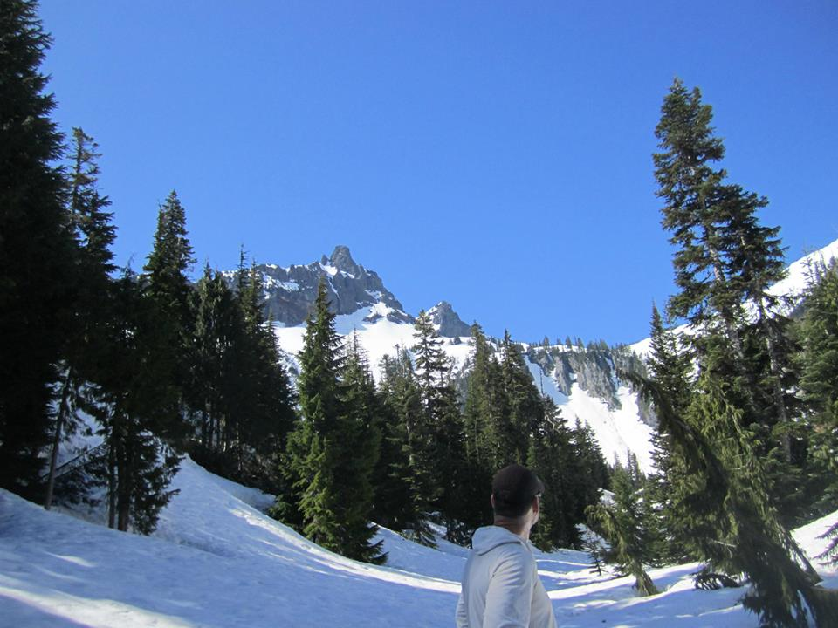
Unicorn Peak

Slide 47
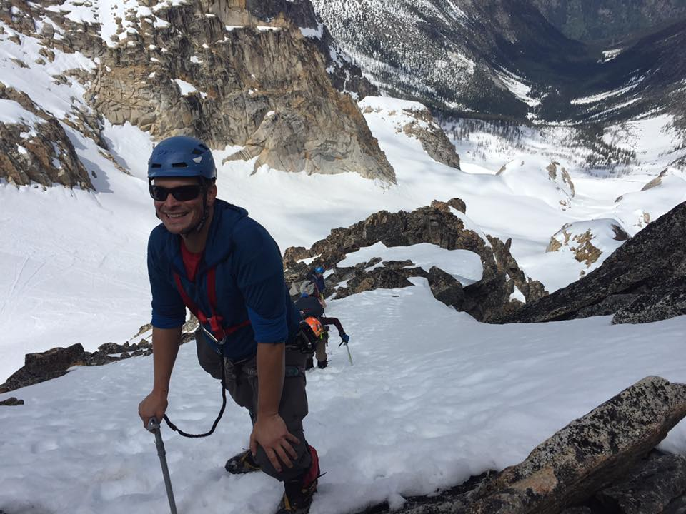
Silver Star Mountain

Slide 48
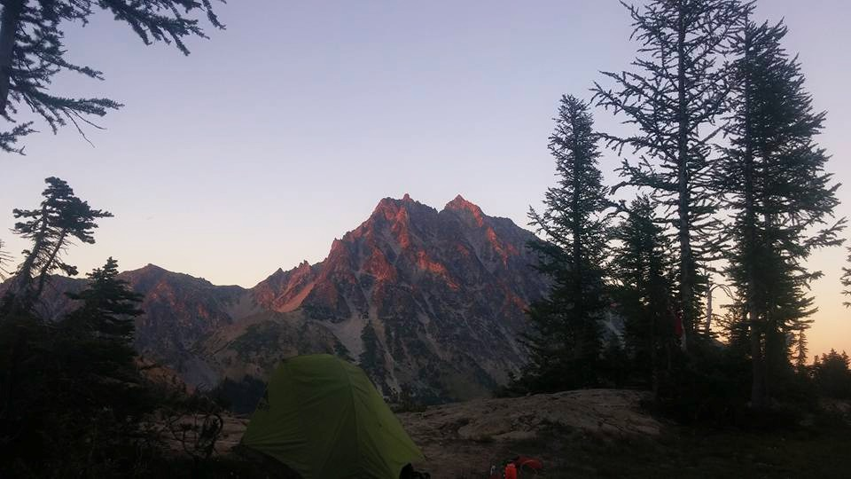
Mt. Stuart - Cascadian Couloir

Slide 49
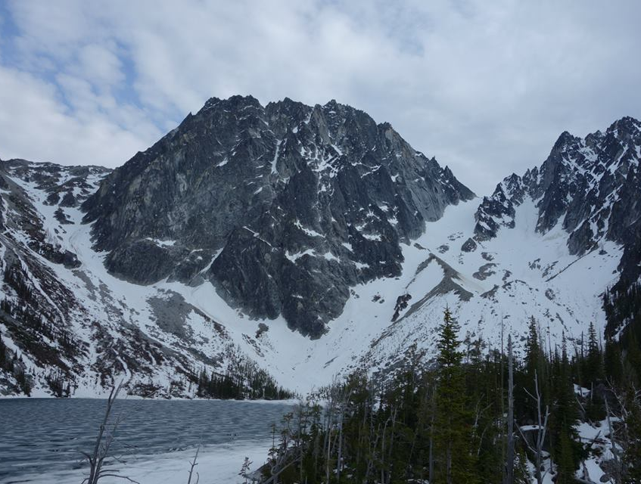
Colchuck and Dragontail Peaks

Slide 50
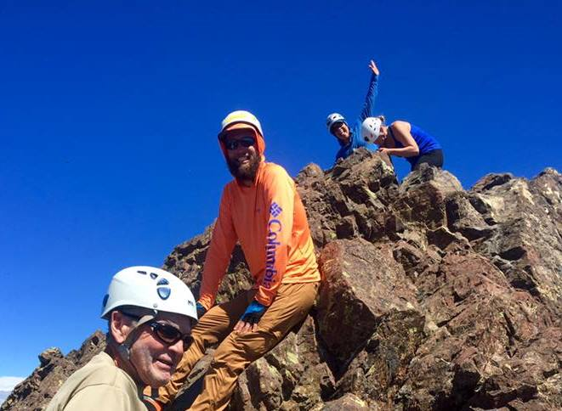

Mt. Washington (Olympics)

Slide 51
How is the course organized?
Like a college course
Lectures, reading, studying and practicing on your own, field trips, tests along the way, and a final exam at the end
All lectures and field trips are mandatory
Benchmark tests along the way in order to move on to the next subject matter or skill set

Slide 52
Your time commitments
MANDATORY & SCHEDULED
REQUIRED FOR GRADUATION (but done on your own time)
5 evening lectures
1-2 conditioner hikes
3 evening field trip preparation nights
7 weekend field trips
1 written final exam
Wilderness First Aid Course (full weekend + one weekday evening)
Navigation Course (two evening lectures and one Saturday field trip)
1 trail maintenance or stewardship activity
Minimum of 2 successful Mountaineers climbs
Reading designated chapters of Freedom of the Hills

Slide 53
Optional, but highly encouraged
3 mentor nights
extra conditioning hikes (either on your own or with the club)
extra work on skills with your mentor
supplemental reading, suggested in your manual

Slide 54
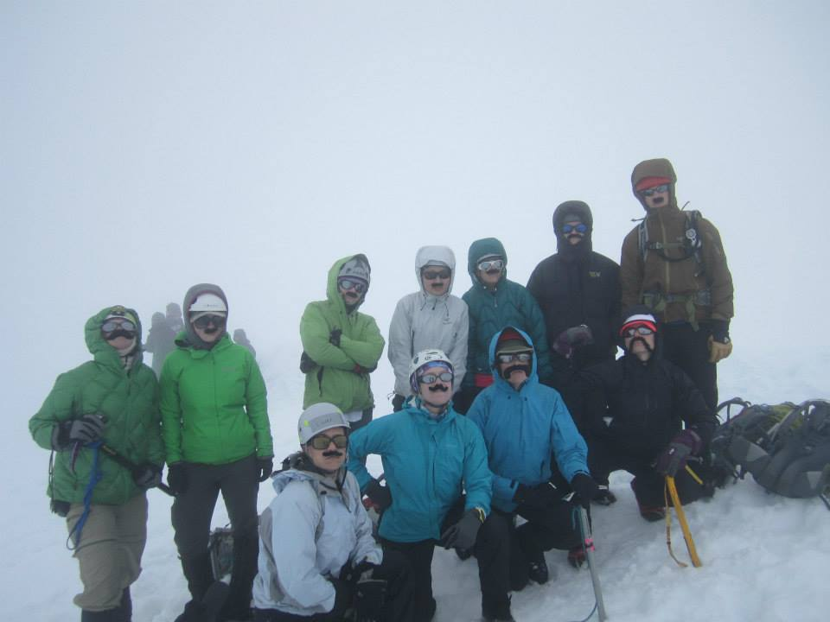
Who is going to be teaching you all this stuff?
All volunteers
Intermediate students
Climb Leaders
Some just love teaching, meeting new people, and spending some time in the mountains.
ALL of your instructors are knowledgeable, dedicated folks who have spent real time climbing mountains!
All volunteers
Intermediate students
Climb Leaders
Some just love teaching, meeting new people, and spending some time in the mountains.
ALL of your instructors are knowledgeable, dedicated folks who have spent real time climbing mountains!

Slide 55
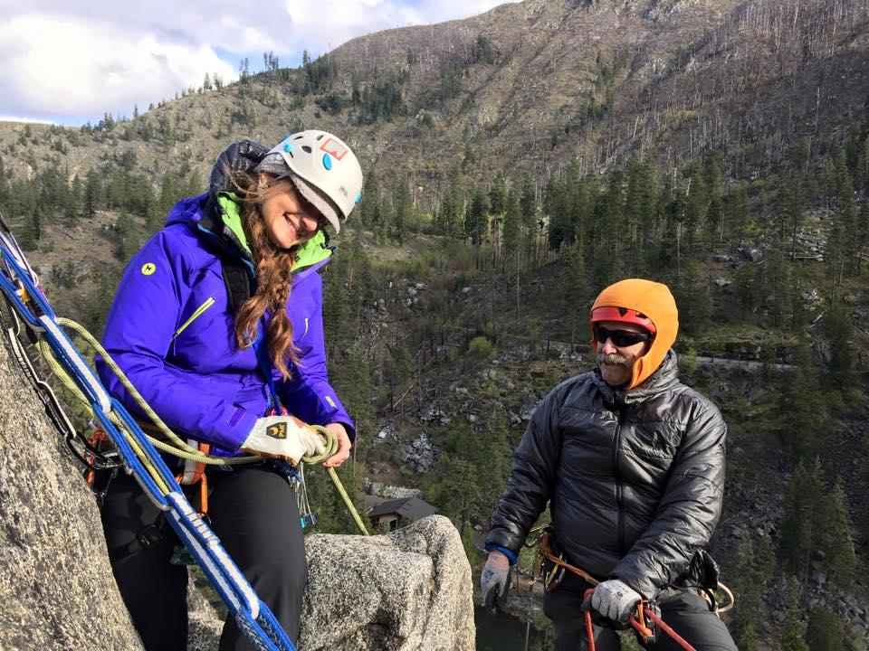
Many different instructors
Wide variety of perspectives, teaching styles, and experiences
Learn in small groups

Slide 56
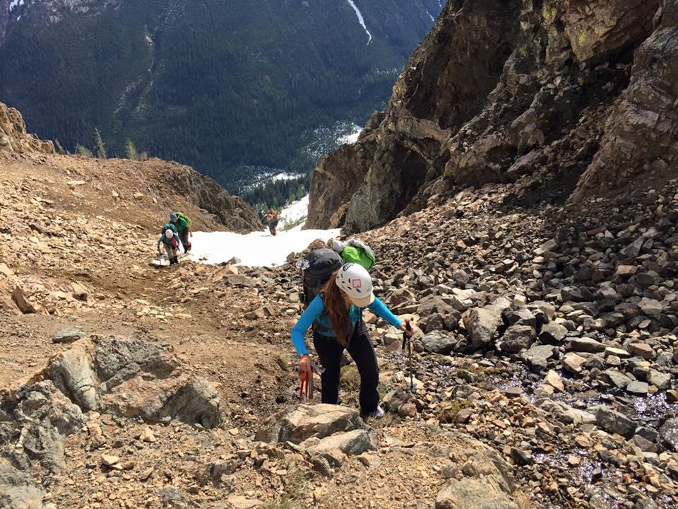
Conditioning!!!
Fitness is key - especially endurance
MINIMUM of 8 hours of continuous moving
12 hour days are more like the average. And 17-18 hour days are not uncommon.

Slide 57
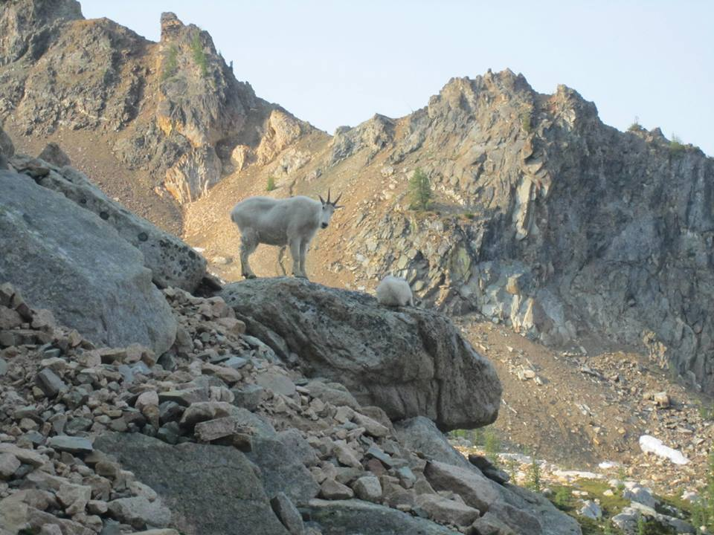
You’ll need to be like one of these guys….
Not just hiking!
Approaches are often rugged and steep
Bushwhacking and boulder hopping
Carrying a heavy pack.
Kicking steps in snow, and moving over uneven ground.

Slide 58
How to Train (in very, very simplified terms)
Lots of aerobic training! Conversational pace.
Strength training - prevent injury, carrying a pack
Flexibility also helps prevent injury
Practicing on a rock wall

Slide 59
Take your conditioning seriously
Extra fitness can help make up for inefficiencies in moving across terrain
Sign up for conditioner hikes early
Conditioners generally require at least 2,500 feet of elevation gain and a 35 pound pack. Participants must complete the hike within a time frame given by the leader.
Success of climbs depends on everyone’s fitness!

Slide 60
Conditioner Requirement
All students must do a conditioner hike with The Mountaineers, before the Winter Overnight field trip (FT 3)
Ok if you don’t pass the first time
Must PASS conditioner by Field Trip 5 - Rock 2 field trip.

Slide 61
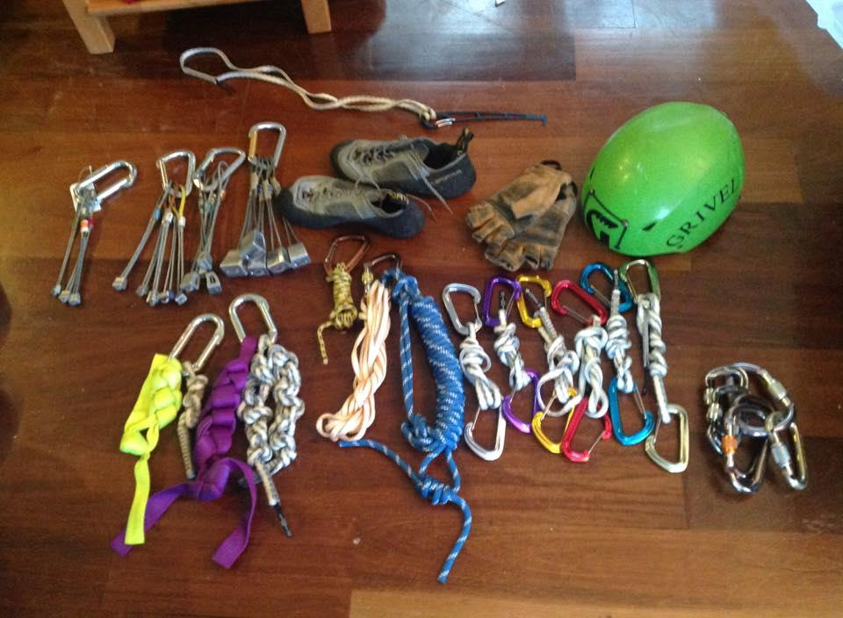
Preparation - we can’t stress this enough either!!
Bring the right gear

Slide 62
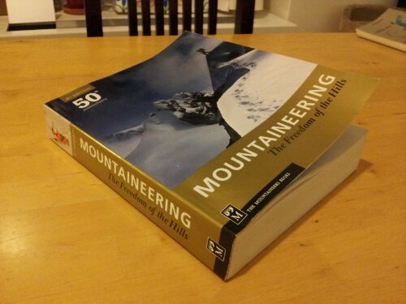
Preparation, continued...
Do the reading.

Slide 63
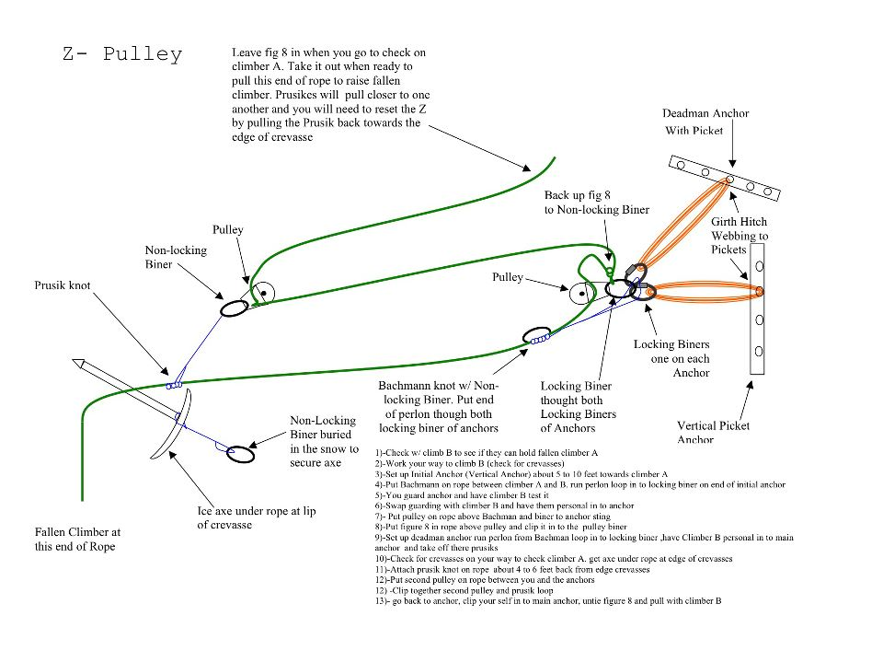
Preparation, part 3
Practice, practice, practice!

Slide 64

Punctuality
Extremely important in the sport of mountaineering
People get cold
Get through hazardous areas at certain times
Punctuality is expected at climbs, field trips, and lectures!!!
Notes:
Being prompt and ready is extremely important in the sport of mountaineering. If you are late - it means your partners are standing around getting cold, waiting for you. Climbs are time-sensitive - you often have to make it through certain hazardous areas before the sun warms the snow, or through places with treacherous footing while you still have the light of day. Punctuality is expected at climbs, field trips, and lectures!!!

Slide 65
Missing dates
Lectures are mandatory and cannot be substituted.
The only field trips that can be substituted are Field Trip 1, Field Trip 4 Prep, and Field Trip 4.

Slide 66
It takes considerable time, effort, planning, permits, and volunteer hours to plan and execute a field trip. We do not have the time or capacity to do individual make-ups. THIS IS NOT AN OPTION.

Slide 67
Your 2018 Basic Committee
Plan, organize, and execute this course.
Make sure that reservations get made, lecturers and instructors are recruited and scheduled, climbs get planned, records are kept, techniques are updated, and students get help when they need it.
LOTS of work behind the scenes!
Notes:
The Basic Committee are the folks who plan, organize, and execute this course. We make sure that reservations get made, lecturers and instructors are recruited and scheduled, climbs get planned, and students get help when they need it. A lot of behind the scenes work goes into this course. Even if you don’t see us at every field trip or lecture, we are busy working for you!

Slide 68

Course Chair - Jill Uthoff
Rightful Chair of the Basic Alpine Climbing Course
Rightful Co-Chair of the Intermediate Climbing Course
The Leader of Climbs
The Unburnt

Slide 69

Co-Chair - Natalia Martinez-Paz
Your go-to person for questions at lecture
Does whatever Jill wants
Don’t mess with her when she’s hungry

Slide 70

Lecture Co-Chair - Ben Brown
Recruits lecturers and structures lectures for maximum student learning
Makes lectures awesome, collaborative, and goal-oriented

Slide 71

Critical Skills Chair - Chris Charron
Coordinates make-up testing and extra help for students who struggled at a field trip
Makes sure instructors are up to date on new techniques
Manages progress of 2nd year students

Slide 72

Field Trips Chair - Scott Schissel
Takes care of field trip reservations and permits
Recruits and trains field trip leaders and instructors
Will help you purchase the right gear at REI
Leads 4.9+

Slide 73

Mentoring Chair - Jessie Worley
Recruits and guides mentors
Assigns each student to a mentor
Leads mentor nights

Slide 74

Records Chair - Carrie Kavanaugh
Keeps records of everything you’ve done so you can GRADUATE!
Himalayan badass

Slide 75

Climbs Chair - Owen Gabrielson
Recruits climb leaders and helps students get their climbs in
Helps guide prospective leaders through the climb leader process
Keeps climb descriptions accurate and up to date
Wants you to not be a wanker

Slide 76

Manuals Chair - Marek Karbarz
Edits your student manual.
Edits, prints your yellow field trip books.
Marek worked hard on the manual, so use it.
If you’re not sure, it’s probably in the manual.
Don’t email us. Look in the manual.
If you call us, it better not be in the manual.

Slide 77

Jim Paxinos - Tacoma Branch Chair
Runs administrative side of Tacoma Branch
Campfire/BBQ/Bartender extraordinaire
Only wears shorts

Slide 78


Slide 79
Not for you?
For cancellations before March 1st, advise course leader via email before March 1st and the cancellation fee is $75.
After March 1, no refunds will be made.

Slide 80
Excited, but don’t think you can finish this year?
Don’t fret, we offer a second year extension to this course for about $75.

